Slide 1
Rami Alsaberi
PhD Candidate
Possible SNR at High Galagtic Latitude
Supervisors:
Prof. Miroslav Filipovic
Prof. Ray Norris
Dr. Nicholas Tothill

Slide 2
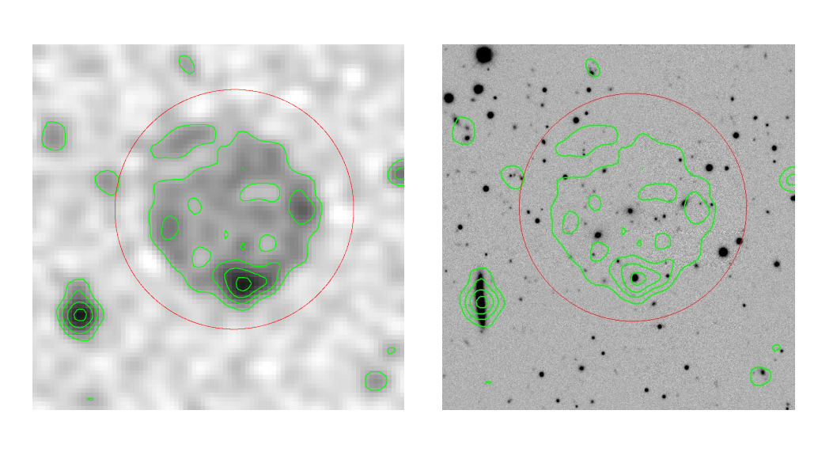
Bright Sources
Centre

Slide 3
WISE J210300.30–620025.8
GALEXASC J210257.91–620045
WISE J210258.15–620014.4
WISE J210257.88–620046.3

Slide 4
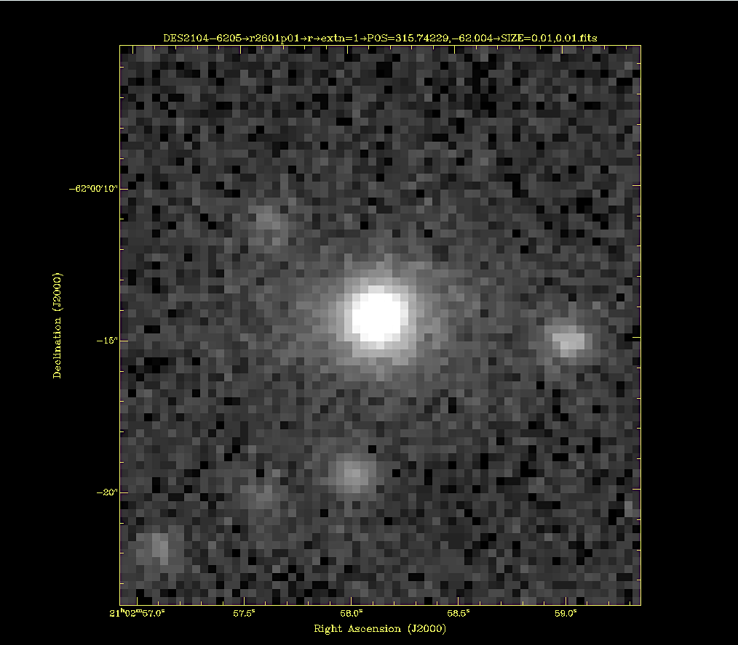
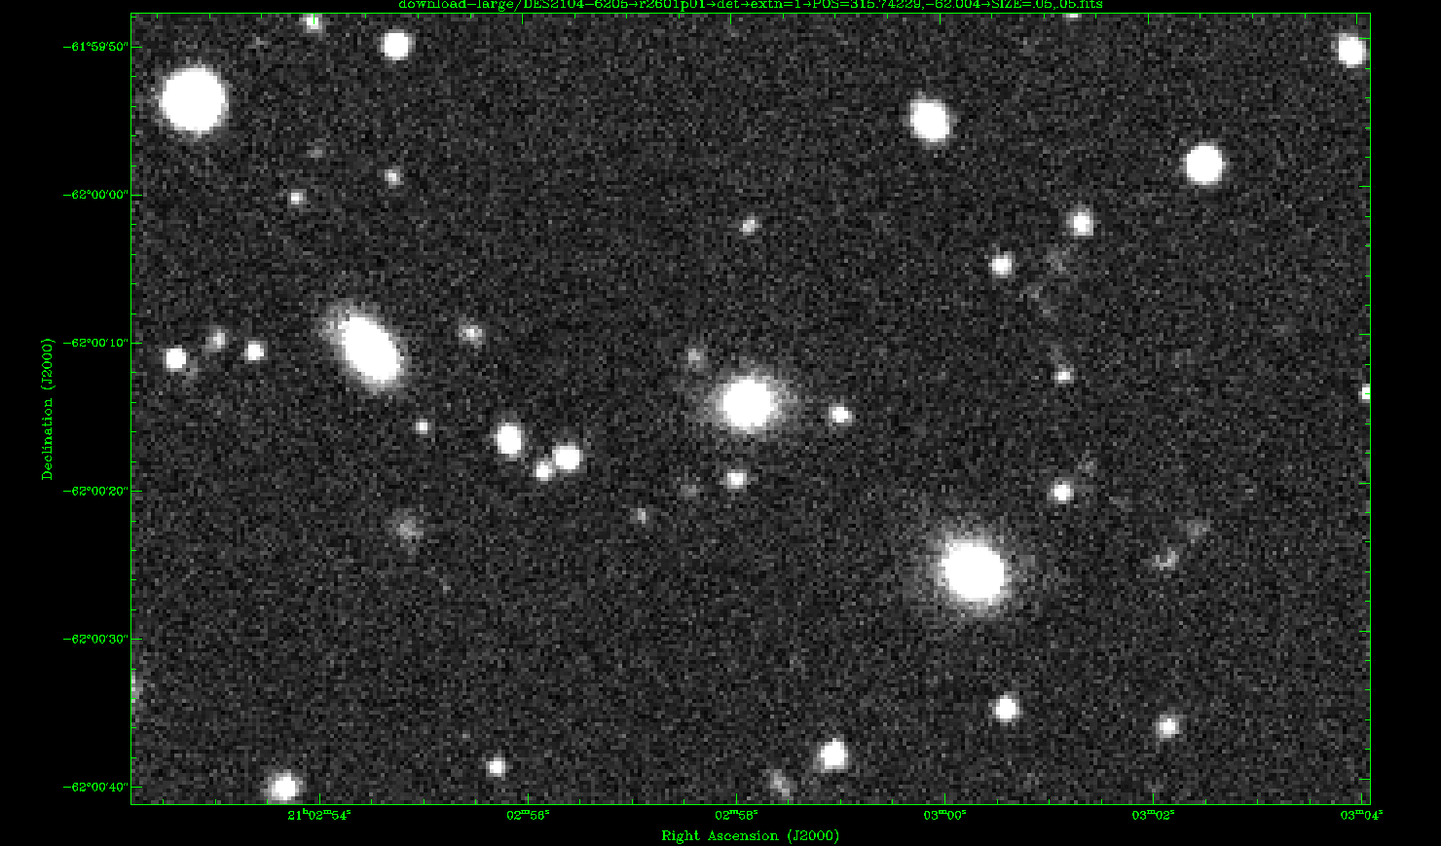
Faint Structures (6 arcsec)

Slide 5
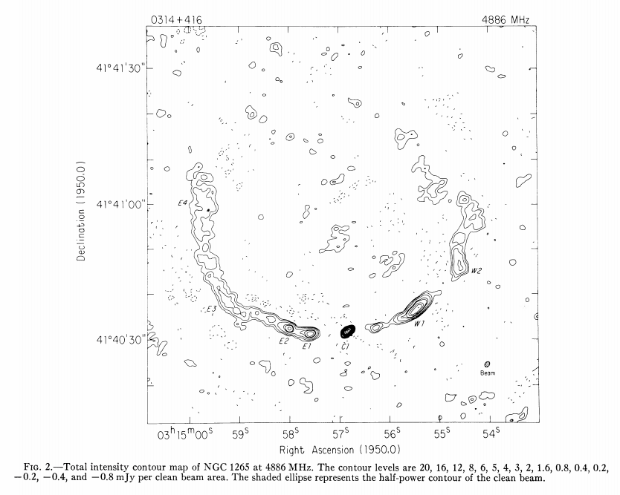
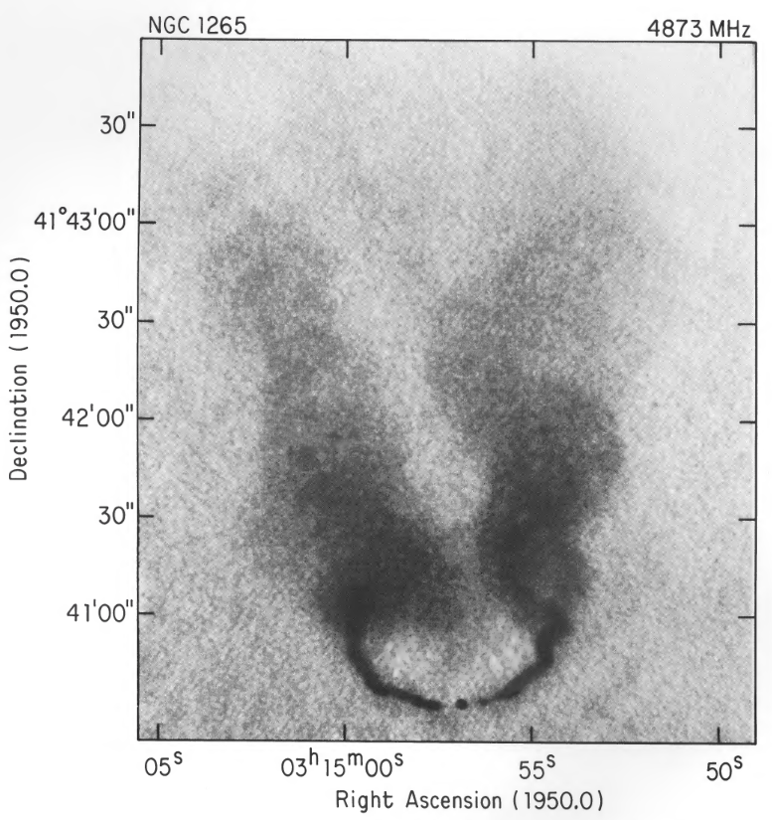
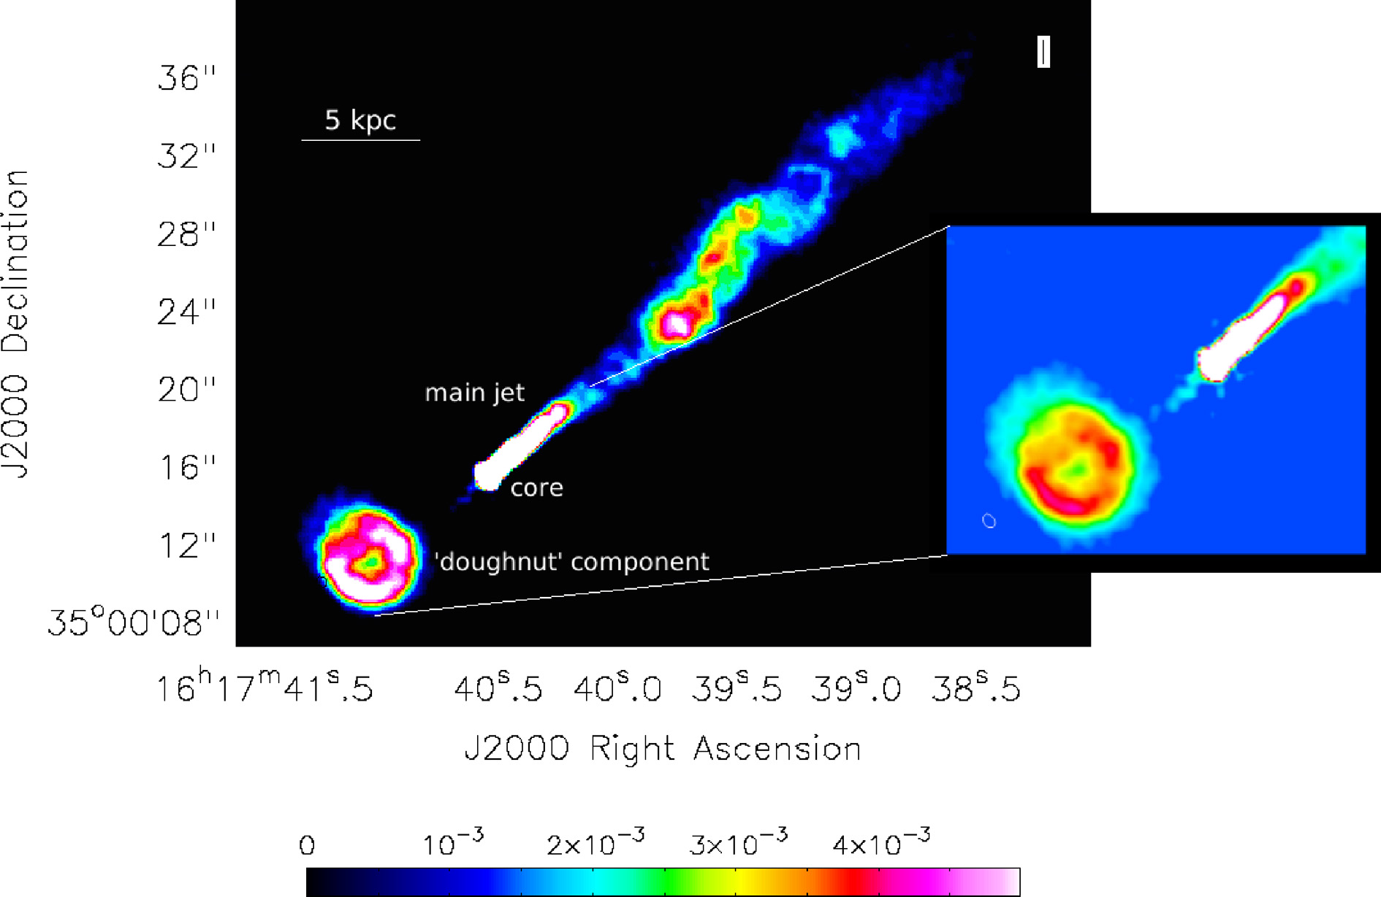
Summary
Artifact
SNR
A wide-angle tail (WAT) radio galaxy, similar to radio galaxy NGC1265/3C83.1B (Owen et al. 1978; O’Dea and Owen, 1986)
A shell or sphere centred on star forming galaxy (WISE J210258.15–620014.4), similar to doughnut+jet radio emission in NGC 6109 (Rawes et al. 2018)
Other possibilities?
1%

Slide 6
Thank You

