Slide 1
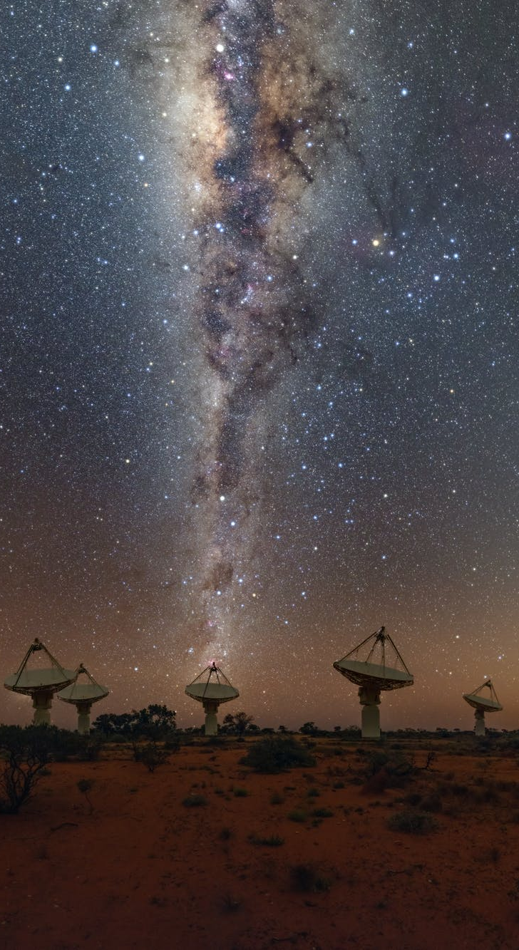


A first glimpse of the Galactic Plane with ASKAP: the SCORPIO field
G. Umana INAF-Osservatorio Astrofisico di Catania, Italy
on behalf of the Radio-ICT Catania group and
Galactic EMU team
Credits: CSIRO/A. Cherney

Slide 2

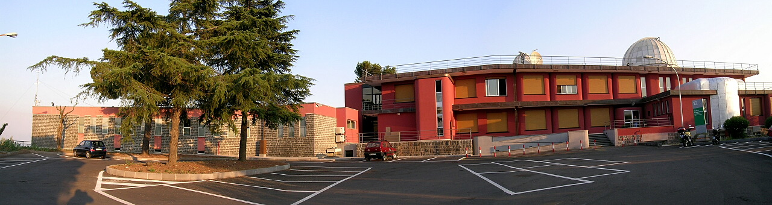
INAF Osservatorio Astrofisico di Catania
One of the 16 INAF Structures
HQs in Catania, inside University of Catania Campus
Synergy with UNICT
Staff: 62 (researchs/technicians/amministratives)
30 non-staff (Students, PdD students, post-doc……)…..)
Notes:
The Scorpio project is an international project involiving people coming from different Institution from different countries. However most of the work is carried out at Catania Observatory, one of the 16 structures INAF has spread over the Nation

Slide 3

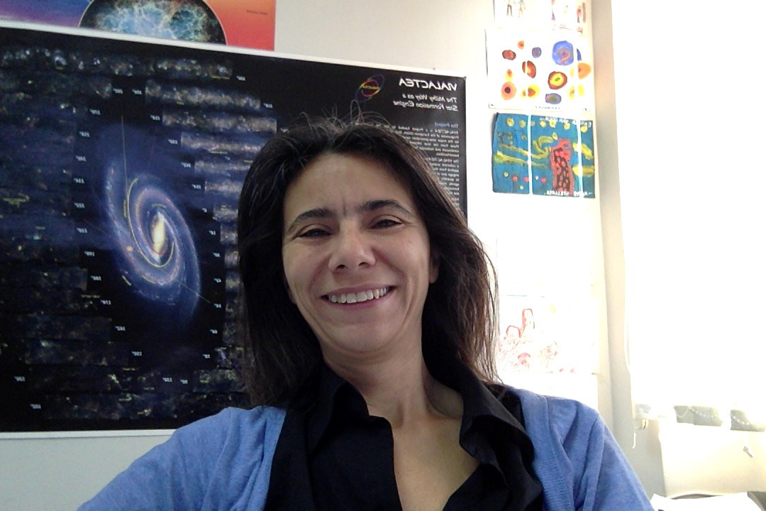









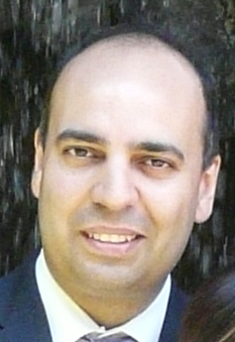


SKA & precursors task force @ INAF-OACT
Grazia Umana
Corrado Trigilio
Paolo Leto
Carla Buemi
Milena Bufano
Francesco Cavallaro
Adriano Ingallinera
Sara Loru
Francesco Schillirò
Ugo Becciani
Alessandro Costa
Eva Sciacca
Fabio Vitello
Simone Riggi
Radio & ICT groups working together since 2012: Successful initial experience for Competence Center
  14 people involved in different projects (see below): 10 TI + 2TD + 2 AdR
  Galactic Radio Astronomy /Modeling/data reduction
  Corrado Trigilio Radioastronomy course at UNICT
  Software expertises: data reduction software, HPC/HTC, Visual analytic & Virtual Reality, …
OACT in SKA & precursors science groups
  SKA “Our Galaxy” KSP (co-lead: G. Umana); The SCORPIO project (PI Umana)
  SKA AENEAS WP 3.3 (lead: U. Becciani) & WP 5.3 (lead. A. Costa)
  ASKAP EMU Galactic Plane KSP (co-lead: G. Umana)
  ASKAP EMU Dev. Projects “GP Imaging & Diffuse Sources” DP4 (leads: S. Riggi, F. Cavallaro), DP6 & Parkes GP survey
  ASKAP SCORPIO Early Science Project (lead: C. Trigilio)
Notes:
This is the team working on SCORPIO with different professionality. Since 2012, the radio group in Catania merged with the ICT group
This has been a successful experience for competence center.
----- Note riunione (22/10/19 22:23) -----
Here a list of the many activities -Ska and its precursors/pathfinders related- at Catania Observatory

Slide 4
The impact of SKA on Galactic Science
Large area Surveys
Statistical studies of different populations of radio emitting Galactic Objects
All-sky/deep
The place where you look at makes the difference:
most of the Galactic sources localised in/close the GP
The concept of generic surveys:
Maximize the return for “priority Science”
Maximize the commensality
Better angular resolution and sensitivity (Continuum & Spectral) than
any ongoing/planned survey of the Galactic Plane
Notes:
SKA will be a state of the art radiotelescope optimised for both large area surveys as well as deep pointed observations.
And for galactic studies a ska survey will be the best approach for statistical studies of different populations One of the main output of the first SKA KSPs meeting was the concept of generic survey as a possible component of the KSP programme of SKA1. The concept is still under debate among the SKA SWGs.
The basic idea is that there might be significant benefit in defining a small number of “generic” SKA1 surveys, whose design provides maximum commensality to a wide range of scientific objectives.
In the table –adapted from the still working document by the SKA Science Team- the parameter and foreseen performance of the Surveys relevant for Galactic studies are reported.
In particular, for galactic studies band-2 (950-1760 MHz) , 5 microJy sensitivity and 0.8 arc resolution for an all-sky survey and band-5 (4.6-13.8 GHz), SKA1-MidB, with 6 microJy sensitivity and 0.2 arcsec resolution are the more interesting.

Slide 5
The concept of Generic Surveys
SKA1_MID-A Generic Survey @ Band 2b (Full BW)
(rms 5μJy/b, 0.8”), ≈8000 hrs, All-sky
SKA1_MID-D Generic Survey @ Band 5 (Full BW)
(rms 6μJy/b, 0.2”), ≈2000 hrs, 480 deg²/GAL
The most complete catalogue of the Galactic Plane to date
  Much deeper and higher resolution than any other survey
  Will bridge the gap in sensitivity and resolution between available GP surveys
High angular resolution, limited areas:
THOR (Bihr et al., 2016) 6cm, 10-20 arcsec, 100 deg², few mJy
CORNISH (Purcell and Hoare, 2010) 6cm, 1-6 arcsec, ≈100 deg², few mJy
MAGPIS (Helfand et al., 2006) 20/6cm “ “
Lower angular resolution, wide areas:
CGPS (Taylor et al., 2006), 20cm, arcmin, several 100 deg², few mJy
SGPS (McClure-Griffiths et al., 2005)
Notes:
SKA1 will provide better sensitivity and angular resolution than any of ongoing/planned surveys of the GP. With both all-sky or deep (including the GP) survey the SKA will creating a sensitive wide-field atlas of Galactic continuum emission.
SKA1_Mid surveys will bridge the gap between the existing GP. Up to now, existing interferometric radio continuum surveys of the Galactic Plane are either at high angular resolution but over a limited survey area, or cover a wide area at low angular resolution.

Slide 6
The impact of SKA on Galactic Science
A SKA-survey results will address several science topics:
(list not exhaustive!)
Massive stars formation
A census of the early stage of massive stars formation in the GP
Giant HII and interaction with their environments: triggered star formation
Evolved stars
Detection of SNRs
Detection of PNs
Radio Stars
Serendipitous discoveries
To derive accurate space density and rate formation
Radio needed for robust identification
Providing the most complete catalog of Galactic Sources to date
Notes:
SKA will give the opportunity to create a sensitive atlas of discrete radio sources and to address sevaral science topics (LIST IS NOT EXHAUSTIVE).
Most of the sources represent the interaction of stars at various stages of evolution with the environment. Among possible science goals that can be addressed with the SKA:
• A complete census of the early stages of massive star formation in the Southern Galactic Plane,
• Understanding the complex structures of giant HII regions and the inter-relationship of dust, ionised gas and triggered star formation,
• Detection of planetary nebulae, which are the most abundant compact Galactic sources and can be useful tools for measuring extinction and estimating the starformation rate of stars too small to make SNe or HII regions.
• Detection of new supernova remnants.
Radio stars

Slide 7

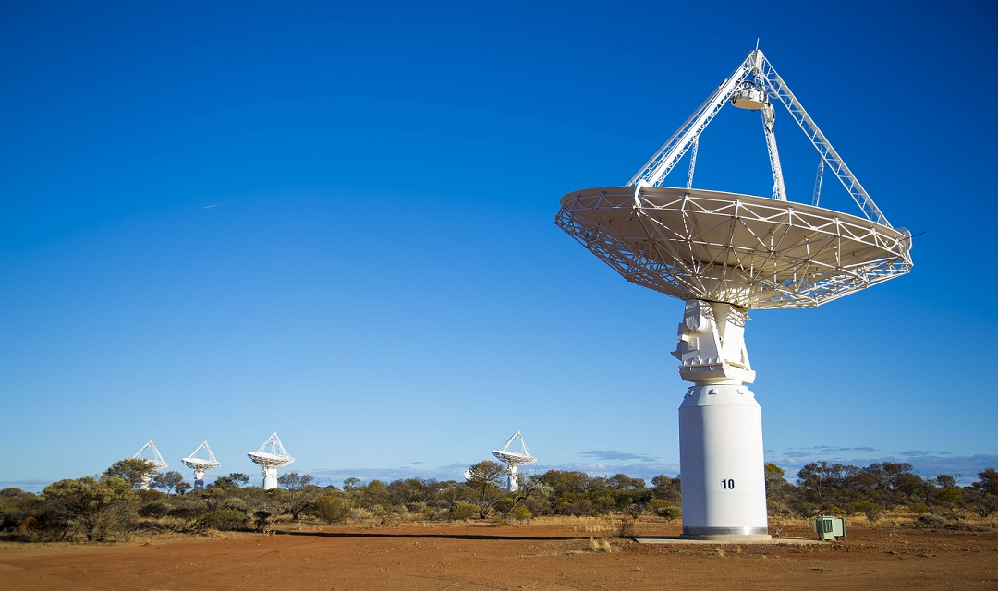
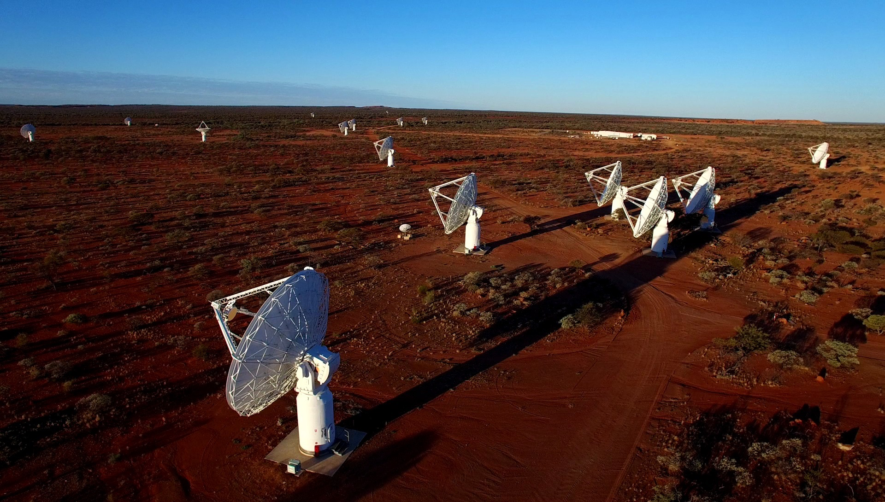
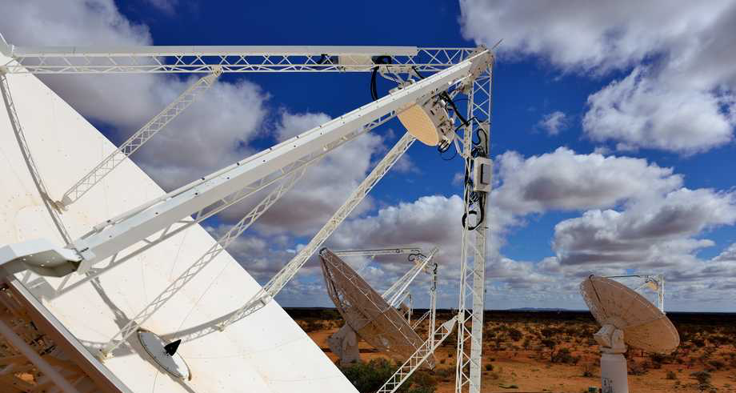
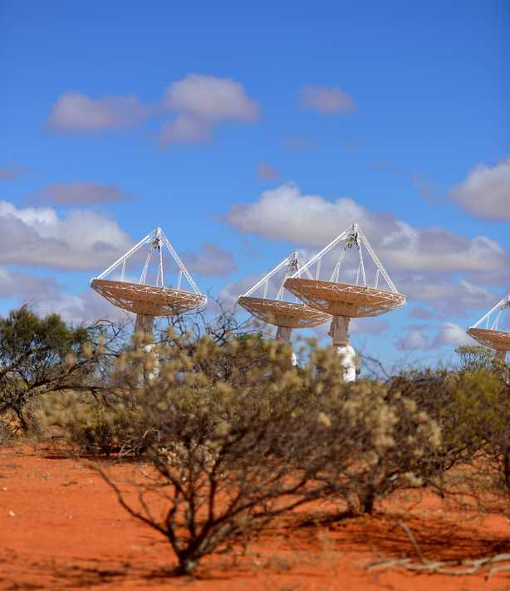
Norris et al., 2011
ASKAP Deep radio image of 75% of the sky (up to declination +30°), 1130-1430 MHz, 10 μJy/b, 10 arcsec .
Will detect and image ~70 million galaxies
Primary science goal: How did galaxies form and evolve?
But…..will provide a “good view” of the Galactic Plane @ L-Band
EMU team currently involved in the ASKAP Early Science Programm
CSIRO
Notes:
While waiting for the SKA, there are a number of precursors and pathfinder that have been built and tested and are already producing data.
One of these is the Australian SKA Pathfinder (ASKAP) a 36-dish array radio telescope located on a radio-quiet site in Western Australia – in the same site where SKA_Low will be built-
ASKAP consists of 36 12-metre antennas spreadover a region 6 km in diameter.
During ASKAP’s first five years of operation at least 75% of its time will be used for large Survey Science Projects and one of such surveys is “The Evolutionary Map of the Universe ((EMU: Norris et al. 2011b))”.
Designed for extragalactic work, EMU will observe also ∼ 75 percent of the Galactic plane, creating the most sensitive wide-field atlas of Galactic continuum emission yet made in the southern hemisphere.

Slide 8
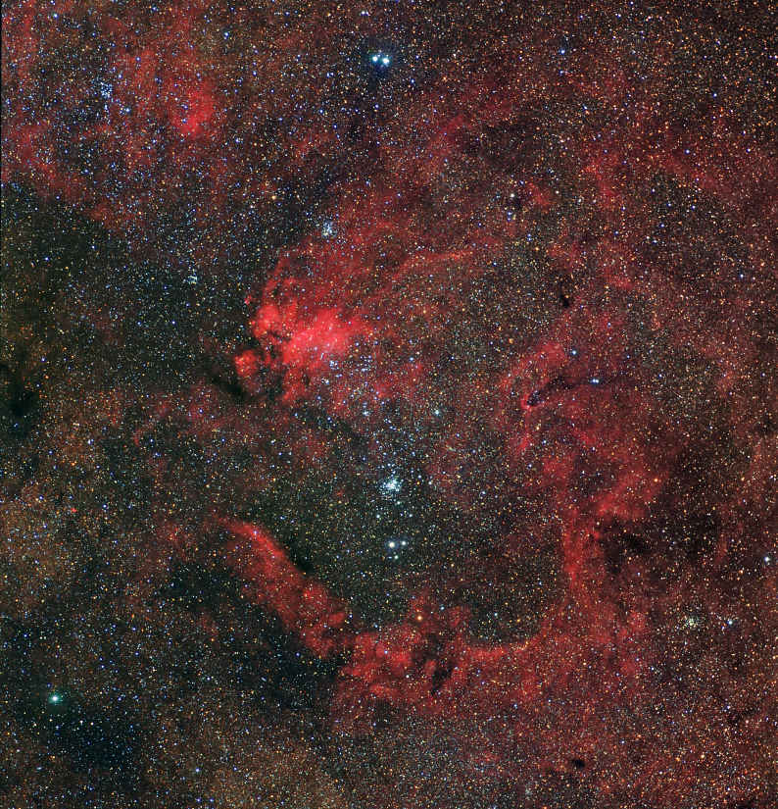
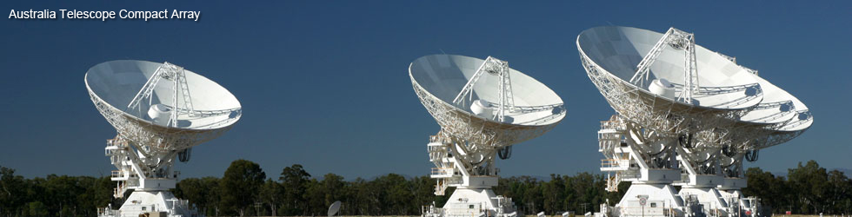
SCORPIO: A deep radio survey in the GP with the ATCA
Frequency L-Band, comparable to EMU
High Sensitivity: approaching future radio facilities
Same observing strategy as ATLAS
(to capitalize on previous experience)
At low Galactic latitude
(well suited for stellar/Galactic work)
2 deg
GP
In the tail of SCORPIO
2 x 2 deg² @ l=343.5, b=0.75
Notes:
In the framework of the EMU project and, in particular, in order to be ready to face all the problems and challenges we are going to find when working close to the GP, few years ago we started a pilot project- a path finder for EMU.
The SCORPIO project is a ATCA blind survey of an approximately 2 × 2-deg2 area of sky centred at Galactic coordinates l = 343.5◦ , b = 0.75◦ (Umana et al. 2015) at 1.4 GHz in a sky patch well suited for stellar work, with goal to reach a sensitive limit approaching that of future radio facilities. The experiment was designed with the same set-up as the ATLAS project, an extragalactic survey, to capitalise ion previous experience.

Slide 9
SCORPIO: A deep radio survey in the GP with the ATCA
Requirements:
Close to the GP, extending to higher b
A “sufficient” number of stars, good spread in potentially radio emitting objects.
Few radio sources already detected in it: to be used as check
Multi-λ observations available for
comparative studies.
2 deg
In the tail of SCORPIO
l=344.25
b=0.50
GP
In the tail of SCORPIO
2 x 2 deg² @ l=343.5, b=0.75
Notes:
The selected field needs to satisfy the following requirements: (i) it should contain a sufficient number of stars, with a good spread in different classes of stellar objects thought to be radio emitters; (ii) it should contain sources already classified as radio emitters to enable verification of the data; (iii) it should have been already observed in other spectral regions to gather additional information to help with the classification of new, unexpected objects or to allow complete studies for the classified objects.
The selected field is a 2 x 2 square degrees, centered at galactic coordinates l=343.5, b=1.0, well suited for stellar work.

Slide 10
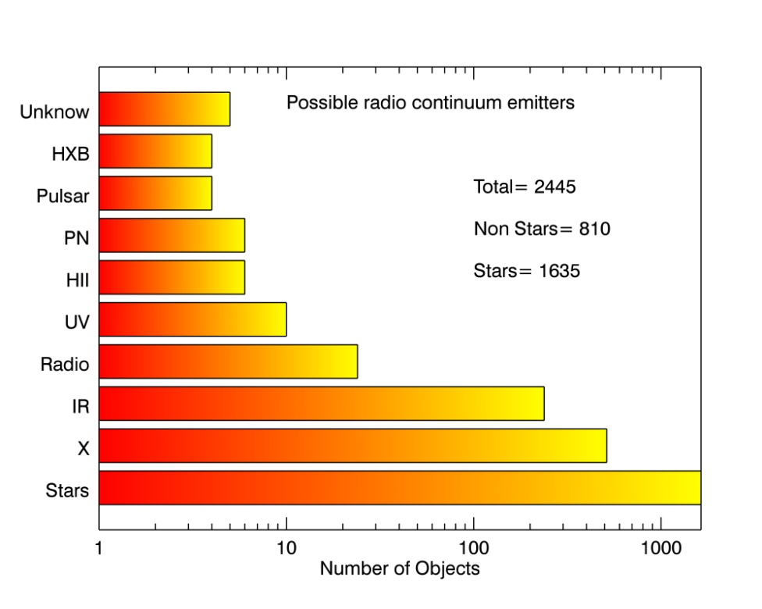
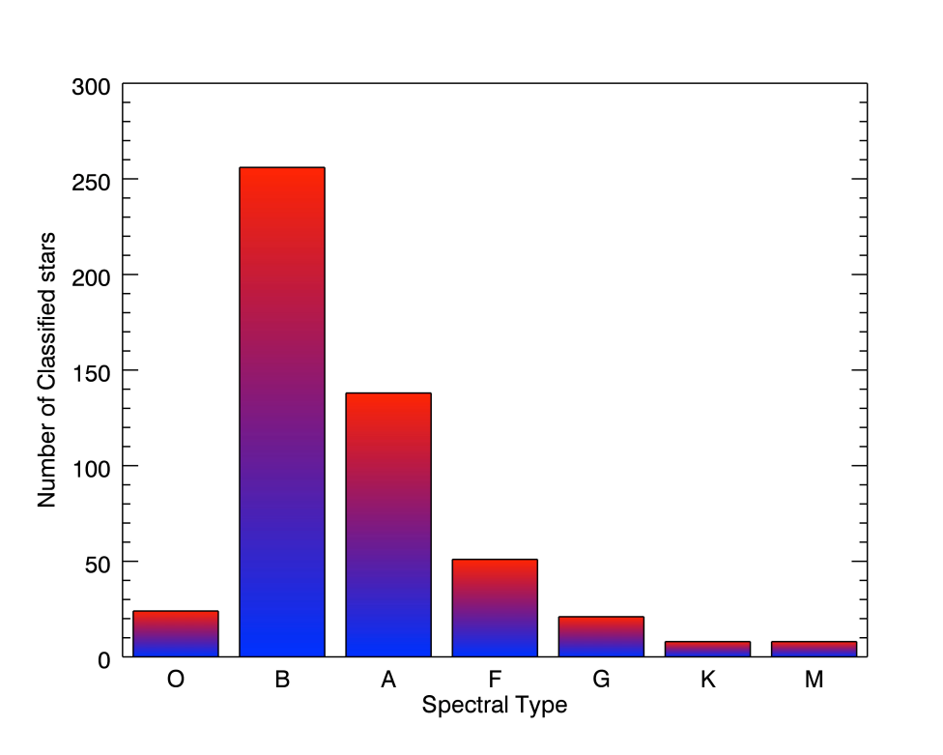
SCORPIO: A deep radio survey in the GP with the ATCA
From SIMBAD database
2 deg
GP
In the tail of SCORPIO
2 x 2 deg² @ l=343.5, b=0.75
Notes:
Because we intend to get statistical information from the survey we choose this sky patch only
on the a priori knowledge of the presence of a significative number of stars in it.
Quering the SIMBAD database we found a total of 2445 objects, 1635 of which are classified as stars, with a good spread in different classes of stellar object thought to be radio emitters and a good representation of different spectral types.

Slide 11
SCORPIO: A deep radio survey in the GP with the ATCA
Part of the sky patch has been surveyed by:
Spitzer GLIMPSE 3.6, 4.5, 5.8 8.0 μm
MIPSGAL 24, 70
(Benjamin et al., 2003, Carey et al., 2009)
HERSCHEL Hi-GAL 70, 160, 250, 350, 500μm
(Molinari et al., 2010)
MOLONGLO 834 MHz (MGPS)
Sydney University Molonglo Sky Survey
2 deg
Multi-wavelength observations will help:
The classification of new detections
Detailed studies of classified objects
GP
In the tail of SCORPIO
2 x 2 deg² @ l=343.5, b=0.75
Notes:
Part of the proposed patch has already been surveyed in the mid-IR by SPITZER, the GLIMPSE and MIPSGAL surveys (Benjamin et al. 2003; Carey et al. 2009), and by Herschel HI-GAL survey (Molinari et al. 2010).
All these ancillary observations will provide more information to help the classification of new,
unexpected detection or to allow complete studies for the classified objects.

Slide 12
SCORPIO
Stellar Continuum Originating from Radio Physics In Ourgalaxy
Two aims:
Provide a good estimation of the scientific potential of deep radio surveys in the field of stellar/Galactic radio astronomy.
Catalogues of different population of Galactic radio sources
Define detection rates for different classes of radio stars.
Prove the importance (uniqueness) of radio observations in the field of
Stellar Astrophysics
Scientific
Test bed for the EMU/SKA surveys: strategy for the GP section
Source complexity: issues due to complex structures in the GP
Source variability: issues due to the variable sources in the GP
Source finding: issues due to the diffuse emission in the GP
Source identification: how to identify/discriminate different populations
(e.g. Galactic vs Extragalactic, different type of stars)?
Technical
Notes:
The aim of the SCORPIO project is twofold: The first is scientific: to provide a good estimation of the scientific potential of deep radio surveys in the field of stellar astrophysic and Galactic Astronomy, in general.
The major scientific goals of SCORPIO are the production of catalogues of different populations of Galactic radio sources and the study of circumstellar envelopes (related to young or evolved massive stars, PNe and SNRs) which is extremely important for understanding the Galaxy evolution (e.g. ISM chemical enrichment, star formation triggering, etc.).
Besides these scientific outputs, SCORPIO will be used as a technical test-bed for the EMU survey, helping to shape the strategy for its Galactic plane sections.
SCORPIO results are, in fact, intended to guide EMU design in: identifying issues arising from the complex structure; identifying issues arising from the variable sources; testing which is the most appropriate method of finding and extracting sources embedded in the diffuse emission expected at low Galactic latitude; quantifying how effectively we can identify counterparts to the extracted sources and disentangle different radio source populations.

Slide 13
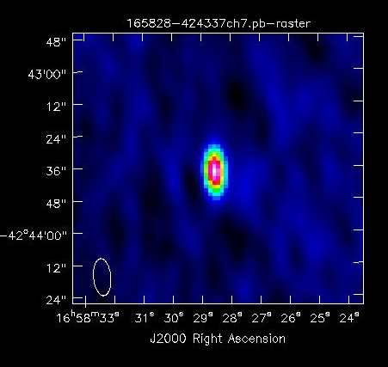
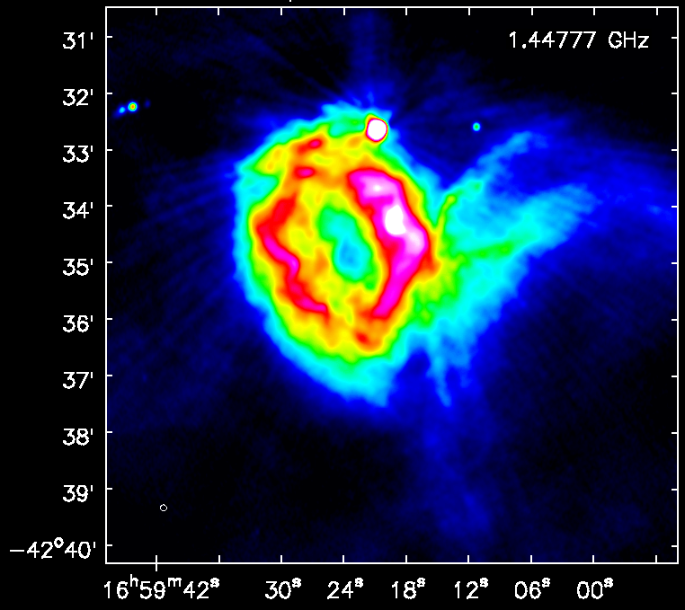
The SCORPIO zoo
Found 2206 “point-like sources”, with a cut of 5σ
614 in the pilot experiment (Umana et al., 2015)
matches with SIMBAD
Stars
PNe
Pulsars
IR
HII
1Variable (z¹ Sco)
2 WR
3 in Open Cluster (in NGC6231)
1 YSO
1 Be
1 Cp star
13 stars with no references
Point Sources
6 pulsars
30 UCHII/HCHII
6 PNe
≈ 1900 without classification
Expected many extragalactic
“contaminants”
Extended Sources
99 in total
35 new detections 64 known objects
41 classified- 23 unclassified
39 classical HII
1 PNe
1 SNRs
Notes:
This a quick summary of the SCORPIO Zoo. We did detected stars, pulsars, UCHII, PNe but the majority of the detected point sources are still without any classification and we expect to have many extragalactic contaminants. We detected also 99 extended sources, 35 are new detections, 64 known radio sources with 23/64 without classification.
We found about 2206 in the entire SCORPIO field (ATCA) and 614 in the pilot.

Slide 14
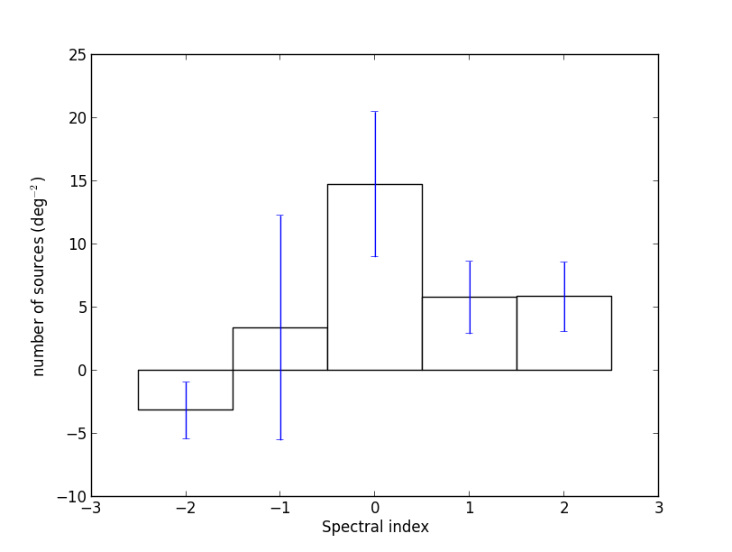
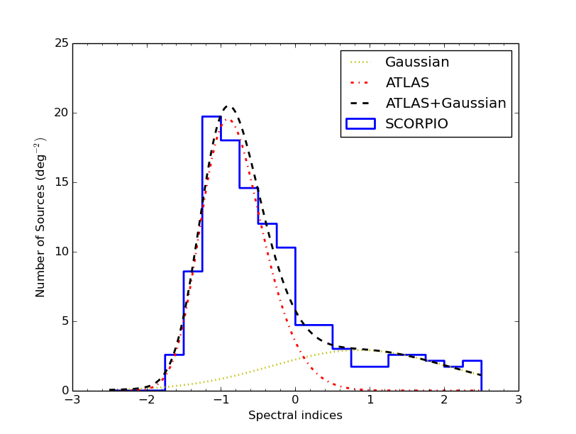
SCORPIO Dealing with (many) point sources
Radio spectral index analysis to characterize the point source emission
-disentagle between Galactic and extragalactic population?
-automatic procedure (run in Casa- imfit, imstat)
to estimate the spectral index of source from multi
frequency radio images.
Comparison with ATLAS:
no difference for α << 0
source excess for α ≥ 0
Above 1 mJy, the source density in SCORPIO is 20%
greater than in a typical extragalatic field
Cavallaro + 2018
Notes:
The SCORPIO field was designed to be an intermediate step between current- technology observations and future surveys. In particular, for the purpose of source detection and classification it is still quite small to allow source identification by visual inspection, but it is also sufficiently large for testing and training automated algorithms usually requiring moderately large samples of test objects. In this case, the human-driven visual inspection can be used as a verification check of the automated algorithms.
We started to face the problem to manage big catalogue and to deal with many point sorces. A way to characterize the detections and to disentangle a Galactic population from extragalactic contaminants is to get information on spectral index.
An automatic procedure was written by Cavallaro et al., to extract point sources and estimates spectral indexes. This procedure was applied to SCORPIO point sources (higher than mJy) and to ATLAS sources. We found that the source density with s.i. typical for thermal objects is 20% greater then in a typical extragalactic field.

Slide 15
SCORPIO Dealing with extended sources
SCORPIO field is:
  Small enough to allow source identification by visual inspection
  sufficiently large for testing and training automated algorithms
  human-driven visual inspection can be used as a verification check of the automated algorithms.
From a field
To a list of extended sources
Riggi et al., 2016 Uses SCORPIO to test the automated extraction algorithms CAESAR (Compact And Extended Source Automated Recognition)
Notes:
The SCORPIO field have the right dimension to extract extended sources visually but in the same time large enough to test and training automated algoritms. One of this is CAESAR developed by S. Riggi that used SCORPIO maps as test bed.

Slide 16
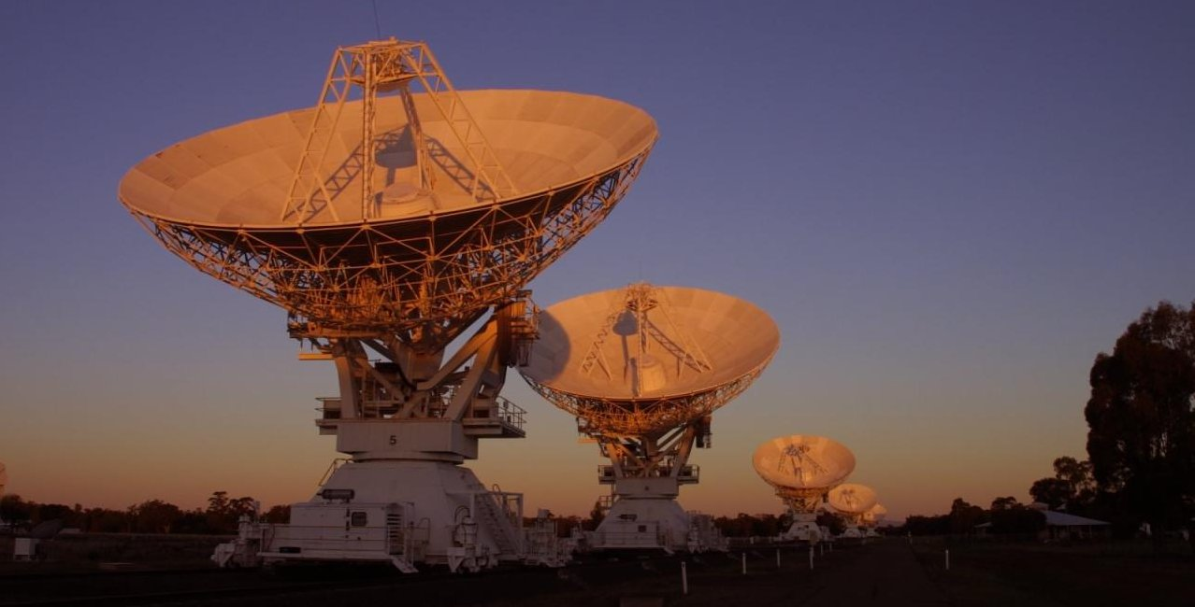
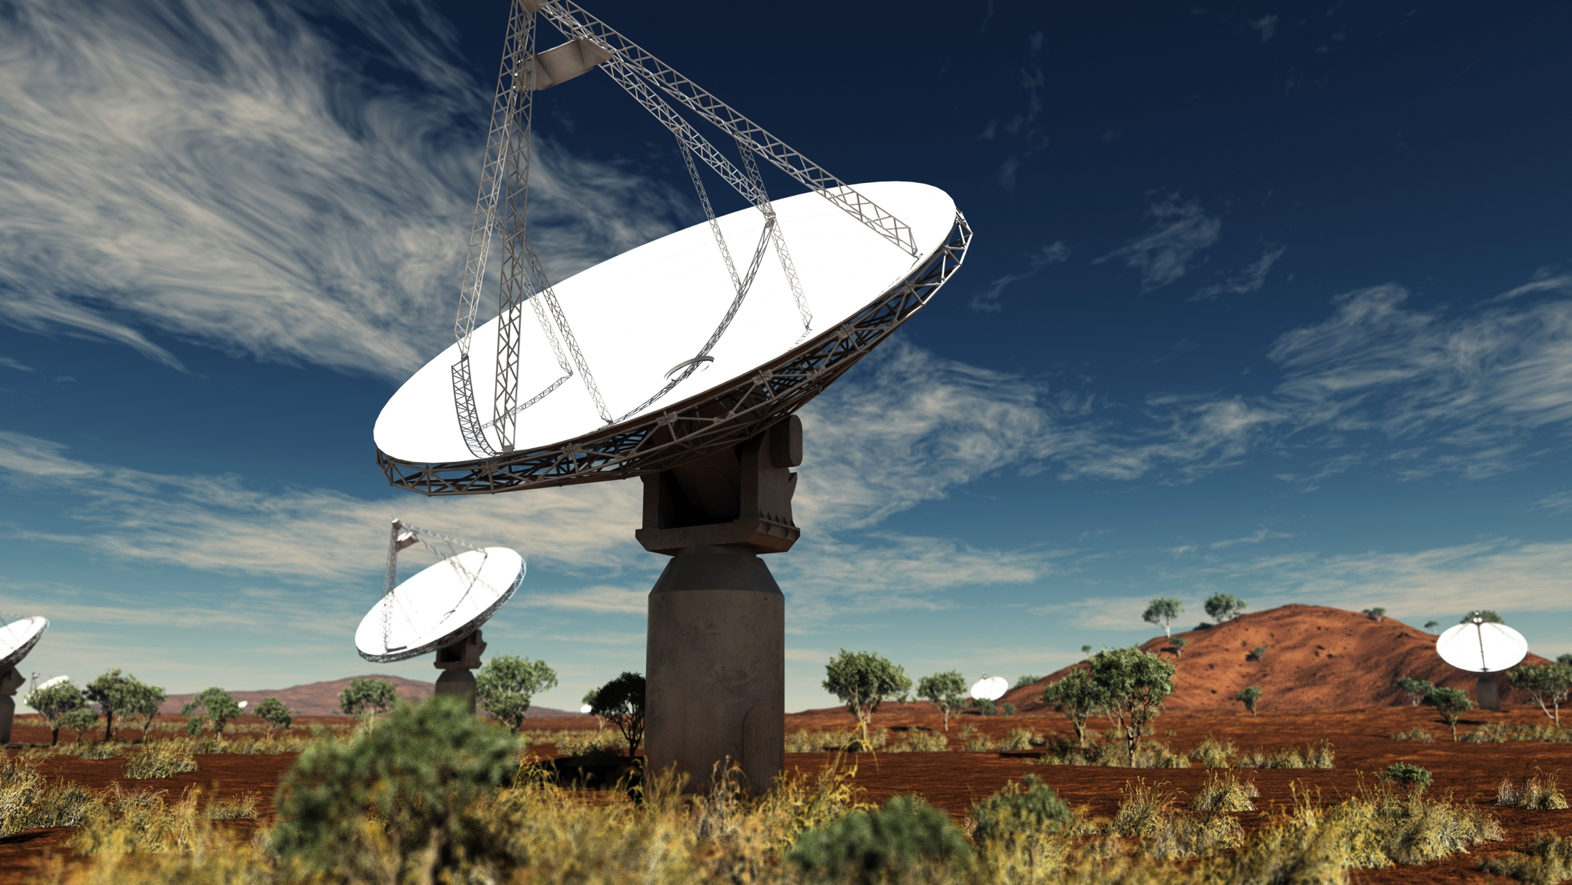
The SCORPIO field ASKAP Early Science
2 x 2 deg² @ l=343.5, b=0.75
A much larger region of SCORPIO field
observed during ASKAP Early Science
Freq: 792-1032 MHz (240MHz)
Ang. Res. 24.1x 21.1 arcsec²
Total integration time: 32 hrs
(including overheads for calibration)
rms ≅ 130μJy (outside GP)
<rms> ≅ 500μJy
ATCA- 133 pointings, 3σ= 90 μJy, 4 deg²
Freq: 1.1-3.1 GHz (2.1 GHz)
Total integration time: 320 hrs
ASKAP-12 1 pointing! 40 deg²
Umana+2019 in prep.
Notes:
The Scorpio field has been observed in 2018 as part of the ASKAP Early Science. The observations were performed with ASKAP-12 (15 antennae) with a central frequency of 912 MHz and an angular resolution of 24.2x21.1 arcsec and covered covered a total area of about 40 square degrees
Total integration time was 32hrs (compared to 320 hrs ATCA) but almost 30% of the data (9TB) were lost due to flagging (RFIs)-

Slide 17
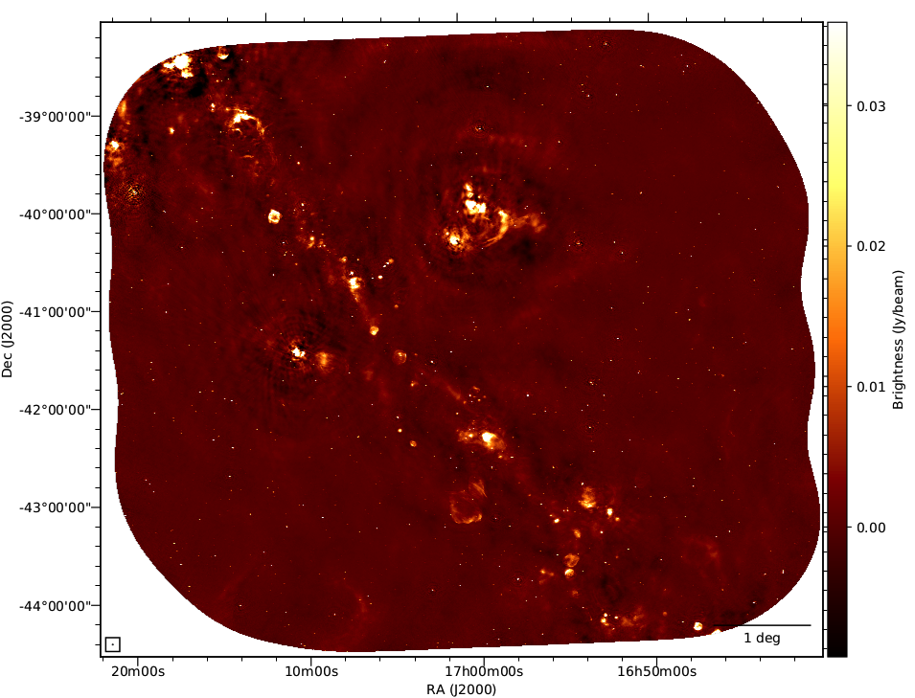
The SCORPIO field ASKAP map
Field center 343.5, 0.75
Dimensions 6x6 deg²
Band 1 (920 MHz, B=300 MHz) ASKAP-12
ASKAP-36 to be processed
Band 1 (920 MHz, B=300 MHz)
Band 2 (1296 MHz)
Band 3 (1630 MHz)

Slide 18
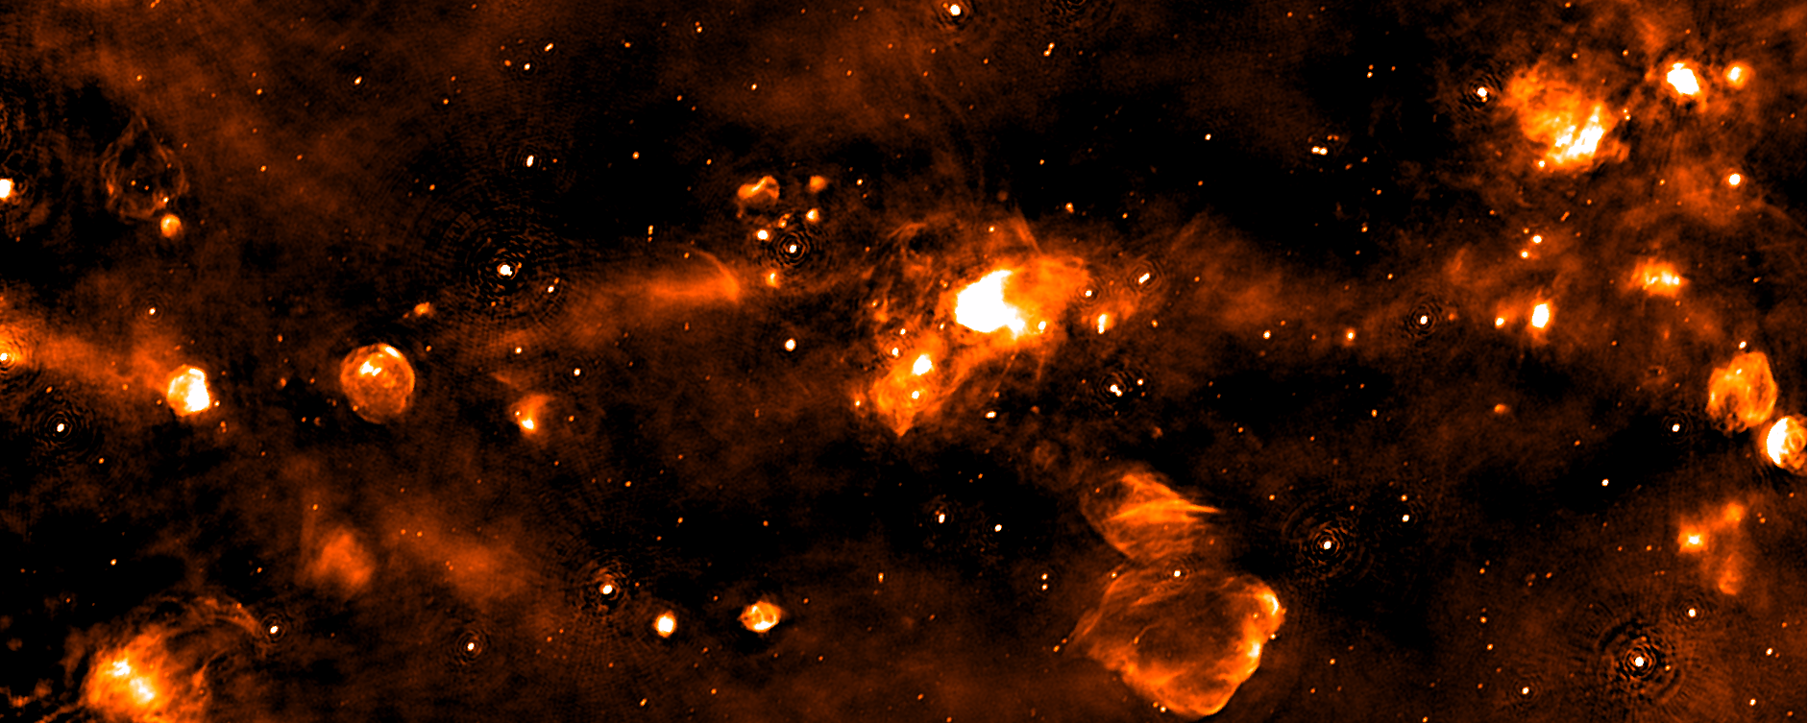
The SCORPIO field ASKAP map
Field center 343.8 -0.2
Dimensions 5.4x1.3 deg²
Band 1 (792-1032 MHz)

Slide 19
The SCORPIO field ASKAP map
1 deg

Slide 20
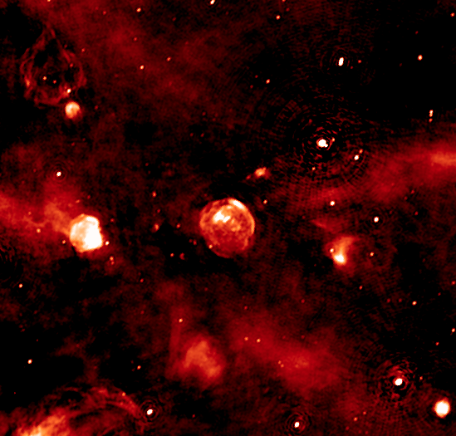
The SCORPIO field ASKAP map

Slide 21
The SCORPIO field ASKAP map
1 deg

Slide 22
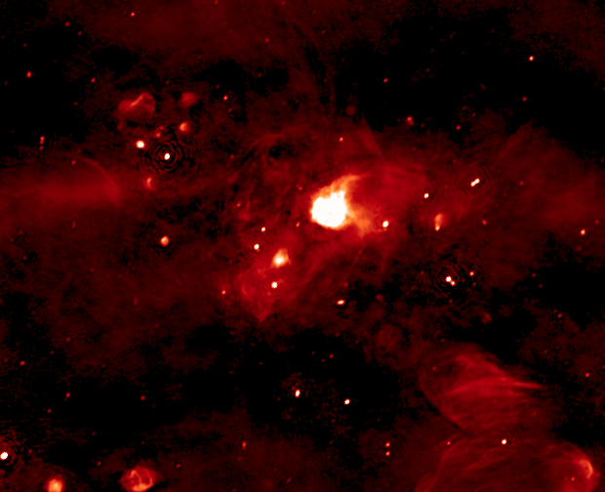
The SCORPIO field ASKAP map

Slide 23
The SCORPIO field ASKAP map
1 deg

Slide 24
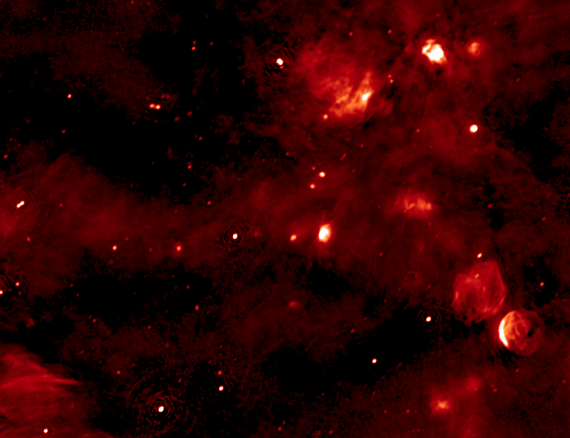
The SCORPIO field ASKAP map

Slide 25
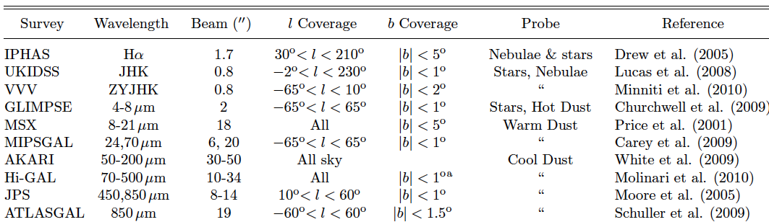
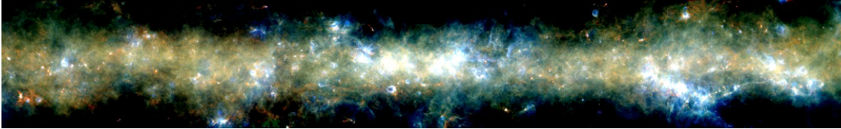
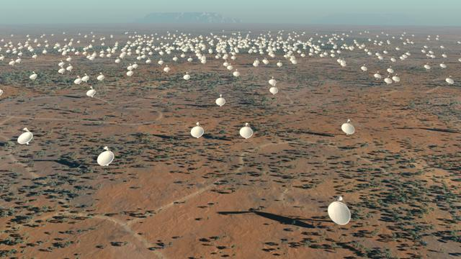
Synergy with multi-frequency Galactic Plane surveys
Adapted from Hoare + 2012
Synergies: tabella da CORNISH
For several classes of Galactic objects robust classification is
possible only by combining radio and IR information
Hi-GAL (Molinari+ 2010) 345d<l<330d
R=350μm; Y=160μm; B=70μm
Notes:
The study of star formation, stellar populations and Galactic structure is currently beeing transformed by a new generation of Galactic plane surveys.
For sevaral classes of Galactic objects robust classification is possible only by combining radio and IR information
Very important for Galactic studies will be the synergy with the available galactic plane survey carried out at other wavelenghts, with angular resolution comparable to EMU as those summarized in Hoare et al., 2012, which trace stars, nebulae, cold and hot dust.
Indeed, for several classes of Galactic objects robust classification is possible only by combining radio and mid-ir information.

Slide 26
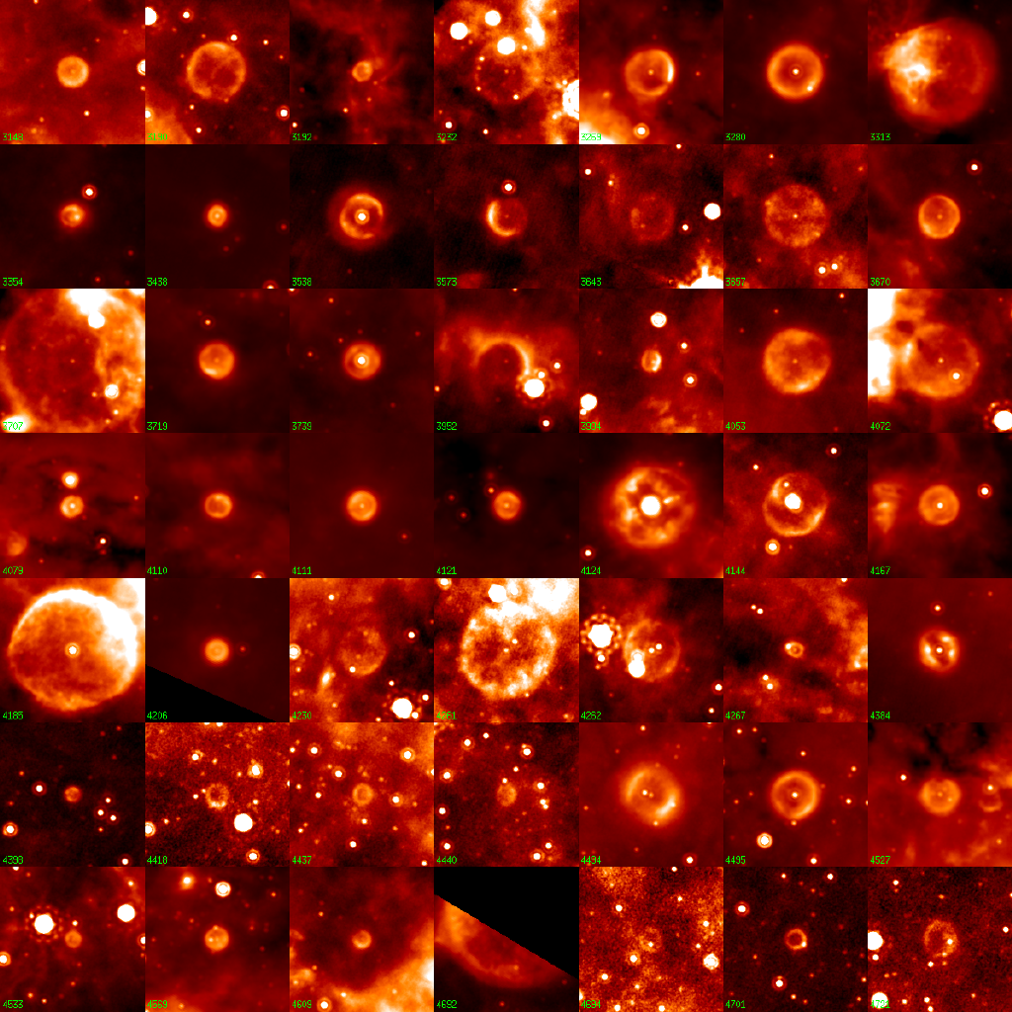
The Bubbling Galactic Plane
About 400 “bubbles” found
in MIPSGAL (24 μm)
Carey et al., 2009, Mizuno et al 2010
Possibly related to late stages
of stellar evolution
only 10% have been identified
Radio observations:
Detailed morphology
Spectral index
Polarization
to discriminate
LBV, PN, WR (thermal)
from SNR (non-thermal)
24 μm
Credit: Spitzer MIPSGAL Legacy Team
Notes:
They have been new discoveries done with the most recent GP IR surveys, in particular many mid-iR bubbles have been discovered to be present in the GP. Those are mostly observed at 24μm and appear to be related to a hidden population of massive stars: LVB, WR and PN. When the central object is not visible, radio observations are the only mean to discriminate between thermal (PN, LBVs) or shocked nebulae (SNRs)-

Slide 27
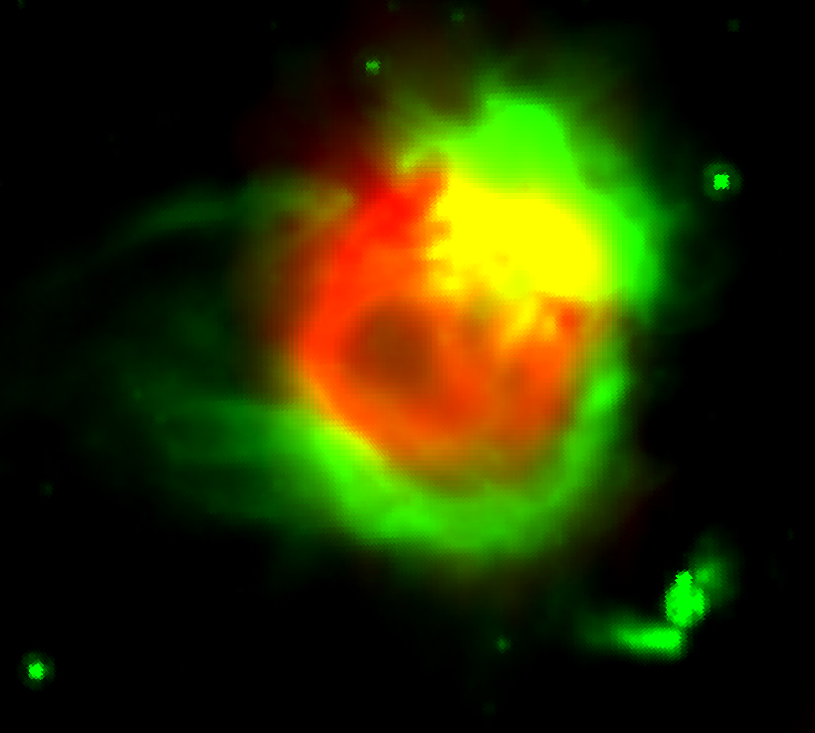
SCORPIO Dealing with extended sources
Comparing radio and IR morphology, is possible to distinguish HII from evolved stars
  In HII, radio emission wrapped by 8μm emission (Deharveng +2010)
  In PN radio and 8μm are cospatial (Ingallinera +, 2016)
RADIO:
Ionized gas
IR (8μm):
PAH emission
  Use of radio and IR morphology to classified extended sources in SCORPIO
  (Ingallinera + 2016; Ingallinera +2019)
  To explote the use of radio and IR morphology to automated source
classification for large surveys by means of edge-sensitive algorithms
  SCORPIO field of the “right” dimension for the human-driven visual
  inspection be used as a verification check.
Notes:
We don’t need only to pick-up extended sources. We need also to characterise them.
Indeed comparing the radio morphology with the IR morpholgy (i.e. 8micron) would help in disentgle HII from bubbles related to evolved stars.
This has been done by Ingallinera et al in a seris of papars and the next step will be to use this phisical information in an automated procedure.

Slide 28
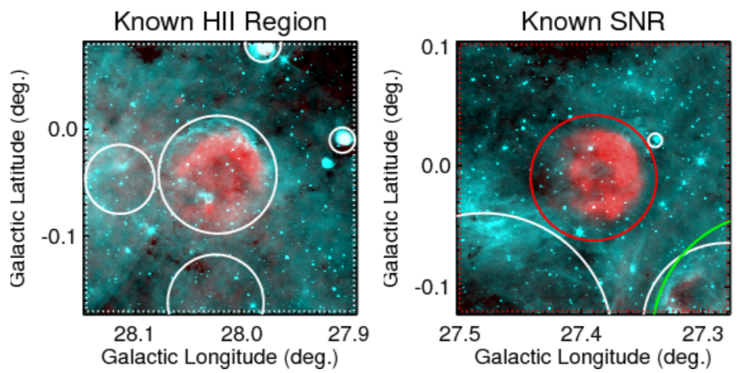

SCORPIO Dealing with extended sources
Comparing radio and IR morphology is possible to spot Supernova Remnant
  In HII, radio emission wrapped by 8μm emission (Deharveng +2010)
  In SNR the 8μm emission in essentially absent and MIR/radio ratio much lower than HII regions (e.g. Anderson+2017)
GLIMPSE 8 μm
THOR+VGPS 21 cm
Anderson+17
Finding Missing SNR population: use of radio and IR morphology to individuate new SNR candidates in SCORPIO field
(ASKAP vs Hi-Gal images; Bufano+in prep.)
Study of the origin of dust in SNRs: use of IR data to produce 2D maps of the dust physical properties (T, β and τ_{ν}) distribution, from the pixel to pixel SED.
Notes:
Le immagini 8mic/radio sono del lavoro di quelli di THOR. Mostra che l’emissione a 8mic e’ assente, ma in generale nel MIR e’ molto piu’ debole
che per le HII region. Tipico valore medio 24mic/1.4GHz e’ 4, mentre per HII region e’ almeno un ordine superiore

Slide 29
The SCORPIO field ASKAP map
Field center 343.8 -0.2
Dimensions 5.4x1.3 deg²
Green 8μm GLIMPSE
Red 70μm Hi-GAL
Blue ASKAP 912 MHz
Notes:
This is a portion of the SCORPIO field (radio in blue) with superimposed data at 8 micron GLIMPSE/SPITZER, that trace warm dust and PAH, and 70 micron data from HiGAL/Herschel, that trace cooler dust.
It is possible to easily pick-upSNR with no or small ammount of dust associated to them.

Slide 30
The SCORPIO field ASKAP map
Field center 343.8 -0.2
Dimensions 5.4x1.3 deg²

Slide 31
The SCORPIO field ASKAP map
Field center 343.8 -0.2
Dimensions 5.4x1.3 deg²

Slide 32
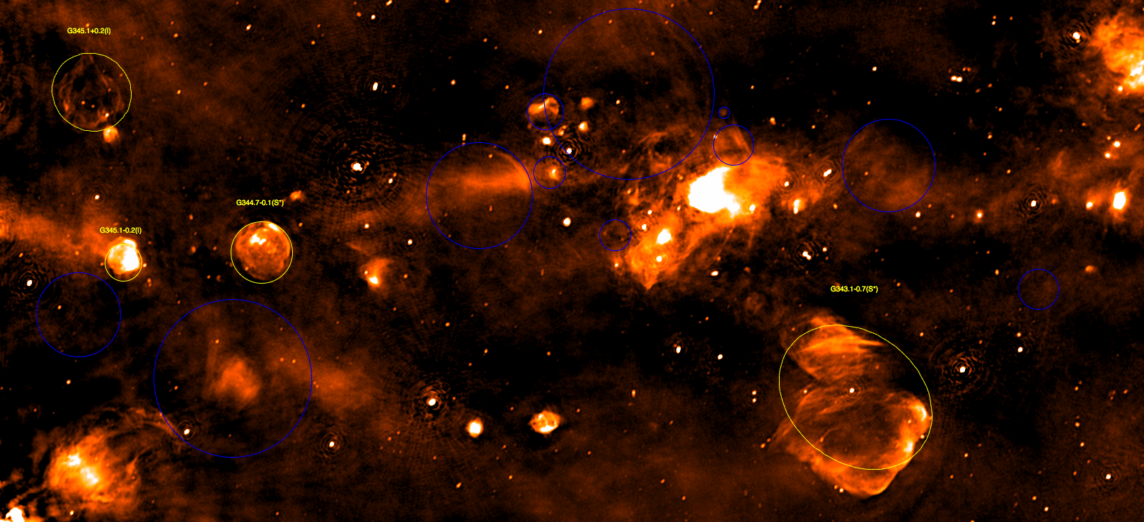
The SCORPIO field ASKAP map
Field center 343.8 -0.2
Dimensions 5.4x1.3 deg²
Yellow –17 known SNRs from Green et al. 2014
Blue 23 new SNRs candidates (FIR much weaker or absent with respect to HII regions)
Notes:
SCORPIO_SNR
The most complete catalogue of galactic SNRs is the Green 2014 catalogue, compiled from literature radio data. In the SCORPIO region there are 17 SNRs reported in the Green 2014 and all of them are visually matched in the SCORPIO map. A SNR is usually identified in the radio by its typical ‘shell-like’ morphology and from its non-thermal radio emission. Moreover, a robust classification can been assured if observations at other wavelengths are avail- able. For example an anticorrelation between radio emission and 8 μm IR emission in SNRs is well established (Brogan et al., 2006; Anderson et al., 2017) There are many extended sources in the SCORPIO field that satisfy the morphological criterion for SNRs, a very promising sample of possible candidates

Slide 33
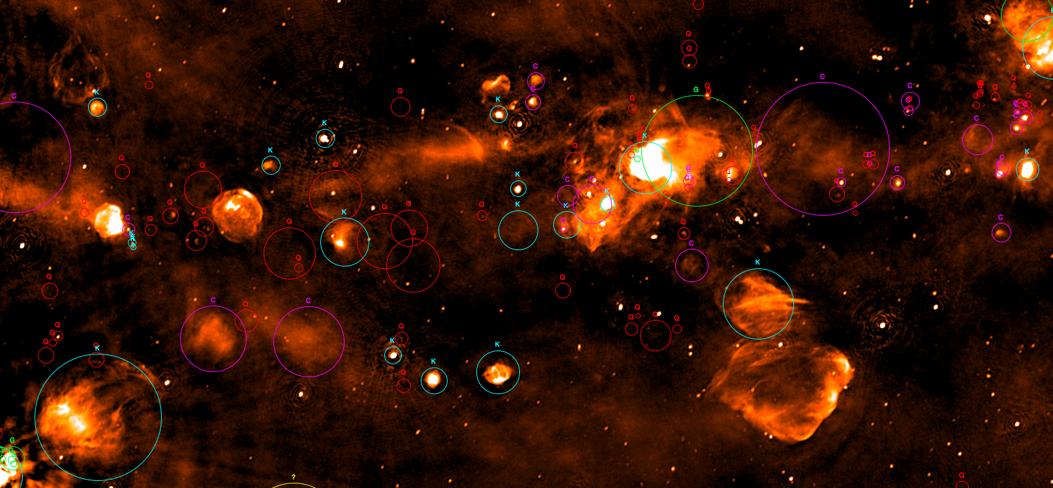
The SCORPIO field ASKAP map
Field center 343.8 -0.2
Dimensions 5.4x1.3 deg²
HII Regions as from the WISE catalog (Anderson+2014)
Light-blue K Known HII
Green G Group
Purple C Candidate
Red Q radio quite
A total of 388 HII in SCORPIO/ASKAP map
All the known and candidate HII are detected
220/388 are Q HII regions
99/220 (45%) are detected in SCORPIO/ASKAP
Notes:
The most updated catalogue of Galactic H II regions has been com- piled by Anderson et al. 2014. Those authors used the mid-infrared (MIR) observations from the Wide-Field Infrared Survey Explorer (WISE) satellite and made a catalogue of 8000 sources taking advantages of the typical morphology that H II regions show in the MIR.
Within the SCORPIO region there are 382 sources catalogued in the Anderson et al. 2014 as following: 63 known H II regions (K), 72 candidates (C), 220 radio quiet (Q), 22 closely located to a known H II regions (G), 5 without radio data (?).

Slide 34
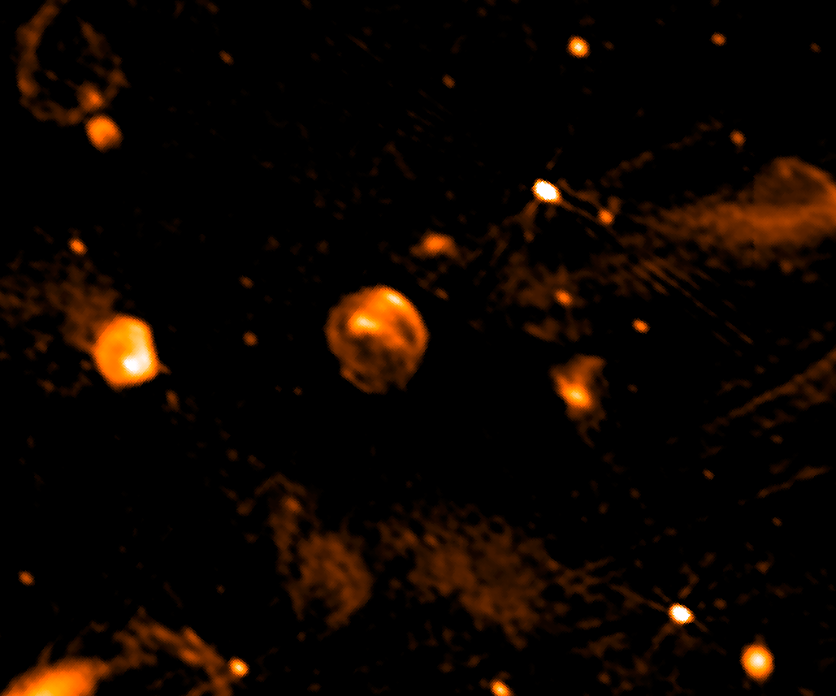
Field around SNR G344.7-0.1
912 MHz ASKAP
MOST 843 MHz
The ASKAP image is sharper and more sensitive, showing fainter diffuse features and
additional details compared to the previous “best” image of the same patch in the sky
Notes:
A small section of the SCORPIO field (about 1.5 deg) mapped with ASKAP (right pannel) compared to an equivalent observations made with MOST.
The ASKAP image is sharper and more sensitive, showing some fainter features with additional details not visible in the previous best imag of this patch in the sky.

Slide 35
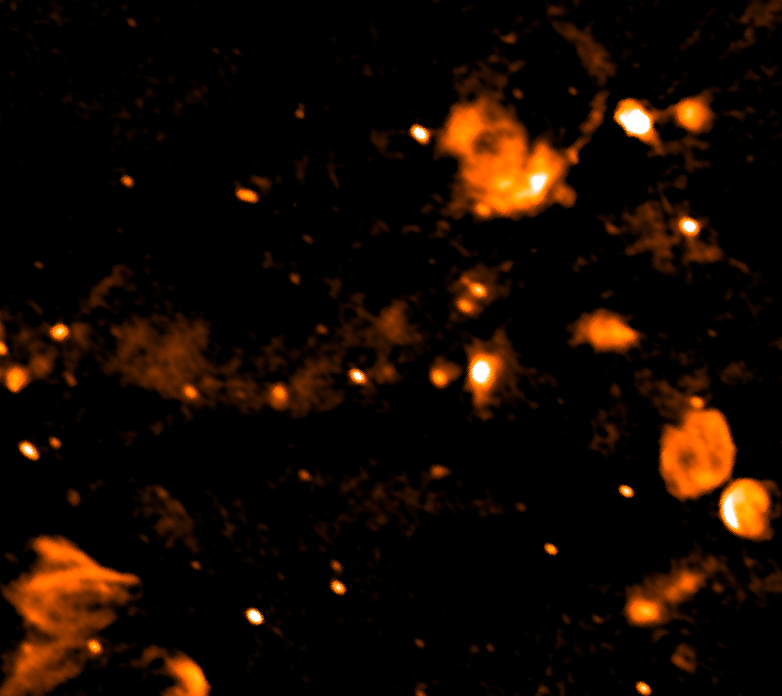
The SCORPIO field
912 MHz ASKAP
MOST 843 MHz
The ASKAP image is sharper and more sensitive, showing fainter diffuse features and
additional details compared to the previous “best” image of the same patch in the sky

Slide 36
The SCORPIO field
Green 8μm GLIMPSE
Red 70μm Hi-GAL
Blue ASKAP 912MHz
912 MHz ASKAP

Slide 37
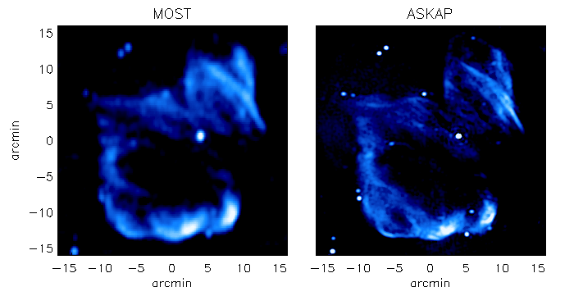
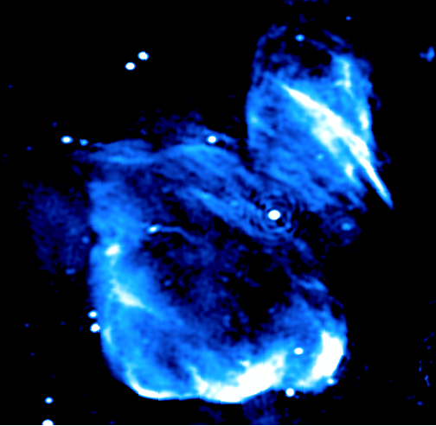
SNR G343.1-0.7
MGPS conducted with the Molongo Observatory Synthesis Telescope
843 MHz
843 MHz
912 MHz
Overall structure of the remnant recovered by the two instruments
The better resolution of ASKAP (20” vs 45”) allow to appreciate finer details
Notes:
In the Figure we compare how the SNR G343.1-0.7 is observed by ASKAP and by MOST. The overall structure of the remnant is well recovered by both instru-ments. However, the better resolution achieved with ASKAP, twice as good as MOST, allows us to appreciate finer details of the source visible in the map. In particular, a better spatial definition of the brighter regions in the southern edges of the remnants, very proba- bly associated to areas where interaction with ISM is taking place, is obtained.

Slide 38
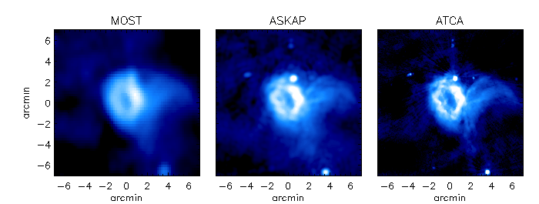
Bubble S17 -Churchell et al., 2006
ASKAP provides the best compromise between fine details and diffuse emission
Great potentiality for Galactic Plane studies.
Notes:
Another useful comparison is reported here, where we compare the same field around the H II region [C06] S17 as observed by MOST, ASKAP and by ATCA. Despite the great difference in terms of instrument capabilities, the overall morphology of the source is again well reconstructed by ASKAP, which provides the best compromise between fine details and extended structures.
All the compact components and detailed edges of the inner region, as detected in the ATCA image, are indeed present in the ASKAP map. On the other end, all the extended diffuse emission, as detected in the MOST map, are successfully recovered by ASKAP, including the new detection of some diffuse, low-brightness features in the southern part of the nebula, indicating the superior capability of ASKAP, compared to other radio facilities, to recover low-brigtness diffuse emission up to angular scales comparable to its LAS.

Slide 39
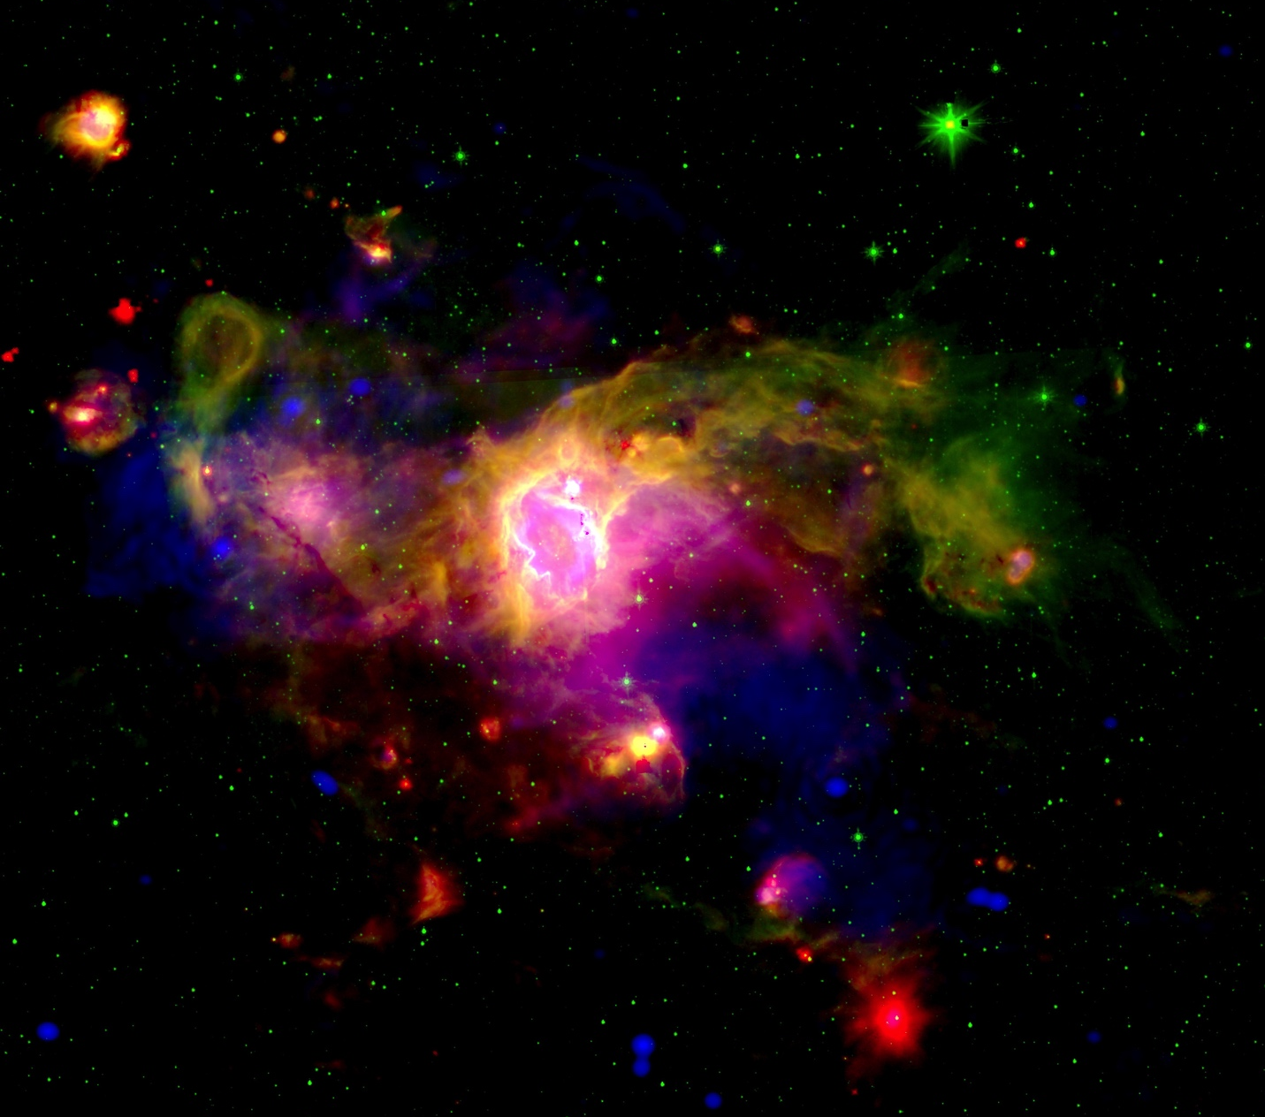

Bubble S17 -Churchell et al., 2006
Green 8μm GLIMPSE
Red 70μm Hi-GAL
Blue ASKAP 912MHz
The VIALACTEA knowledgebase: a unique tool for source
identification and classification

Slide 40
G345.94-00.779
HII (Caswell 1987, Anderson 2014)
MGPS conducted with the Molongo Observatory Synthesis Telescope
843 MHz
SCORPIO/ASKAP@912 MHz
Finer details and overall structure
Extrordinary capability of ASKAP to map
Galactic sources up to 50’ (LAS@912 MHz)
Notes:
Here there is another example of a HII known in litterature (check if detected in the radio) with an extension of about 20 prime.
Again this indicate the superbe capability of ASKAP to map finer details of the source- look at filaments on the right and, at the same time, recover the more extended structures, allowing a robust measurements of the radio flux density.

Slide 41
SNR candidate SNR G344.7-0.1

Slide 42
ASKAP
925 MHz
Central Source
ATCA
1400 MHz
Notes:
Among these objects, we selected the source MSCG345.1−0.2 (also listed in the MOST catalogue as a possible SNR; Whiteoak & Green 1996, A&A 118, 329). Our ASKAP map at 925 MHz (Figure 1, left panel) shows that MSC G345.1−0.2 has the typical appearance of a composite SNR. The whole nebula has a power- law spectrum (Sν ∝ ν−α) with α=0.66 and flux at 925 MHz of 2.6 Jy. The northern part is characterized by a nearly semi-circular shell-like emission, while the brighter southern emission has a plerionic aspect, with a compact source slightly displaced from the geometrical center of the nebula. This source is nearly resolved with ASKAP and a has a flux density of 0.22 Jy. The rest of the bright southern region has a flux density of 0.74 Jy. The morphology of the central source can be appreciated in the ATCA map at 1400 MHz (Figure 1, right panel), where an elongation in the SE-NW direction is evident (PA=55◦, angular size of ∼ 35′′ × 14′′). We found also evidence that the spectral index varies from α ∼ 0.9 in the northern shell to α ∼ 0.6 in the brightest southern region. The spectrum of the central compact source is flatter, with α ∼ 0.55. These properties strongly suggest that MSC G345.1−0.2 contains a PWN.

Slide 43
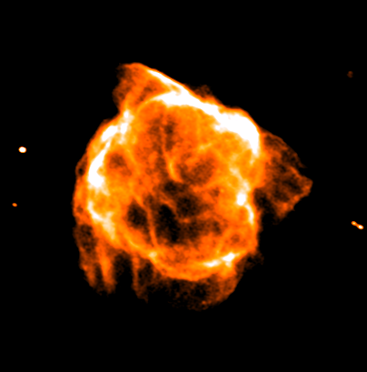
Band-3 SCORPIO family album SNR G346.6-0.2 SNR G346.6-00.2
15’
Band 3 (1630 MHz)
Notes:
SNR already studied in the radio-

Slide 44
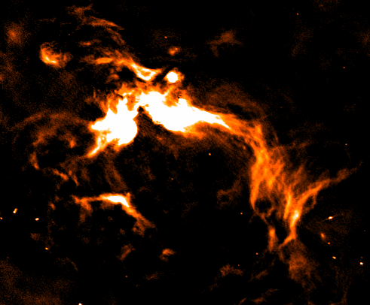
SFR gal 347.6 0.2
30’
gal 347.6 0.2

Slide 45
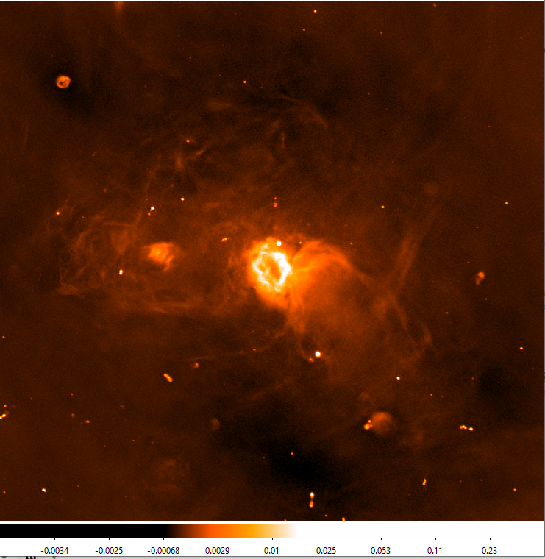
Bubble S17 -Churchell et al., 2006

Slide 46
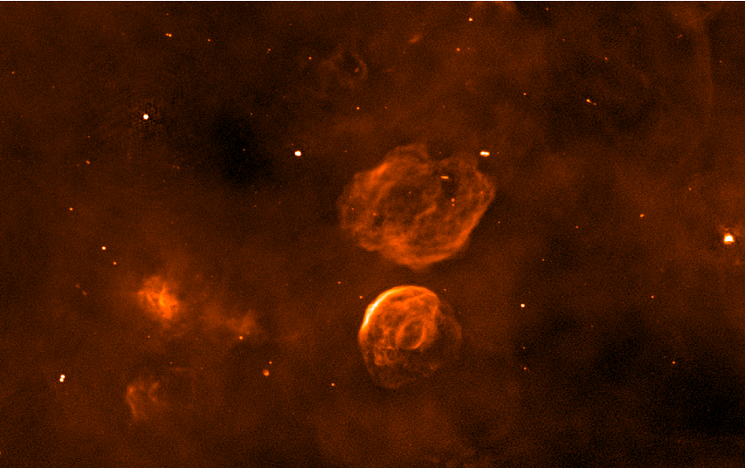
SNR G342.0-0.2 and SNR G341.9-0.3
1 deg

Slide 47
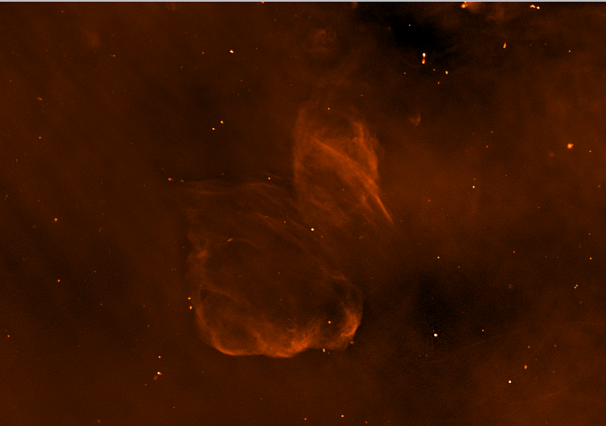
SNR G343.1-0.7

Slide 48
SCORPIO as design study for EMU
SCORPIO has proven to be an extremely valuable project from a scientific and a technical point of view.
The expertise and the knowledge acquired on this patch of the sky have been helpful in the ASKAP early science phase and can be considered as a design study for the Galactic section of EMU
SCORPIO used as testbed to test the ASKAP capability on the GP:
to evaluate the limitations in depth of EMU close to the GP
(bright, extended Galactic sources and diffuse emission)
To evaluate the need for single-dish data
SCORPIO
Provides inputs for ASKAP data reduction and analysis
fulfillment of SCORPIO technical goals
Provides reliable forecasts for EMU discovery potential
fulfillment of SCORPIO scientific goals.
✔
✔

Slide 49
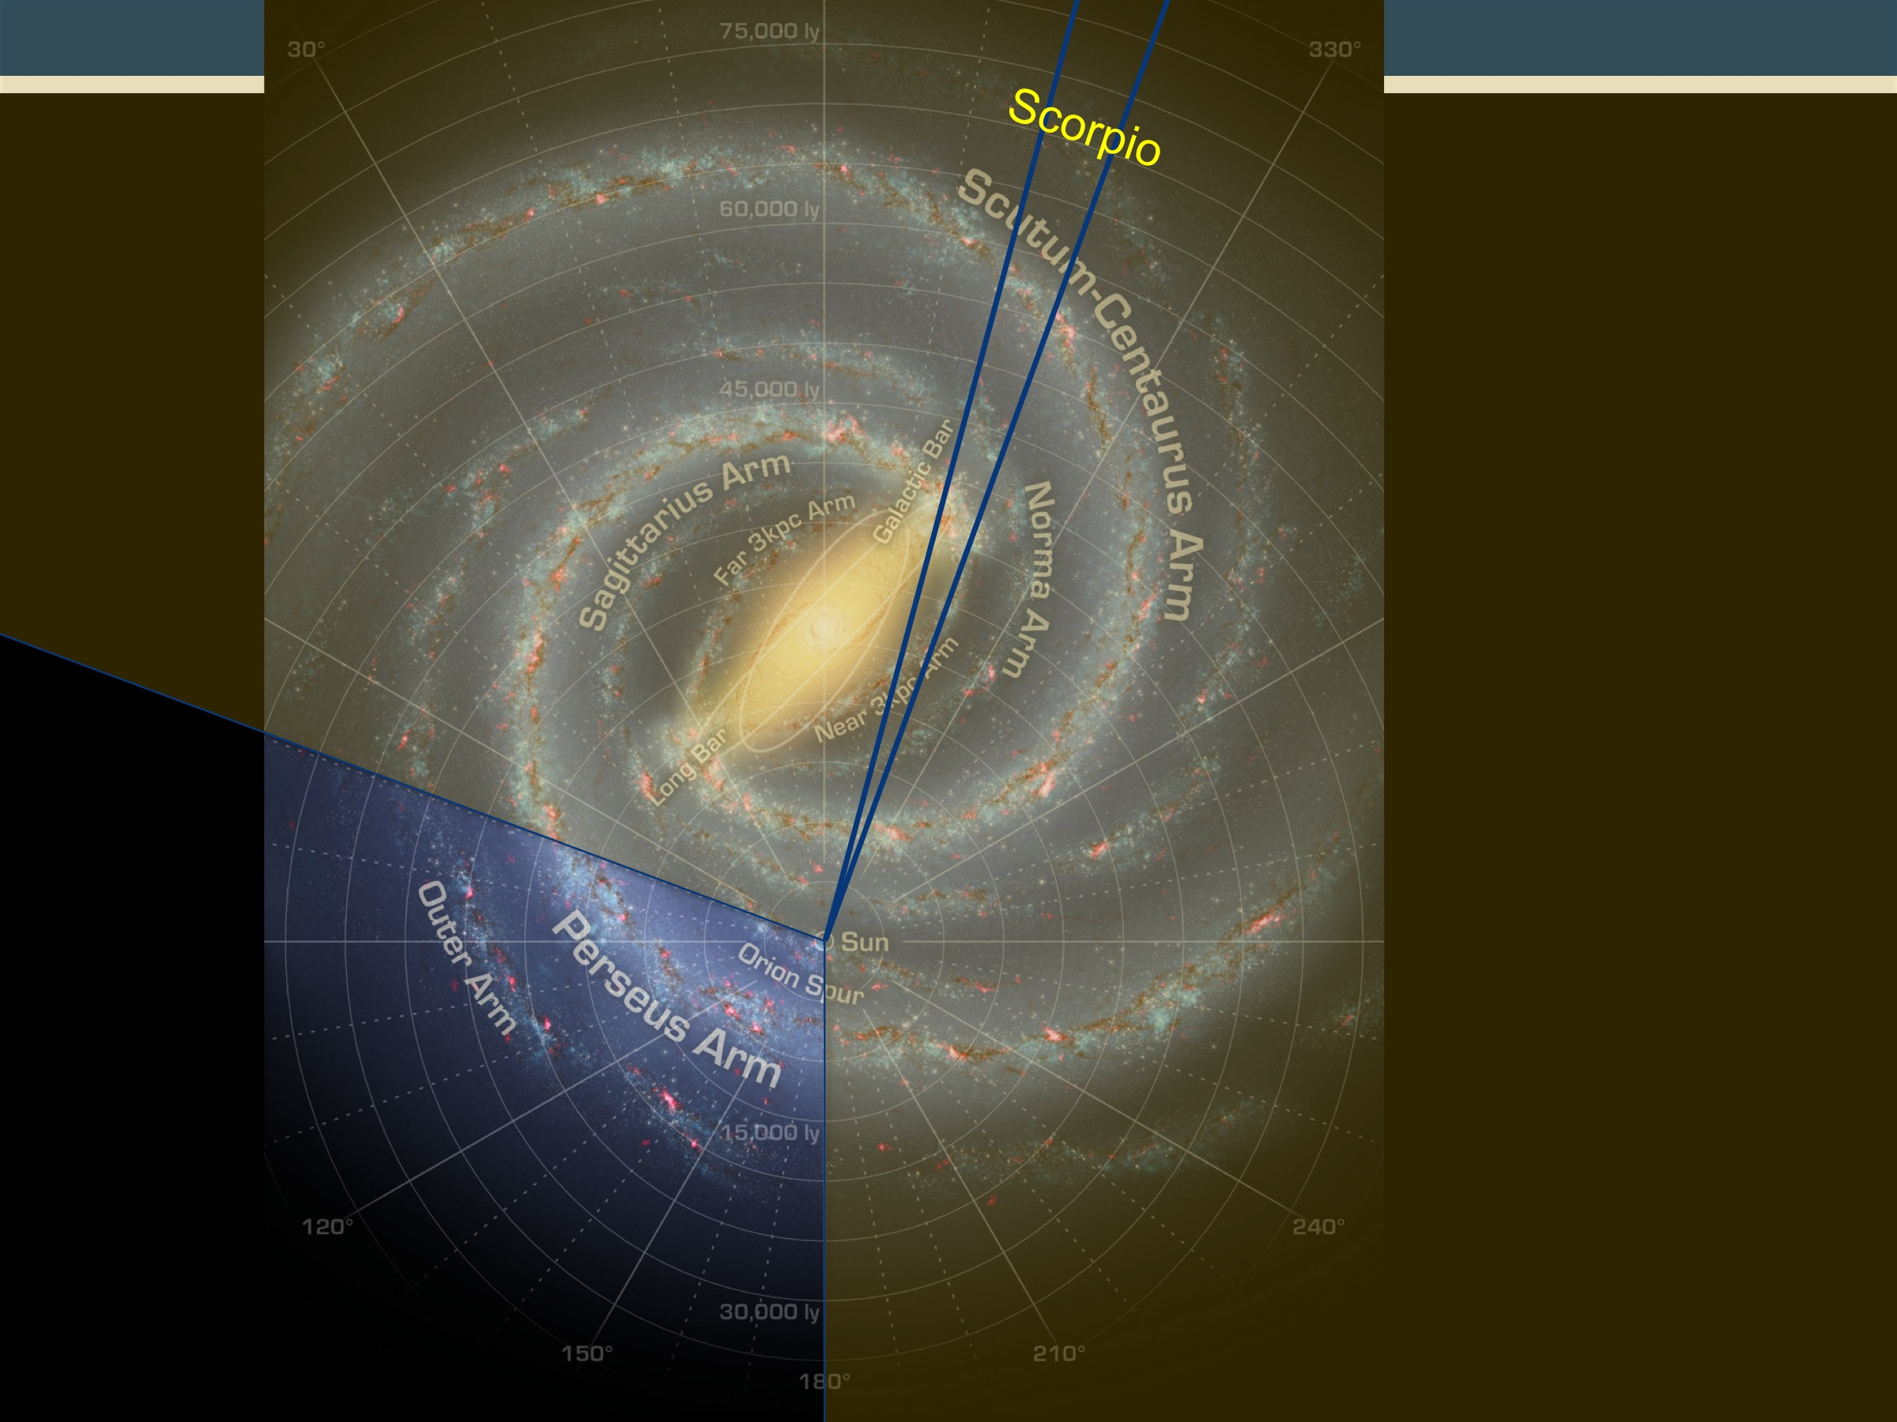
The SCORPIO field ASKAP map
Field center 343.8 -0.2
Dimensions 5.4x1.3 deg²
Green 8μm GLIMPSE
Red 70μm Hi-GAL
Blue ASKAP 912MHz

