Slide 1
Using PINK for cross-matching
ML Meeting

Slide 2
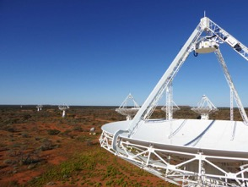
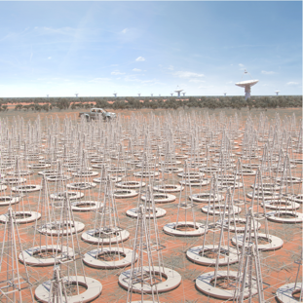
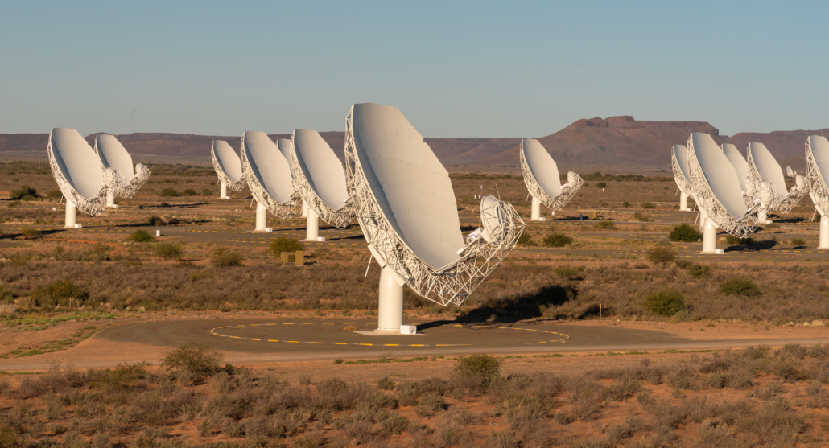
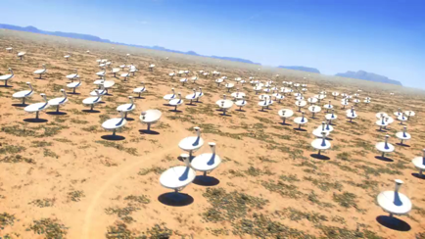
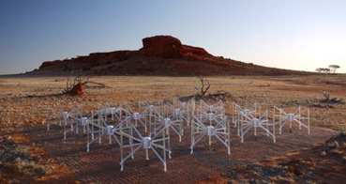
The Challenge
Aus SKA Pathfinder
MeerKAT
Extracting knowledge from these machines
Square Kilometre Array
Murchison Widefield Array
Notes:
So why are we interested in machine learning?
The challenge is that in astronomy we have new radio telescopes are being built around the world. ASKAP, MeerKAT, the square kilometer array.
These new radio telescopes are really data telescopes.
The surveys on these telescopes will lead to a huge amount of data. The data rate from ASKAP will be 200 TB a day of raw visibilities. 5 PB/year of images, cubes, science data, cont. averaged visibilties. The SKA in 5 to 7 years time will generate 10 times that amount of data. To deal with the amount of data we’re getting we will have to use machine learning and artificial intelligence techniques.

Slide 3
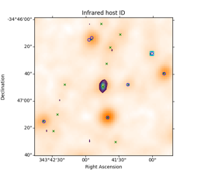
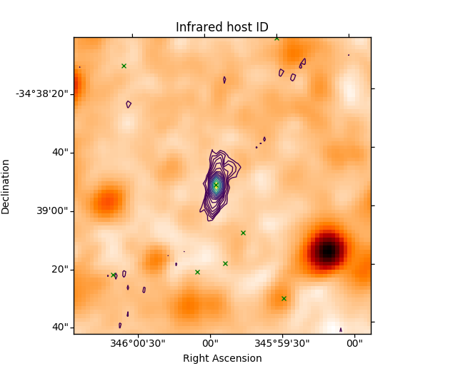
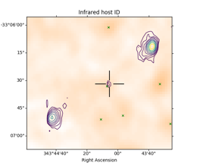
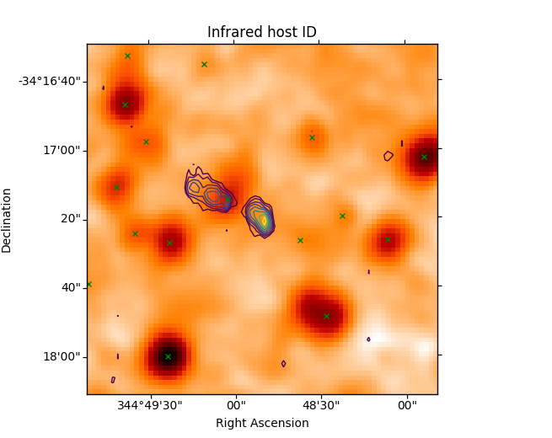
The name of the game
GLASS ATCA + WISE
Catalogue the Universe
Produce a catalogue that describes galaxies and the set of resolved components they may have, including the host galaxy position in the case of resolved features
Notes:
To deliver the EMU science we need to classify and cross match the radio sources to a host galaxy. Here I’m showing some examples of radio sources. . The contours are from the radio source, and the white-black background is an infrared image. In most cases the source is compact, and there is no jet extension, the counterpart or host galaxy is easy to pick
This is an extended source with some jet extension, the host galaxy is at the center. This source is even more complex. The jets have extended out to here, these are the hotspots of the jets, but the core is here, and the host galaxy is here. And what about this one? The jets are assymetrical, the core and host galaxy we think is here.
So radio sources can be complex, we will have 10s of millions in future – too many for humans to look at!!

Slide 4
Solutions
Locking astronomer/s in a room under duress is no longer ethical
Divide and conquer
  Crowd sourcing through zoo-inverse platform, see “radio galaxy zoo”
Machine Learning
    Convolution Neural Networks
    Simple vs complex sources (Lukic et al. 2018)
    Host galaxy identification (Alger et al. 2018)
    CLARAN – source classifying (Wu et al. 2019)
    Requires labels
      New Universe, new sensitivities, new frequencies, new instruments …
      How well do labels extrapolate?
      How well do models transfer?

Slide 5
What we will have
Set of images (from the instrument)
Set of source positions (from a source finder)
How far can we go with just these products?

Slide 6
Self-organizing Maps
Unsupervised – attempts to understand the structure of the data
Input vector is a training dataset
SOM aims to represent predominate features
  Single circle on lattice (neuron) is a single predominate feature
For each item in training data
  Find best matching neuron
  Weighted average together
  Propagate those changes out radially, further weighted by distance

Slide 7
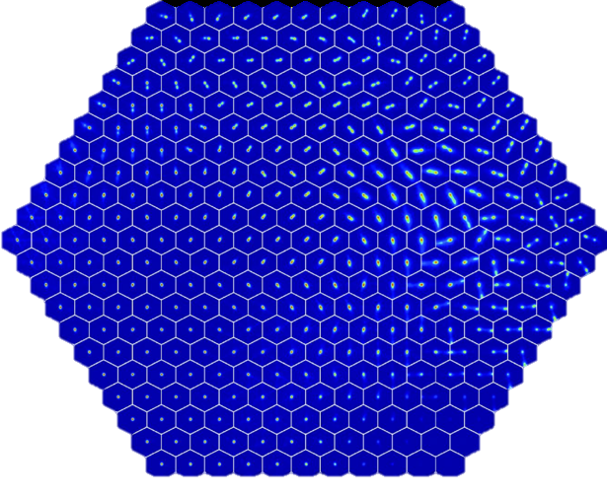
PINK
Polsterer et al. 2015
Doubles
Separated
Doubles
Trained against 200,000 images from Radio Galaxy Zoo objects using FIRST data (Becker et al. 1994)
SOM with rotational invariance
Unsupervised
Clustering of objects pretty obvious
Can’t infer much more than the SHAPE of radio structure
  Two SFG or single AGN?
Noisy Image
Extended
Sources
Weak
Sources
Point Sources
Notes:
For example, the radio object types cluster like this on the Map:
We have point sources …

Slide 8
Lets start
Started with the FIRST radio catalogue
  ~950,000 source components (rows in the table)
  No prior knowledge about how/which sources/rows are related – just a flat table
End goal – identify the related rows within the catalogue and add new information
Postage stamps images downloaded at the centered FIRST positions positions
  IR gives information to infer object type
  Images cubes were made
Notes:
So our self-organized map was trained on 100,000 images.
We used both radio and infrared images, to get host galaxy information.
The radio images come from the VLA First survey.
And the infrared imaging is from the WISE infrared satellite.
The picture on the right shows an example of one of the. Galaxies – radio on top, infrared on bottom.

Slide 9
SOM Layer One

Slide 10
Layer Two
40x40 neurons actually
This is the radio channel

Slide 11
Layer Two
40x40 neurons actually
This is the IR channel
Yes, very much aware not much detail can be seen

Slide 12
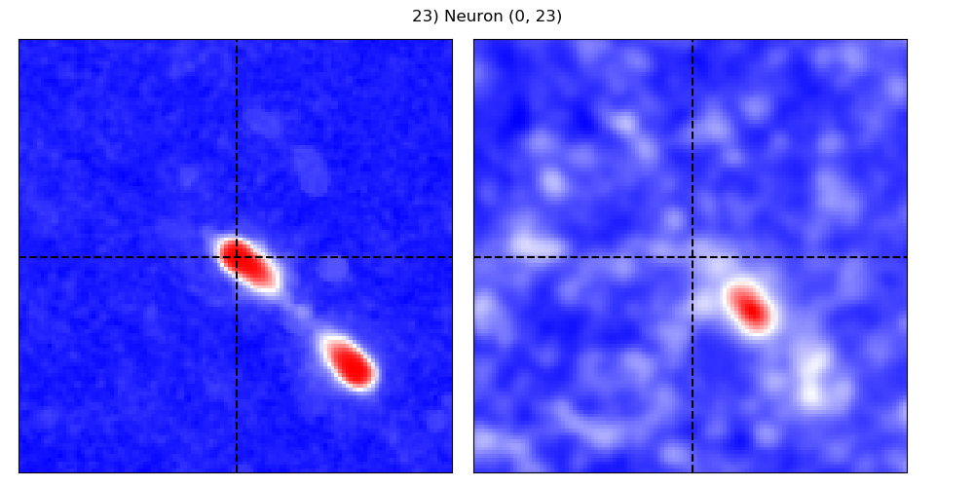

Slide 13
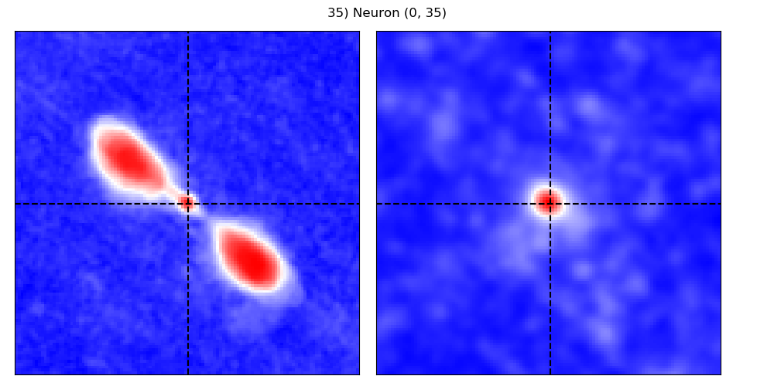

Slide 14
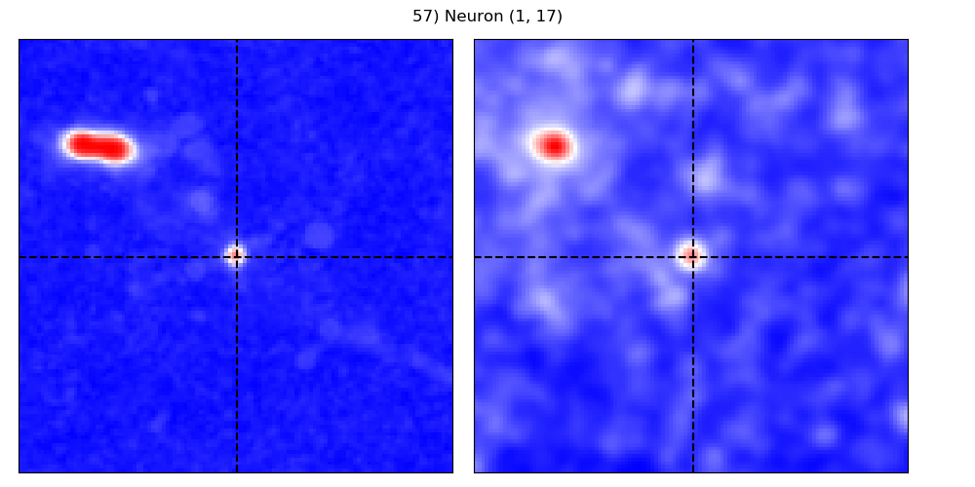

Slide 15
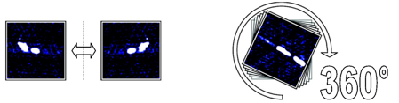
More importantly though
PINK achieves rotational invariance through brute force
  Accelerated computation made possible with GPUs
Lets label what a neuron contains and where it is located (pixels)
  Transfer labels from neuron to objects that best match to them
  Sky reference frame of source image + transform function + pixel locations =
  absolute sky positions

Slide 16
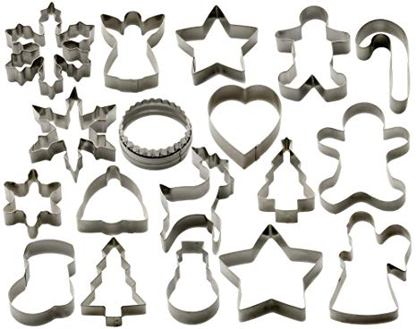
Thresholding
Labeling can be extended to create filters of arbitrary shapes
Can force these shapes through catalogue space, filters relate components meaningfully

Slide 17
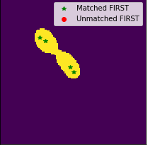
Basic idea becomes
For each row in catalogue
  Locate best matching neuron
  Take its filter
  Project catalogue sources across filter
  Group components together with unique identifier
Many ways of tweaking this basic procedure
I’m attempting to follow the KISS principal for this initial publication
3.5’
3.5’

Slide 18
Examples
Twenty objects, selected based on the number of grouped FIRST components (rows in catalogue)
No curation of good/bad examples

Slide 19
Examples

Slide 20
Start to go GRG hunting
Cross reference to SDSS for redshifts
  Only using spec-z, have photo-zs as well
17 GRGs between 0.7 – 1.5 Mpc
  Neuron FoV comes into play
Model was not trained for GRGs
  Just a product of model understanding the structure of data

Slide 21
Curved Sources
Problematic for IR host, but can isolate
Given the pair of component in group, solve for the shortest path
Curliness = shortest path / max distance
Not perfect

Slide 22
Outliers

Slide 23
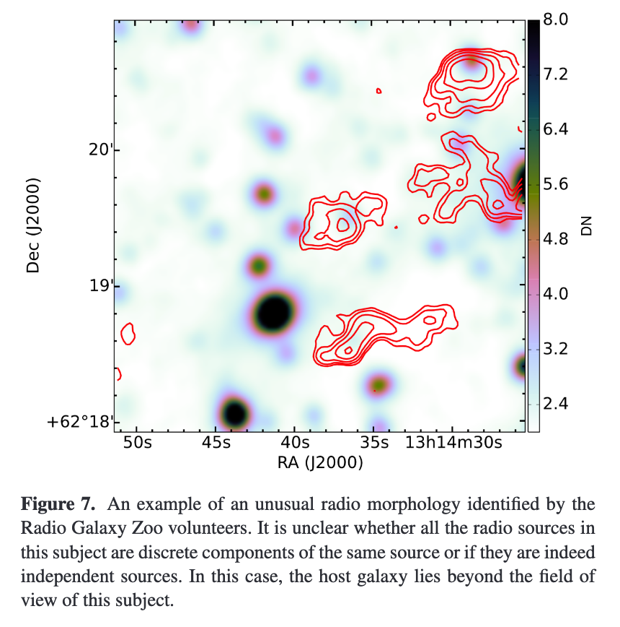
Outliers

Slide 24
Cluster Components
Pulling out VLA PSF from catalogue components
Sidelobe reliability from the FIRST catalogue using an ensemble of decision trees

Slide 25
Conclusions + Future
Unsupervised training method can be used to reduce dimensionality of data, letting one efficiently annotate and transfer knowledge back
  Certainly has it problems that bug me more than they should
Results group components into meaningful objects
Facility to cross reference between different wavelength surveys
  Curved objects are tricky!
Easily can improve each stage – adopted KISS principal
  Not a total black box
  More thorough annotation/labeling scheme

