Slide 1
supercomputing systems ag
company profile and selected applications
by christof bühler and felix eberli
september 2021
Notes:
Almost 30 years ago we built the second fastest, but smallest and power efficient supercomputer computer in the world. Due to our expertise in high-performance computing, electronic and software-engineering we are confident that we can provide added values to the SKA project in the field of 1) data processing and 2) precision time management.
I very much welcome you to our presentation. My name is CAB, and jointly with my college FE we are showing you some customer projects that aim at demonstrating our expertise in the claimed SKA-fields.

Slide 2
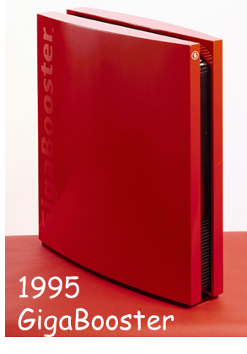
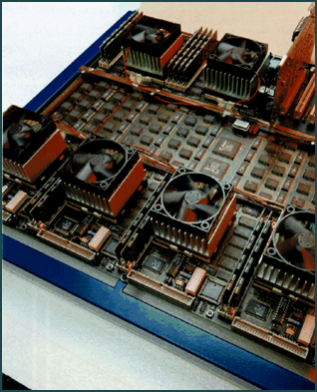
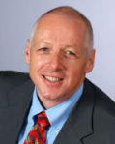

supercomputing systems - our origin
founded in 1993 by
prof. dr. anton gunzinger
≈ 130 employees
service provider for
industry & academics
ip goes to customer

Slide 3

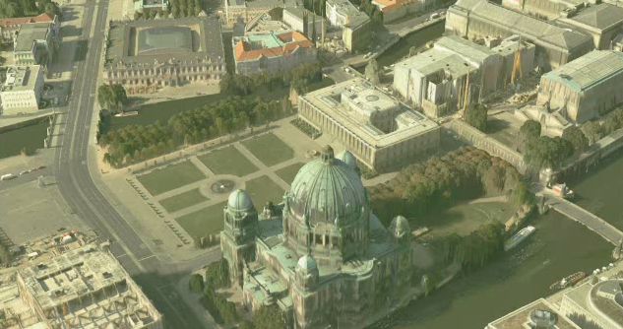
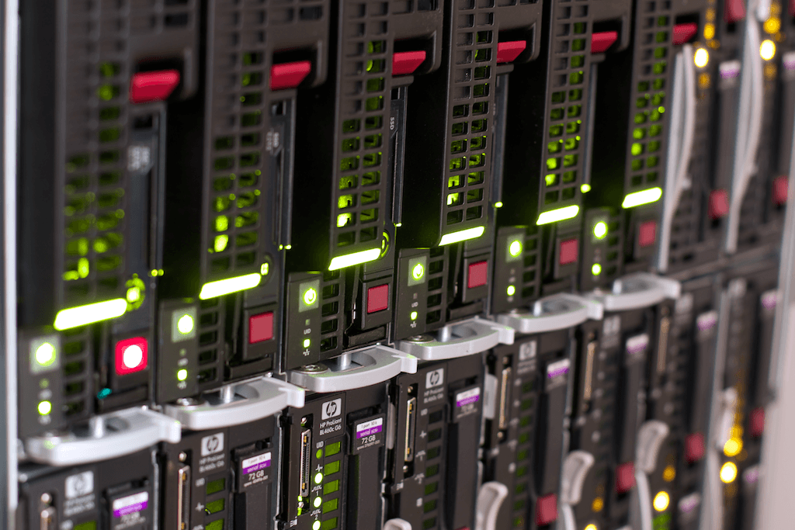
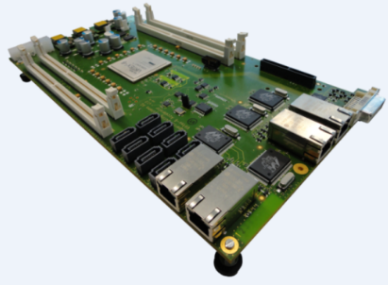
speed-up photogrammetry
5 kW blade server
1 core
= 95s / frame
0.1kW scs-board
1 virtex6 board
= 1.6s / frame
reduced processing time: 3 weeks ⇨ 1 day
Notes:
Generic HW-platform with FPGA accelerator, GigE, PCIe, SATA, large on-board memory
FPGAs are cost- and power-effective alternatives to large servers
architecture fully exploits parallelism
provide high computational bandwidth

Slide 4
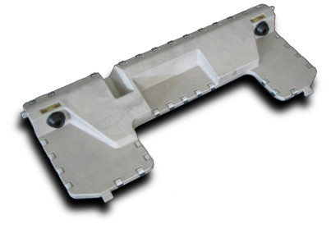
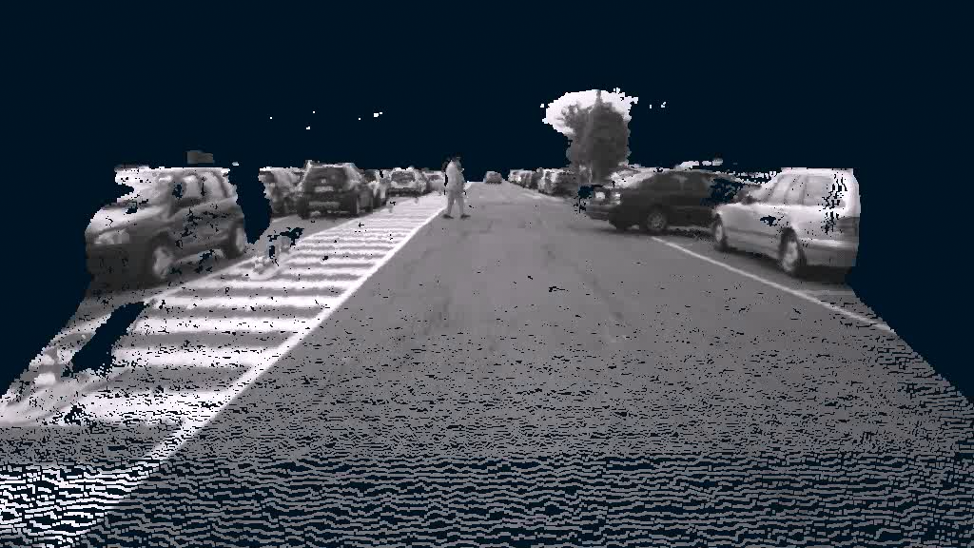

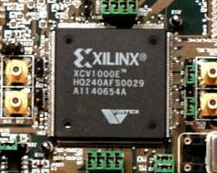

automotive stereo vision sensor
FPGA
2008 world-wide first real-time implementation of Semi-Global Matching on an automotive compliant FPGA
speed-up time: 2s/frame ⇨ 20frames/s

Slide 5
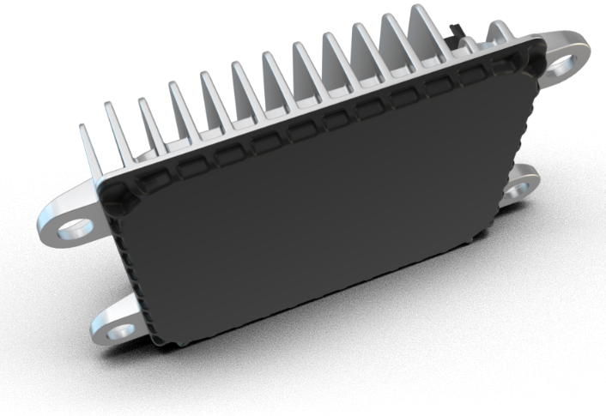
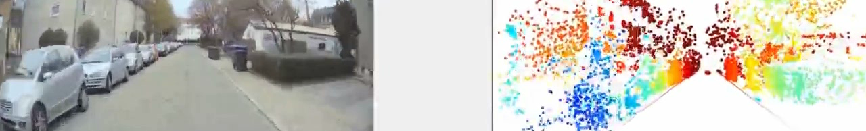
automotive 4D high-resolution radar 77GHz
superior detection performance in the four dimensions
of speed, distance, angular resolution and height
high-resolution, 3D surrounding image
192 channels, up to 350m optical range

Slide 6
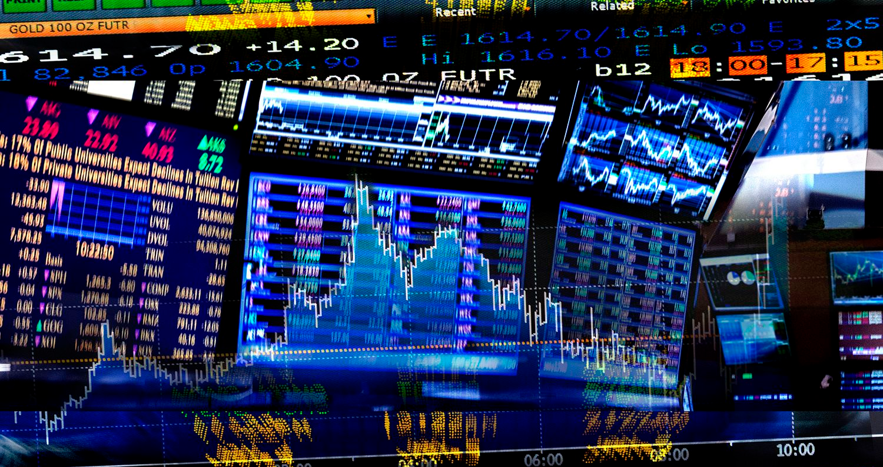
high-frequency trading infrastructure
trading box
system
low latency matcher*
redundant network ( hot-hot )
throughput = 735k orders/s
fully deterministic latency via
  fpga (altera stratix v gx)
  precision time
matcher_{p}
matcher_{s}
switch
switch
switch
switch
switch
switch
hft-client₁
hft-client₂
hft-client₃
gw-client
* guaranteed µs-latency ⇨ < 3 µs order-2-ackn
Notes:
Our Key Message: We can manage precise timing via GM
Supplementary Information
FPGA => Altera Stratix V GX
Matcher => Our matcher can hold up to 5 Mio order books in DDR4
An order matching system or simply matching system is an electronic system that matches buy and sell orders for a stock market, commodity market or other financial exchange. The order matching system is the core of all electronic exchanges and are used to execute orders from participants in the exchange.
- Our matcher can hold up to 5 Mio order books

Slide 7
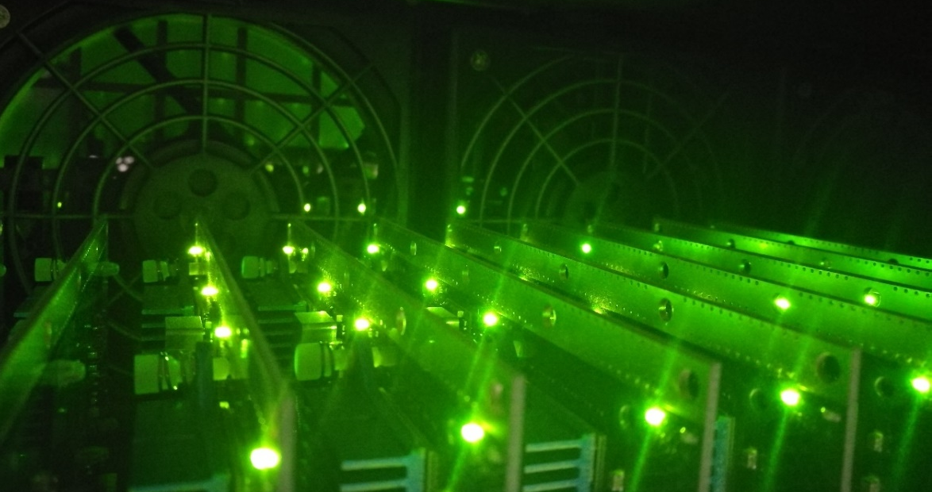


fpg-based crypto engine
crypto key retrieval
up to 96-bit key length
4.9 exa operations/s
scs-contribution
crypto analysis
design: hardware
design: fpga fw & embedded sw
high-performance computing ⇨ 10¹⁸ ops/s

Slide 8
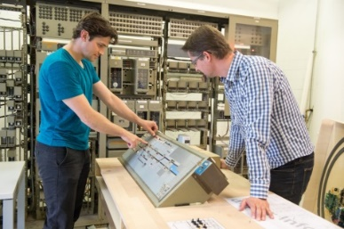
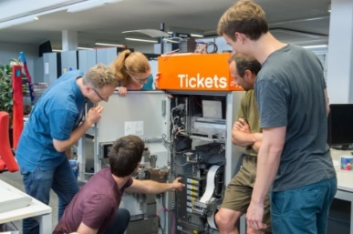
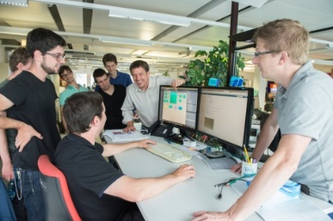
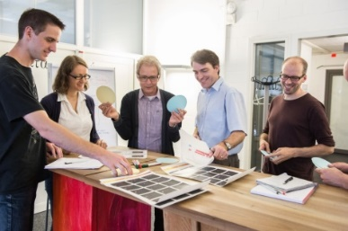

scs - our contributions to ska
data processing ⇨ we number-crunch
precise timing ⇨ we manage it
not existing ⇨ we make it for you

Slide 9
supercomputing systems ag
christof.buehler@scs.ch +41 43 456 16 59
felix.eberli@scs.ch +41 43 456 16 19

