Slide 1
Networks for Global Transport of SKA Data
From the work of:
SKA Regional Centres Coordination Group
and
AENEAS WP4
Richard Hughes-Jones

Slide 2
World-wide Network for SKA

Slide 3
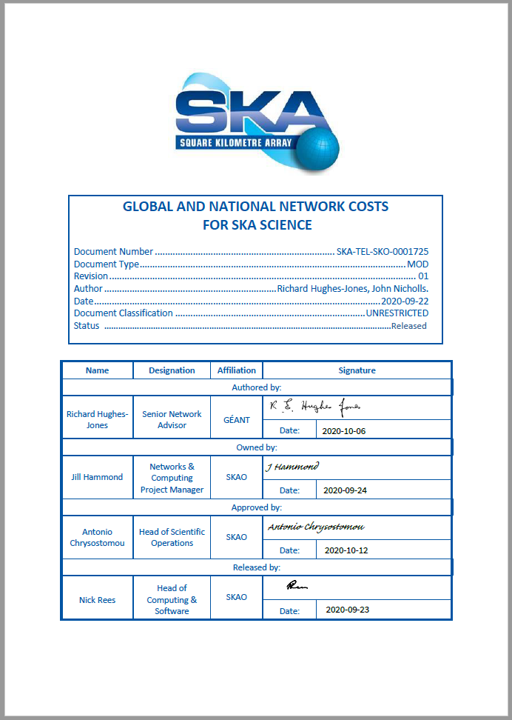
Fibre and Cable Systems and major NREN paths
The current (2020) intercontinental fibre cable systems used by the international research and education community.
Document produced for the SKA Regional Centres Coordination Group
Notes:
Revised document done in Sep 2020 Budgetary OPex Costs 2025 price estimates

Slide 4
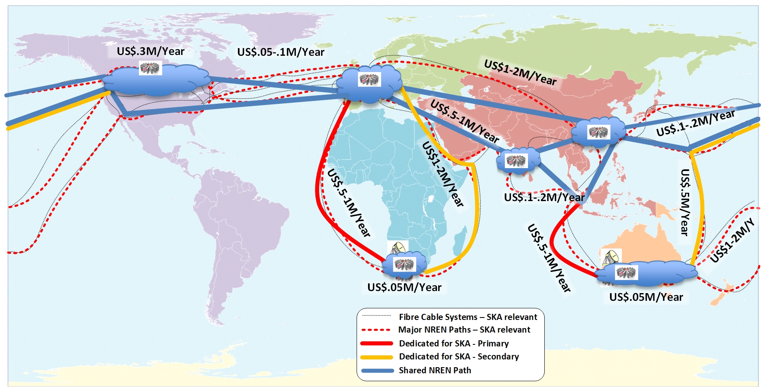
Global Network & Paths of Interest to SKA
Dedicated Primary (red lines) & Backup links (yellow lines) from both telescopes
Use of the shared academic network (blue lines).
1 PetaByte/day pushed by SDP from each Telescope → 100 Gigabit/s
Costs based on 10 to 15 year IRU per 100 Gbit circuit projected to 2025 prices
Budgetary OPex Costs (2020)
Primary links USD 1.7 – 2.3 M per year
Backup links USD 2.3 – 3.3 M per year
Now a new affordable path Singapore – Europe direct
Notes:
Budgetary OPex Costs 2025 price estimates done in 2020

Slide 5
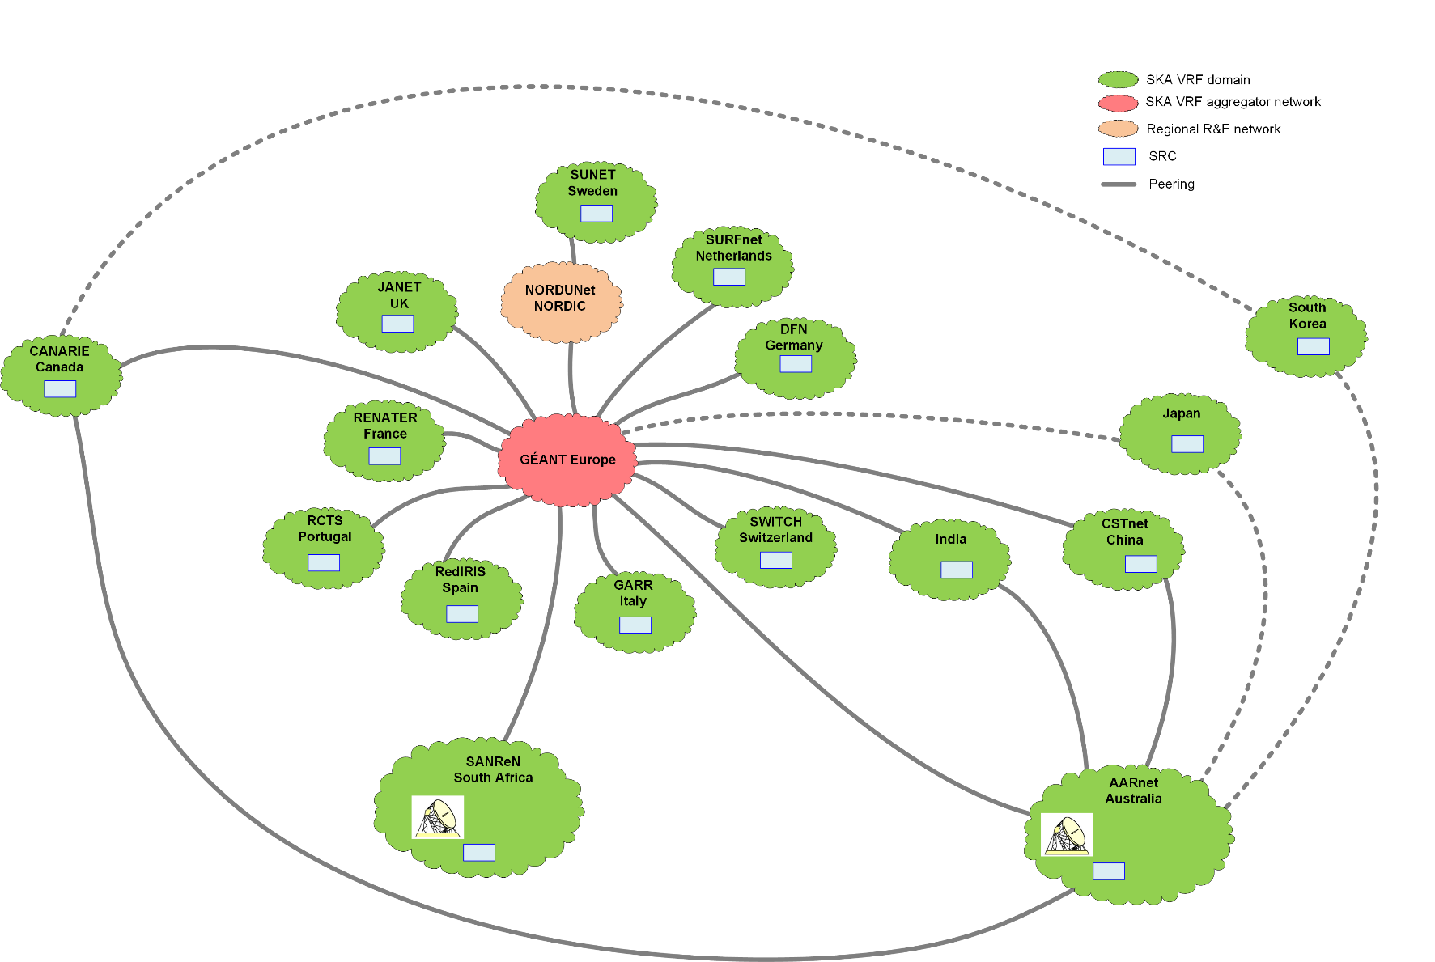
Global Network Architecture for SKA
Global VRF based overlay with peering linked over the shared academic network
Isolation of SKA traffic from other users
Easier for NRENs to implement the
routing, policies and monitoring
SKA traffic can be engineered
  Use specific paths & routes
Layer 3 routing provides isolation
  any network configuration issues
  strictly limits broadcast storms
Layer 3 will re-route traffic as long as
there is an alternative network path
Configuration actions have to be undertaken
by the NREN and a Site to join the SKA VRF,
which provides an extra layer of security
Notes:
Similar to WLCG network
VRF == Virtual Routing and Forwarding
Japan & S.Korea: early stages

Slide 6
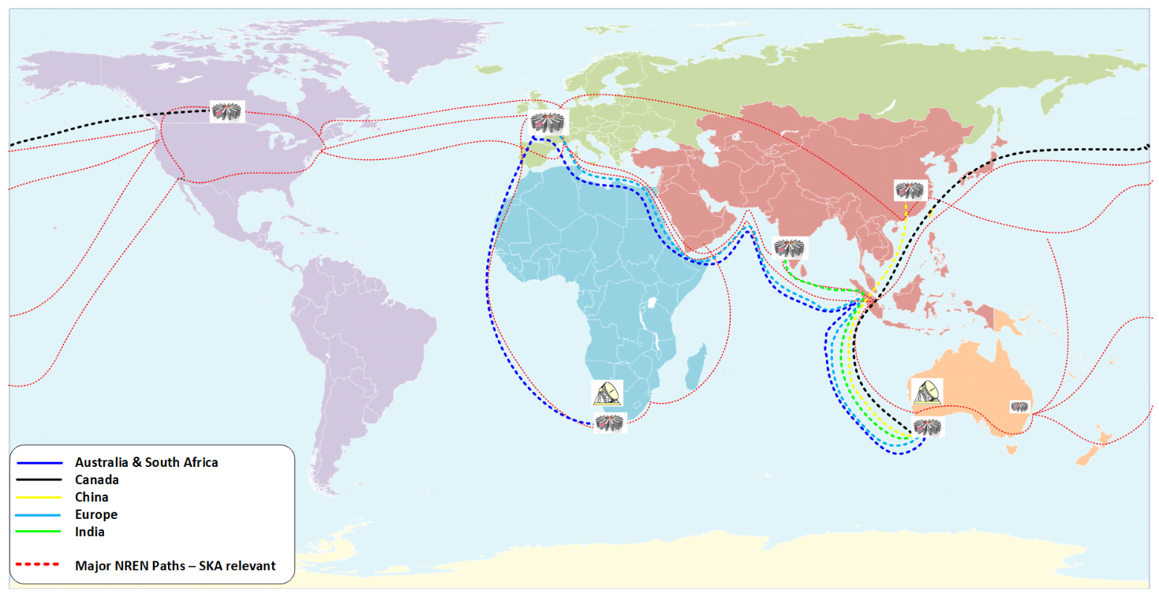
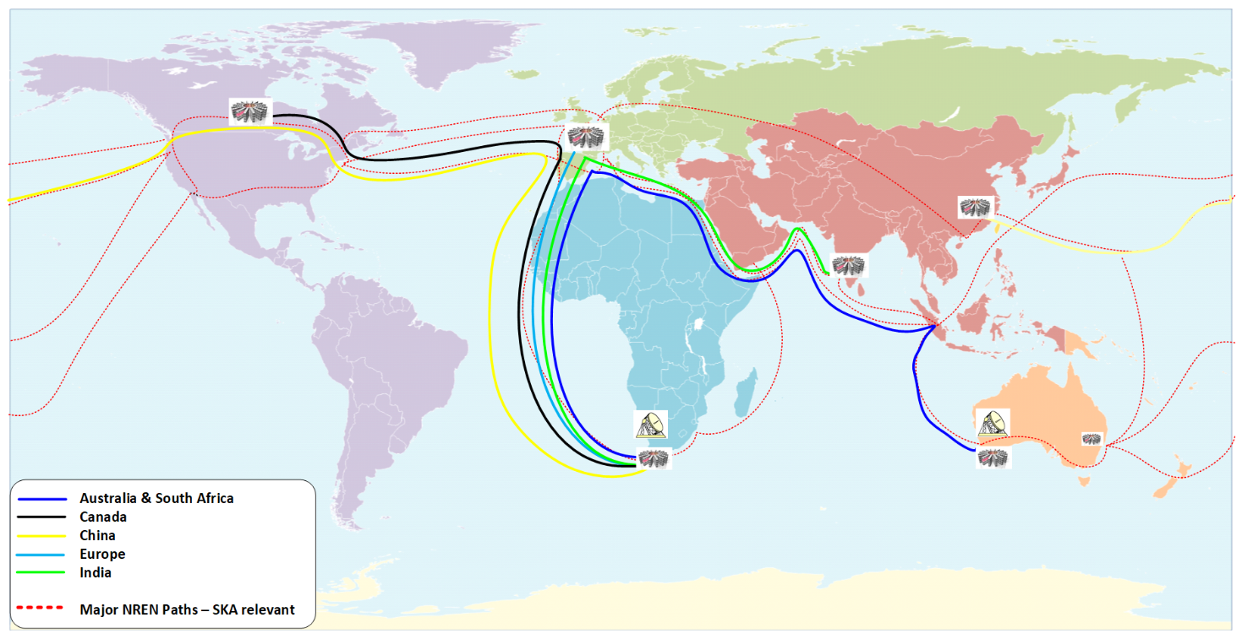
Global Paths of the Data Flows Pushed to the SRC 1 Replica
The Impact of Data Placement 1
Five flows on the submarine cable from Perth to Singapore .
Then join the general purpose routed IP academic network.
Single flows on the routes to Canada, China and India,
Australia is local, and
two 20 Gbit/s flows would be carried to London to reach SRCs in Europe and South Africa.
Five flows on the submarine cable from Cape Town to London.
Then join the general purpose routed IP academic network.
Different submarine cables used to reach India and Australia,
Europe is local, and
two 20 Gbit/s flows cross the Atlantic to SRC in Canada and China.
SKA1-LOW Australia
SKA1-MID South Africa
Notes:
Budgetary OPex Costs 2025 price estimates done in 2020
Primary links USD 1.7 – 2.3 M per year
Backup links USD 2.3 – 3.3 M per year
Total say USD 5 M per year

Slide 7
Global Data Flows if Europe has a Full Copy of SKA Data
The Impact of Data Placement 2
One lambda carries the ~20 Gbit/s flows to the global SRCs like the 1 replica scenario
Another 100 Gbit/s supplies the other Data Products to Europe
Europe funds extra intercontinental OPEX of USD 1.7M/year.
Extra load on SDP buffer systems.
Consideration to be given to the cost of provision of diverse backup paths.
Notes:
Extra dedicated 100 Gigabit links
SKA1-Low
Cape Town – London USD 750K per year
SKA1-Mid
Perth – Singapore USD 750K per year
Singapore – Europe USD 200K per year
Total cost to Europe USD 1.7 M per year

Slide 8
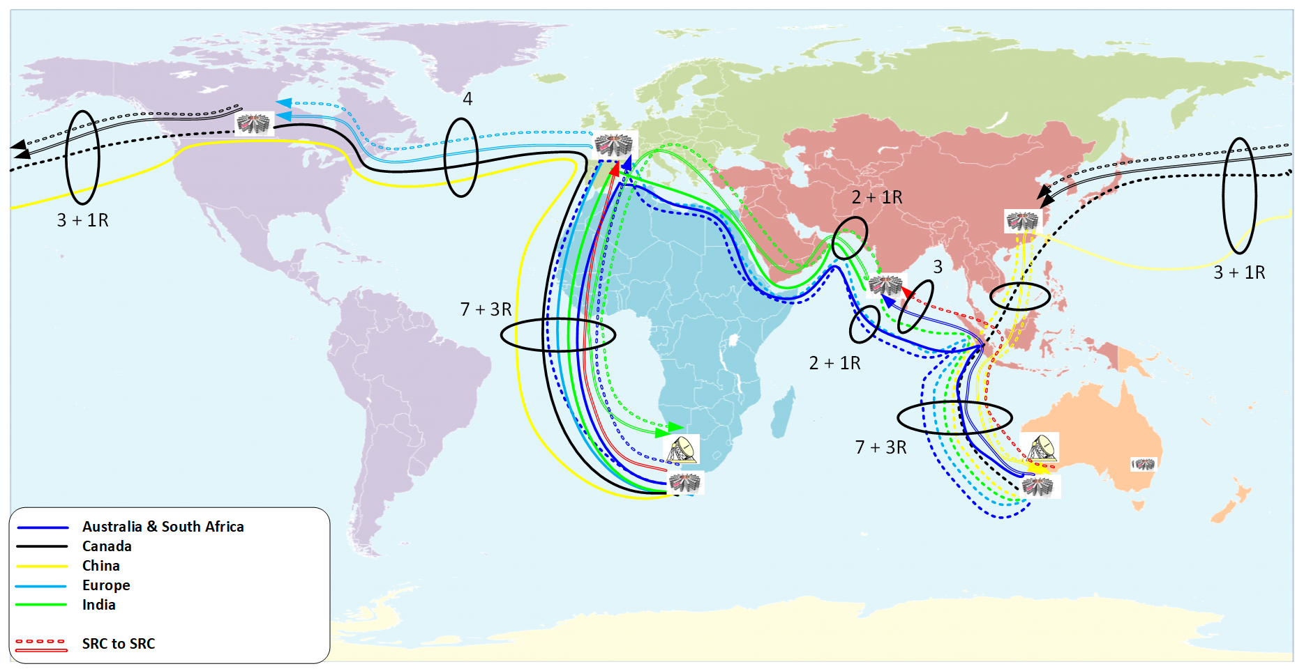
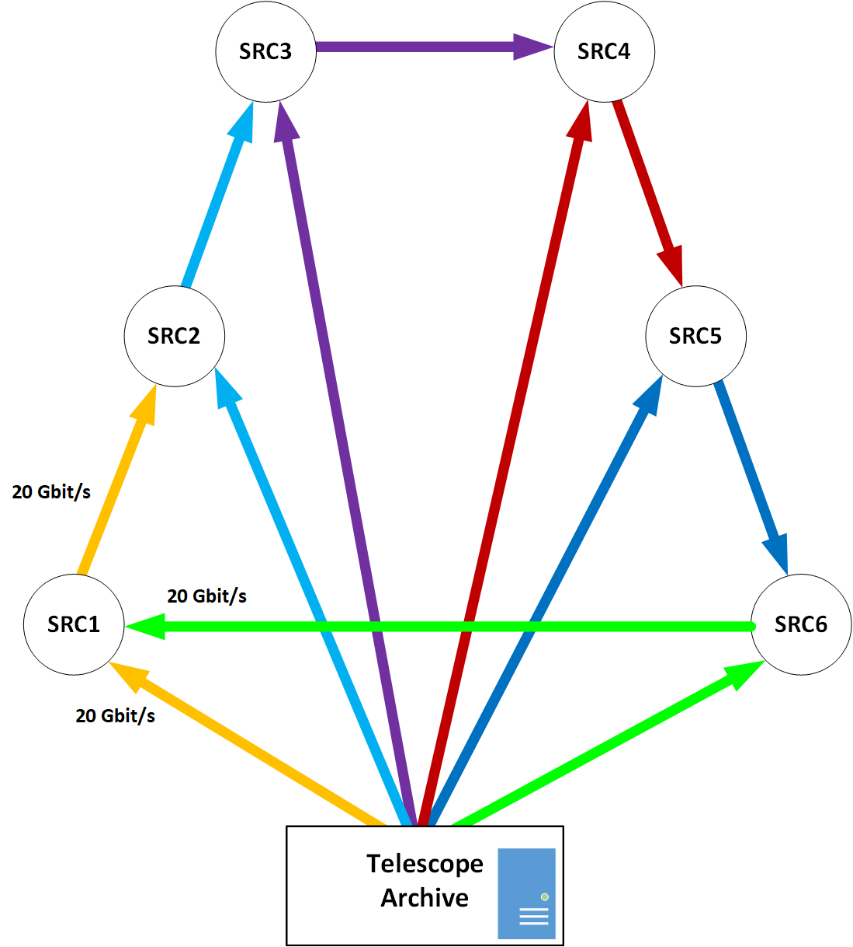
Global Data Flows if the SRC Re-distribute data 2 Replicas
The Impact of Data Placement 3
Each SRC accepts its fraction of the Observatory Data Products and re-distributes to another SRC.
SRC has 20 Gbit/s flow from the telescope & a second continuous 20 Gbit/s flow from another SRC.
Each SRC sends out a 20 Gbit/s flow.
Makes substantial use of the shared academic network which would imply charges to the SKA community.
Cost to SKA community Very approx. ~ 0.8 M USD/year not allowing for the extra BW from the telescopes.

Slide 9

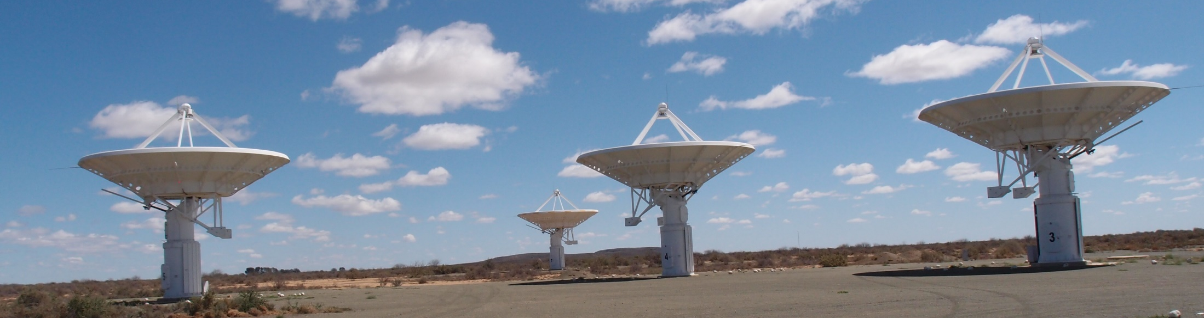
Questions ?

Slide 10
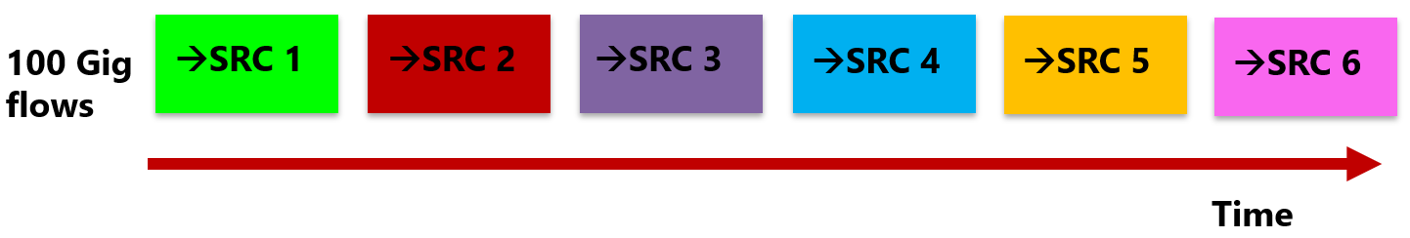
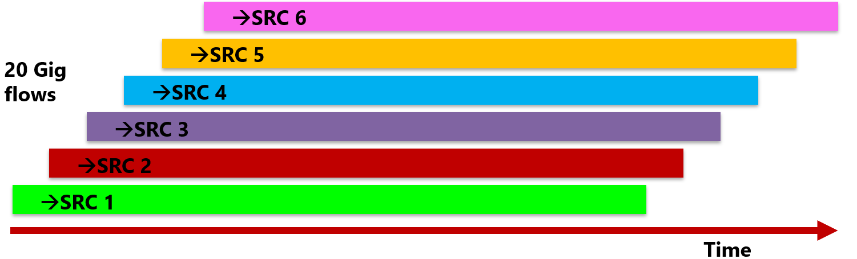
Models of Data Flows from the Telescopes to a SRC
Data sent to each SRC in turn.
Requires clean 100Gbit/s paths to each SRC.
Worst case the SRC would require a 200 Gbits/s link.
Several flows to different SRC taking place in parallel.
Operationally more realistic.
Makes efficient use of the network to each SRC.
WP4 demonstrated stable
28 Gbit/s flows – TCP limit.
The SDP push model gives the advantage of scheduling the use of the bandwidth on the telescope access link .

Slide 11
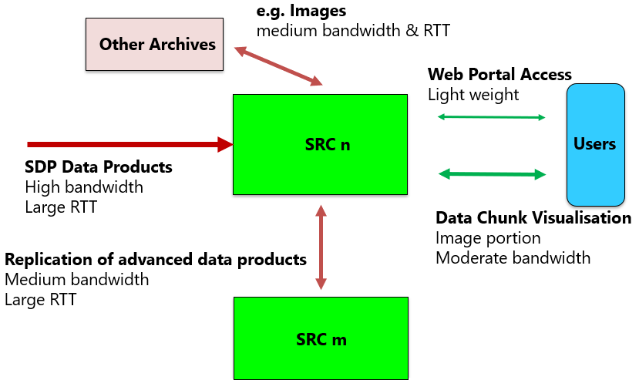
Network Traffic into & out of a SKA Regional Centre
Assumptions
20 Gbits/s at a time from each Telescope
peak 40 Gbit/s to a site
At a given time all of a Data Product goes to one site
10 Gigabits/s to other ESRC sites
10 Gigabits/s to non SKA data Archives
10 Gigabits/s to other RDC
70 Gigabit/s (peak) to each site.
Flexible but secure ACL and high performance DMZ
Say 100 Gigabit/s for SKA to each site in 2024/25.
This is affordable.
(c.f. the UK WLCG sites which have 10-40 Gbit/s dedicated links now)

