Slide 1


SKA LOW 2022 Meeting
History and comparison of calibration of SKA-Low prototypes
A/Prof Randall Wayth on behalf of the ICRAR/Curtin
+ international team
8 February 2022

Slide 2
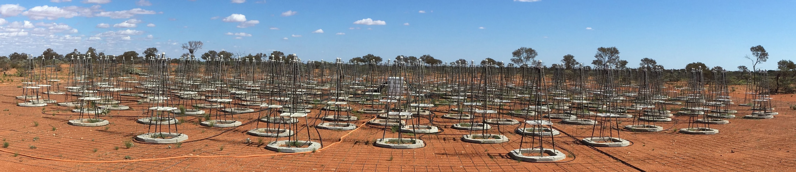
Summary of AAVS1
  See Benthem et al 2021: 10.1051/0004-6361/202040086
  The bulk of observations from 2018 were in correlator mode.
    Most data from 160 MHz
    Initial focus on basic functionality
    Subsequent focus on calibration
  Initially there was also concern about emission on the horizon, but this got overtaken by larger calibration issues

Slide 3
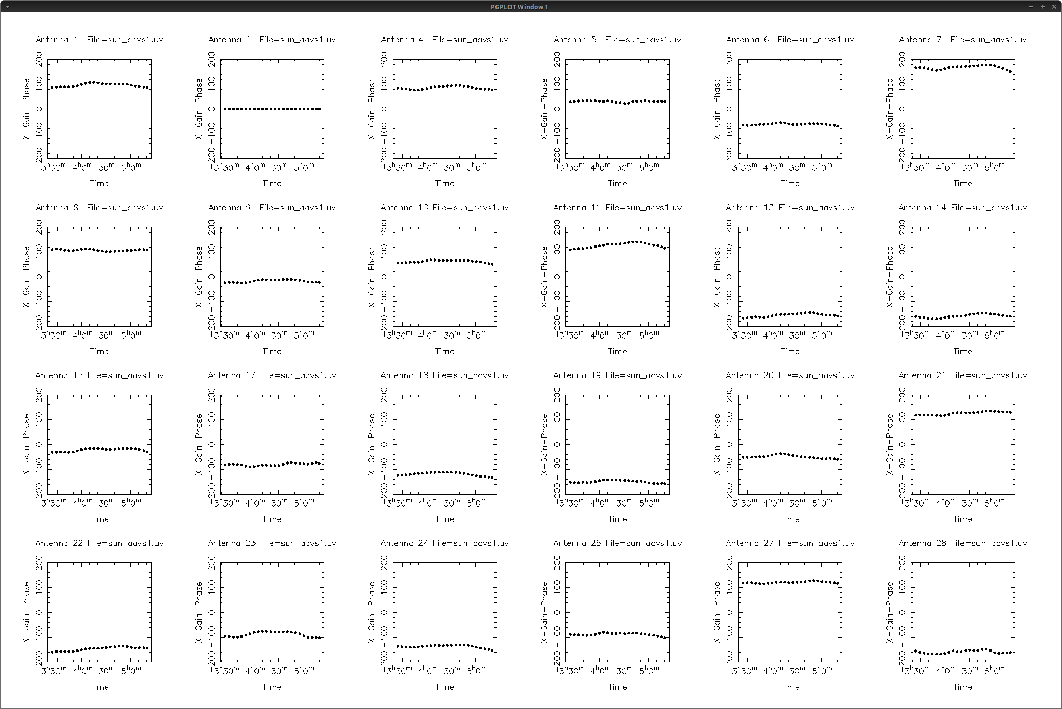
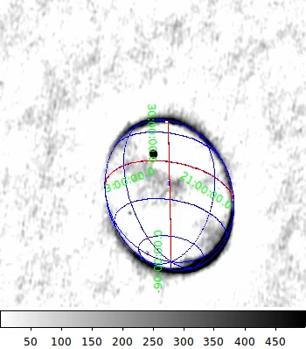
Results: AAVS1 Sun-based calibration (Apr 2018)
Multi-hour observations of the Sun @ 160 MHz.
Sun is dominant compact source, no Galactic plane. Ref ant=2.
Calibration is clearly stable, with ~10 degree variations about the mean
Notes:
Phases of antenna gains are clearly stable on hour long timescales. Small, 10-20 degree wiggles visible at different times on different antennas. Focus of much work in 2018 has been understanding these wiggles.

Slide 4
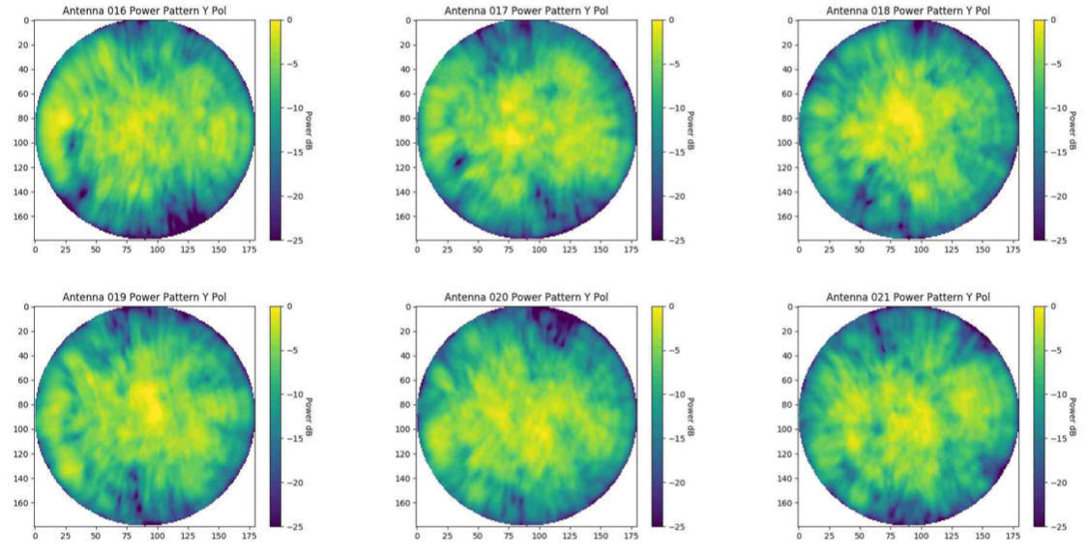
SKALA2 element patterns @160 MHz: amplitude

Slide 5
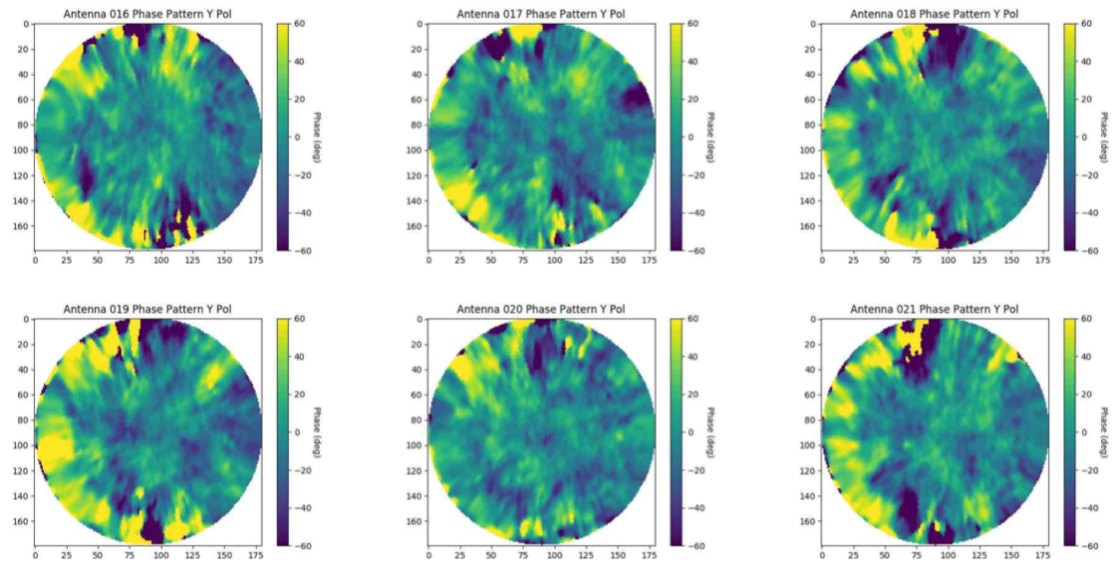
SKALA2 element patterns @160 MHz: phase

Slide 6
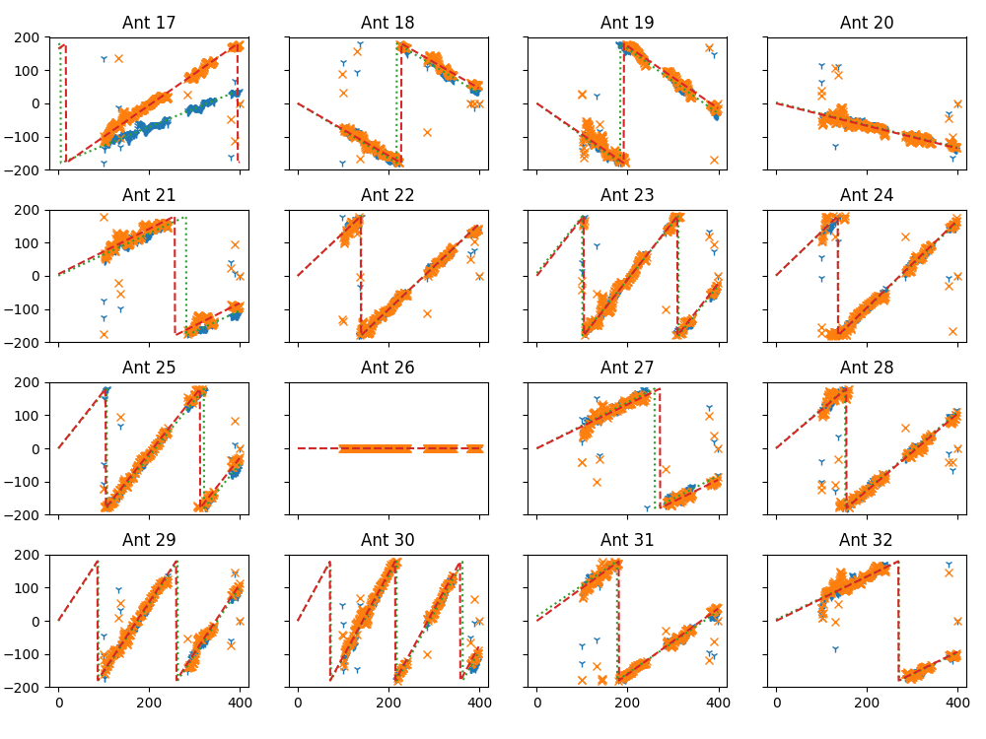
AAVS1 Results: calibration model
Calibration vs frequency shows clear physical basis of uncalibrated phase due to small uncorrected delays
  Green/red lines are fit to data from 100-350 MHz
  Channels with RFI or low SNR not used in fitting
Some antennas have clear polarity reversal, otherwise most antennas intercept 0 degrees at 0 Hz
Implies 1 parameter model per pol
Wiggles over frequency get averaged out
coarse channel

Slide 7
Post AAVS1 questions motivating the Bridging Arrays
  Calibration accuracy of individual elements in the station
    Risks identified w.r.t complexity of element patterns
  Spectral response of antennas (and station)
  Temporal stability
  Requirements for sky model
  Subsequently: sensitivity, polarisation
  AAVS1+ generated a substantial effort to understand element patterns and their impact. E.g.:
Details of doing the modelling correctly:
Davidson et al, 2019:
Steiner et al, 2020
Estimating the magnitude of the coupling:
Davidson et al, 2019
Di Ninni et al, 2019
Davidson et al., 2020
Borg et al., 2020
Verification and consistency of simulations:
Paonessa et al, 2020
Estimating the impact of not using FEE patterns:
Wijnholds 2020
Jones & Wayth, 2020

Slide 8
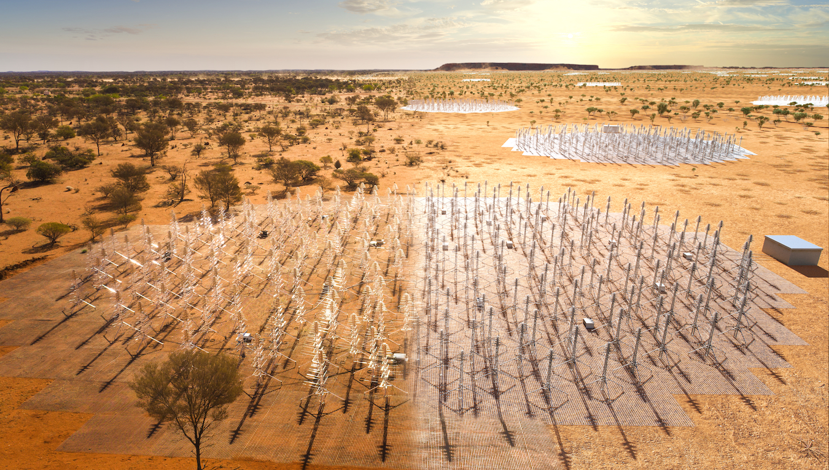
SKA-Low Prototypes – 2nd generation
  SKA1-Low specs:
  512 stations
  256 antennas / station
  50-350 MHz
  Full digital beamforming
  300 MHz instantaneous bandwidth
  Current prototypes:
    EDA2
    AAVS2

Slide 9
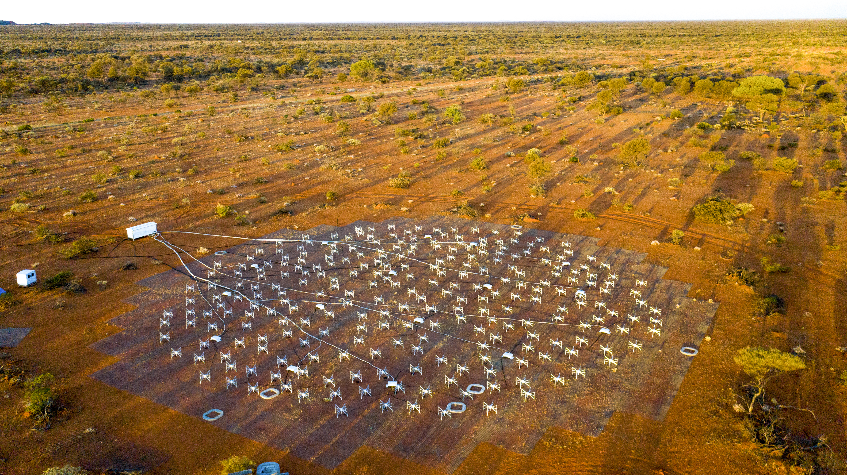
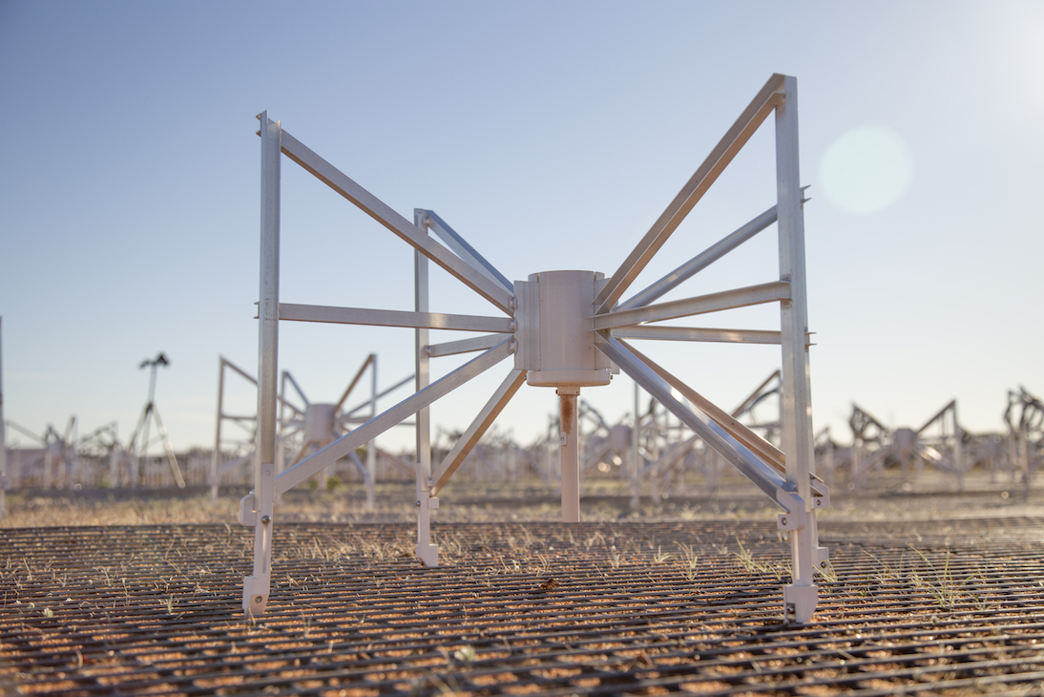
Engineering Development Array 2 – Completed June 2019
EDA2 facing north-east
Wayth et al, 2021. SPIE JATIS.
Notes:
The EDA2 is a full station of 256 antennas where the signal from each antenna in converted to optical fibre and sent downstream for full digital beamforming.

Slide 10
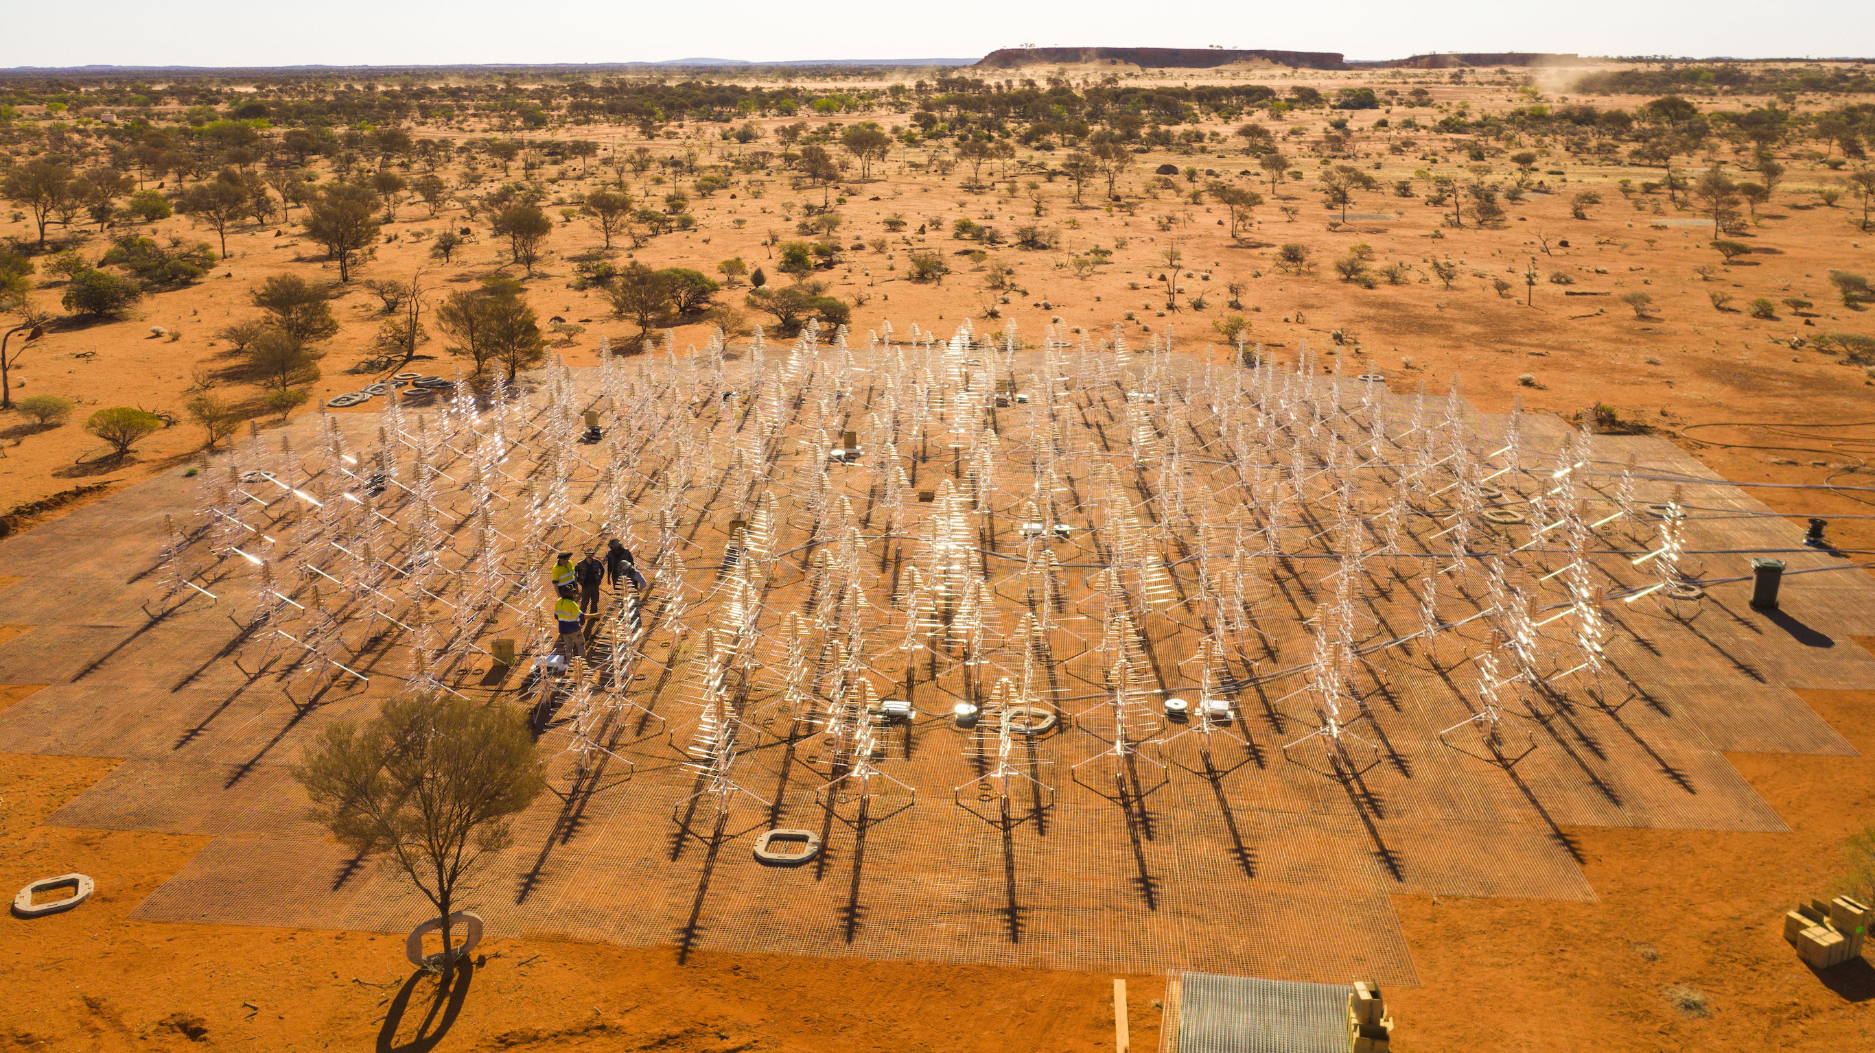
Aperture Array Verification System 2
van Es et al. ,2020. Proc SPIE. DOI: 10.1117/12.2562391
Macario et al., 2021. SPIE JATIS.
AAVS2 partially complete with new SKALA4
log periodic antennas
Notes:
AAVS2 is a full station of 256 new design log-periodic antennas.

Slide 11
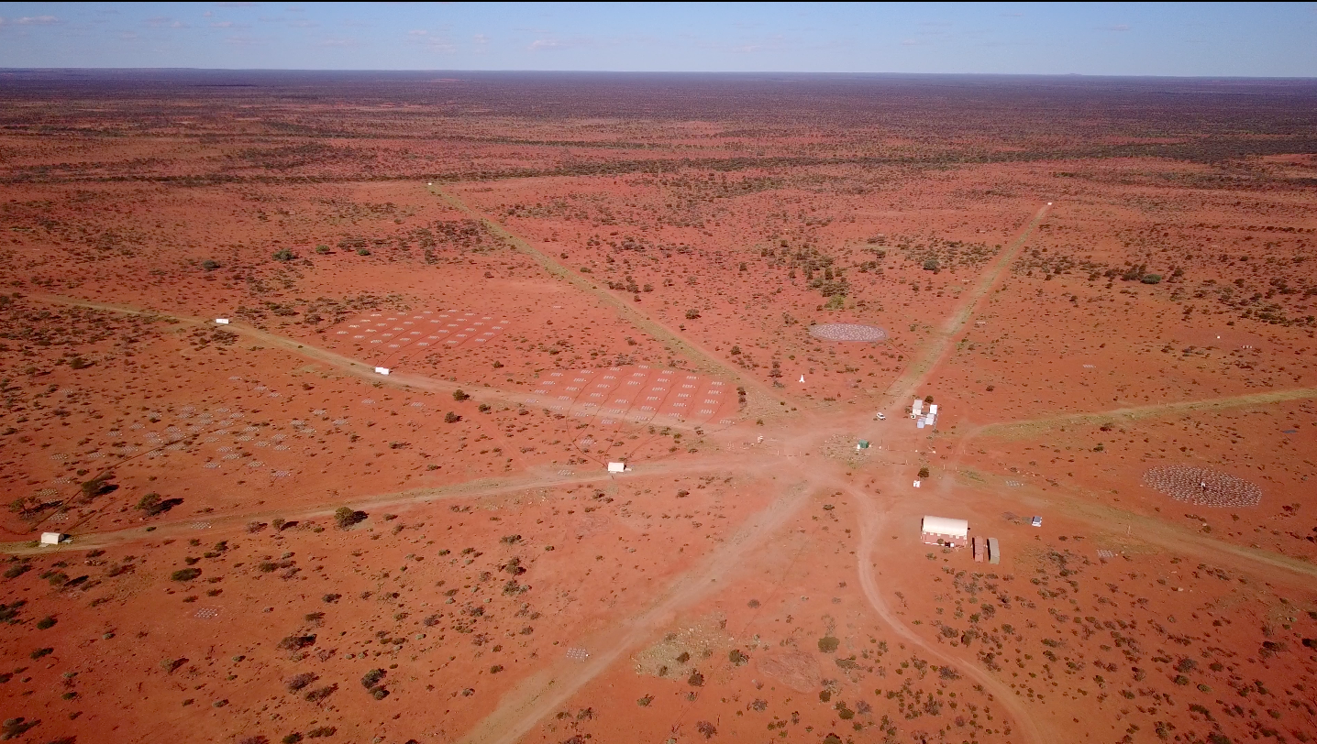
Hosted within MWA, using some MWA and Murchison Radio-astronomy Observatory (MRO) infrastructure
Engineering
Development
Array #1 (now
decommissioned)
MWA core
and hexes
AAVS1
Notes:
The aperture array verification systems are hosted within the MWA radio telescope and make use of infrastructure from both the MWA and observatory site.

Slide 12
Types of data recorded
  1- Correlated data
    single coarse channel (0.9 MHz), no frequency resolution
    all polarisation products
  2- Raw voltage data from all antennas
    single coarse channel, both polarisations
    only ~1 second at a time, very large volume
    can be correlated OR beamformed.
  3- Real-time station beam data
    currently single coarse channel, both polarisations

Slide 13
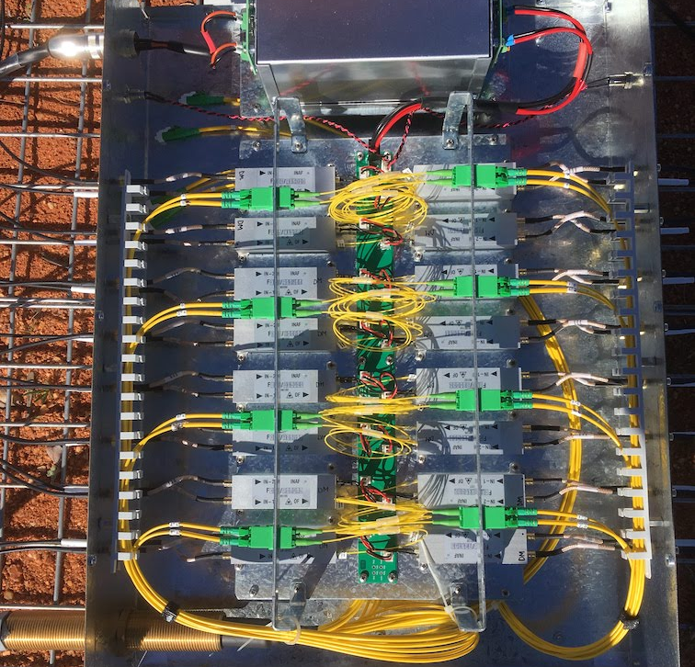
Goals for the 2nd generation “bridging” arrays
    Calibration accuracy: can we calibrate the arrays to sufficient accuracy?
      Evaluation of two antenna types with different electromagnetic mutual coupling and optimisations.
    Calibration stability: what is the timescale required for (re)calibration?
    On-sky sensitivity: measure it
    Exercise the firmware & software backends for monitor and control
    Understand the realities of deployment at scale on site
A significant change from the 1st generation system (AAVS1) moved the optical transmitters out of the antenna apex.
Inside a “SMART” box. 16 antennas electrical -> optical

Slide 14
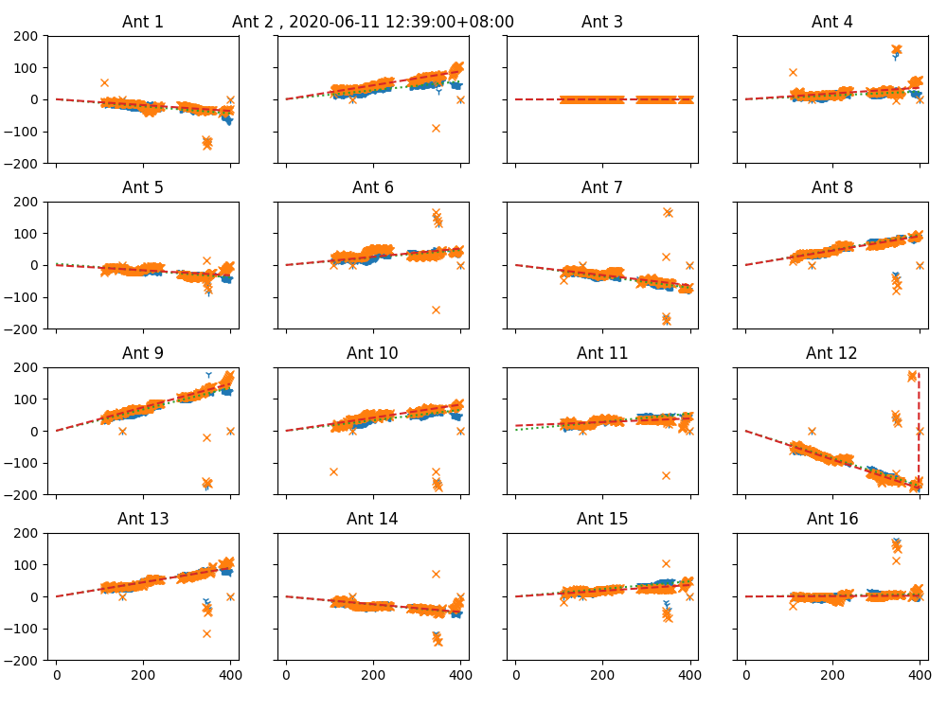
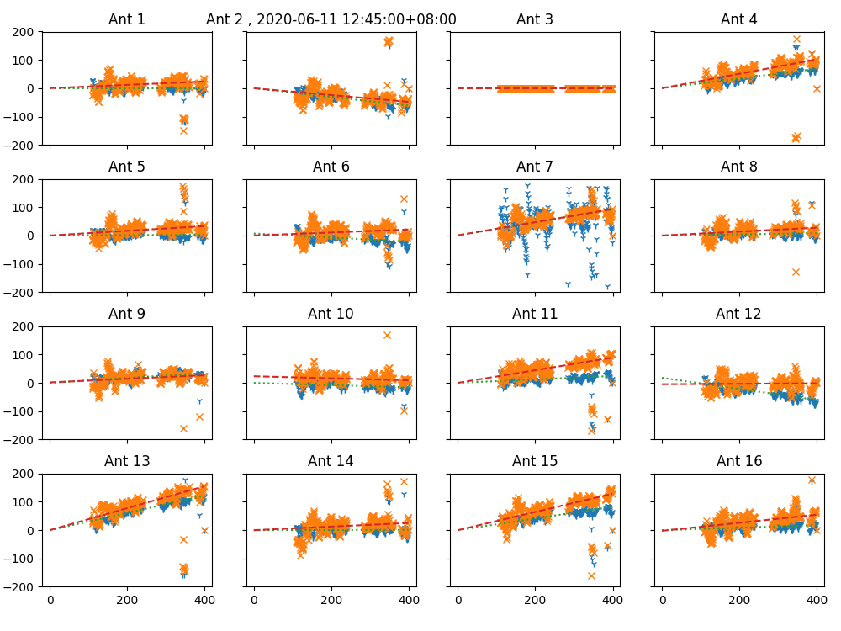
Calibration (around midday) in all frequency channels every few days
Used to measure and correct antenna delays. Required for real-time beamforming.
EDA2
AAVS2

Slide 15
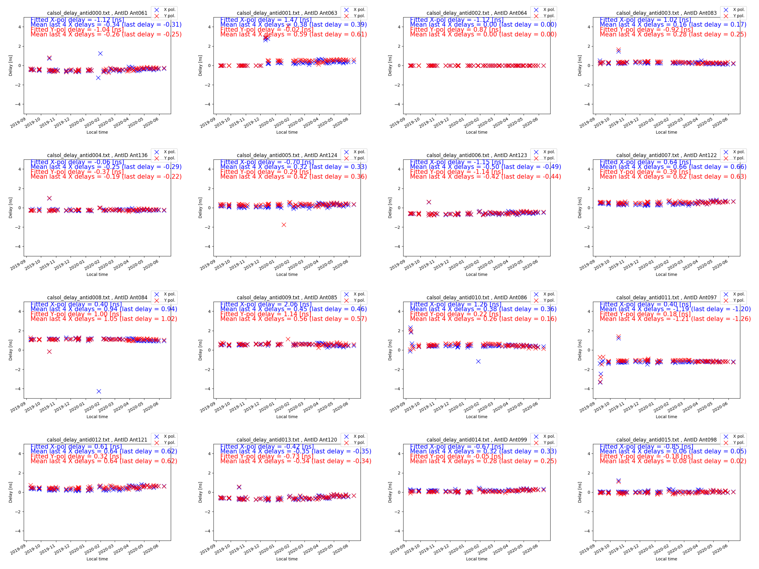
Results: stability of delay solutions - EDA2
9 months

Slide 16
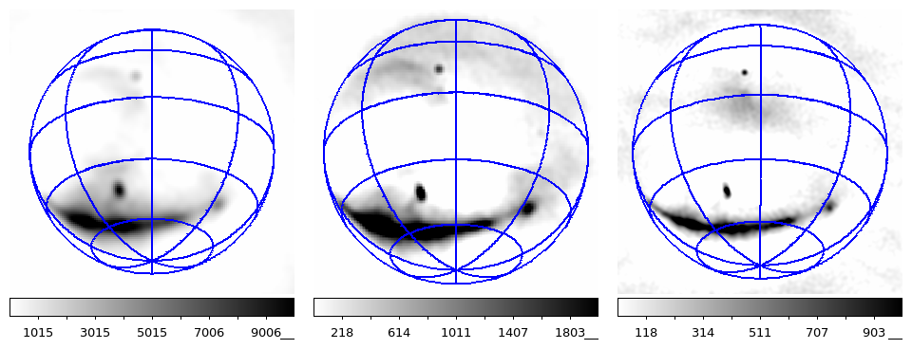
Outputs: all-sky images, every 2 seconds
110 MHz
159 MHz
230 MHz
Science outputs: All-sky monitor with 2s timescale. Sokolowski et al., 2020.
Rate/strength of RFI sources in FM band: Tingay et al, 2020.

Slide 17
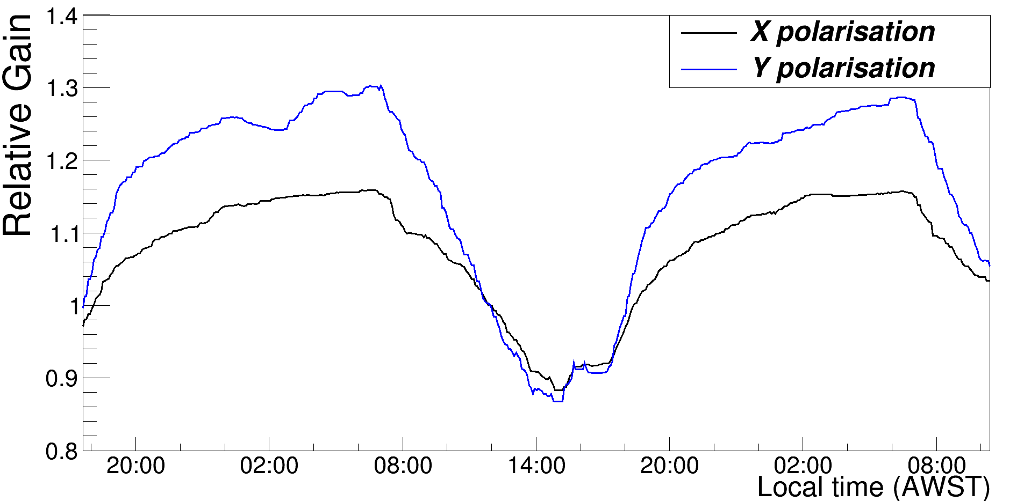
Results: temperature dependent gain effect

Slide 18
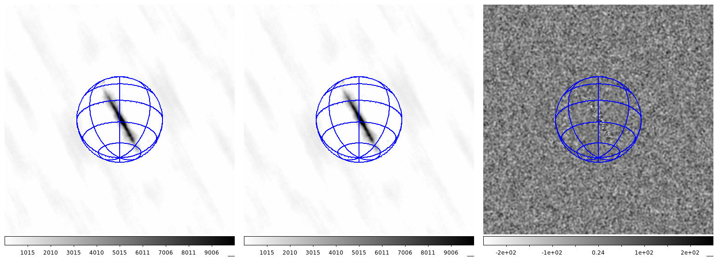
Results: sensitivity
    Snapshots are confusion limited, but difference images are noise-like
    This allows direct measurement of the on-sky array System Equivalent Flux Density (SEFD) from calibrated images
Consecutive snapshots separated by ~0.5s

Slide 19
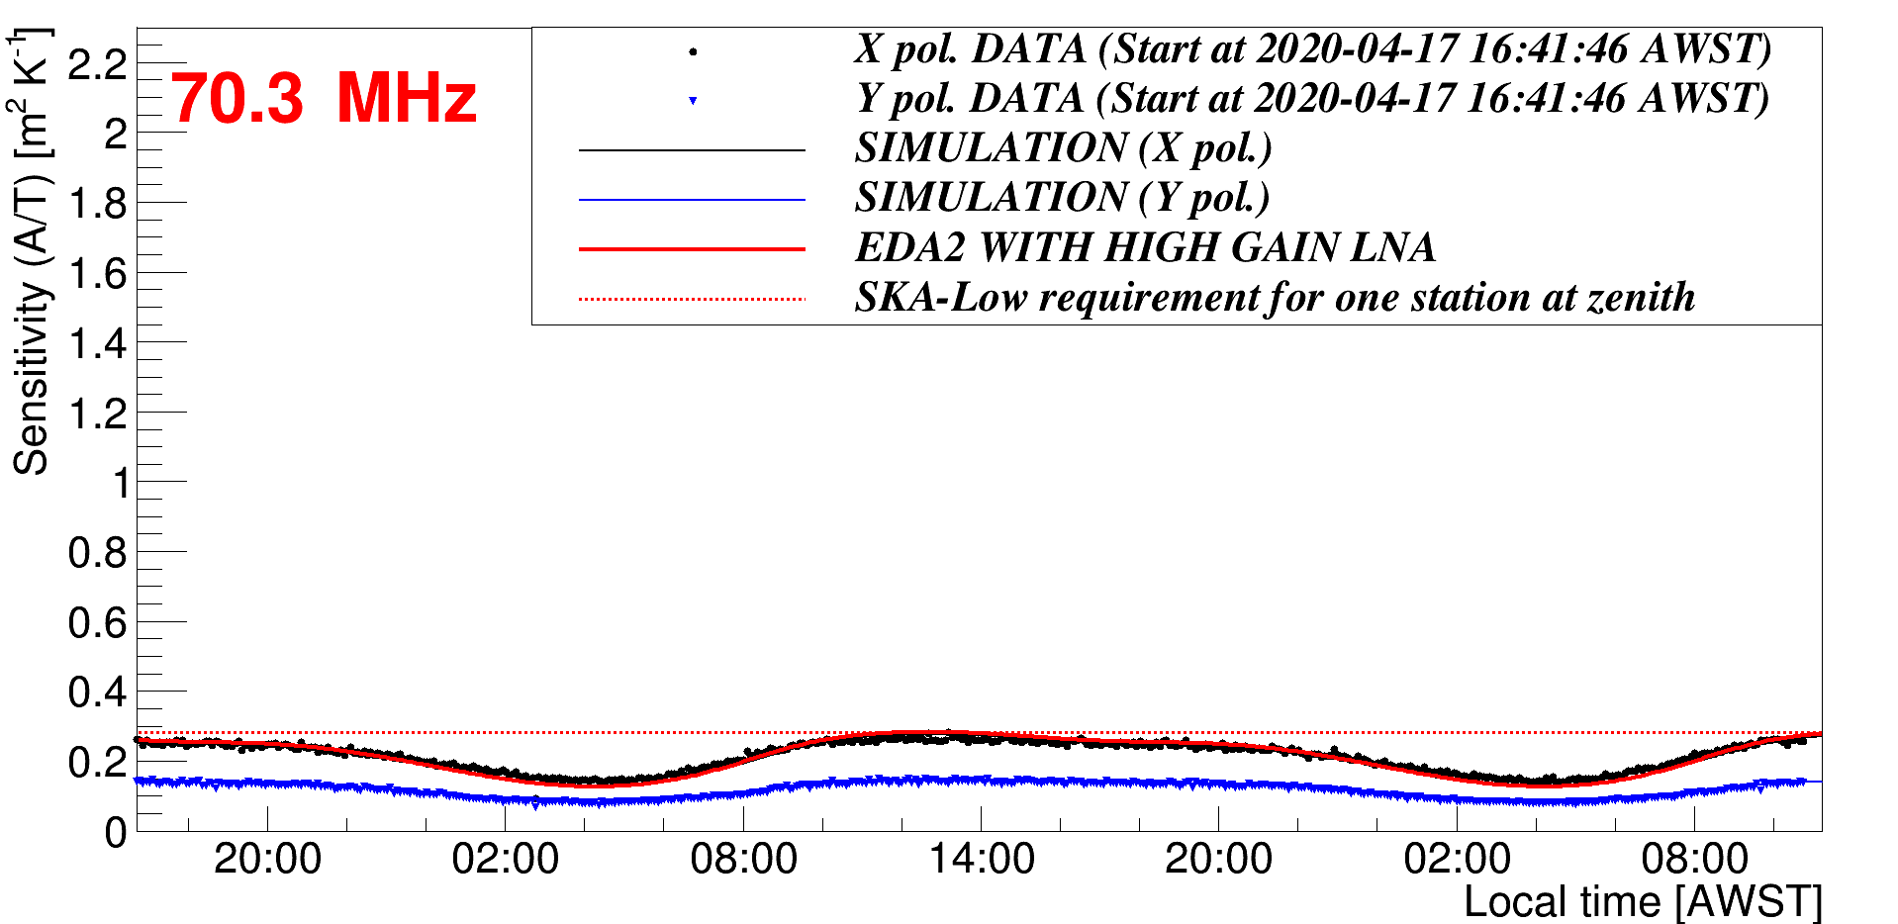
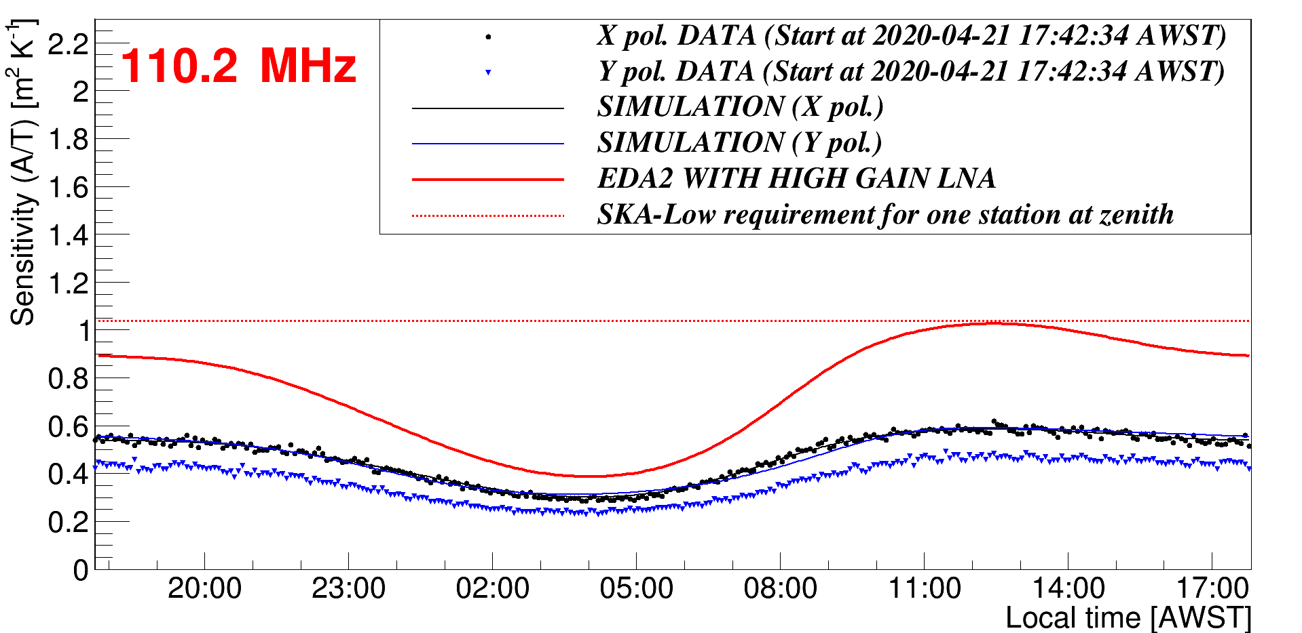
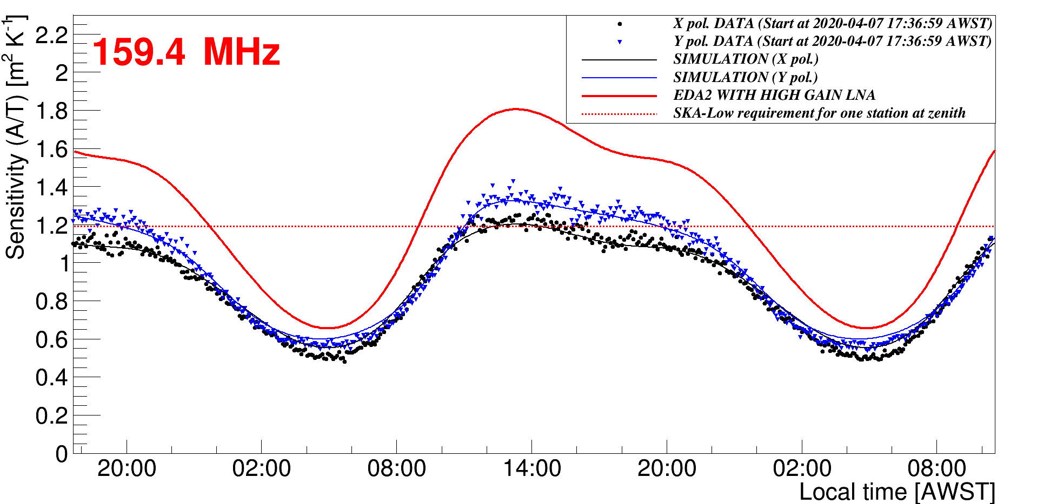
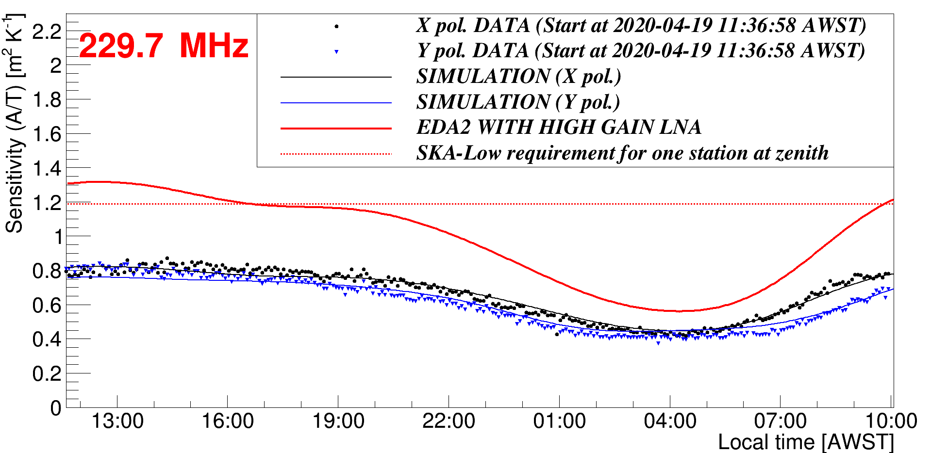
Results: EDA2 sensitivity
Wayth et al 2021
https://doi.org/10.1117/1.JATIS.8.1.011010

Slide 20
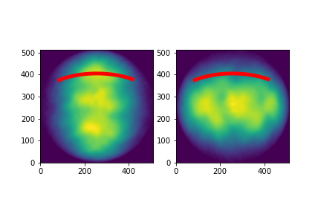
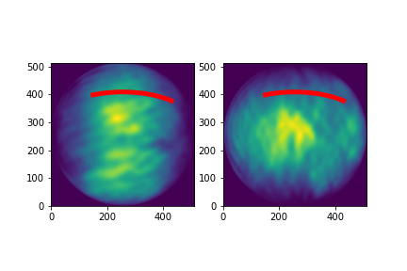
Verification of FEE patterns via solar calibration
FEKO full EM simulations for AAVS2 and EDA2
Probe beam by using sun as calibrator over ~6 hours, with 10min cal interval
Provides a direct measure of each beam at each cal time
XX
YY
EDA2 ant 0 power, orthographic
linear scale
Track of sun through EDA2 beam @ 230 MHz
XX
YY
AAVS2 ant 0 power, orthographic
linear scale
Track of sun through AAVS2 beam @ 110 MHz

Slide 21
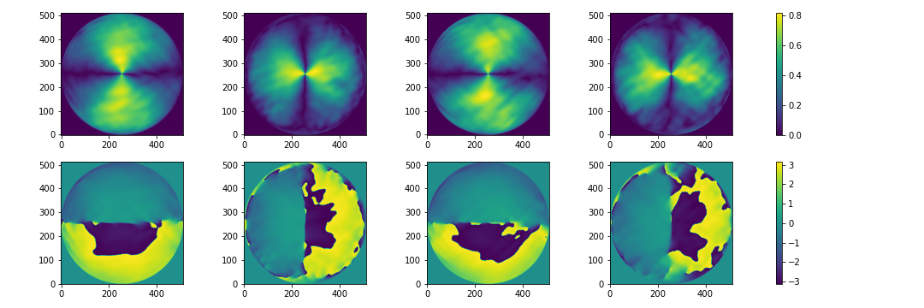
Jones matrix components – AAVS2 example ant 0,1
AAVS2 110 MHz – these are the (reprojected) outputs of FEKO for antenna index 0 and 1
Ant 0 E_phi
Ant 0 E_theta
Ant 1 E_phi
Ant 1 E_theta
amp
phase

Slide 22

AAVS2 110 MHz results: cal vs model
X cal phase
X model phase
Y cal phase
Y model phase

Slide 23
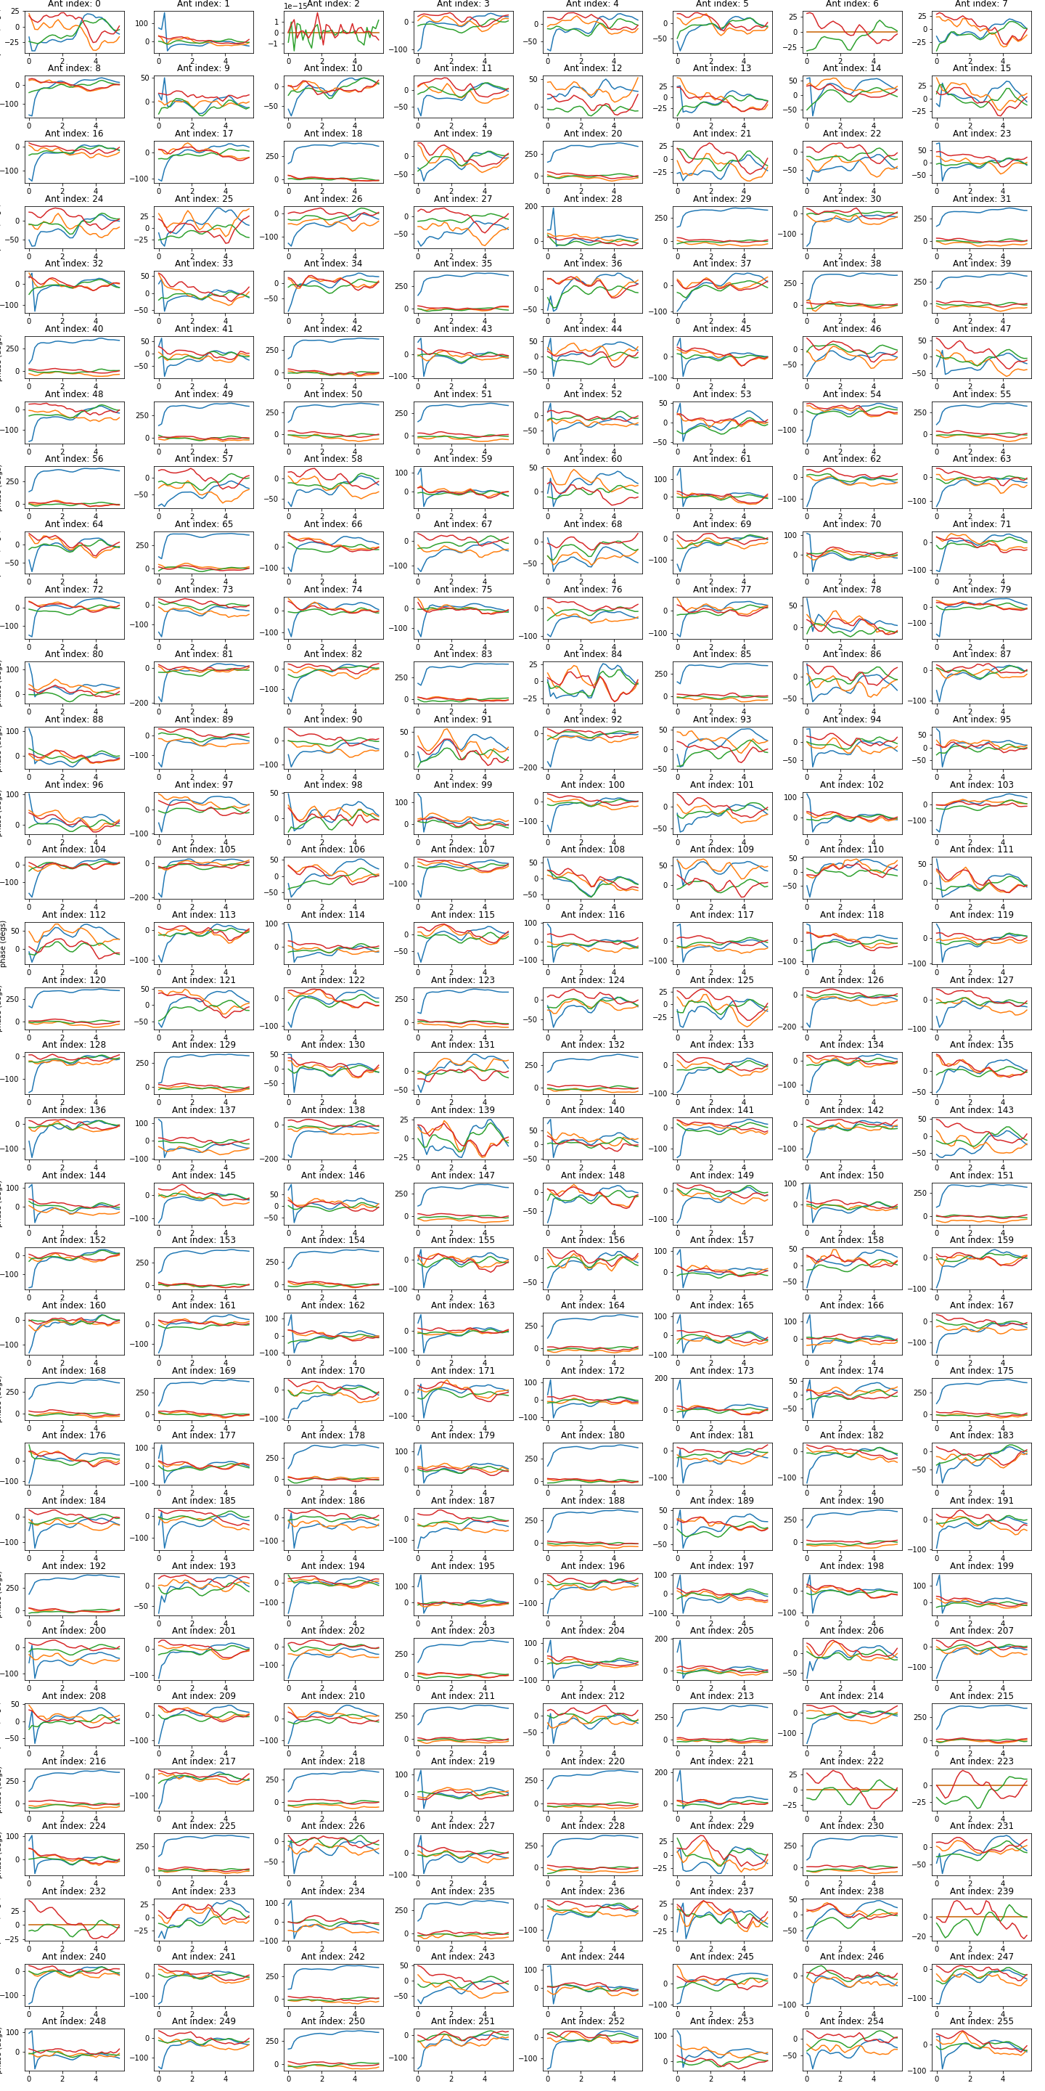

Slide 24
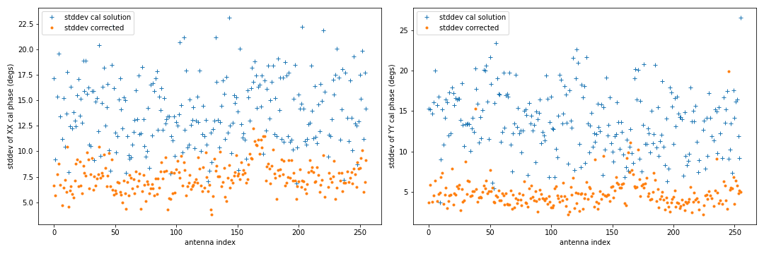
Stddev over time for each antenna – AAVS2 110 MHz
Residual phase variation over time is 5-7 degs after applying FEE beam correction
X pols
Y pols

Slide 25
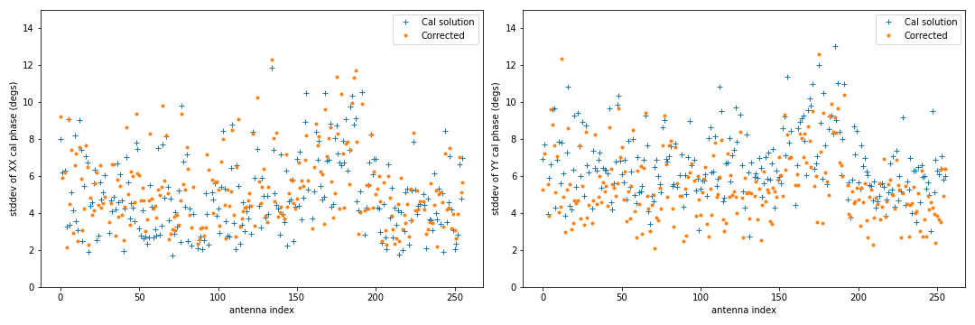
Stddev over time for each antenna – EDA2 230 MHz
Intrinsic phase variation over time is 4-7 degs. Corrections make negligible difference.
X pols
Y pols

Slide 26
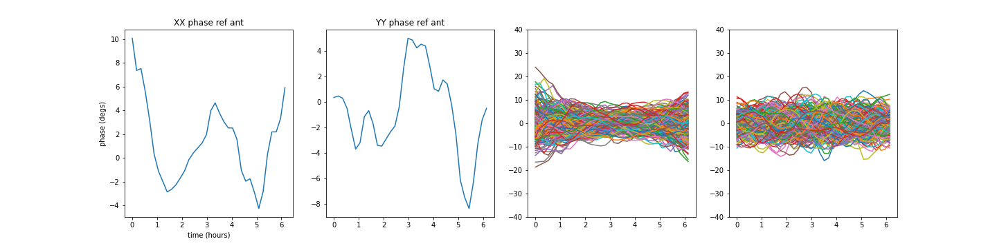
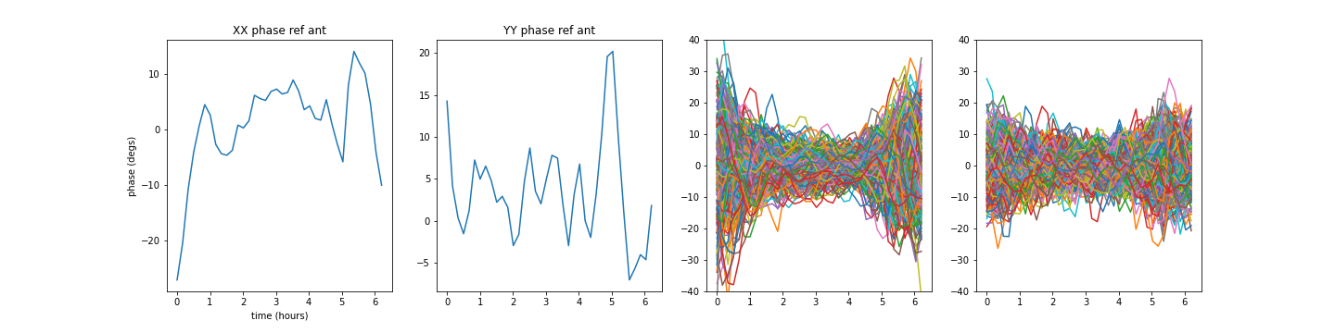
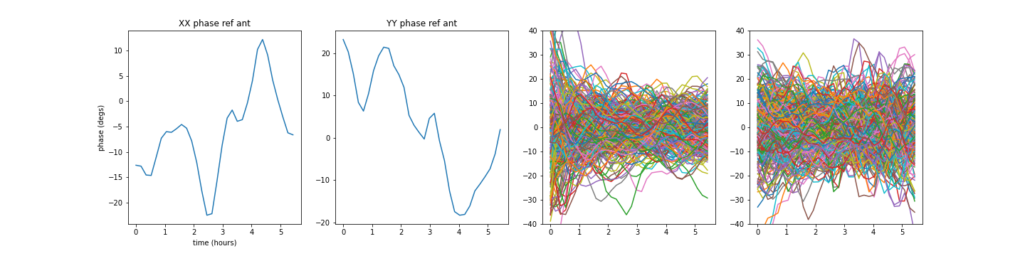
Model phases for different ants, freqs (same scale)
EDA2 X pols
230 MHz
EDA2 Y pols
230 MHz
AAVS2 X pols
230 MHz
AAVS2 Y pols
230 MHz
AAVS2 X pols
110 MHz
AAVS2 Y pols
110 MHz

Slide 27
Conclusions
Delay-based cal model are very stable
“Intrinsic” (can’t be explained by FEE beams) phase variations in analogue chain of order 5-7 degs (at 110 and 230 MHz at least)
FEE models are required for unbiased calibration when predicted variations are > intrinsic variations.
Beams are highly variable near the horizon – we should not trust models when strong sources are near the horizon.

Slide 29
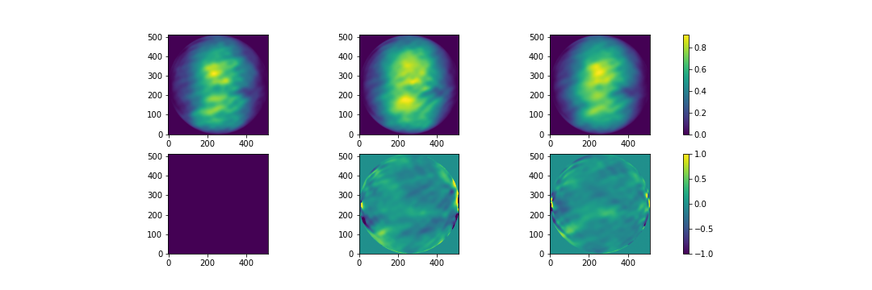
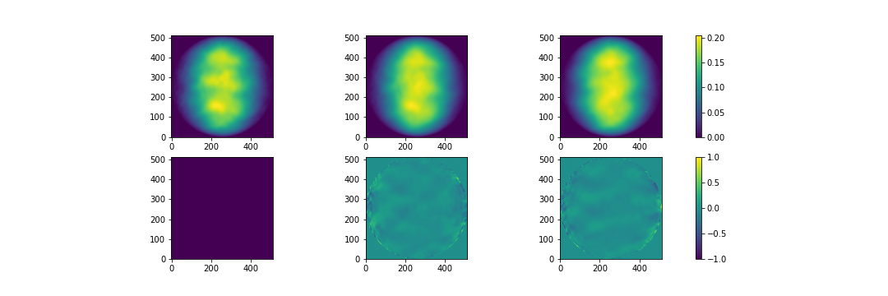
Cross power examples – amp & phase
AAVS2 110 MHz
Amp
Phase (radian)
EDA2 230 MHz
0-0 XX
0-1 XX
0-2 XX

Slide 30
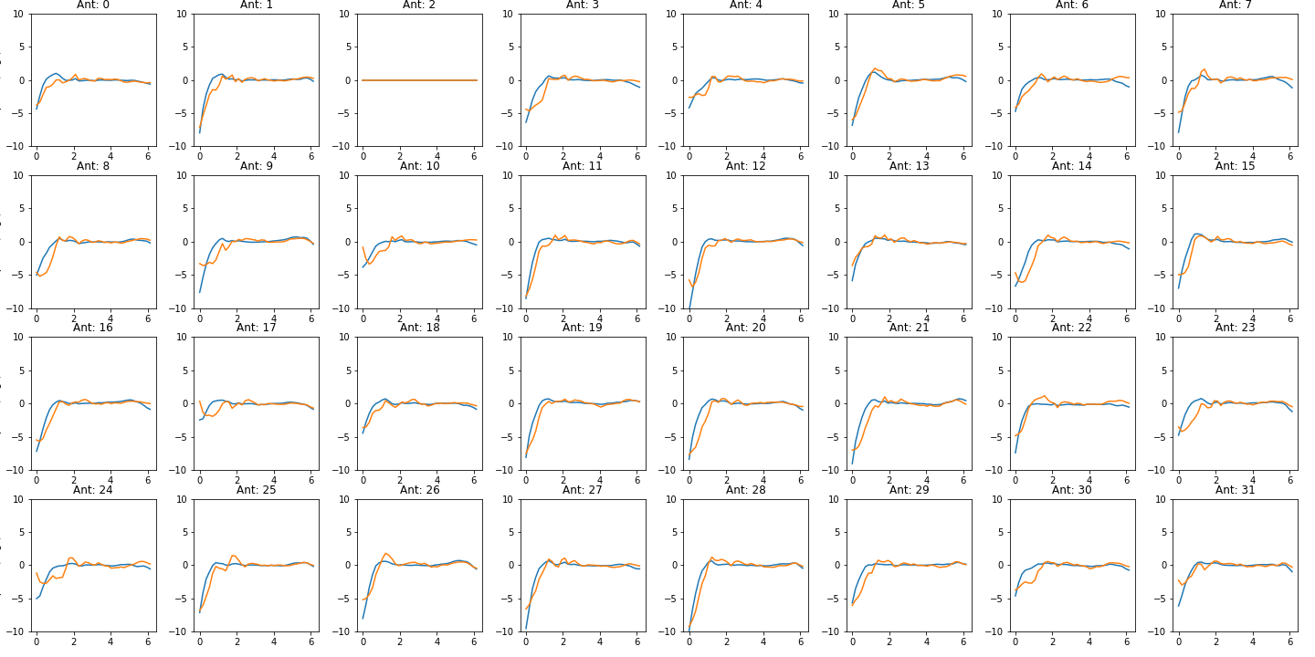
Does rest of sky bias model? Not after GC sets (EDA 230 MHz)
Simulated cal solutions generating vis with full sky, then just cal on the sun. After GC sets, very good agreement.

Slide 31
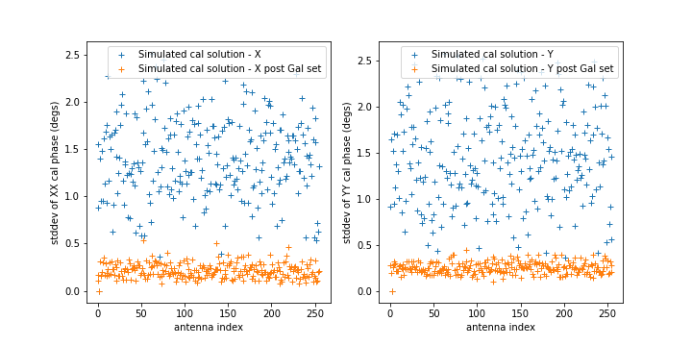

Slide 32
Guidelines
The presentation will be around 20 minutes and in all cases there will 10 minutes for questions from the audience
Please respect the timeslots
When available it is strongly advised to make document(s)/papers available supporting your talk that can be read in advance. These will be linked to your agenda slot.

