Slide 1
SKA LOW 2022 Meeting
Overview of Station Calibration using EEPs
Ravi Subrahmanyan [S&A CSIRO, Curtin-CIRA]
8 February 2022

Slide 2
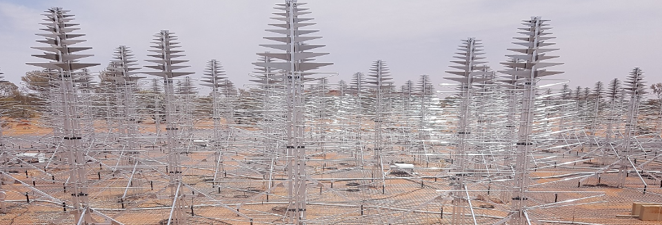
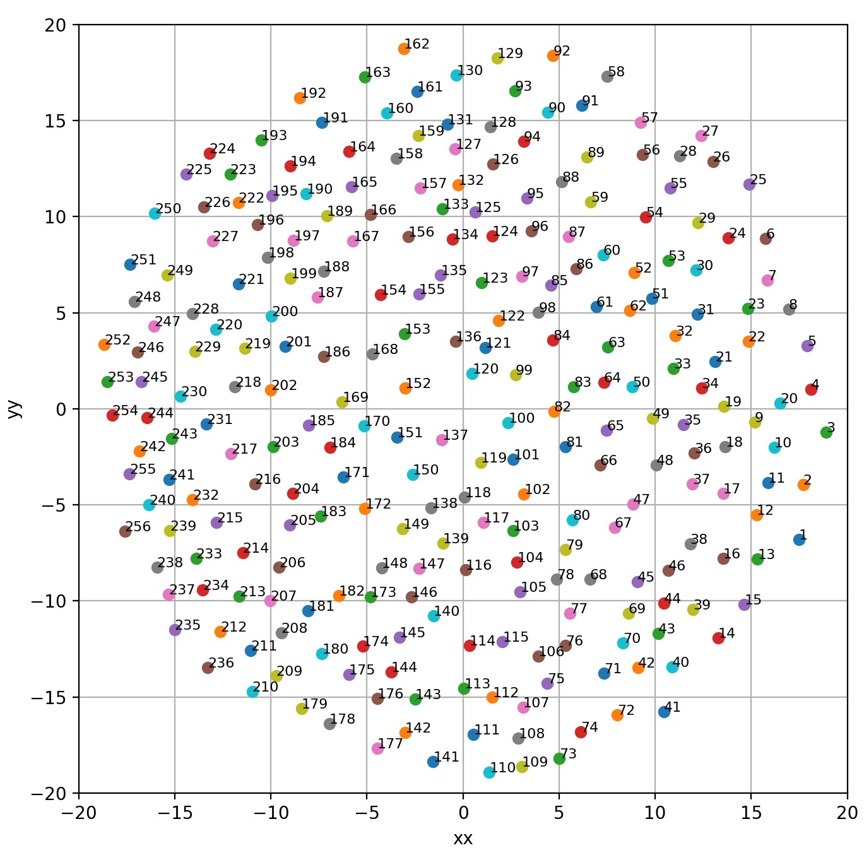
AAVS2 embedded element patterns
Mutual coupling between antennas in the station. Results in distortions to the beam patterns of the embedded antennas.
Embedded Element Patterns (EEPs):
$${ B}_{Xφ} { B}_{Xθ}{ B}_{Yφ}{ B}_{Yθ}$$
Complex, direction-dependent, voltage patterns of the X & Y polarized feeds: their response to
H and V sky polarization.

Slide 3
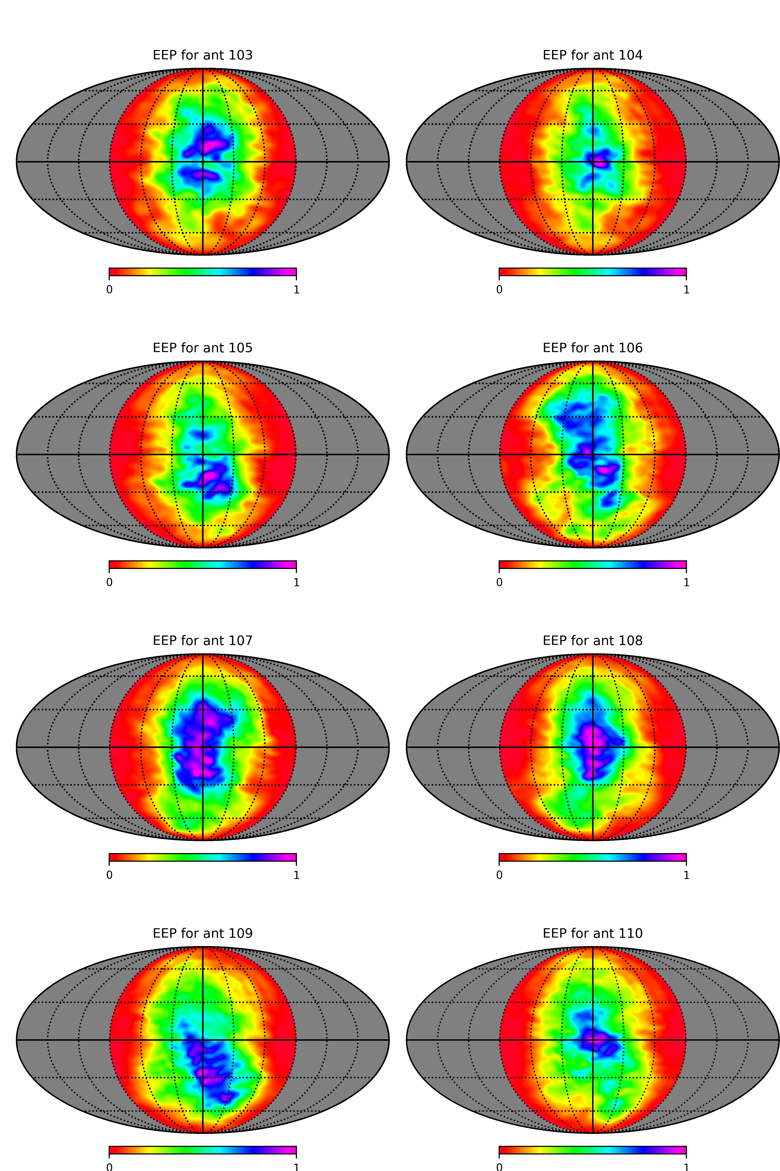
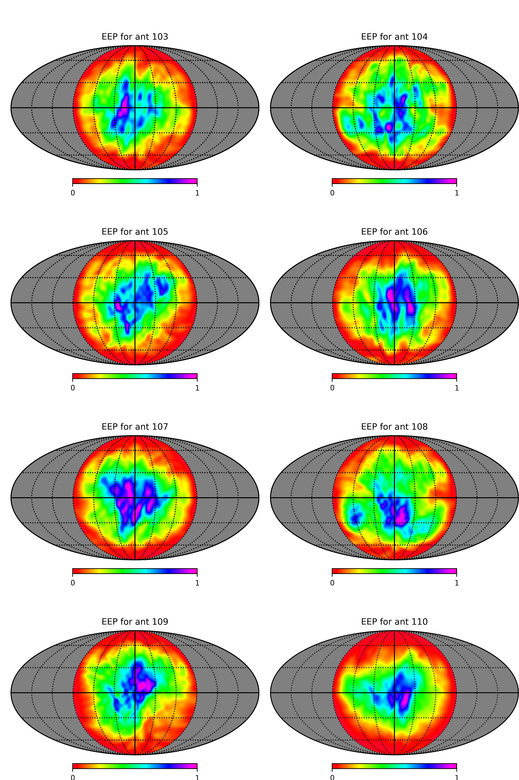
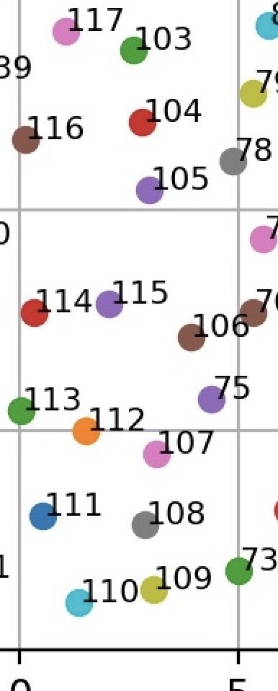
EEPs @ 110 MHz
(antenna power patterns)
X-pol
Y-pol
Calibration needs to take into account the direction-dependent antenna gains

Slide 4
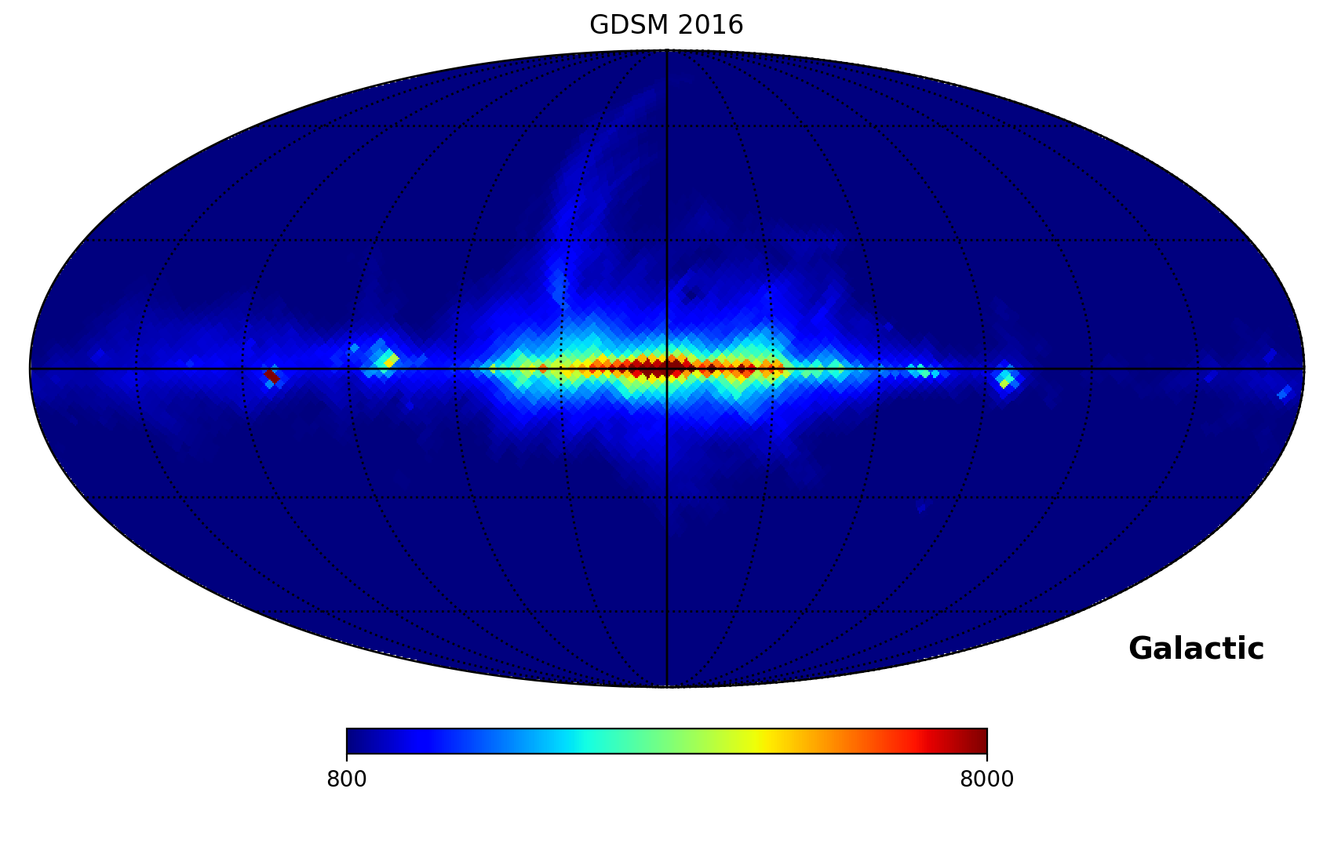
Sky Model: GSM+Sun
Healpix Global Sky Model
[Zeng ++ 2016; PyGSM]
Degraded to 1.8 deg resolution (nside=32 healpix) as model for 110 MHz AAVS2
Sun added in at each timestamp in appropriate pixel with pixel-averaged temperature
Sun flux density from [Benz 2009]

Slide 5
Measurement data
110 MHz AAVS2
21/22 April 2020 – 250 functioning antennas (6 faulty antennas)
Intra-station correlations XX, YY for all 31125 baselines
Frequency averaged over 0.926 MHz coarse channel
Time averaged to give integration time 0.28 sec
Snapshot observations available every 5 mins.

Slide 6
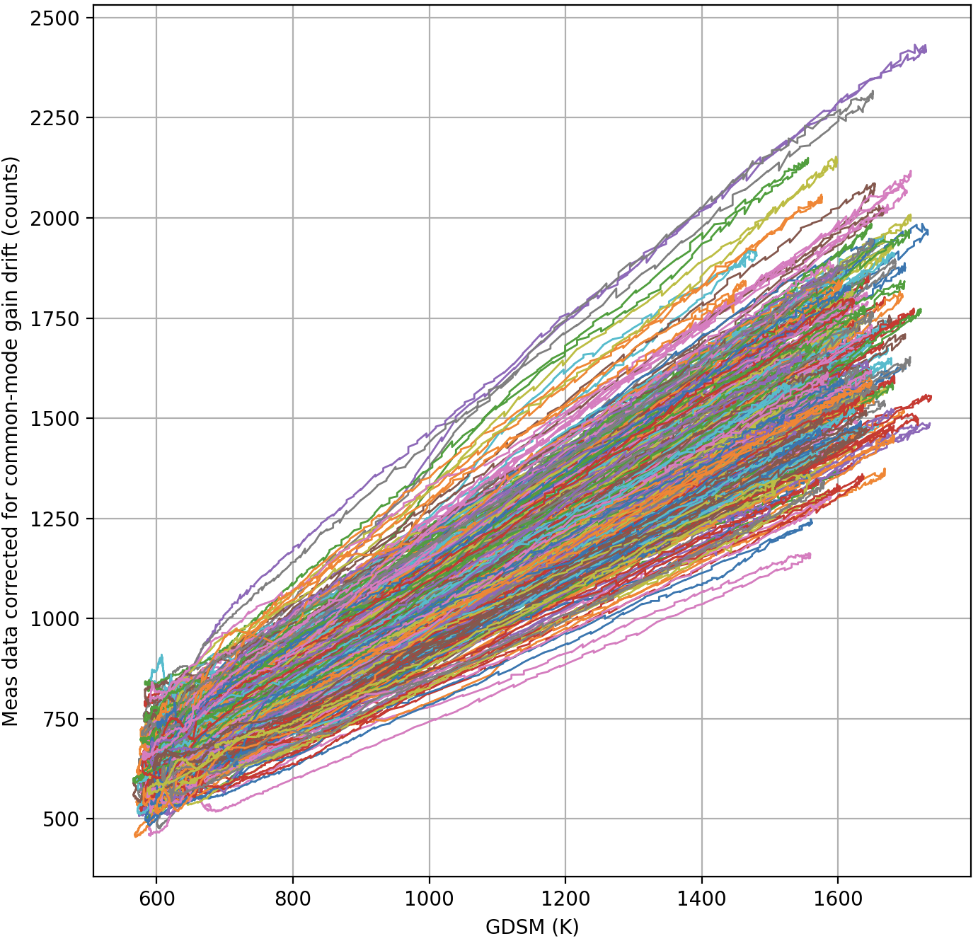
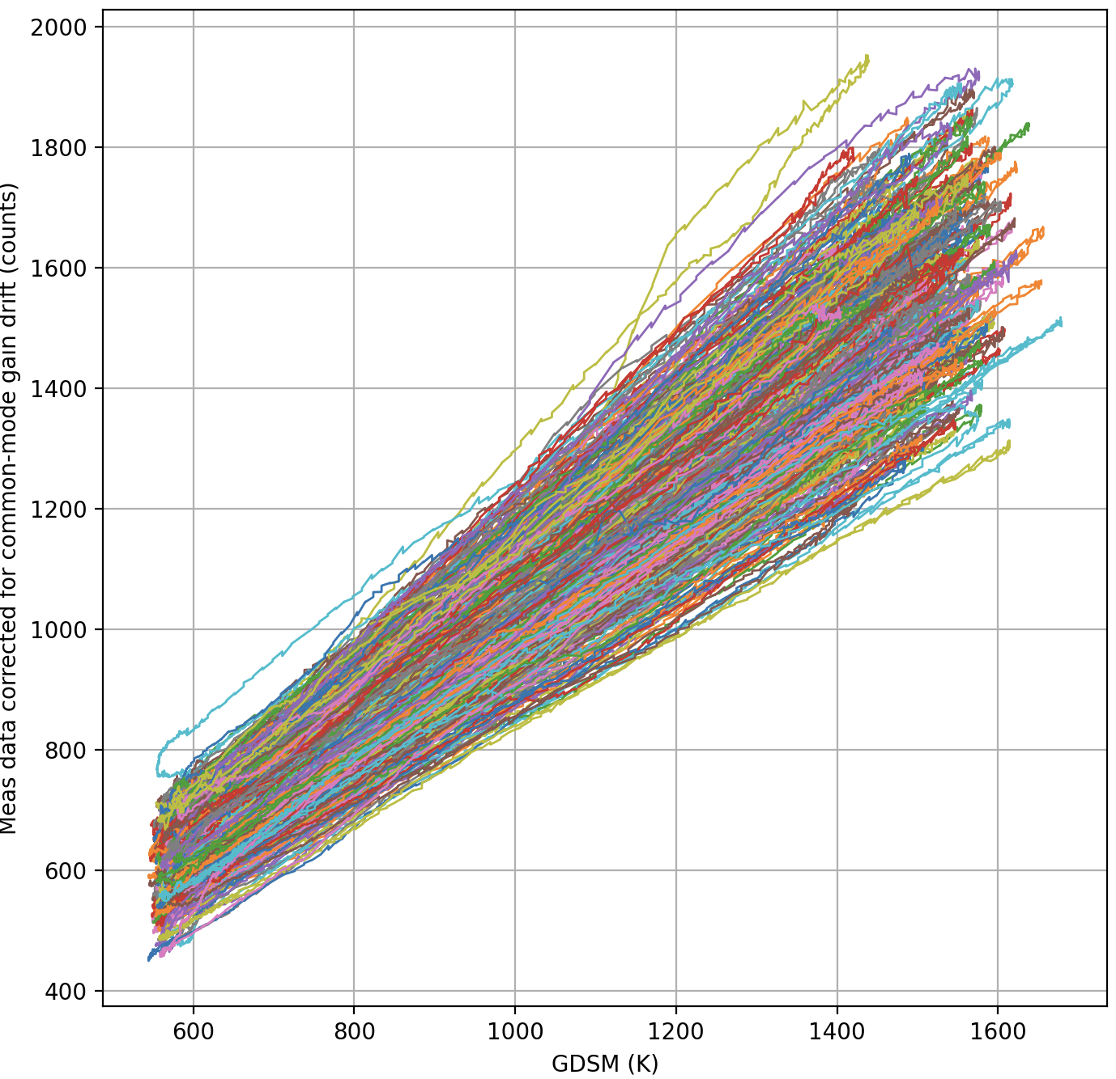
Calibration of XX, YY autocorrelations (110 MHz):
Plot measured XX, YY Counts versus predicted XX, YY antenna temperature.
Fit straight line to get offset (Treceiver) and slope (gain: counts/K).
Apply the additive and multiplicative calibration factors to each antenna
X-pol
Y-pol
Mean of the fit offsets: 40 K
(consistent with expectation for receiver noise temperature)

Slide 7
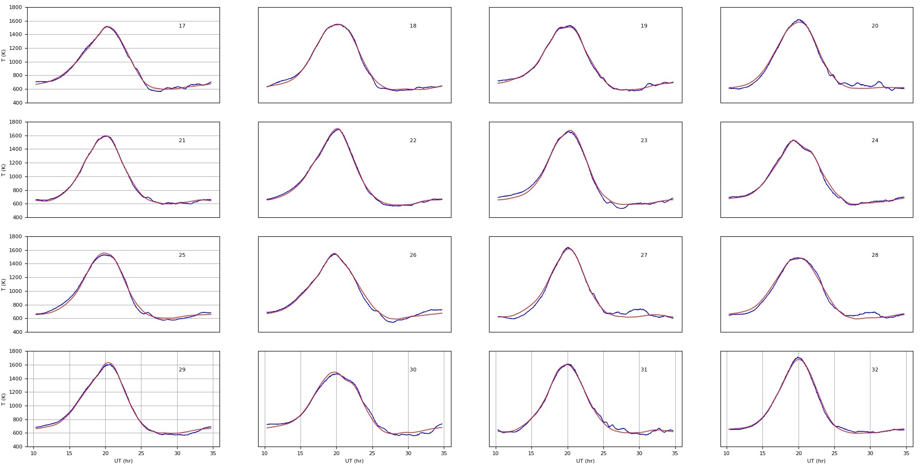
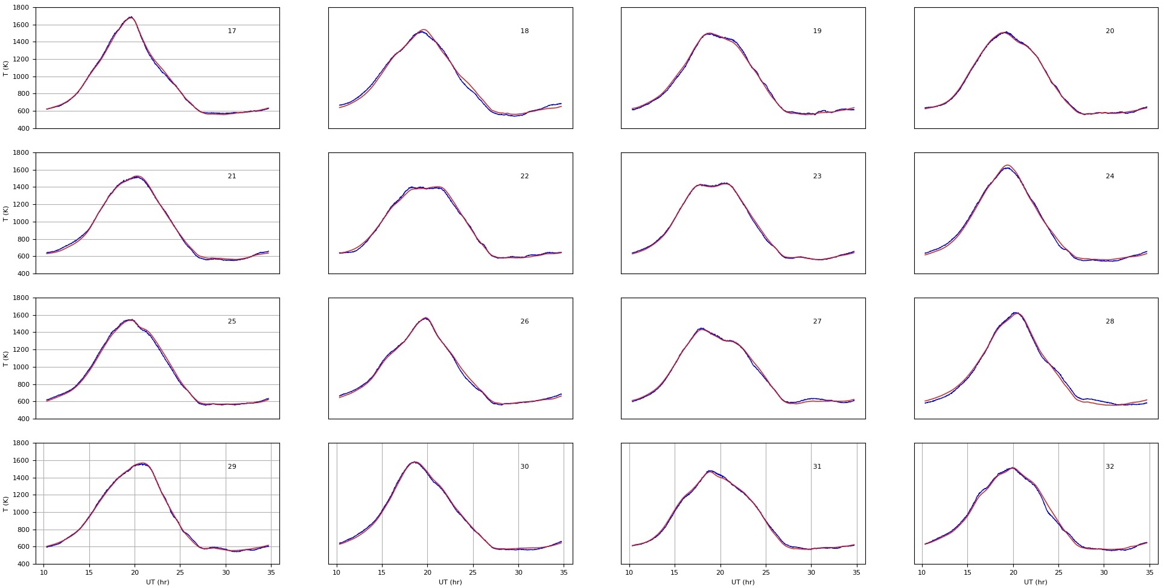
Comparison: calibrated XX, YY autocorrelations versus predicted antenna temperatures (using EEPs)
X-pol
Y-pol
Verifies connectivity, configuration,
basic performance, EM models

Slide 8
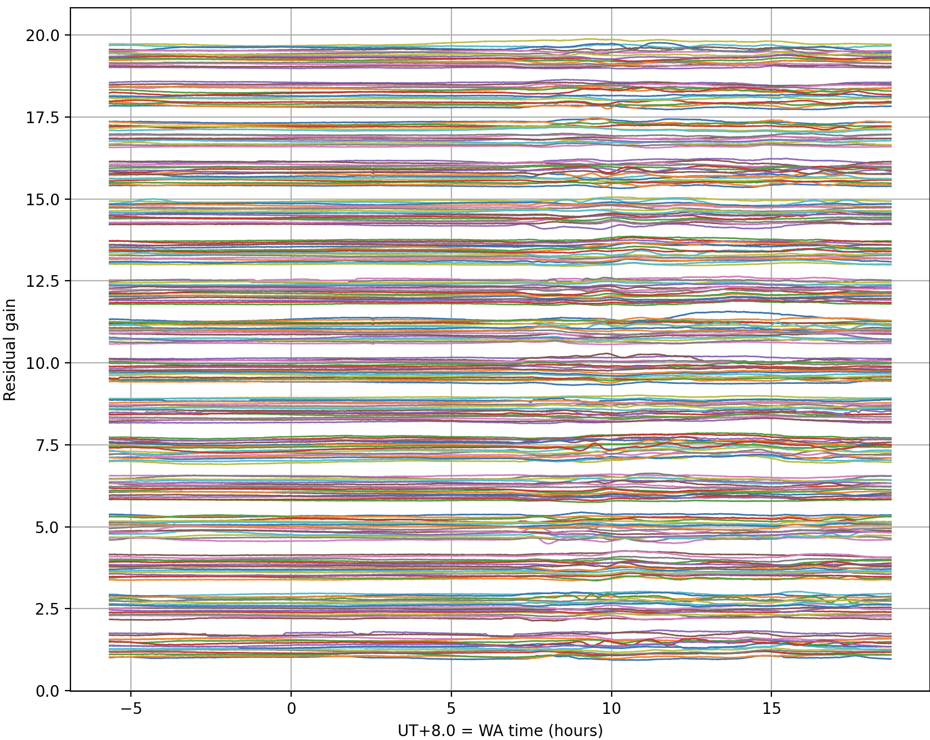
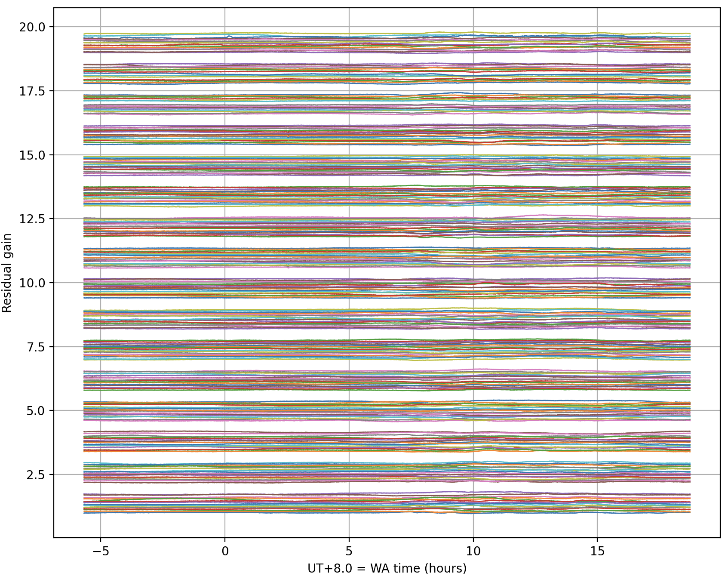
Residual gain variations over the day/night:
X-pol
Y-pol
Calibration with EEPs has the potential to reveal intra-station gain drifts.
Gain variations are more in day compared to night; more in X compared to Y.
Differing in antennas serviced by same SMART boxes.

Slide 9
Calibrations of XX & YY cross correlations (110 MHz):
Predict visibility amplitudes/phases on all baselines/times:
3D FT from l,m,n of pixels in healpix sky to u,v,w of baselines
Correct for direction dependent complex gains of antennas forming the baseline – this is a complex correction for each pixel, each baseline, each polarization.
Sky model + Sun assumed unpolarized.

Slide 10
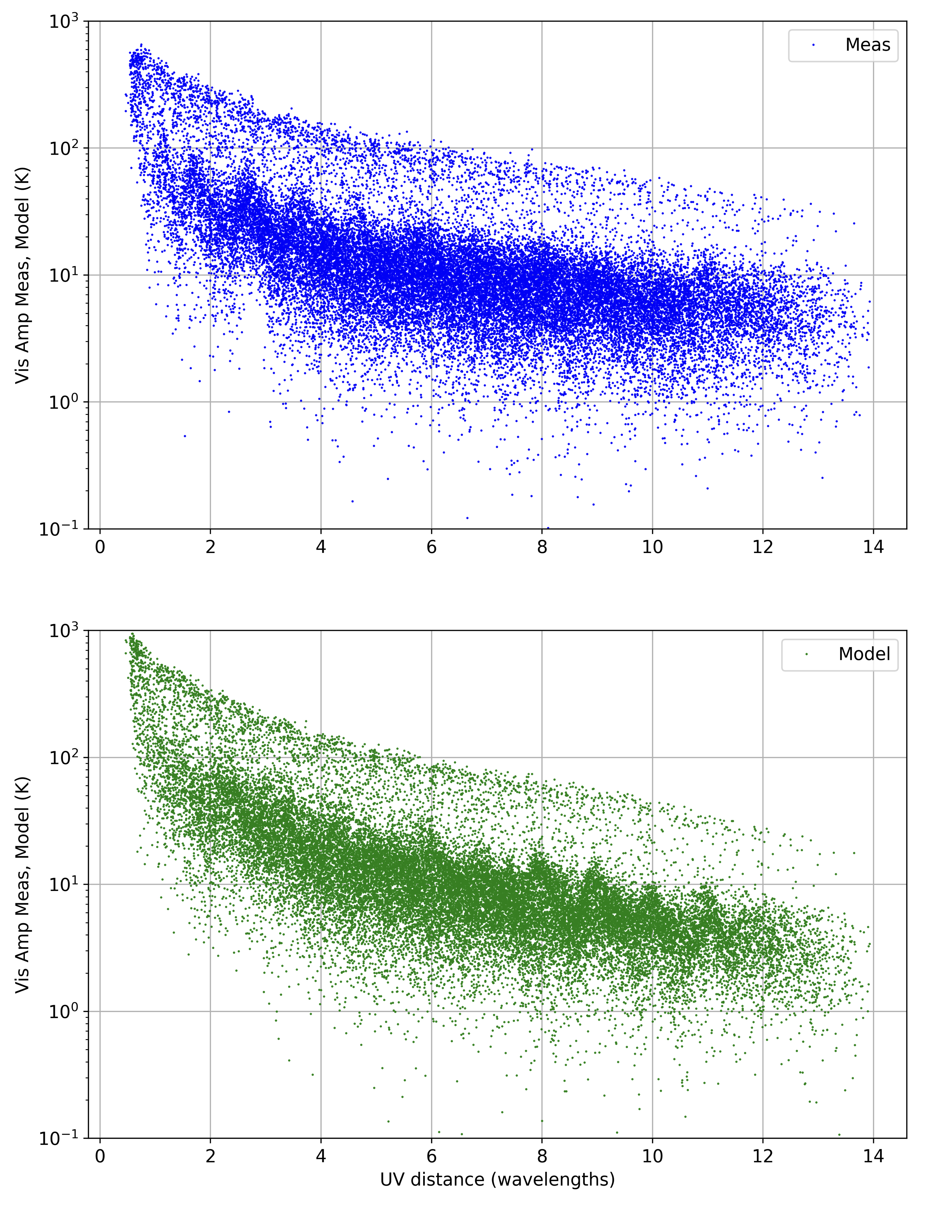
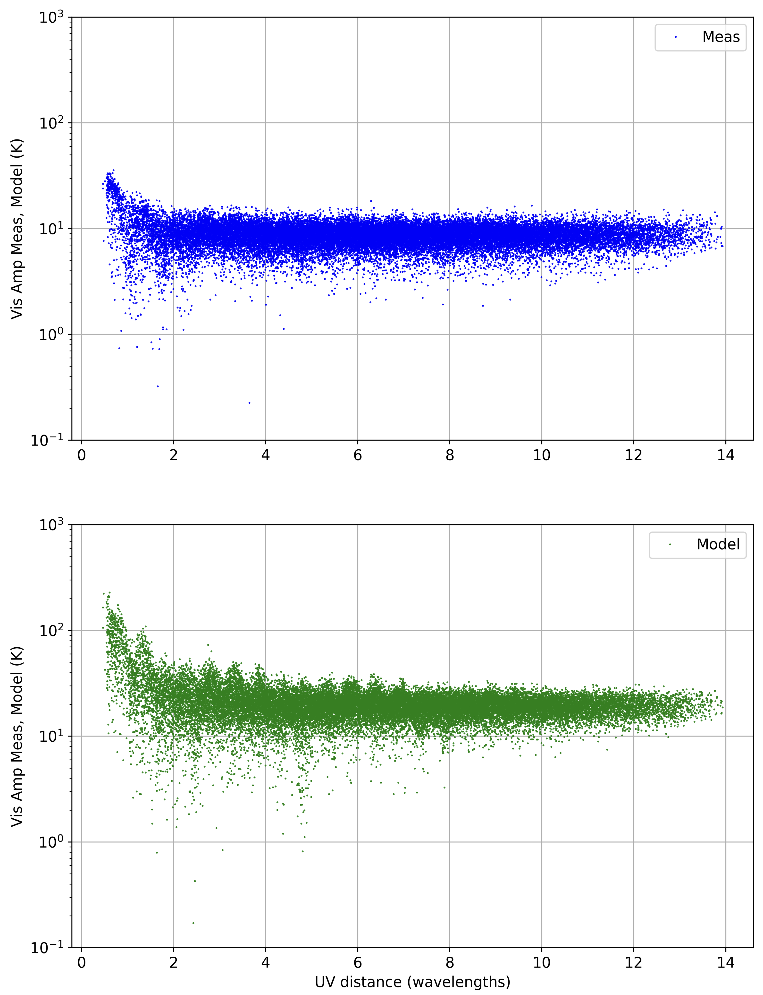
At time when GC is at zenith
At time when Sun transits the meridian
Measured (uncalibrated)
Visibility amplitudes
Predicted (kelvin units)
Visibility amplitudes

Slide 11
Antenna-based gain solutions
Comparing the 31125 baseline visibility predictions & measurements.
XX and YY correlations separately
Solving for 250 amp/phs gain solutions independently at each time
Using MIRIAD SELFCAL. Although this is “calibration” and not “self-calibration”
Removing common mode gain drifts – which do not affect station beamforming

Slide 12
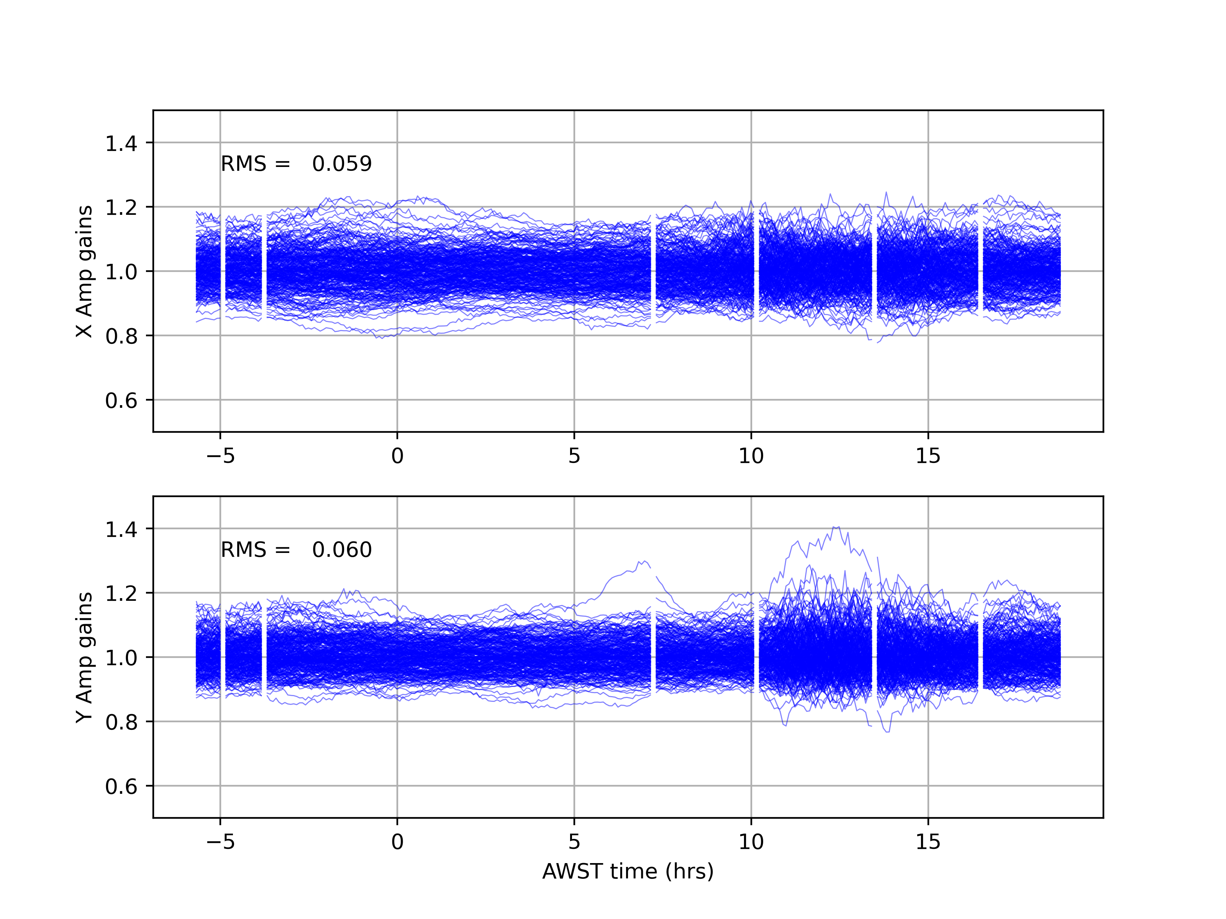
Antenna-based intrastation gain solutions
X-pol
STD = 0.059
Amplitude gains
Y-pol
STD = 0.060

Slide 13
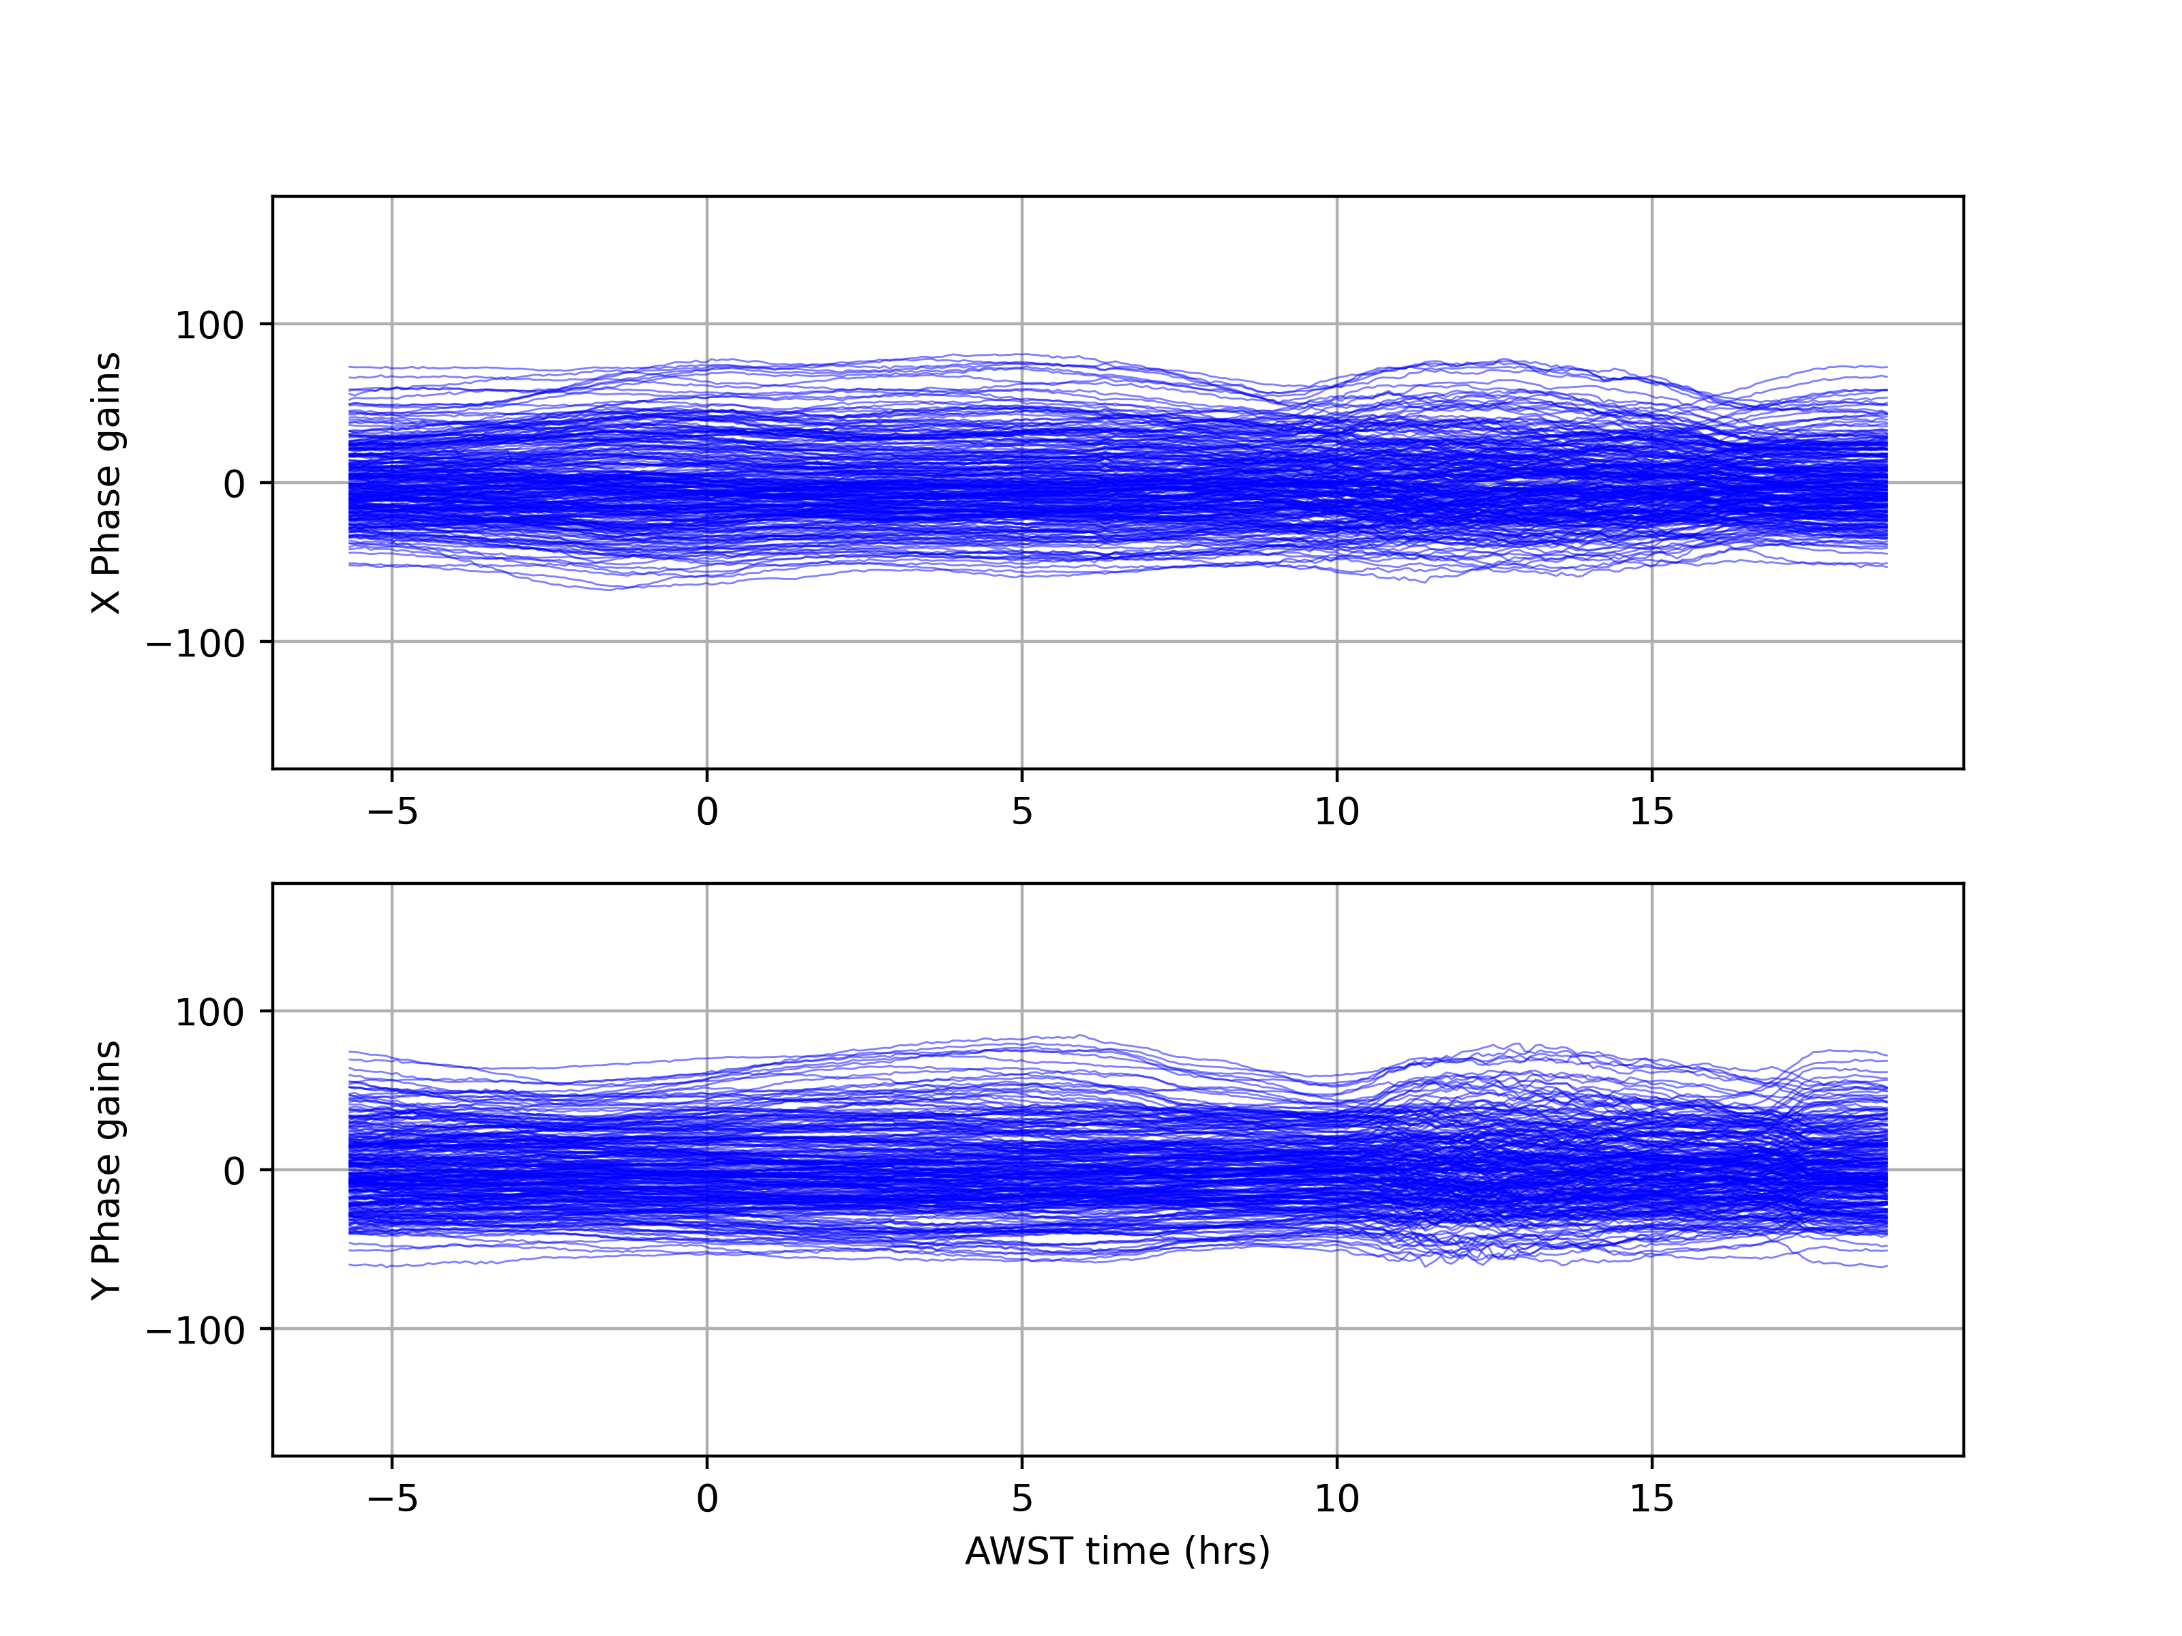
Antenna-based intrastation gain solutions
X-pol
STD = 5.99 deg
Phase gains
Y-pol
STD = 6.06 deg

Slide 14
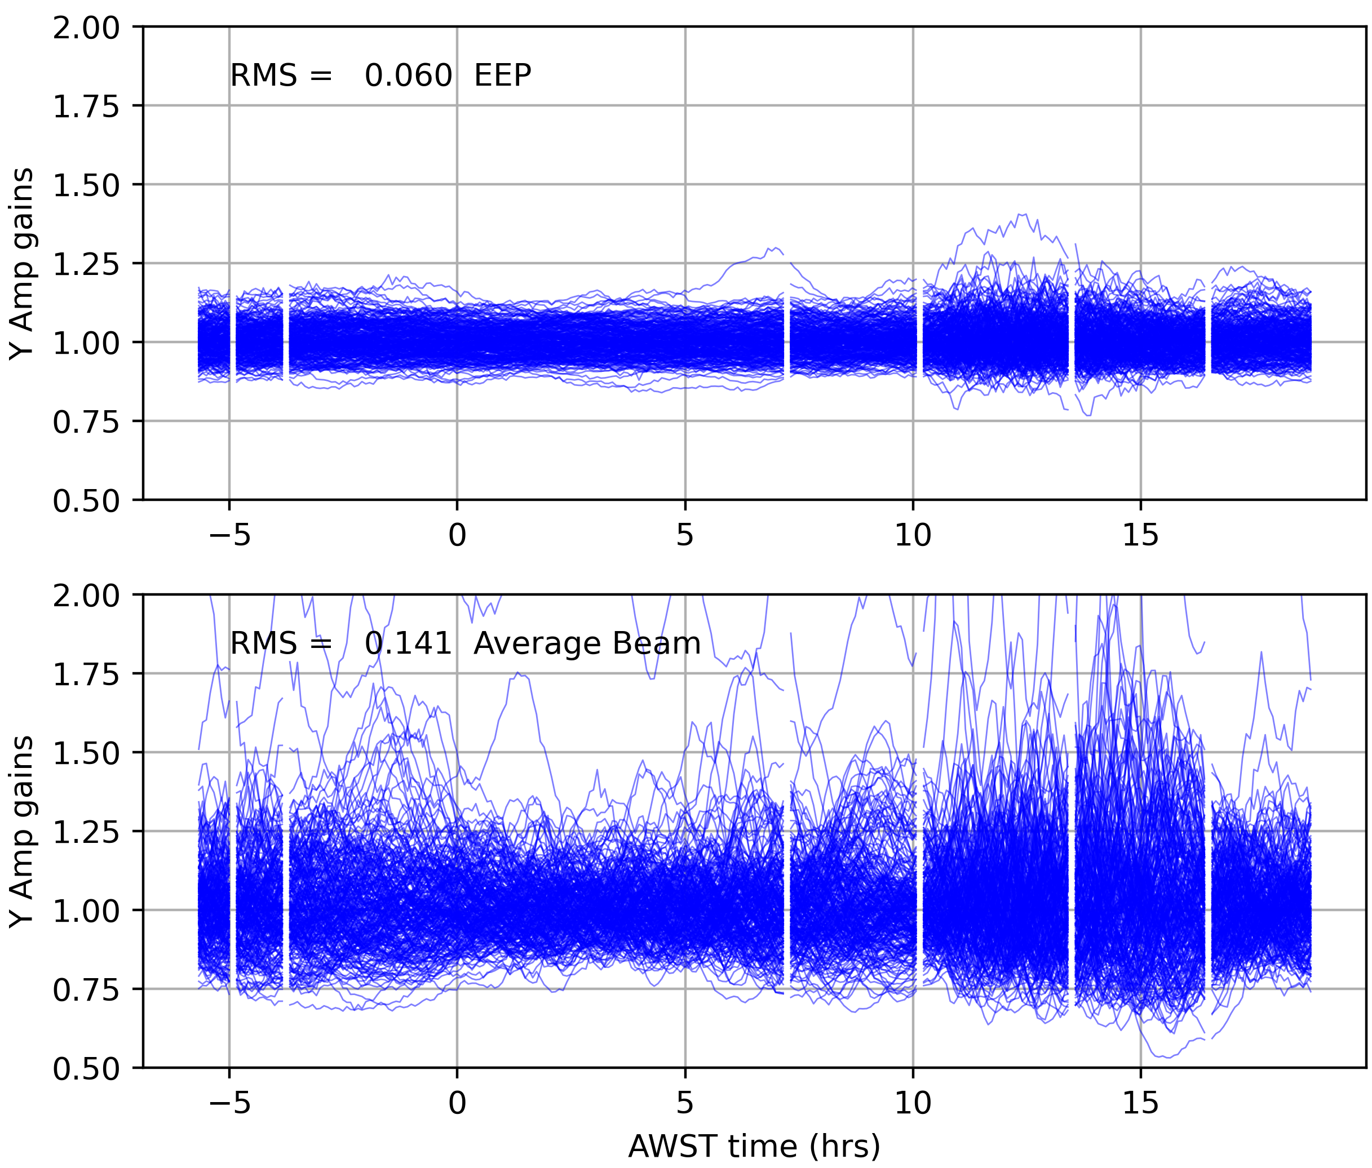
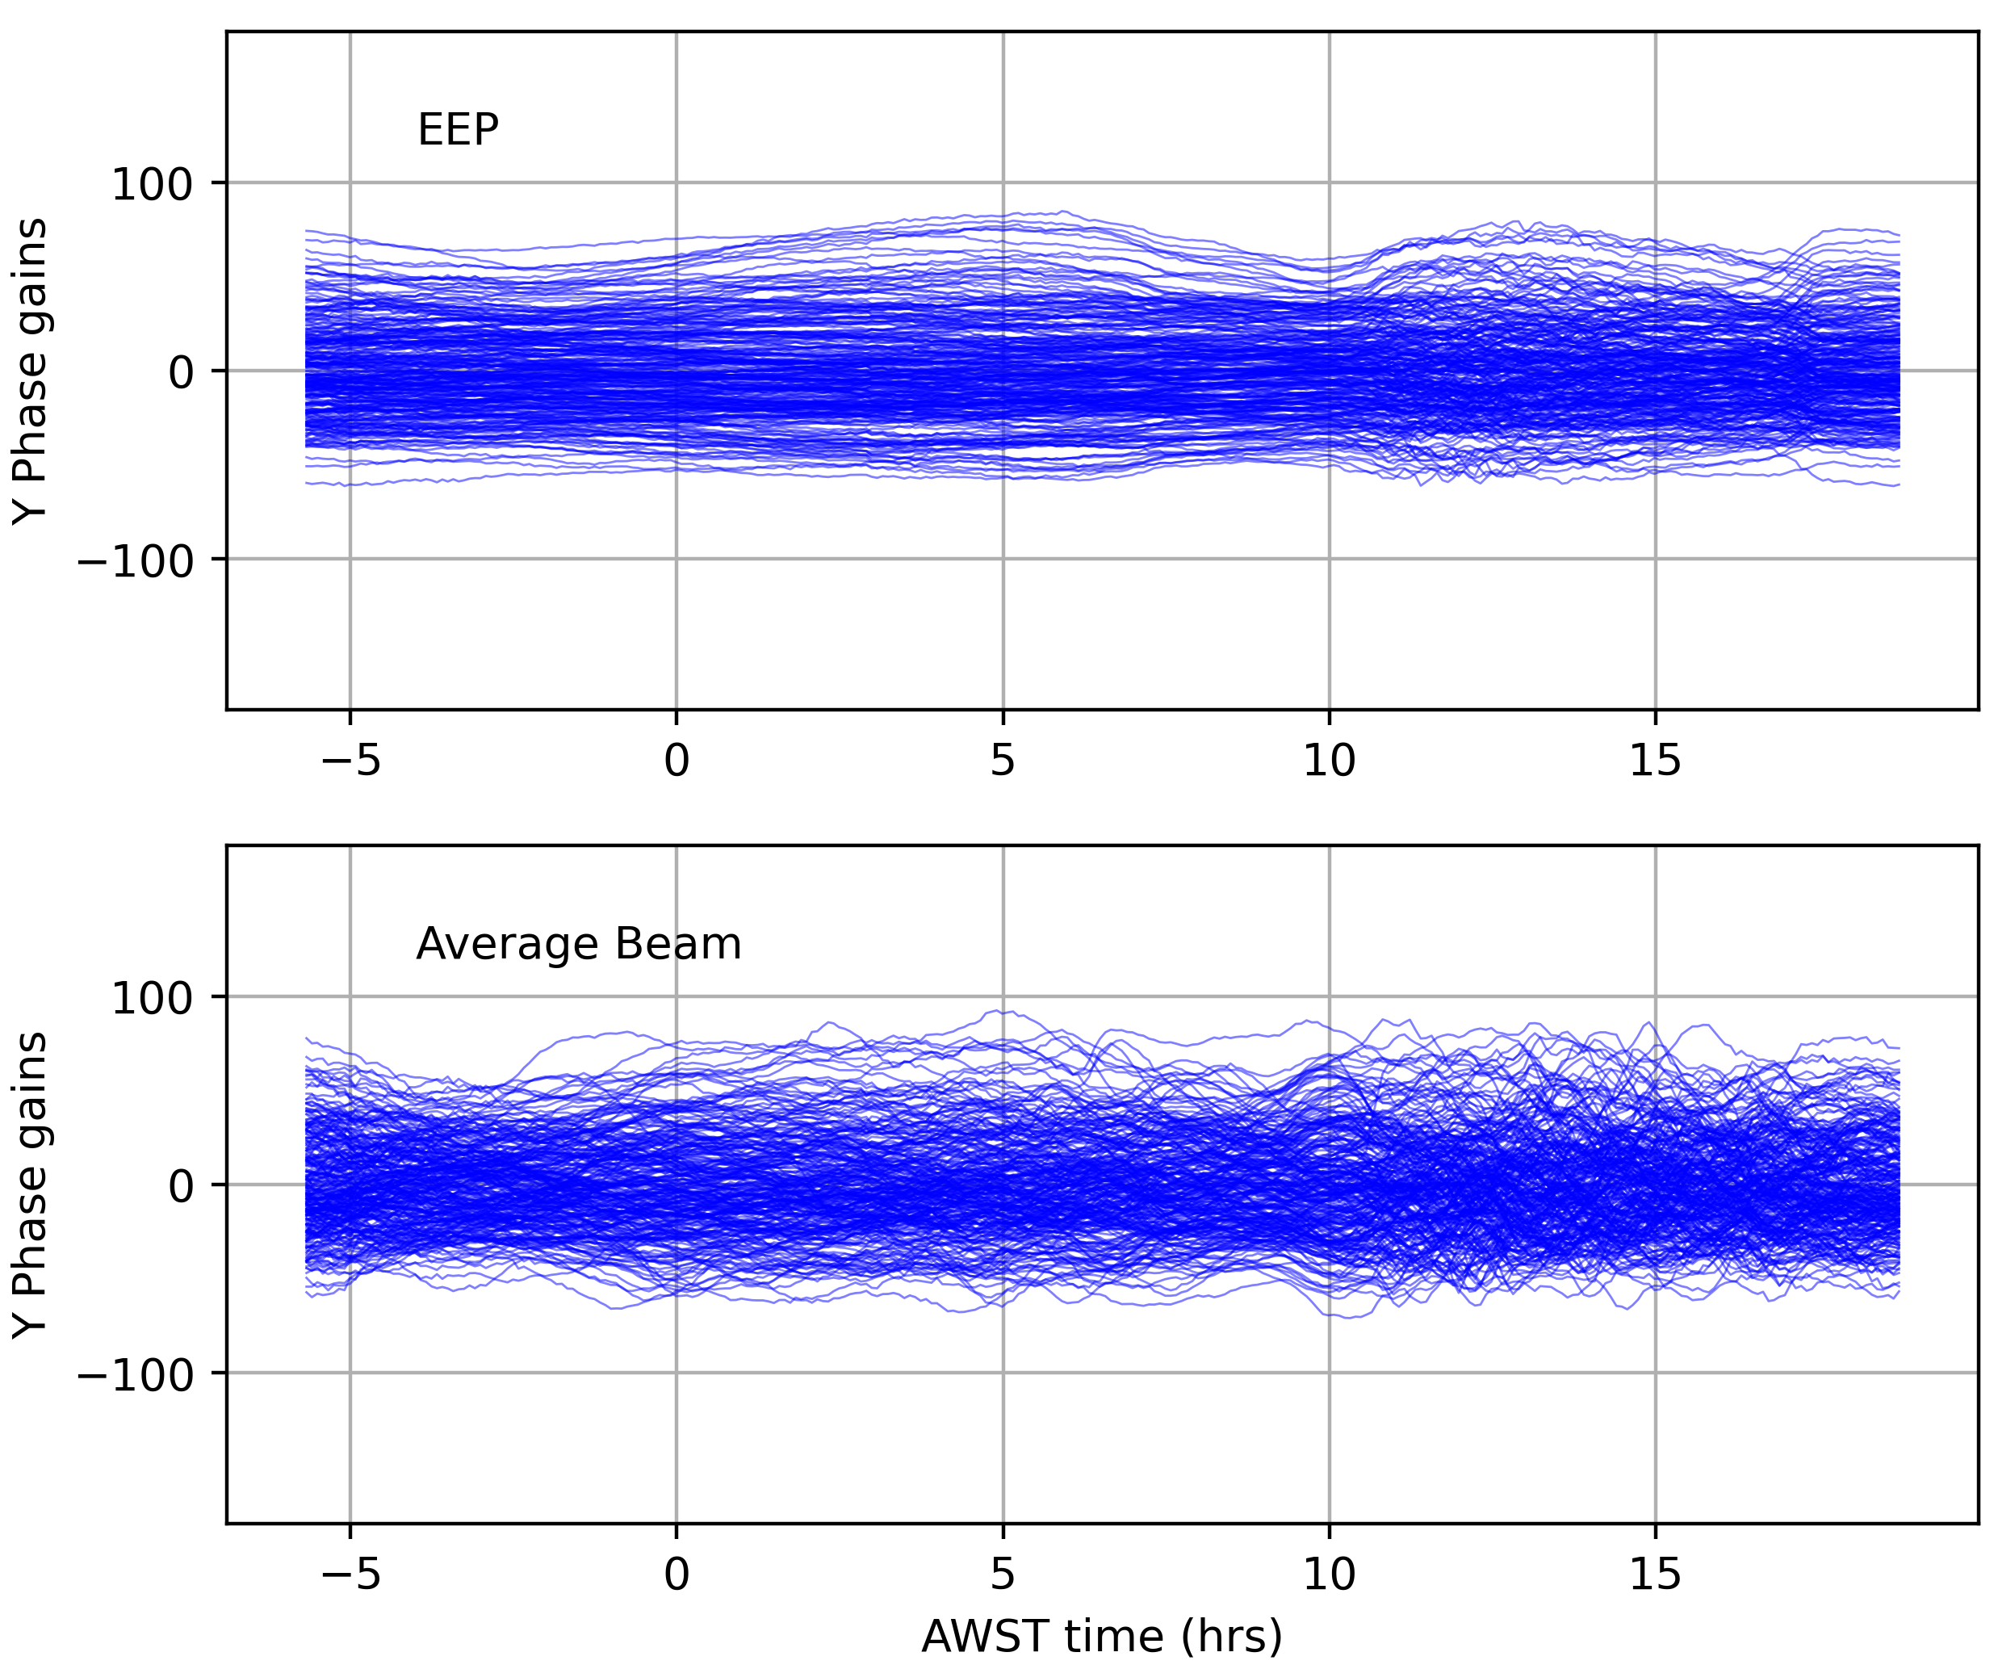
Comparison of gain solutions: EEP vs Average EEP

Slide 15
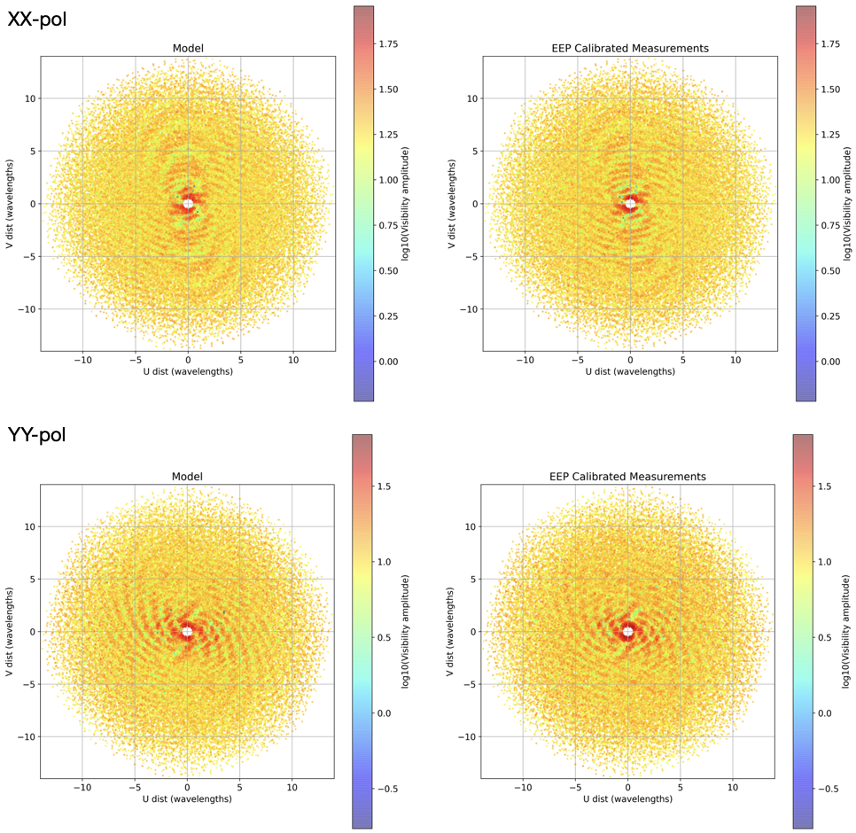
Calibrated visibilities: Model versus Data
At time when
Sun transits the meridian

Slide 16
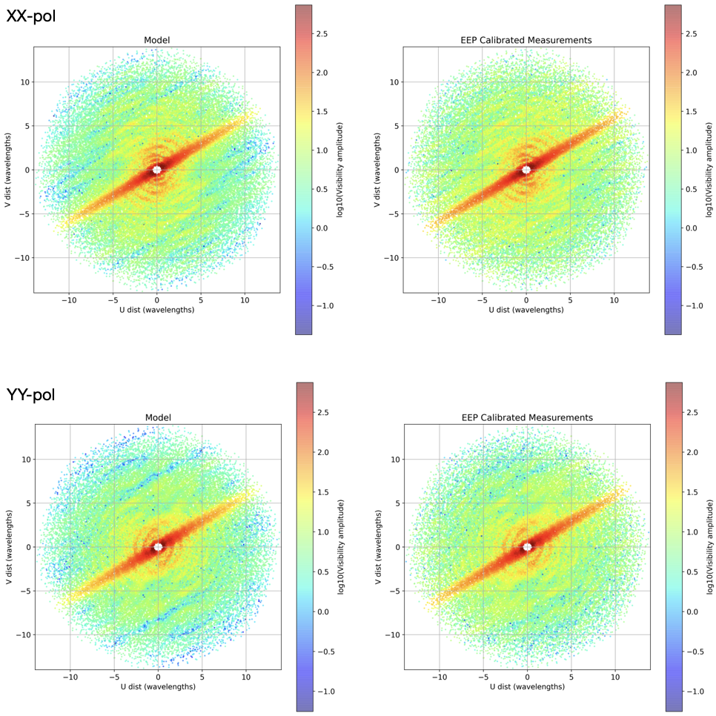
Calibrated visibilities: Model versus Data
At time when
GC transits the meridian

Slide 17
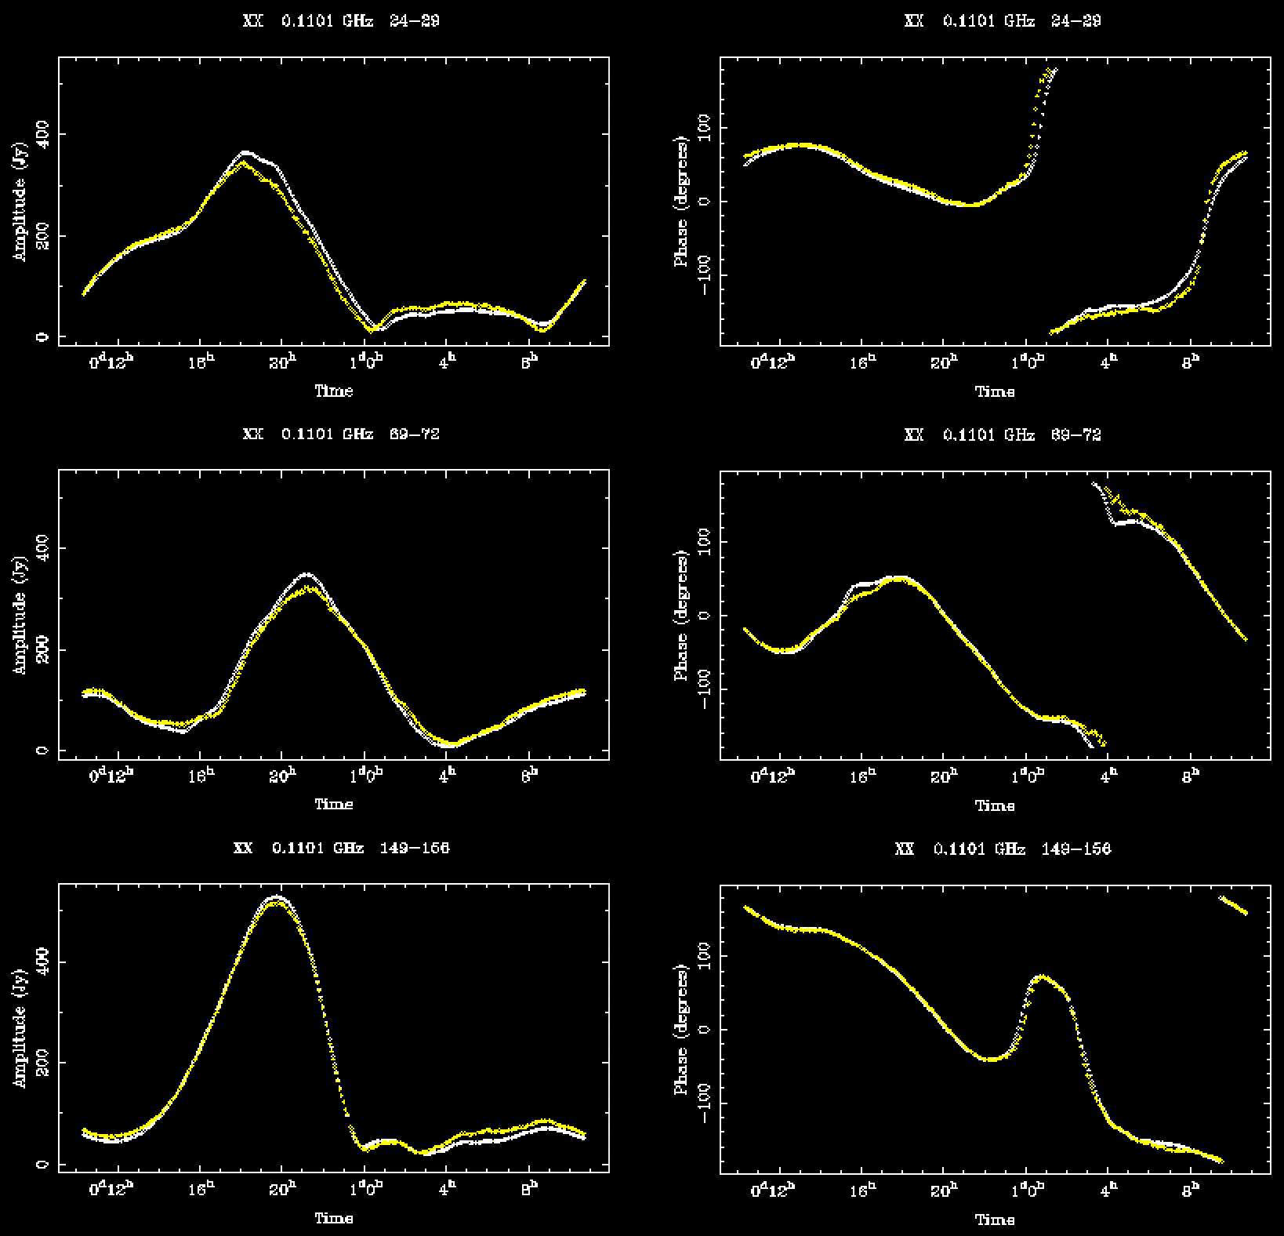
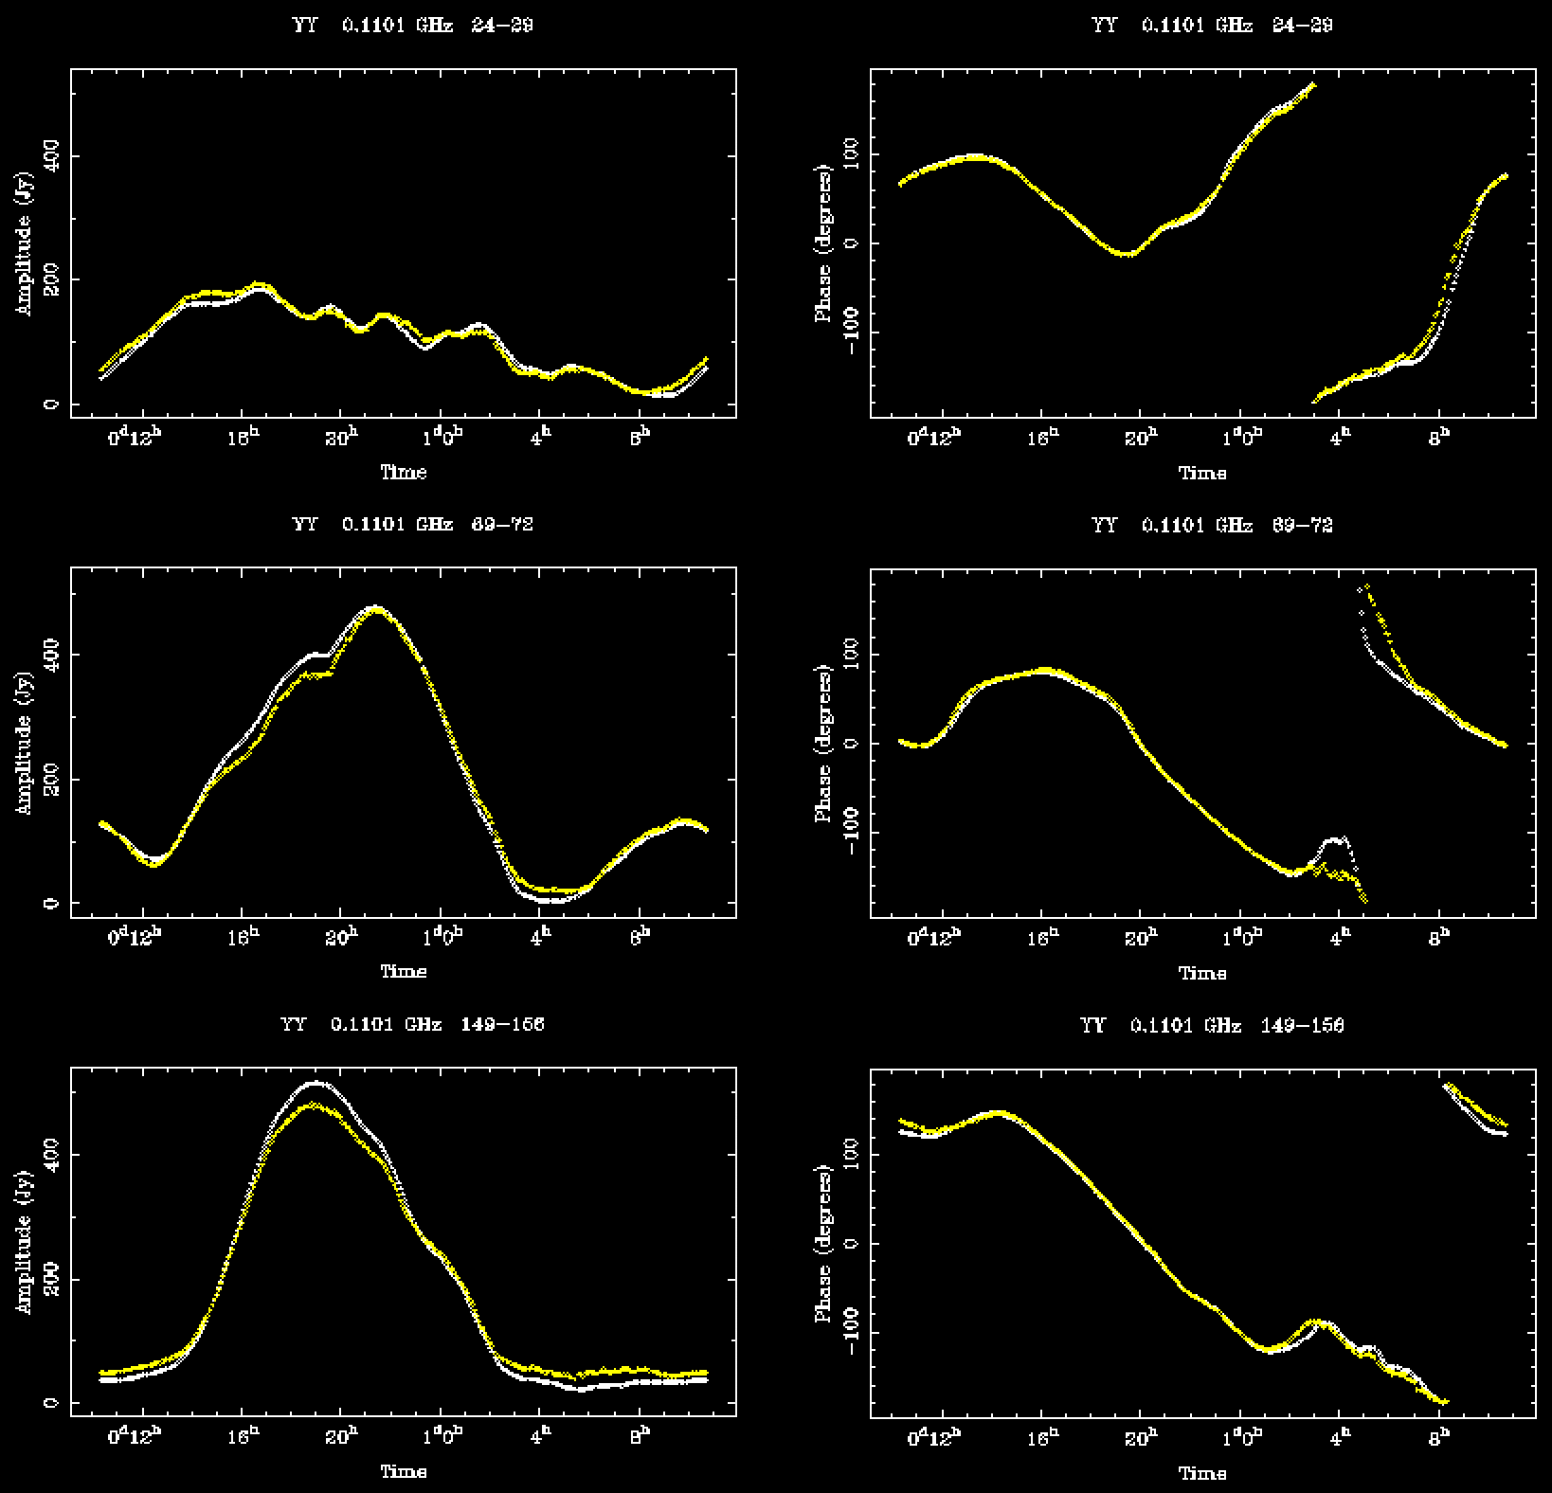
Comparison of calibrated data & model visibility versus UT on shortest baselines 0.5-0.7 wavelengths 1.4-1.9 metres

Slide 18
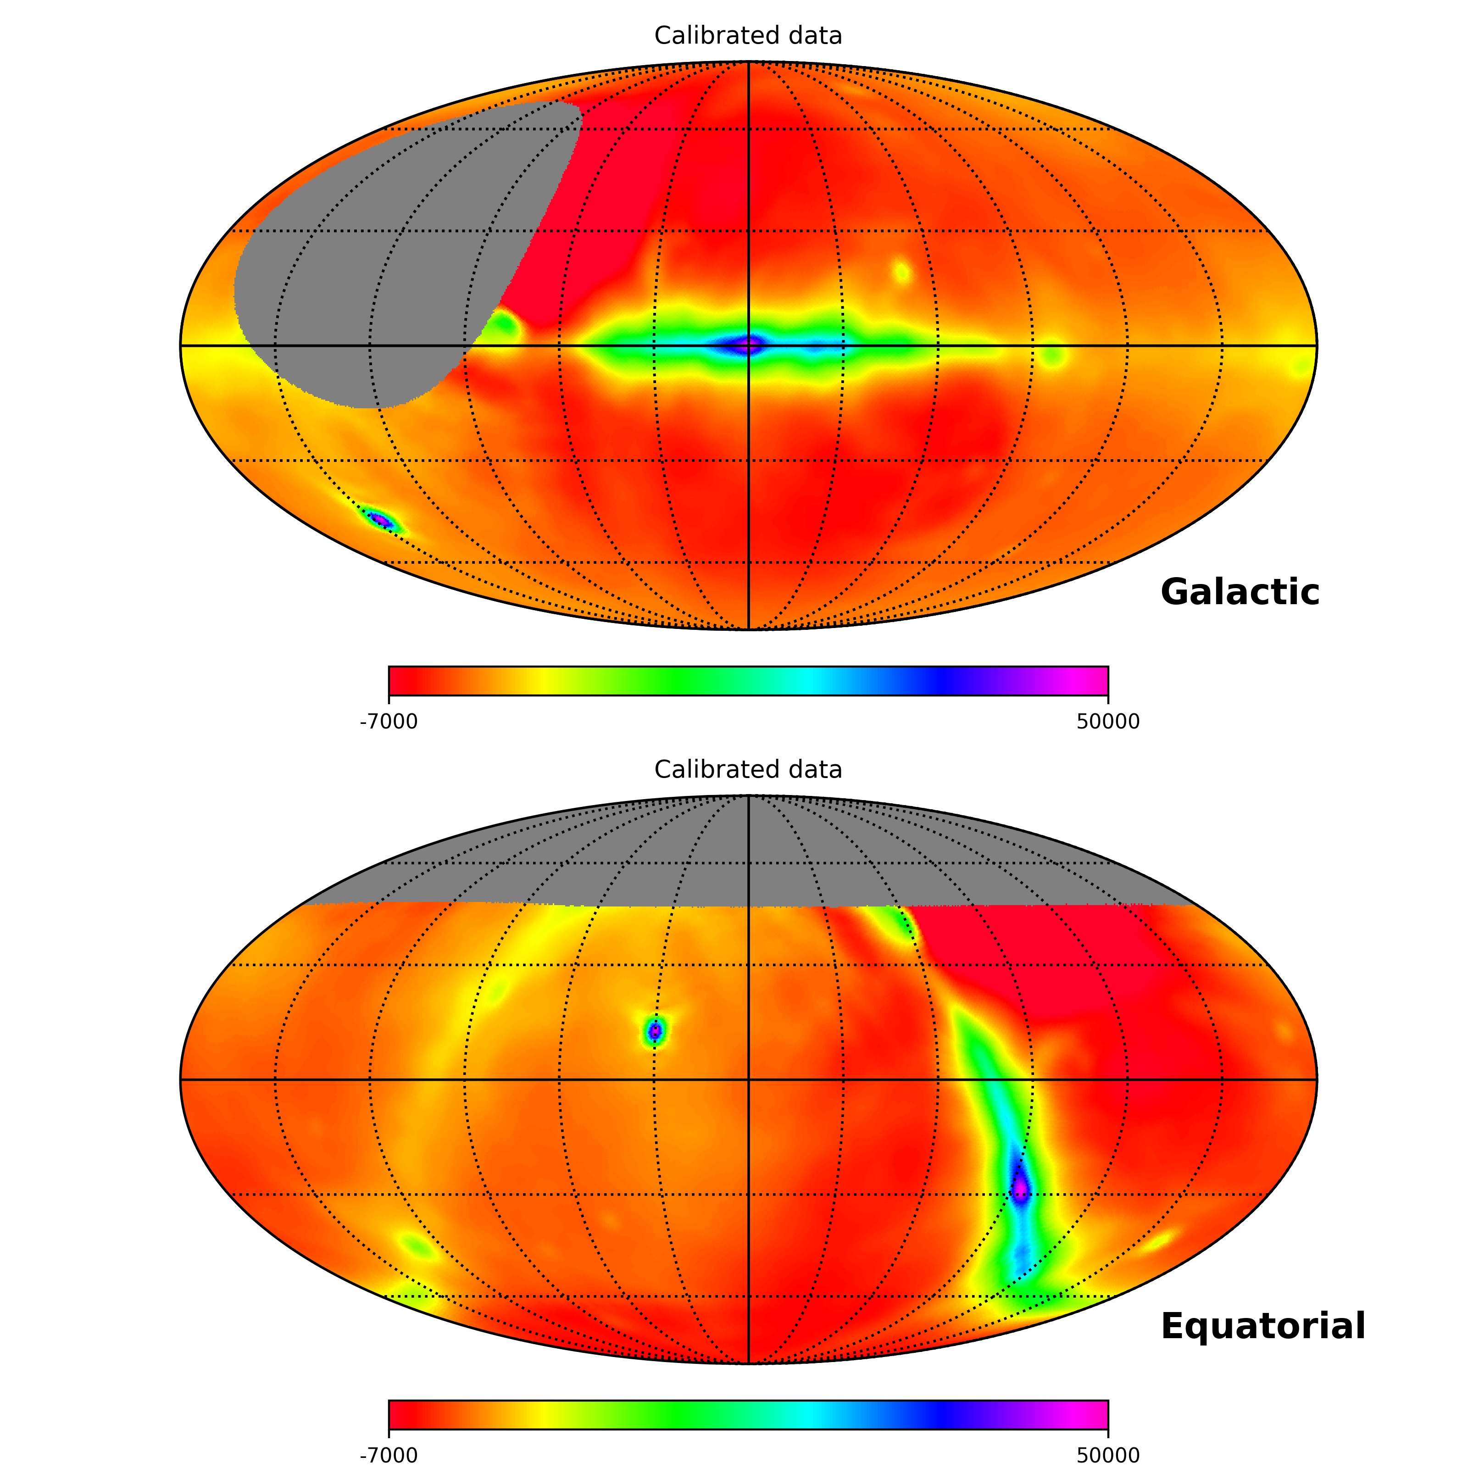
All-sky image in Stokes I: Made as 3D transform from u,v,w at all times to a common drifting healpix sky Using the EEPs to compute the direction-dependent complex gains for each baseline

Slide 19
Summary:
Antenna amplitude calibration to within 3% RMS accuracy is possible using predictions from GSM + Sun + EEPs.
Intra-station complex gains are stable over the day/night to within 6%, 6 deg std.
Complex gain solutions are possible in snapshot data at all LSTs – to within this accuracy – using GSM + Sun + EEPs. Quantifying the accuracy of calibration is work in progress.

