Slide 1
SKA LOW 2022 meeting
Software
Marco Bartolini, Alan Bridger, Peter Lewis, Juande Santander-Vela, Sonja Vrcic, Mark Waterson, Peter Wortmann
7 Feb 2022

Slide 2
Guidelines
Overview of the system is presented in advance
The presentation will be around 10 minutes and in all cases there will be plenty of time for questions from the audience
Keep it high level (birds-eye view) and avoid in-depth technical details
It is strongly advised to make document(s)/papers available supporting your talk that can be read in advance. These will be linked to your agenda slot.

Slide 3
Index
Software development organisation
Software development Roadmap
Overview of the overall software architecture
Overall architecture at AA0.5
MCCS development roadmap
MCCS architecture

Slide 4
SKA Software Development
Software Organisation and Roadmap
Juande Santander-Vela
Head of Software Product Management

Slide 5
SKAO Software Development
During Pre-Construction/Consortia time, we pivoted from document-oriented/DRD-driven CDRs to SEI-based Architecture Tradeoff Analysis Method (ATAM) reviews and Architecture Documentation.
Software Architecture Documents based on Views and Beyond.
We also pivoted from traditional software development lead by different, disparate groups, into an integrated, agile development at scale.
Selected well-recognised, world-wide available framework: Scaled Agile Framework (SAFe®)
Auditioned for consultants to help us through: selected Ian Spence from Ivar Jacobson International.

Slide 6
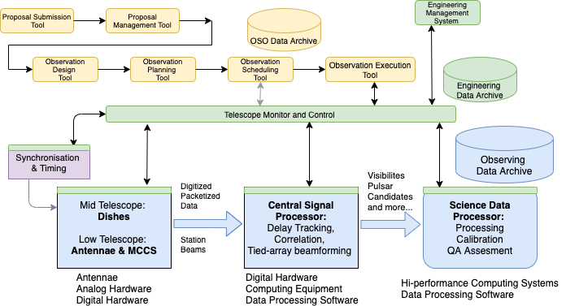
SKA Software - Key components
Courtesy Marco Bartolini

Slide 7
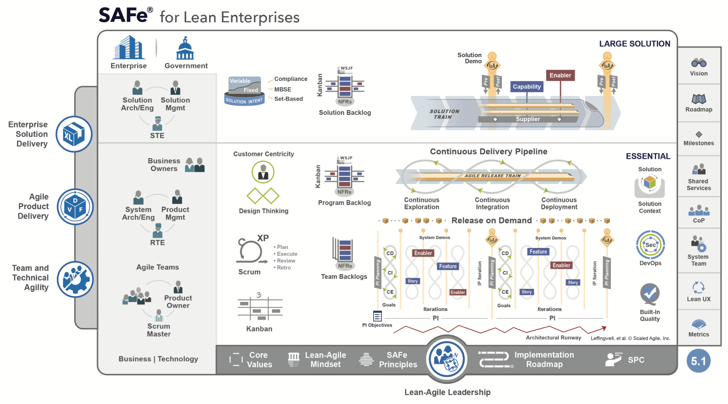
SAFe: The Big Picture

Slide 8
Why Agile?
SKA Software is challenging, and to resolve the challenges it poses the Agile Manifesto values can really help:
Individuals and interactions over processes and tools
Working software over comprehensive documentation
Customer collaboration over contract negotiation
Responding to change over following a plan
Plan-Do-Check-Adapt allows for reaction in shorter timescales → delivering the software that is actually needed
Need for high Autonomy and Alignment
Well-known Cadence:
PI Planning every 3 months → updates on Alignment, keeping Autonomy
Delivery of value at least every two weeks

Slide 9
SAFe: The Big Picture

Slide 10
SAFe: The Big Picture

Slide 11
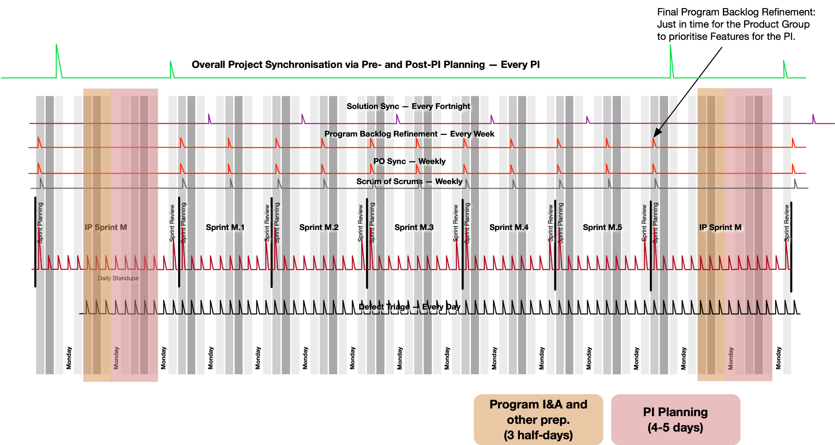
The SKAO Agile Heartbeat (the Cadence)

Slide 12
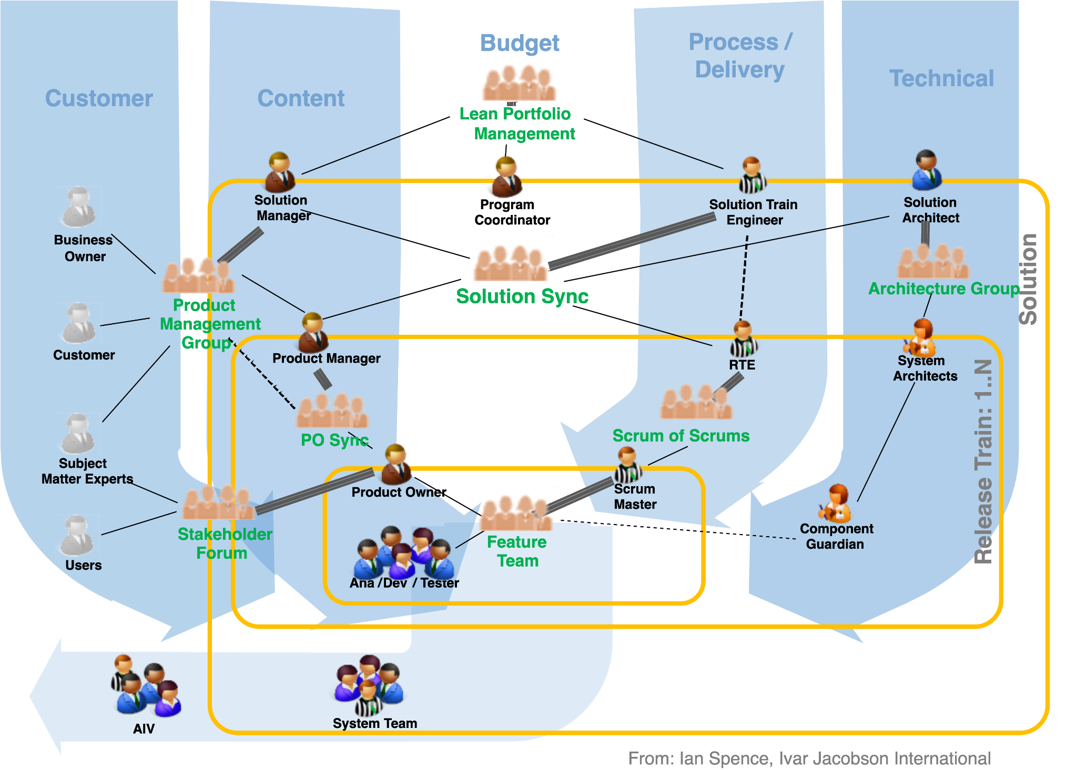
Communication Flows

Slide 13
SAFe: The Big Picture

Slide 14
Vision and Roadmap
Where do we want to go?
How do we get there?
Tailored at each level of autonomy

Slide 15
High-Level Vision for the Software Groups
We are a global collaboration committed to building and delivering a world-class software and computing ecosystem, enabling the SKAO community to achieve transformational science.
Our culture of innovation, shared governance, and respect for diversity drives mutual value for all.
Statement comes from a shared understanding from the Getting to We workshops

Slide 16
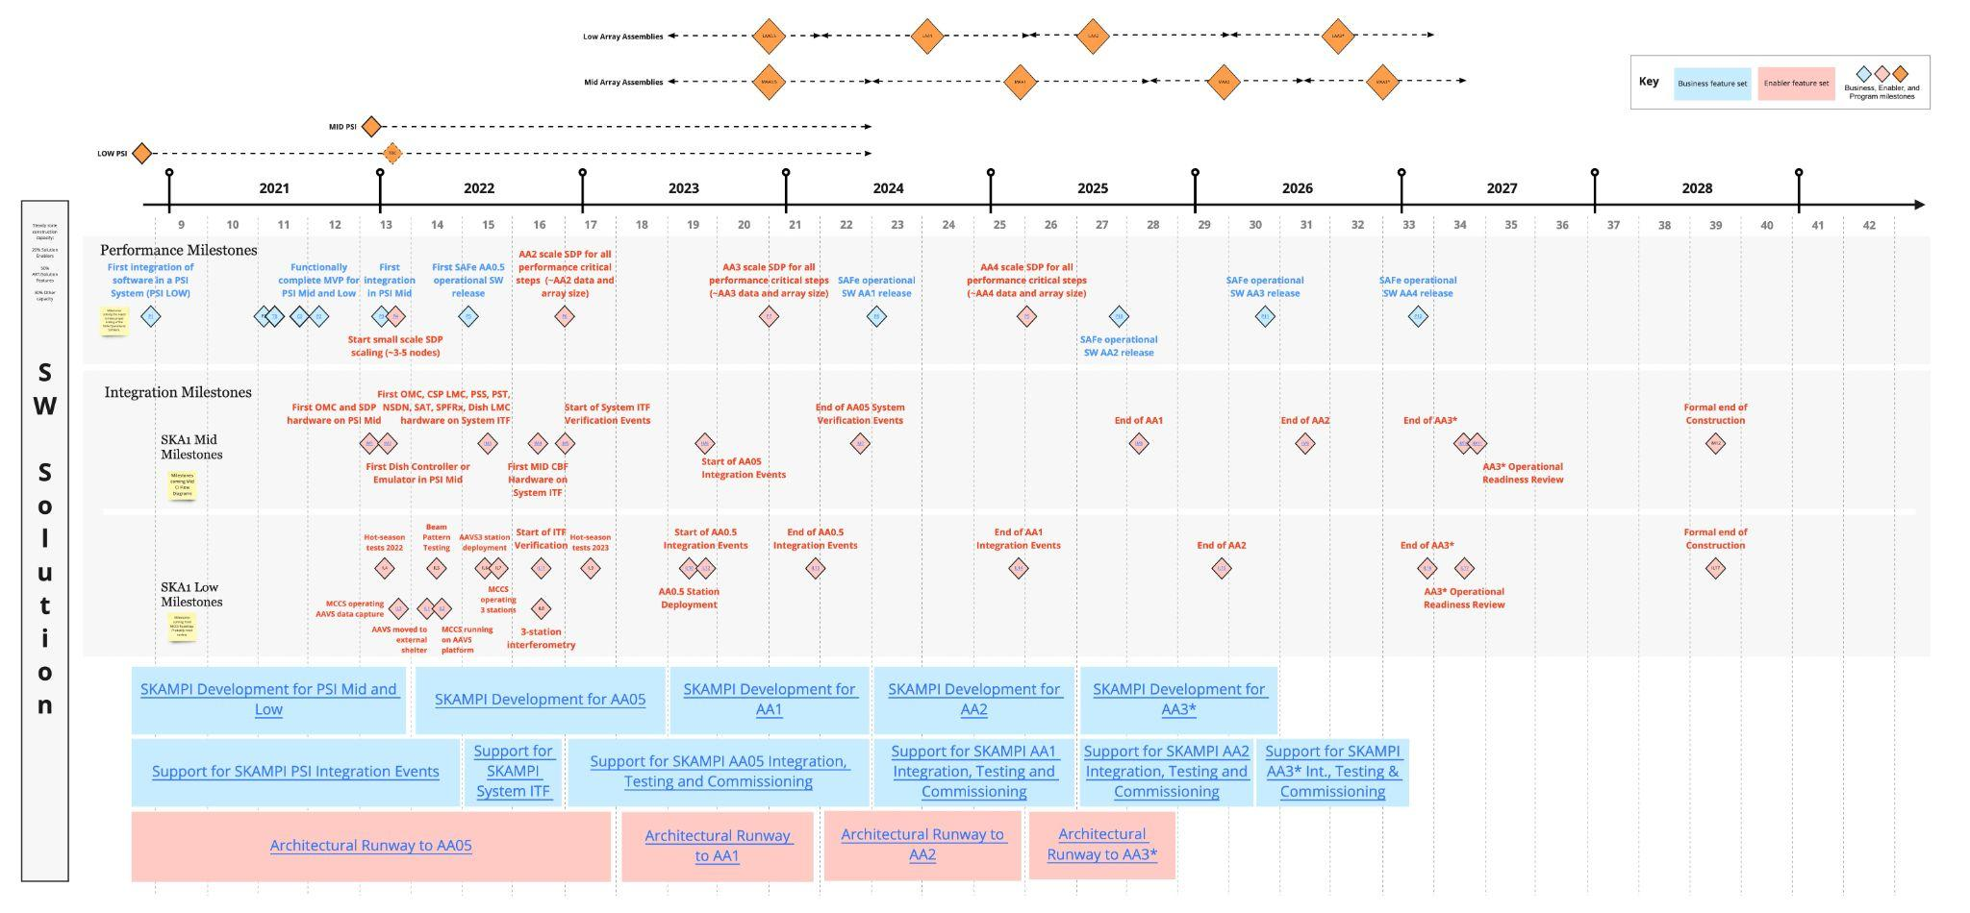
When do we need to do things? Solution Roadmap
The definition of what is expected on these stages comes from the Roll-Out Plans, and the Verification Plans
PSI Low
Low
AA3*
Low
AA1
Low
AA2
AAVS2.5/3
Low
AA0.5
Low
ITF
Mid ITF
Mid
AA0.5
Mid
AA1
Mid
AA2
PSI Mid
Mid
AA3*
We will be providing further definition as we get near the milestones…
And sometimes we will be asking teams for help on the solutions!

Slide 17
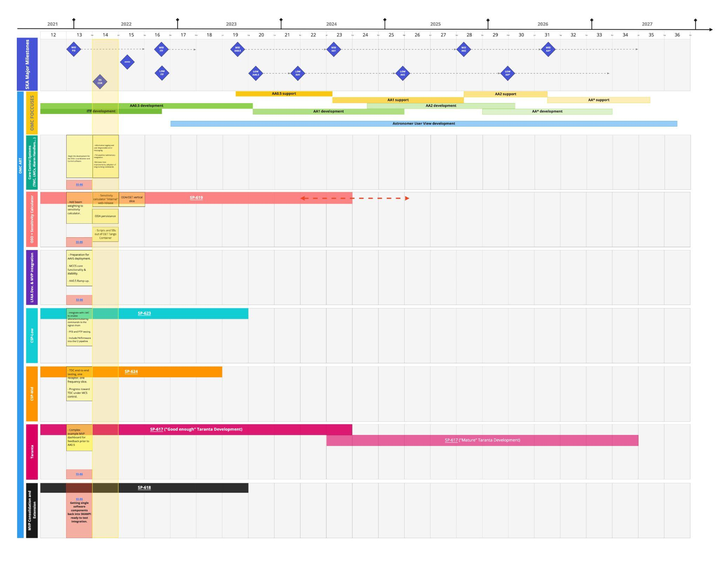
OMC
OMC Roadmap updated in a more goal- oriented way

Slide 20
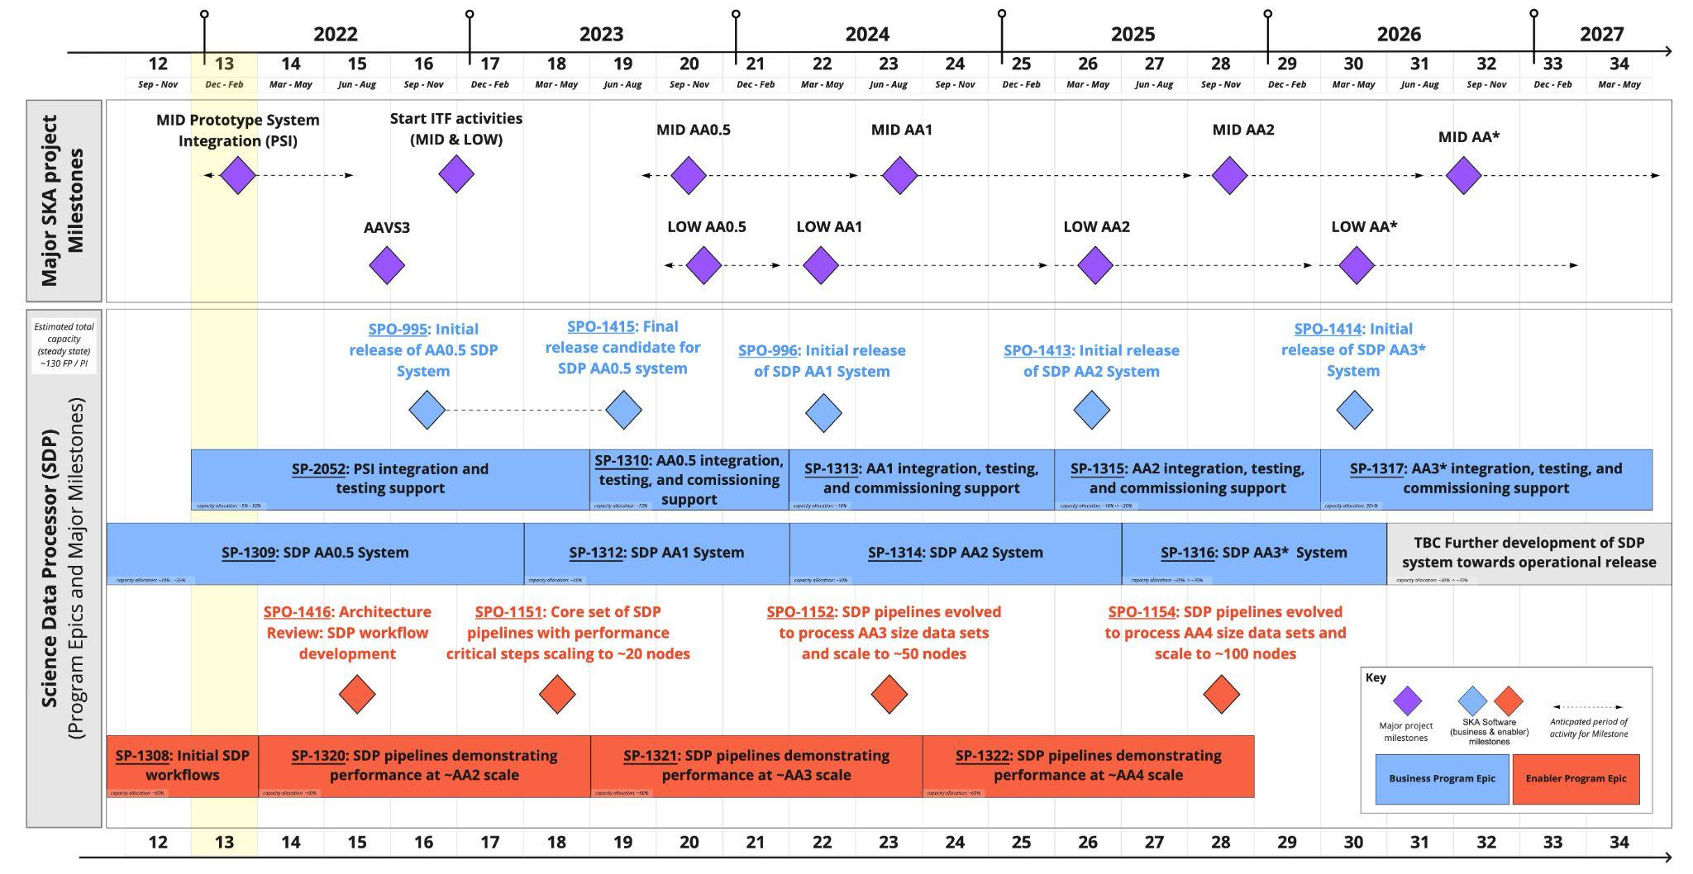
SDH&P Roadmap

Slide 21
Apart from the milestones, we need to define what is AA0.5
As presented in Robert’s slides of the Business Context

Slide 22
Aligning with the Telescope Delivery Teams
Content and Architecture Leads are core members of the Telescope Delivery Teams for both TDT-Mid and TDT-Low.
PI Planning also for TDTs!
Backlog alignment meetings every PI (next one, February 10th)
Dependencies across TDTs and software teams, IPS milestones, etc. shown on the SKAO Program Board.

Slide 23
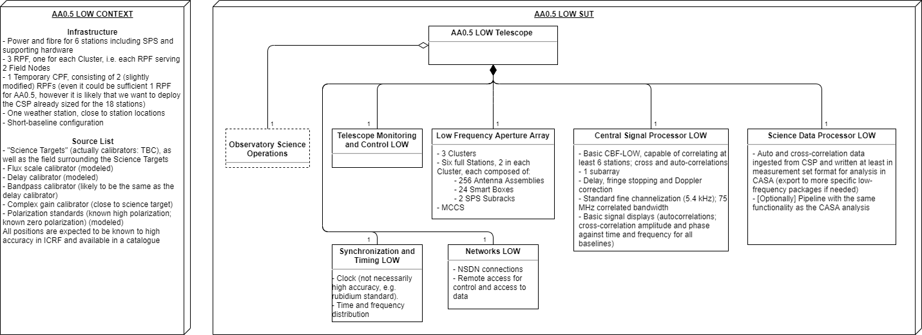
SKA1_Low AA0.5 System

Slide 24
The Roadmap(s) and the Integrated Product Schedule
Assessment of progress in software development currently only understood from PI to PI; EVN progress based on expert advice.
Working with Project Controls to have more significant software milestones in the IPS
Also working to better define progress and testing for AA0.5 through Use Cases, and linkage to testing in the Use Case Jira Project.

Slide 25
SKA LOW AA0.5
SKA-TEL-AIV-4410001 Roll-out plan for SKA1_LOW
System Science - AA0.5 Scenarios
AA0.5 Use Cases

Slide 26
SKA LOW Software - AA0.5

Slide 27
SKA Software - Key components

Slide 28
Observation Monitoring and Control
OSO - Observatory Science Operations
TMC - Telescope Monitoring and Control
What is the purpose of the OSO and TMC?
Manage the design, scheduling and execution of all observing on both telescopes.
Correctly operate and monitor the observatory and telescopes.
Why are they important for the telescope to function correctly?
Key interface between the science community users and the observatory.
Ensure efficient, complete and reliable data and meta-data collection.

Slide 29
Proposal Observation Flow
OSO is the suite of software tools that support the entire science process from proposal submission to data-product delivery.

Slide 30
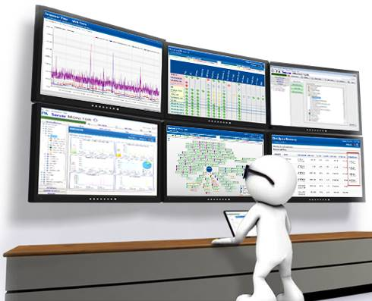
Telescope Control System
The role of the Telescope Control System may be classified in the three key areas:
Instrumental monitor and control
Observation configuration, execution and monitoring
Support for sub-arraying
Implementation is based on the
TANGO controls framework

Slide 31
Science Data Processor
SDP performs “main” data reduction (~factor 40) - challenges:
Performance & Scalability
Compute, I/O & Storage
>10 Pflop/s effective
~0.77 TB/s ingest rate
~4 TB/s into processing
>40 PB tiered buffer
Need to scale
Trivial (e.g. Ingest) and expensive (e.g. ICAL) workflows co-exist
SKA “>1” will be even harder on SDP
Modifiability & Maintainability
Long lifespan (>50 yrs)
Software changes
Execution Engines
Science Workflows
Processing Components
Data Models
Hardware changes
Processing
Storage
Network
Buildability,
Affordability
COTS components
Get going quickly
Externalise/share maintenance
Support agile development
Small functional increments
Parallel work of different teams
Testability
Continuous Integration
Test outside SDP
Support different development speeds
Ensure scientific validity
Must trust pipelines with autonomous analysis
Portability
SKA Low, SKA Mid, SRCs

Slide 32
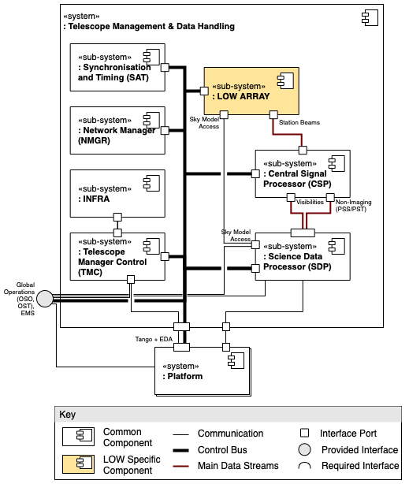
SKA LOW Software in AA0.5
TMC needs to be reliable and enable operations and monitoring
OSO needs to provide enough functionalities to enable commissioning activity
SDP is needed to enable calibration, quality monitoring and data ingest and storage
SKA Software Architecture AA0.5 - Telescope Management and Data Handling

Slide 33
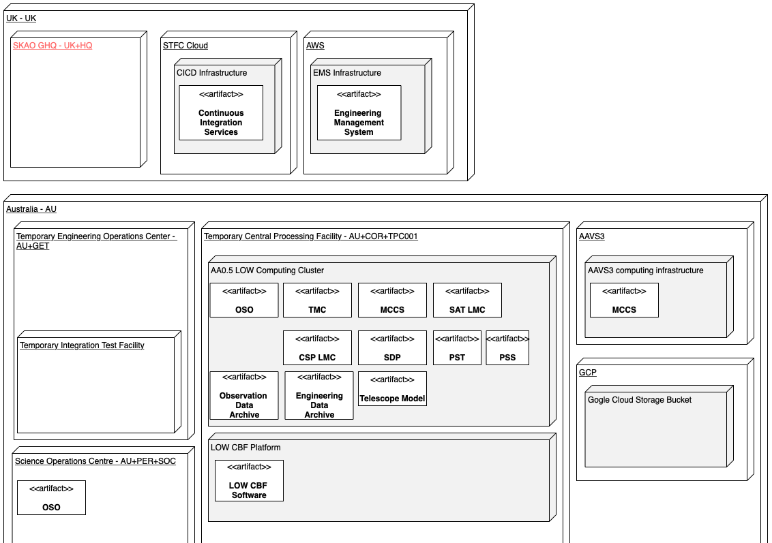
Deployment
Current baseline
Showing also some essential external components
SKA Software Architecture AA0.5 - Deployment View

Slide 34
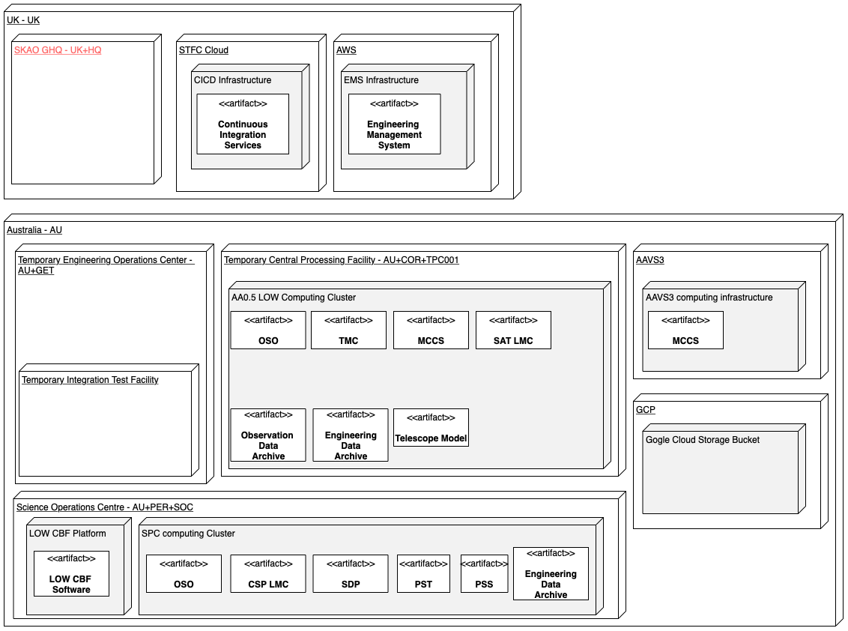
What if ?
Supporting deployment at SOC in AA0.5
Better alignment to the final design
More initial complexity
SKA Software Architecture AA0.5 - Deployment View

Slide 35
OSO capabilities at AA0.5
Observation Design Tool (ODT) ability to create/edit/store SB Definitions consistent with the AA0.5 system capabilities.
Expected to be first version editors (i.e. simple)
Ability to create/edit/store observing scripts
Observation Execution Tool (OET) ability to retrieve and execute SB Instances derived from these definition
OET ability to execute observing scripts outside SB context
Initial version of Shift Log Tool (SLT) available to log operator comments.

Slide 36
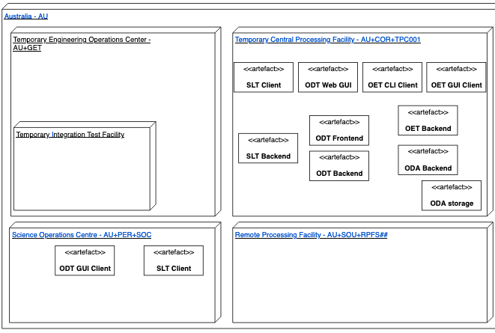
OSO Deployment
Assume Observation Data Archive (ODA) storage at temporary CPF, but could be cloud-based.
Assumed all UI clients (ODT, OET, SLT) available at temporary CPF. ODT and SLT clients additionally at SOC (and possibly SKAHQ?)
OSO Architecture AA0.5 Deployment View

Slide 37
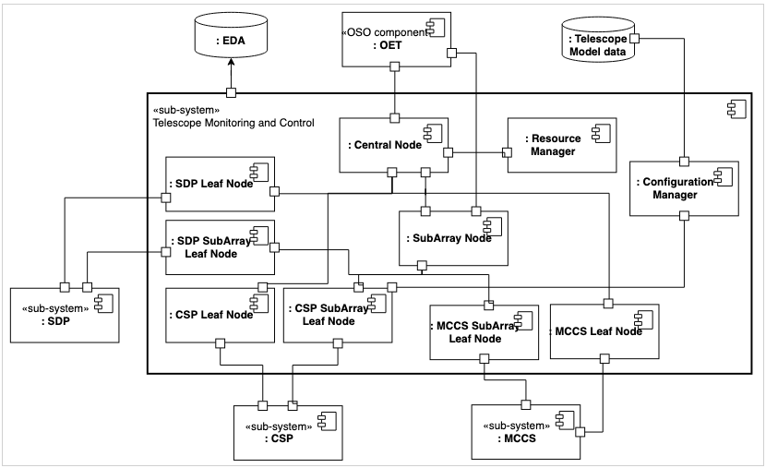
Overall TMC architecture AA0.5
TMC Architecture AA0.5 - C&C View

Slide 38
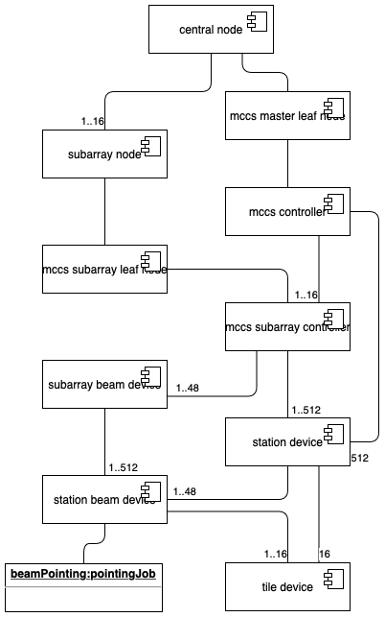
Developing the system
Addressing detailed design decisions and gaps in the design of the software system
Evolving our understanding of the system in successive iterations
ADR-23 Decide the architecture of pointing control for LOW telescope
ADR-44 Engineering Subarray
DECIDED
IN PROGRESS
ADR-23 component view

Slide 39
Control System Dashboards
Web based
Integrated on the TANGO system

Slide 40
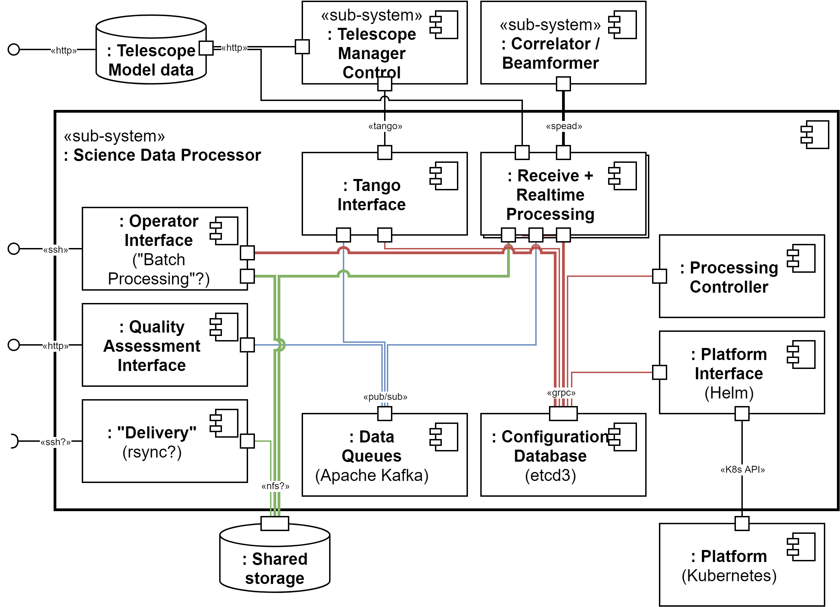
Overall SDP Architecture AA0.5
Notable features
Batch processing Simple CLI
Storage Shared storage
Delivery Synchronise with external location(s)?
Quality information displays
Robust fallbacks (e.g. control via CLI)
SDP Architecture AA0.5 C&C View

Slide 41
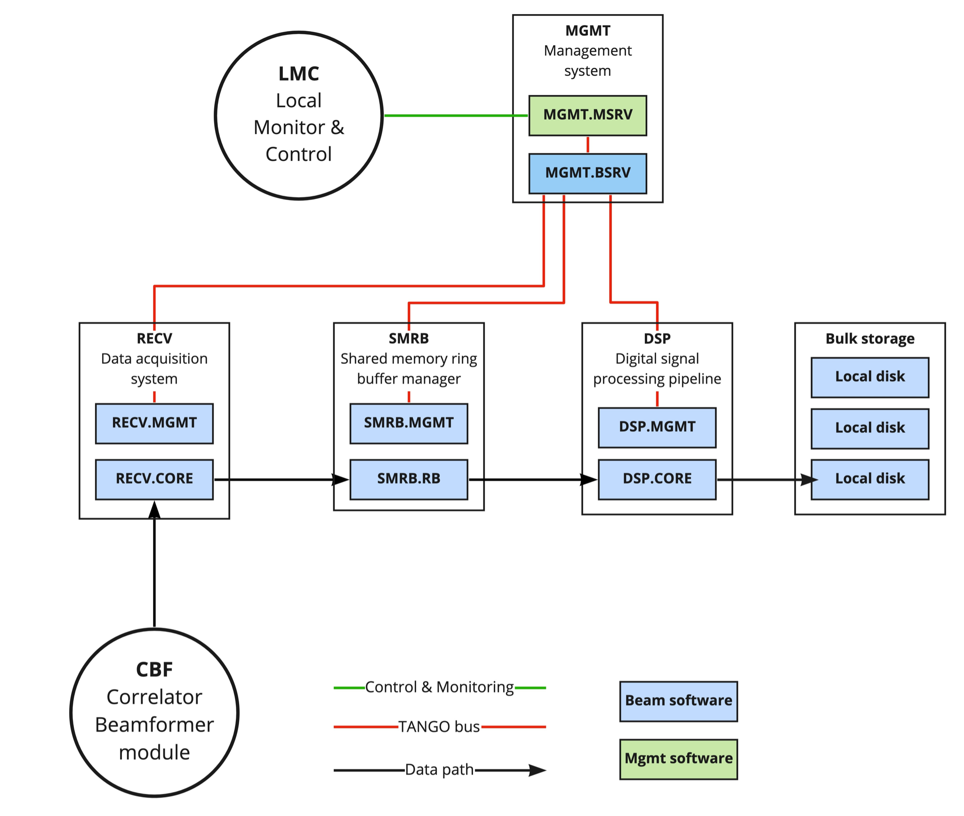
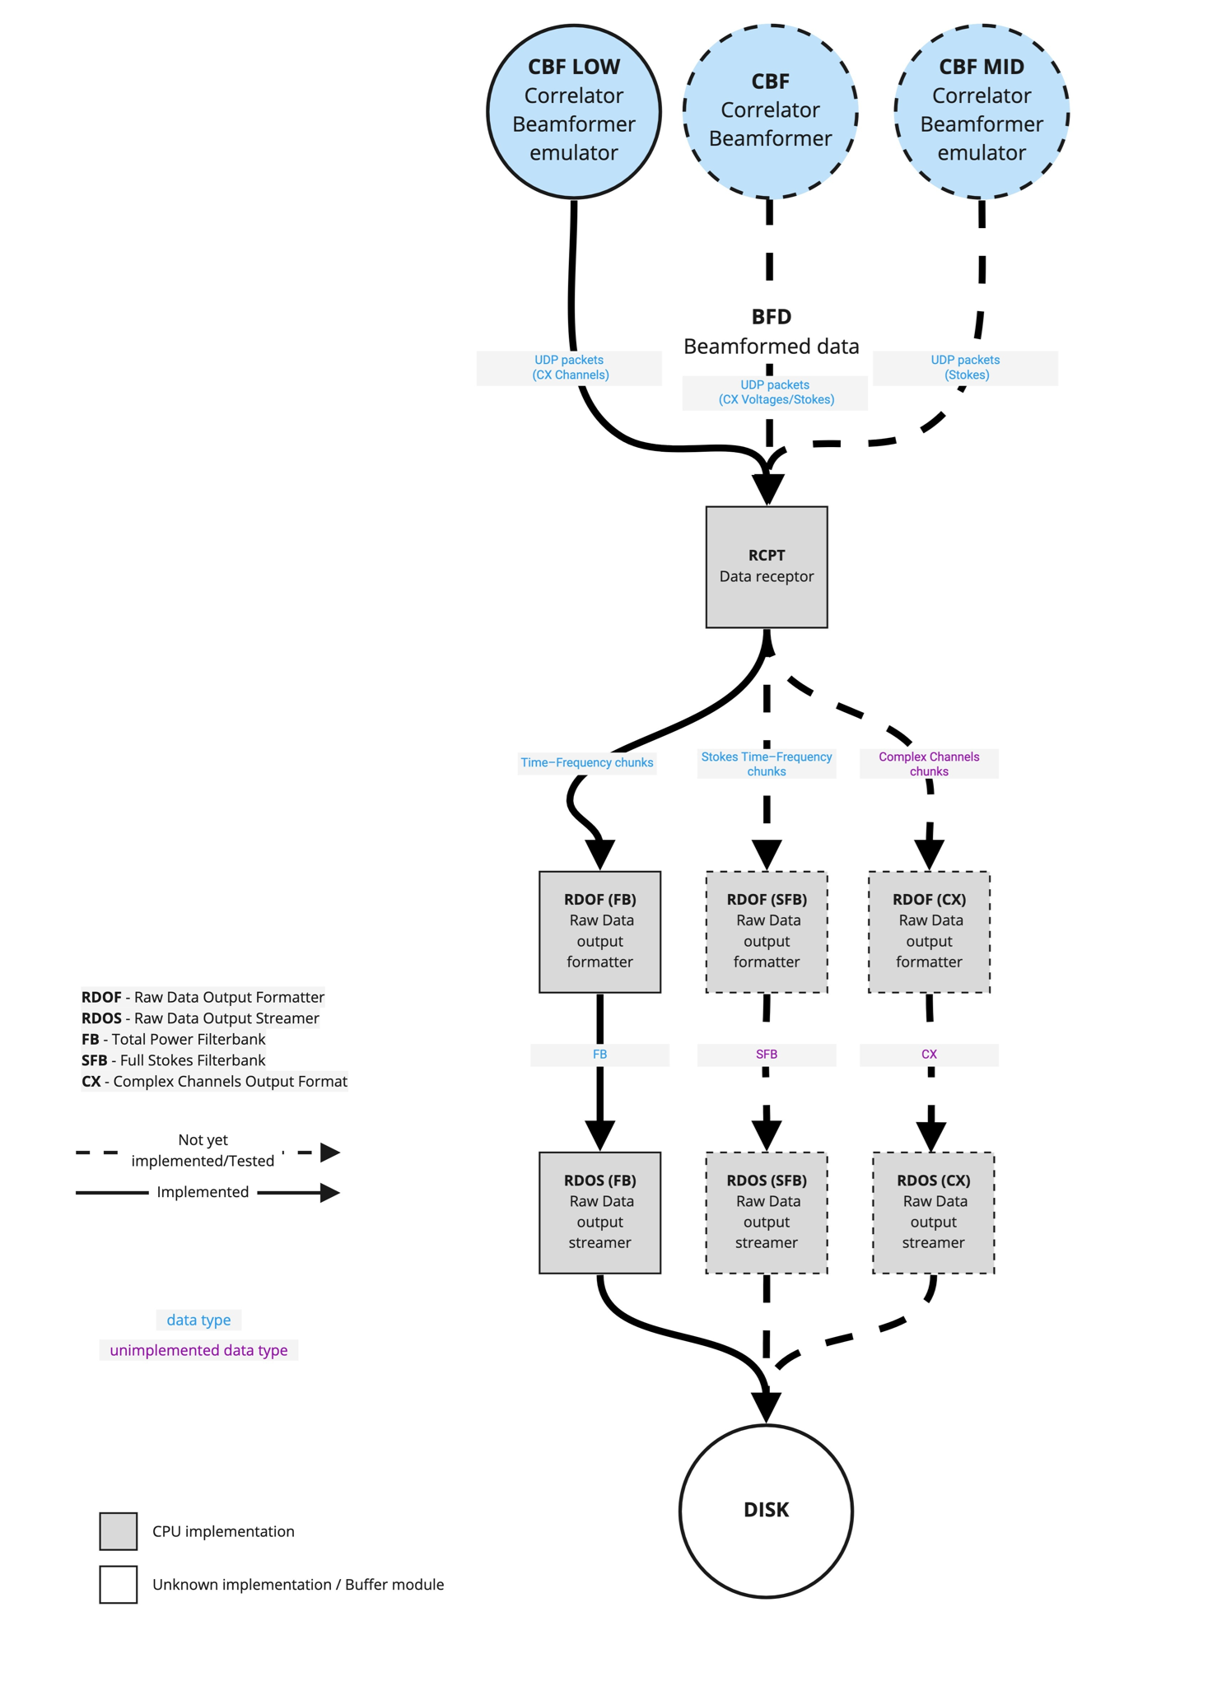
Pulsar Processing
Main driver at AA0.5 is to verify beamforming functionalities
Missing link to SDP
Processing can happen offline
Integration with LOW CBF is more mature for PST
PST Architecture at AA0.5
PSS Architecture at AA0.5

Slide 42
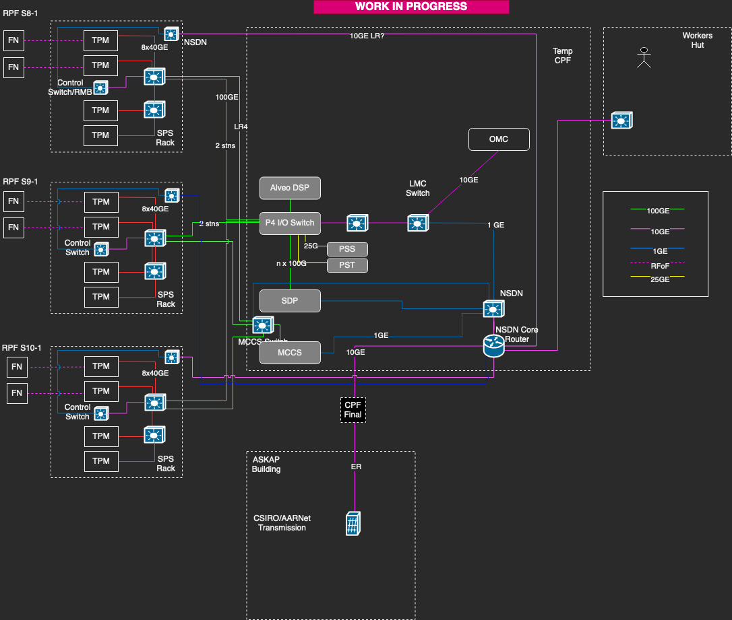
SKA LOW AA0.5 Network
AA0.5 Network is very much ‘Work in Progress’ pending the CBF location.
Network transports 6 stns from 3 RPFs (2 per 100GE) back to the P4 I/O switches of the CBF
Also Monitor and Calibration data to and from the MCCS cluster
NSDN carries LMC data back to TMC
Should the CBF move we will need to backhaul all the station data to Perth

Slide 43
Data Management
Consolidating the picture in view of AA0.5 - data management for early array releases
Want to build on the experience with AAVS
It would be good to have some feedback about:
Access patterns to data. Who's really accessing and using AAVS data? Can we have some numbers and stats?
Feedback from using GCP as a data storage backend
Do we need more meta-data or is the existing structure good enough to enable browsing and finding data sets?
Access control and availability of data to users

Slide 44
MCCS

