Slide 1
SKA LOW 2022 Meeting
The Real Stuff AAVS->AA0.5 Architecture and Status
Mark Waterson
7 February 2022

Slide 2
AAVSx Design
Technology demonstrator from 2015+
Single station equivalent
Only front end (receiver) - all processing off-line
Includes representative components for all elements
Evolutionary
…v4.1 antenna
…v2 field control + signal transport (RFoF)
…v1.6 digitizer …

Slide 3
Status
Operational for ~2 years
TBs data collected
imaging, sensitivity, stability investigations linked with lab work support (Curtin, INAF)
parallel effort in EM simulation to advance beam understanding/model
Calibration methods evolving

Slide 4
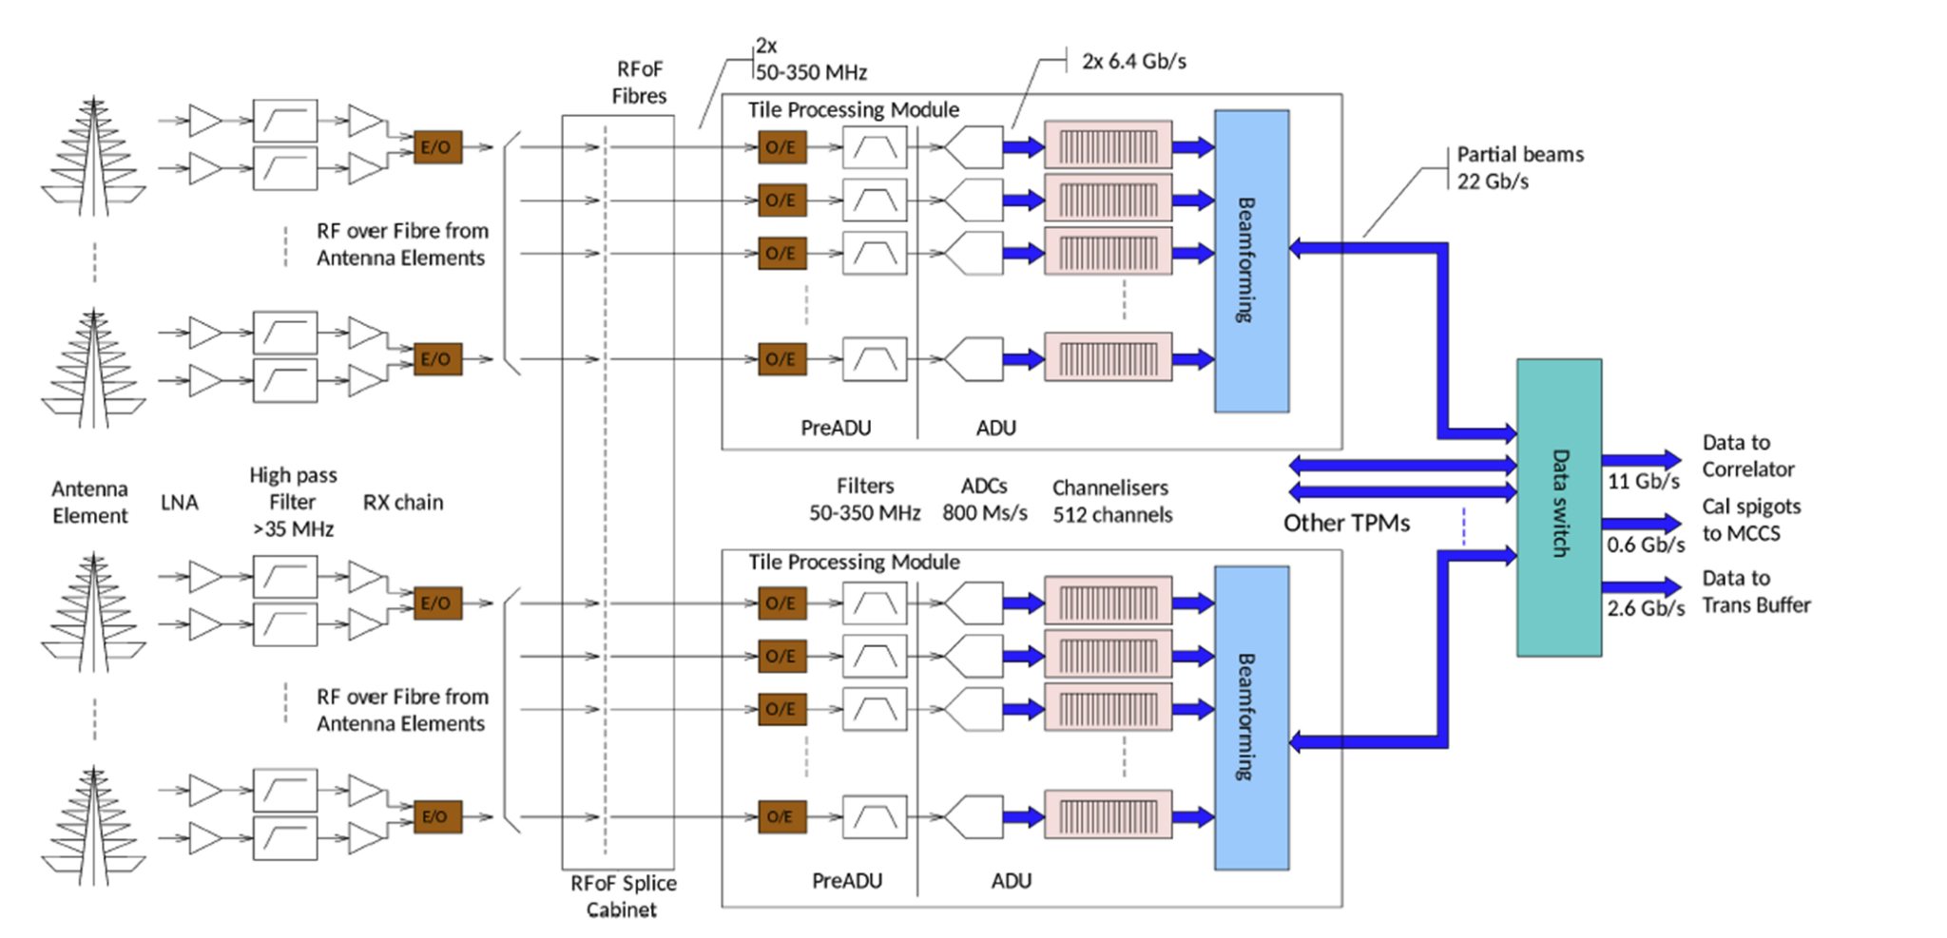
Block diagram

Slide 5
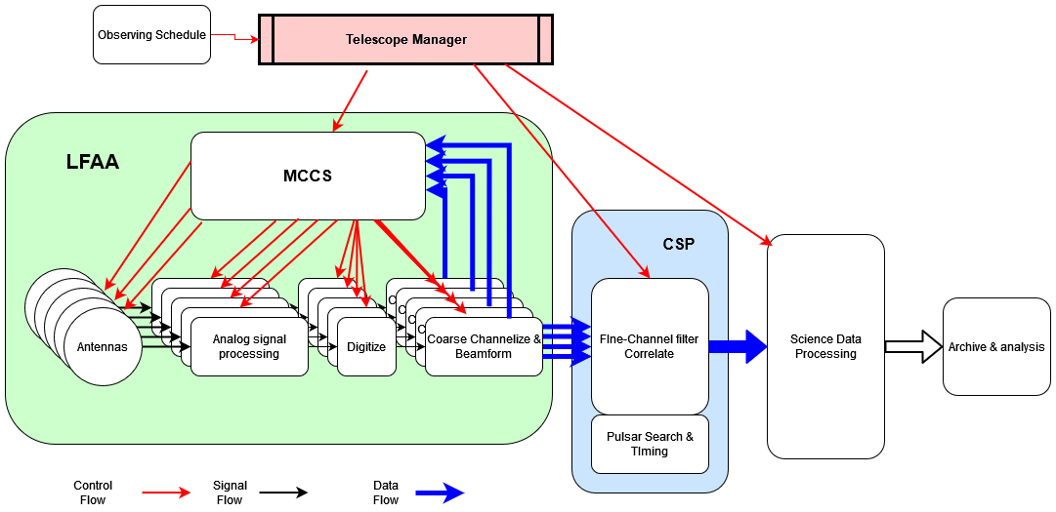

Slide 6
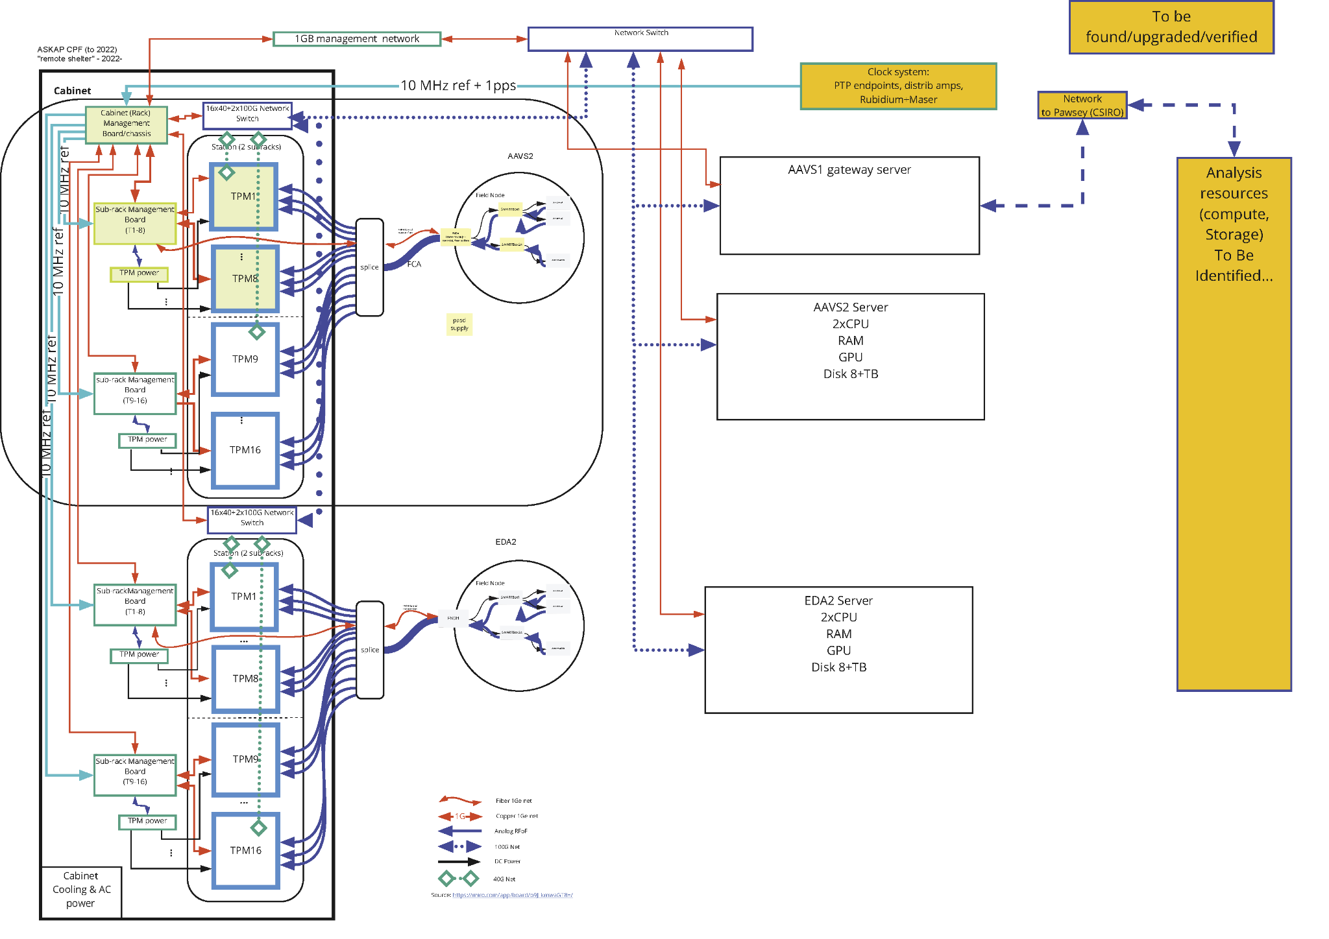
AAVS2 EDA2

Slide 7
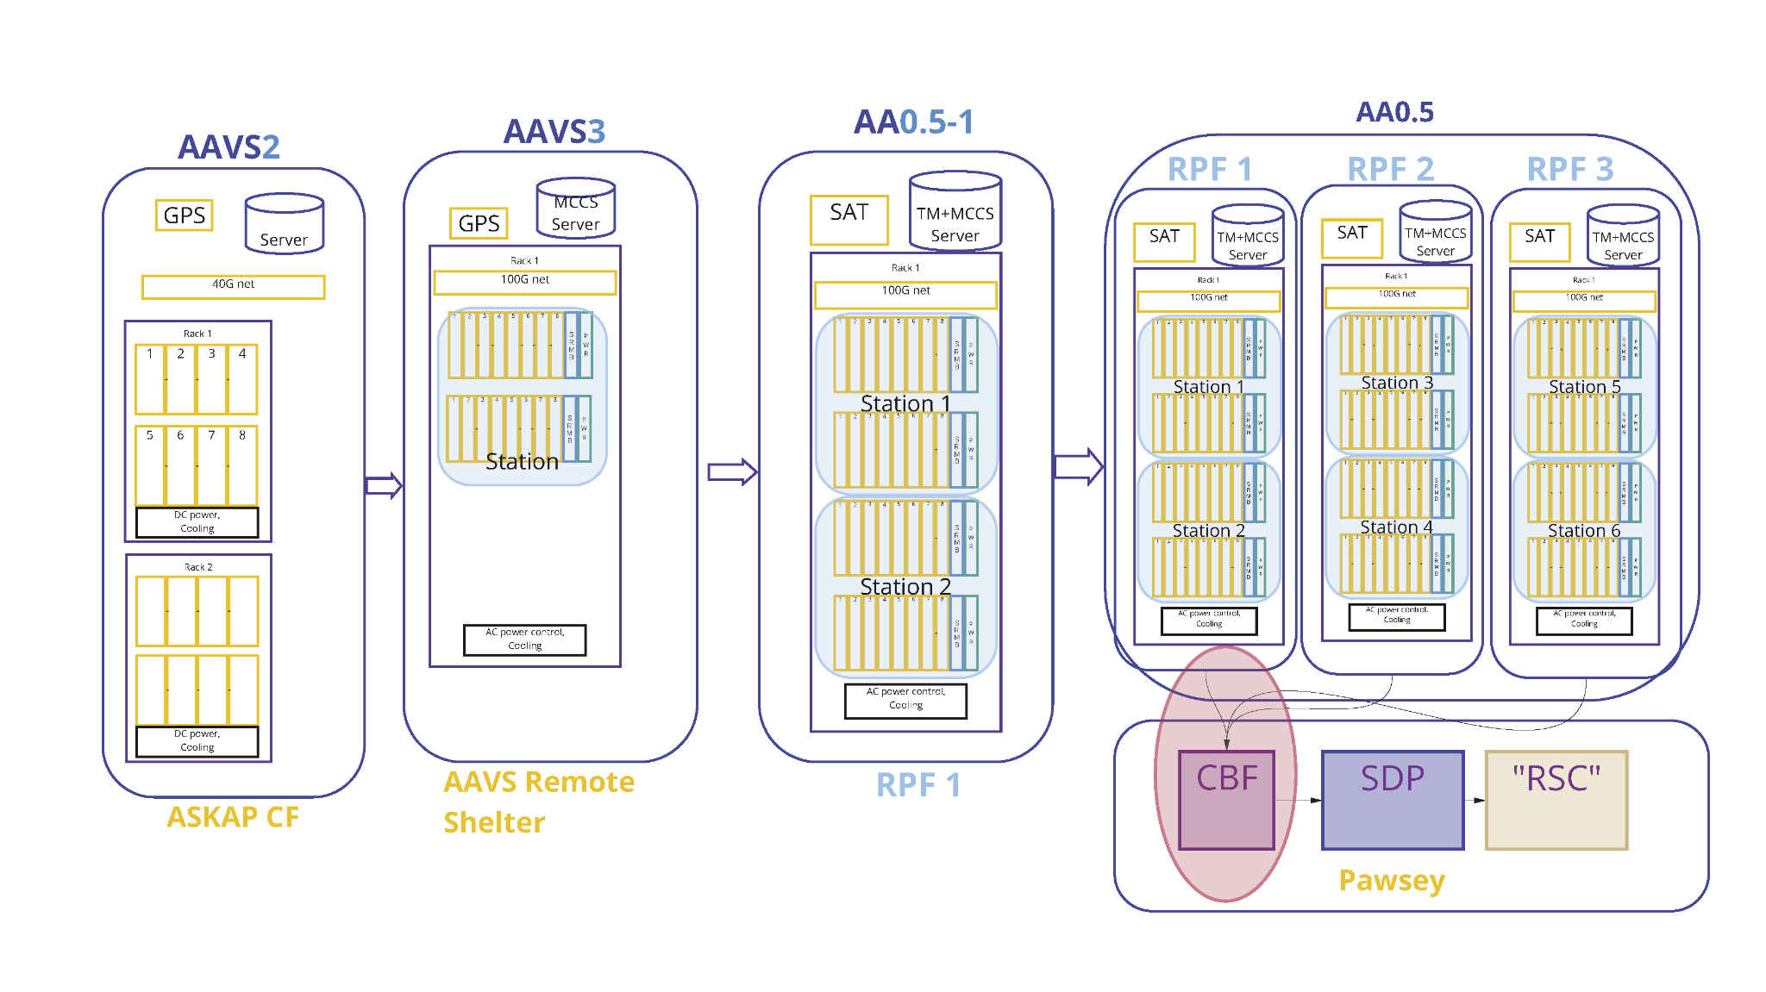

Slide 8
Aerial shot looking to the west, over the Donga towards The Breakaway, with ASKAP in the distance.
ASKAP (white dots in the distance are dishes)
“The Breakaway” The previous photo was taken from on top of this land formation which can be better seen in the next slide
The Dome and the Donga (2 small white structures)
AAVS2
EDA2
AAVS1 (obsolete)
EDA1 (obsolete)

Slide 9
Another view to the west, looking over EDA2 towards The Breakaway.
The Breakaway
AAVS2
AAVS1 (obsolete)
The Dome
EDA2

Slide 10
Some INAF guys heading south from the donga, walking towards the AAVS2 field node.
The FNDH is the white box that can be seen here.
The donga is behind the camera.
The dome is about 200 m off to the right and, about 1000m beyond that is “The Breakaway”
EDA2 is about 200m off to the left.

Slide 11
Jader, on the mesh, working on a SMART Box in the AAVS2 field node, surrounded by SKALA4.1 antennas.

Slide 12
