Slide 1
SKA LOW 2022 Meeting
MCCS Architecture and Status
Mark Waterson
7 February 2022

Slide 2
Monitor, Control & Calibration System
LMC control system for the LFAA front end (receivers)
monitor and derive Health for components, both physical (power supply, digitizer) and virtual (Station, Beam)
configure and trigger data collection & beamforming
control transmission of data to CBF or local files
capture data and run calibration algorithms
wash and dry dishes (and put them away, too)...

Slide 3
MCCS Abstraction

Slide 4
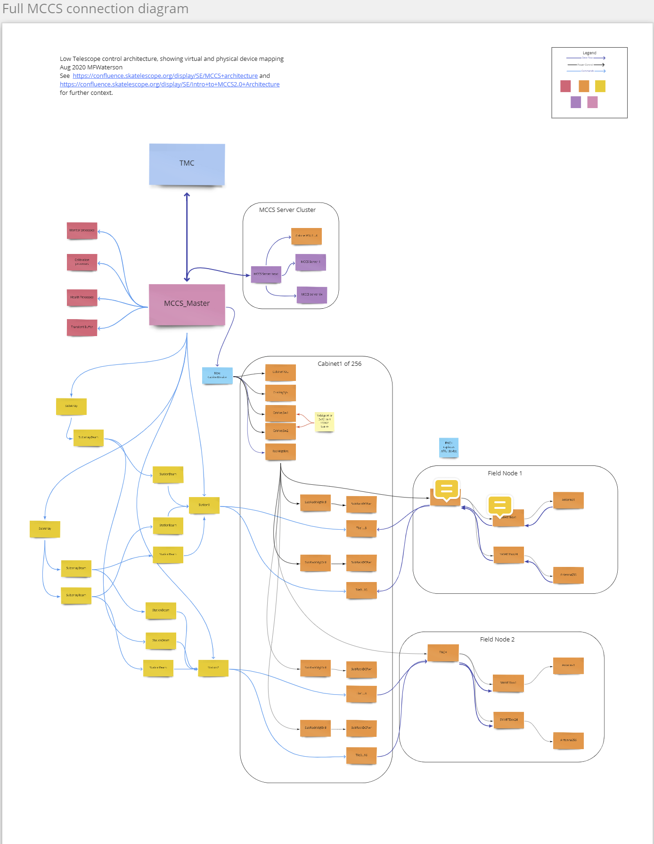
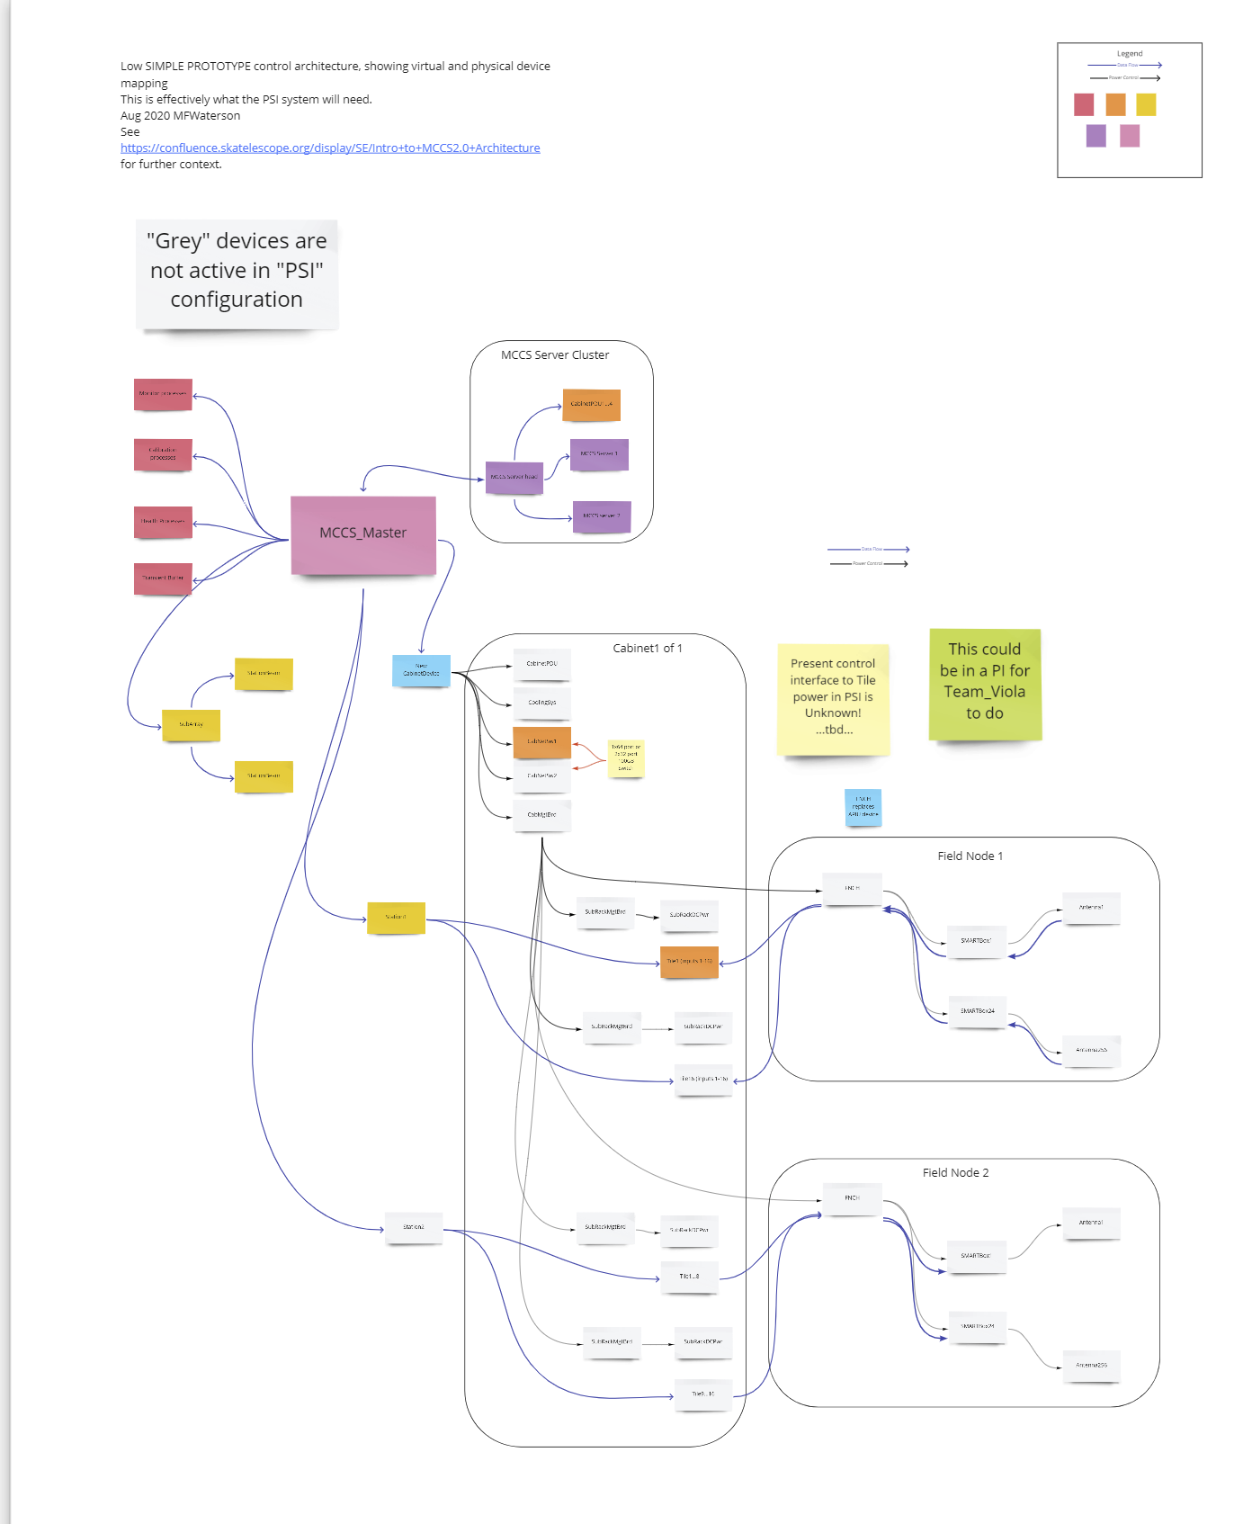
MCCS Architecture (abstract)
MCCS Architecture Diagrams

Slide 5
Status/Objectives
Roadmap planned through 2023
AAVS->minimum capability - set up a simple data-capture observation to disk, using a basic iTango/Taranta GUI
Evolve to AA0.5 through the continuous-integration model to release features as available
Make AAVS a key component of the test/release process

Slide 6
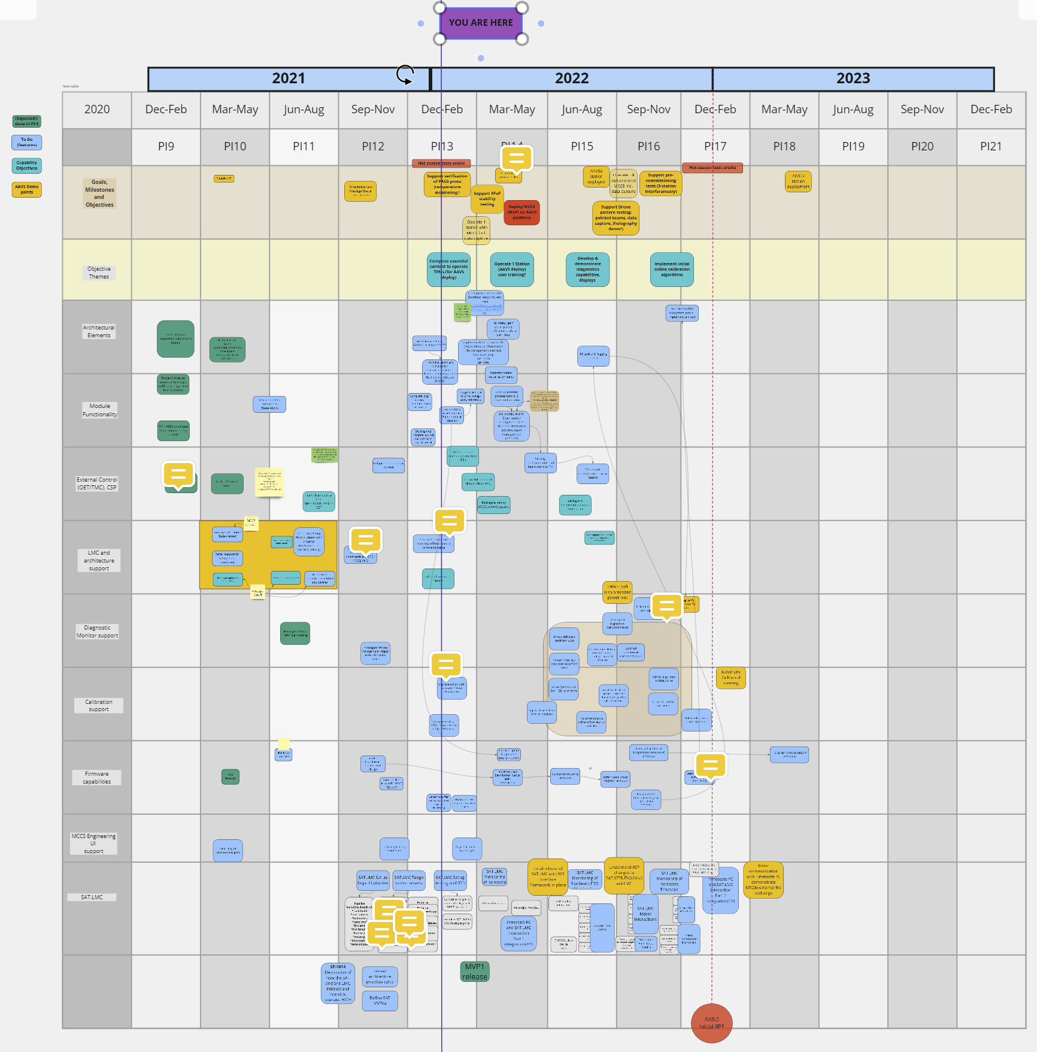
Status
MCCS Development Roadmap

