Slide 1
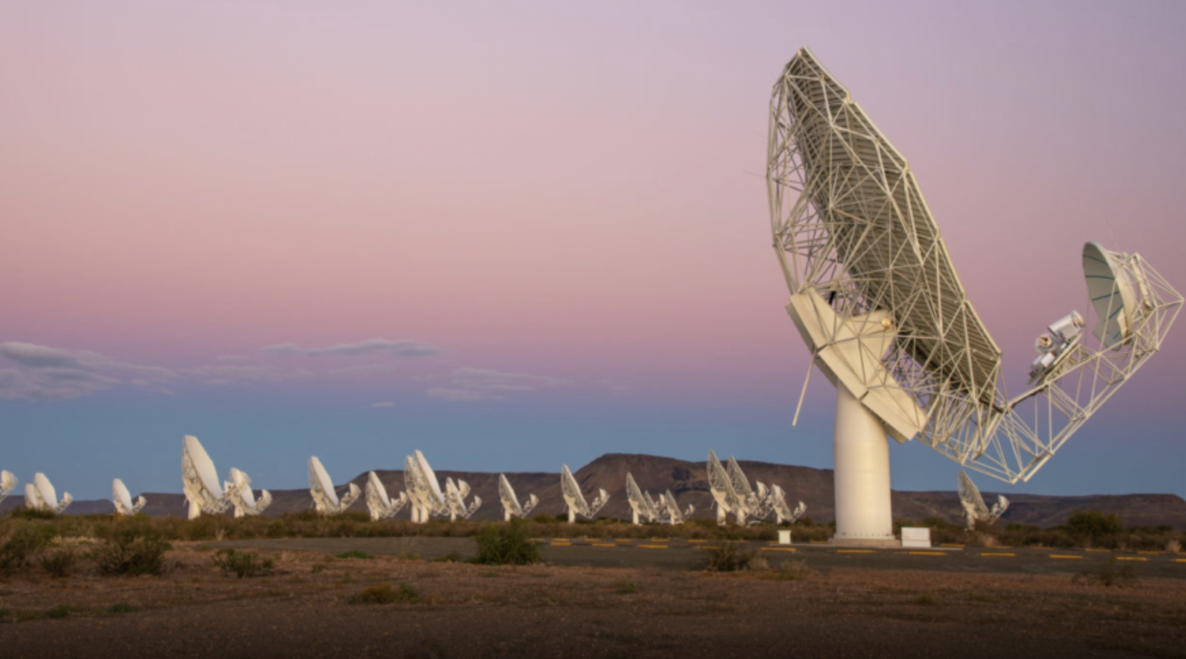
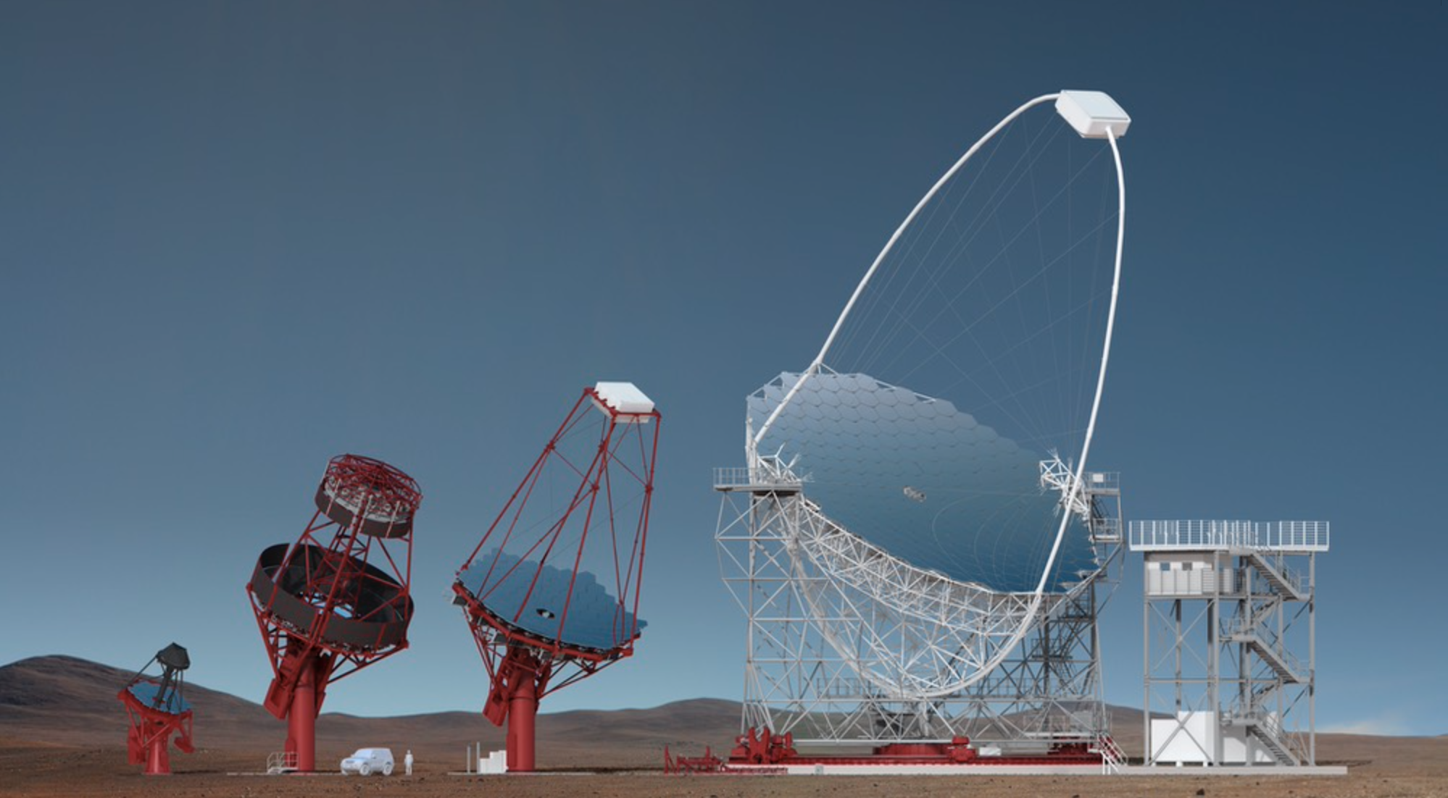



CTA-SKA connections
Andrii Neronov
EPFL & APC Paris
$$γ$$
SKA
CTA
$$e^{−}$$
$$e^{+}$$
radio
visible
gamma-ray
1 eV
1 keV
1 MeV
1 GeV
1 TeV
1 PeV
energy
frequency
1 MHz
1 GHz
10¹² Hz
10¹⁵ Hz

Slide 2

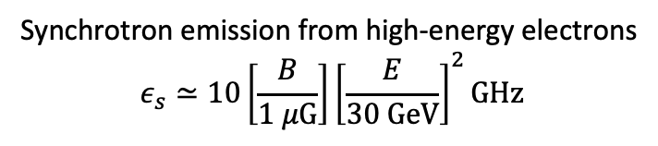
CTA-SKA connections
Synchrotron emission from high-energy electrons
$$ε_{s}≃10\left[\frac{B}{1 μG}\right]{\left[\frac{E}{30 GeV}\right]}^{2}GHz$$
SKA
CTA
radio
visible
gamma-ray
1 eV
1 keV
1 MeV
1 GeV
1 TeV
1 PeV
energy
frequency
1 MHz
1 GHz
10¹² Hz
10¹⁵ Hz

Slide 3
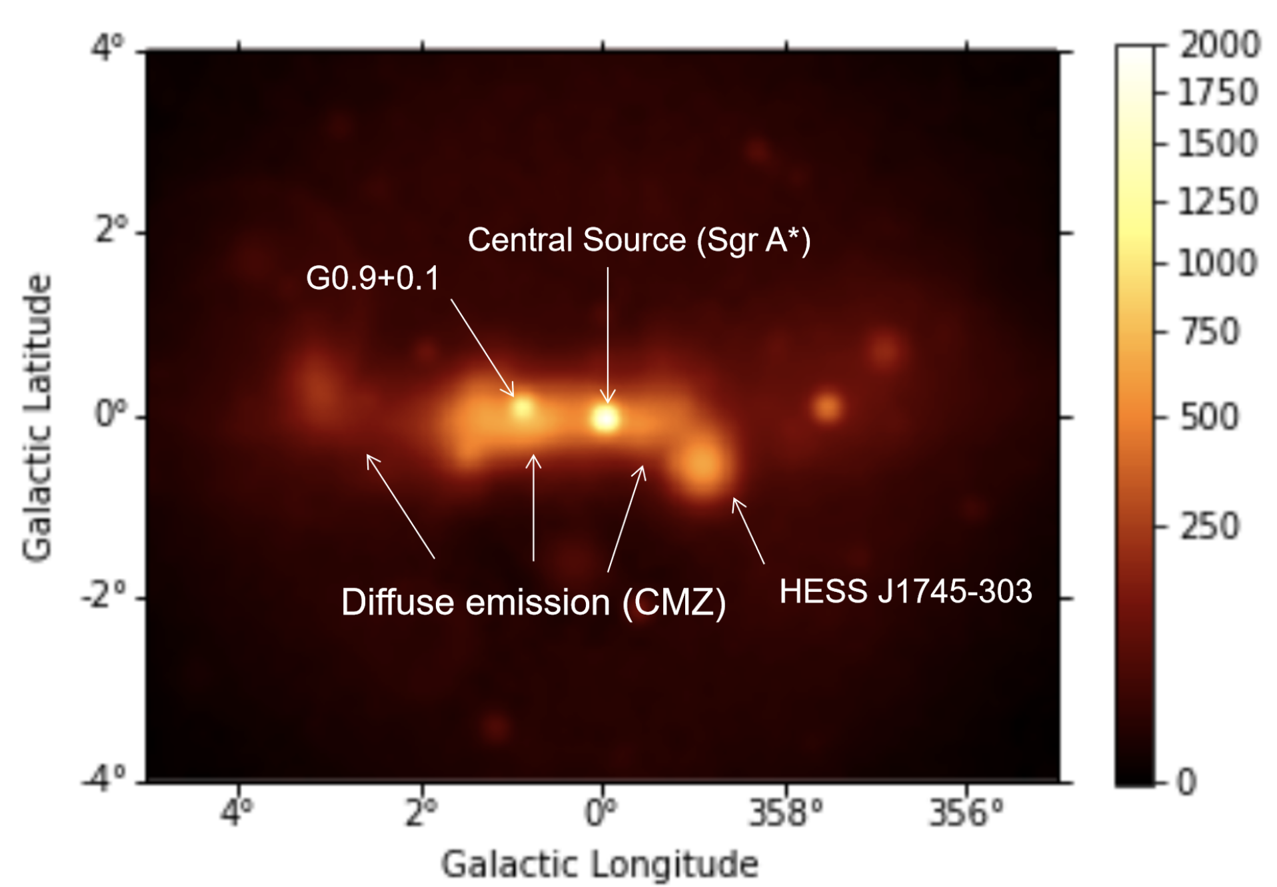
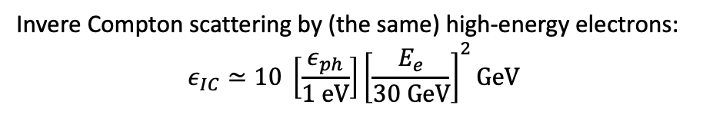
CTA-SKA connections
Synchrotron emission from high-energy electrons
$$ε_{s}≃10\left[\frac{B}{1 μG}\right]{\left[\frac{E}{30 GeV}\right]}^{2}GHz$$
Invere Compton scattering by (the same) high-energy electrons:
$$ε_{IC}≃10 \left[\frac{ε_{ph}}{1 eV}\right]{\left[\frac{E_{e}}{30 GeV}\right]}^{2}GeV$$
SKA
CTA
CTA
radio
visible
gamma-ray
1 eV
1 keV
1 MeV
1 GeV
1 TeV
1 PeV
energy
frequency
1 MHz
1 GHz
10¹² Hz
10¹⁵ Hz

Slide 4
CTA-SKA connections
Synchrotron emission from high-energy electrons
$$ε_{s}≃10\left[\frac{B}{1 μG}\right]{\left[\frac{E}{30 GeV}\right]}^{2}GHz$$
Invere Compton scattering by (the same) high-energy electrons:
$$ε_{IC}≃10 \left[\frac{ε_{ph}}{1 eV}\right]{\left[\frac{E_{e}}{30 GeV}\right]}^{2}GeV$$
SKA
CTA
supermassive black hole Sgr A*
Youngest Galactic supernova G0.9+0.1
CTA
“unidentified” TeV source
HESS J1745-303
Diffuse emission from cosmic ray interactions
(protons / atomic nuclei / electrons + positrons)
trapped by Galactic magnetic field
radio
visible
gamma-ray
1 eV
1 keV
1 MeV
1 GeV
1 TeV
1 PeV
energy
frequency
1 MHz
1 GHz
10¹² Hz
10¹⁵ Hz

Slide 5
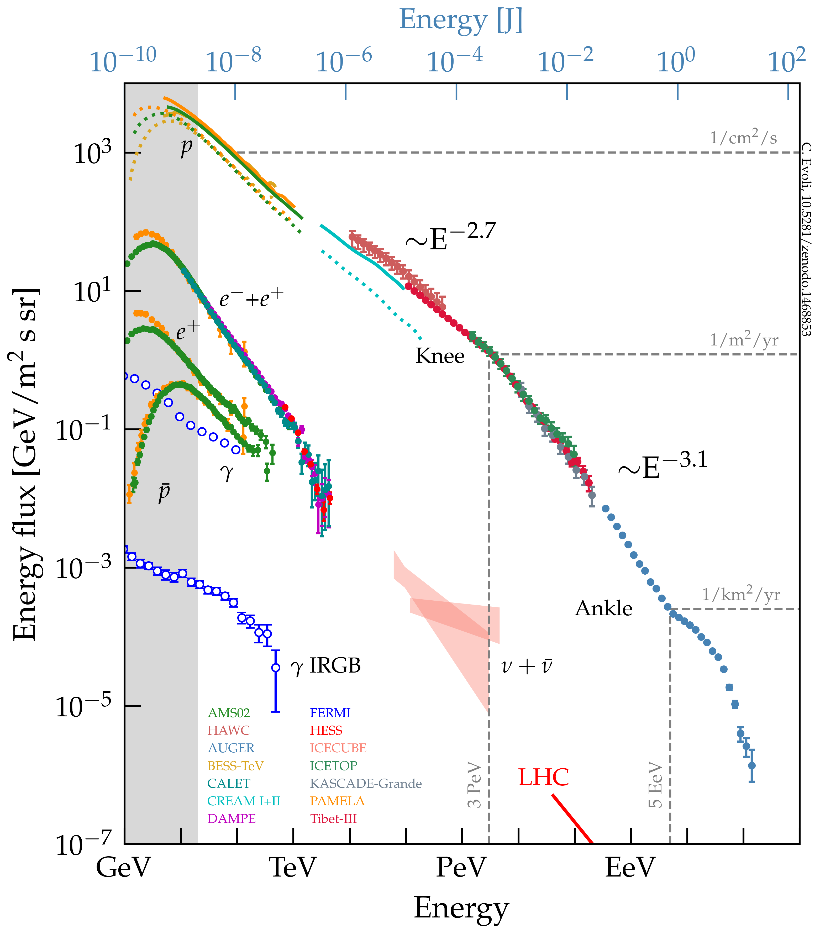
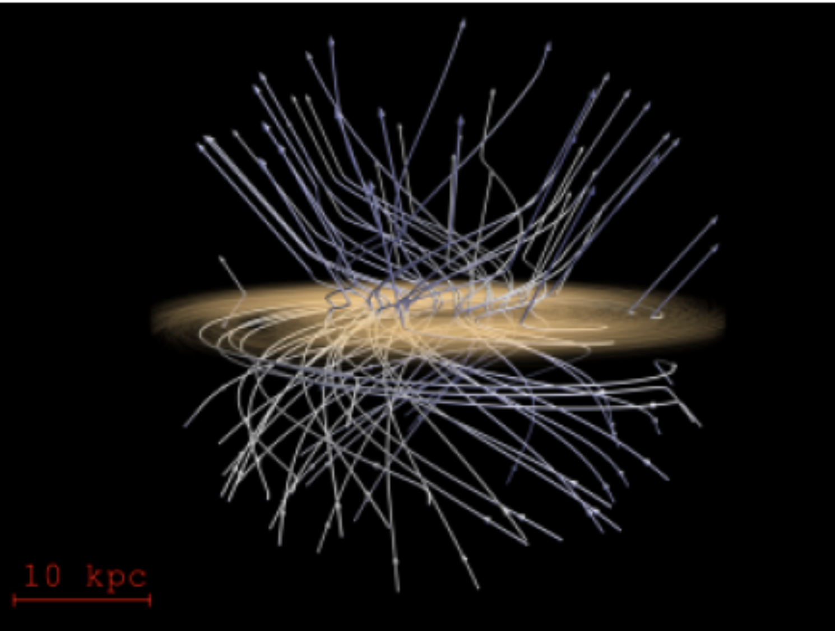
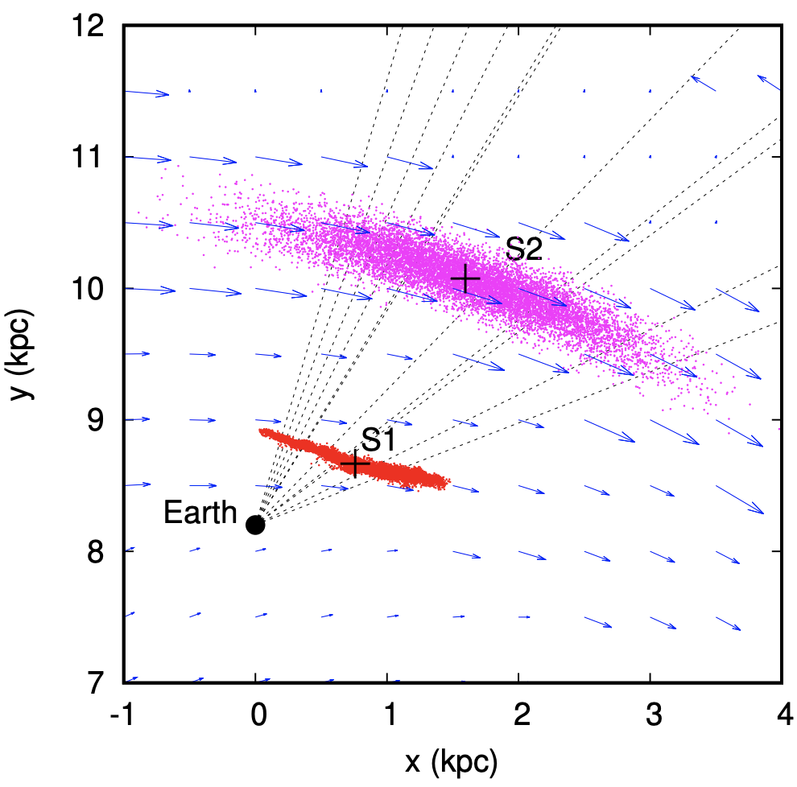
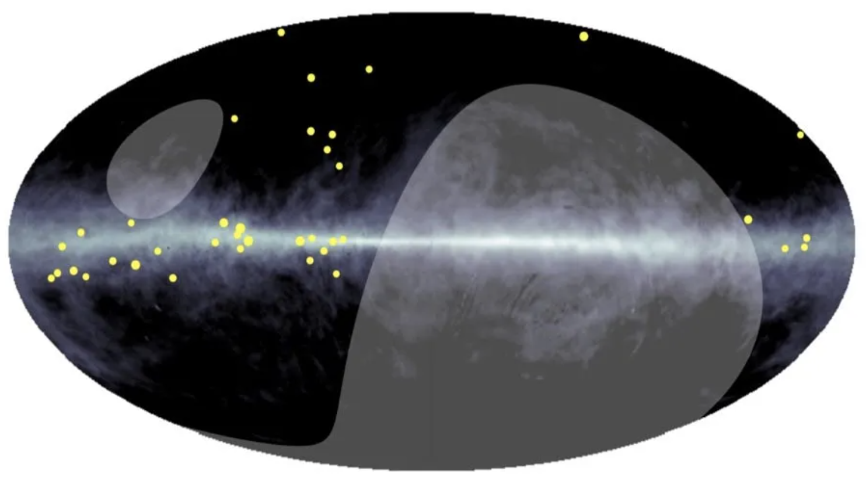

Galactic cosmic rays, Galactic magnetic field, supernova remnants, pulsars,
Analytical model of Galactic magnetic field
https://arxiv.org/abs/1204.3662
Cosmic rays are (perhaps) accelerated in objects originating in supernova explosions (supernova remnants, pulsar wind nebulae, gamma-ray bursts).
Cosmic ray production rate is (perhaps) regulated by the star formation activity.
Cosmic rays escape from the Galaxy by diffusing and streaming through the Galactic magnetic field (of yet uncertain structure).
Current generation gamma-ray telescopes have started to detected unidentified sources (pulsar wind nebulae or supernova remnants?) and diffuse emission (from cosmic ray proton or electron interactions?) from the Milky Way at energies to 1 PeV. CTA will extend population of galactic sources, provide high-statistics view of newly discovered extended sources and diffuse emission structures.
All these sources and structures have radio counterparts. SKA (and its precursors) observations of CTA source counterparts in radio will clarify the nature of the sources and type of particles responsible for gamma-ray emission (electrons or protons/nuclei?).
Cosmic rays diffuse and stream through Galactic magnetic field. SKA will provide knowledge of its overall geometry in 3D, including turbulent and regular field components.
Model of diffusion of PeV cosmic rays
https://arxiv.org/abs/2203.11052
PeV diffuse gamma-rays detected by Tibet AS$γ$
https://arxiv.org/abs/2104.05181

Slide 6
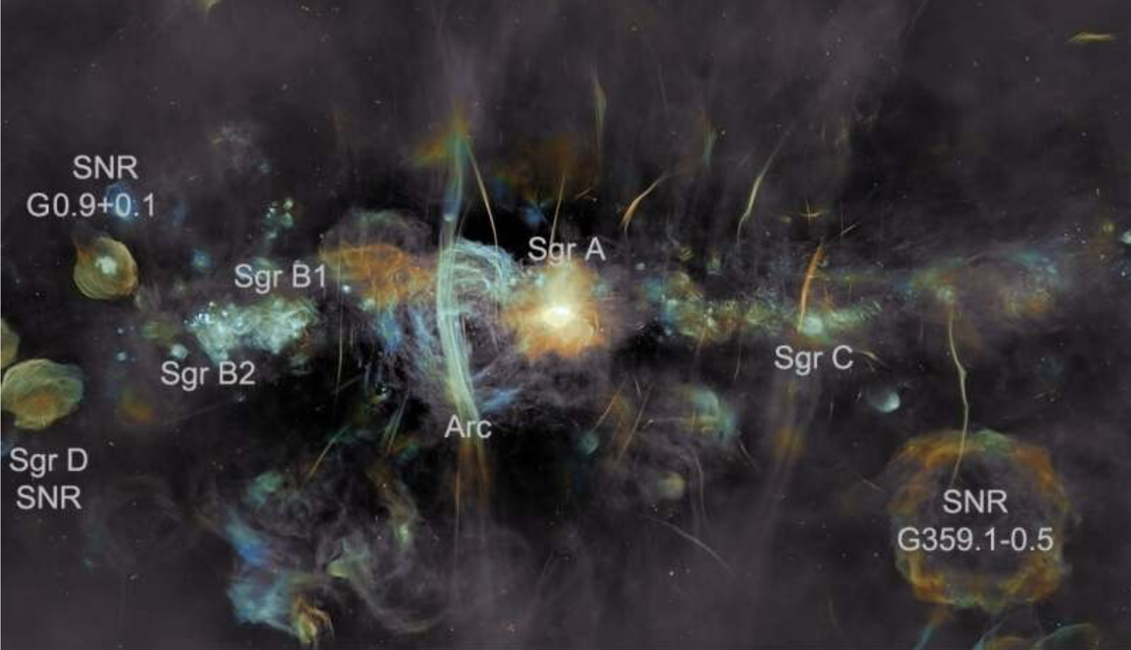
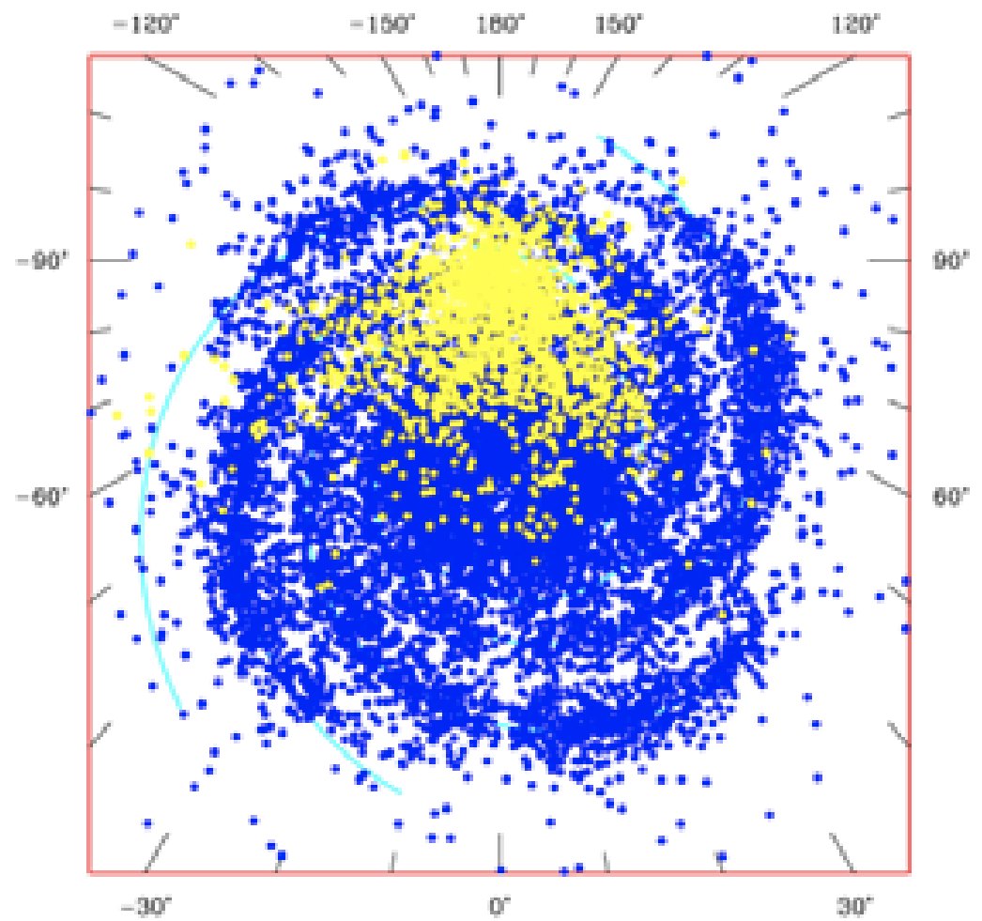
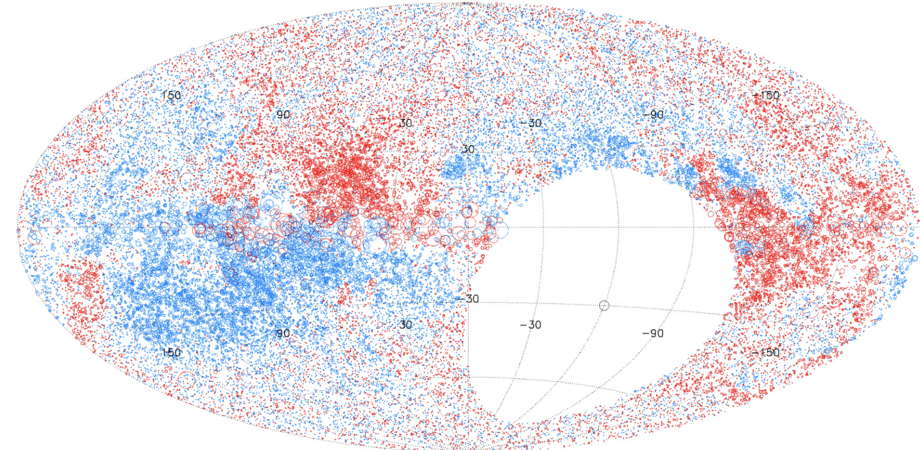
Galactic cosmic rays, Galactic magnetic field, supernova remnants, pulsars,
Cosmic rays are (perhaps) accelerated in objects originating in supernova explosions (supernova remnants, pulsar wind nebulae, gamma-ray bursts).
Cosmic ray production rate is (perhaps) regulated by the star formation activity.
Cosmic rays escape from the Galaxy by diffusing and streaming through the Galactic magnetic field (of yet uncertain structure).
Current generation gamma-ray telescopes have started to detected unidentified sources (pulsar wind nebulae or supernova remnants?) and diffuse emission (from cosmic ray proton or electron interactions?) from the Milky Way at energies to 1 PeV. CTA will extend population of galactic sources, provide high-statistics view of newly discovered extended sources and diffuse emission structures.
All these sources and structures have radio counterparts. SKA (and its precursors) observations of CTA source counterparts in radio will clarify the nature of the sources and type of particles responsible for gamma-ray emission (electrons or protons/nuclei?).
Cosmic rays diffuse and stream through Galactic magnetic field. SKA will provide knowledge of its overall geometry in 3D, including turbulent and regular field components.
Expected distribution of pulsars detectable with SKA https://arxiv.org/abs/0811.0211
https://iopscience.iop.org/article/10.1088/0004-637X/702/2/1230
Faraday rotation measure image of the sky (revealing Galactic magnetic field direction along the line of sight)

Slide 7
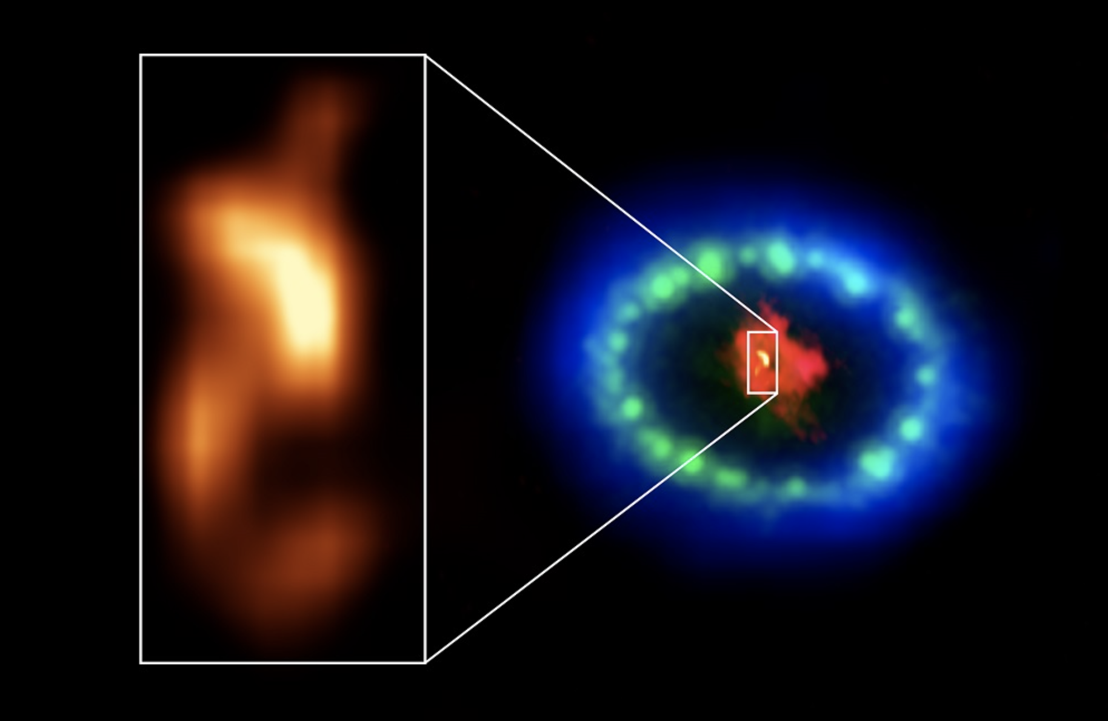
Galactic cosmic rays, Galactic magnetic field, supernova remnants, pulsars,
Cosmic rays are (perhaps) accelerated in objects originating in supernova explosions (supernova remnants, pulsar wind nebulae, gamma-ray bursts).
Cosmic ray production rate is (perhaps) regulated by the star formation activity.
Cosmic rays escape from the Galaxy by diffusing and streaming through the Galactic magnetic field (of yet uncertain structure).
Current generation gamma-ray telescopes have started to detected unidentified sources (pulsar wind nebulae or supernova remnants?) and diffuse emission (from cosmic ray proton or electron interactions?) from the Milky Way at energies to 1 PeV. CTA will extend population of galactic sources, provide high-statistics view of newly discovered extended sources and diffuse emission structures.
All these sources and structures have radio counterparts. SKA (and its precursors) observations of CTA source counterparts in radio will clarify the nature of the sources and type of particles responsible for gamma-ray emission (electrons or protons/nuclei?).
Cosmic rays diffuse and stream through Galactic magnetic field. SKA will provide knowledge of its overall geometry in 3D, including turbulent and regular field components.
ALMA and Chandra view of SN1987A showing evidence for a newly born neutron star.
https://arxiv.org/abs/2004.06078 (ALMA)
https://arxiv.org/abs/2101.09029 (Chandra)

Slide 8
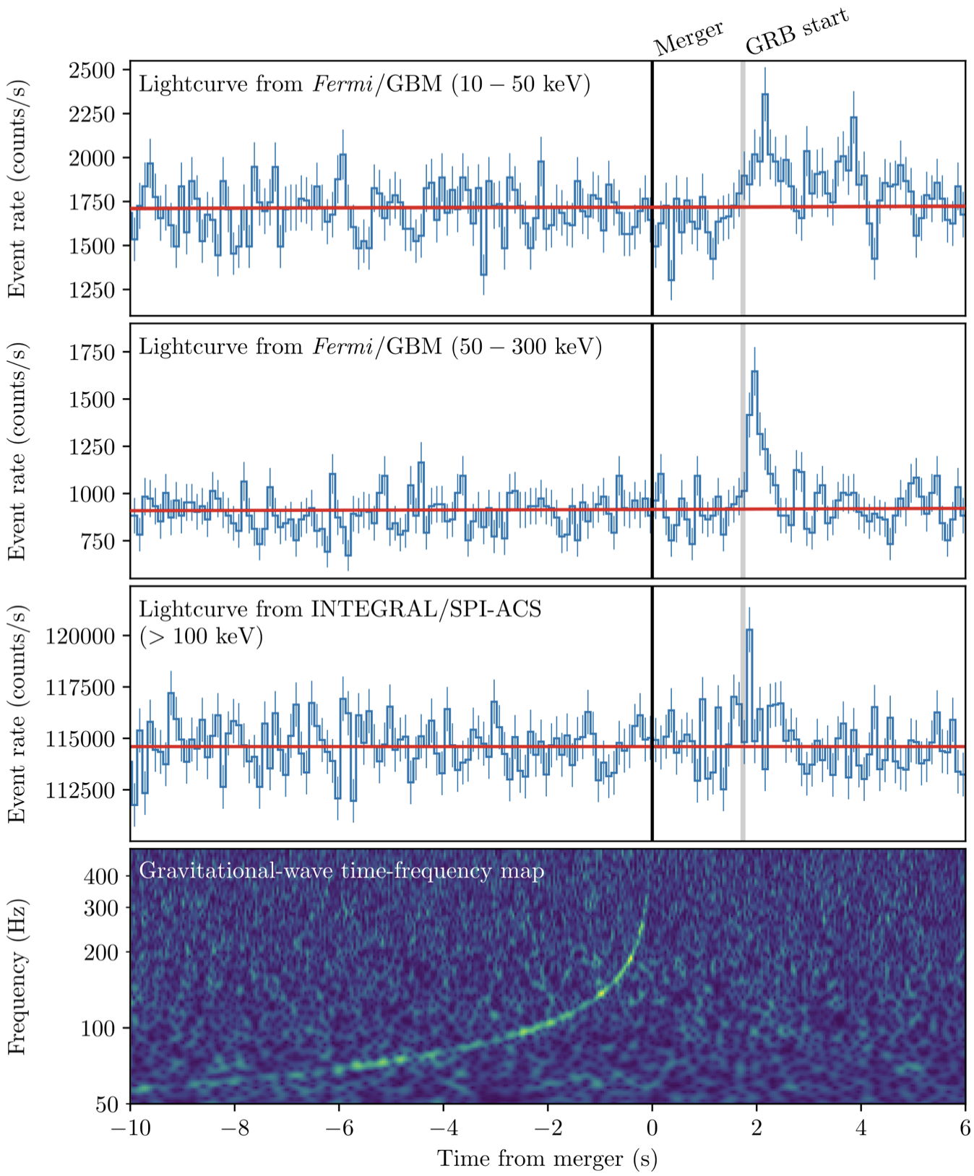
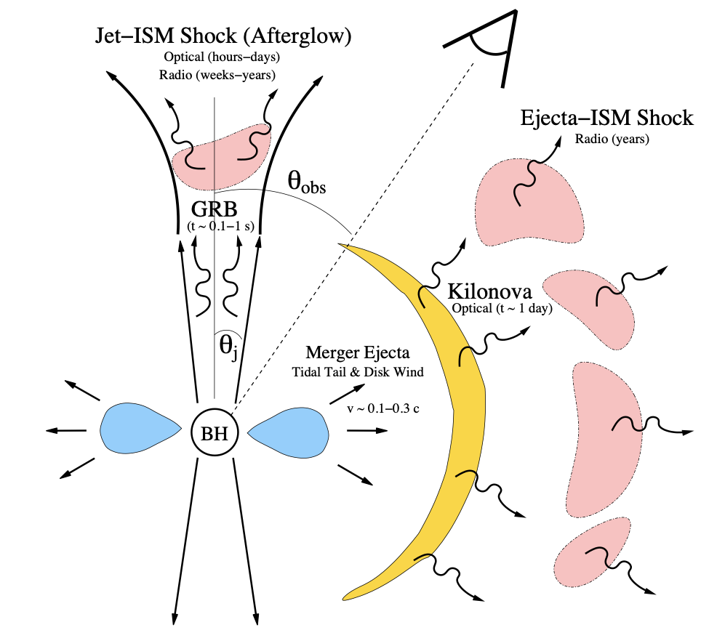
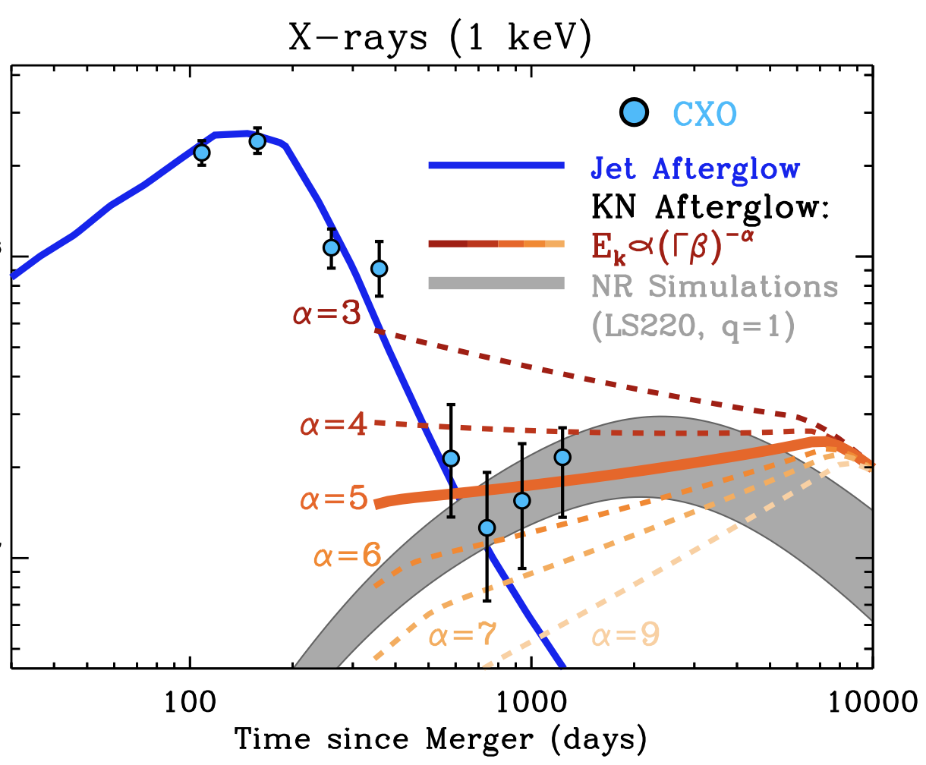
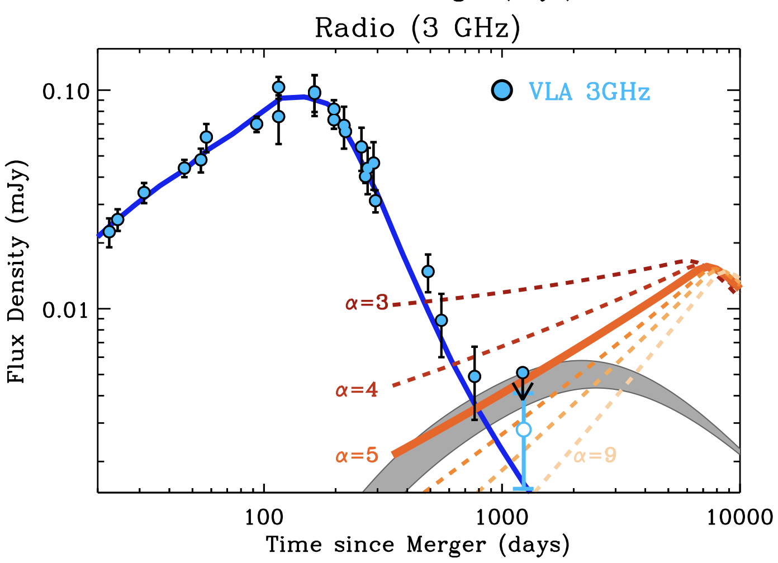
Supernovae, kilonovae, gamma-ray bursts, gravitational wave bursts, fast radio bursts
GW170817
New types of multi-messenger transient astronomical sources are being discovered. Violent phenomena involved in their activity result in particles acceleration. Properties of synchrotron (SKA) and inverse Compton (CTA) (or Bremsstrahlung, or pion production and decay?) emission provide diagnostics of (yet uncertain) physical processes involved.
Next runs of gravitational wave detectors LIGO, VIRGO, KAGRA (next one is scheduled for early 2023) will start systematically detecting such events. Neutron star mergers is (perhaps) the phenomenon responsible for (most of the?) short Gamma-Ray Bursts (GRBs).
Hajela et al. 2104.02070
SKA (and its precursors) will routinely observe particle acceleration in kilonovae, short and long GRBs. Properties of time-dependent synchrotron emission constrain the physics of relativistic outflows generated by the explosive events.
CTA detection (or non-detection?) of gamma-ray emission from relativistic electrons (or protons/nuclei?) from this source type will provide complementary information.
Flux density (re-normalized)
GW170817 neutron star merger that produced a “kilonova” explosion event is currently the only source that has been observed in gravitational waves + electromagnetic (radio-to-gamma-ray) emission, it was (is still?) visible in radio, years after the merger.
https://arxiv.org/abs/1710.05832 https://arxiv.org/abs/1710.05449

Slide 9
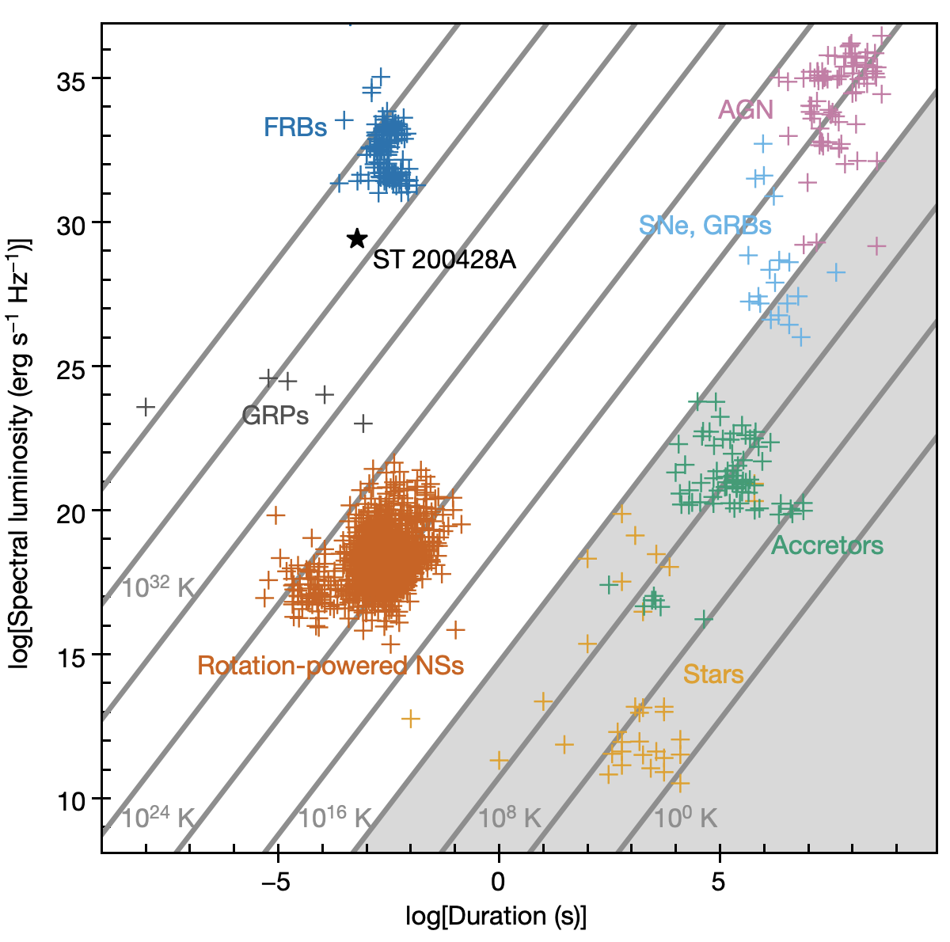
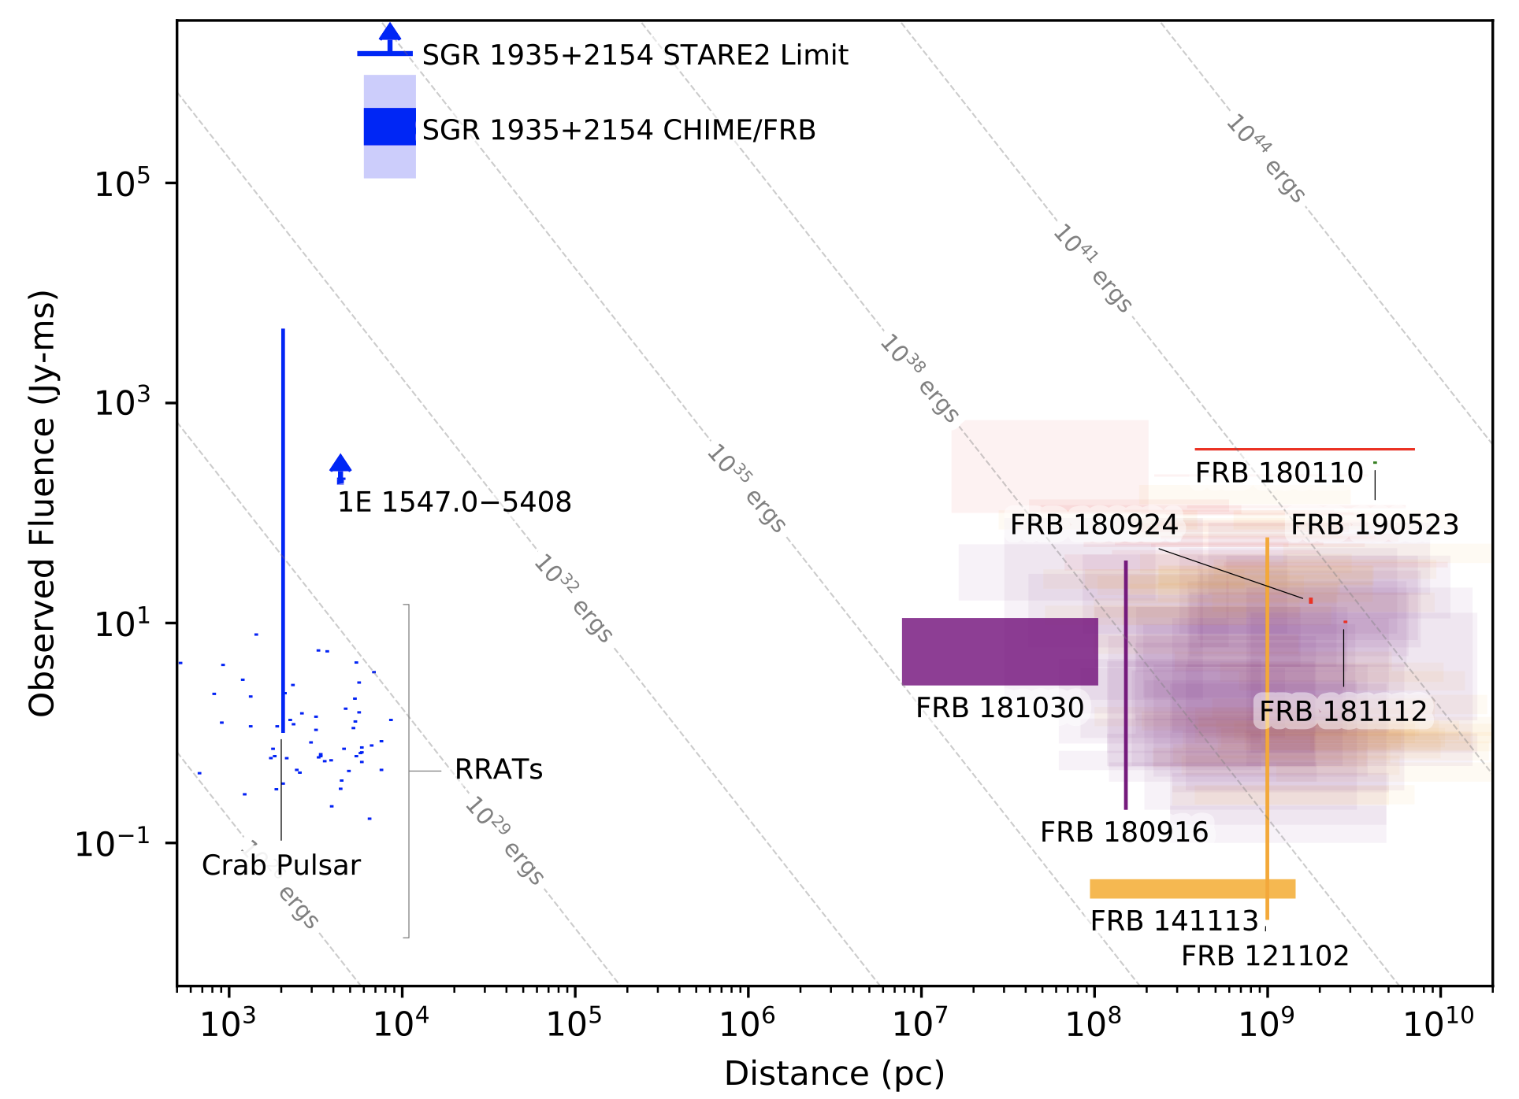
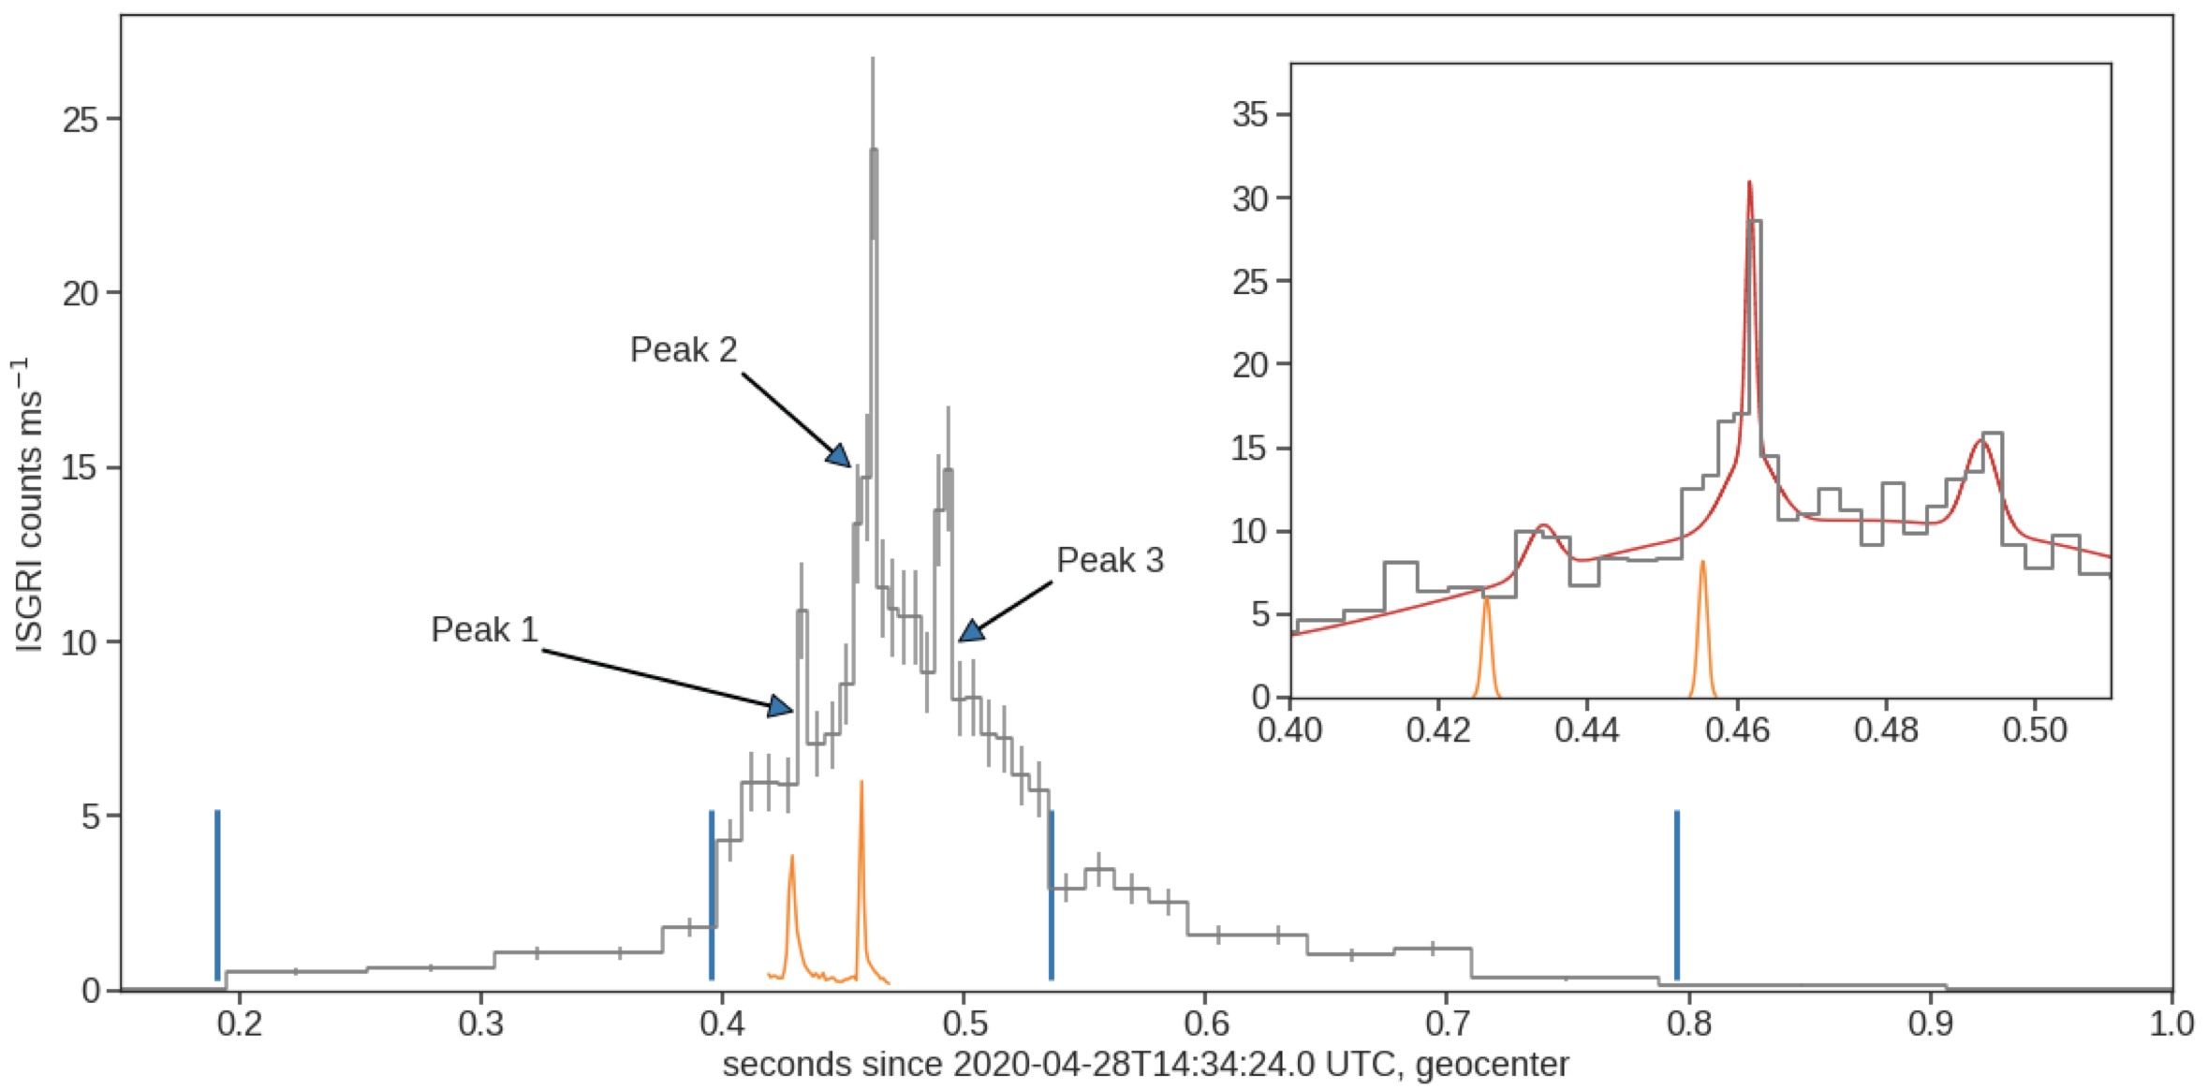
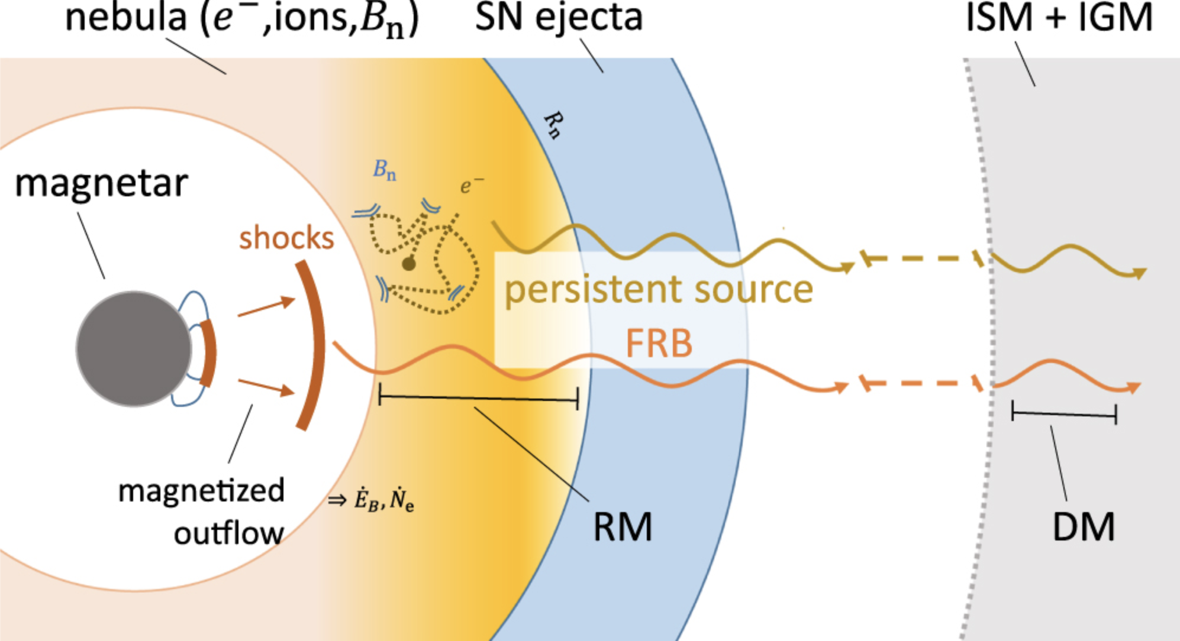
Supernovae, kilonovae, gamma-ray bursts, gravitational wave bursts, fast radio bursts
New types of multi-messenger transient astronomical sources are being discovered. Violent phenomena involved in their activity result in particles acceleration. Properties of synchrotron (SKA) and inverse Compton (CTA) (or Bremsstrahlung, or pion production and decay?) emission provide diagnostics of (yet uncertain) physical processes involved.
Fast radio bursts are millisecond-scale transients first discovered in 2007. They are (possibly) associated with giant pulses of magnetars (extremely magnetized neutron stars), as demonstrated by detection of a magnetar counterpart SGR 1935+2154 for one of FRBs.
Magnetars (Soft Gamma Repeaters, SGR) in other galaxies perhaps constitute second major type of phenomena responsibly for short GRBs.
SKA (and its precursors) will routinely observe FRBs and clarify the nature of this phenomenon.
Contrary to lower magnetic field pulsars, magnetars have never been detected in high-energy and very-high-energy gamma-ray band accessible to CTA. Is this because particle energies do not reach GeV-TeV band? Or because of lack of sensitivity? What is the mechanism of outbursts of magnetars?
https://arxiv.org/abs/2005.10324
https://arxiv.org/abs/2005.06335

Slide 10
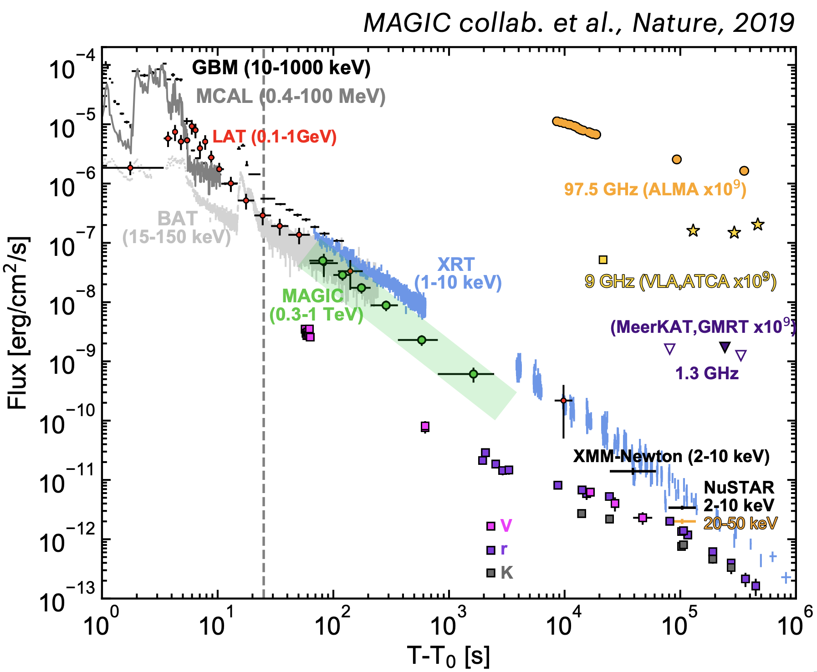
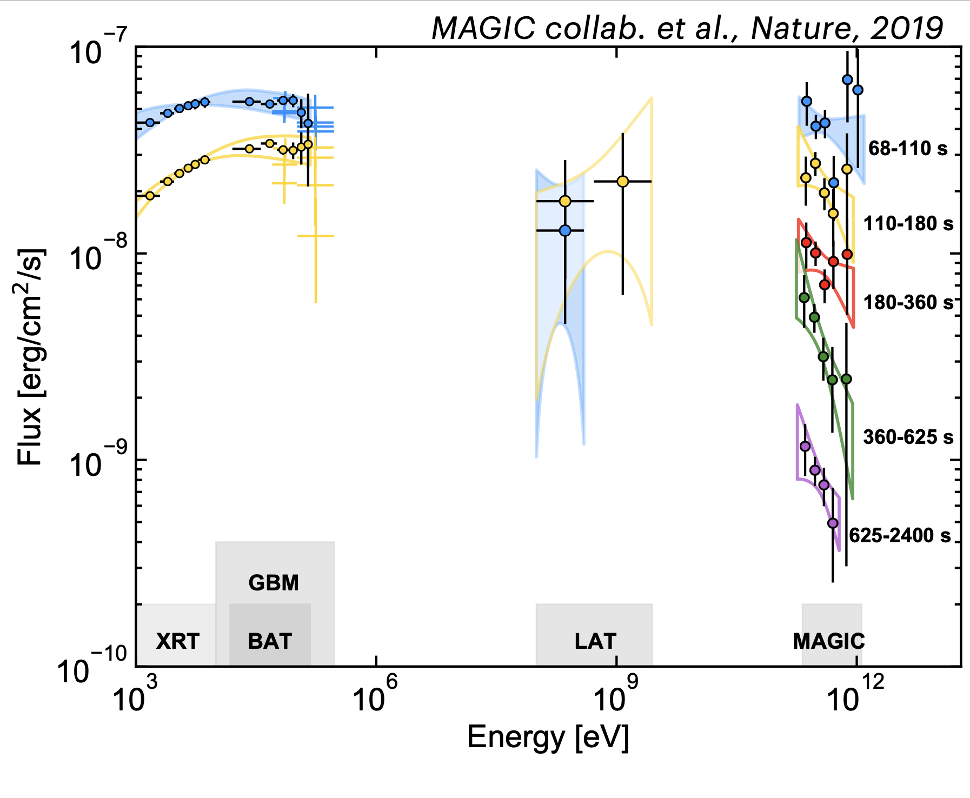
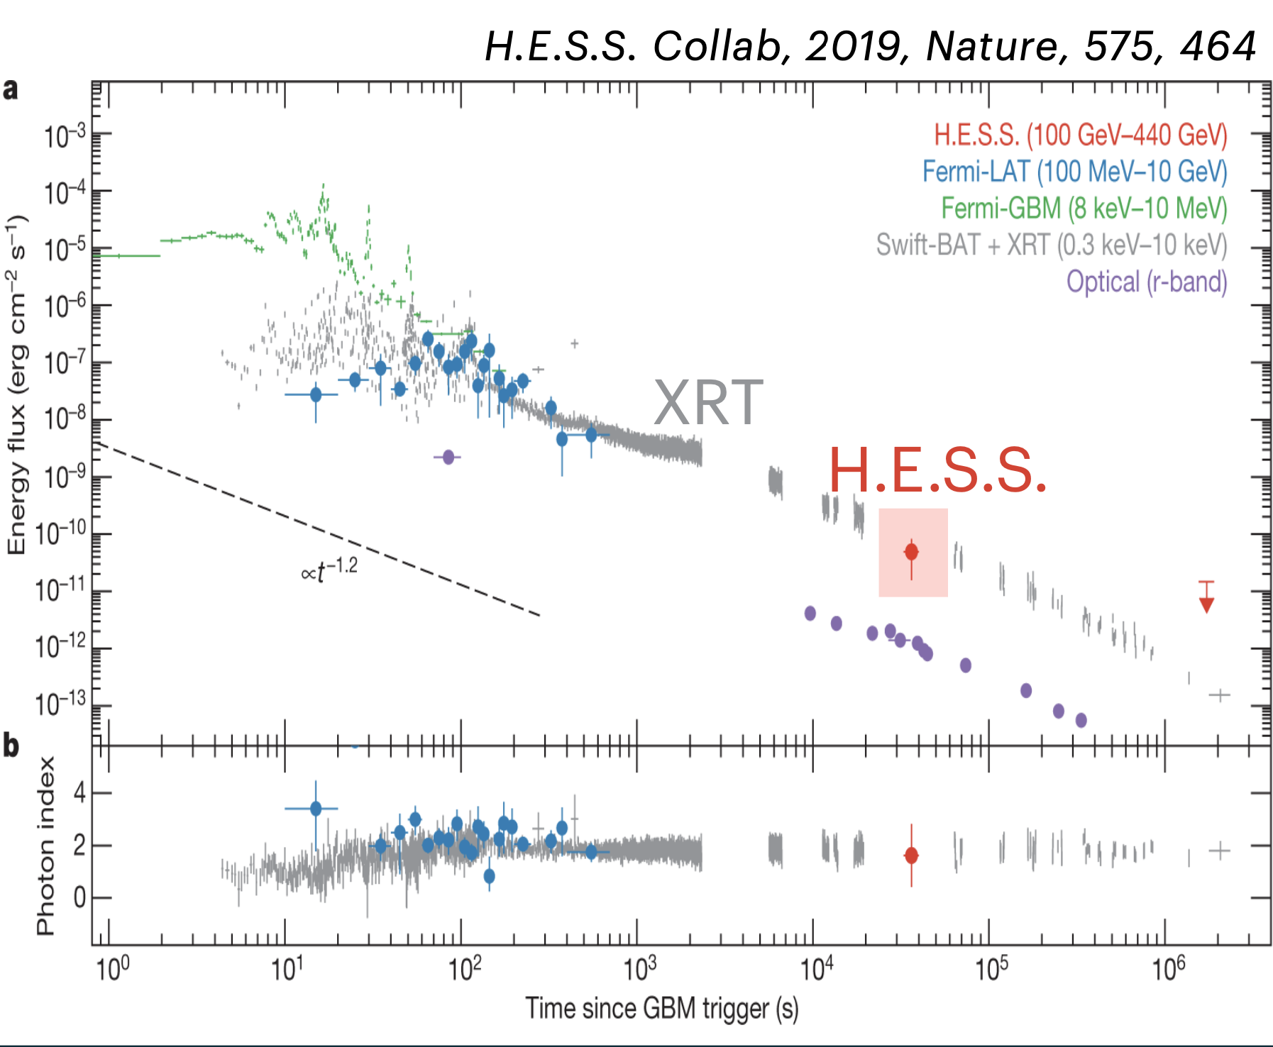
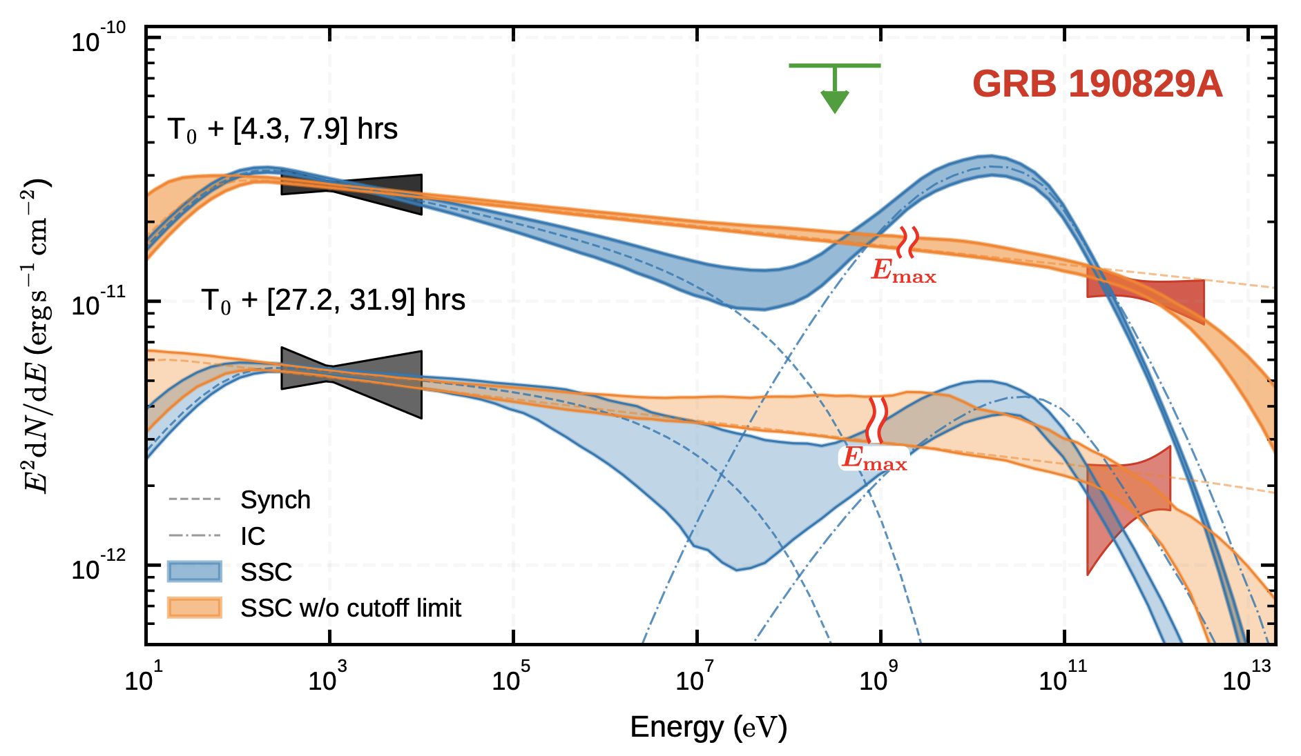
Supernovae, kilonovae, gamma-ray bursts, gravitational wave bursts, fast radio bursts
New types of multi-messenger transient astronomical sources are being discovered. Violent phenomena involved in their activity result in particles acceleration. Properties of synchrotron (SKA) and inverse Compton (CTA) (or Bremsstrahlung, or pion production and decay?) emission provide diagnostics of (yet uncertain) physical processes involved.
Existing Cherenkov telescopes (HESS, MAGIC) started to detect TeV emission from long GRBs, in the afterglow phase. The nature of this emission is uncertain. It can be inverse Compton scattering by electrons in relativistic outflow, but the spectral properties of the signal do not match the model. It can possibly be an extreme example of synchrotron emission (hence stretching from radio to very-high-energy gamma-rays.
CTA is specially designed for fast re-pointing for observations of GRB afterglows. It will start to uncover the GRB source population in TeV range.
SKA (and its precursors) will be able to catch the GRB afterglows earlier than existing telescopes, at the phase where the emission is still optically thick (self-absorption). Possibly observe afterglows simultaneously with CTA, to constrain the properties of relativistic outflow from which TeV emission comes.

Slide 11
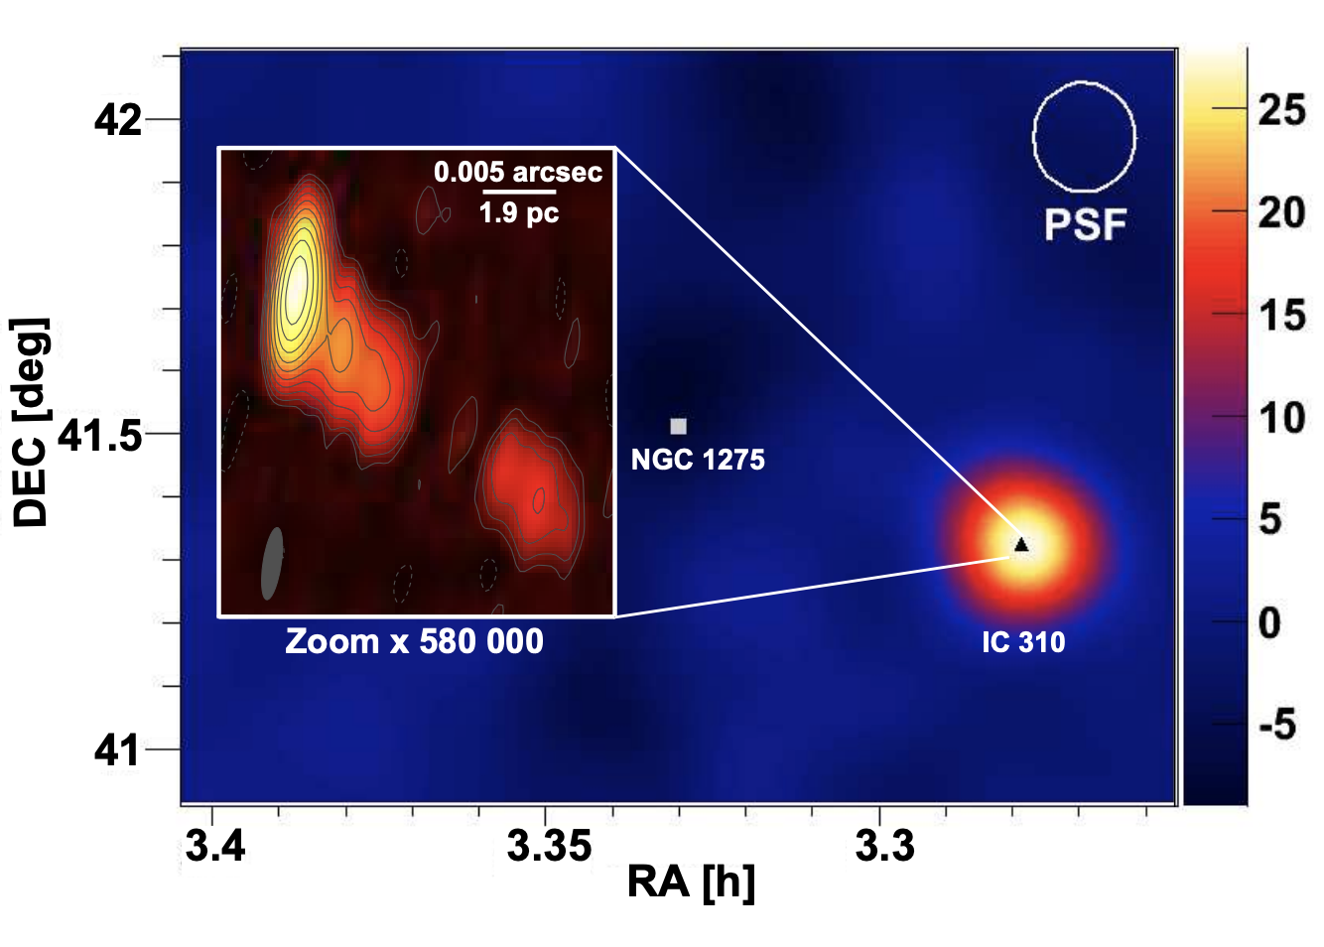
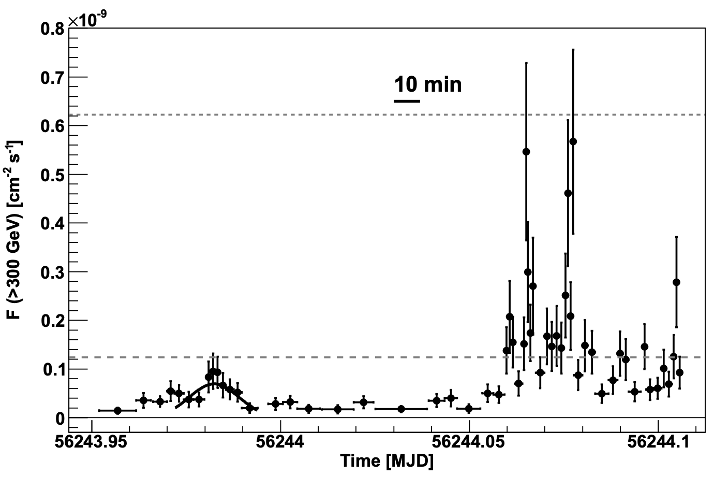
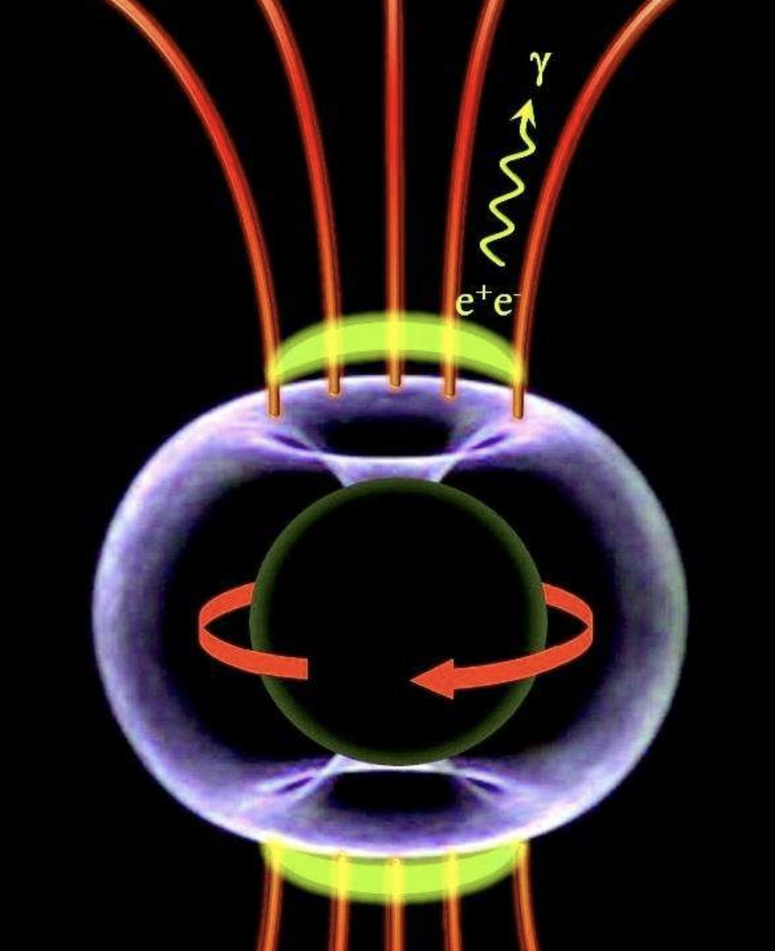
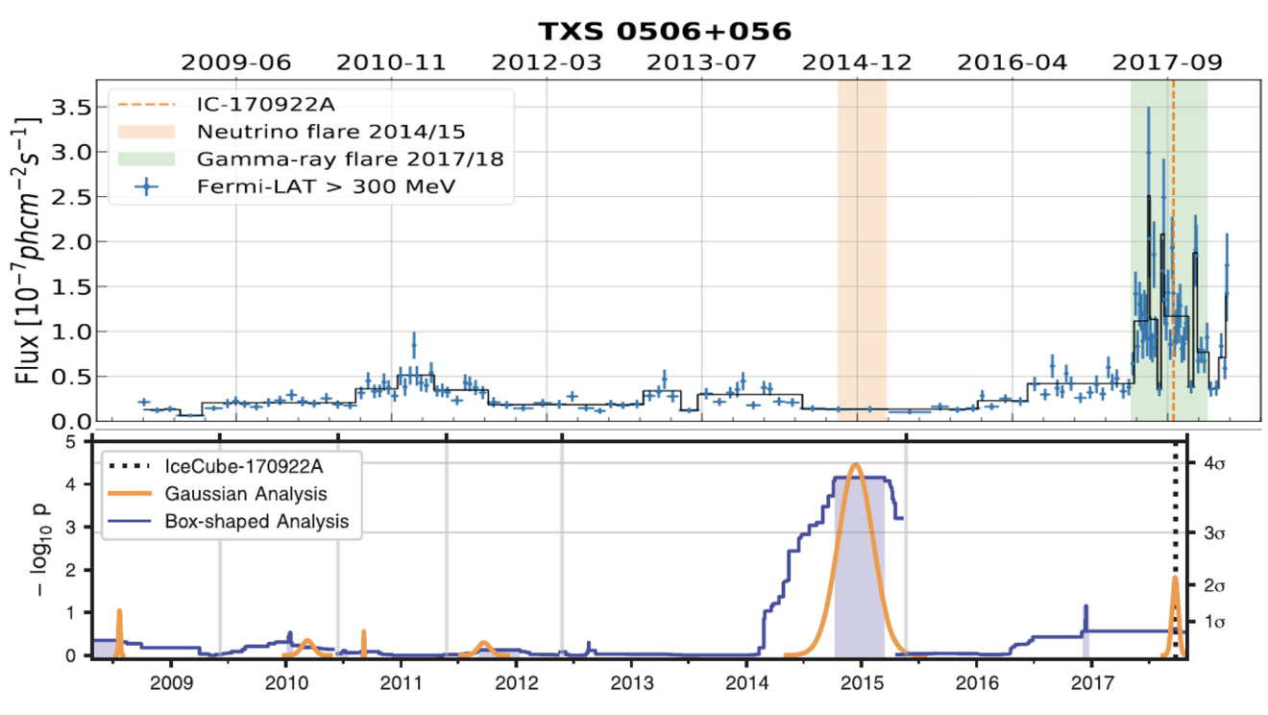
Active Galactic Nuclei, radio galaxies
Very-high-energy gamma-ray emission is currently predominantly detected from blazars, radio-loud AGN with jets aligned along the line of sight. Location of “blazar zone”, region of Doppler-boosted gamma-ray emission, is uncertain. Fast variability suggests its origin close to supermassive black hole. However, TeV gamma-rays cannot escape from this region, because of pair production of ultraviolet radiation from accretion flow.
“Mainstream” point of view is that gamma-rays are generated in tiny clumps far away from the black hole in 1-100 pc-scale jets (often resolved in radio VLBI).
AGN jets may be powered by acceleration of protons (rather than electrons). This can be tested via detection of neutrinos from (radio-brightest, gamma-ray brightest?) AGN.
https://arxiv.org/abs/1412.4936
IC310, MAGIC
CTA will start to routinely sample fast (minutes-to-days, depending on the black hole mass scale) variability of emission in blazars and radio galaxies. By the time of SKA1 operations, more powerful neutrino telescopes (KM3NET, IceCube-Gen2) will be able operational.
Simultaneous SKA and precursors data on counterparts of TeV outbursts and/or neutrino arrivals (from parsec-scale jets, AGN cores? Detectable through radio flares? Polarisation changes? Resolvable with VLBI?) will be crucially important.
https://arxiv.org/abs/1807.08794, https://arxiv.org/abs/1807.08816

Slide 12
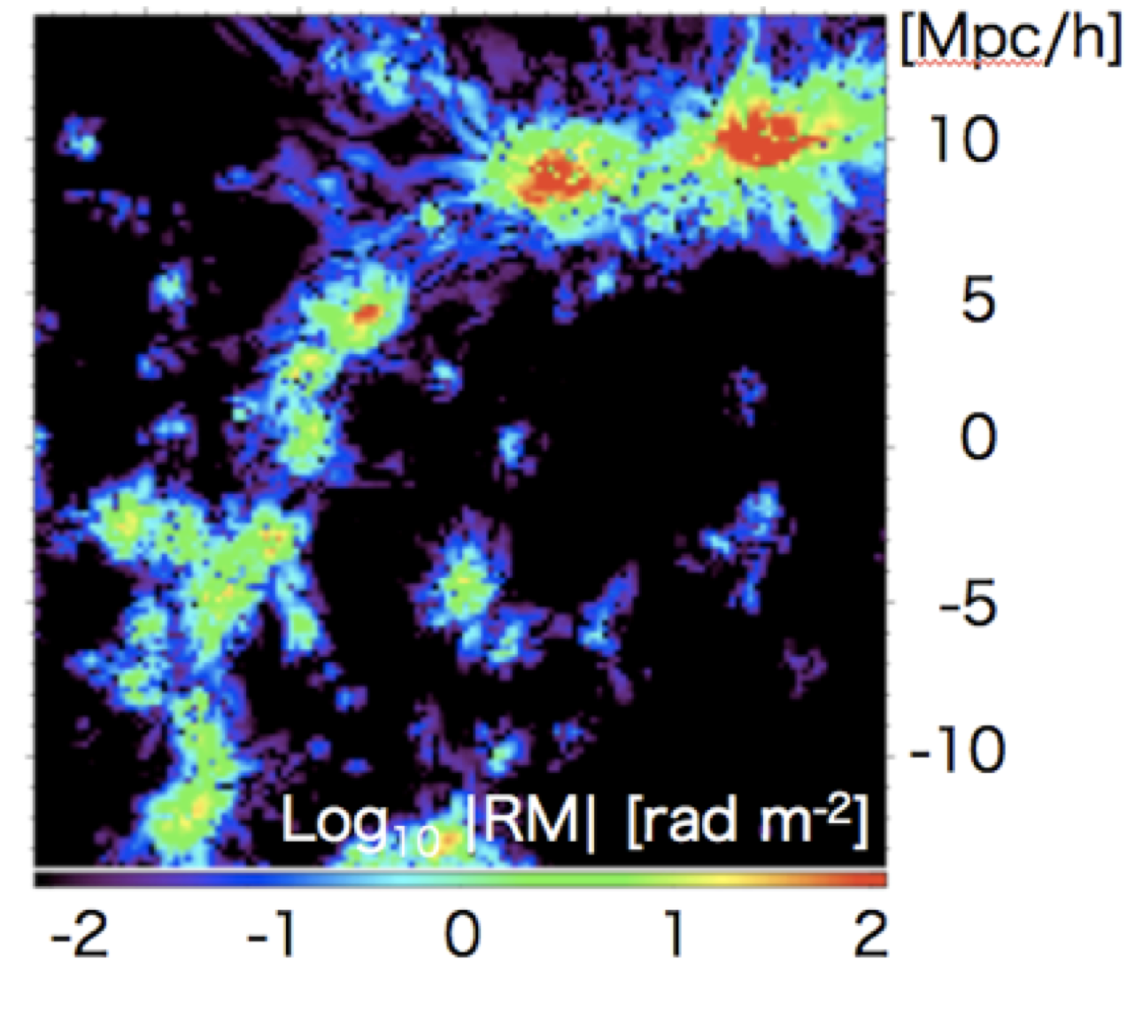
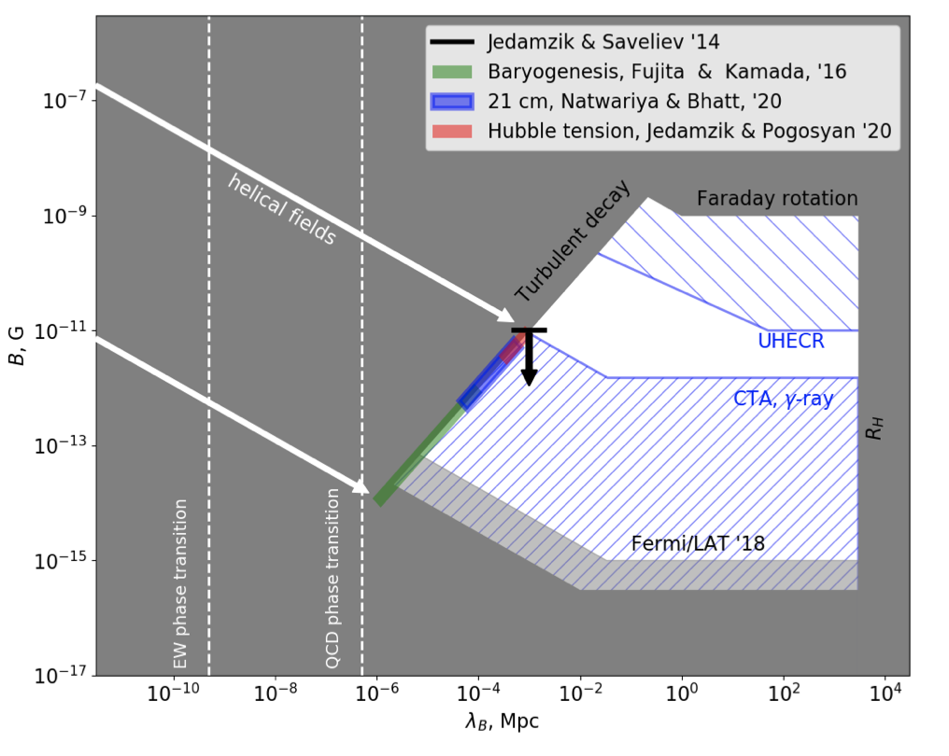
Intergalactic medium, intergalactic magnetic fields
Very-high-energy gamma-ray signal from distant AGN is attenuated by the effect of pair production on visible-infrared background.
Polarized radio emission from extragalactic sources experiences Faraday rotation.
Both effects can be used to infer magnetic fields in the Large Scale Structure: magnetized bubbles around galaxies, filaments, voids. Current generation gamma-ray telescopes have established existence of non-zero magnetic field in the voids, perhaps of cosmological origin.
Gamma-gamma pair production
Inverse Compton scattering
Faraday rotation of radio signal
Magnetized bubbles around galaxies (detectable via Faraday rotation?)
SKA will provide an order-of-magnitude increase of the sample of Faraday rotation data (up to 100 measurements per square degree), enabling detection of magnetized bubbles produced by AGN and star-formation driven outflows from galaxies. It will verify if magnetic field in the voids may be result of “pollution” of voids by baryonic feedback.
CTA will provide sensitivity sufficient for measurement of cosmological magnetic field in the voids, possibly originating from the first 10 microseconds after the Big Bang.
Cosmological magnetic field (detectable via gamma-ray signal?)
https://arxiv.org/abs/1006.3504
https://arxiv.org/abs/1303.7121

Slide 13
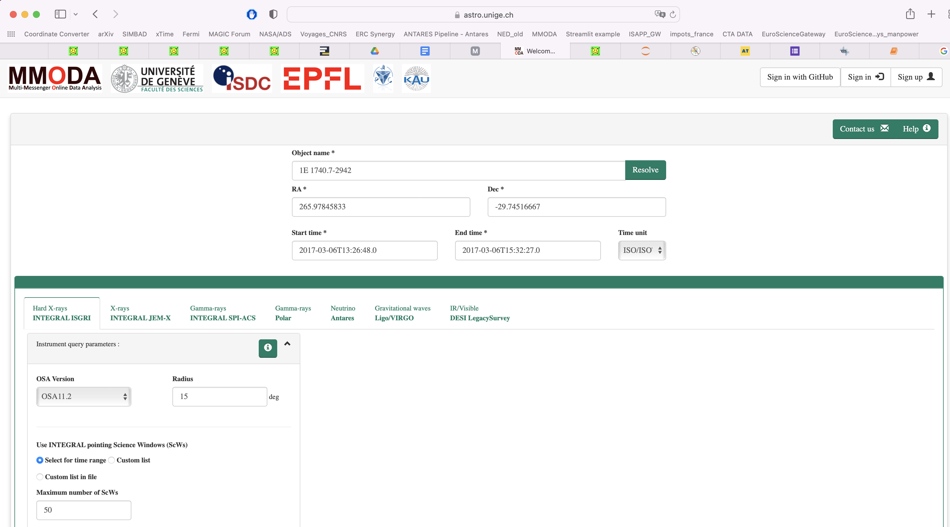
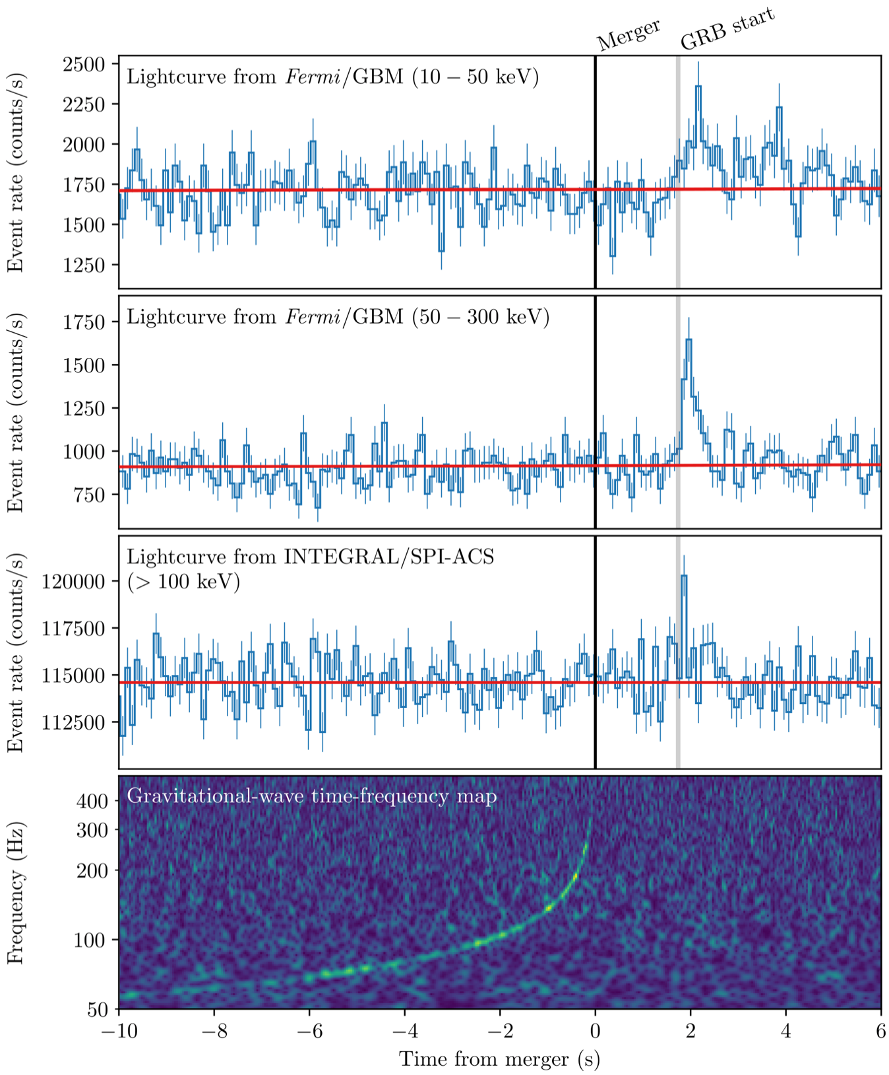
Multi-wavelength and multi-messenger data analysis: added value to CTA and SKA data
https://www.astro.unige.ch/mmoda/
Understanding of multi-wavelength and multi-messenger sources requires efficient combination of diverse types of data, possibly in real-time regime.
Multi-messenger online data analysis (MMODA) platform aims at enabling such combination through online data analysis services.
We plan to integrate SKA (precursors) and CTA data into online data analysis environment of MMODA.

Slide 14
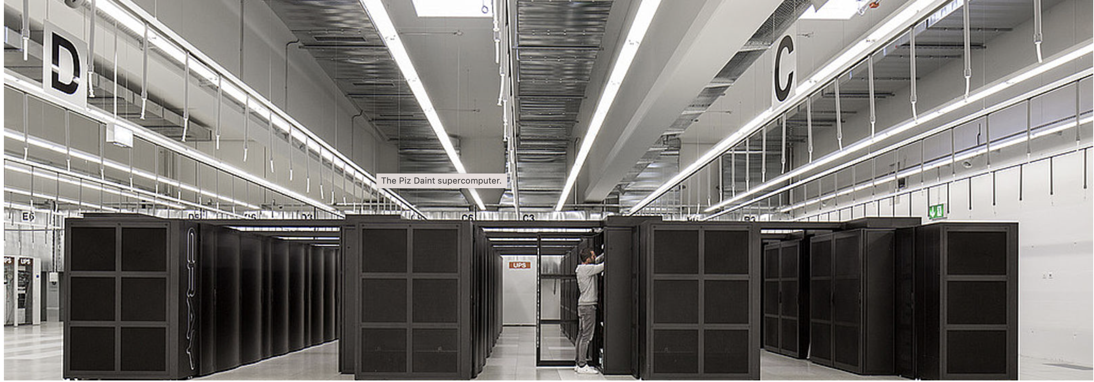

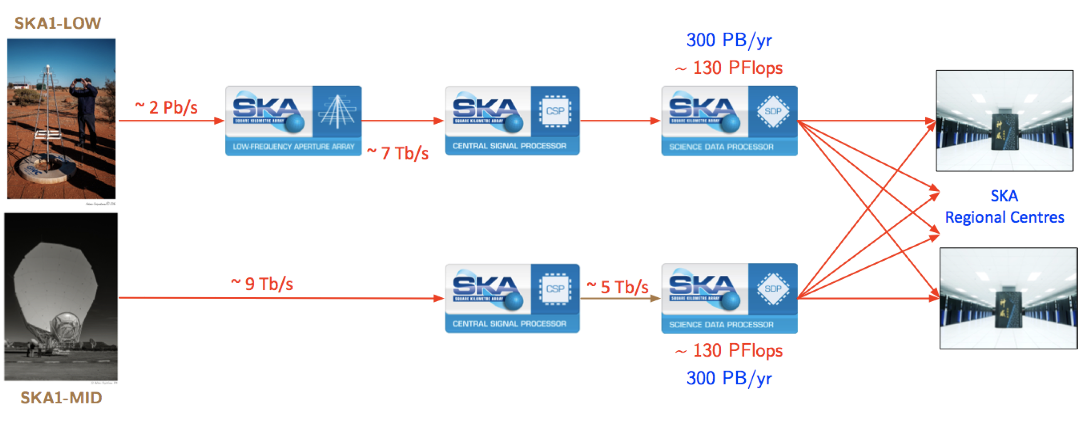
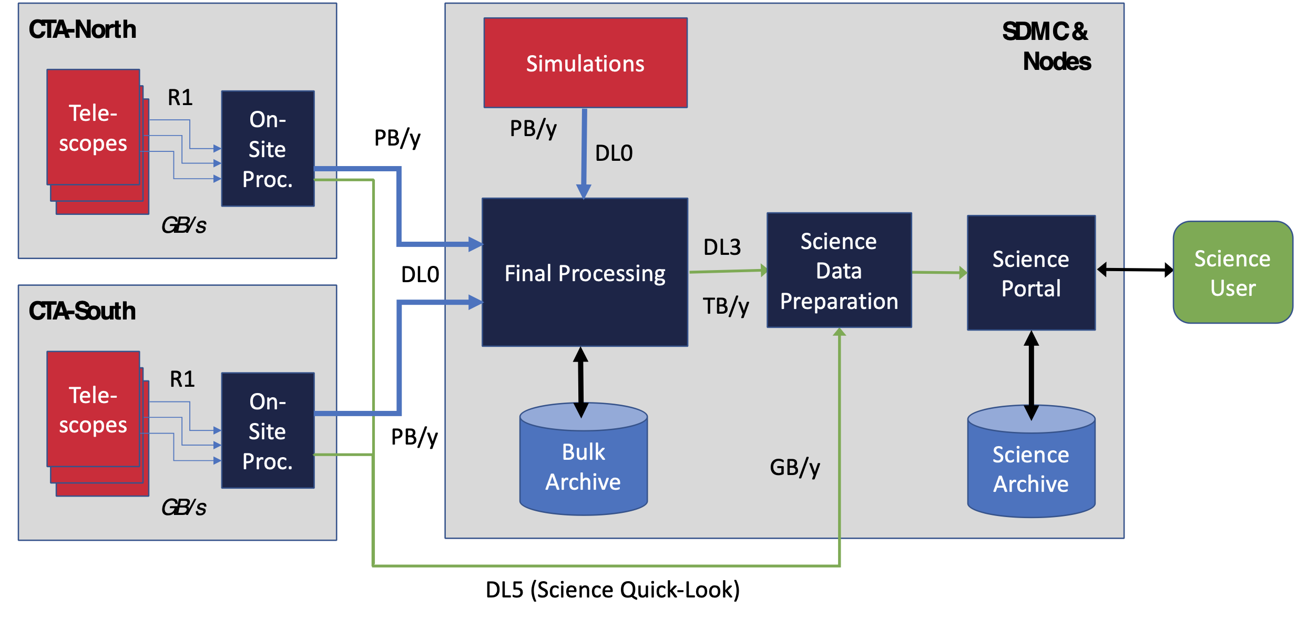



Multi-wavelength and multi-messenger data analysis: added value to CTA and SKA data
regional data centre SKA
Off-site data centre CTA

