Slide 1
IAU Centre for the Protection of the Dark and Quiet Sky from Satellite Constellation Interference
(IAU CPS)
Federico Di Vruno
SKAO Spectrum Manager
Co-Director IAU CPS
In collaboration with:
Connie Walker (Co-Director IAU CPS)
Piero Benvenutti (Director IAU CPS)
Notes:
Hello all, it is a pleasure to be here with you in this beautiful city, and with this great weather!
I will provide an update on the activities the IAU CPS is doing regarding the protection of the dark and quiet skies.

Slide 2
Sky view from South Africa Lat = -31 deg 60 seconds el>10 deg
Notes:
Although I suppose you are all aware of the situation with the very large satellite constellations, I wanted us to do a little exercise to warm up.
Imagine you are in South Africa (where SKA-Mid) is under construction, and you have a way to see where satellites are, (click) this is what we would see if we track the position of satellites above 10 deg elevation for 1 minute. Here you see the active satellites in 2018, before Starlink constellation was launched. (click-click) when Starlink and oneweb are both deployed in full the number of satellites above 10 deg will increase by about 100. But of course there are many more constellations, and many much larger than these two, (click) like for example the Guowang Chinese constellation (clik clik) and the OneWEb phase 2 and Starlink phase 2. (click) so in the case that operators deploy as many satellites as are planned, the number of satellites above 10 deg elevation will increase significantly. And this is not even the total number of planned constellations.

Slide 3
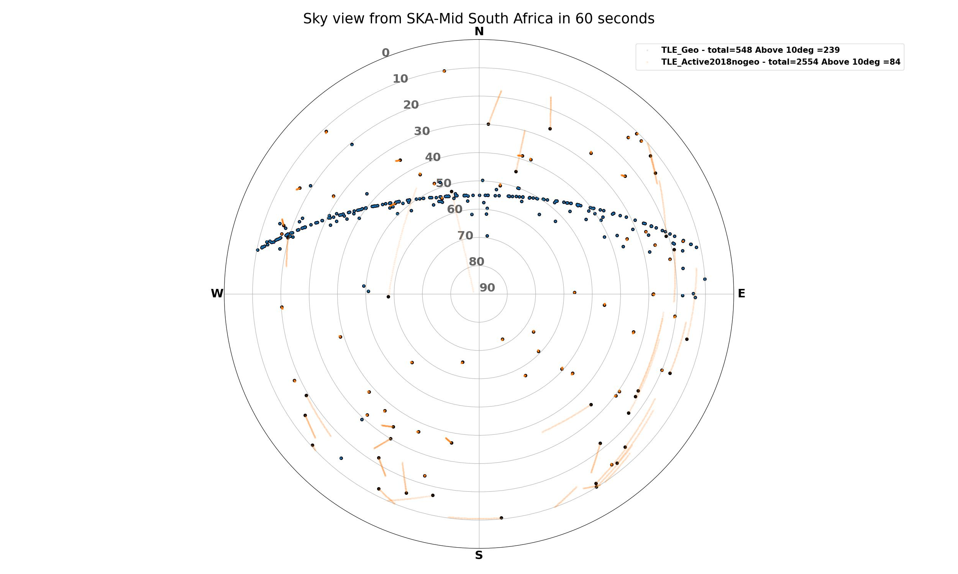
Sky view from South Africa Lat = -31 deg 60 seconds el>10 deg
Notes:
Although I suppose you are all aware of the situation with the very large satellite constellations, I wanted us to do a little exercise to warm up.
Imagine you are in South Africa (where SKA-Mid) is under construction, and you have a way to see where satellites are, (click) this is what we would see if we track the position of satellites above 10 deg elevation for 1 minute. Here you see the active satellites in 2018, before Starlink constellation was launched. (click-click) when Starlink and oneweb are both deployed in full the number of satellites above 10 deg will increase by about 100. But of course there are many more constellations, and many much larger than these two, (click) like for example the Guowang Chinese constellation (clik clik) and the OneWEb phase 2 and Starlink phase 2. (click) so in the case that operators deploy as many satellites as are planned, the number of satellites above 10 deg elevation will increase significantly. And this is not even the total number of planned constellations.

Slide 4
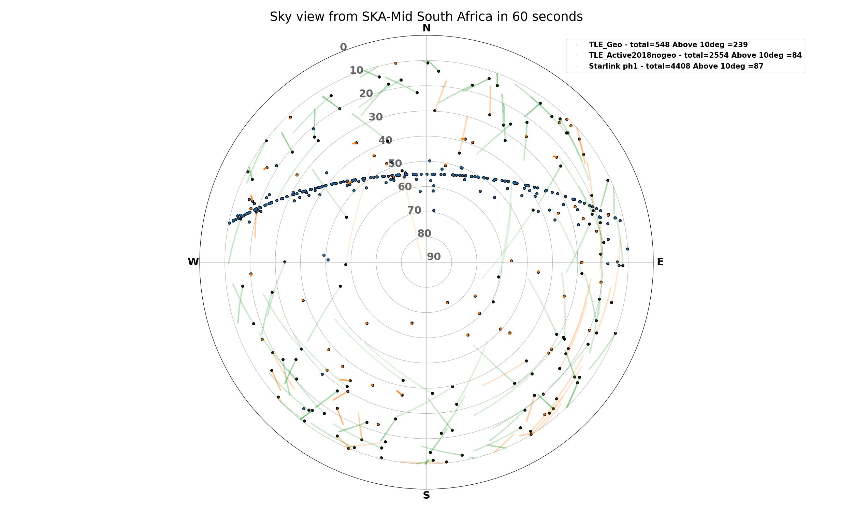
Sky view from South Africa Lat = -31 deg 60 seconds el>10 deg
Notes:
Although I suppose you are all aware of the situation with the very large satellite constellations, I wanted us to do a little exercise to warm up.
Imagine you are in South Africa (where SKA-Mid) is under construction, and you have a way to see where satellites are, (click) this is what we would see if we track the position of satellites above 10 deg elevation for 1 minute. Here you see the active satellites in 2018, before Starlink constellation was launched. (click-click) when Starlink and oneweb are both deployed in full the number of satellites above 10 deg will increase by about 100. But of course there are many more constellations, and many much larger than these two, (click) like for example the Guowang Chinese constellation (clik clik) and the OneWEb phase 2 and Starlink phase 2. (click) so in the case that operators deploy as many satellites as are planned, the number of satellites above 10 deg elevation will increase significantly. And this is not even the total number of planned constellations.

Slide 5
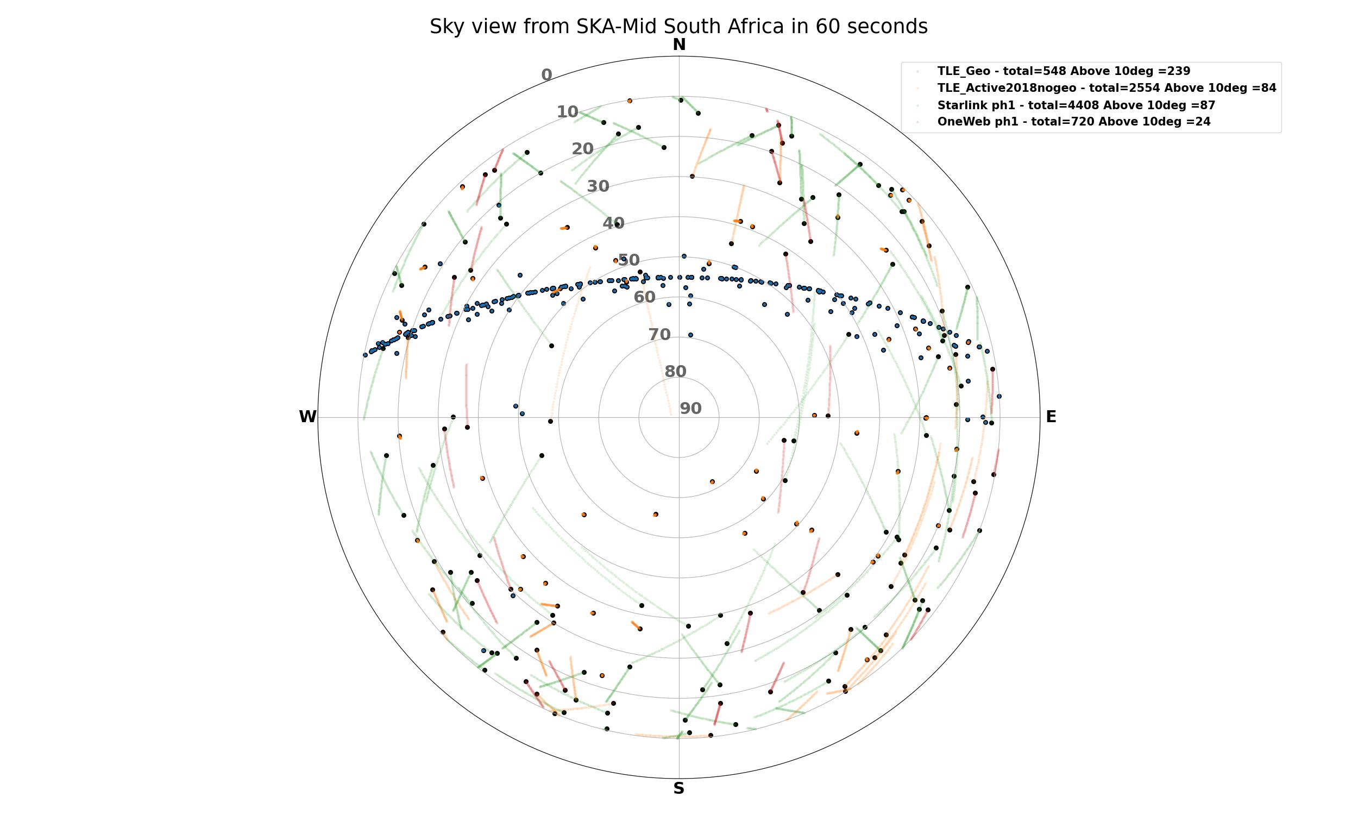
Sky view from South Africa Lat = -31 deg 60 seconds el>10 deg
Notes:
Although I suppose you are all aware of the situation with the very large satellite constellations, I wanted us to do a little exercise to warm up.
Imagine you are in South Africa (where SKA-Mid) is under construction, and you have a way to see where satellites are, (click) this is what we would see if we track the position of satellites above 10 deg elevation for 1 minute. Here you see the active satellites in 2018, before Starlink constellation was launched. (click-click) when Starlink and oneweb are both deployed in full the number of satellites above 10 deg will increase by about 100. But of course there are many more constellations, and many much larger than these two, (click) like for example the Guowang Chinese constellation (clik clik) and the OneWEb phase 2 and Starlink phase 2. (click) so in the case that operators deploy as many satellites as are planned, the number of satellites above 10 deg elevation will increase significantly. And this is not even the total number of planned constellations.

Slide 6
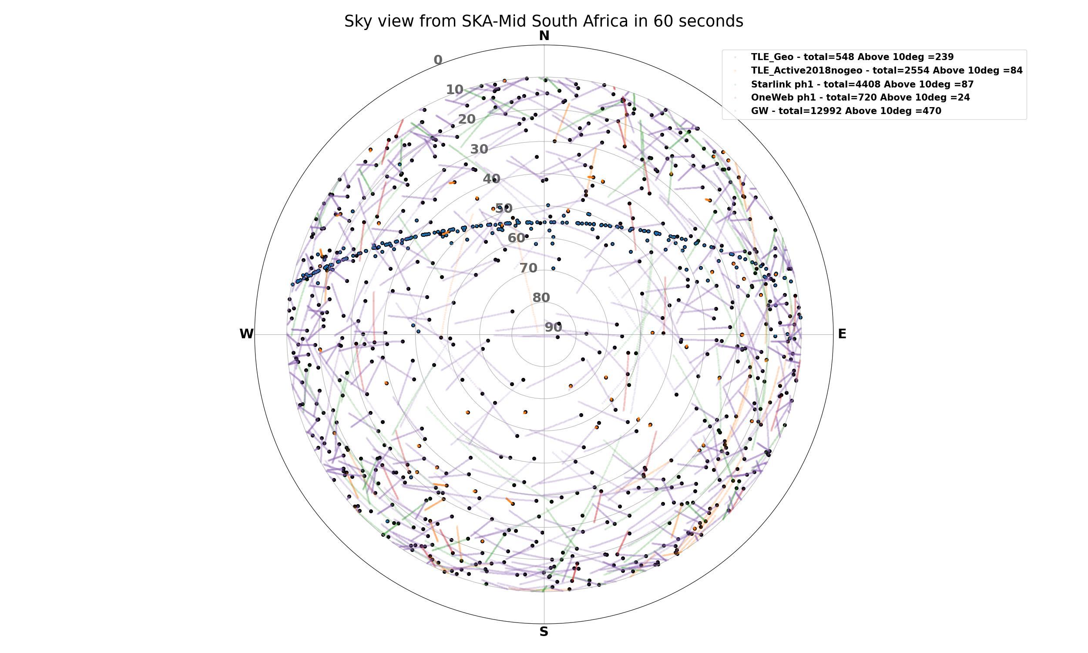
Sky view from South Africa Lat = -31 deg 60 seconds el>10 deg
Notes:
Although I suppose you are all aware of the situation with the very large satellite constellations, I wanted us to do a little exercise to warm up.
Imagine you are in South Africa (where SKA-Mid) is under construction, and you have a way to see where satellites are, (click) this is what we would see if we track the position of satellites above 10 deg elevation for 1 minute. Here you see the active satellites in 2018, before Starlink constellation was launched. (click-click) when Starlink and oneweb are both deployed in full the number of satellites above 10 deg will increase by about 100. But of course there are many more constellations, and many much larger than these two, (click) like for example the Guowang Chinese constellation (clik clik) and the OneWEb phase 2 and Starlink phase 2. (click) so in the case that operators deploy as many satellites as are planned, the number of satellites above 10 deg elevation will increase significantly. And this is not even the total number of planned constellations.

Slide 7
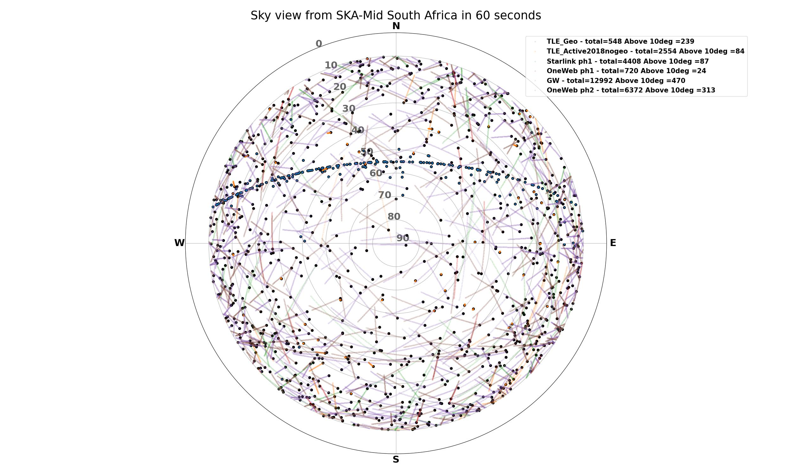
Sky view from South Africa Lat = -31 deg 60 seconds el>10 deg
Notes:
Although I suppose you are all aware of the situation with the very large satellite constellations, I wanted us to do a little exercise to warm up.
Imagine you are in South Africa (where SKA-Mid) is under construction, and you have a way to see where satellites are, (click) this is what we would see if we track the position of satellites above 10 deg elevation for 1 minute. Here you see the active satellites in 2018, before Starlink constellation was launched. (click-click) when Starlink and oneweb are both deployed in full the number of satellites above 10 deg will increase by about 100. But of course there are many more constellations, and many much larger than these two, (click) like for example the Guowang Chinese constellation (clik clik) and the OneWEb phase 2 and Starlink phase 2. (click) so in the case that operators deploy as many satellites as are planned, the number of satellites above 10 deg elevation will increase significantly. And this is not even the total number of planned constellations.

Slide 8
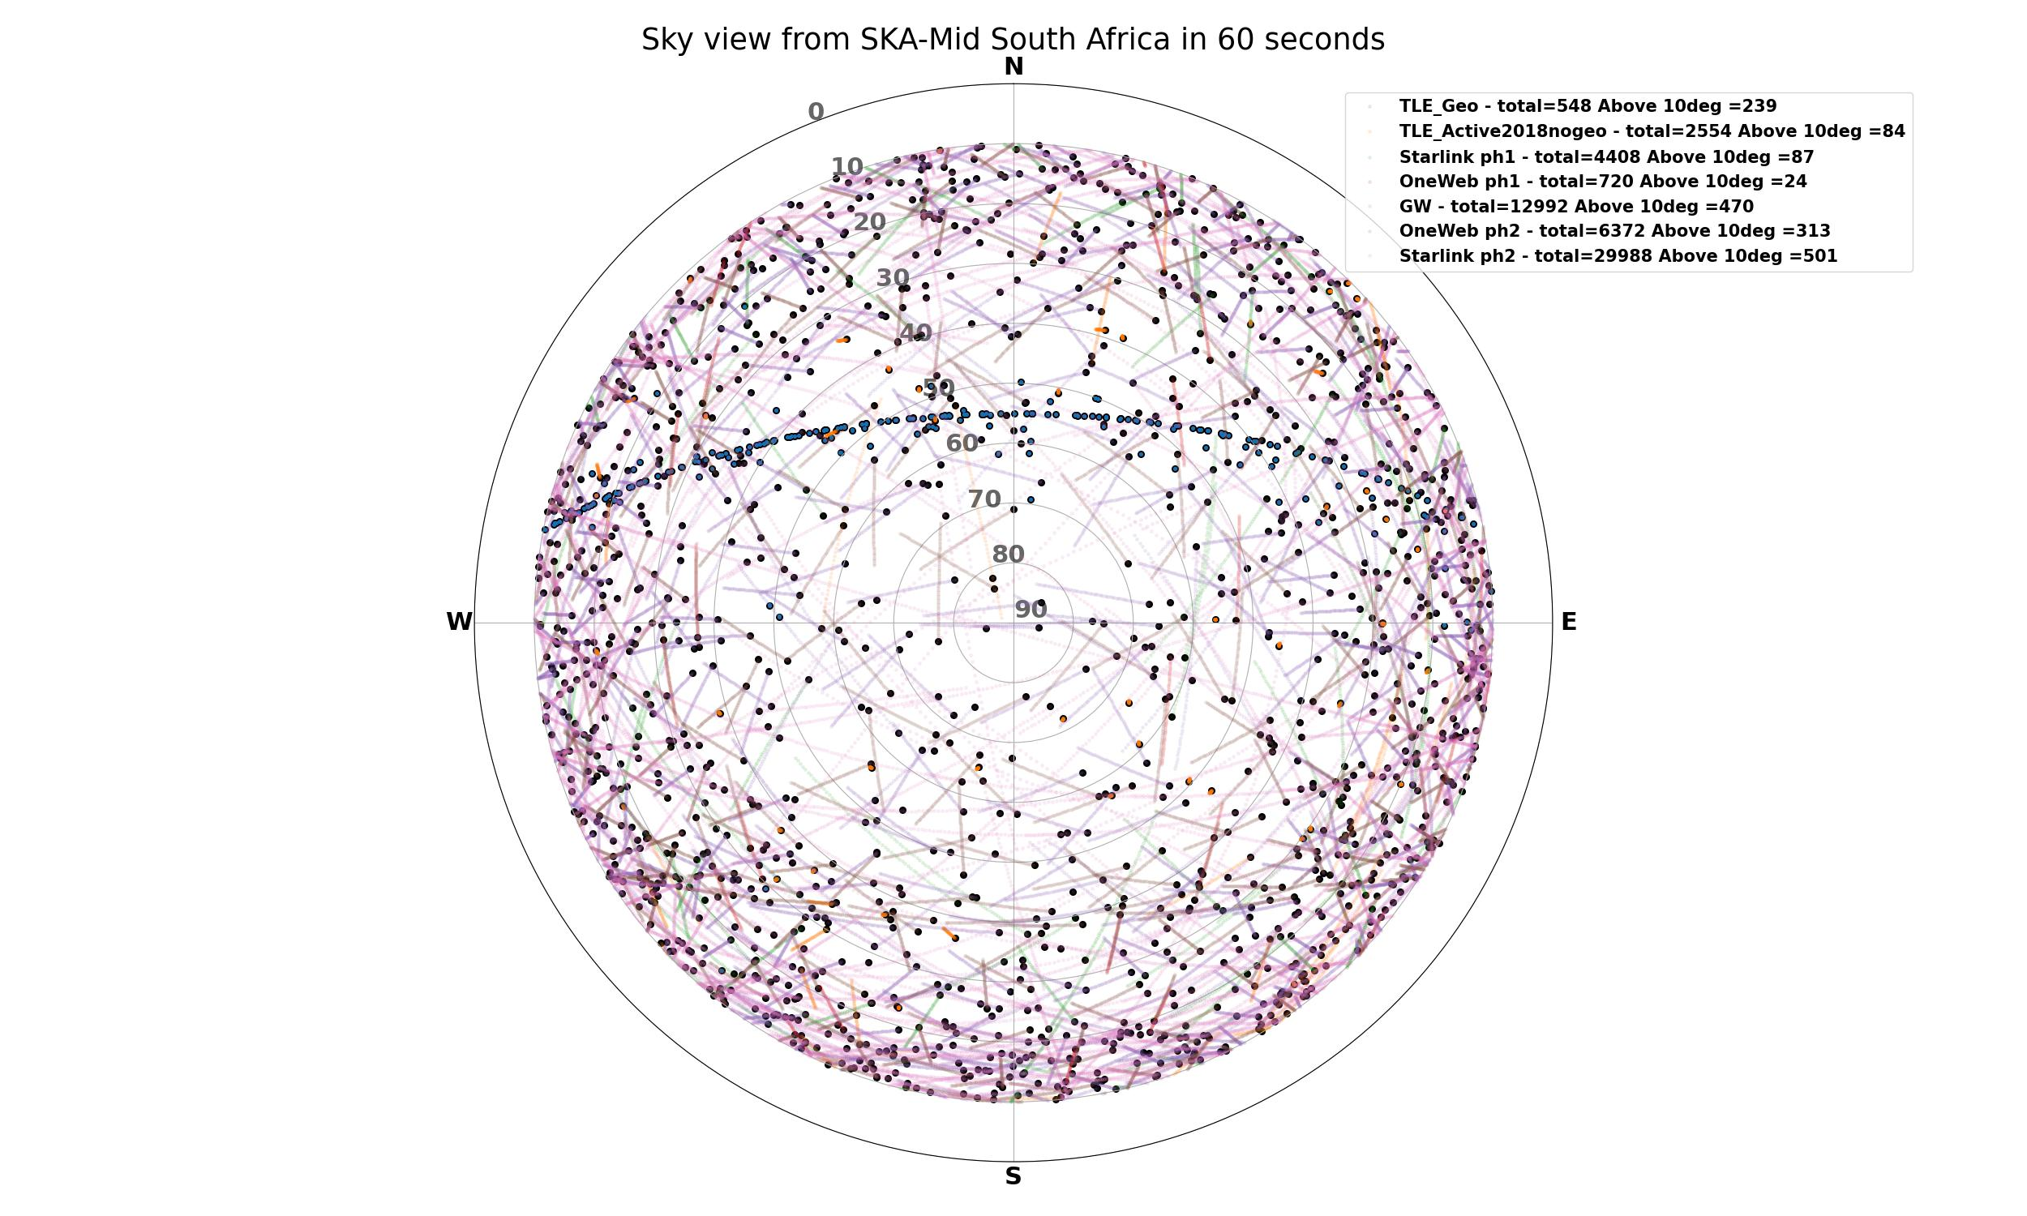
Sky view from South Africa Lat = -31 deg 60 seconds el>10 deg
Notes:
Although I suppose you are all aware of the situation with the very large satellite constellations, I wanted us to do a little exercise to warm up.
Imagine you are in South Africa (where SKA-Mid) is under construction, and you have a way to see where satellites are, (click) this is what we would see if we track the position of satellites above 10 deg elevation for 1 minute. Here you see the active satellites in 2018, before Starlink constellation was launched. (click-click) when Starlink and oneweb are both deployed in full the number of satellites above 10 deg will increase by about 100. But of course there are many more constellations, and many much larger than these two, (click) like for example the Guowang Chinese constellation (clik clik) and the OneWEb phase 2 and Starlink phase 2. (click) so in the case that operators deploy as many satellites as are planned, the number of satellites above 10 deg elevation will increase significantly. And this is not even the total number of planned constellations.

Slide 9
Sky view from South Africa Lat = -31 deg 60 seconds el>10 deg
Satellites from large-constellations above 10 deg = 1395
Notes:
Although I suppose you are all aware of the situation with the very large satellite constellations, I wanted us to do a little exercise to warm up.
Imagine you are in South Africa (where SKA-Mid) is under construction, and you have a way to see where satellites are, (click) this is what we would see if we track the position of satellites above 10 deg elevation for 1 minute. Here you see the active satellites in 2018, before Starlink constellation was launched. (click-click) when Starlink and oneweb are both deployed in full the number of satellites above 10 deg will increase by about 100. But of course there are many more constellations, and many much larger than these two, (click) like for example the Guowang Chinese constellation (clik clik) and the OneWEb phase 2 and Starlink phase 2. (click) so in the case that operators deploy as many satellites as are planned, the number of satellites above 10 deg elevation will increase significantly. And this is not even the total number of planned constellations.

Slide 10
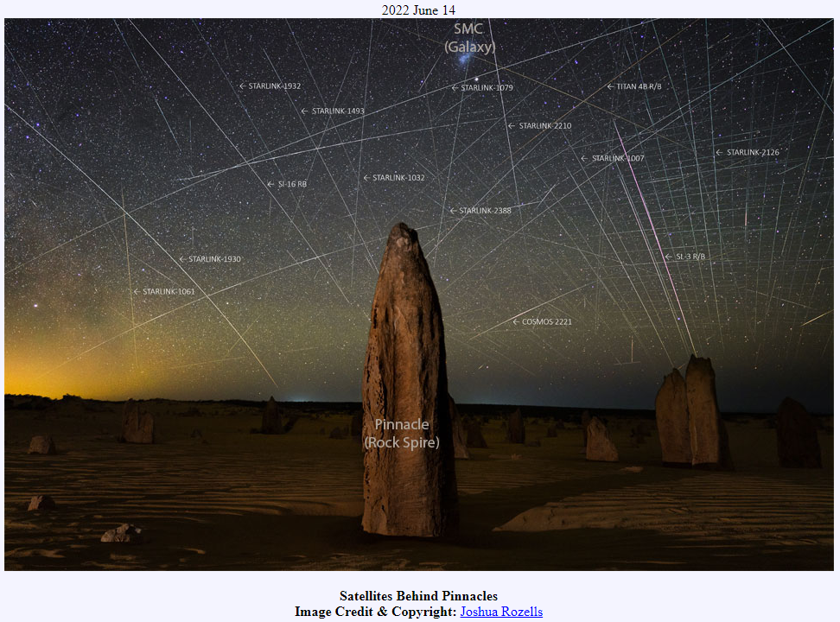
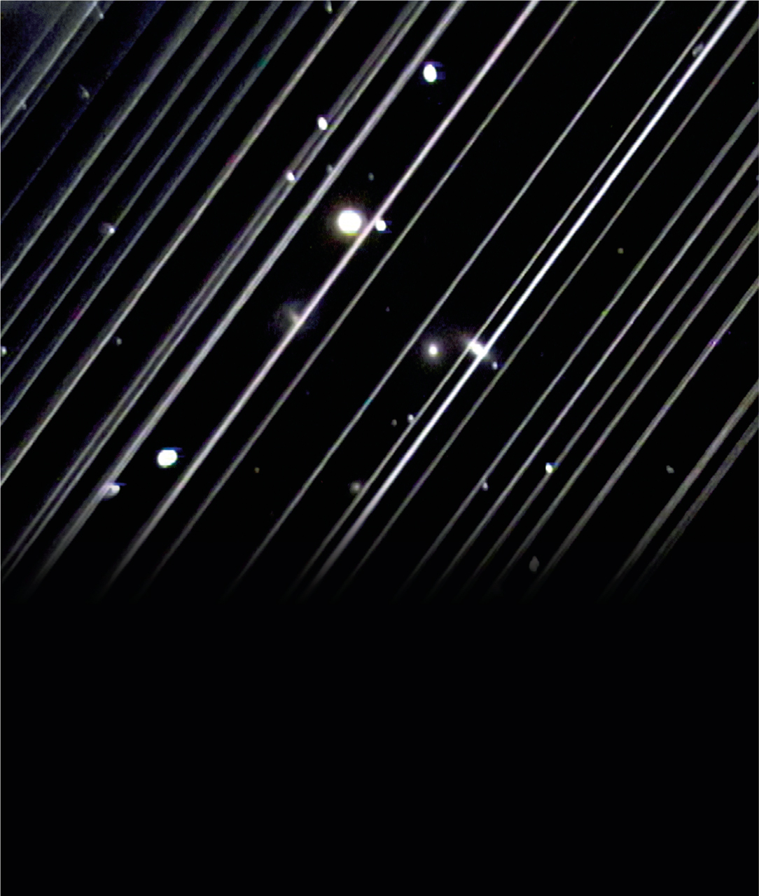
Effects of mega-constellations
Illuminated satellites can affect the Night Sky
Professional Astronomy
Nature
Tourism
Astro-photography
Amateur astronomy
Cultural heritage
Source: Victoria Girgis/Lowell Observatory
Notes:
All these constellations may affect the night sky by reflecting sunlight. Optical observatories, amateur astronomers, Nature, cultural heritage sites and many others could be affected by this. The sky is only one and humanity must use it sustainably.

Slide 11
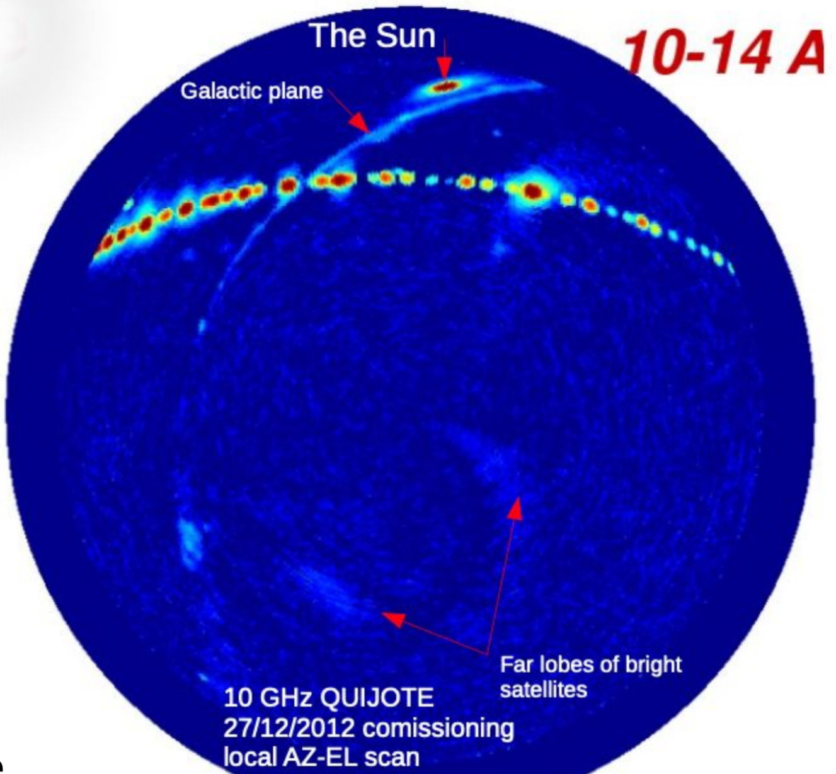
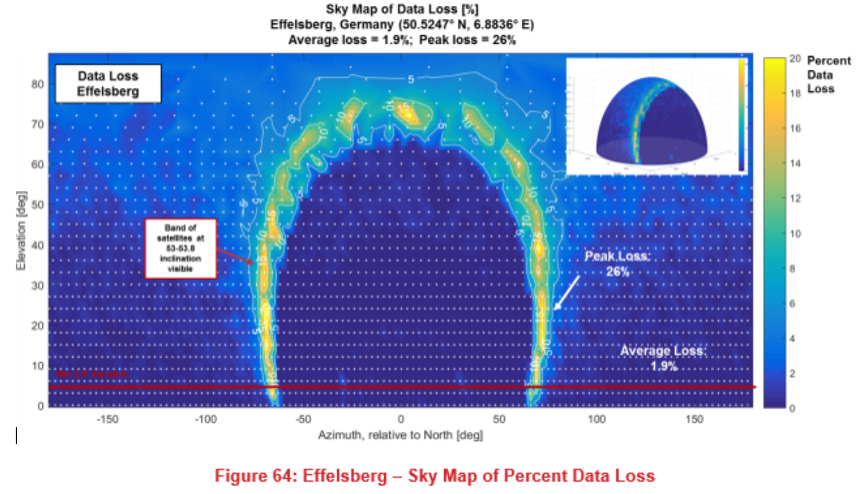
Effects of mega-constellations
Radio emissions from satellites can affect Radio Astronomy
Strong signals (beam to beam illumination)
Protected radio astronomy bands
Wideband observations in Radio Quiet Zones
Aggregated noise background for CMB
Radio astronomy protected freqs adjacent to constellations freqs
10.6-10.7 GHz
22.21 – 22.5 GHz
43.5 – 43.5 GHz
76 – 77.5 GHz
Observation with QUIJOTE in 2012 showing GEO satellites as a string of pearls in 10 GHz. Source Bob Watson/Mike Peel
Data loss in 10.6-10.7 GHz band from Starlink #1.
Source: ECC report 271
Notes:
Radio astronomy can also be impacted by these constellations in different ways: by strong signals when beam to beam coupling happens (ie. Radio telescope and satellite pointing to each other), or spurious emissions (meaning unwanted) leaking into adjacent radio astronomy bands, Wide frequency ranges could be affected in radio quiet zones, and the aggregated noise from all satellites could severely impact CMB observations.

Slide 12
The SKA Observatory + IAU response
SKAO:
Spectrum Management in ITU, highlighting the new challenges for radio astronomy
Simulate the effect and planning measurement campaigns of the currently deployed satellites
Collaborate with satellite operators to find feasible mitigation measures for the Radio Quiet Zones
Assist national regulator to study the impact to radio astronomy and implement protections
Permanent Observer in UN COPUOS
International Astronomical Union (IAU):
Promoting guidelines and regulations at the UN COPUOS level
Creation of the “IAU Centre for the Protection of the Dark and Quiet Skies from Satellite Constellation Interference” (SKAO and NSF’s NOIRLab)
Many national and regional astronomy groups:
EAS, RAS, AAS
Notes:
So what are we currently doing from SKAO and IAU? SKAO keeps working at the ITU-R level, highlighting the new challenges that radio astronomy faces with this. We have also conducted simulations of the impact in our observations with Band 5B and we are collaborating with operators and regulators to protect the SKA radio quiet zones. We participate as a permanent observer in UN COPUOS
The IAU on one front started working in UN COPUOS in about 2017, with documents, presentations and organizing support from national delegations to introduce the topic of D&QS.
On the other front, the IAU issued a call for proposals to establish a centre for the protection of the dark and quiet skies. SKAO and the NSF’s NOIRLab in the USA joined to propose what we know today as the CPS.

Slide 13
CPS - a brief summary https://cps.iau.org
The Centre will coordinate efforts and unify voices of the global astronomical community with respect to the protection of the Dark and Quiet Sky from satellite constellations.
The Centre will bring together astronomers, industry and the wider community and act as a bridge between all stakeholders to protect the dark and quiet skies.
The Centre will collect, produce and disseminate information and resources to which any stakeholder group will be able to contribute and draw in support of their own activities.
Will produce information open and free
Notes:
The CPS is a virtual centre, dedicated to coordinate the efforts of many volunteers from the astronomical community and other areas. It is also intended to act as a bridge to brign together astronomers, industry and other stakeholders and facilitate an open and collaborative discussion. The Centre collects, produces and disseminates information and resources that can be useful to all its membership, and very important these resources will be open and free.

Slide 14
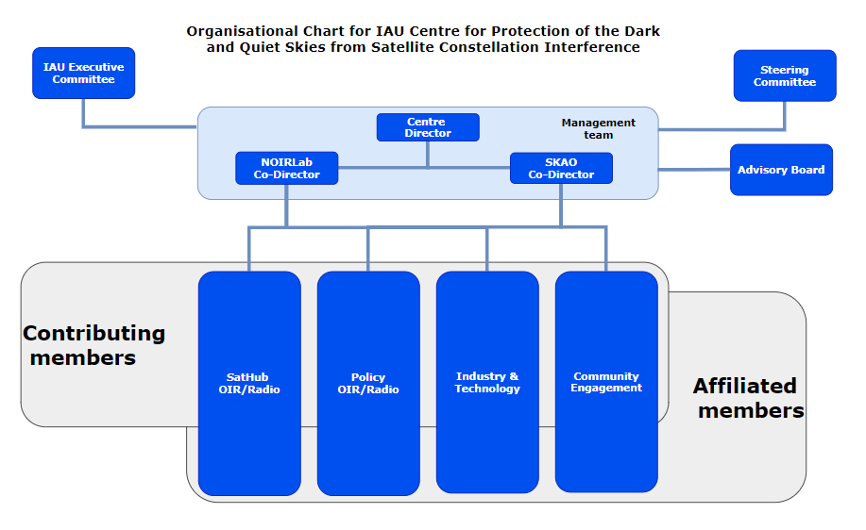
Organigram of the CPS
Piero Benvenuti (Director)
Connie Walker (Co-Director)
Federico Di Vruno (Co-Director)
Meredith Rawls (SatHub)
Mike Peel (SatHub)
Chris Hofer (Industry Hub)
Tim Stevenson (Industry Hub)
Jessica Heim (CE Hub)
John Barentine (CE Hub)
Andrew Williams (Policy Hub)
Richard Green (Policy Hub)
Carolyn Crichton (Governance support)
Charles Mudd (Legal advisor)
William McGinn (Project Manager)
90 Affiliated members (Oct 2022)
Notes:
Here is a diagram of the organisation of the CPS, with the management team in the middle, our governance structure on the top and a technical advisory board. In the box on the right you see the people that helped create the CPS and establish each of the four Hubs: SatHub, Policy Hub, Industry and Technologiy and Community Engagement.
And we are proud to announce that we have about 90 Affiliated members at the moment, these are individuals that have signed our collaboration agreement. This is very recent and the hub leaders are defining the groups and work packages where each member could collaborate.

Slide 15
Hubs spotlight
Notes:
Because there is not much time for this update, I wanted to quickly take you to some highlights for each hub:

Slide 16
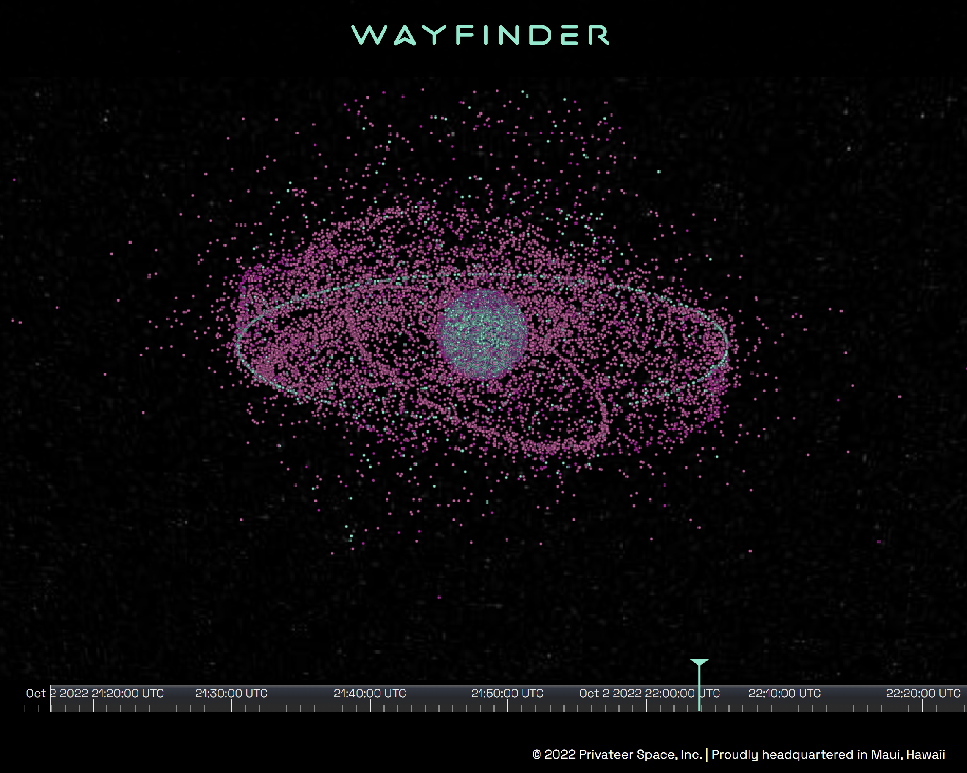
SatHub (observations, mitigation and prediction software)
Active collaboration on Slack for observations of satellites in optical and radio
Meet with Space Situational Awareness data provider to discuss possible collaborations to obtain high accuracy ephemerides and reflectivity predictions (Will establish a group of astronomers to test their data)
Assembling teams to develop software for prediction and post processing mitigation (free access)
Notes:
Sathub is all about Observations, mitigations in telescopes by astronomers and software development.
Sathub has:
Started the collaboration to carry out observations of satellites in optical and radio domain, where observations are starting to be shared.
Meet with a Space Situational Awareness data provider to discuss possible collaborations to obtain high accuracy ephemerides and reflectivity predictions. We are working on establishing a group of astronomers to test their data.
And it is assembling teams to develop software for prediction and post processing mitigation

Slide 17
Policy Hub
Working on the “Astronomy Module” for the Space Sustainability Rating
Expert group defined (4 optical, 2 radio)
Next meeting end October
IAU contributed a paper to the Informal Consultation on the Long Term Sustainability group of UN COPUOS
Assisting in coordination for next UN COPUOS STSC
Notes:
Policy hub started the discussions with the Space Sustainability rating team to define an “astronomy module” to potentially include in the rating. We see this as a very positive opportunity for astronomy since the SSR is very well known within the industry and would make all operators consider astronomy in some form. The policy hub has already identified a group of 6 experts who will meet at the end October for the first revision of the proposal.
Also Policy hub is collaborating with the IAU, ESO and SKAO in the work at UN COPUOS, only in coordination as the IAU is the permanent observer and not the CPS.

Slide 18
Community Engagement Hub
Developing an accessible document to communicate the situation with satellite constellations to a broad audience
Defining the focus groups to contact and invite to share perspectives on satellite constellations and the night sky.
Notes:
Community engagement hub is developing an accessible briefing document that describes the situation of the constellations, intended to reach a broad audience. And are building the core working group with experts and interested groups.

Slide 19
Industry Hub
Approaching and inviting constellation operators to the CPS
Developing an Astronomy 101 document for industry induction
Discussing reflectivity models and measurements and how the Astro community can verify them
Notes:
And finally Industry and technology is working on bringing more operators into the CPS, is developing an Astronomy 101 document intended for industry to give them the first general view on the challenge. Also within the industry group there are discussions about simulating, testing and verifying reflectivity.

Slide 20
Future activities

Slide 21
Future activities
4 Hub kick-off meetings with all members
Creating sub-working groups and produce the first outputs
Plan IAU 385 symposium “Astronomy and Satellite Constellations: Pathways Forward” (October 2023 - La Palma, Spain)
Establish Contributing Agreements (Organisations and Members)
Notes:
4 Hub kick-off meetings with all members
Creating sub-working groups and produce the first outputs
Plan IAU 385 symposium “Astronomy and Satellite Constellations: Pathways Forward” (October 2023 - La Palma, Spain)
Establish Contributing Agreements (Organisations and Members)

Slide 22
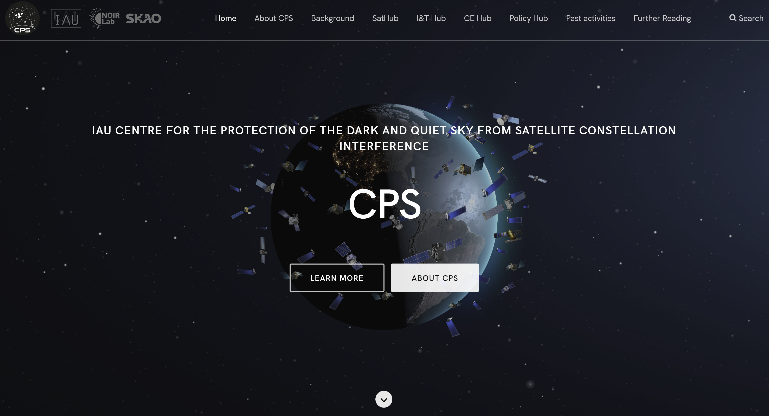
Thank you very much for your attention! info@iau.cps.org https://cps.iau.org Federico.divruno@skao.int

Slide 23
Extra slides

Slide 24
Hubs objectives
SatHub (Meredith Rawls, Mike Peel)
Astronomical Data Repository
Orbital Solution Portal
Software Tools
Training Curriculum
Real Time Collaboration
Industry & Technology Hub (Tim Stevenson, Chris Hofer)
Build Outreach Plan for Stakeholders & Public
Create Reference & Educational Materials
Advance Mitigations & Analytical Tools
Endorse Space Safety Initiatives Helpful to Astronomy
Encourage Implementation of Best Practices & Mitigations
Develop Standard Measures of Mitigation Success

Slide 25
Hubs objectives
Community Engagement Hub (Jessica Heim, John Barentine)
Identify the communities
The sat constellations as a case study
Fair-minded discussion material on technological development vs human progress
Collaboration with the IAU Offices (OAO, OAD, OAE)
Policy Hub (Andrew Williams, Richard Green)
Portal of existing national and international policies and regulations.
Policy forum for interested national policy makers and stakeholders (Fall 2022)
Coordinate actions (in D&QS) among COPUOS Delegates and Observers
Study and compare ITU-R regulations for possible extensions to O/IR case

