Slide 1
High-resolution simulations of subsonic Turbulence using SPH-EXA
Axel Sanz (Universitat Politècnica de Catalunya)
Rubén Cabezón (sciCORE - University of Basel)
Domingo García-Senz (Universitat Politècnica de Catalunya)
Osman Seckin (University of Basel)
Sebastian Keller (Swiss National Supercomputing Centre, CSCS)
Florina Ciorba (University of Basel)

Slide 2
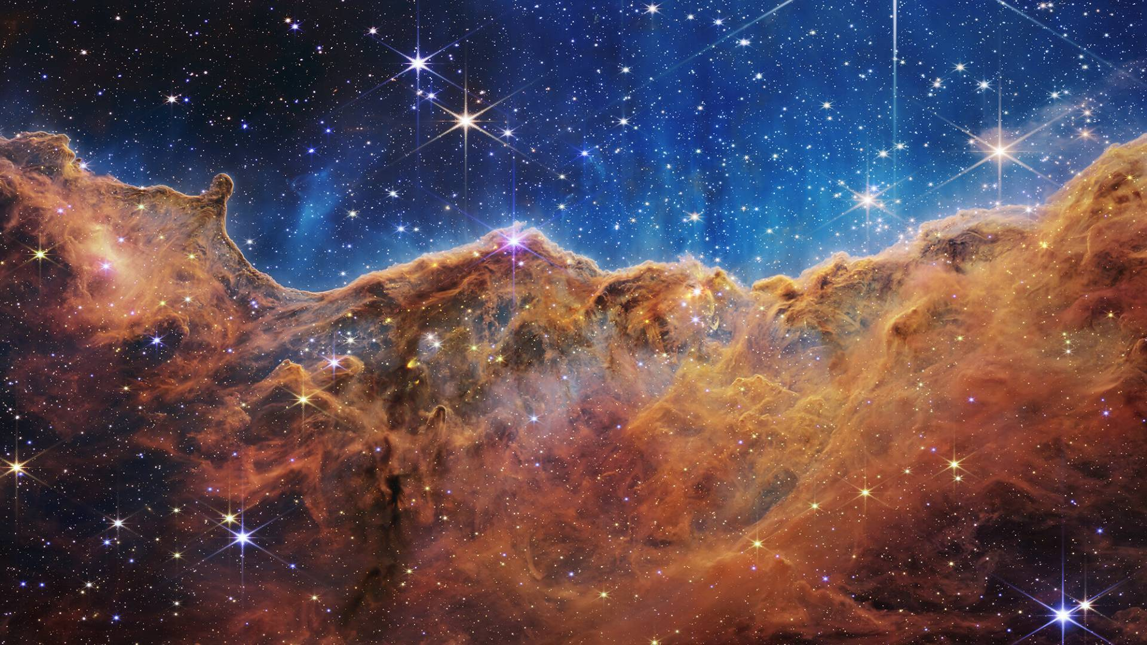
Why caring about turbulence in Astrophysics?
2
SN Ia ignition
Star Formation
SN Ia of a rapidly rotating WD as a delayed detonation
Credit: M. Fink, M. Kromer, et al. (2020)
James Webb telescope image of Carina Nebula.
Credit: NASA, ESA, CSA, and STScI (2022)

Slide 3
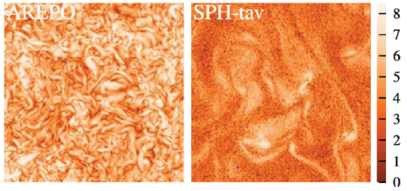
Previous Work: issues in SPH at subsonic regimes
3
Latest important work on SPH-based turbulence by Andreas Bauer & Volker Springel (2012).
Old SPH formulation (based on standard SPH from 70s & 80s) provided poor results due to lack of small scale structure. Causes:
Low accuracy calculation of gradients
Viscosity (Artificial Viscosity) to be improved
New methods for improving these results:
Integral approach to gradients, AV switches & cleaning, generalized Volume Elements
Achieved higher resolutions (N = 1000³)
velocity field
curl field

Slide 4
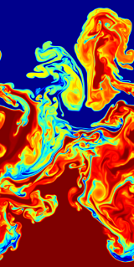
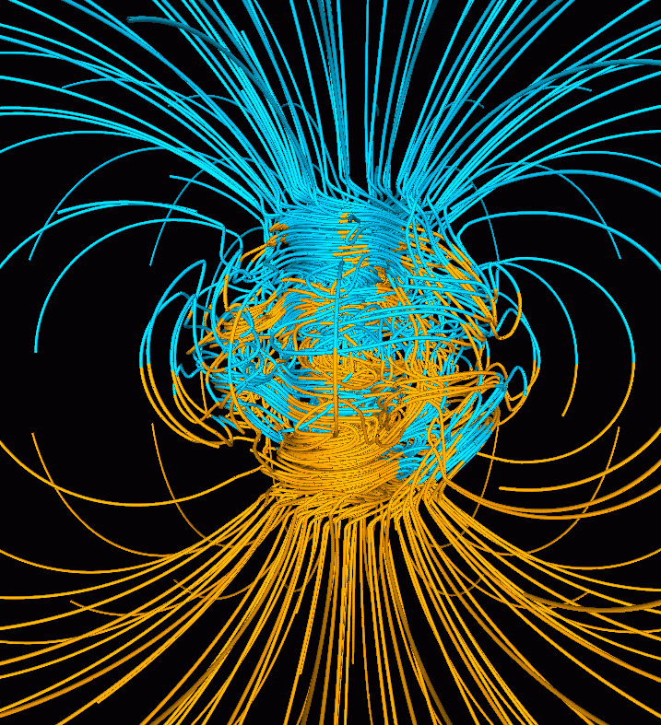
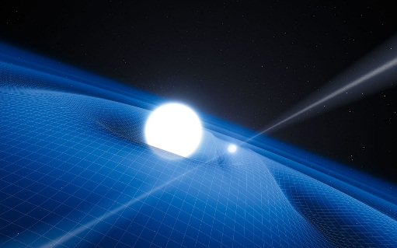
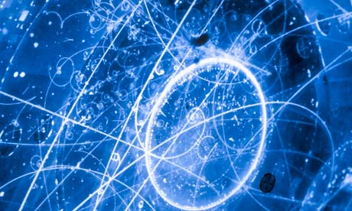
SPH-EXA: Smoothed Particle Hydrodynamics at Exascale
4
SPH-EXA¹: first Swiss scalable and fault-tolerant SPH framework.
Interdisciplinary co-design between computer scientists, astrophysicists, cosmologists, and visualization specialists.
Provides optimized C++ implementation, employing adaptive load balancing and fault-tolerance.
Implements basic to advanced SPH operands.
Extensible framework that can be collaboratively added for high performance and scalability.
Hydrodynamics
Magnetic fields
General Relativity
Nuclear Physics
1: SPH-EXA repo: https://github.com/unibas-dmi-hpc/SPH-EXA

Slide 5
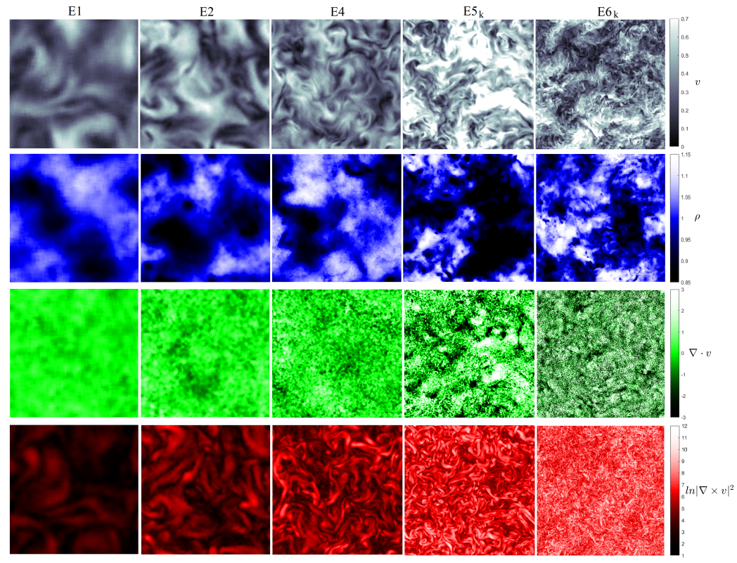
Results
5
New SPH formulation + higher resolution allows reaching smaller scales without losing them to dissipation.
Implemented on SPH-EXA framework.
Simulations run on
Piz Daint (CSCS)
Number of particles:
50³ 100³ 200³ 400³ 1000³

Slide 6
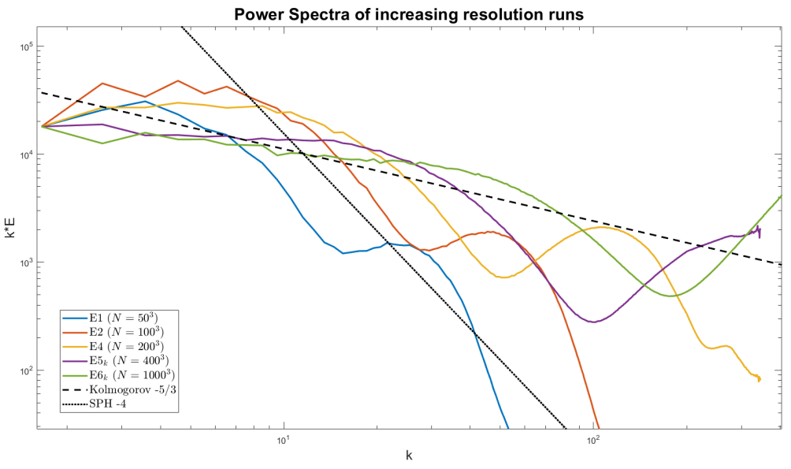
Power Spectra for Increasing Number of Particles (N)
6
Increasing resolution further sustains energy before decaying to ~ -4 slope characteristic of SPH.
More resolution also extends the inertial range similar to Kolmogorov slope

Slide 7
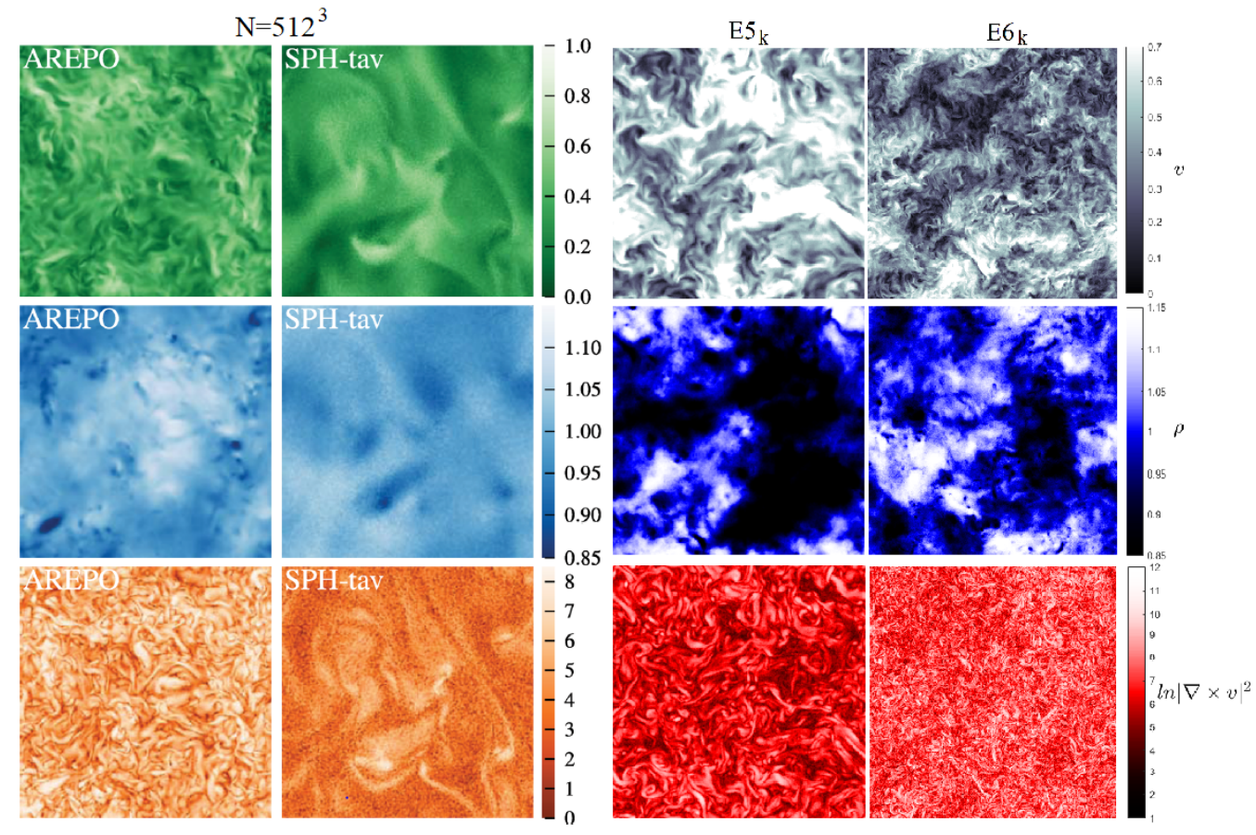
Conclusions
7
Achieved competitive results with SPH-EXA (comparable to mesh-based codes).
Clear evidence hinting to a much extended inertial range than in previous studies.
The inertial range depends on resolution, not the case in previous works due to the errors in SPH derivatives
Results obtained with SPH-EXA (github.com/unibas-dmi-hpc/SPH-EXA)

Slide 8
Acknowledgments
8
axel.sanz@estudiantat.upc.edu
ruben.cabezon@unibas.ch
domingo.garcia@upc.edu
osman.simsek@unibas.ch
keller@cscs.ch
florina.ciorba@unibas.ch

Slide 9
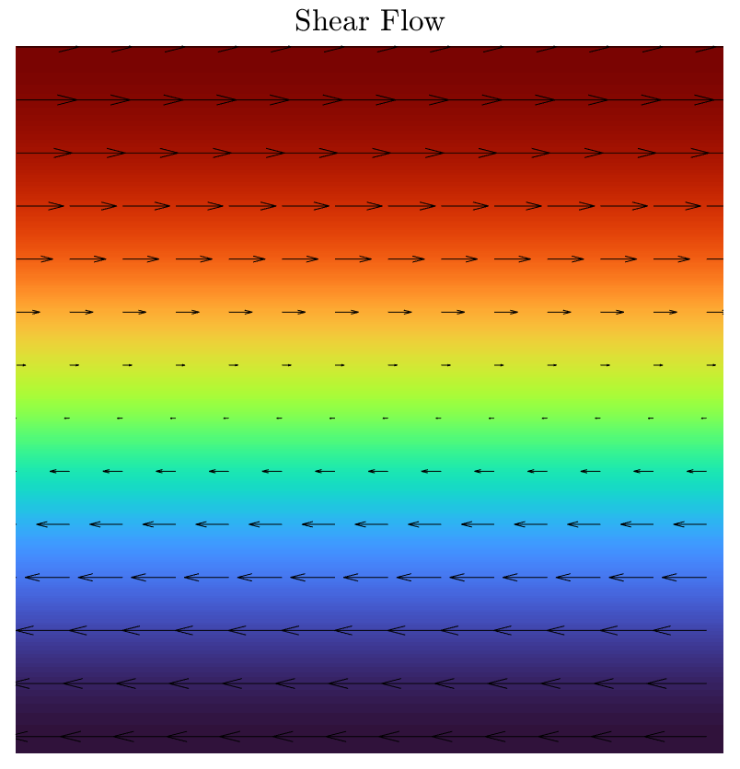
Backup Slides: Artificial Viscosity
Algorithm used to mimic viscous effects in the fluid
Accurate at super-sonic regimes and shocks,
but typically poor for sub-sonic velocities.
AV active when particles approach each other:
Problems in shear flows due to no compression

Slide 10
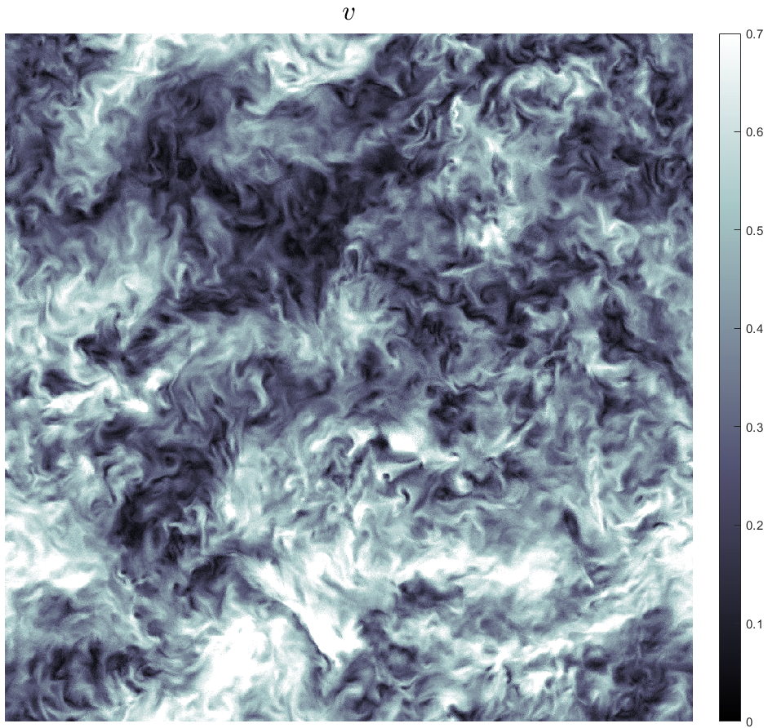
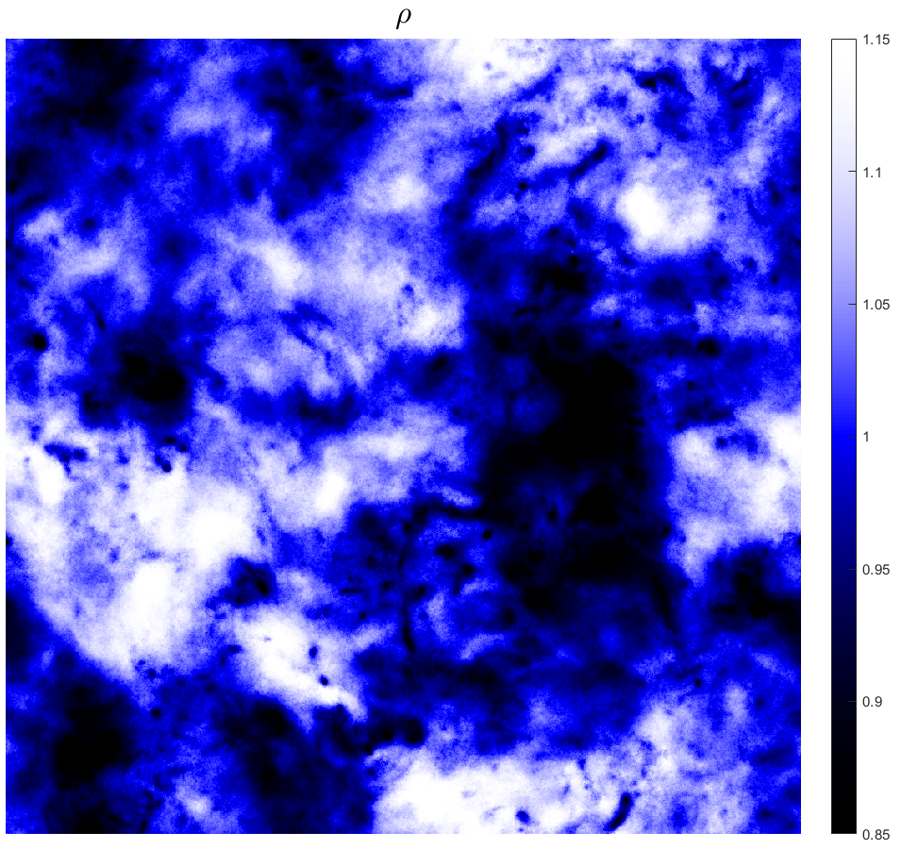
Backup Slides: Highest resolution run (N = 1000³)

Slide 11
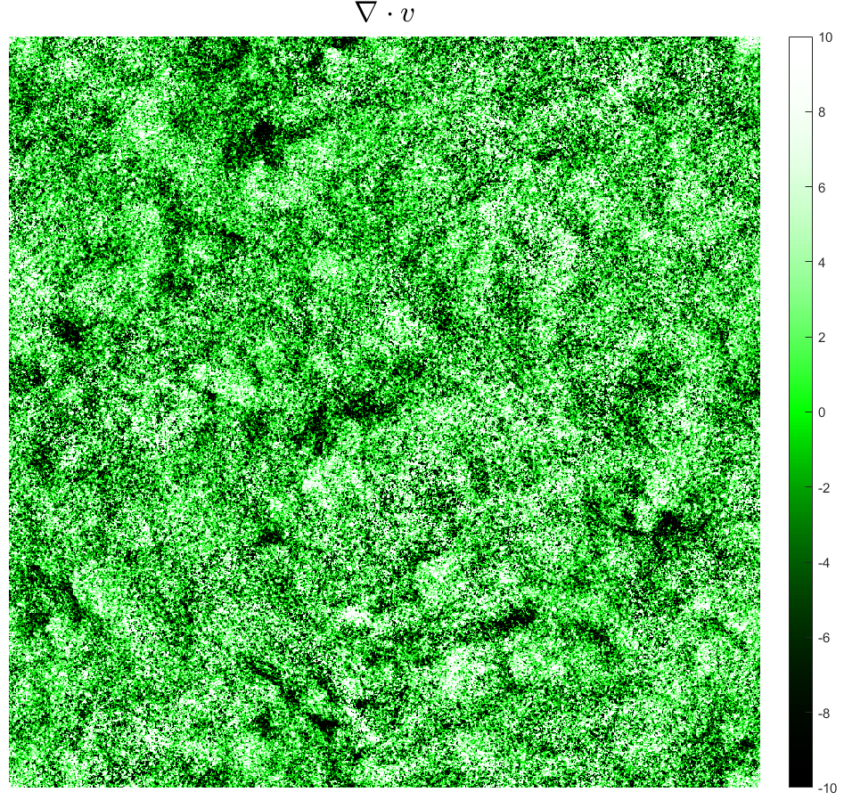
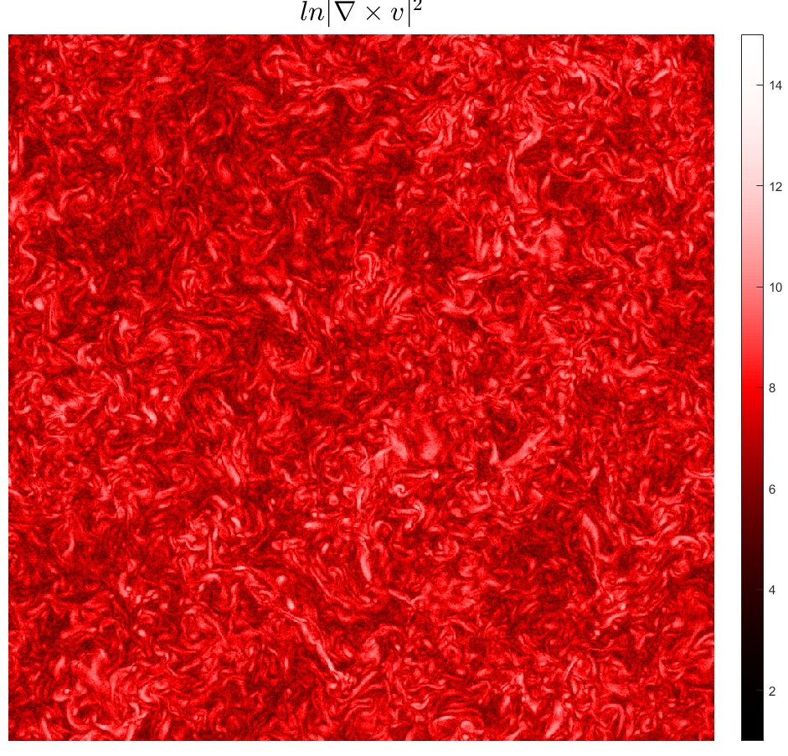
Backup Slides: Highest resolution run (N = 1000³)

