Slide 1



Radio-astronomical imaging with HIP
In collaboration with:
Bram Veenboer
Stefano Corda
stefano.corda@epfl.ch
04-10-2022
Swiss SKA Days, Lugano

Slide 2
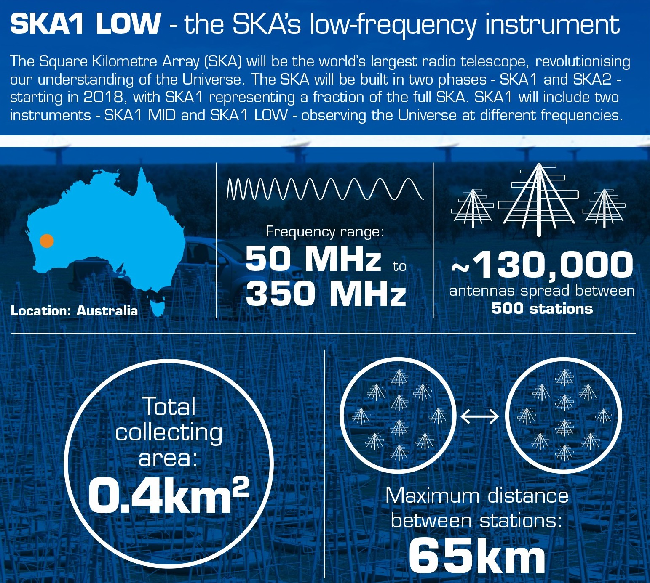
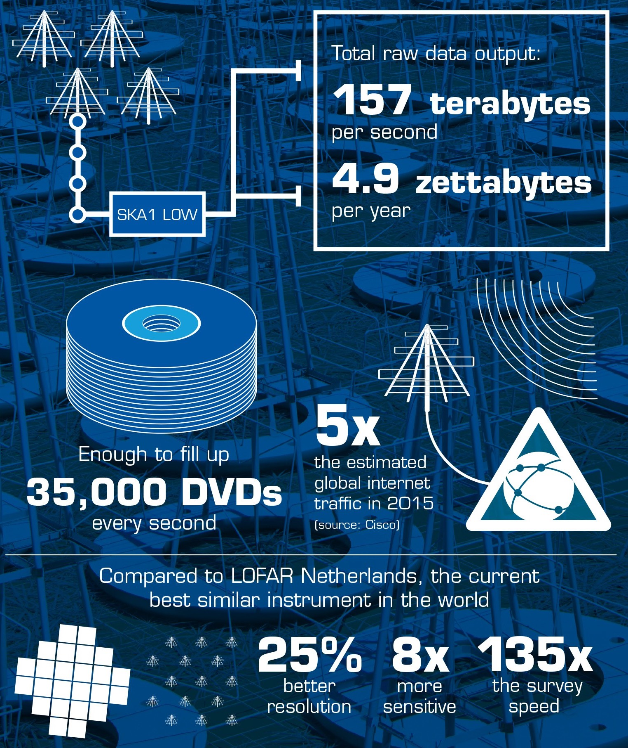
Square Kilometre Array Challenge
SKA (Square Kilometre Array) requirements (per Science Data Processor (SDP) site):
  ~ 260 PFlop/s
  ~ 157 TB/s
  ~ 5 MW
https://netherlands.skatelescope.org/2016/11/03/ogen-gericht-op-de-toekomst-tijdens-staatsbezoek-australie/
B. Veenboer et al., “Image-Domain Gridding on Graphics Processors” IPDPS 2017

Slide 3
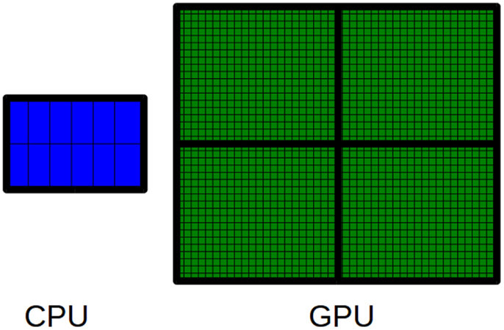
Hardware trend
Accelerators (GPUs and FPGAs) achieve better performance and energy efficiency than CPUs.
Interesting competition in the GPU market (AMD vs NVIDIA).
AMD systems are in the first positions of TOP500 and Green500 (ISC 22).
A. Manconi et al. “G-CNV: A GPU-based tool for preparing data to detect CNVs with read-depth methods”, Frontiers in Bioengineering and Biotechnology 2015

Slide 4
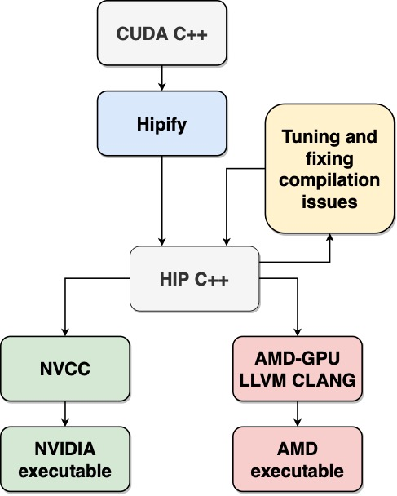
HIP
Portability: code is compiled with NVIDIA or AMD compilers.
Programmability: semantic is similar to CUDA (> 99%).
  First attempt (industry partner from France):
  Porting all CUDA code to HIP with Hipify
  Fixed some compilation issues
  Same performance on NVIDIA GPUs
  Poor performance on AMD GPUs
→Start again, port one kernel at a time

Slide 5
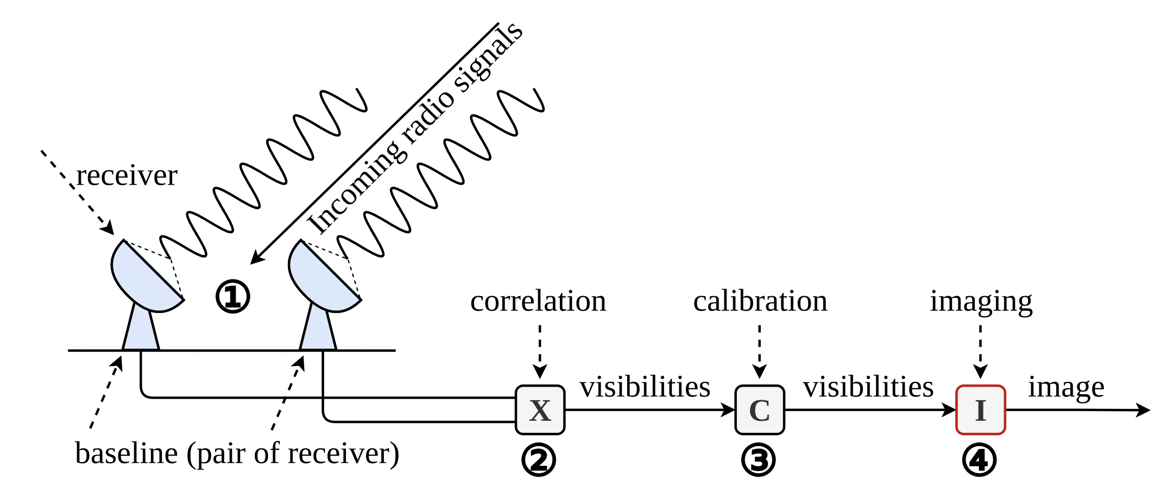
Interferometry
U. Rau et al., “Advances in Calibration and Imaging Techniques in Radio Interferometry”, Proceedings of the IEEE 2009

Slide 6
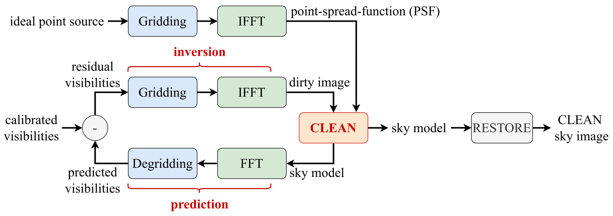
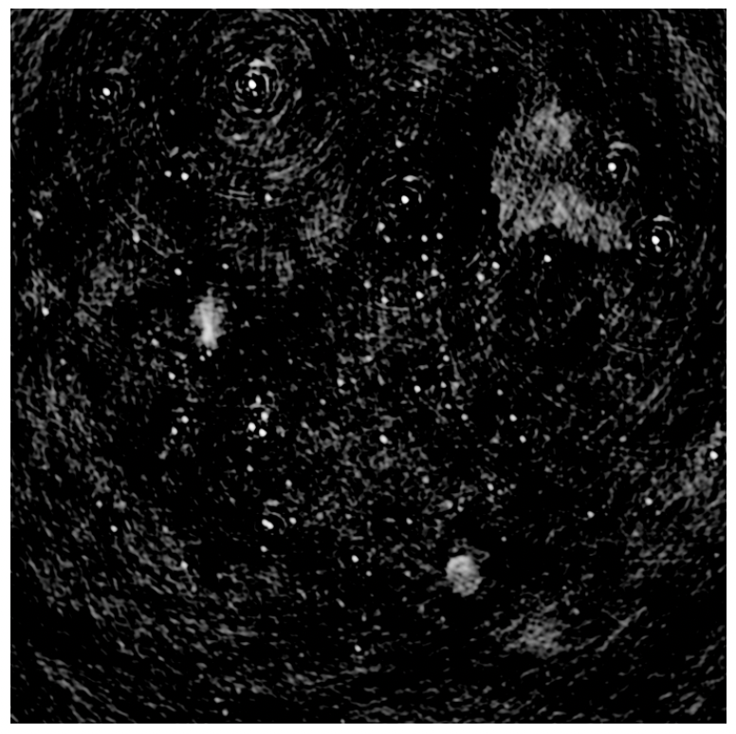
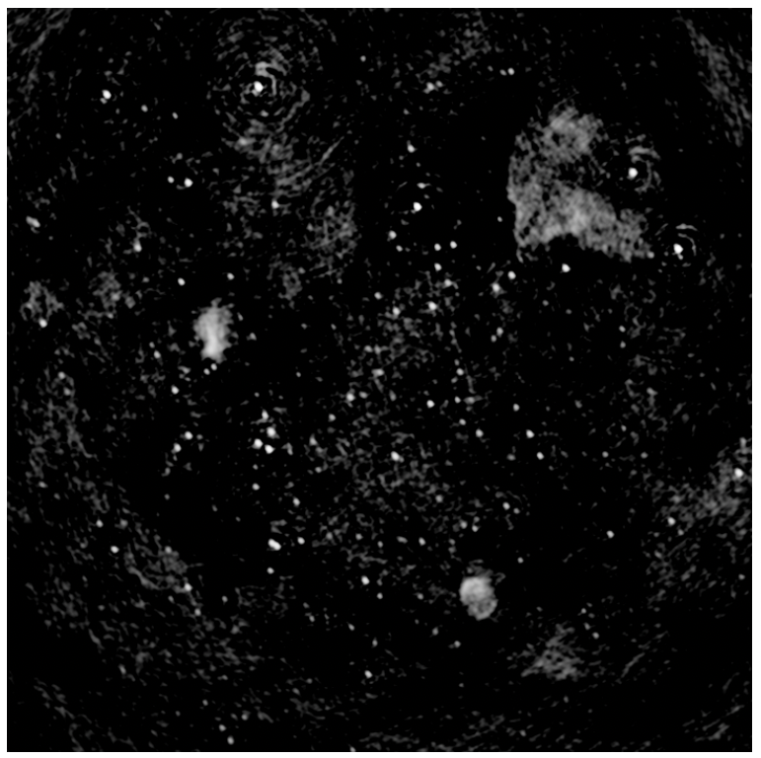
Radio-astronomical imaging
Image-Domain Gridding (IDG)
S. Van der Tol et al., “Image Domain Gridding: a fast method for convolutional resampling of visibilities”, A&A 2018
A. R. Offringa et al., “An optimized algorithm for multiscale wideband deconvolution of radio astronomical images”, MNRAS 2017
S. Corda et al, “Near memory acceleration on high resolution radio astronomy imaging”, MECO 2020
S. Corda et al., “Reduced-precision acceleration of radio-astronomical imaging on reconfigurable hardware”, IEEE ACCESS 2022

Slide 7
Performance Metrics
The visibilities, which are correlations of station signals, contain information on amplitude and phase of the source.
  MVis/s: number of Mega Visibilities per second (throughput)
  MVis/J: number of Mega Visibilities per Joule (energy efficiency)

Slide 8
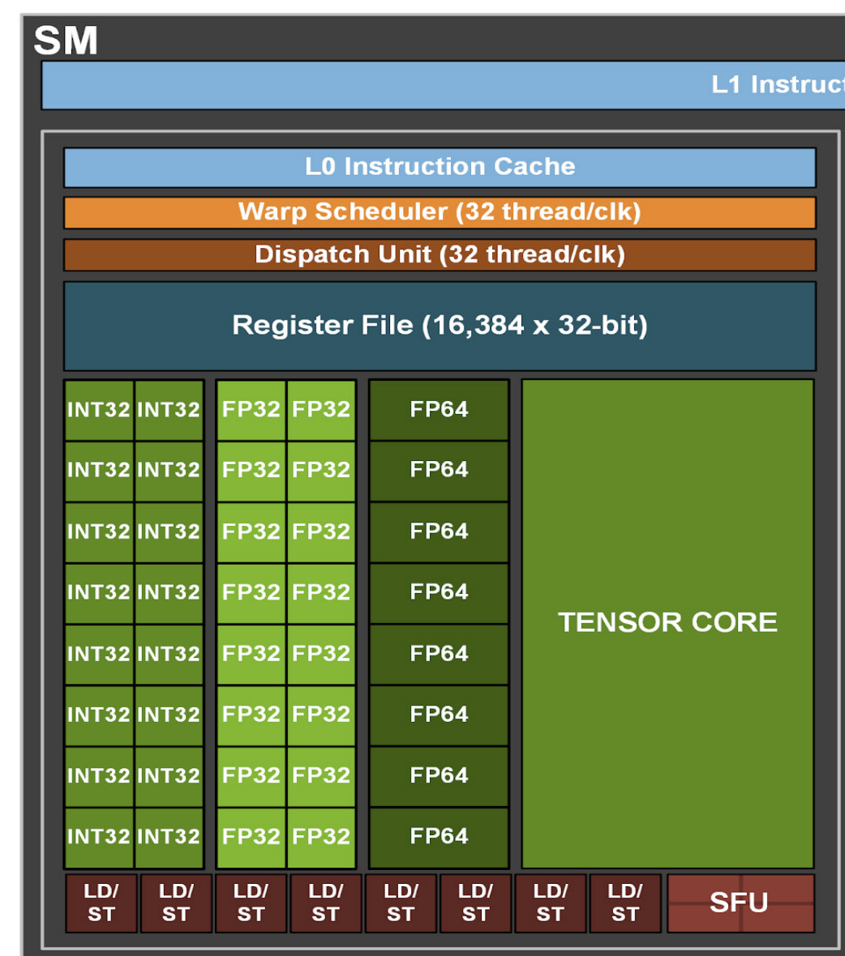
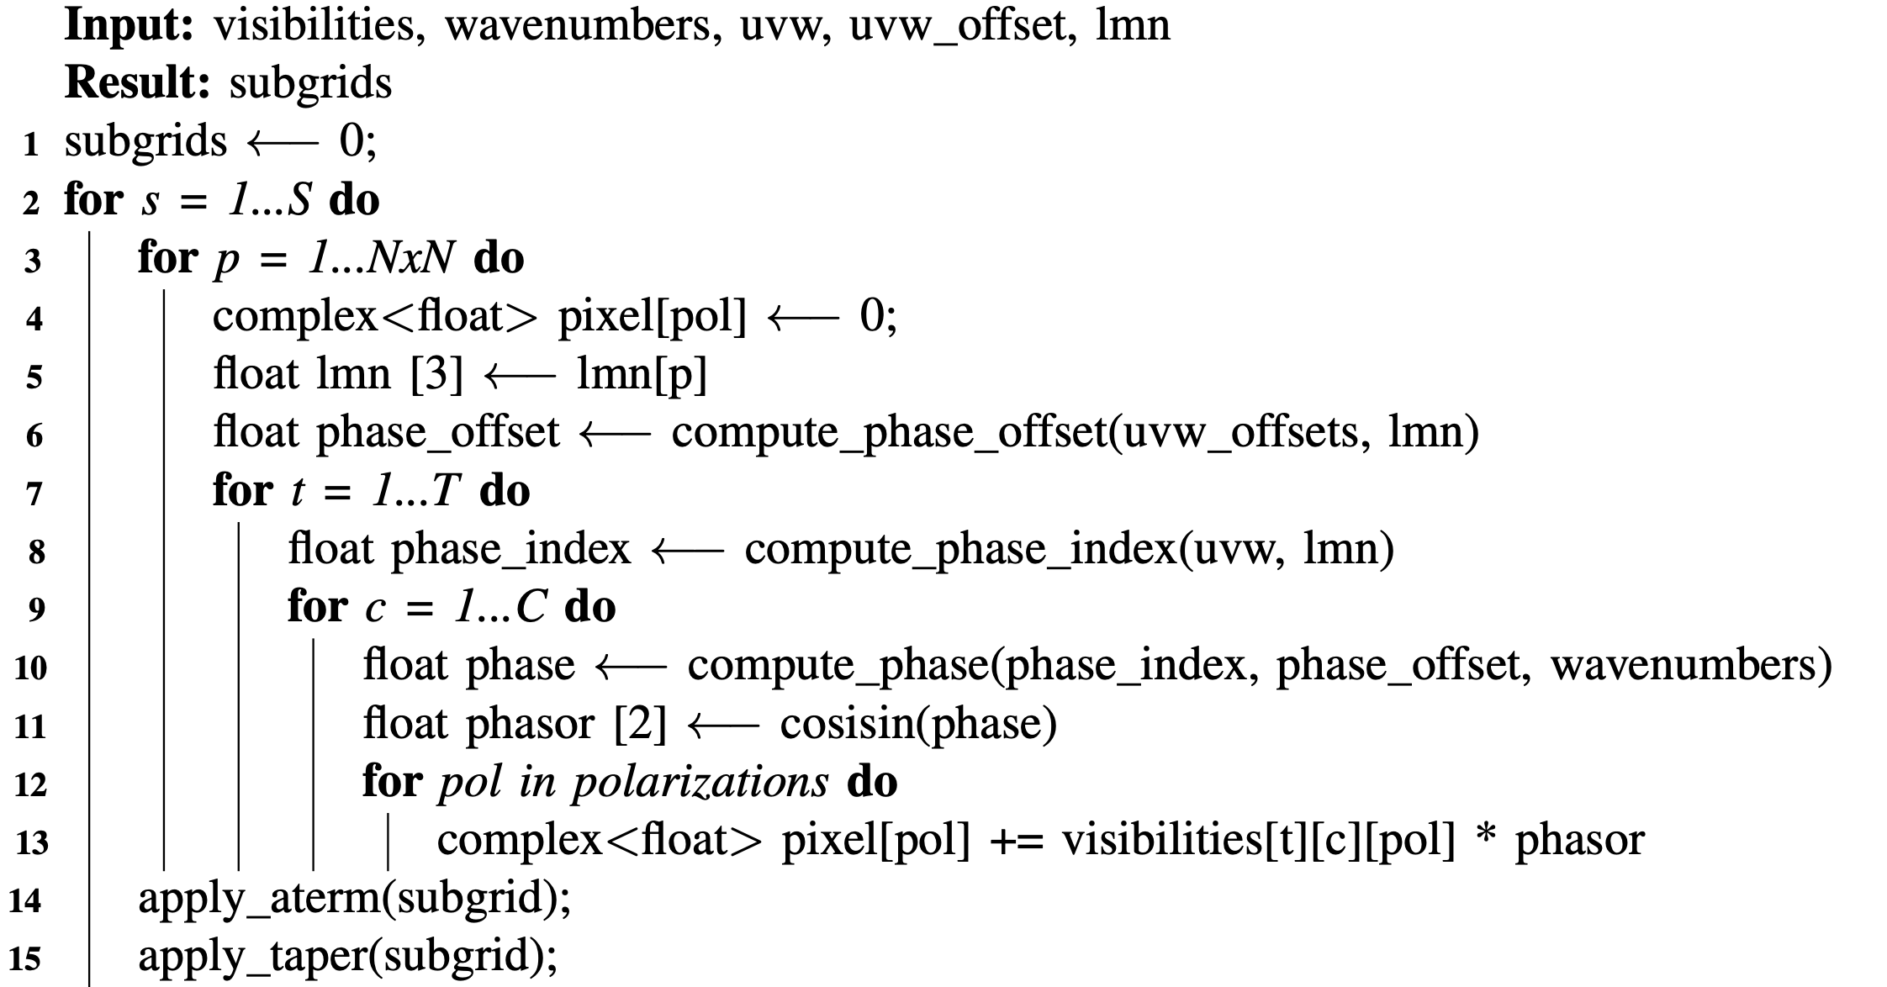
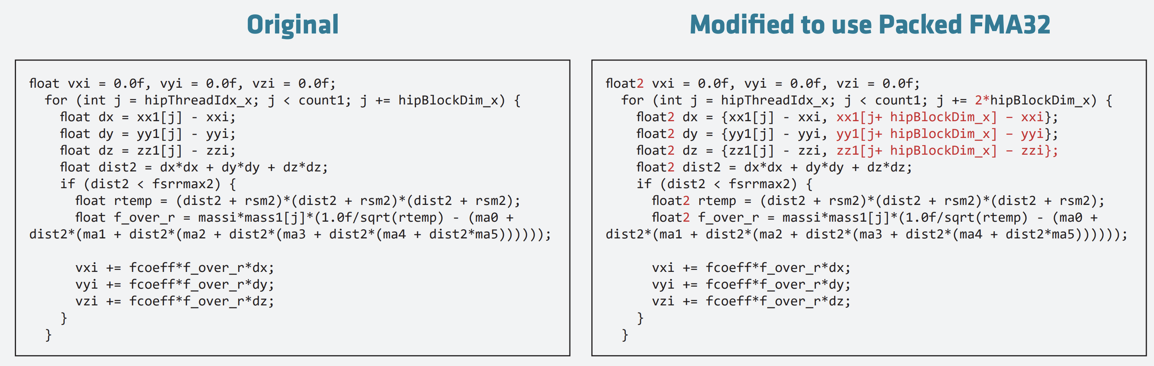
Optimizations
v2
v5/v6
v9
NVIDIA A100 whitepaper
AMD CNDA2 whitepaper

Slide 9
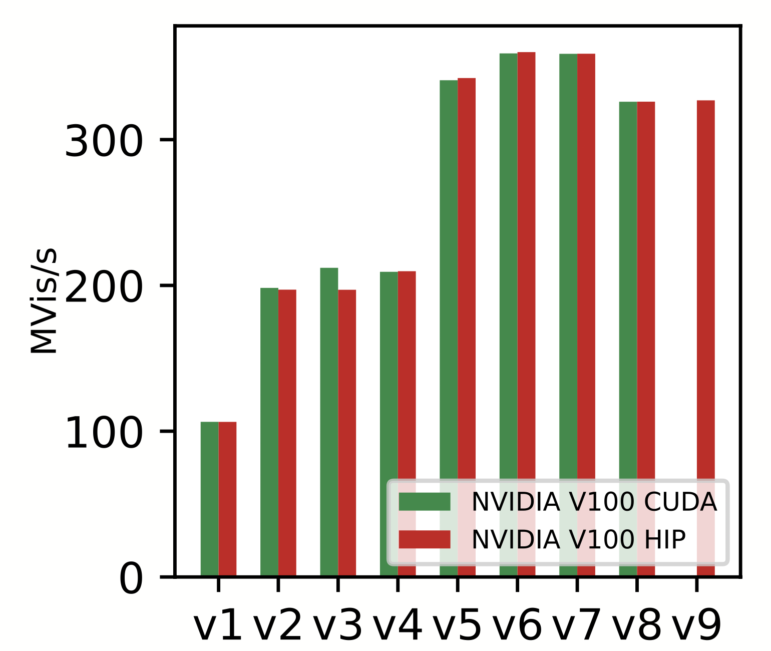
V100: CUDA vs HIP
Marginal differences
Certain optimization are better implemented by HIP and others by NVIDIA compiler

Slide 10
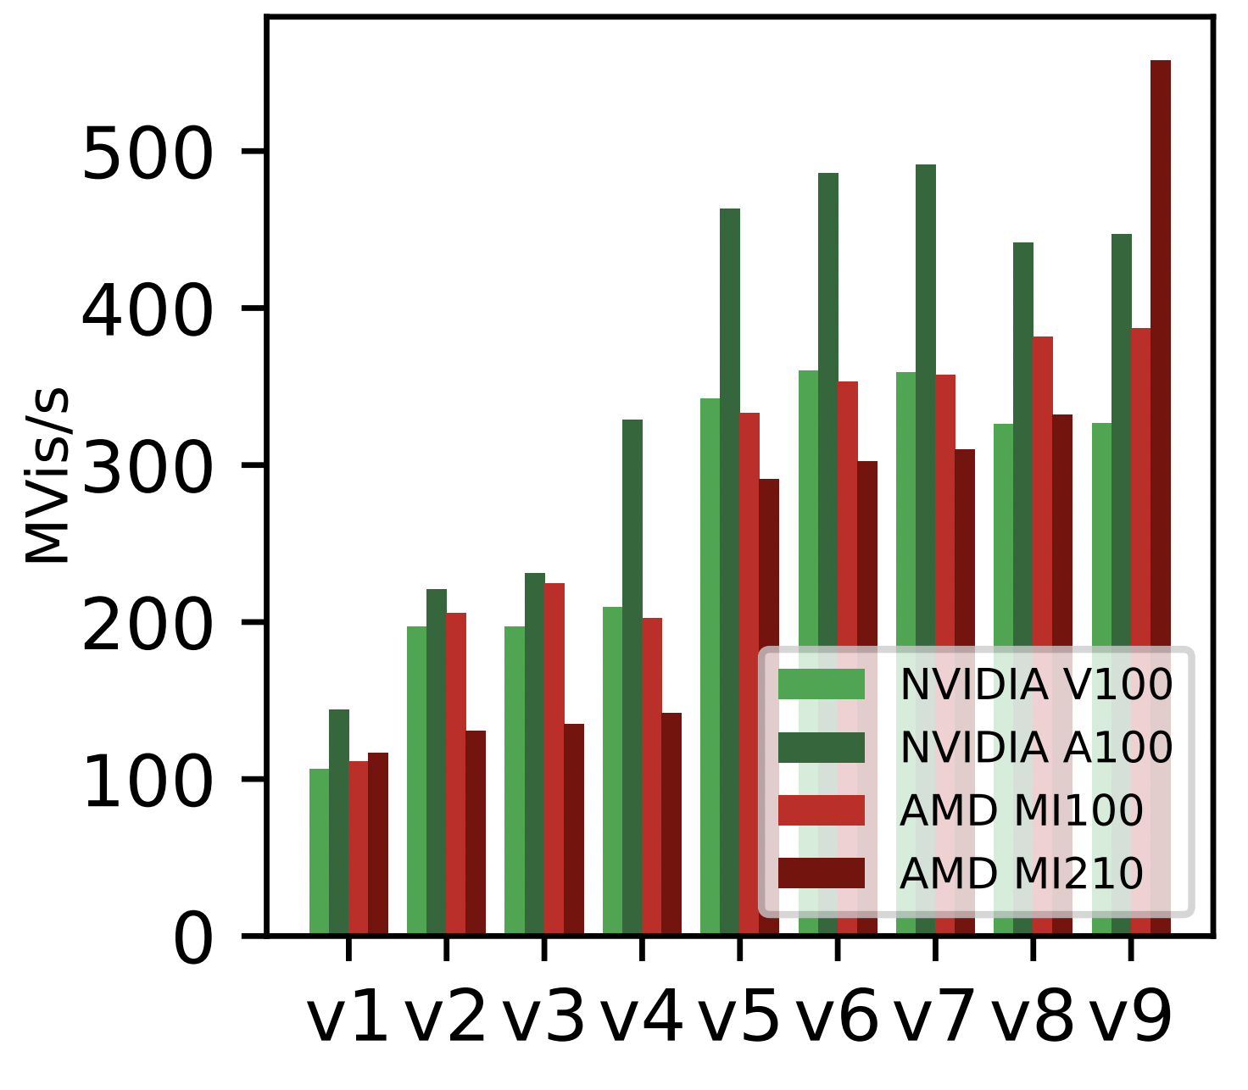
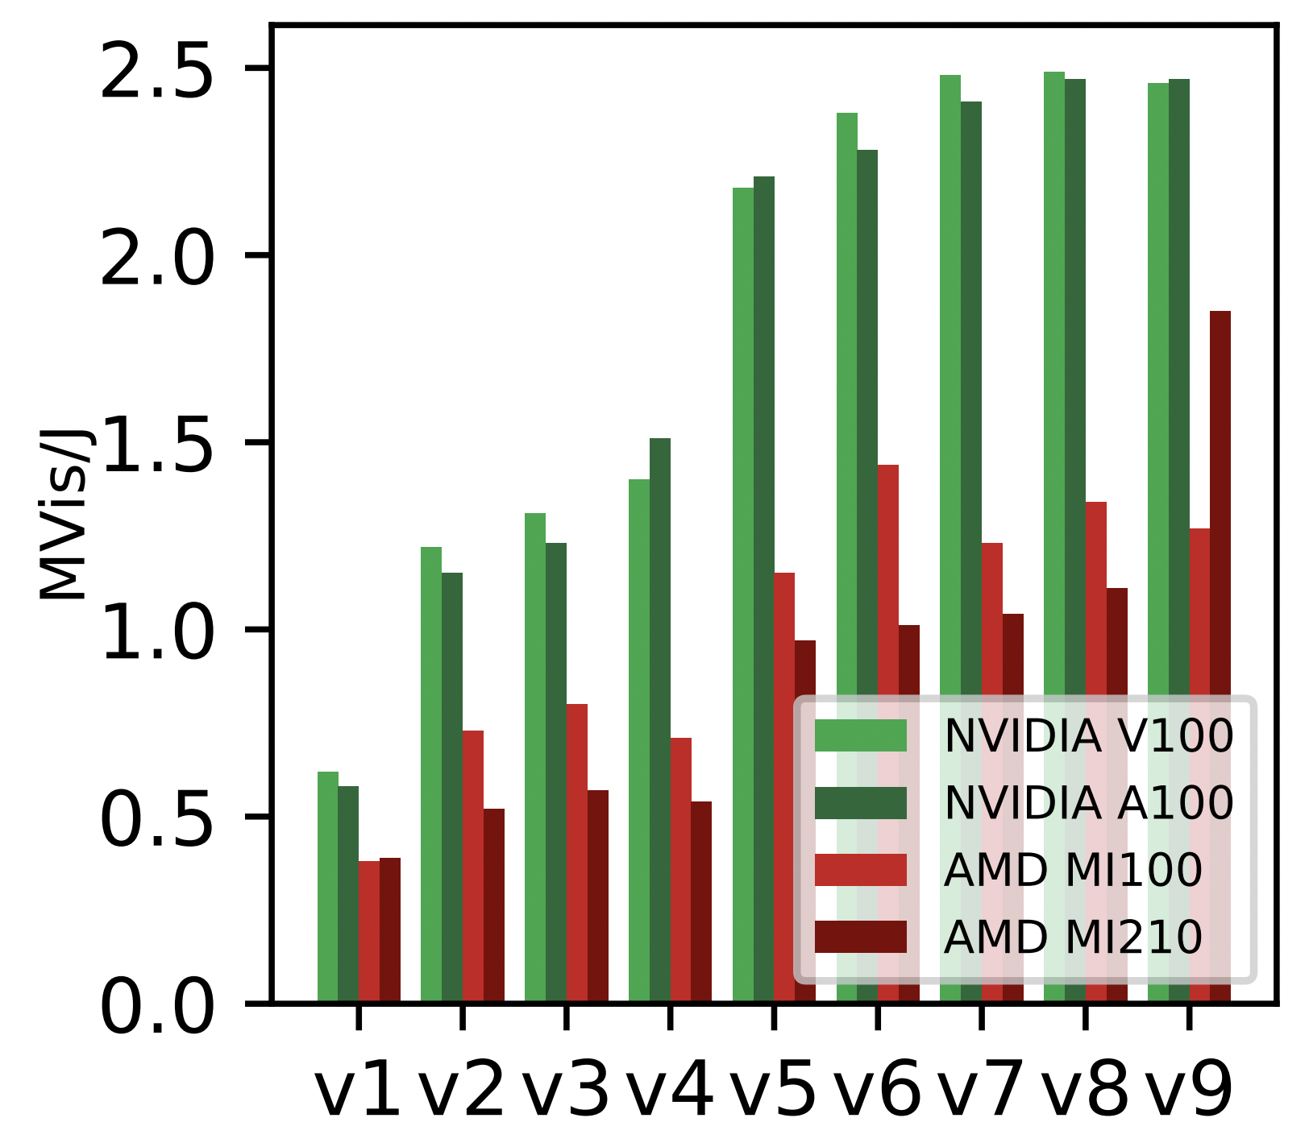
Performance (gridder)
CDNA2 shows good potential by exploiting FP32 packed instructions (v9)
Application code needs additional tuning to achieve better performance
S. Corda, B. Veenboer and E. Tolley, “PMT: Power Measurement Toolkit”, accepted at Supercomputing Conference 2022 (HUST workshop)

Slide 11
Large 2D FFTs
“Cold run” issue
GPUs outperform CPUs

Slide 12
Conclusions
  HIP provides equivalent performance for the IDG gridder/degridder on NVIDIA GPUs
  HIP provides "acceptable" performance portability to AMD GPUs
    Easier than maintaining both a CUDA and OpenCL codebase
    Additional tuning is needed to get closer to peak performance
  Recent AMD GPUs can achieve competitive performance if the application can be re-shaped to support single-precision packed instructions
  We step on several issues running HIPFFT (performance on AMD and compatibility with NVIDIA).
  Next Steps:
    Gridder/Degridder performance difference analysis and optimization
    Discuss with AMD HIPFFT issues
    Port CUDA production code with HIP
    Co-design evaluation on several AMD/NVIDIA GPU generations

Slide 13
Radio-astronomical imaging on GPUs and FPGAs
Thanks!
Stefano Corda
stefano.corda@epfl.ch
04-10-2022
Swiss SKA Days 2022, Lugano

