Slide 1



Evidence for a milli-parsec separation Supermassive Black Hole
Binary with quasar microlensing
M. Millon, C. Dalang, C. Lemon, D. Sluse, E. Paic, J.H.H Chan, and F. Courbin
https://arxiv.org/abs/2207.00598
COSMICLENS

Slide 2
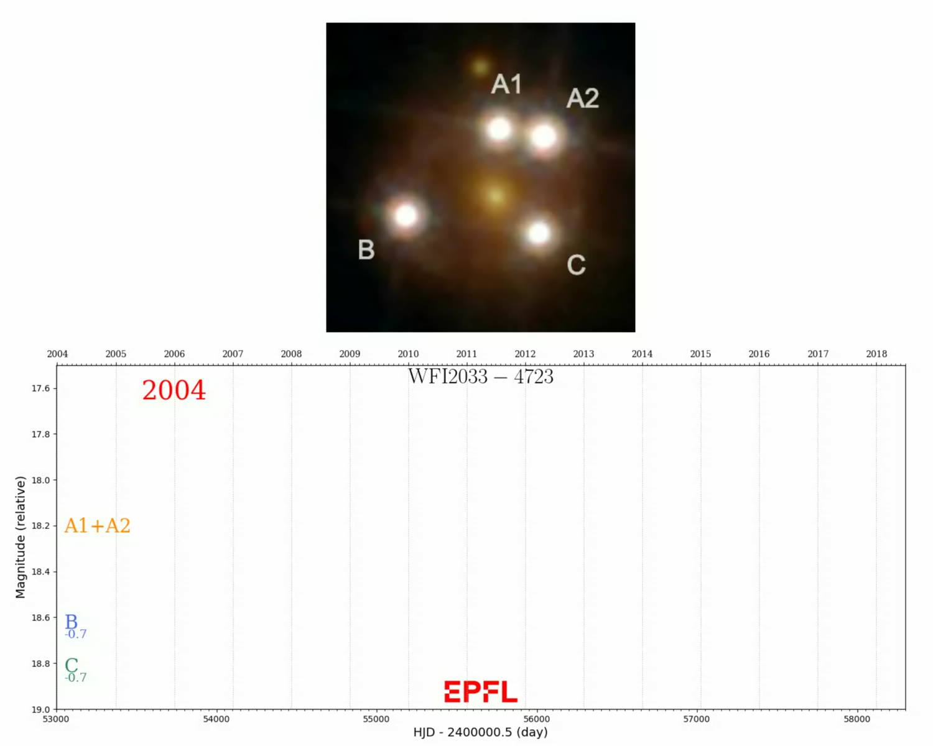

Slide 3
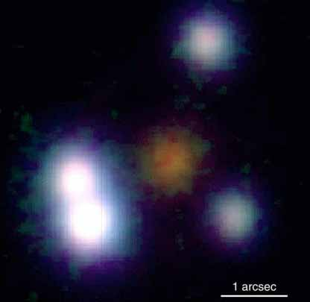
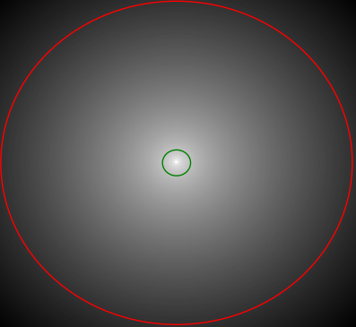
Microlensing
C
A2
B
A1
μ-arsec
Image credit: CISCO, Subaru 8.3-m Telescope, NAOJ
Notes:
There is a variety of phenomenon that can introduce extrinsic variability, and this is detailed in my manuscript but the main source of extrinsic variability is probably microlensing.
This happens when a star of the lens galaxy is passing in front of one of the multiple image, and this produces some extra magnification that is added to the macro magnification produced by the lens.
click
So here you see the magnification maps, with all the caustics produced by the stars at the position of the multiple image. You see that the number of caustics depends on the stellar density at this position, so some image are more affected than the others.
Click
As the quasar moves though these patterns, the magnification is modulated, which introduced variations that differ form image to image.

Slide 4
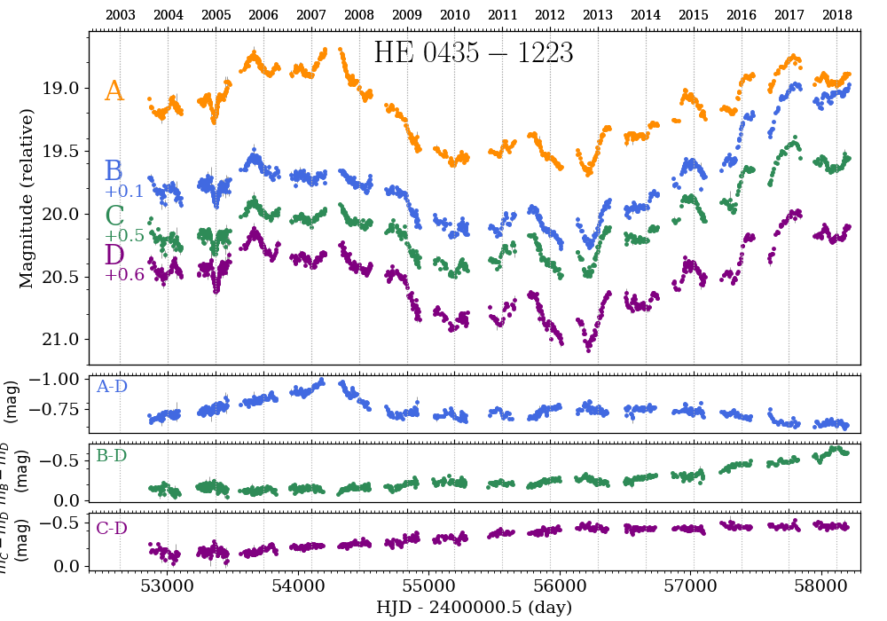
Slow microlensing in HE0435

Slide 5
Time delay : 22.7 ± 3.6 days
A
B

Slide 6
A
Time delay : 22.7 ± 3.6 days
A
B
B
Oscillations ?

Slide 7
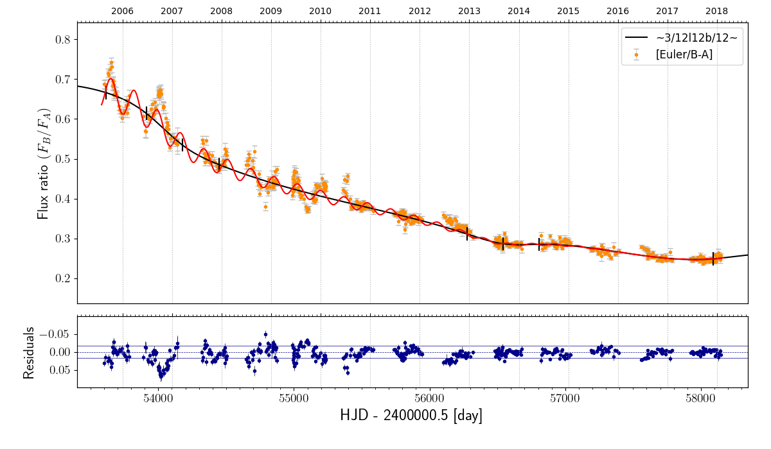
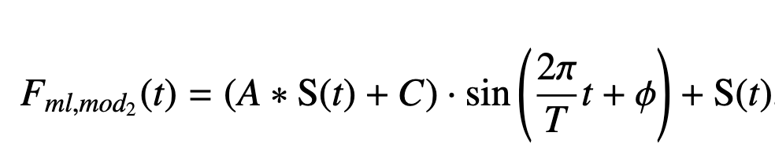
2005 - 2018
S(t) = third order polynomial
χ² = 6.06

Slide 8
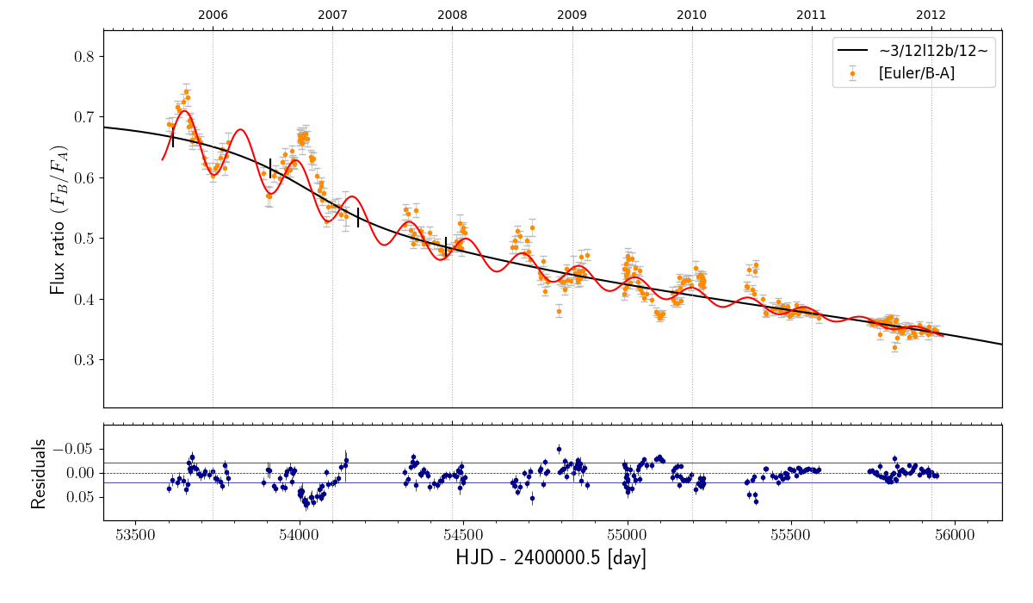
2005 - 2012
Period = 172.6 +/- 0.9 days

Slide 9
Lomb-Scargle Periodogram
First harmonic at 342 days
Second harmonic at 684 days

Slide 10
Origin of the periodic signal
H0 : Binary microlenses (or planetary system acting as a microlens)
H1 : Binary Supermassive Black Holes
H2 : Relativistic “hotspot” in the accretion disk

Slide 11
H0 : Binary microlenses
Keplerian motion in the lens plane
Image credit : Caltech, IPAC, R.Hurt

Slide 12
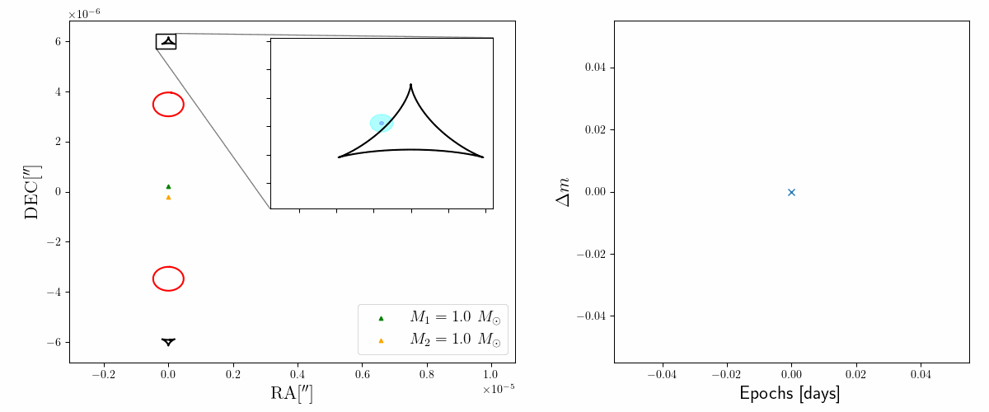
H0 : Binary microlenses
M₁ = M_{sun}
M₂ = M_{sun}
a = 400 AU
R₀ = 7.9e14 cm

Slide 13
H0 : Binary microlenses
4 orders of magnitude too small !
Fixed orbital period to :
P = 172 /(1+z_{l}) *2 = 260 days

Slide 14
H0 : Binary microlenses
Observed amplitude
Free orbital period :

Slide 15
Keplerian motion in the source plane
H1 : Binary Supermassive Black Holes

Slide 16
Long-term microlensing trend :
H1 : Binary SMBH

Slide 17
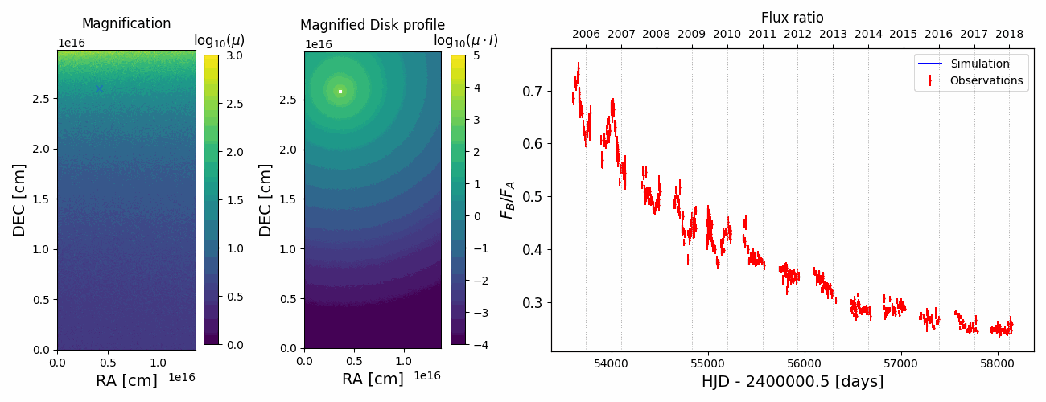
H1 : Binary SMBH
Best-fit for a mass ratio of ~4.5

Slide 18
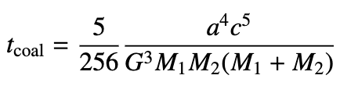
H1 : Binary SMBH
Orbital parameters :
Coalescence time-scale :
M₁ = 1.3e8 M_{sun}
M₂ = 2.6e7 M_{sun}
P = 75 days in source plane
a = 189 AU (∼ 10⁻³ pc )
Velocity : 0.09c
t_{coal} ∼ 1000 years

Slide 19
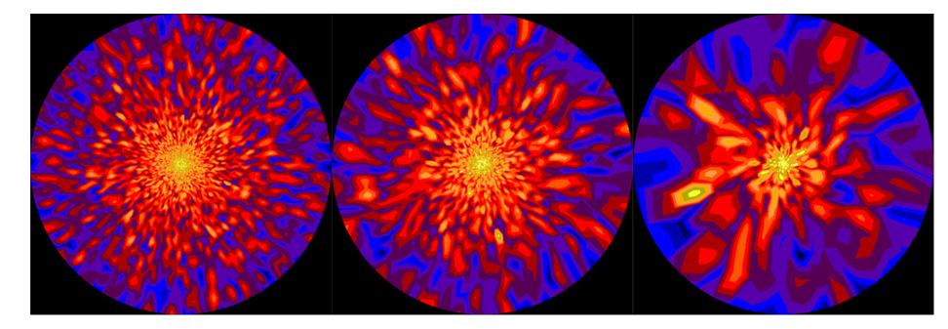
Inhomogeneous accretion in the source plane
H2 : relativistic “hotspot” in the accretion disk
Dexter and Agoll (2011)

Slide 20
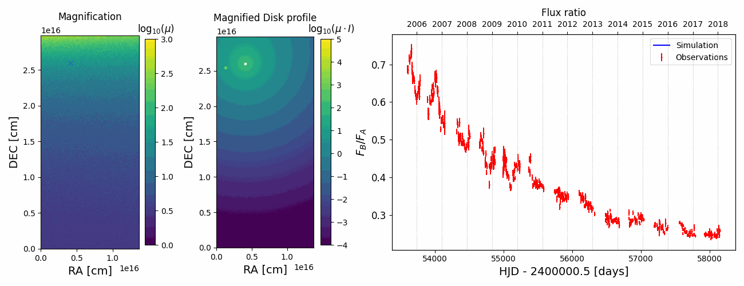
H2 : relativistic “hotspot” in the accretion disk
Best-fit for a luminosity ratio of ~5

Slide 21
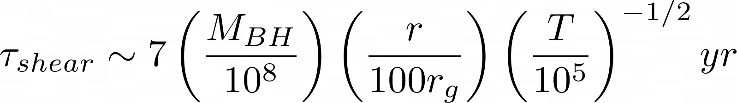
H2 : relativistic “hotspot” in the accretion disk
1) What mechanism can produce 1/5th of the total UV-luminosity of the disk and stay compact on an orbit at 15-25 R_{ISCO} ?
Disk instability ? Turbulent accretion ?
Accretion on secondary BH ?
2) These “hotspots” would be disrupted by Keplerian shear on a timescale of :

Slide 22
Conclusion
Binary microlenses : Seems impossible to reproduce both the period and amplitude of the signal.
Binary SMBH : Reproduces the observation but such systems should be extremely rare unless angular momentum is transported from the circumbinary disk.
Hotspot in the disk : Also reproduces the observation. Can a hotspot emits or absorb ~1/5th of the total luminosity and stay compact in an accretion disk ? It would be disrupted by Keplerian shear if not bound by gravity.

Slide 24
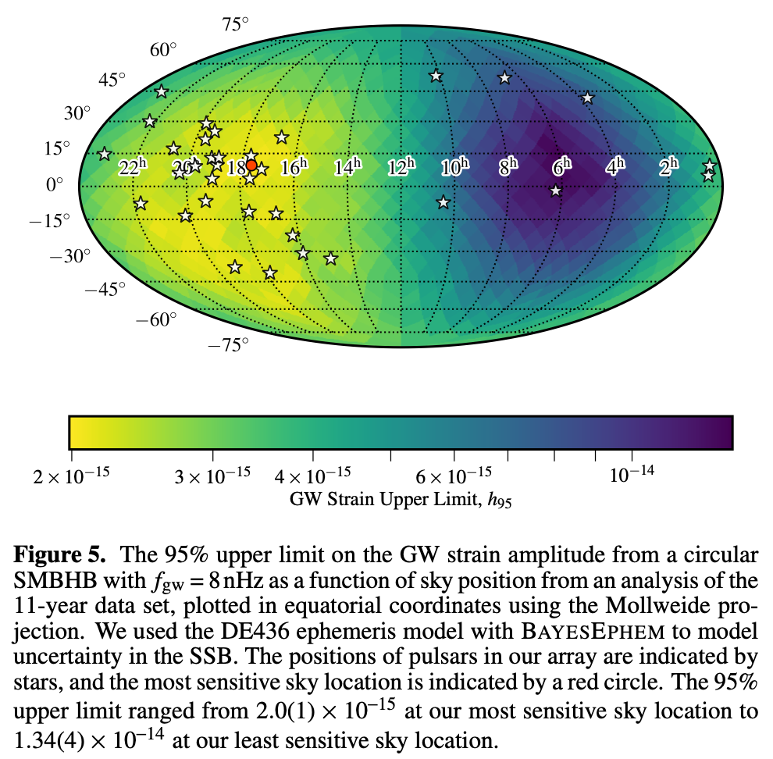
NANOGrav array sensitivity map
So far no detection of SMBH from current
PTA experiments, BUT:
We know where J0158-43 is
VLT follow-up (wobbling)
Current sensitivity is already ok !
Rubin-LSST should find even more !
Aggarwal et al. 2020 ApJ, 889, 38

