Slide 1
SKA MID: Technical Challenges
Robert Laing
MASUM - May 10 2022

Slide 2
Improving the Design Baseline
System analysis and performance (test and simulation): what doesn’t work (yet)?
Has the external environment changed: what’s different?
One example of each
Notes:
One example of each. No attempt to be comprehensive.

Slide 3
What doesn’t work (yet)?
Dish pointing

Slide 4
Basic Interferometry with Dish Arrays
Resolution (rad) ≈ λ/d_{max} (λ = wavelength, d_{max} = maximum baseline)
Field of view (rad) ≈ λ/D (D = dish diameter)
Largest scale of structure ≈ λ/d_{min} (d_{min} = minimum baseline; slightly larger than D)
Noise level ∝ D⁻²[N(N-1)ΔνΔt]^{-1/2} (N = number of dishes, Δν = bandwidth, Δt = observing time)
Image fidelity increases with the number of baselines, N(N-1)/2.
Optimisation of performance and cost → N = 197, D = 15 m, d_{max} = 150 km
We have to point the dishes to a small fraction of λ/D.

Slide 5
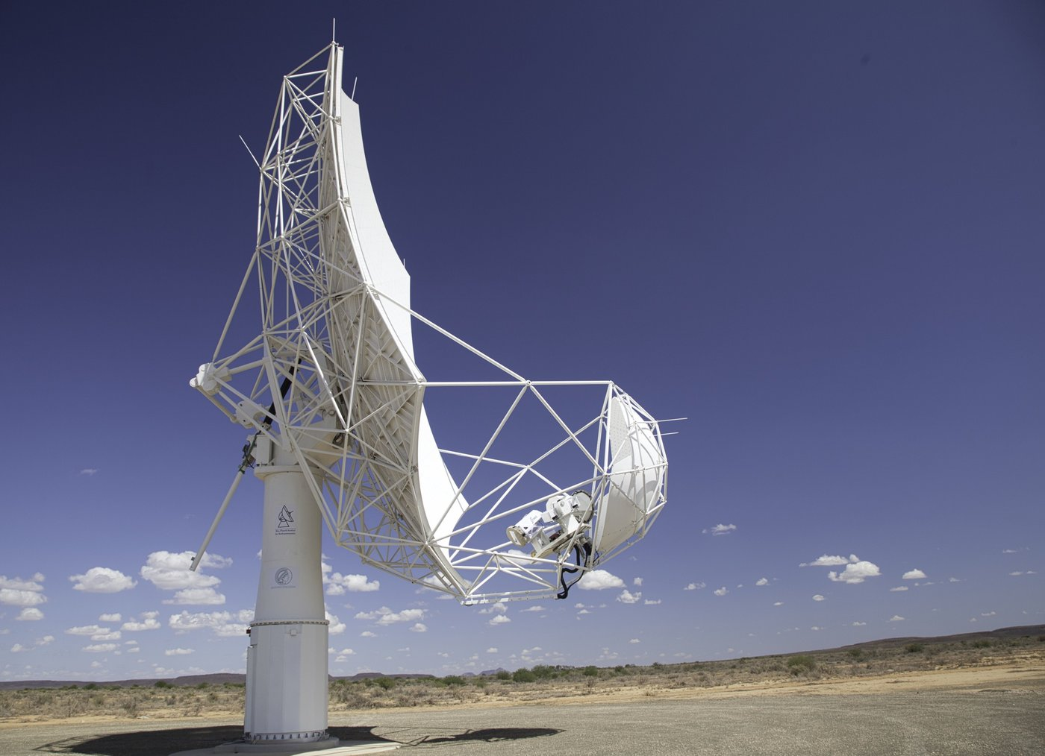
Offset Gregorian Optics
Pro:
Unblocked aperture
Smooth, azimuthally symmetric beam
Low scattering and spillover noise
High efficiency
Space at the focus for multiple receiver bands
Con:
Not as stiff as classical Cassegrain design
Harder to maintain pointing
Notes:
Concave paraboloid + ellipsoid

Slide 6
Why do we need good pointing?
We want to map the sky brightness I(l,m) where l and m represent direction on the sky
A perfect interferometer between dishes 1 and 2 measures the visibility
V(u,v) = ∫∫I(l,m) exp[-2πi(ul+vm)] dl dm
(u, v are the baseline coordinates).
In practice, we need to include the response of the interferometer element (dish), so we end up measuring
I(l,m) D₁(l,m)D*₂(l,m)
where D₁ and D₂ are the responses of the two dishes.
This is fine if we know D₁ and D₂ exactly, but not otherwise.
Various effects cause D₁ and D₂ to vary unpredictably with time: pointing errors (e.g. due to wind), dish deformations (gravity, thermal), ionosphere.
Notes:
If D1 andD2 are the same, can simplify. Also helps if they have no azimuthal dependence.

Slide 7
What happens in real observations?
Imaging artefacts
Increased noise level
Correction in post-processing
is theoretically possible, but
tricky in practice
Deliberately mispointed
WSRT observation
Notes:
Explain why calibration is hard: time variable; beam not well enough known.

Slide 8
Computing the effects of pointing errors
Error models (per dish; correlated or random)
Dynamic pointing error due to wind, assuming constant direction and variable speed
Static pointing error
Models for beam, sky and array layout
Compute interferometric visibilities with and without pointing errors
Difference
Image → Metric is rms noise on the difference image

Slide 9
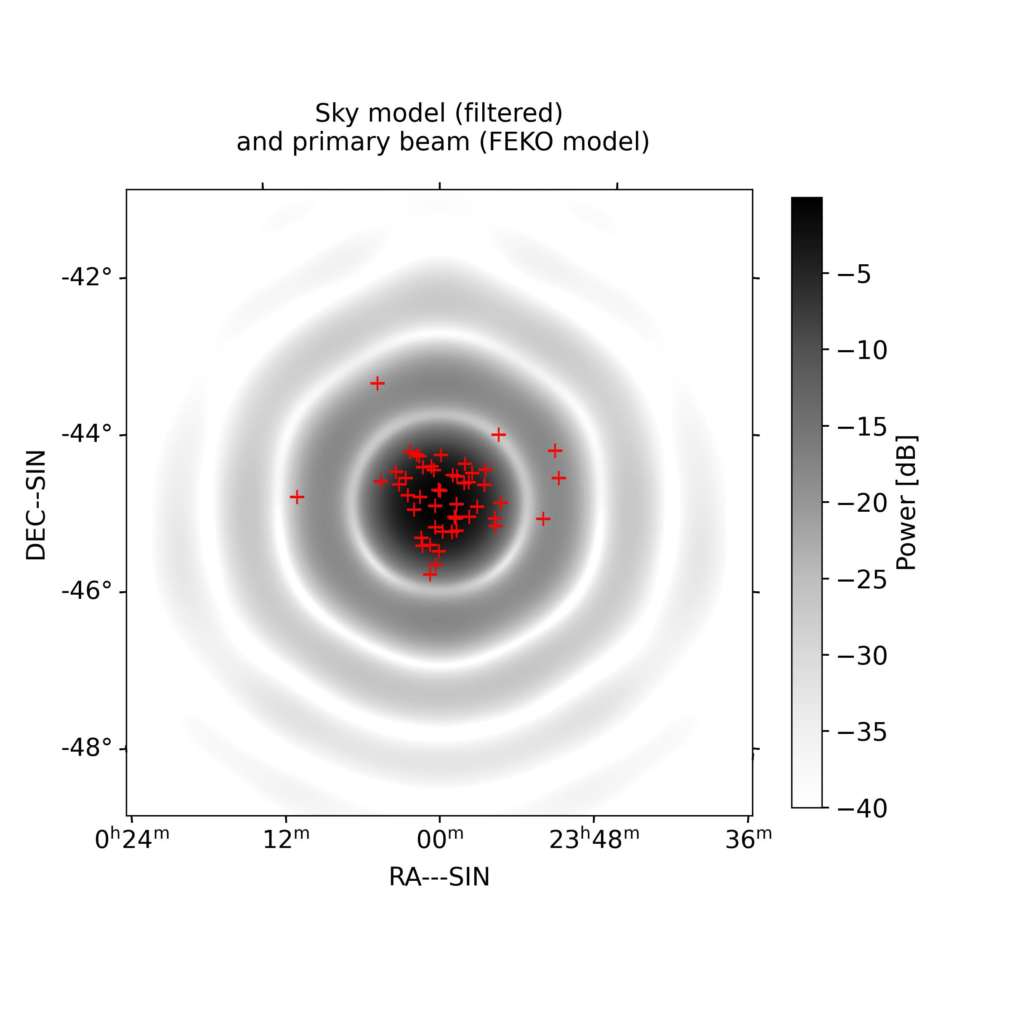
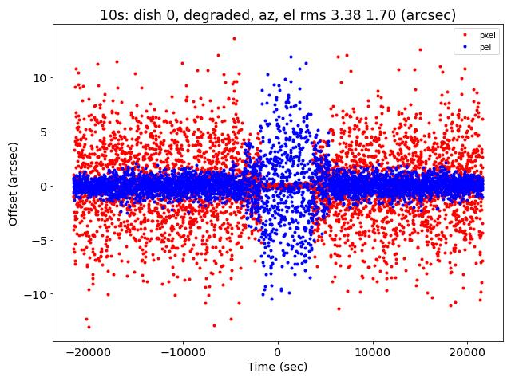
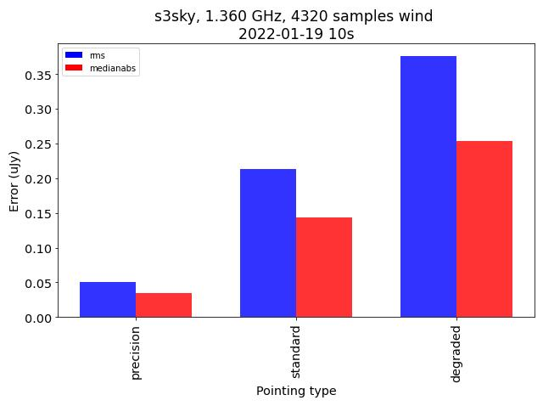
Results (Maciej Serylak)
Source model Pointing errors Image errors
Given a distribution of pointing errors (in this case too optimistic),
we can compute imaging errors for a typical field

Slide 10
This is where the L1 Requirements come from:
Blind pointing <9, 18, 36 arcsec rms (precision, standard degraded conditions)
Relative pointing (10º separation) <1.3, 2.6, 5.2 arcsec rms
Tracking <2.3, 4.6, 9.2 arcsec rms
These specifications can easily be met by Cassegrain, CFRP antennas designed for mm wavelengths (ALMA): the challenge is to achieve them with a steel, offset Gregorian design at much lower cost.
→ Ockert’s talk

Slide 11
What’s different?
Satellite Mega-constellations
(slides from Federico di Vruno)

Slide 12
Satellite Mega-Constellations
Low Earth Orbit
Very large number of satellites
Starlink, OneWeb, …
Allocated frequency range in Band 5b
10.7- 12.75 GHz: large fraction of the band (8.3-15.4 GHz)
Impacts on radio astronomy
I: High power into analogue/digital signal chain
II: RFI in wide-band observations (line and continuum)

Slide 13
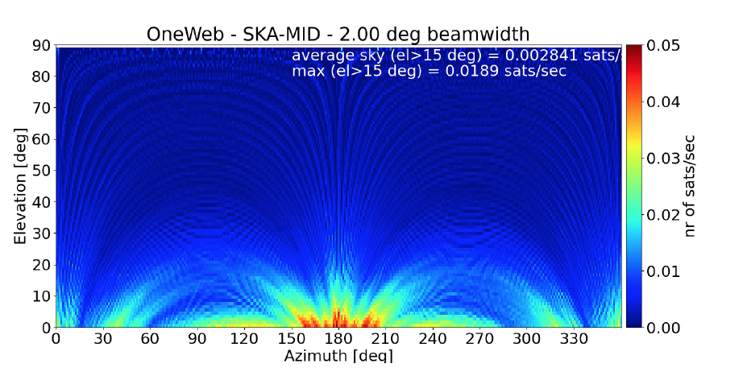
Need increased dynamic range in digitizer

Slide 14
Mitigation
Satellite RFI is not a new situation for radio astronomy:
Satellite prediction/avoidance
On- and off-line processing
Interferometers less vulnerable
Regulation
No direct satellite downlinks within a defined radius of observatory (Germany, Spain)

Slide 15
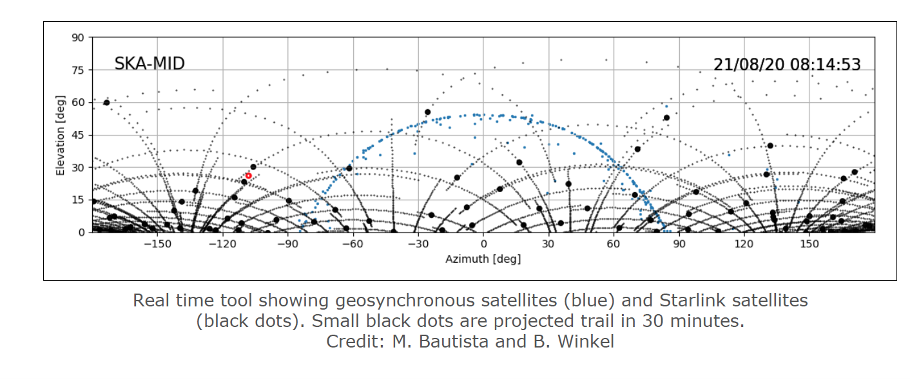
Mitigation 1: Prediction – needs accurate orbital elements

Slide 16
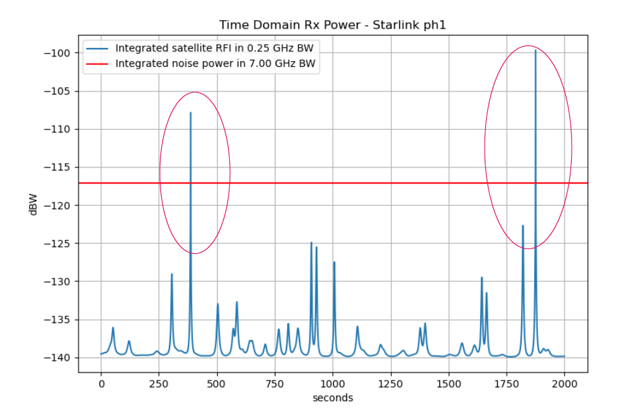
Mitigation 2: Flagging
Incoherent RFI
Increases system temperature
Lower effective bandwidth and sensitivity
Coherent RFI
Persists after correlation
Imaging artefacts
Mitigate with algorithms like AOFlagger (sum-threshold)

Slide 17
Mitigation 3: Decoherence on long baselines

Slide 18
Mitigation 4: Keep-out Areas

Slide 19
High power into receivers with a keep-out zone

Slide 20
Questions?

