Slide 1
SKAO Mid System Engineering
Navigate Between PBS, ICDs and requirement specification to Deliver MID telescope
Andrea Cremonini – MID Telescope System Engineer - System Engineering Team
10 May 2022 – MASUM 2022

Slide 2
Introduction
Building a so ambitious instrument require the establishment of System engineering processes to manage the different phases of the project
But, having too many processes we risk to crystallise the flow from the design to the construction, introducing burden which is usually badly accepted.
It is fundamental :
To Identify the right amount of information necessary to deliver the products
To handle the necessary information, identifying the right amount of :
Processes
Tools

Slide 3
Goal
Manage a clean and trustable set of information in a place easy accessible to relevant stakeholders
Fundamental to have:
Product Breakdown structure (PBS)
Requirement specifications
Interfaces

Slide 4
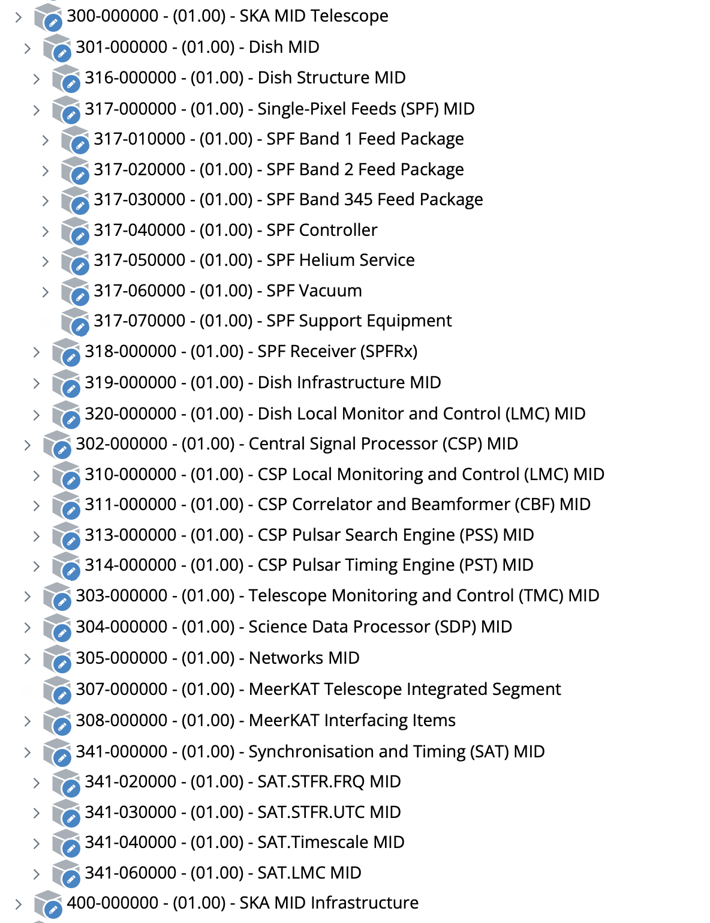
The Product Breakdown Structure
It is a hierarchical description of the products which compose the telescope.
It is not strictly related to any contract, but each contract need to deliver or support the delivery of part of it.
The source of trust
It resides in ALIM, the SKAO CM tool
Attached to each product there are the signed version of documents (requirements Designs Interfaces, Artefacts, Change proposal,
It list all we need to build the SKA1MID Telescope
The current PBS includes all reference documentation from the CDRs.
The new contractual relevant documentation will be provided by the contractors after the reviews or after contractual changes are agreed and approved

Slide 5
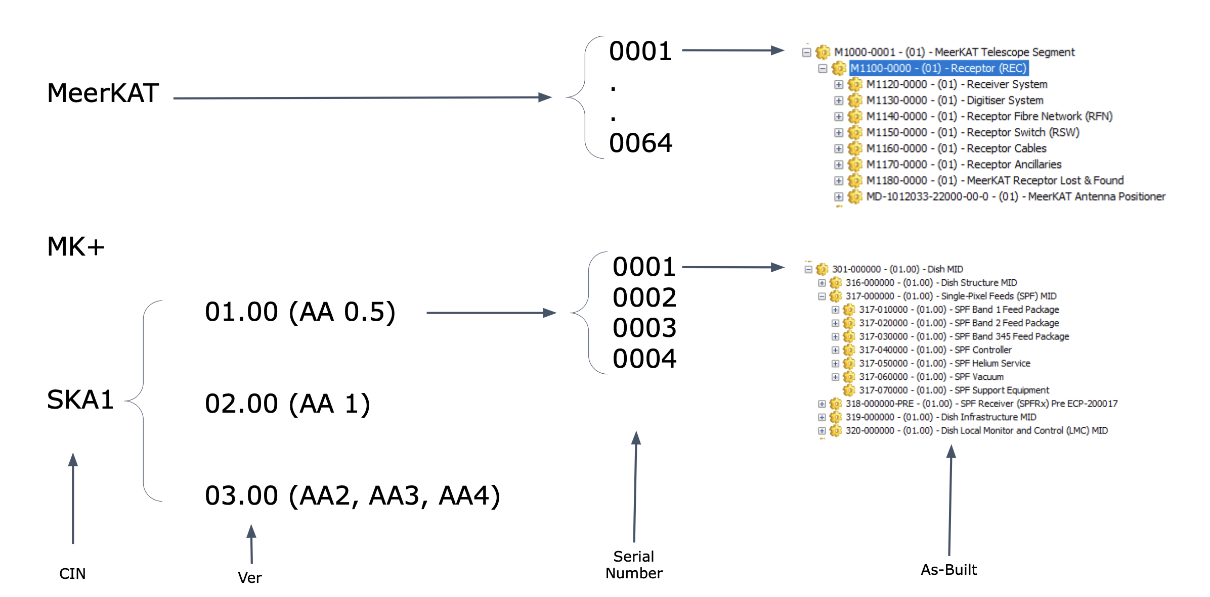
The Deploy Breakdown Structure
It describe the deployment of the MID Telescope, cherry picking the products from the PBS to define the Telescope As-built
It always picture the current status of the telescope reporting the current status of all the hardware and software in use (considering variants, different designs, future developments etc.)
This is an example
This is what we’re currently implementing in MID

Slide 6
Specifications Tree (status) – 1/4
It is build on the PBS and describe the requirement specification tree and who is responsible (owner and accountable) of the requirements

Slide 7
Specifications Tree (status) – 2/4

Slide 8
Specifications Tree (status) – 3/4

Slide 9
Specifications Tree (status) – 4/4
Almost all requirement sets are in Jama
JAMA is the requirement management Tool adopted by SKAO

Slide 10
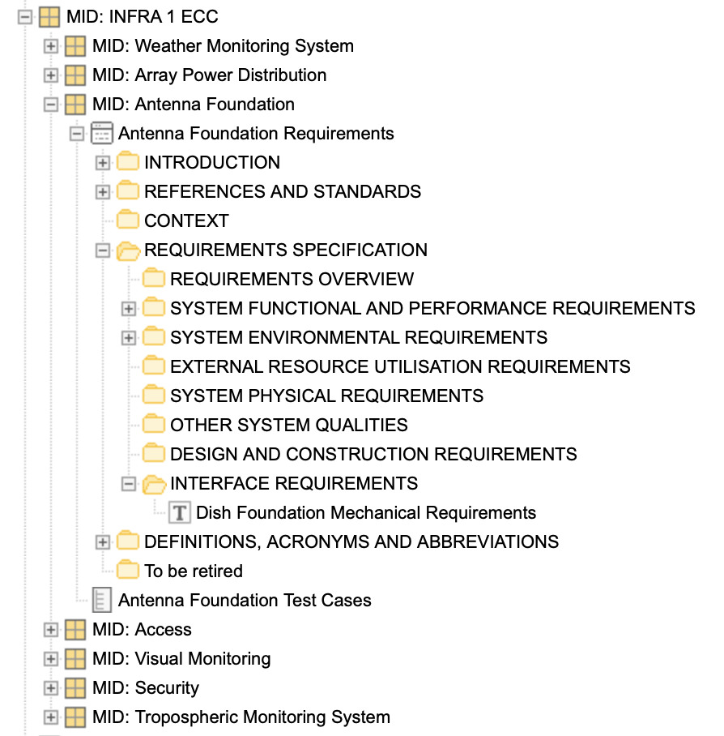
Requirement Specifications (Jama implementation)
Tier 1 Contract Requirement set
Requirement subset
Requirement subset structure
Interface Requirement

Slide 11
Requirement Specifications (Link to interfaces)

Slide 12
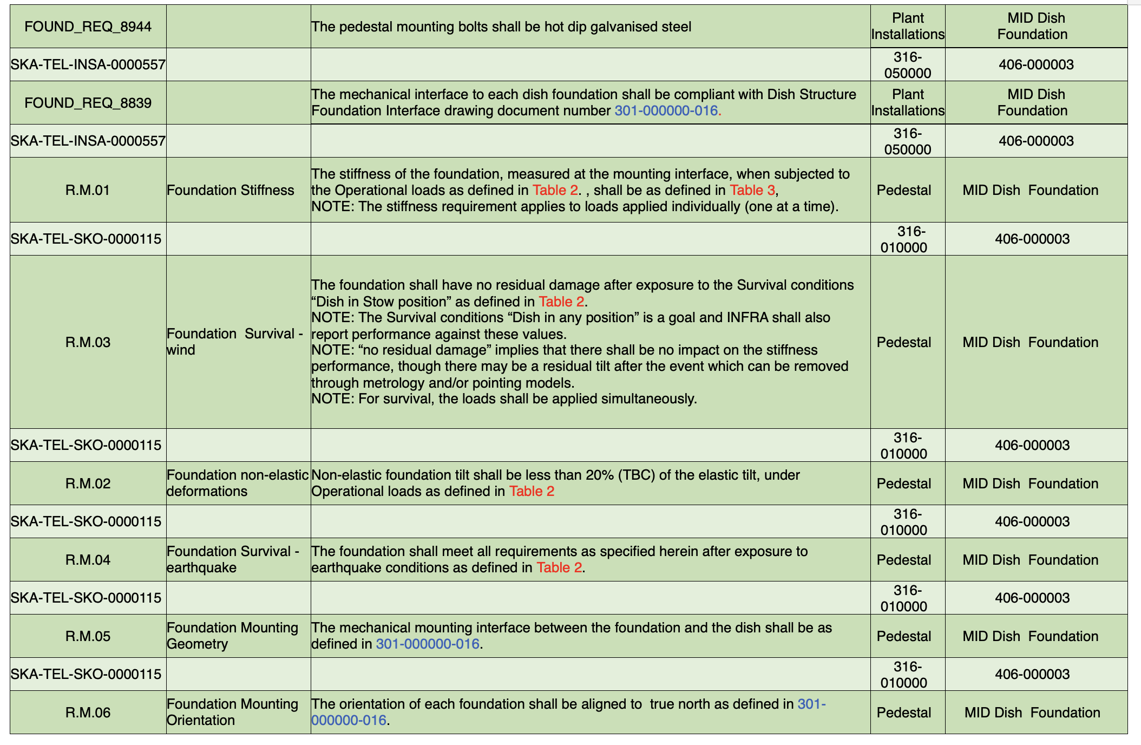
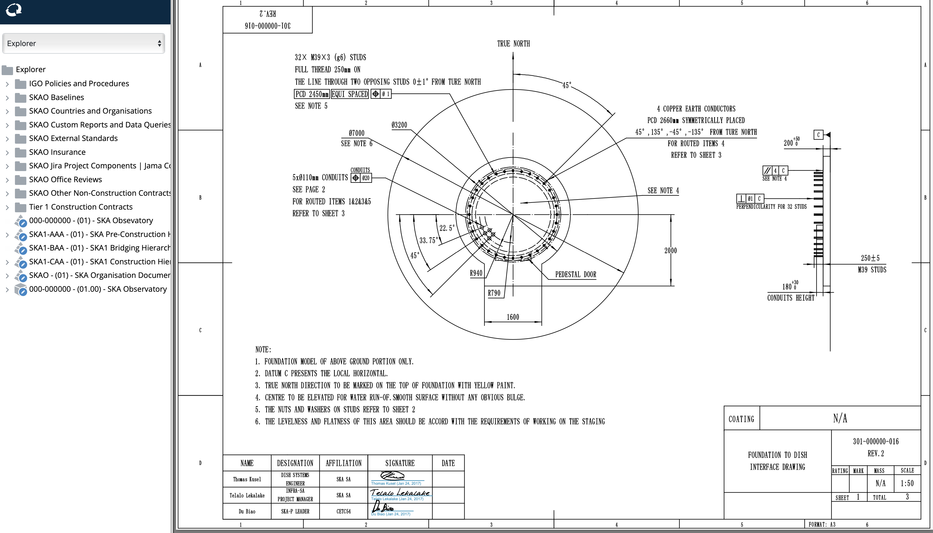
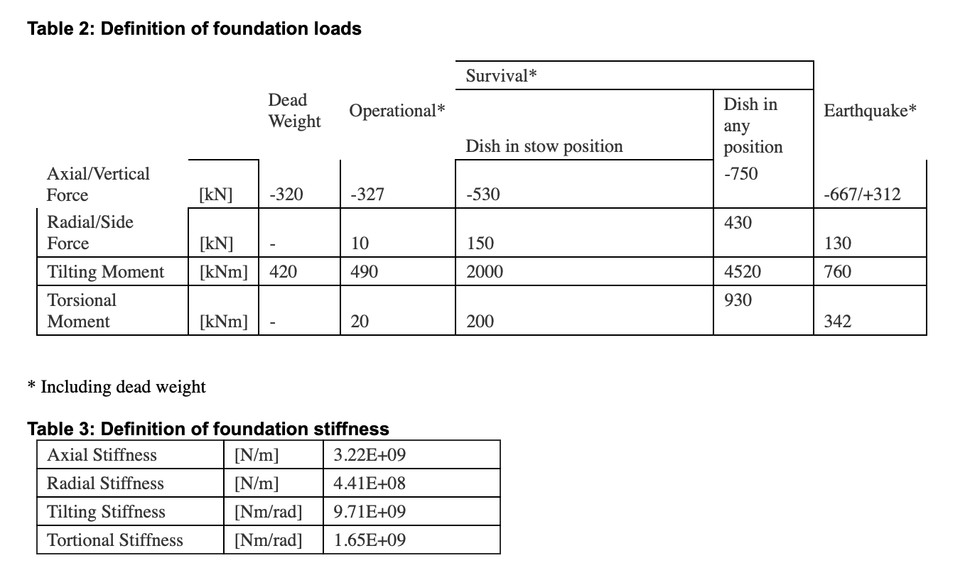
Requirement Specifications (interface content)

Slide 13
Interface
They are “special” requirement
Applicable to the product as well as other requirement specifications
But….
Usually involve 2 parties
The respect of these specification aim to ensure a smooth system integration
Interface Specifications
Contract 1 Requirement specifications
Contract 2 Requirement specifications

Slide 14
Interface (principles)
The main principle behind defining interfaces is to agree trustable agreed boundaries which cannot be changed unilaterally
This Become a contractual obligation respect and change the interface require a mutual agreement between contractors and SKAO as owner of the interface.
This guarantee the contractors can proceed with the design and the parts that will be delivered will fit in the wider system
Interfaces are managed, as well as requirement specifications in JAMA

Slide 15
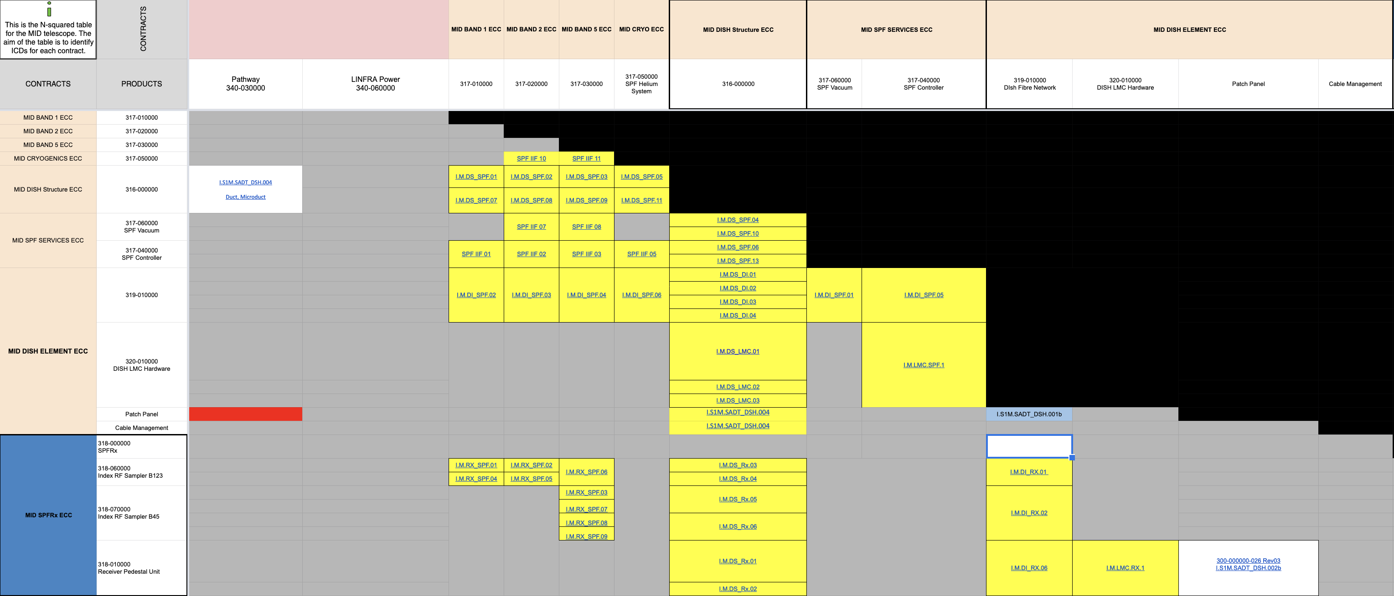
Interface (Generation)
We have identified contract to contract interface by using N^2 Diagram.
Following steps were:
Split and Import the Information contained in the pre-construction Interface control documents in Jama
Reaggregate the information “by Contract”

Slide 16
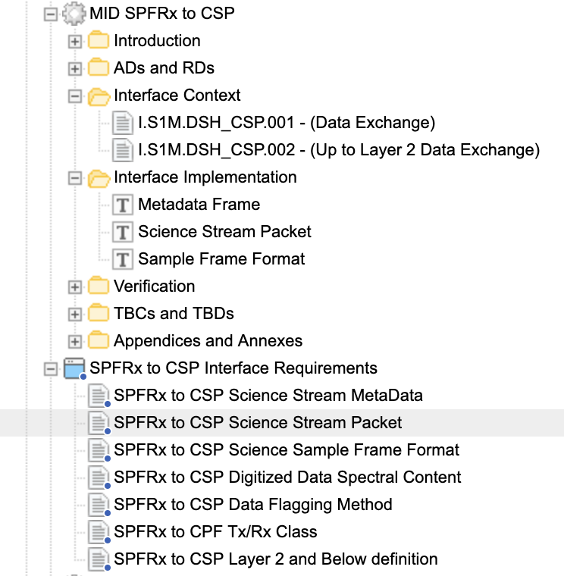
Interface (Information representation)
Interface Component are structure in a shape of a document which contain in 3 key Parts:
Interface description
Interface implementation
Interface requirements

Slide 17
Interface (Status)
All Pre construction ICD have been Imported in Jama
An Interface control Document framework and Template has been agreed
All relevant information have been aggregated following the above framework
Following the contracts priority the Content of the Contract to Contract ICD is reviewed
Currently MID Infrastructure ICDs are in progress
SAT, SPFRx, SPF Services follows

Slide 18
Interface (Implementation)
Once reaggregated reviewed and agreed, the Contract to Contract Interface control Document (ICD) as well as the req specifications documents aregenerated by export from Jama, Signed by relevant stakeholders, and uploaded in ALIM
Jama
Echosign - ALIM
Content Review
Agreement with contractors
Export as a document
Signature process
Config Management
System Engineering Domain
Design Authorities Domain
Configuration Management Domain

Slide 19
Thanks – Questions ?

