Slide 1
SKA1 MID DIGITAL
PROGRESS UPDATE
NONTOBEKO MNYANDU
10 MAY 2022

Slide 2
CONTENT
Milestones Overview
Synchronisation and Timing (SAT) Progress update
Single Pixel Feed Receiver (SPFRx) Progress update
Correlator Beam-former (CBF) progress update
Procurement updates
Next steps

Slide 3
MILESTONES OVERVIEW (Current year)
Synchronisation and Timing (SAT) | Date
Deliver FRQ RM for integration to RXS123 | May 22
Contract Award: Activity management (UoM) | Jun 22
Contract Award: FRQ Distribution System | July 22
Contract Award: Integration Management PSC | Aug 22
Contract Award: UTC Distribution | Sep 22
Contract Award: Timescale | Jan 23
Install FRQ system at S-ITF for QE | Jan 23
Install SAT.UTC system at S-ITF | Feb 23

Slide 4
MILESTONES OVERVIEW (Current year)
Single Pixel Feed Receiver (SPFRx) | Date
SPFRX123 CDR | July 22
Contract Award: Band 5 Temp Downconverter | Sep 22
SPFRx Qualification model to S-ITF | Nov 22
Band 5 Downconverter Requirements Review | Dec 22
Contract Award: SPFRx123 & RXPU Delivery | Jan 23

Slide 5
MILESTONES OVERVIEW (Current year)
Correlator Beam-Former (CBF) | Date
Complete integration for CBF HW Qualification Testing | July 22
CBF Manufacture HW for ITF | Oct 22
Contract Award: CSP Integration Management & CBF delivery | Aug 22
Complete CBF SW, FW Development for S-ITF | Sep 22
Complete HW Qualification testing | Nov 22
CSP & CBF PRR | Nov 22
Complete CBF integration for S-ITF Release | Dec 22

Slide 6
SYNCHRONISATION AND TIMING PROGRESS
SAT System CDR passed in 2018 as part of Signal and Data Transport (SaDT) consortium.
The design was impacted by “Last mile” ECP-200017 which necessitated the redesign and repackaging of SAT receiver module (RM).
1st RM has been developed and tested. It was delivered in April 2022 for initial integration and testing as part of the RXS123.
2nd RM is on-route to Sweden, ETA 18 May 2022, will be integrated on 2nd RXS123 qualification model.

Slide 7
Single Pixel Feed Receiver (SPFRx) PROGRESS
DDR passed in Nov 2019.
“Last mile” ECP 200017 introduced significant design changes leading to delays.
Sweden was allocated Tier 1 lead of SPFRx work package.
QRT in Sweden was selected to implement “last mile ECP”.
The design finalisation efforts are shared between Canada and Sweden.

Slide 8
Single Pixel Feed Receiver (SPFRx) PROGRESS
Initial integration of the SAT receiver module into 1st RXS123 Qual model passed functional tests model and pre-qual tests.
Qualification testing is underway.
CDR takes place 5-7 July in Sweden.
Qualification models are planned for delivery to S-ITF in Nov 22.

Slide 9
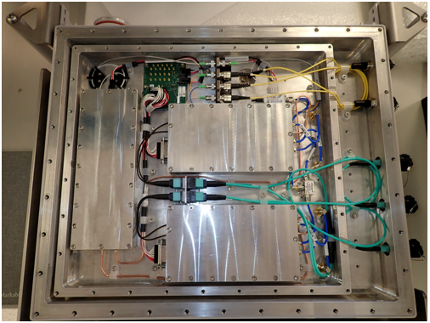
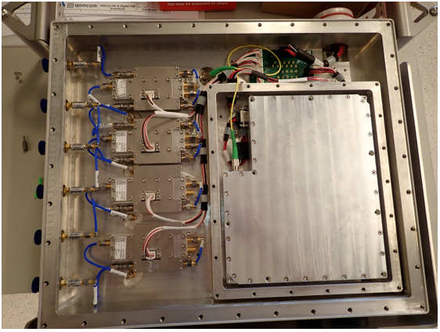
Single Pixel Feed Reciever (SPFRx) PROGRESS

Slide 10
Single Pixel Feed Receiver (SPFRx) PROGRESS
Laboratoire Astrophysique Bordeaux (LAB) have been developing the Band 5 Digitiser (RXS45) for around 4 years.
The design was based on an Adsantec ADC solution following a down selection in 2019. CDR was tentatively planned for April 2023
Ben Lewis, Robert Laing, Shin’Ichiro Asayama attended LAB last week, representing SKA in a meeting designed to expose the constraints of the Adsantec ADC and propose alternate solutions

Slide 11
Single Pixel Feed Reciever (SPFRx) PROGRESS
The Adsantec solution has failed to deliver the performance requirements needed for SKA, particularly in light of the complex RFI situation at band 5B
LAB proposed two alternatives to the Adsantec ADC, one based on a Micram chip and one on an Intel chip.
An initial feasibility study will be conducted over the coming few weeks.
Both solutions come at significantly increased cost and complexity.

Slide 12
Correlator Beam former (CBF)Progress
Mid CBF CDR passed in 2018.
Development activities are led by Canada -NRC working with MDA.
Ongoing HW development for Qualification. Including development of SW, FW for HW Qualification Testing.
Mid CBF qualification test completion end Nov 22.
CBF integration for S-ITF Release is targeted to complete in Dec 22.

Slide 13
PROCUREMENT UPDATE
WORK PACKAGE | CONTRACT TYPE | STATUS | CONTRACT AWARD TARGET
MID Synchronisation and Timing (SAT)
SAT Integration and Management | NEC4 PSC Competitive | Shortlisting of bidders in progress. | Aug 22
SAT Activity Management Support (UoM) | NEC4 PSSC, Sole Source | Invitation to tender issued | Jun 22
SAT Timescale Delivery (incl. Masers) | NEC4 ECC, Competitive | ILO notification | Jan 23
SAT Frequency Distribution System | NEC4 ECC, Sole Source | Invitation to tender underway | Jul 22
SAT UTC Distribution | NEC4 ECC, Competitive | TBA | Nov 22
Single Feed Pixel Receiver (SPFRx)
SPFRx 123 Delivery | NEC4 ECC, Competitive | ILO notification | Jan 23
Band 5 Downconverter Delivery | NEC4 SSC, Sole Source | Pre-qualification underway | Aug 22
MID CSP & CBF
MID CBF delivery & CSP Activity Management | NEC4 ECC, Sole Source | Invitation to tender issued | Aug 22

Slide 14
Next Steps
The SPFRx CDR is a significant milestone coming up in July. Qualification testing is underway.
Various procurement initiative need to be finalised within next 3 months:
SAT FRQ; SAT Integration & Management PSC; SAT Activity management (UoM); CBF and Band5 temporary downconverter.
Focus is also on delivering MID digital systems for S-ITF.

Slide 15
Thank you

