Slide 1
SKA1-Mid Signal Chain
Performance and Characterisation
Bassem Alachkar, Signal Processing Domain Specialist
10 May 2022

Slide 2
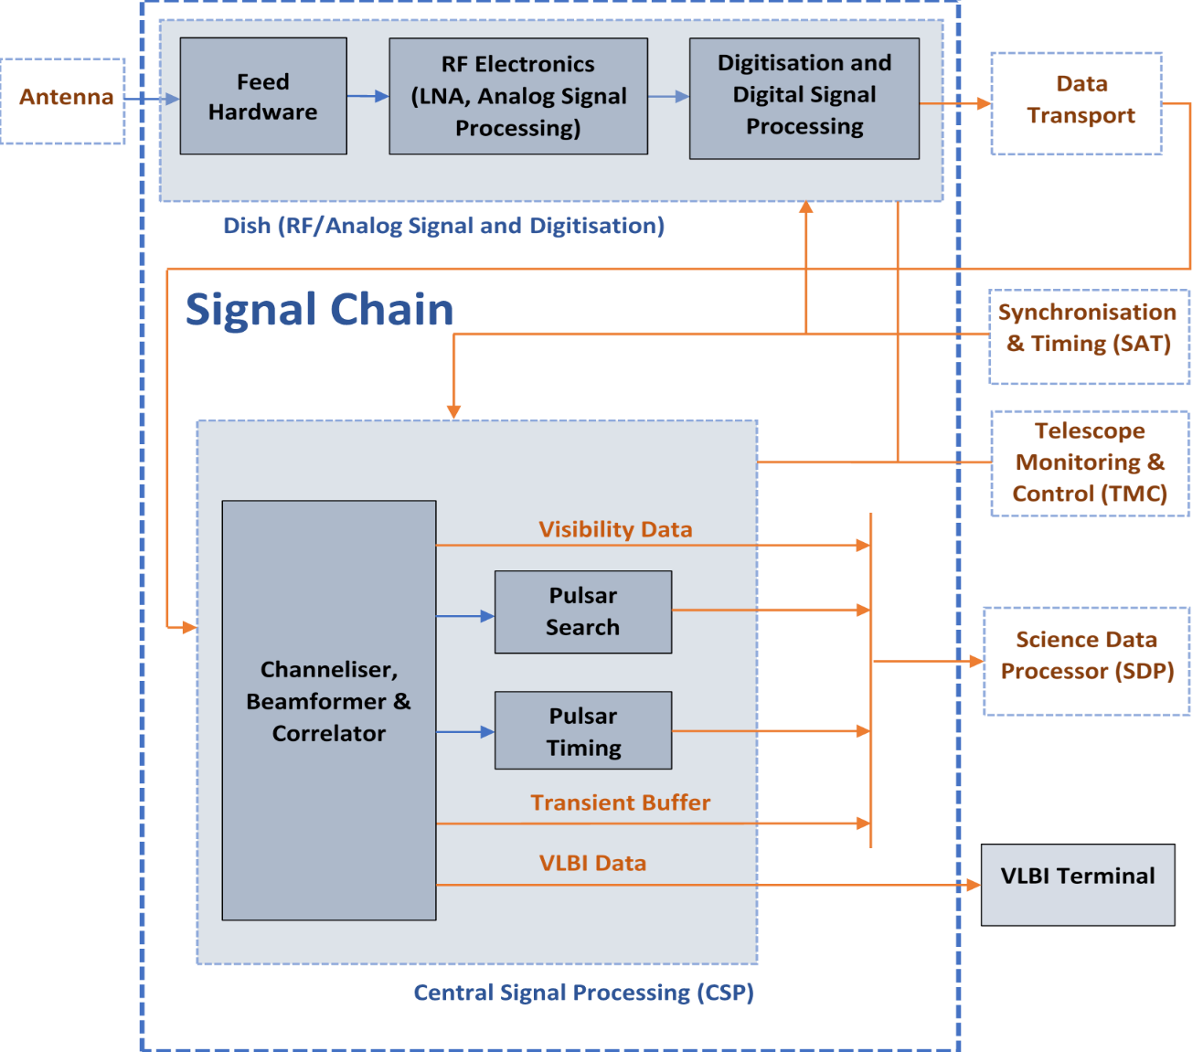
SKA-Mid Signal Chain Scope

Slide 3
Mid and Low Signal Chains- System CDR Documents
Signal Chain for Mid:
SKA-TEL-SKO-0000790
Signal Chain for Low:
SKA-TEL-SKO-0000793

Slide 4
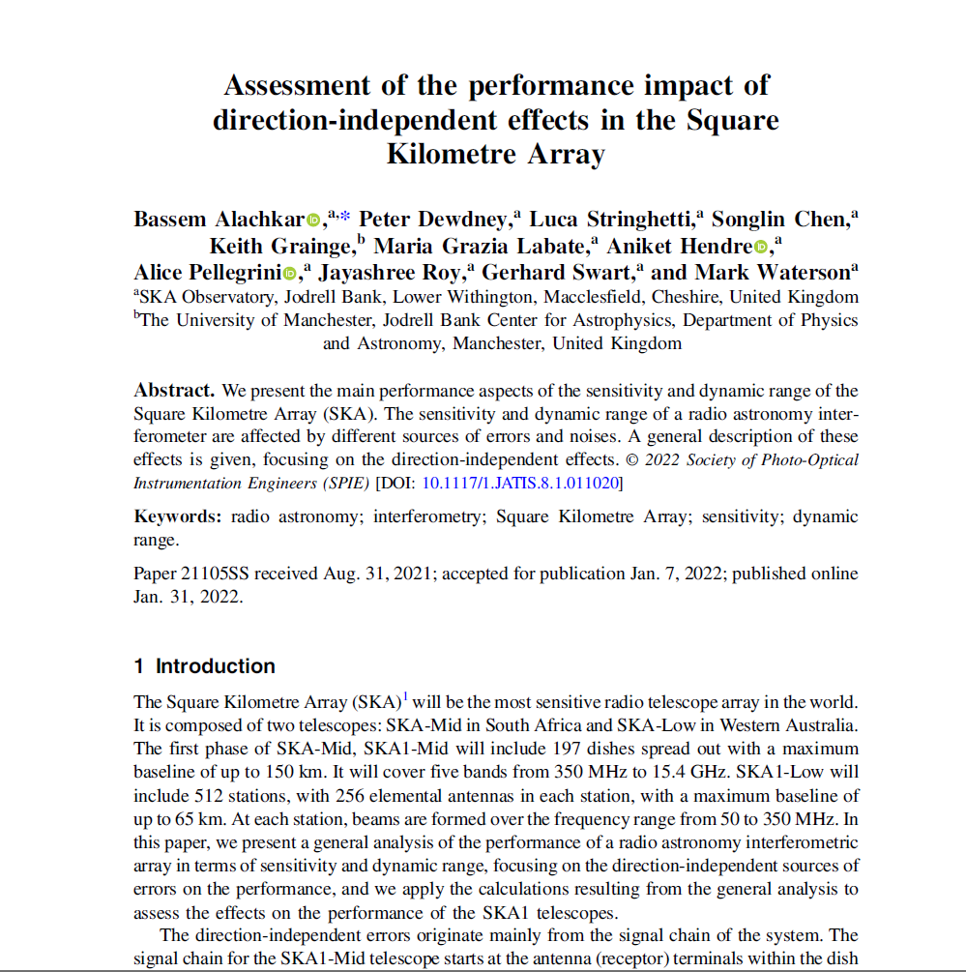
Performance of the Signal Chain
Paper:
Assessment of the performance impact of direction-independent effects in the Square Kilometre Array
© 2022 Society of Photo-Optical Instrumentation Engineers (SPIE) [DOI: 10.1117/1.JATIS.8.1.011020] Link

Slide 5
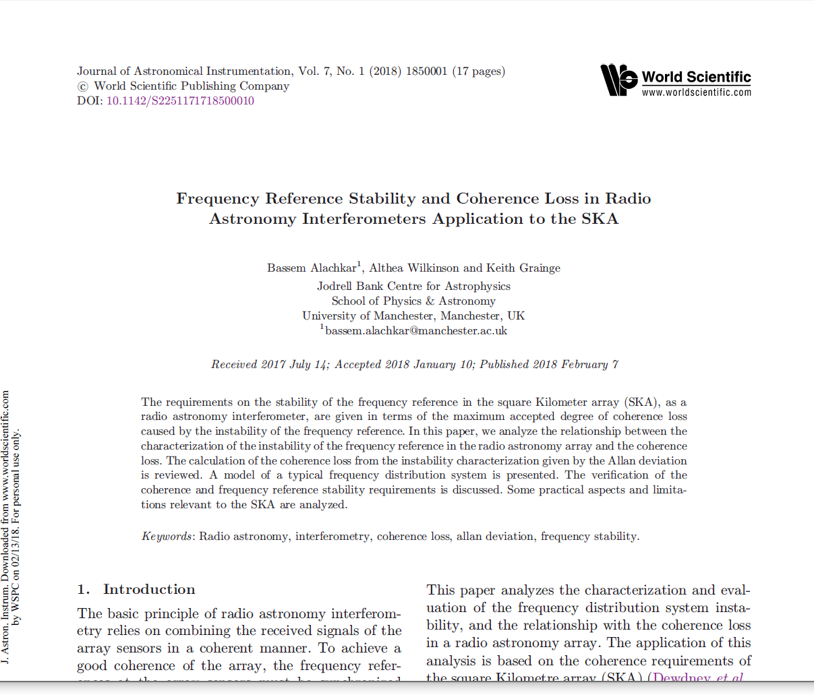
Performance of the Signal Chain- Frequency Reference Stability
Paper:
Frequency Reference Stability and Coherence Loss in Radio - Astronomy Interferometers Application to the SKA
Journal of Astronomical Instrumentation Vol. 07, No. 01, 1850001 (2018)
htthttps://www.worldscientific.com/doi/10.1142/S2251171718500010pshttps://

Slide 6
Sources of errors and imperfections of the Signal Chain
The ideal Signal Chain is Linear, Time-Invariant, with Ideal Band-pass Shape, Minimum Additive Noise.
Errors and Imperfections (deviation from the ideal Signal Chain):
          - Noises (in the analog part, digitisation, and digital part)
          - Time Instability (variation in time)
  - Variation of Gain in frequency (non-flatness)
  - Non-linearity

Slide 7
Sensitivity and Dynamic Range
Main important performance measures of a radio interferometer
Sensitivity:
Itis usually defined by the RMS (Root Mean Squared) of the noises and errors in the image.
It is related to the minimum detectable flux of a radio source in the sky.
It is determined by the effective collecting area of the telescope, and the sources of noises from the sky and in the instrument.
It determines the signal-to-noise ratio (SNR) at the output of the instrument.
It is sometimes represented by the system equivalent flux density (SEFD): the amount of flux of from a radio source that doubles the output signal that is produced by all the sources of noise.
Dynamic Range:
It represents the detectability of a weak source in the presence of a strong source, so that the spurious effects caused by the strong source do not hide the weak sources.
It is defined as the ratio of the flux density of the brightest source in the image to that of the weakest believable source.

Slide 8
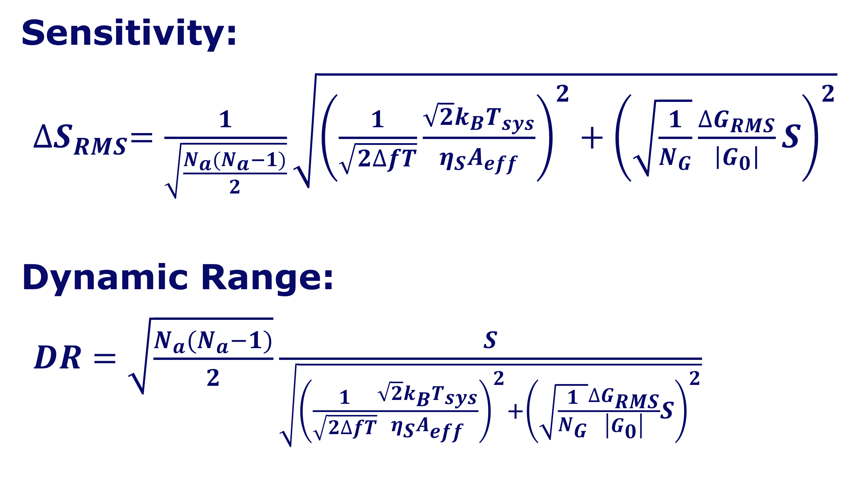
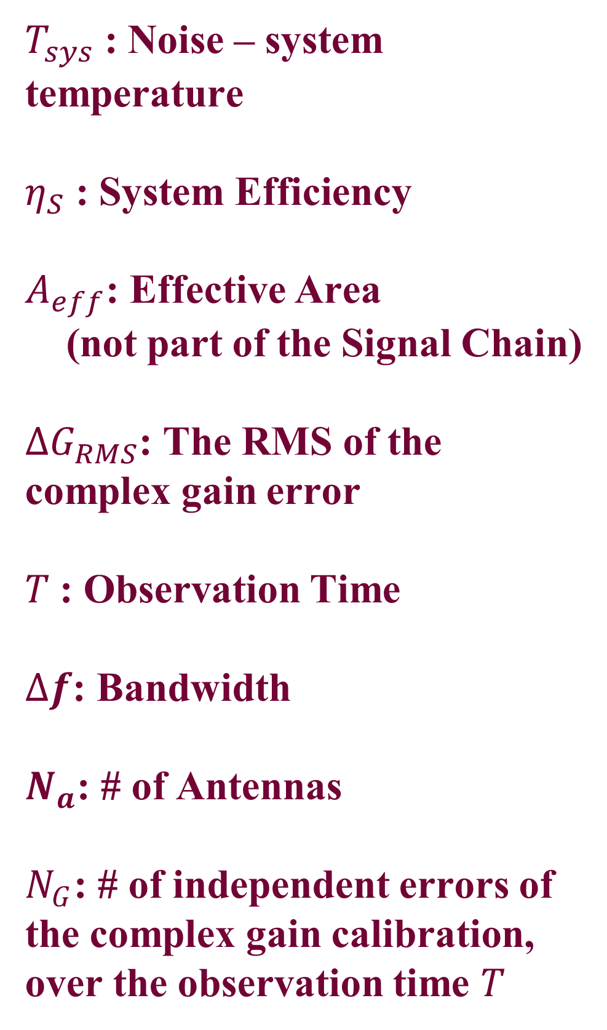
Sensitivity and Dynamic Range
Sensitivity:
${∆S}_{RMS}=\frac{1}{\sqrt{\frac{N_{a}(N_{a}−1)}{2}}}\sqrt{{\left(\frac{1}{\sqrt{2∆fT}}\frac{{\sqrt{2}k_{B}T}_{sys}}{{η_{S}A}_{eff}}\right)}^{2}+{\left(\sqrt{\frac{1}{N_{G}}}\frac{∆G_{RMS}}{\left|G_{0}\right|}S\right)}^{2}}$
Dynamic Range:
$DR=\sqrt{\frac{N_{a}(N_{a}−1)}{2}}\frac{S}{\sqrt{{\left(\frac{1}{\sqrt{2∆fT}}\frac{{\sqrt{2}k_{B}T}_{sys}}{{η_{S}A}_{eff}}\right)}^{2}+{\left(\sqrt{\frac{1}{N_{G}}}\frac{∆G_{RMS}}{\left|G_{0}\right|}S\right)}^{2}}}$
$T_{sys}$ : Noise – system temperature
$η_{S}$ : System Efficiency
$A_{eff}$: Effective Area
(not part of the Signal Chain)
$∆G_{RMS}$: The RMS of the complex gain error
$T$: Observation Time
$∆f$: Bandwidth
$N_{a}$: # of Antennas
$N_{G}$: # of independent errors of the complex gain calibration, over the observation time $T$
Noises
Time Instability

Slide 9
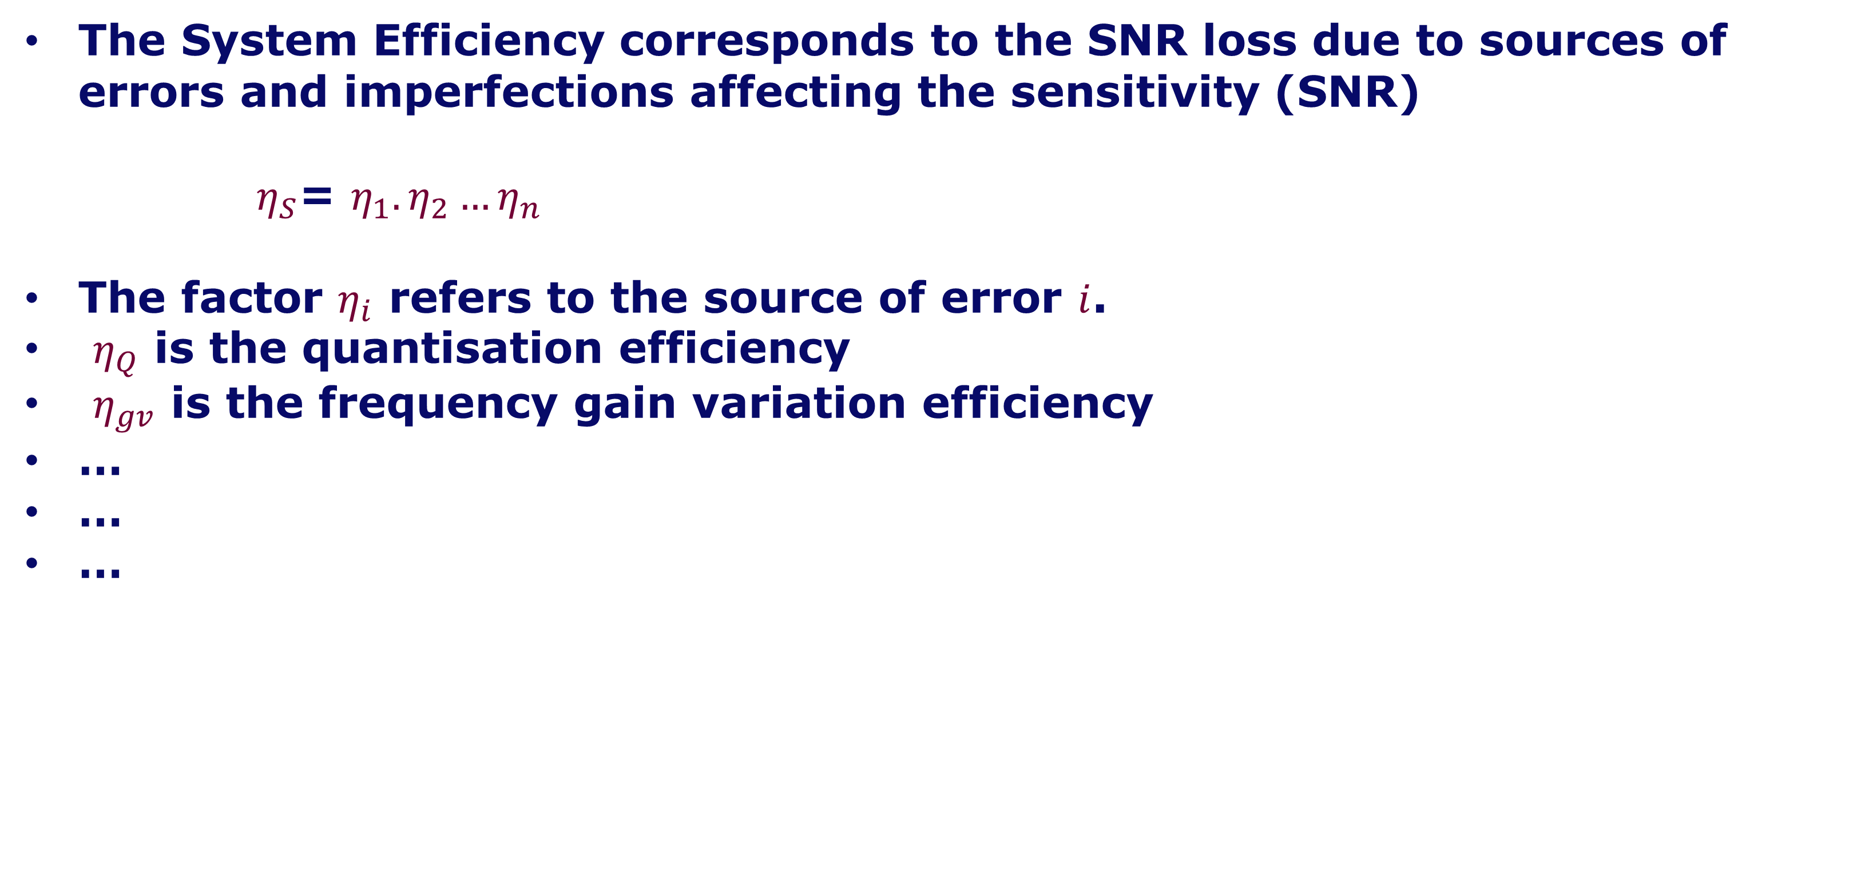
System Efficiency $η_{S}$
The System Efficiency corresponds to the SNR loss due to sources of errors and imperfections affecting the sensitivity (SNR)
$η_{S}$= $η_{1}.η_{2}…η_{n}$
The factor $η_{i}$ refers to the source of error $i$.
$η_{Q}$ is the quantisation efficiency
$η_{gv}$ is the frequency gain variation efficiency
…
…
…

Slide 10
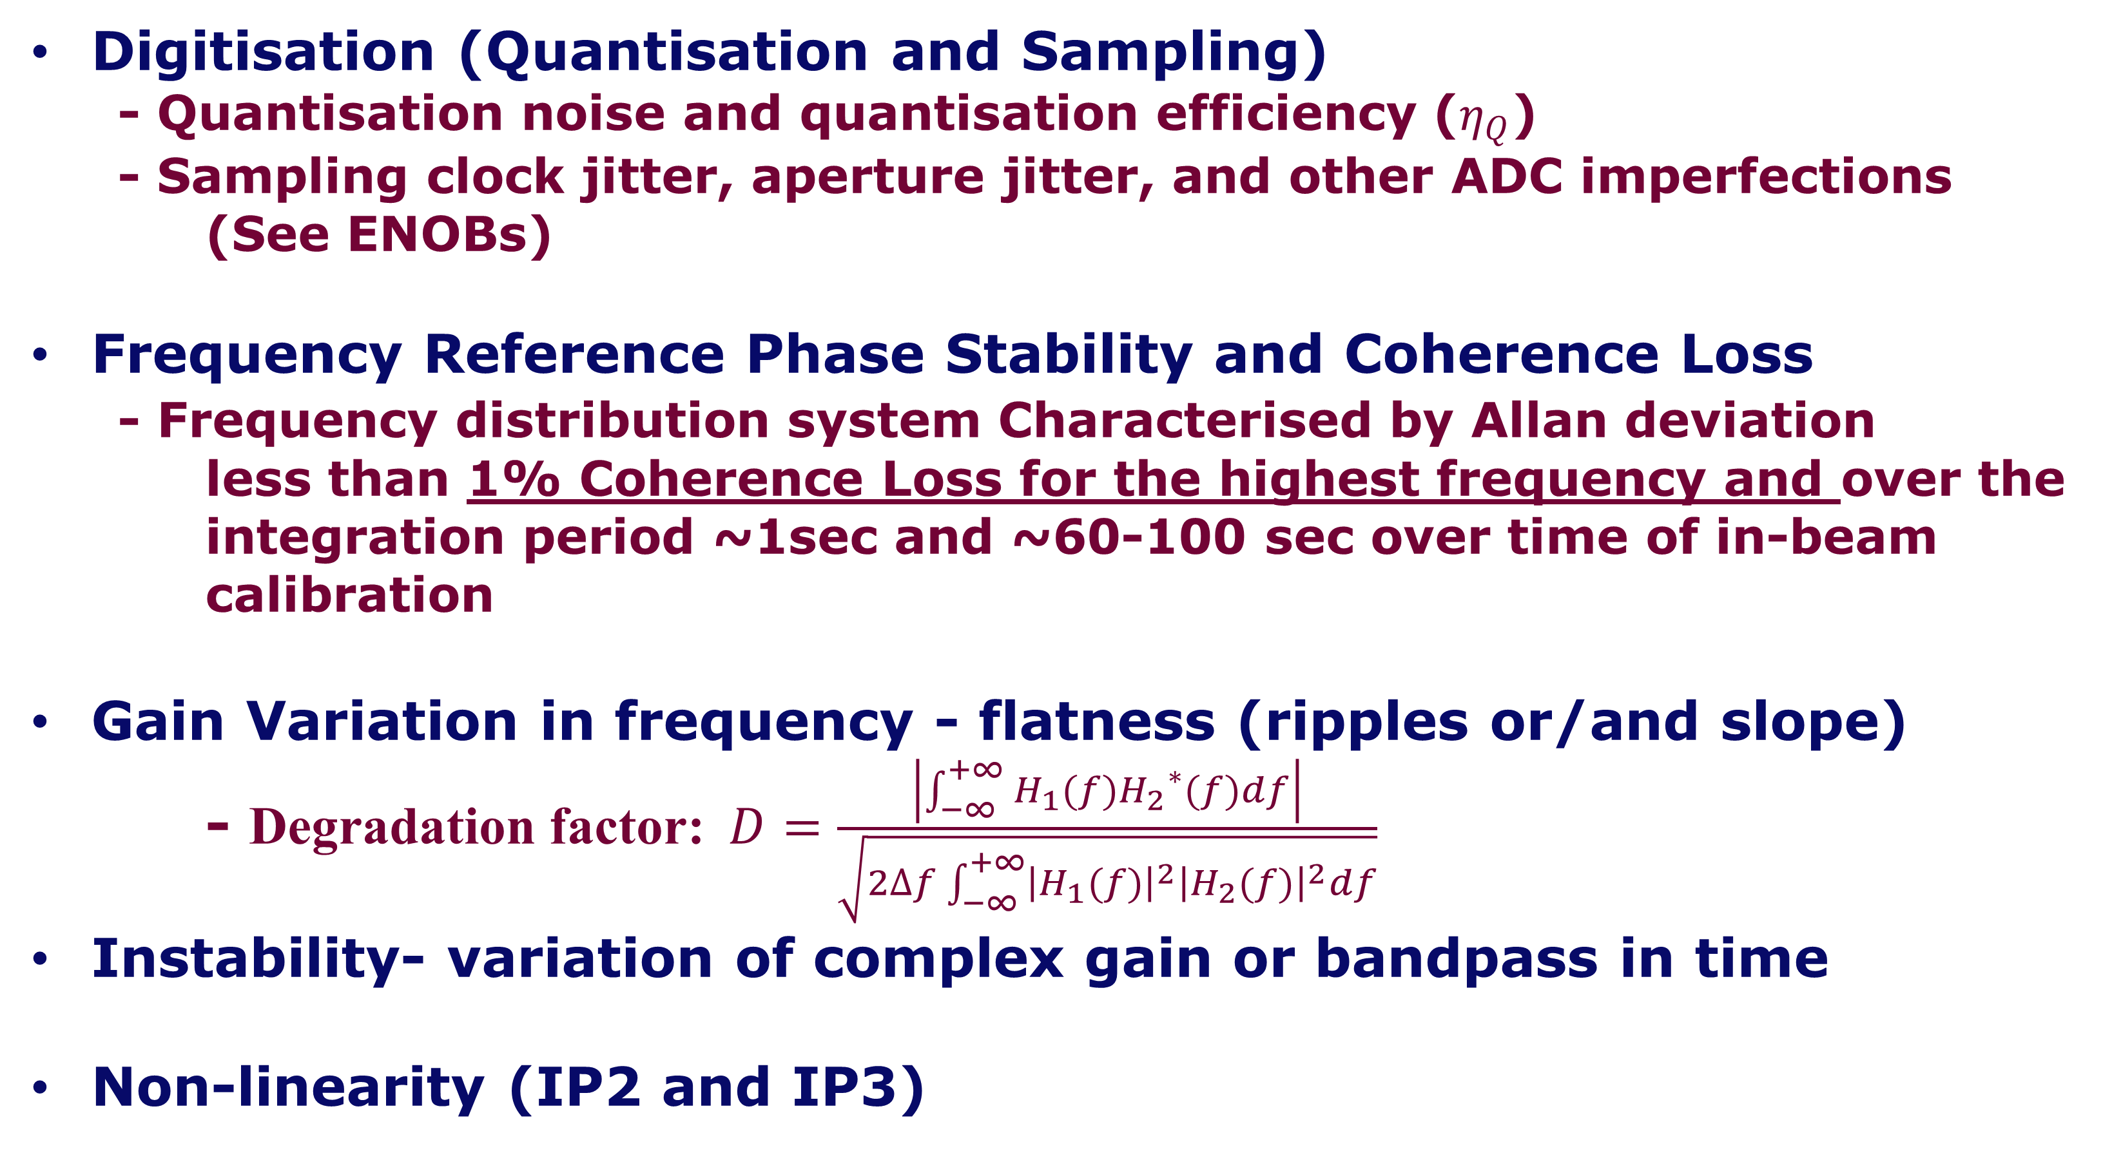
Characterisation of Errors
Digitisation (Quantisation and Sampling)
  - Quantisation noise and quantisation efficiency ($η_{Q}$)
  - Sampling clock jitter, aperture jitter, and other ADC imperfections
  (See ENOBs)
Frequency Reference Phase Stability and Coherence Loss
  - Frequency distribution system Characterised by Allan deviation
  less than 1% Coherence Loss for the highest frequency and over the integration period ~1sec and ~60-100 sec over time of in-beam calibration
Gain Variation in frequency - flatness (ripples or/and slope)
- Degradation factor: $D=\frac{\left|\int_{−∞}^{+∞}{H_{1}(f){H_{2}}^{∗}(f)df}\right|}{\sqrt{2∆f\int_{−∞}^{+∞}{{\left|H_{1}(f)\right|}^{2}{\left|H_{2}(f)\right|}^{2}df}}}$
Instability- variation of complex gain or bandpass in time
Non-linearity (IP2 and IP3)

Slide 11
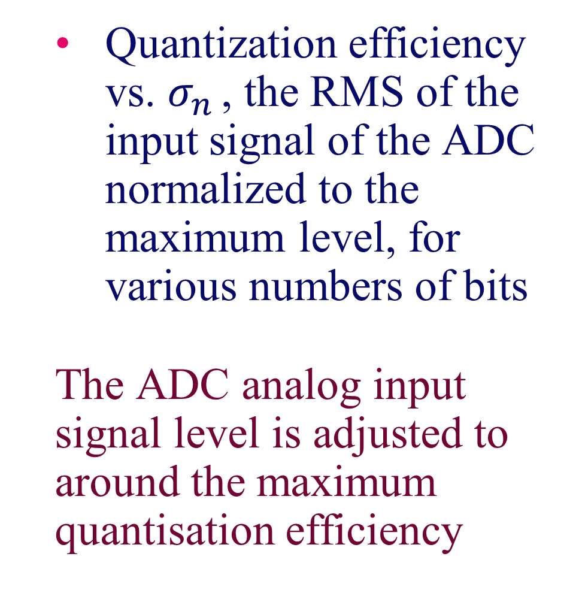

Quantisation Efficiency $η_{Q}$
Quantization efficiency vs. $σ_{n }$, the RMS of the input signal of the ADC normalized to the maximum level, for various numbers of bits
The ADC analog input signal level is adjusted to around the maximum quantisation efficiency

Slide 12
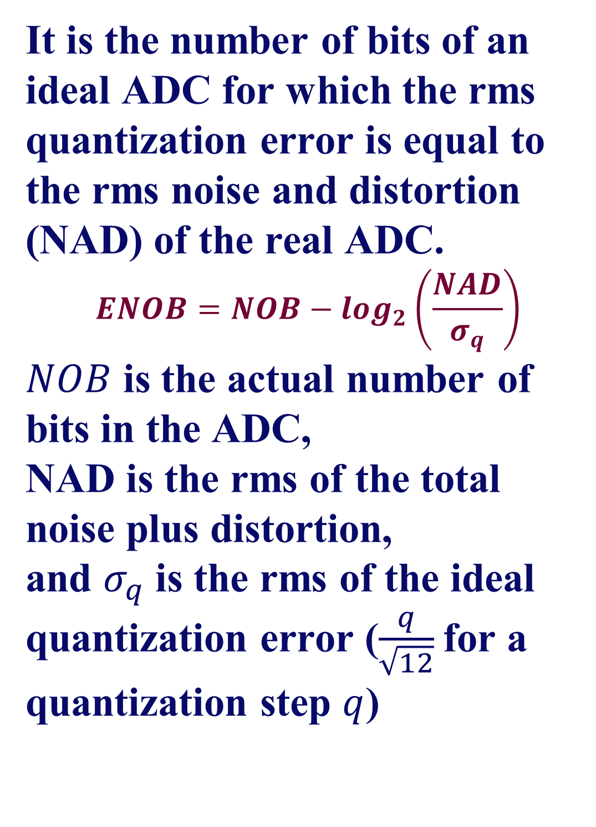
Effective Number of Bits (ENOBs)
The effective number of bits (ENOB) is a standard characterization of the digitisation imperfections.
SKA1-Mid ADC Effective Number of Bits
 | Freq. Range (GHz) | NOB | ENOB | SNR Loss (%)
Band 1 | 0.35 – 1.05 | 12 | 8 | <0.5
Band 2 | 0.95 – 1.76 | 12 | 8 | <0.5
Band 3 | 1.65 – 3.05 | 12 | 6 | <0.5
Band 4 | 2.8 – 5.18 | 8 | 4 | <1.5
Band 5a | 4.6 – 8.5 | 4 | 3 | <4.0
Band 5b | 8.3 – 15.4 | 4 | 3 | <4.0
It is the number of bits of an ideal ADC for which the rms quantization error is equal to the rms noise and distortion (NAD) of the real ADC.
$$ENOB=NOB−\log_{2}\left(\frac{NAD}{σ_{q}}\right)$$
$NOB$ is the actual number of bits in the ADC,
NAD is the rms of the total noise plus distortion,
and $σ_{q}$ is the rms of the ideal quantization error ($\frac{q}{\sqrt{12}}$for a quantization step $q$)

Slide 13
Frequency Response
Dish (SPF and SPFRx) frequency response flatness requirements:
<6.5 dB p-p for bands B1-B4, and < 4 dB p-p for bands 5a & 5b
Analysis in the Signal Chain modelling/simulation:
The frequency response of the combined transfer functions (Dish + CSP) gives the passband flatness and out of band attenuation required (e.g. for zoom windows imaging, ±0.05 dB flatness and -60dB out of band attenuation).

Slide 14
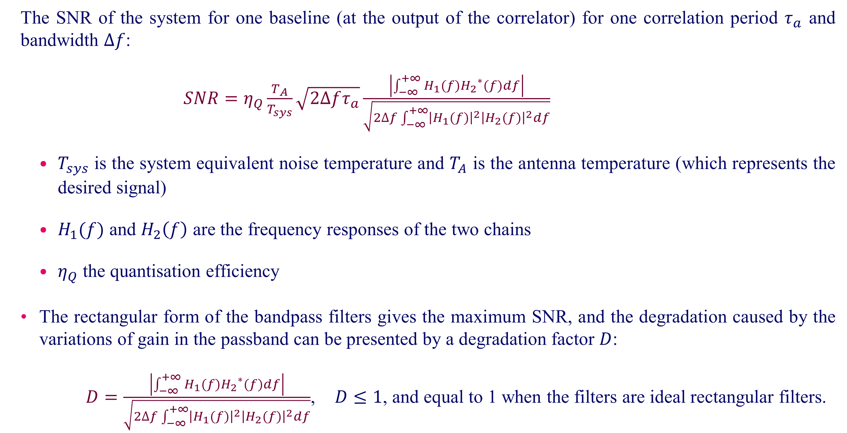
Gain variation in frequency- flatness
The SNR of the system for one baseline (at the output of the correlator) for one correlation period $τ_{a}$ and bandwidth $∆f$:
$SNR=η_{Q}\frac{T_{A}}{T_{sys}}\sqrt{2∆fτ_{a}}\frac{\left|\int_{−∞}^{+∞}{H_{1}(f){H_{2}}^{∗}(f)df}\right|}{\sqrt{2∆f\int_{−∞}^{+∞}{{\left|H_{1}(f)\right|}^{2}{\left|H_{2}(f)\right|}^{2}df}}}$
  $T_{sys}$ is the system equivalent noise temperature and $T_{A}$ is the antenna temperature (which represents the desired signal)
  $H_{1}(f)$ and $H_{2}\left(f\right)$ are the frequency responses of the two chains
  $η_{Q}$ the quantisation efficiency
The rectangular form of the bandpass filters gives the maximum SNR, and the degradation caused by the variations of gain in the passband can be presented by a degradation factor $D$:
$D=\frac{\left|\int_{−∞}^{+∞}{H_{1}(f){H_{2}}^{∗}(f)df}\right|}{\sqrt{2∆f\int_{−∞}^{+∞}{{\left|H_{1}(f)\right|}^{2}{\left|H_{2}(f)\right|}^{2}df}}}$, $D≤1$, and equal to 1 when the filters are ideal rectangular filters.

Slide 15
Gain variation in frequency- flatness
Gain variations (ripples, slope,..) cause loss of efficiency
For example, for bands 5a & 5b requirement without correction in the digitised signal, a ripple in the passband of 4 dB peak-to-peak in a form of a sinusoidal ripple would cause, in the continuum case (integrated power across the band), a loss in sensitivity of 4.3%
The band is flattened before correlation, and the sensitivity loss will be ‘small’.
The calibration residual errors limits the correction.
The main loss of SNR after correcting the band-shape in the digitised signal is the spectral variation created on quantization noise.
The quantization noise is introduced by digitisation is almost spectrally flat within the band.
After bandpass calibration, the resulting non-flat quantisation noise will result in a loss of sensitivity.

Slide 16
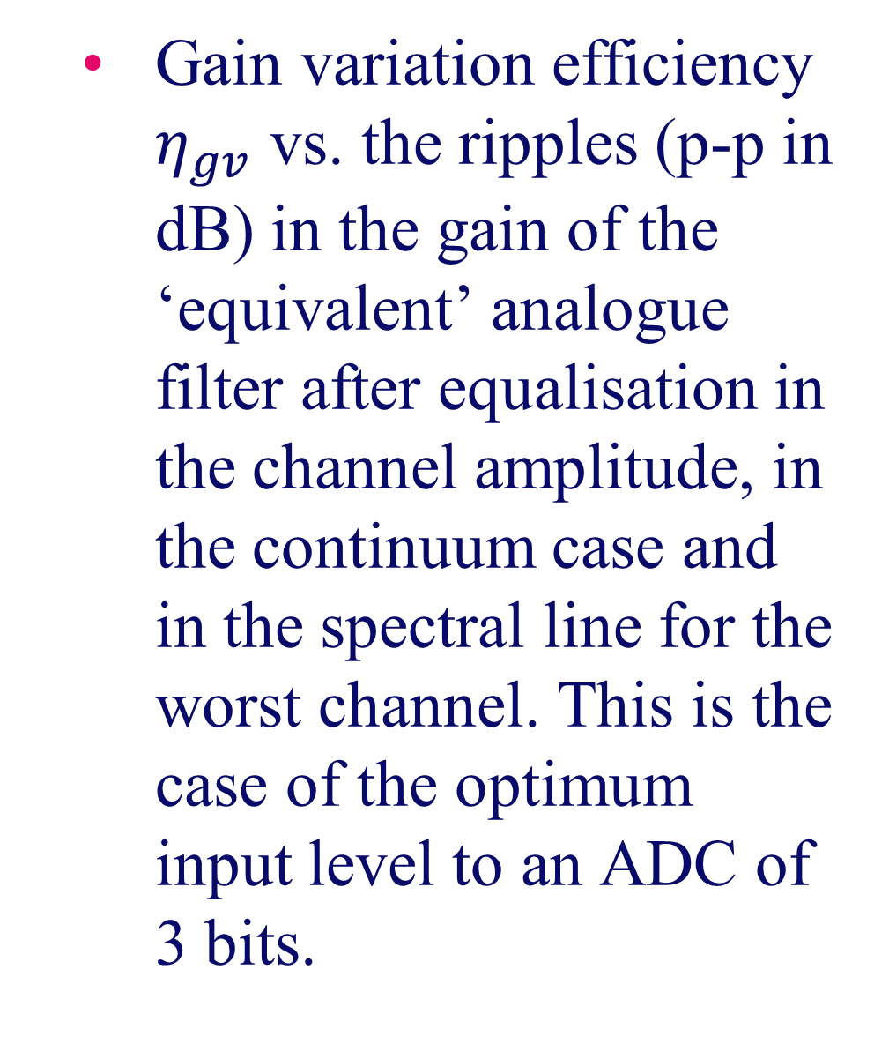
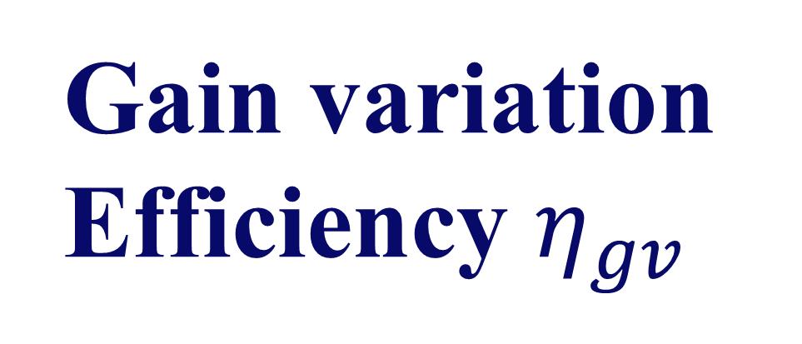
Gain variation Efficiency $η_{gv}$
Gain variation efficiency $η_{gv}$ vs. the ripples (p-p in dB) in the gain of the ‘equivalent’ analogue filter after equalisation in the channel amplitude, in the continuum case and in the spectral line for the worst channel. This is the case of the optimum input level to an ADC of 3 bits.

Slide 17
Complex Gain Stability and Bandpass Stability
This depends on the Calibration
The residual errors after calibration depend on the stability of the Signal Chain and interval between calibrations
A better stability means less frequent calibration
The Dish L2 requirements:
Gain stability of <= 3% RMS over time scales of 5 seconds up to 5 minutes
< 0.1% RMS for short term (<5s)
Phase stability RMS:
Phase stability of <= 2 ° RMS over time scales of 5 seconds up to 5 minutes
SPF Stability requirements (L3)
SPF Gain stability: <0.08% RMS (5s)
SPF Phase stability RMS: <= 0.5° RMS over 5 minutes
SPFRx Gain stability: <= 0.05% RMS (5s)
SPFRX Phase stability RMS: <= 0.5° RMS over 5 minutes

Slide 18
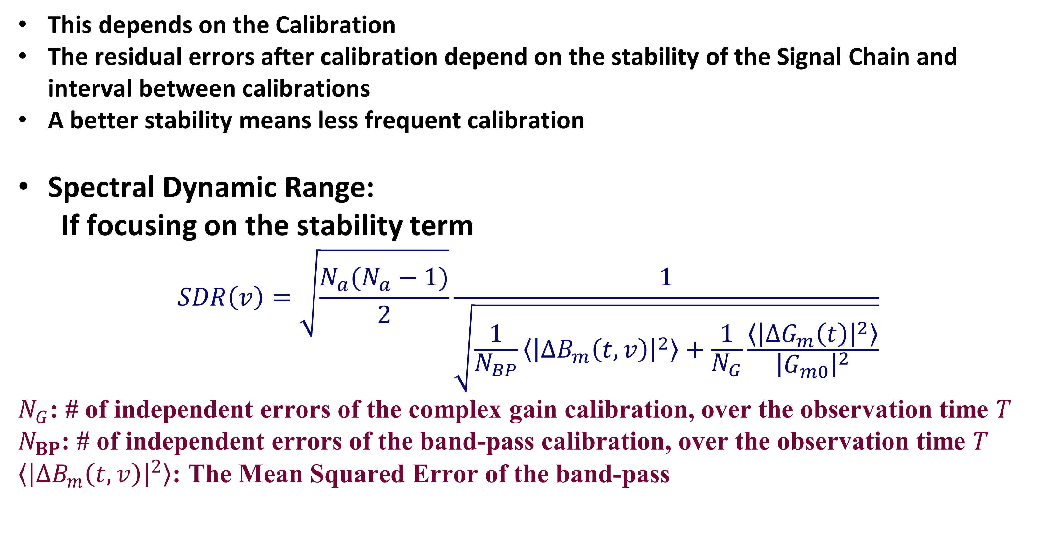
Bandpass Stability
This depends on the Calibration
The residual errors after calibration depend on the stability of the Signal Chain and interval between calibrations
A better stability means less frequent calibration
Spectral Dynamic Range:
  If focusing on the stability term
$$SDR\left(v\right)=\sqrt{\frac{N_{a}(N_{a}−1)}{2}}\frac{1}{\sqrt{\frac{1}{N_{BP}}〈{\left|∆B_{m}\left(t,v\right)\right|}^{2}〉+\frac{1}{N_{G}}\frac{〈{\left|∆G_{m}\left(t\right)\right|}^{2}〉}{{\left|G_{m0}\right|}^{2}}}}$$
$N_{G}$: # of independent errors of the complex gain calibration, over the observation time $T$
$N_{BP}$: # of independent errors of the band-pass calibration, over the observation time $T$
$〈{\left|∆B_{m}\left(t,v\right)\right|}^{2}〉$: The Mean Squared Error of the band-pass

Slide 19
Bandpass Stability
Requirement
Reviewing the Band-pass Stability requirement
SKA1-SYS_REQ-3458 (ECP200016)
The bandpass of SKA1_Mid, on timescales of 600 seconds (10hrs) or less and for all processed bandwidths, post-calibration and RFI mitigation, shall be stable to better than 0.03% (0.1%)

Slide 20
Linearity
Level 1 Requirement:
  The level of spurious products generated by the SKA1_Mid, in the presence of signals representative of the expected RFI environment, shall degrade the expected thermal noise floor of a 1000-hour integration by no more than 10%.
  Non-linearity causes generating spurious components and intermodulation.
  First Analysis on the RFI and Linearity is presented in the Signal Chain document for CDR.
  More analysis is ongoing taking the last characterisations of RFI.

Slide 21
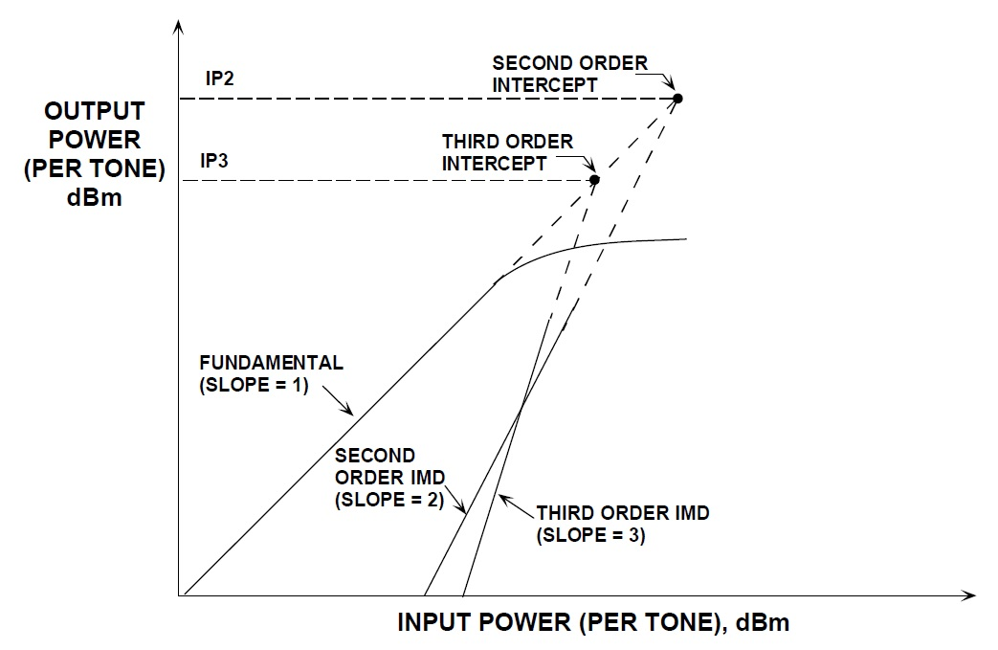
Linearity
Nonlinearities of the Signal Chain are described in terms of the IP2 and IP3 parameters which are linked respectively to the quadratic and cubic terms in the transfer function.
The 1 dB compression point describes the gain dependency on the signal power level. All components in the chain are operated well below the compression, and gain variations are negligible.
  First Analysis on the RFI and Linearity is presented in the Signal Chain document for CDR.
  More analysis is ongoing taking the last characterisations of RFI.

Slide 22
Performance Aspects and Activities
Critical points to continue working on (more related to the analog Signal Chain):
RFI and Linearity
  RFI and flagging: loss of sensitivity by removing segments of the signals in time or in frequency- Linearity is important to reduce the effect of generated spurious components and intermodulation
Stability and Calibration
Spectral stability and Spectral Dynamic Range
Errors in the Correlator are limited: The signal is digitised, and enough number of bits to reduce errors

Slide 23
Verification of the Performance of the Signal Chain
Signal Chain Document for CDR
  System Requirements, budgets of error allocation for elements
  Analysis and modeling- integration between Analog Signal Chain and CSP
  ‘Good’ compliance with the requirements
Verification on prototypes and testing
  SPF and SPFRx qualification and testing results
  Errors in CSP are limited as a digital system, with adequate number of bits processing

Slide 24
Bassem Alachkar
SKAO Signal Processing Domain Specialist
Bassem.Alachkar@skao.int

