Slide 1
Synchronisation and Timing (SAT) System
Overview
Aniket Hendre, DS Time and Frequency
10th May 2022

Slide 2
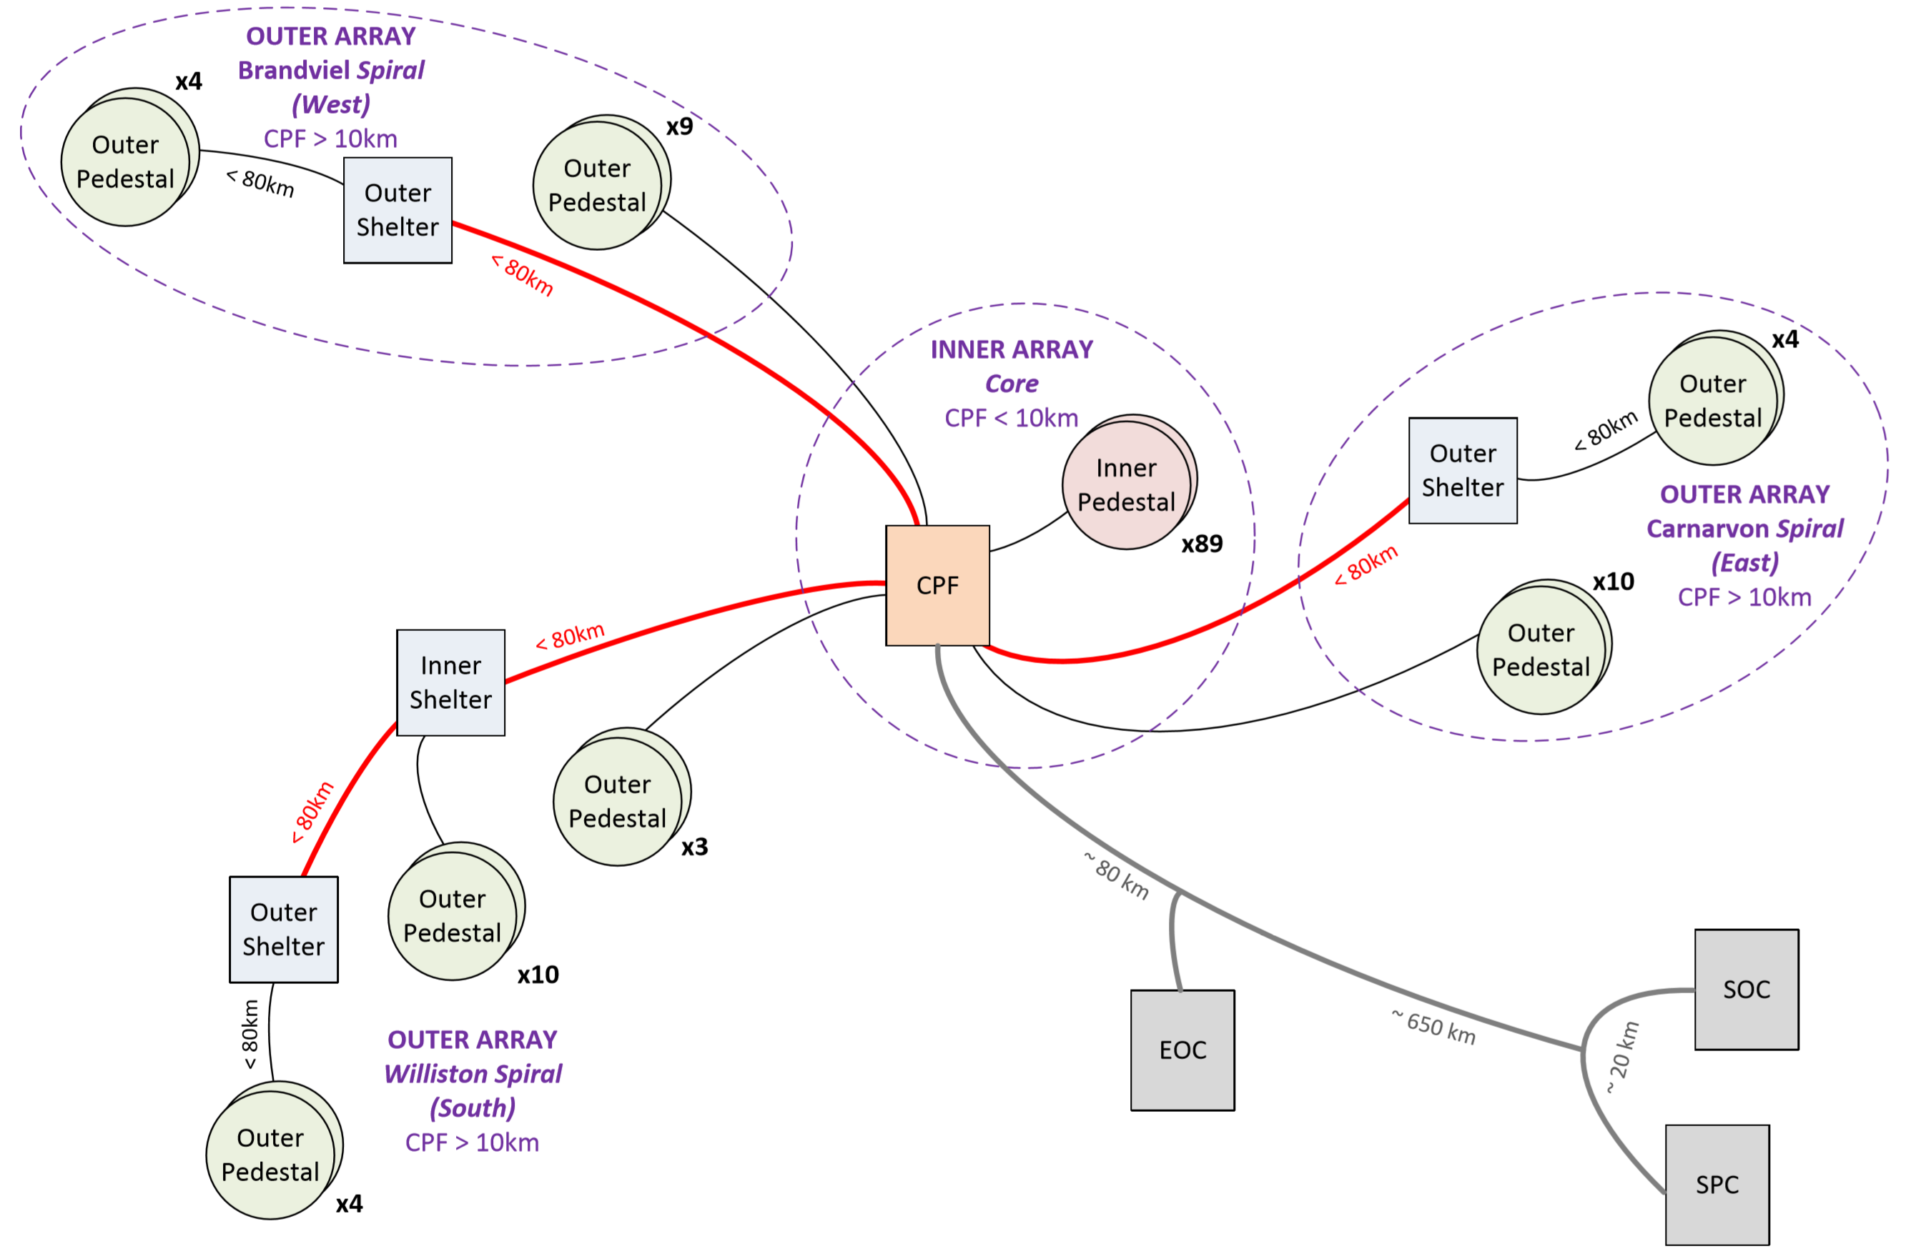
Our Mid telescopes
SKA1-Mid (over-head fibre)

Slide 3
Importance of Synchronisation and Timing (SAT)
Why we need SAT system?
Responsibilities
Maintain time and frequency standards locally [UTC(k)] for each site (SKA1-Low in AU and SKA1-Mid in SA).
Distribute references to each digitiser (dish: SKA1-Mid and RPF: SKA1-Low) with minimal phase fluctuations to maintain high degree of coherence and accurate time.

Slide 4
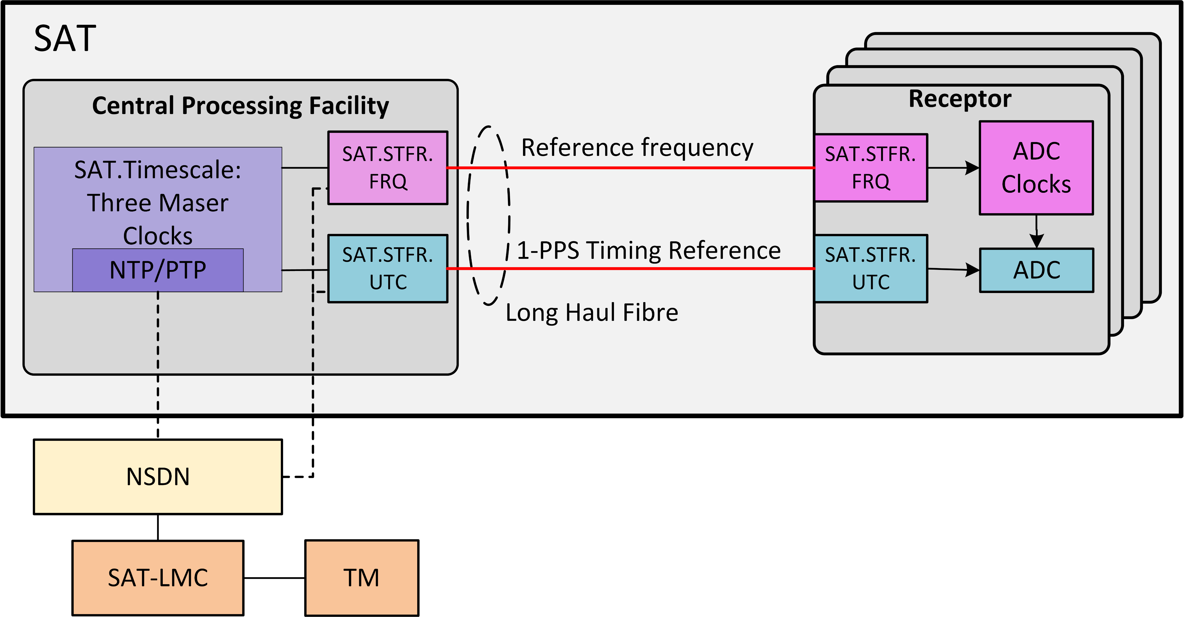
Overview of SAT
SAT.Timescale
SAT.STFR.FRQ
SAT.STFR.UTC
SAT.LMC
SAT: Synchronisation and Timing
STFR: System for Time and Frequency Reference
FRQ: Frequency reference
UTC: Time reference

Slide 5
SAT Sub-systems overview

Slide 6
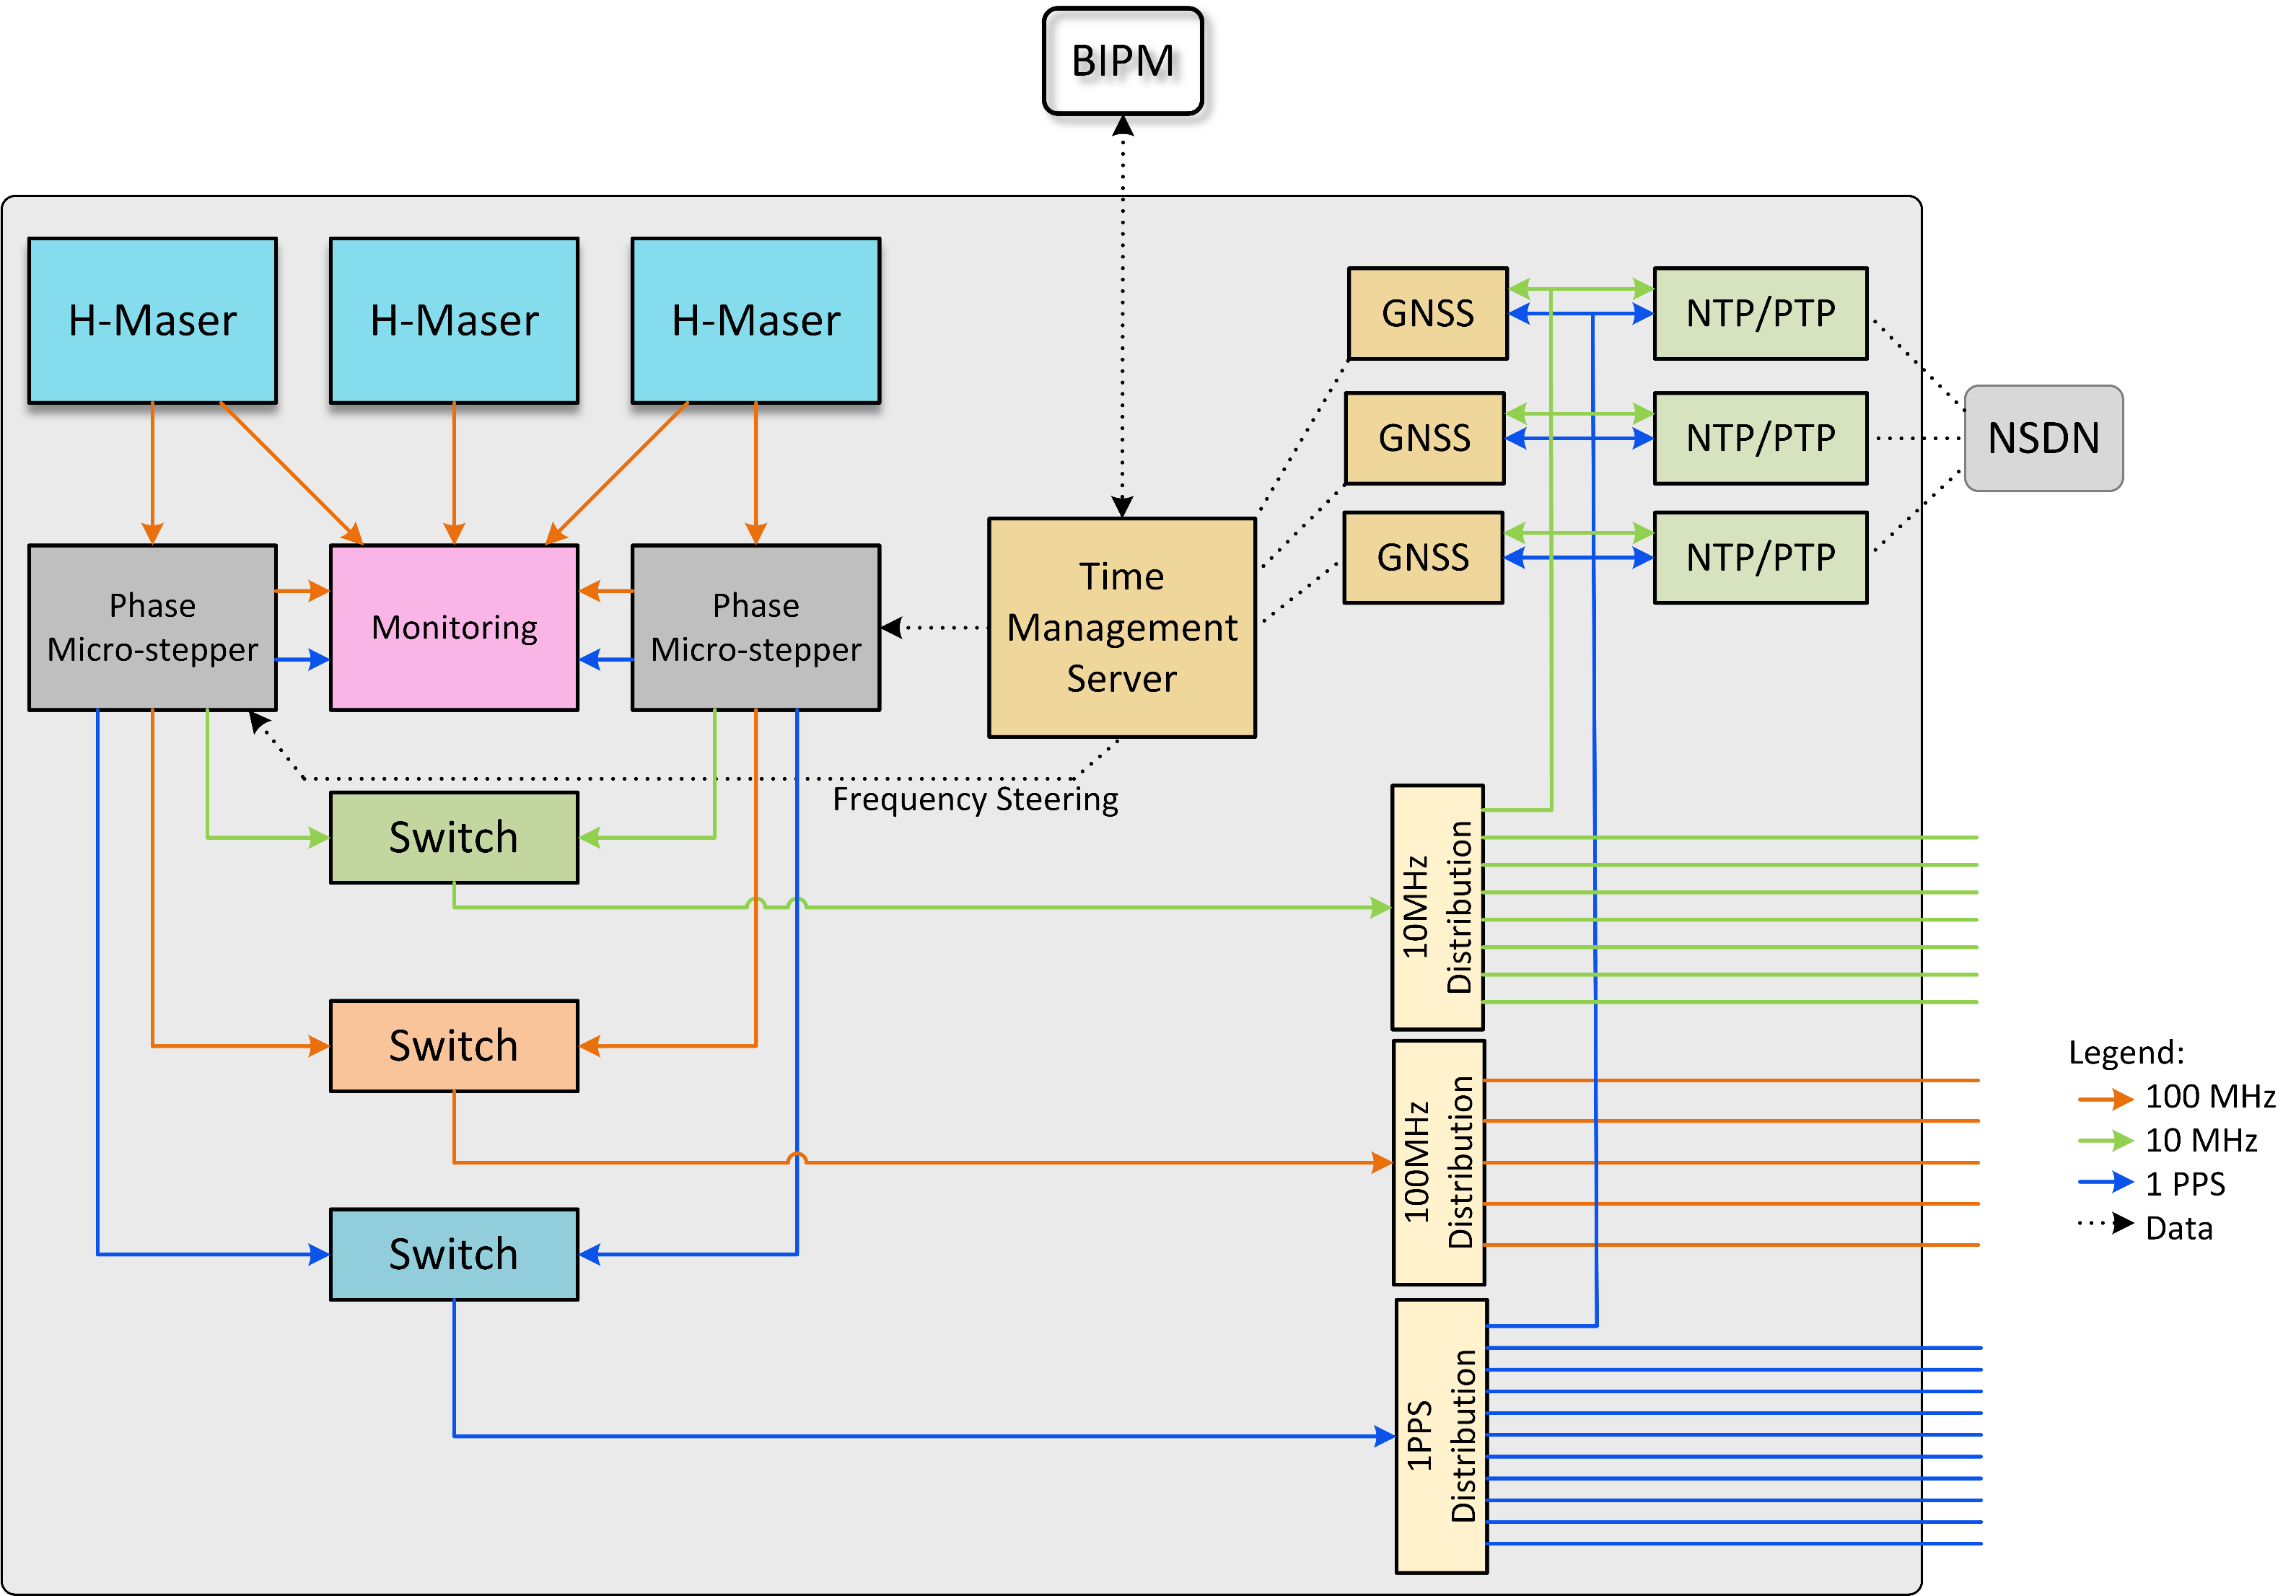
SAT.Timescale
SAT.STFR.FRQ_Mid
SAT.STFR.UTC
Block diagram
Three cornered hat configuration for redundancy
Phase micro steppers are used to avoid frequent steering of Masers
GNSS Common view technique and PPP are used for UTC traceability. TWSTFT is not desirable
Implement UTC(k) for both AU and SA
Incorporate IGS to operate CoRS

Slide 7
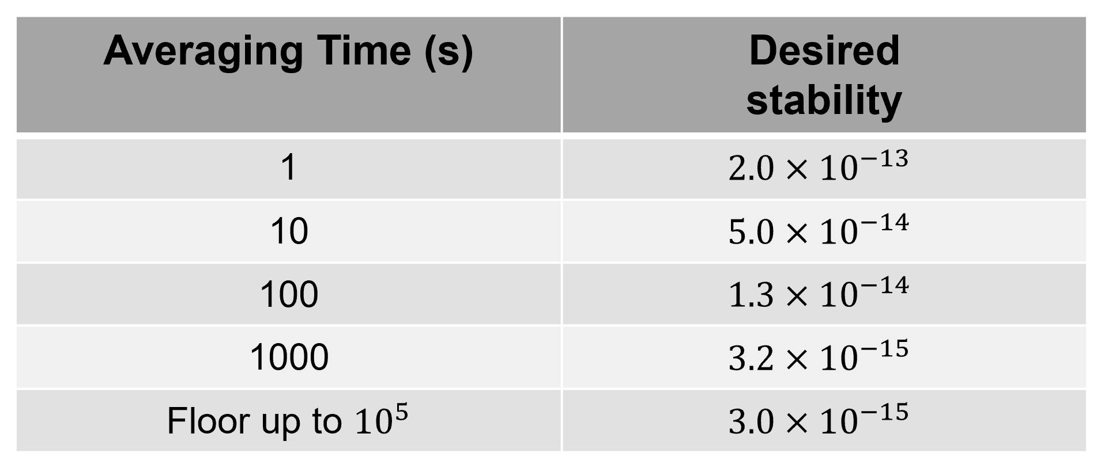
SAT.Timescale
SAT.STFR.FRQ_Mid
SAT.STFR.UTC
Key performance requirements
Reference frequency stability
Time uncertainty from the UTC
Less than 5ns (1-sigma) at least for 10 years
Desired reference frequency stability in terms of Allan deviation for SKA1-Mid and SKA1-Low

Slide 8
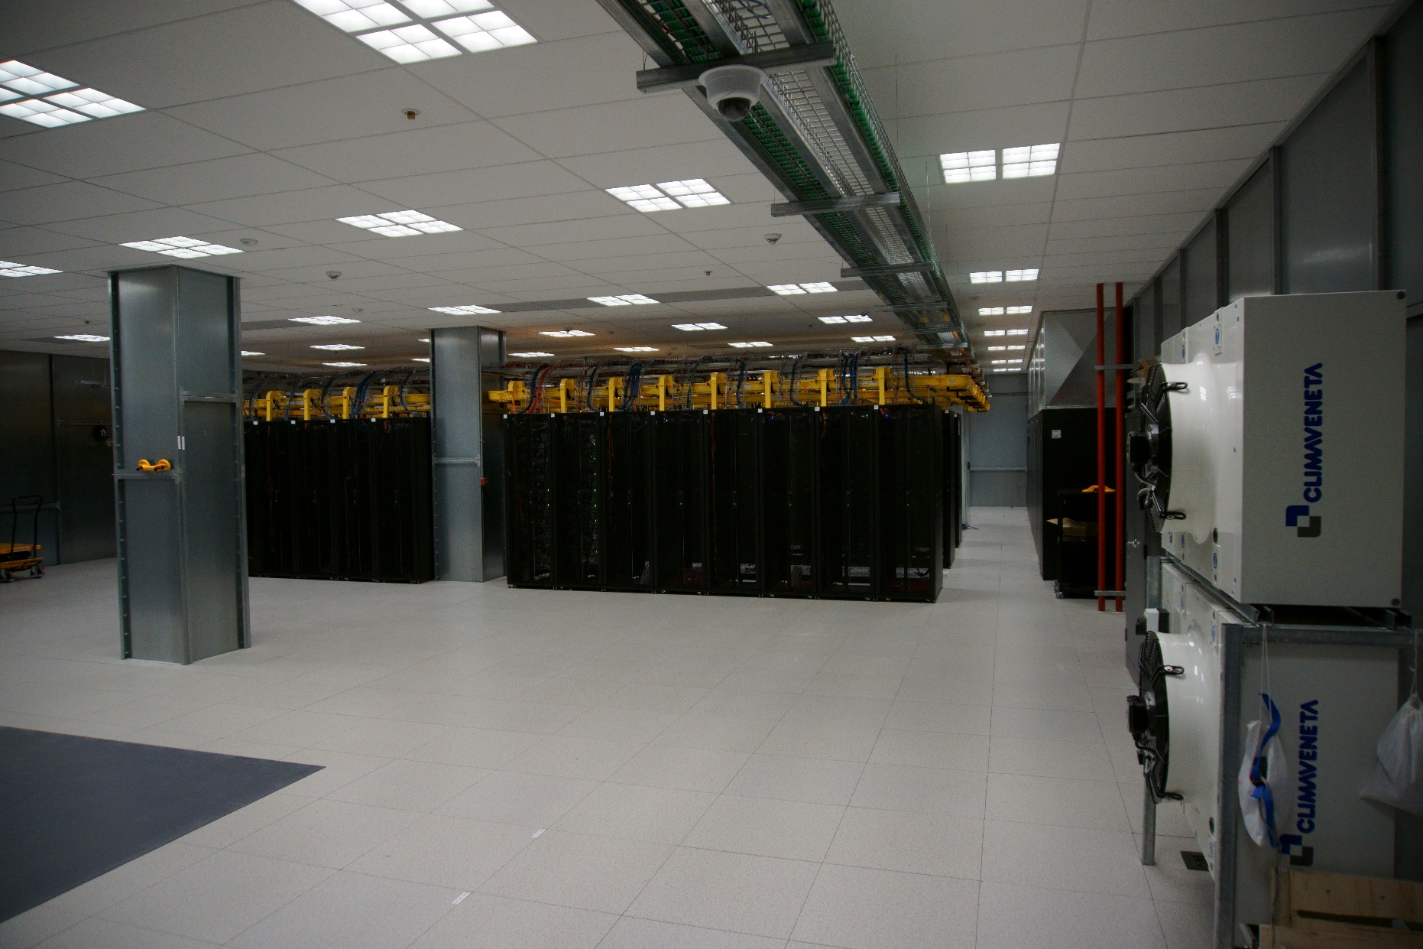
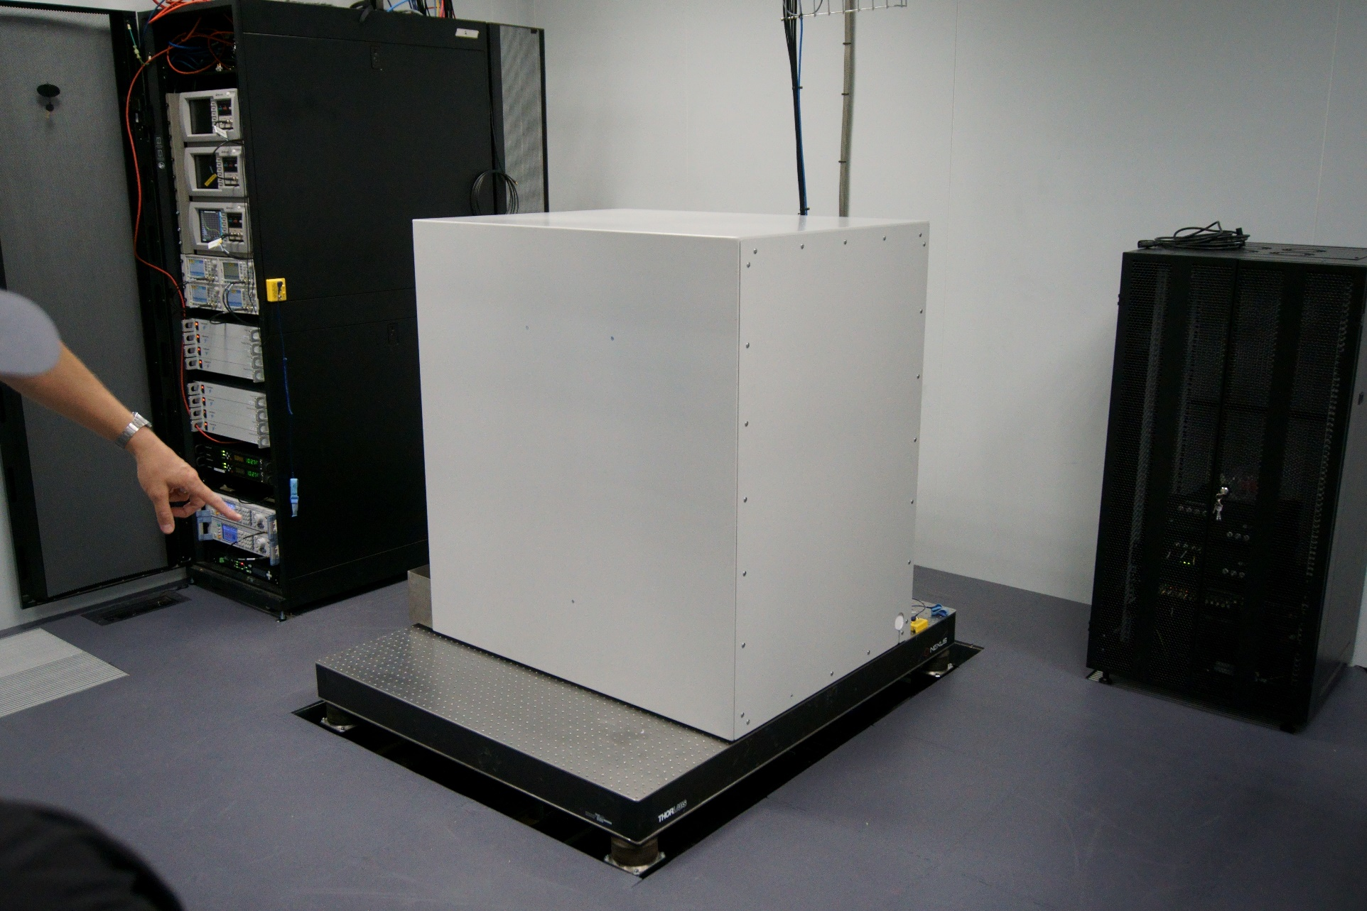
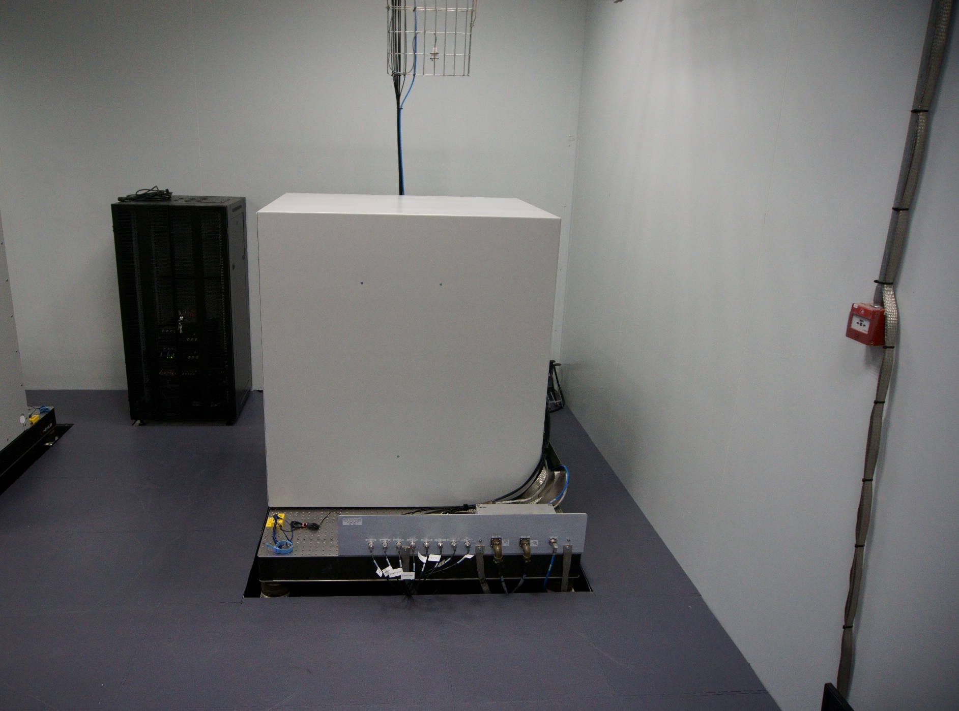
SAT.Timescale
SAT.STFR.FRQ_Mid
SAT.STFR.UTC
SKA1-Mid SAT.Timescale will integrate and replace MeerKAT Timescale

Slide 9
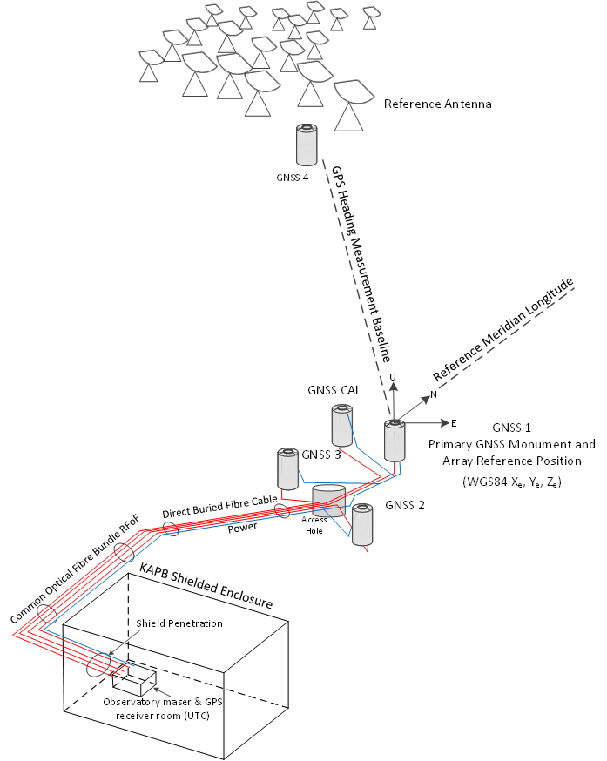
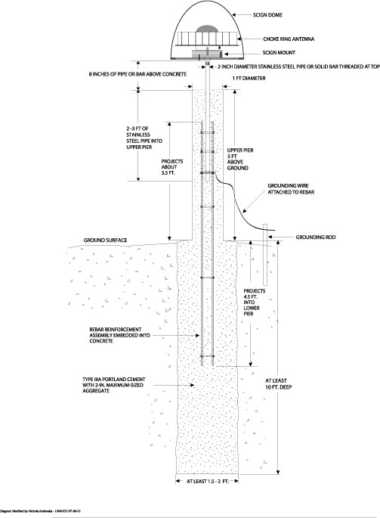
SAT.Timescale
SAT.STFR.FRQ_Mid
SAT.STFR.UTC

Slide 10
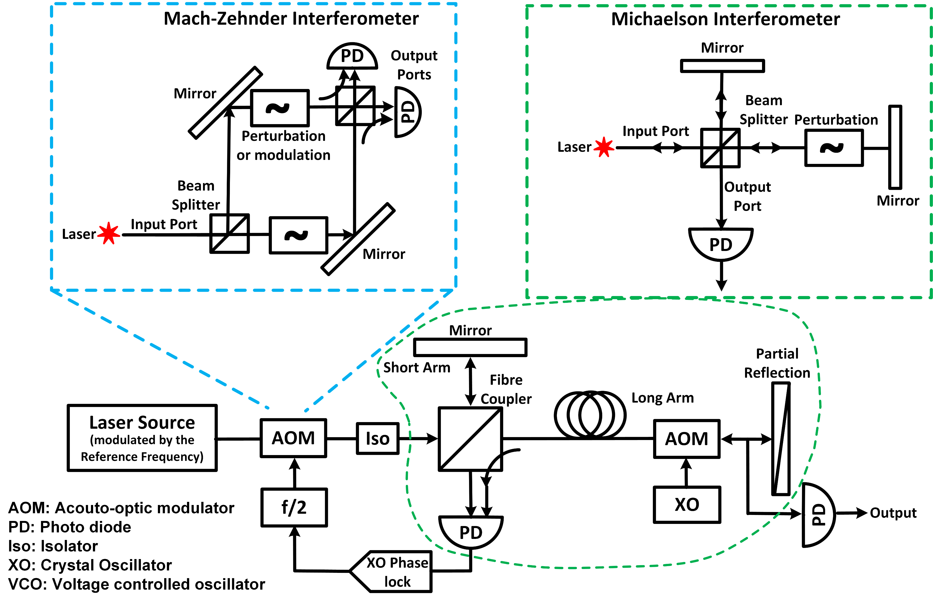
SAT.Timescale
SAT.STFR.FRQ_Mid
SAT.STFR.UTC
Block diagram
Suitable on the overhead fibre cable
Round trip closed-loop feedback control system based on optical phase sensing and actuation
Used AoM as a servo-loop actuator which is very robust and has large bandwidth
Delivers 3.96GHz+offset inside the digitiser enclosure
Coherence loss | Less than 1% for 1s and 60s at 3.96GHz+offset
Phase drift | Less than 0.3 rad for 10min at 3.96GHz+offset

Slide 11
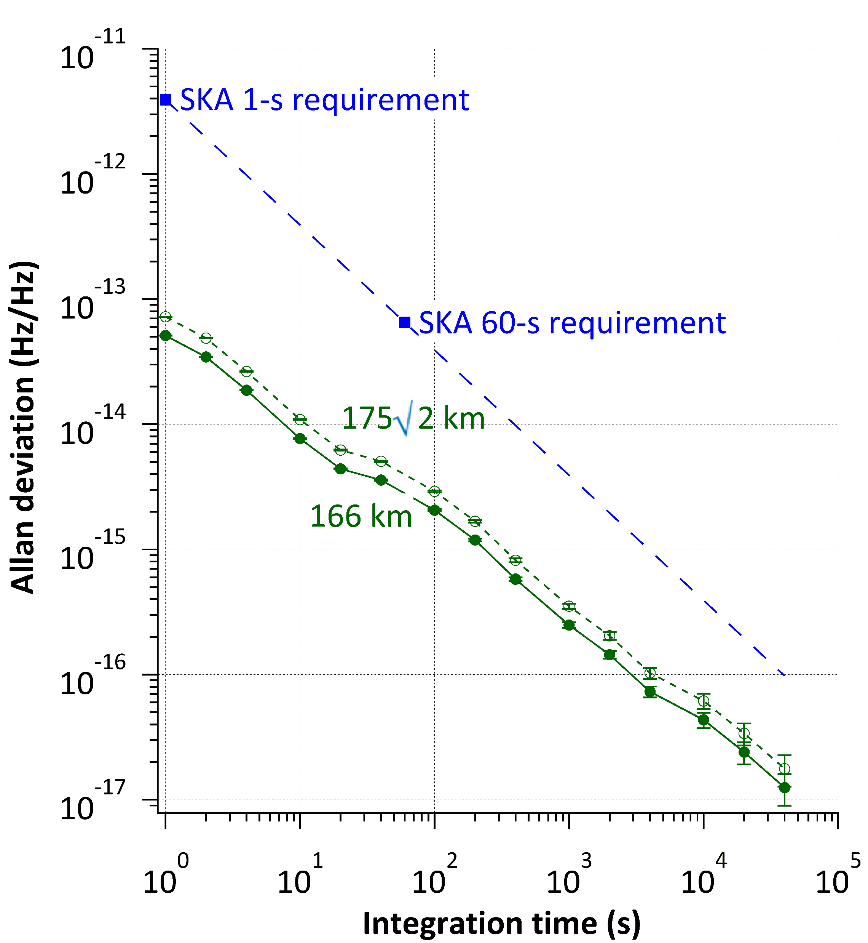
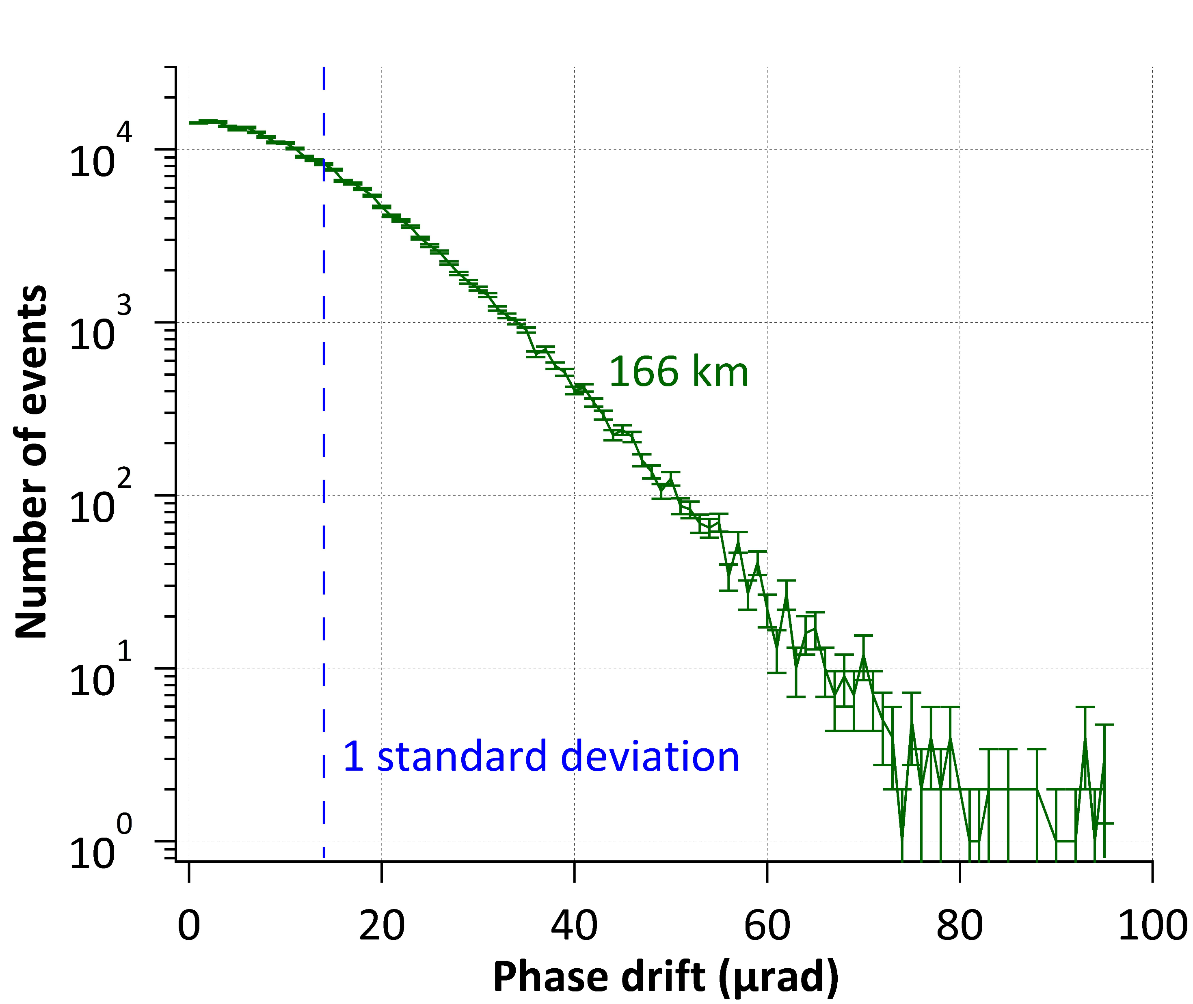
SAT.Timescale
SAT.STFR.FRQ_Mid
SAT.STFR.UTC
Some test results
Frequency stability measured in terms of Allan deviation for reference frequency distribution system for SKA1-Mid telescope tested on 166 km overhead fibre (credit: UWA).
Phase drift measured at the output of frequency distribution system for SKA1-Mid telescope (credit: UWA).

Slide 12
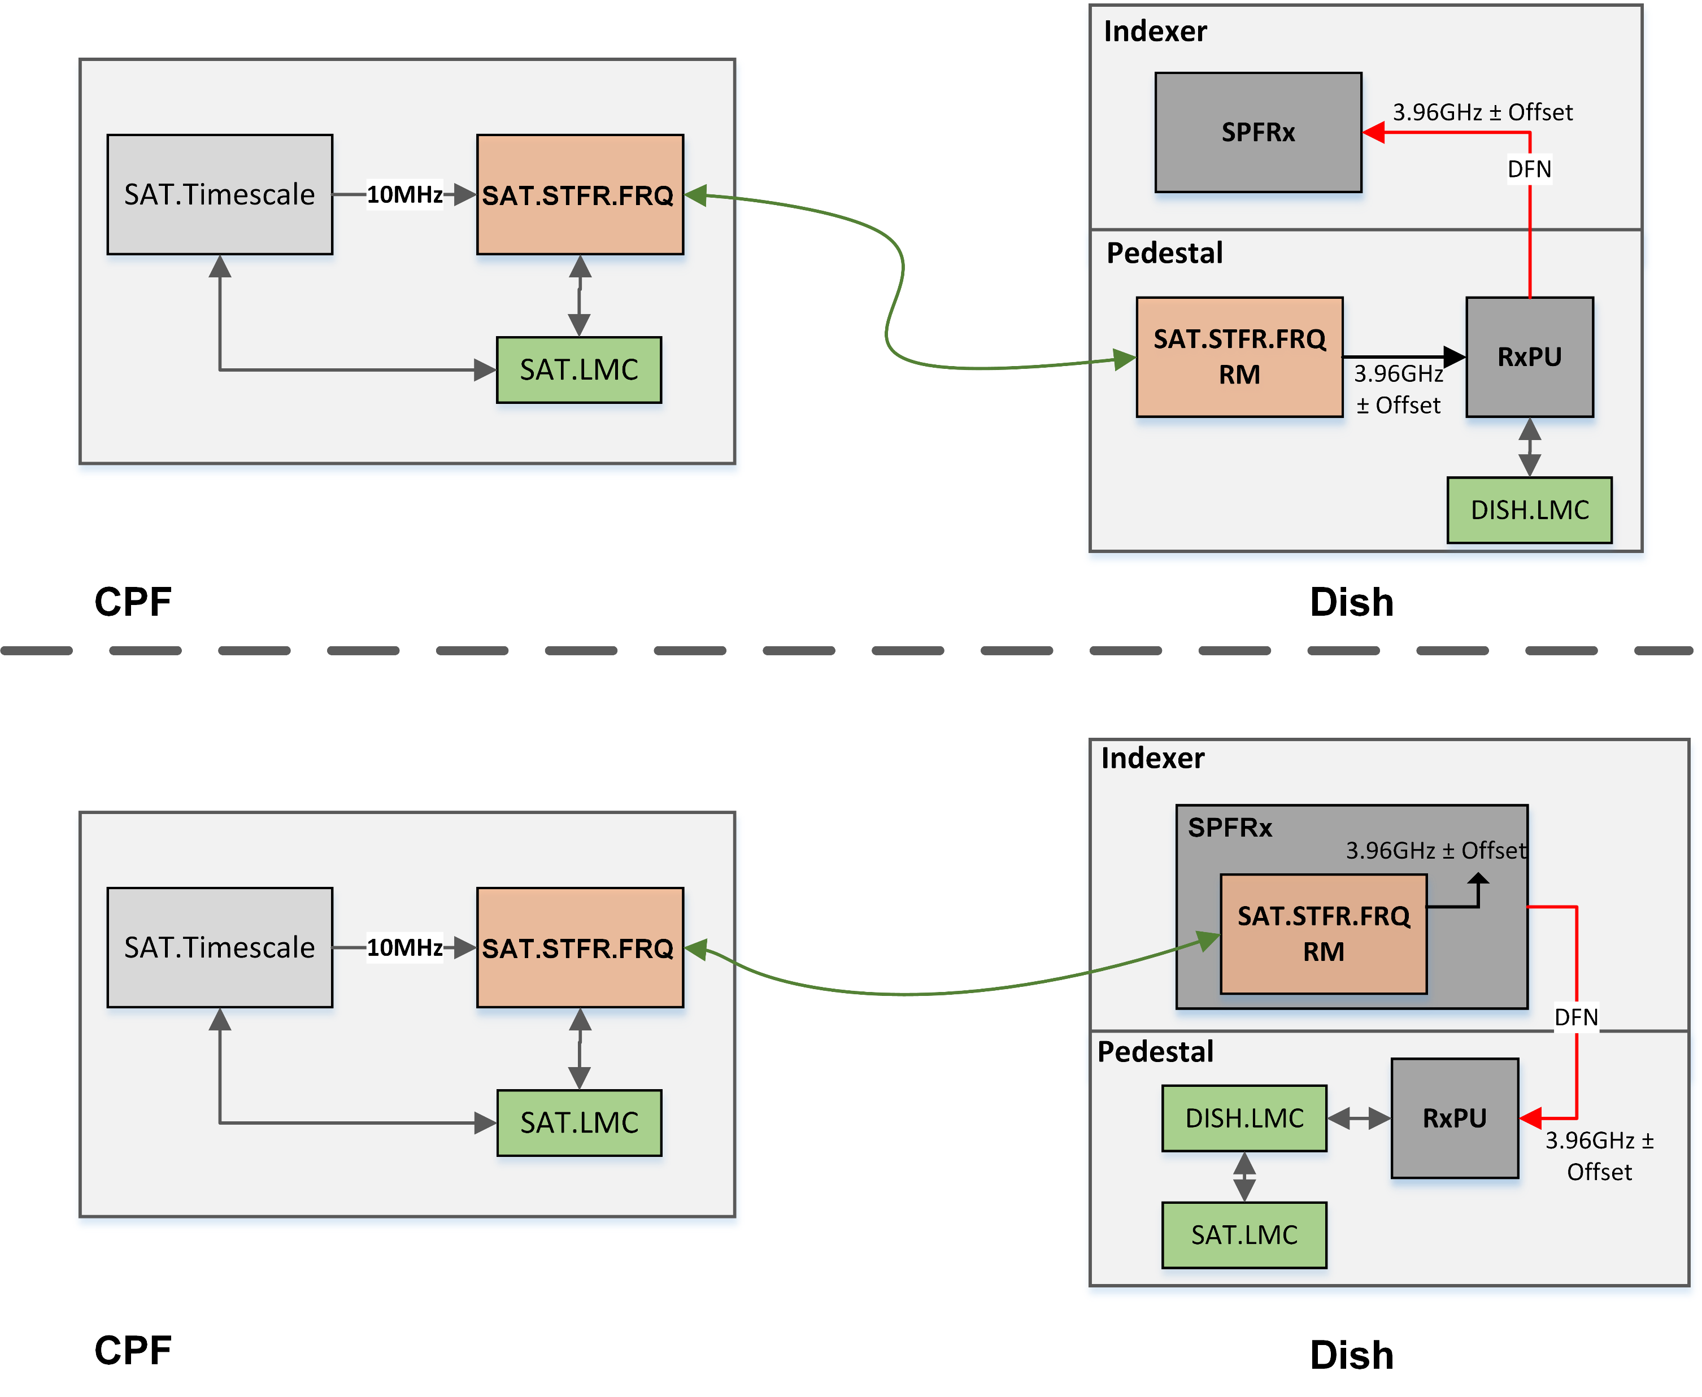
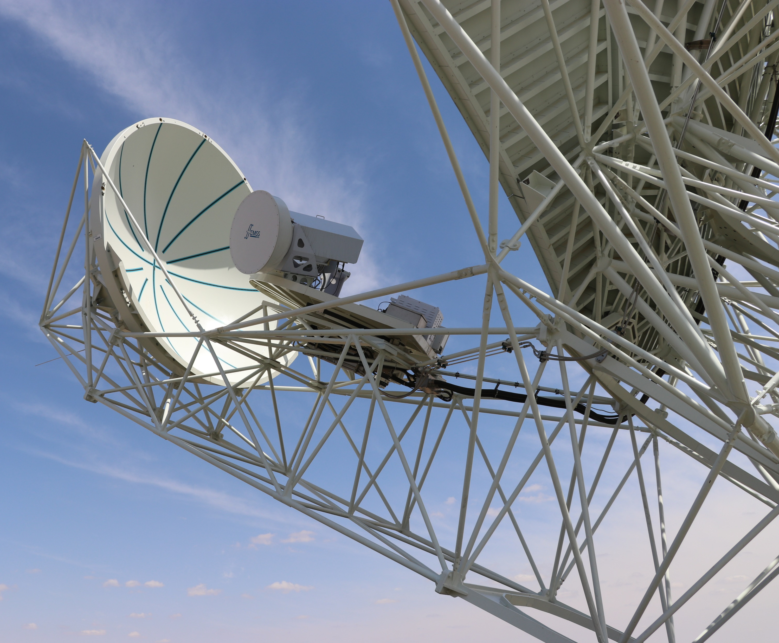
Last Mile ECP Changes

Slide 13
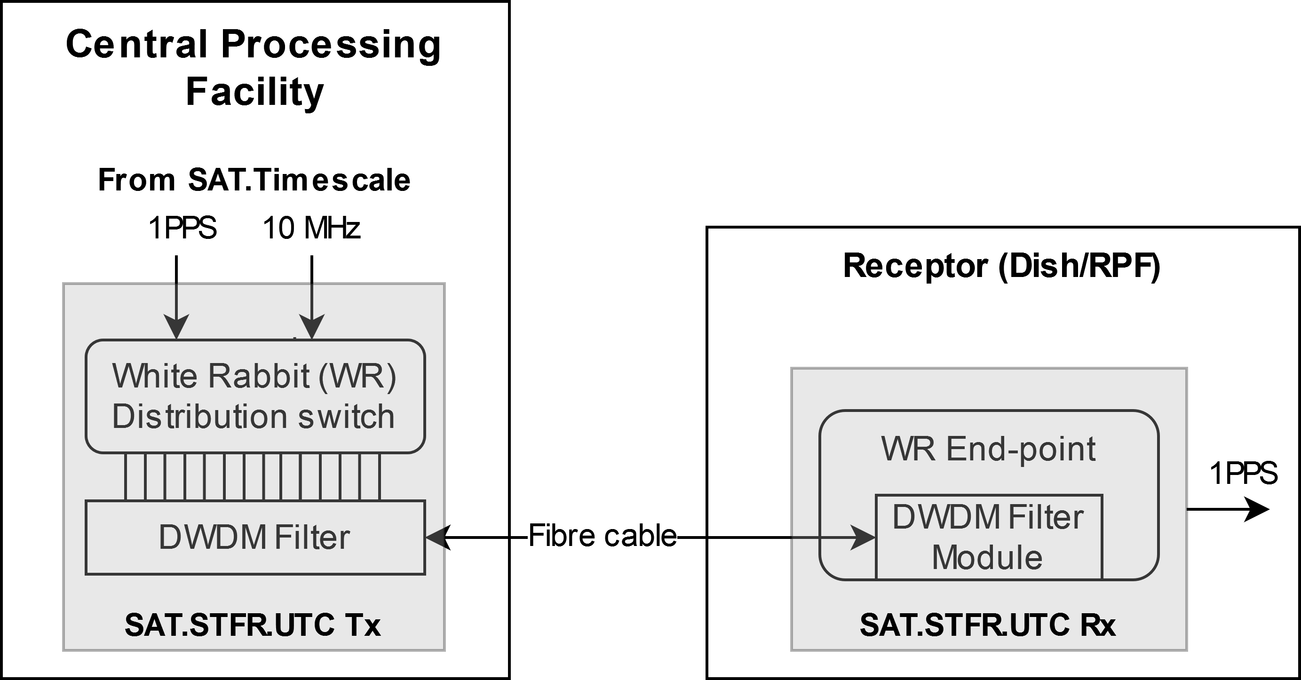
SAT.Timescale
SAT.STFR.FRQ_Mid
SAT.STFR.UTC
Block diagram
WR based system (1ns over 10km).
Long distance + instability of the laser wavelength + fibre dispersion = Timing uncertainty.
It uses SFPs suitable for DWDM network (internal temperature control) to stabilise the wavelength within 0.1nm
The accuracy for long distances is achieved by using long reach SFPs and optical amplifiers.
 | SKA1-Mid
Time accuracy at remote location | 2ns (RMS) as refereeing to SKA-Timescale [UTC(k)]

Slide 14
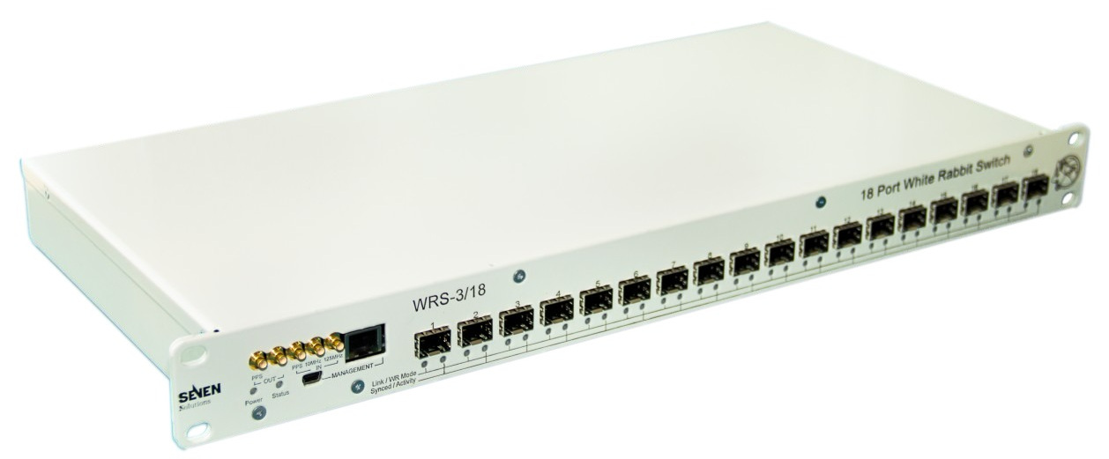
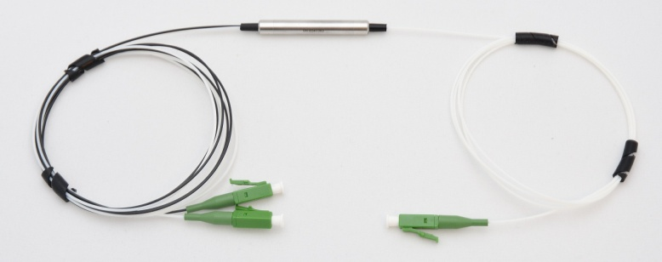
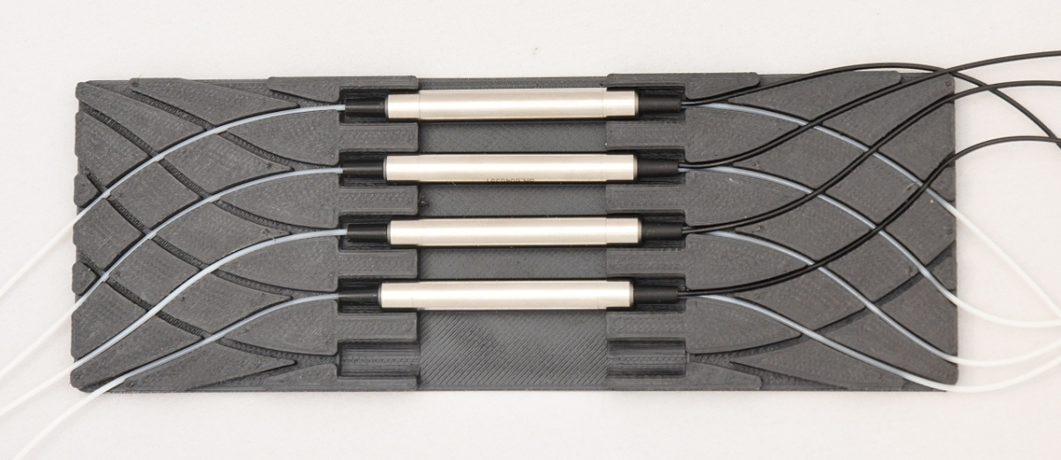
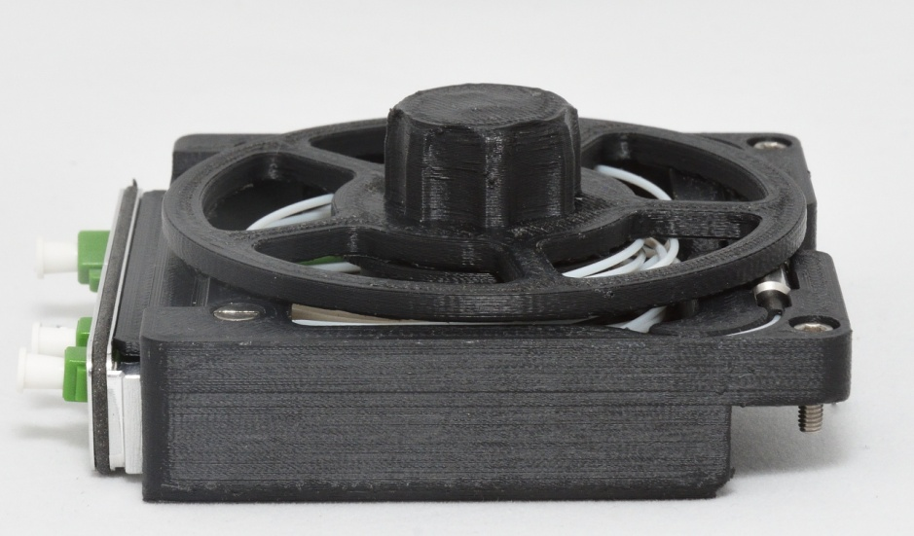
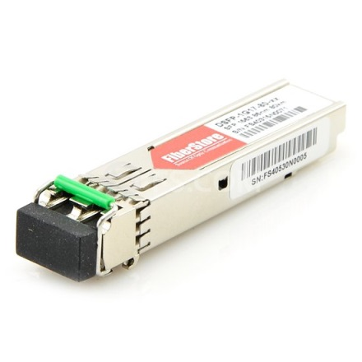
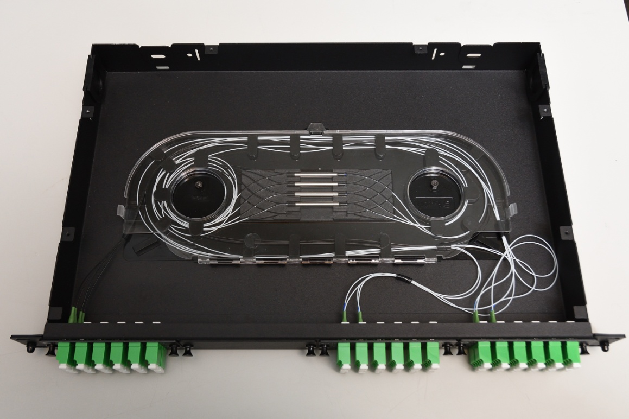
SAT.Timescale
SAT.STFR.FRQ_Mid
SAT.STFR.UTC
Composition

Slide 15
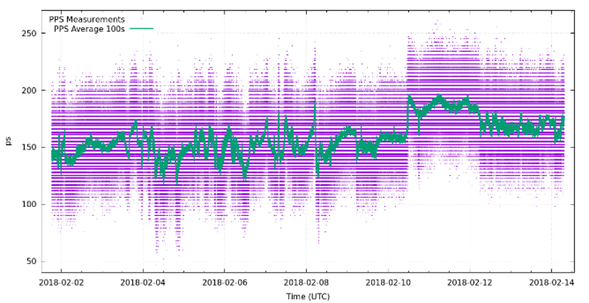
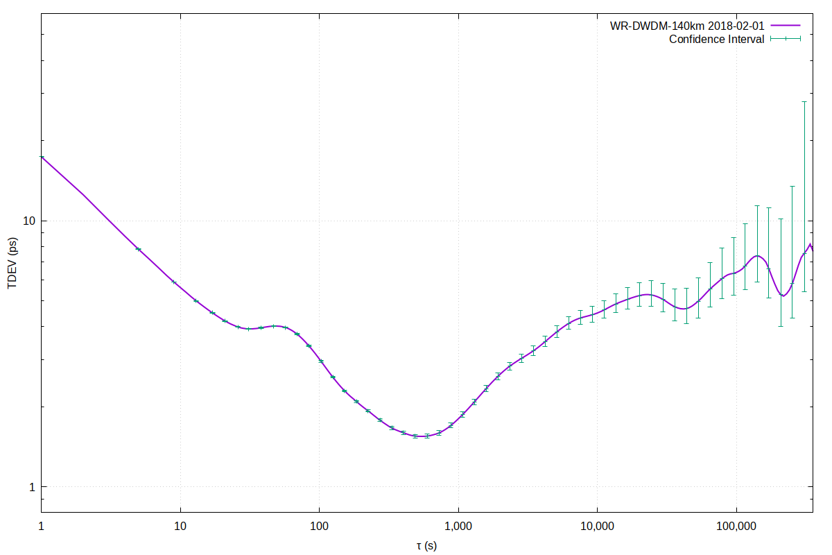
SAT.Timescale
SAT.STFR.FRQ_Mid
SAT.STFR.UTC
Some test results
Time offset of the recovered 1PPS using 140km calibrated WR link. The jitters remain mostly within +-100ps (credit: JIVE).
Time deviation plot for jitters tested over 140km WR link. The RMS jitter on the PPS signal is only 20ps for 1s averaging time (credit: JIVE).

Slide 16
Acknowledgement for SAT in SKA1-Mid
University of Manchester (UoM), for leading Signal and Data Transport consortia (SaDT)
National Physical Laboratory (NPL), UK for designing clock systems for both telescopes
University of Western Australia (UWA) for designing reference frequency distribution in SKA1-Low
Joint Venture of VLBI ERIC (JIVE), Netherland for designing Time distribution system for both telescopes
National Centre for Radio Astrophysics (NCRA), India for designing Local Control and Monitoring system

Slide 17
Thank you…

