Slide 1
SPFRx Technical Overview
Jayashree Roy
10th May, Mid Annual Status Update Meeting 2022

Slide 2

Single Pixel Feed Receiver (SPFRx)
The main task of SPFRx is to condition the incoming RF signals from SPF, perform analog-to-digital conversion forward the digitized RF samples to Central Signal Processor (CSP).
The architecture of the SPFRx aims to achieve the following specific objectives:
Maximize linear dynamic range without compromising noise performance.
Minimize the number of components directly in the analog path to increase the stability, this indicates the signal conversion from analog-to-digital should be close to RF frontends.
Minimize the electrical lengths of interconnects to reduce the ripple from impedance mismatch, loss, and temperature variation.
Maximize immunity to interference, both external as well as self induced RFI. Region around dish focal point is extremely sensitive to EMI, electronics devices (esp. digital circuits) should be minimized, EMI filtered and sufficiently shielded.
Minimize the contribution to mass on the dish indexer, as reflector antenna is a cantilevered structure. This is a challenge because thermal stability requirements and EMI shielding yield to heavy structures.

Slide 3
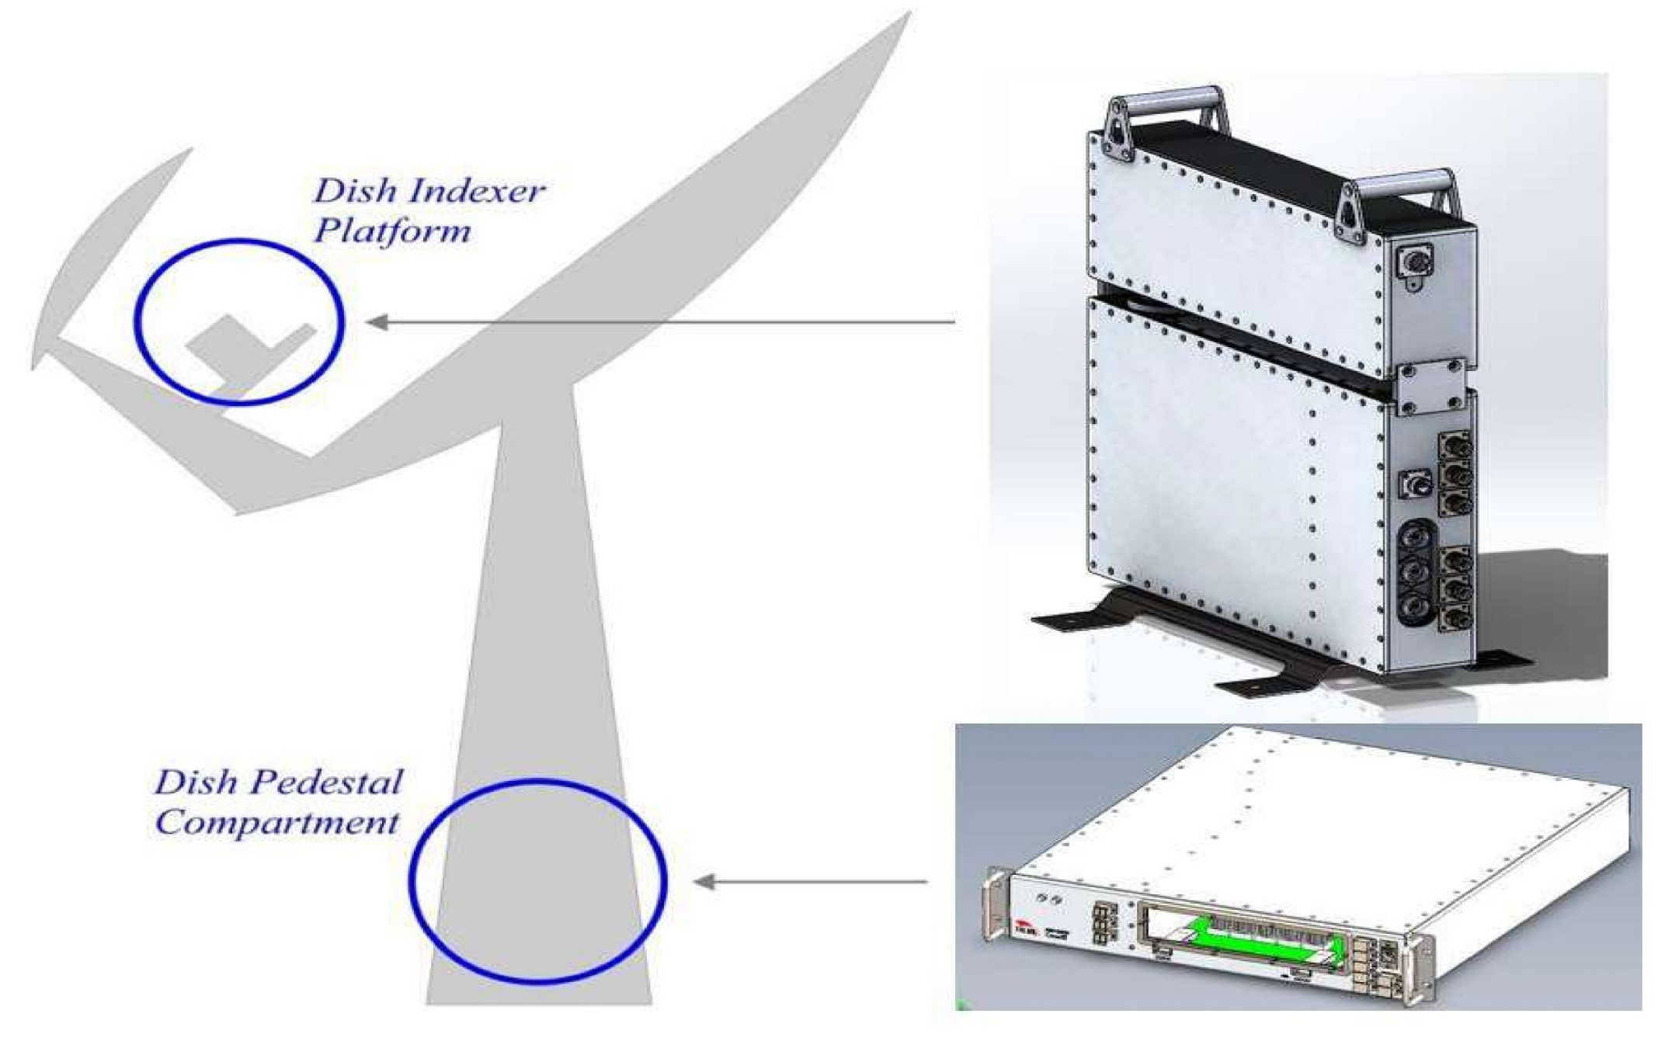
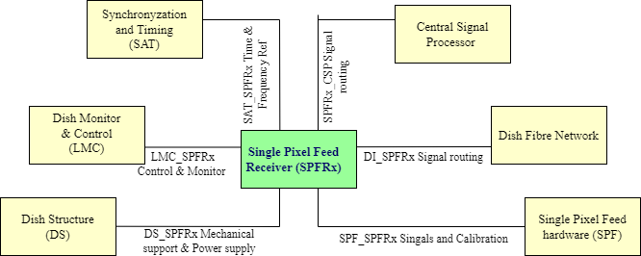
SPFRx Architecture
Objectives have led to three sectional design of SPFRx:
Two EMI shielded enclosures at the dish indexer - RXS123 and RXS45 - include the analog components, ADCs with minimal digital support circuitry.
One shielded unit in the pedestal of the antenna – RXPU – includes digital signal processing hardware, which tends to emit high levels of EMI, is in the multiple layered shielded dish pedestal unit.
Figure: SPFRx Device Locations on Dish (left), Layout of the Dish Indexer showing the RXS123 and RXS45 enclosure positions (mid), Interface of SPFRx with other systems

Slide 4
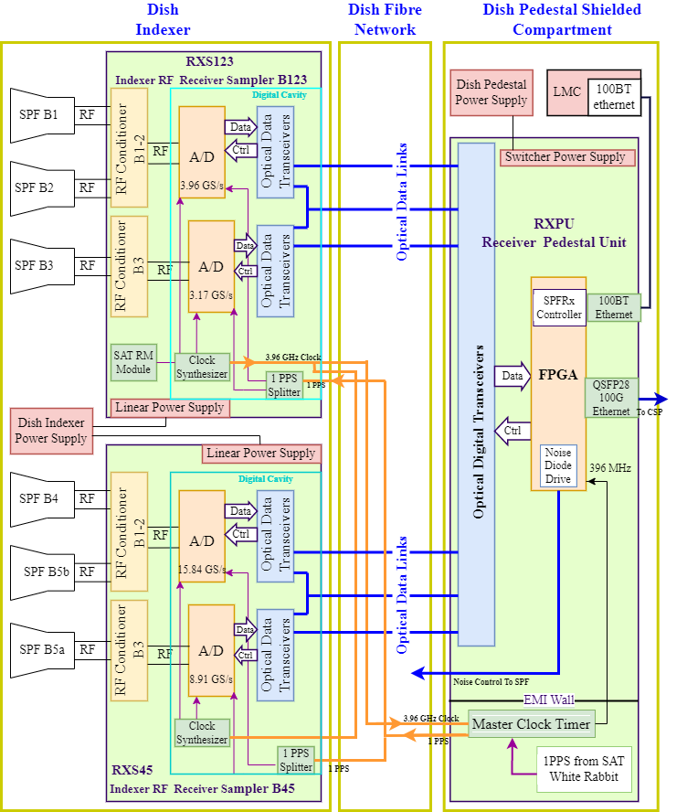
Figure : Simplified Block Diagram of SPFRx

Slide 5
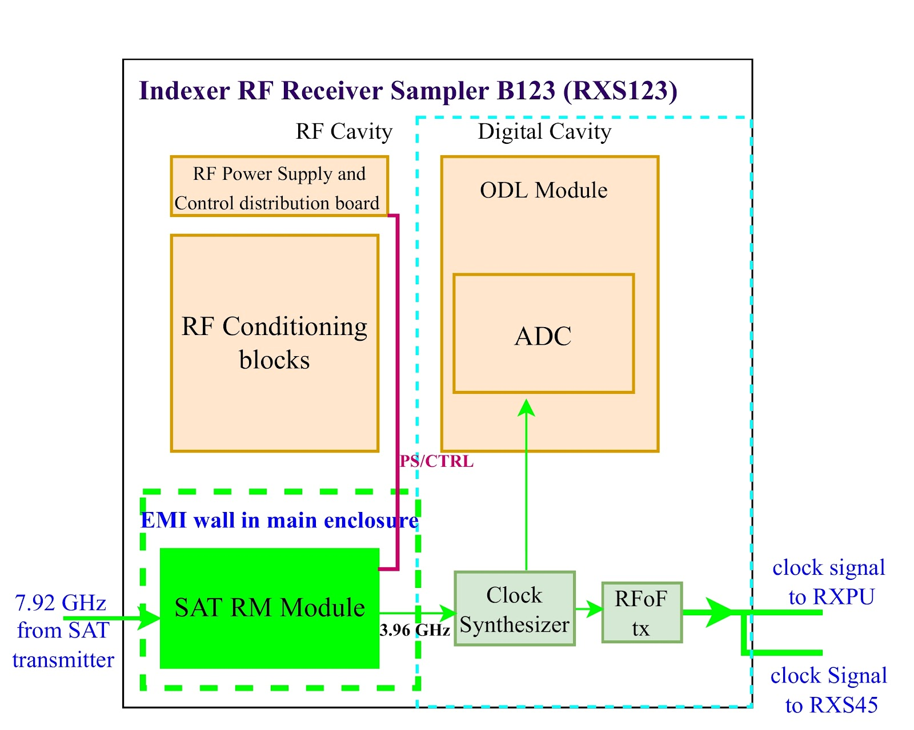
Last Mile ECP
Impacts on SPFRx
RFI Environment: Mitigate the clock signal or spurs generated RFI - with two layered heavy EMI shielding wall with more than 80 dB shielding effectiveness
Power Consumption: Increased power budget allocation to RXS123 Module
Mechanical Provision & Weight: Increased weight (∼50%) and volume (∼45%) of RXS123 enclosure
Thermal Interface Provision: RXS123 provides thermal conducting surfaces with thermal gap pads to maintain SAT.RM temperature <70 DegC (under normal and degraded ambient conditions)

Slide 6
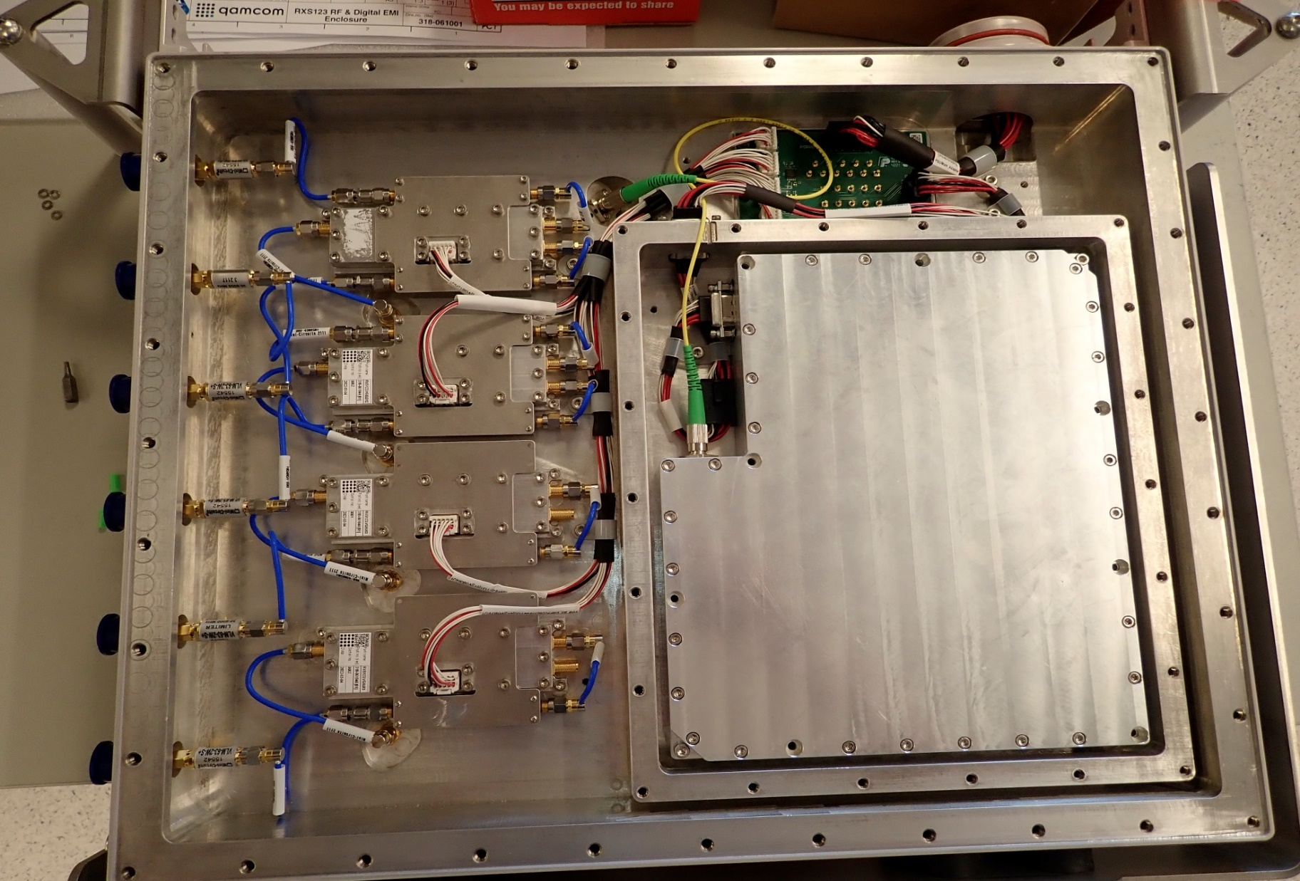
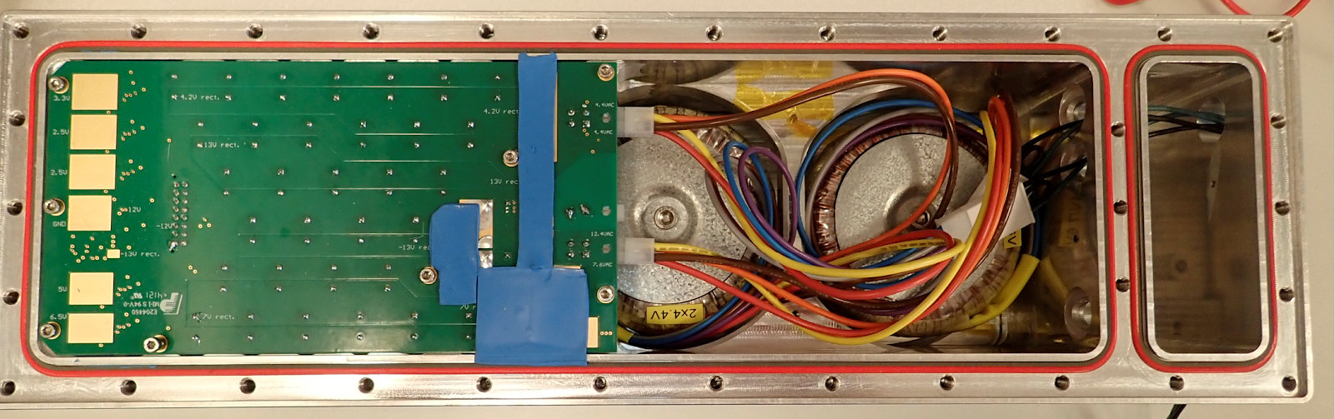
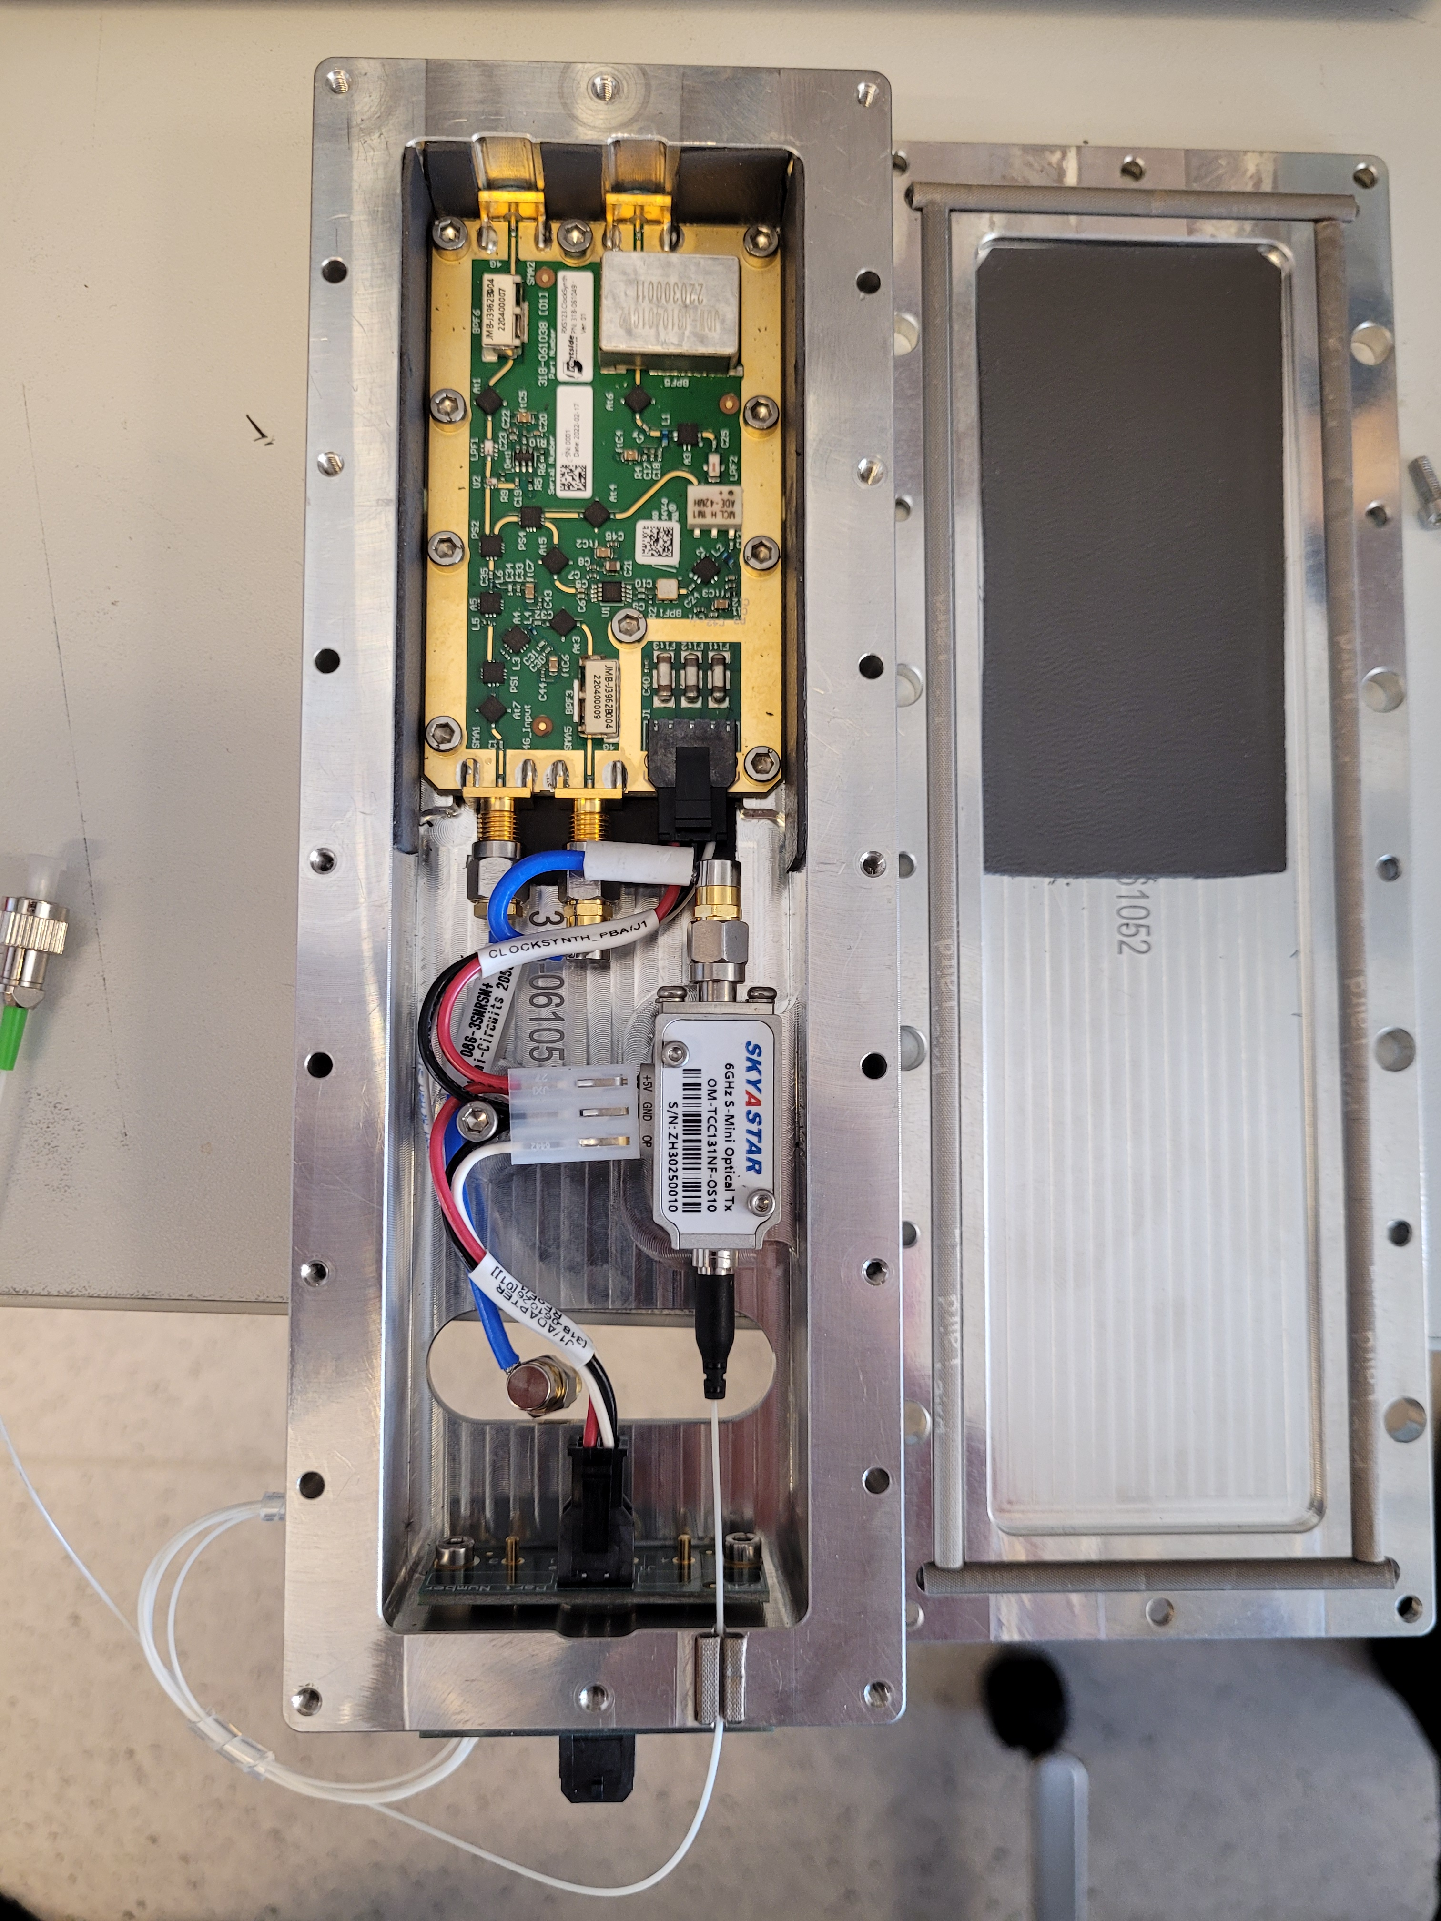
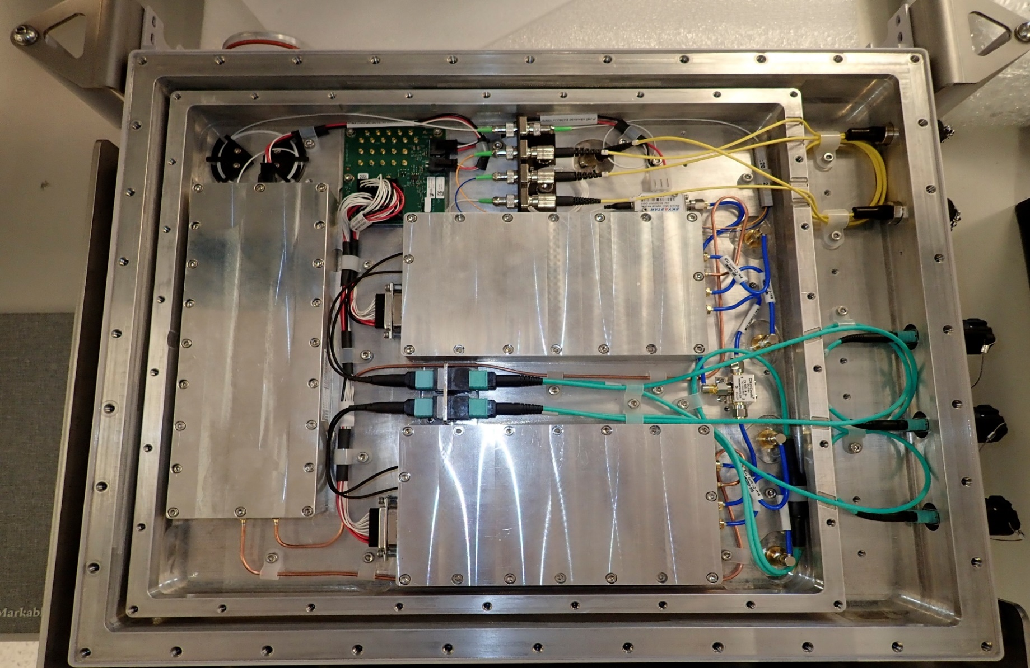
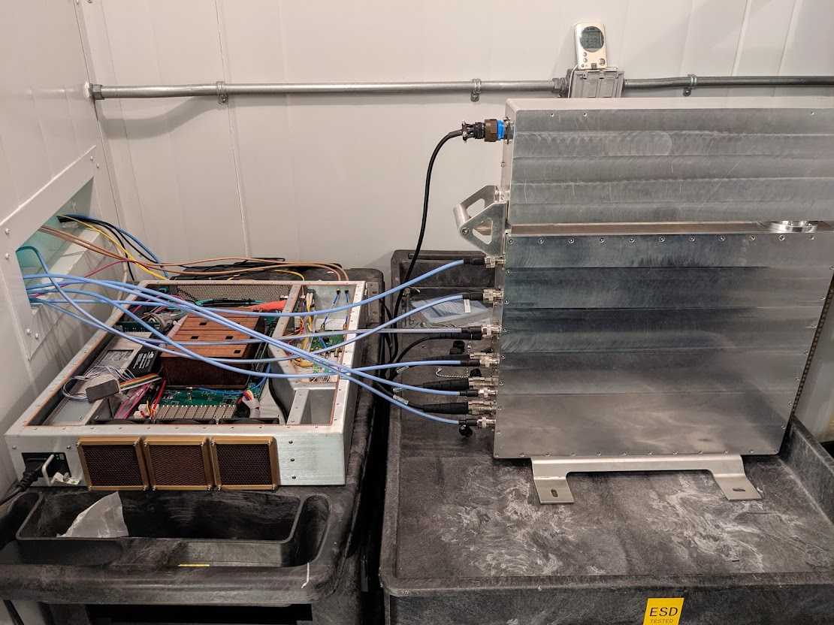
SPFRx Qualification modules
RXS123 RF Cavity (top) , Digital Cavity (below)
Power supply Unit (top), Clock synthesizer module (below-left), RXPU (below right)

Slide 7
Some of the SPFRx requirements challenging to meet
Spurious signal suppression – IIP3: +5 dBm across the specified frequency ranges.
Spurious Free Dynamic Range (SFDR): Band 1/2/3: >= 66 dBFS, Band 4: <= 36 dBFS, Band 5a/5b: 27 dBFS
Gain Flatness: Band 1/2/3/4: <= 2 dBp-p, Band 5a/5b: <= 1.8 dBp-p across any 2.5 GHz intervals
Gain stability: wide band gain stability over 5 s, when sampled with 20 ms intervals, of <= 0.05% RMS.
Phase stability: Phase measured between the receiver's analogue input and digital output ports, shall exhibit phase stability over 5 minutes when sampled with 5 s intervals of:
Band 1/2/3: <= 8° peak to peak, Band 4: <= 5° peak to peak, Band 5a/5b: <= 3.5° peak to peak
And phase stability of <= 0.5° RMS over 5 minutes, after subtracting a linear fit through the data points of the 5 minutes, when sampled with 5 s intervals.
Band 4/5a/5b Bit resolution: Band 1/2: >=8 bits, Band 3: >=6 bits, Band 4: >=4 bits, Band 5a/5b: >=3 bits

Slide 8
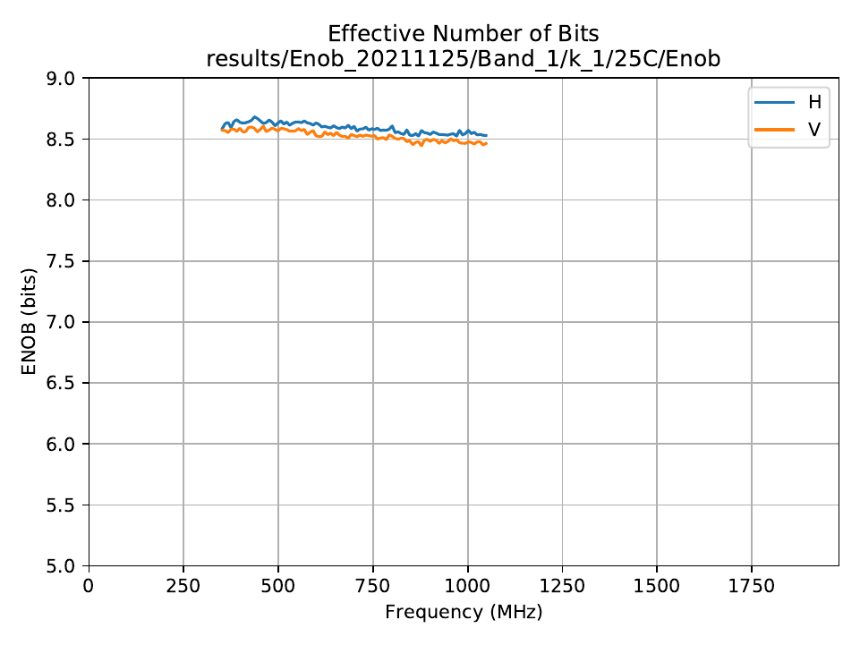
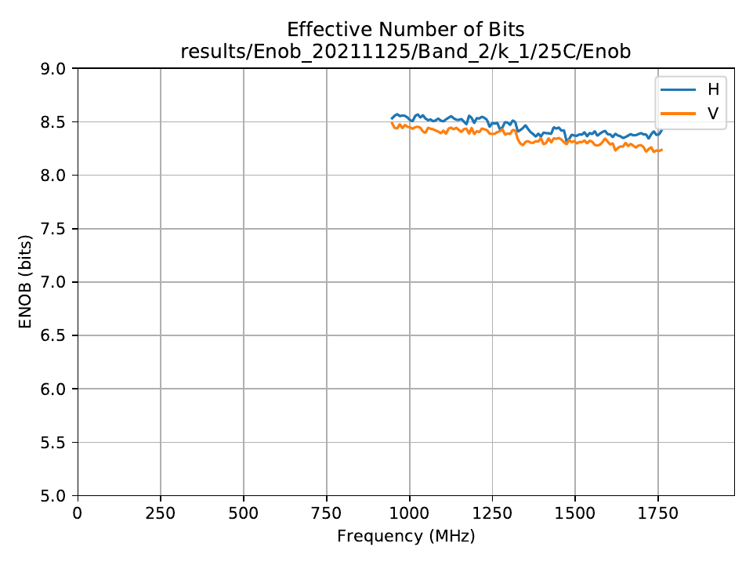
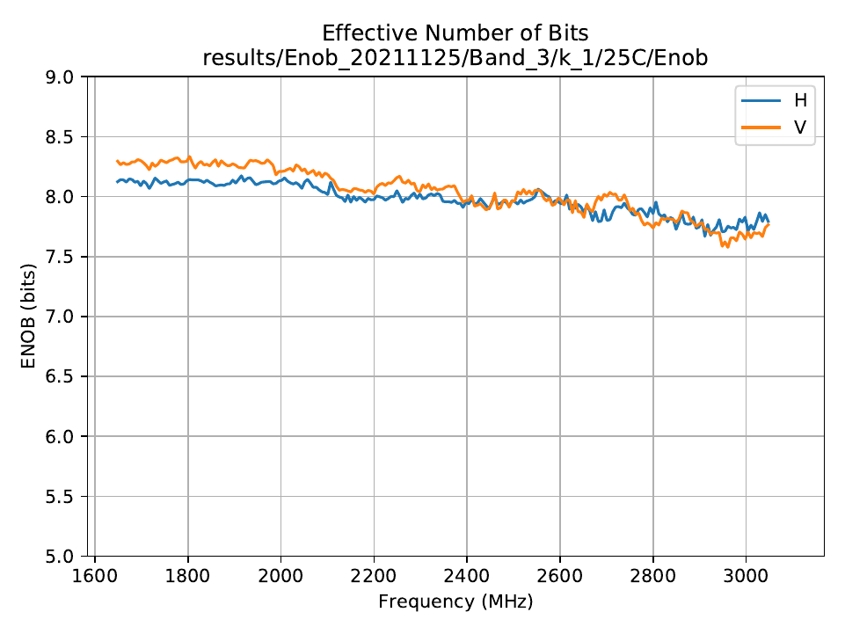
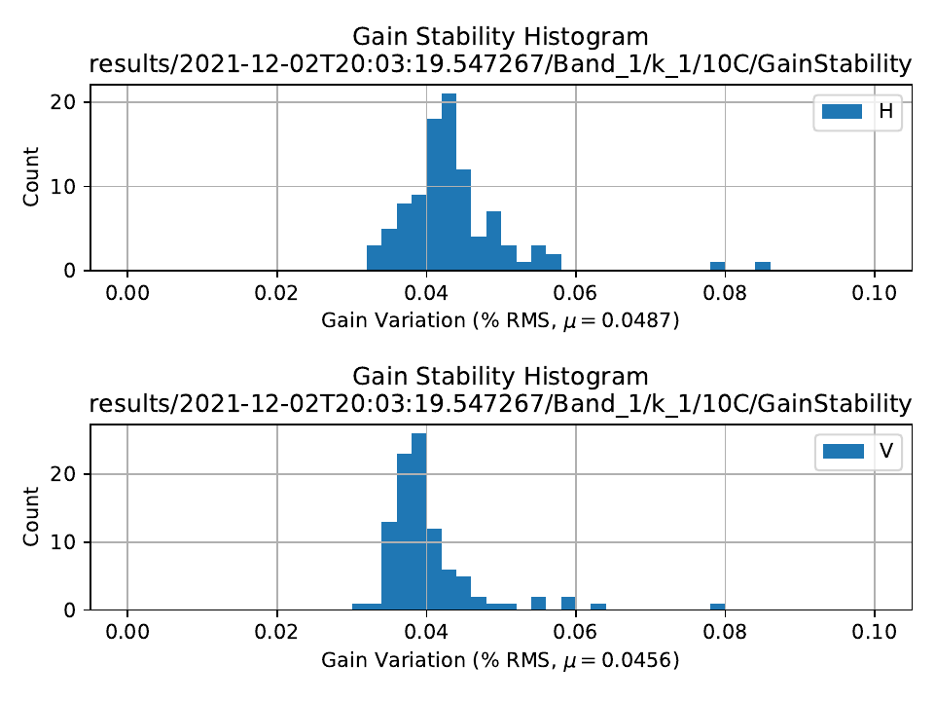
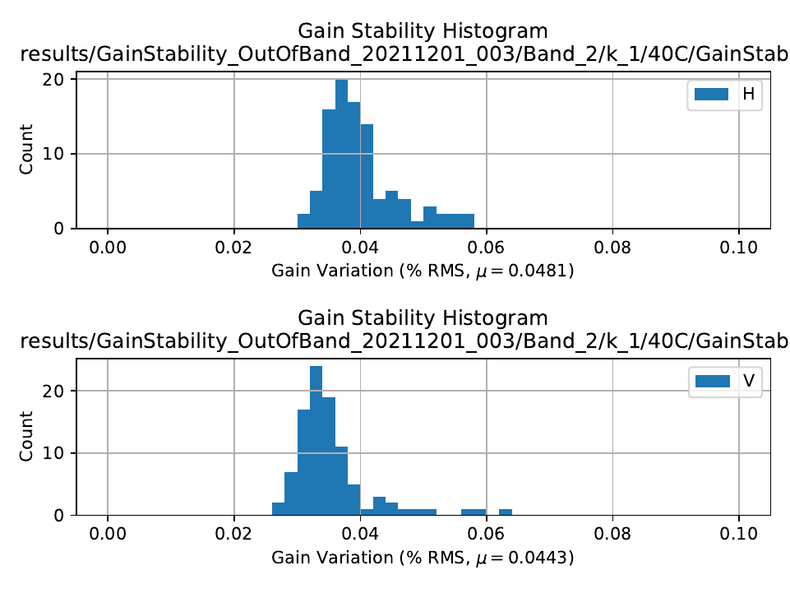
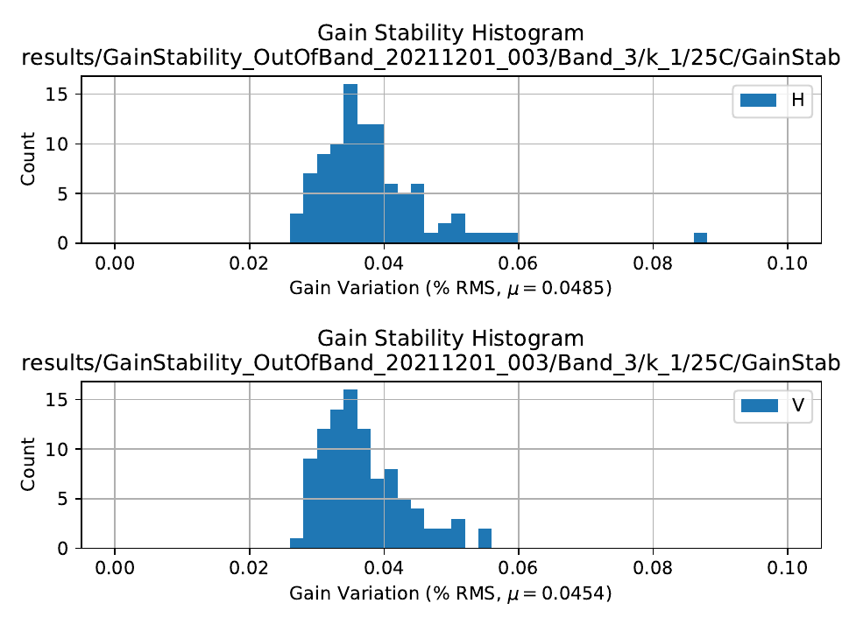
Some results from RXS123 Qualification tests
Figure: RXS Band 123 Effective number of bits (top), and Gain stability plots (bottom)
Above figure represents that all the three bands meet the SKA1-Mid minimum ENOB requirement – 8 bits for Band1 and Band2, 6 bits for Band3
SPFRx Band2 gain stability plot marginally meets SKA requirement to have a wide band gain stability over 5 seconds, when sampled with 20 milliseconds intervals, of<=0.05% RMS (under standard and degraded operating conditions and in the absence of interfering signals).

Slide 9
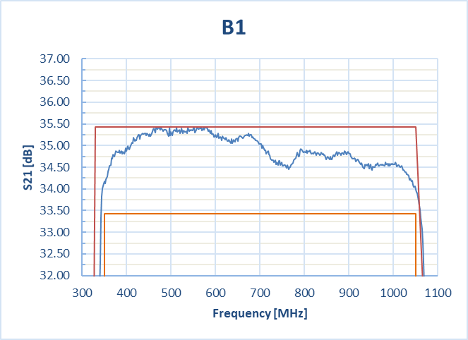
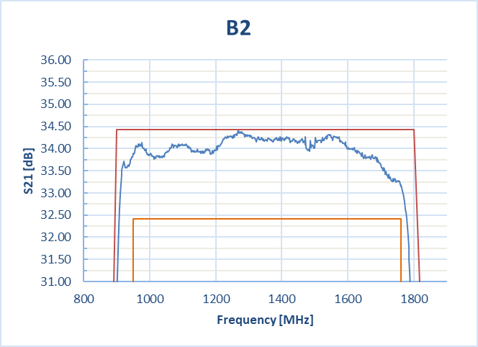
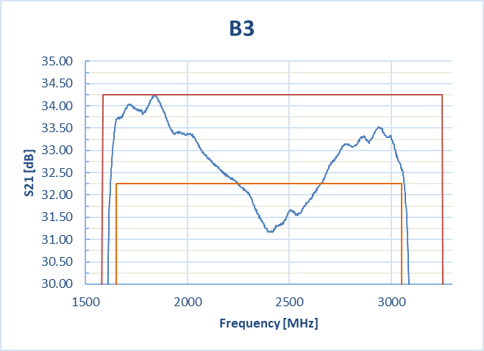
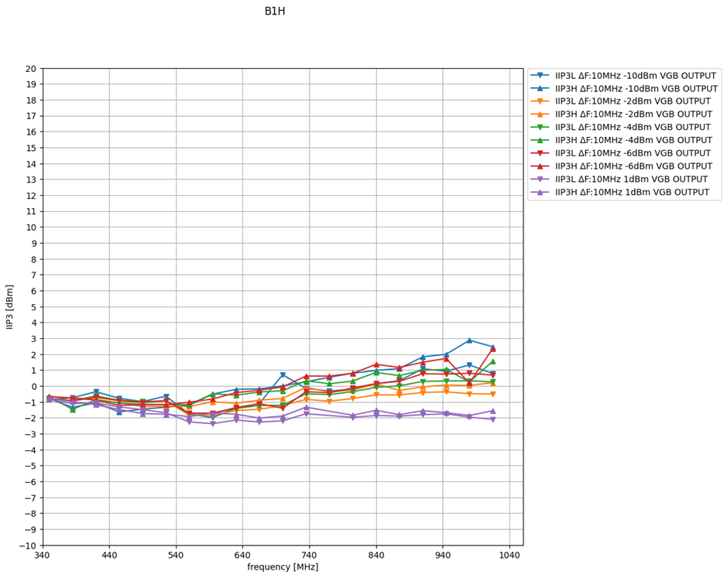
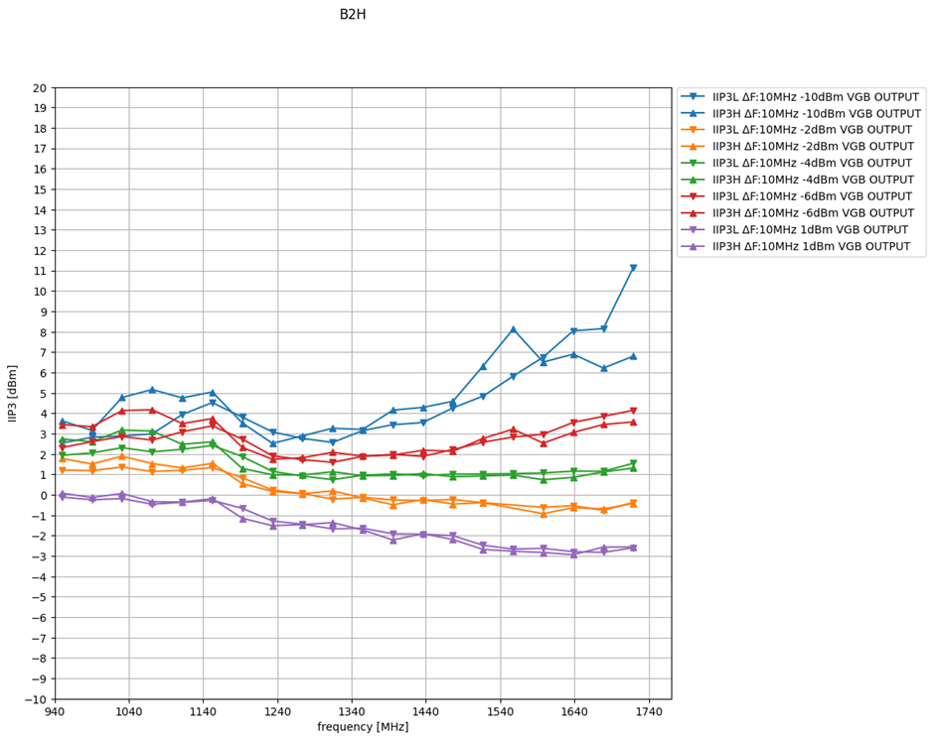
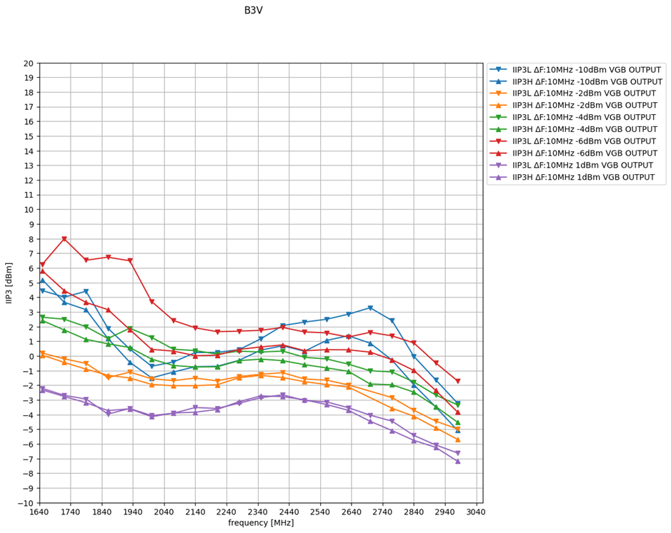
RXS123 VGB - IIP3, Gain Flatness
Linearity requirements of SKA SPFRx are the remaining key challenges to be met by the current RXS123 design.
The requirement of passband flatness is 2dB peak to peak, and the IIP3 of >=+5 dBm for all gain settings.
Figure: RXS Band 123 analogue RF chain Gain Flatness (Top), IIP3 (Bottom)

Slide 10
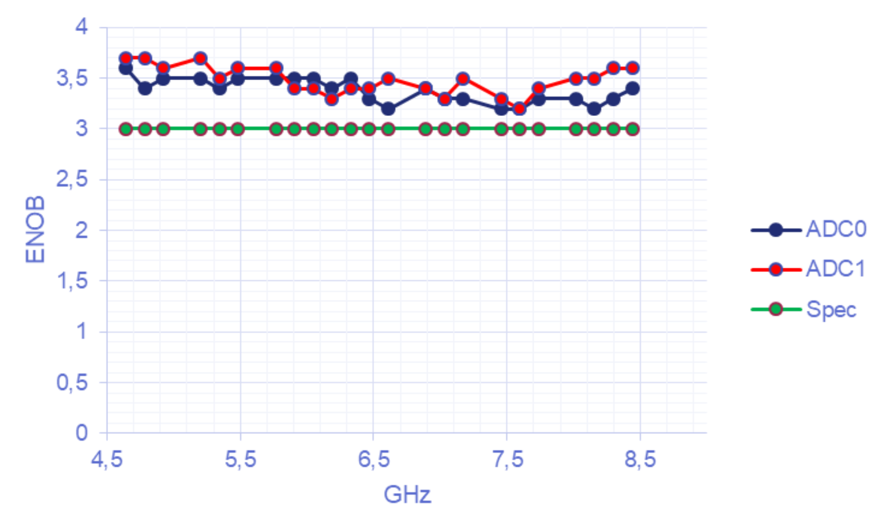
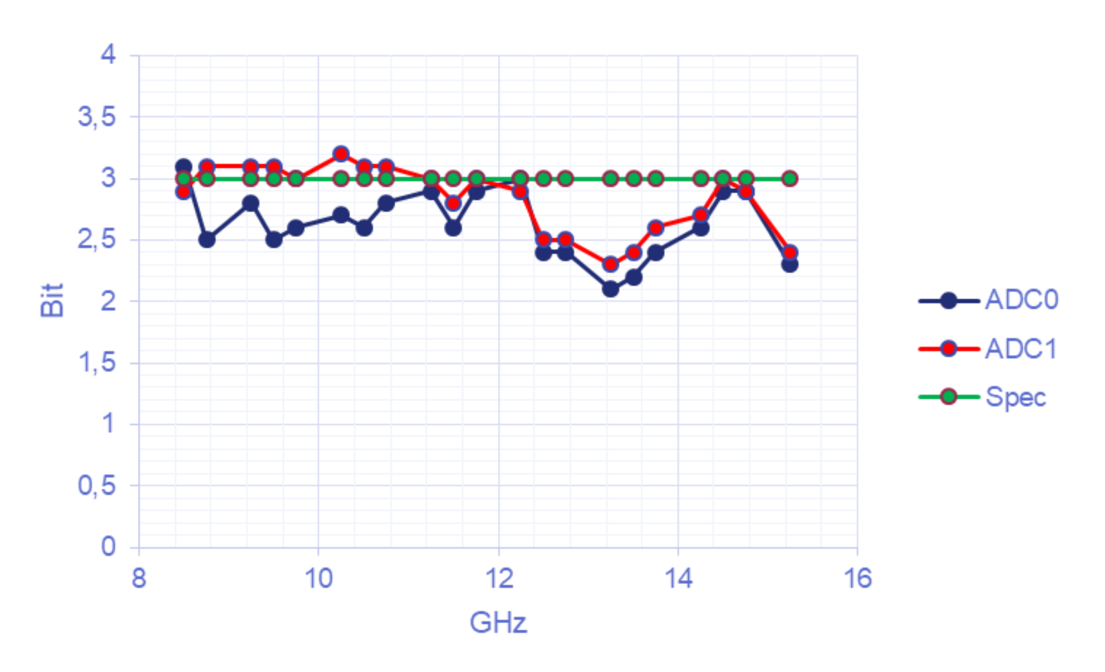
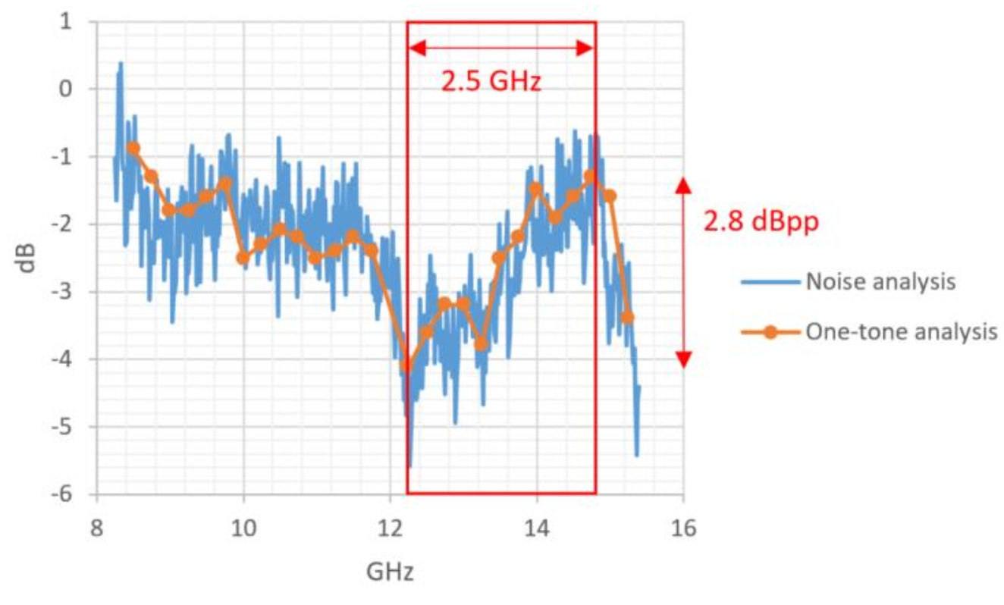
RXS45 Progress and results
The current solution based on Adsantec ADC doesn’t meet the SKA requirement of (1) The 3 bit ENOB specification for band 5b, (2) 1.8 dBpp band flatness specification for band 5
RXS45 team proposed Micram ADC solution and study suggested that it meets the ENOB and band flatness specifications
Trade off study is in progress and still to be considered the following impacts – power, thermal, RFI environment
Figure: ENOB and Flatness results using Adsantec 4-bit 16GSps ADC (top), Results using Micram 6-bit 34GSpsADC (below)

Slide 11
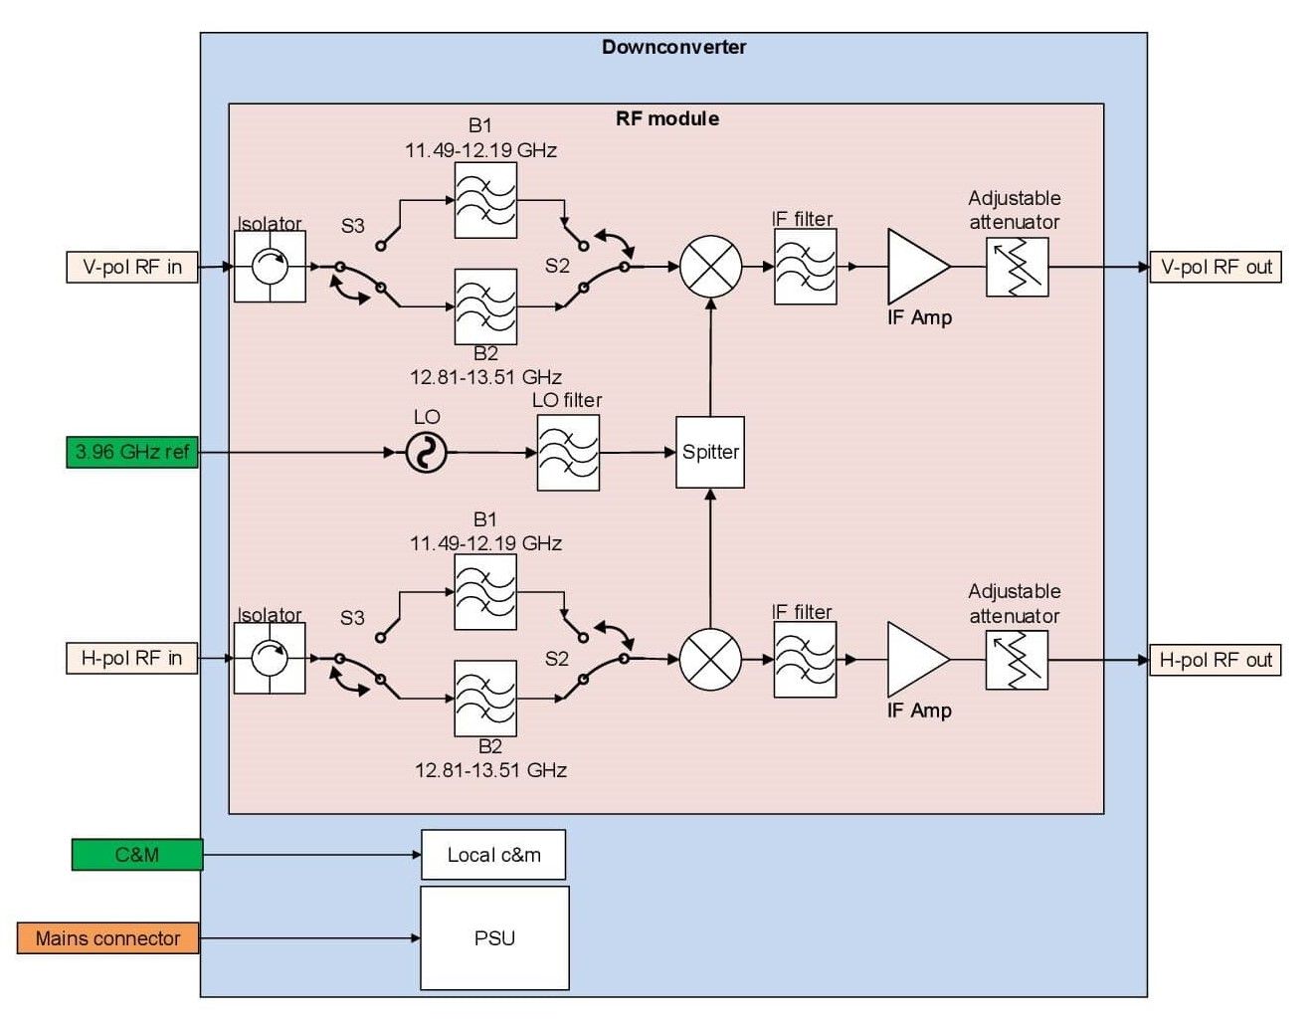
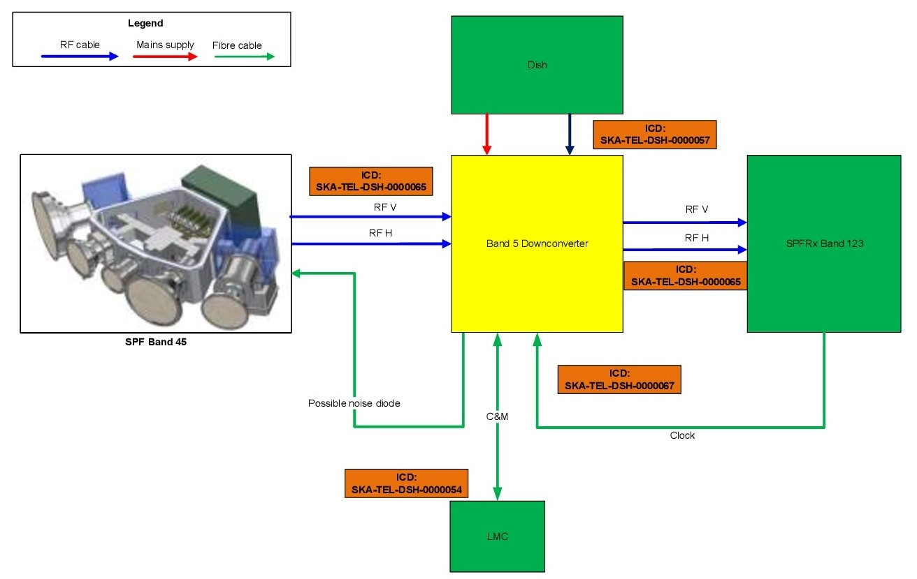
Band5 to Band1 Down-converter
Two sub-bands of the SPF Band5B will be down-converted to the centre frequency of the band1.
To ensure dish element interfaces remain unchanged, the downconverter will be installed in place of the RXS45, hence will use the existing RF, fibre, power and mechanical interfaces of the RXS45.
New interface to route the RF output signals of the Downconverter to the RXS123.
Local oscillator (LO) frequency will be derived from the 3.96 GHz reference supplied by RXS123

Slide 12
Teams working and Acknowledgement:
        National Research Council, Canada - RXS123 & RXPU
        Qamcom Research Technology, Sweden - RXS123 & RXPU
        Chalmers Institute of Technology, Sweden – SPFRx
        South African Radio Astronomy Observatory – SPFRx
        University of Western Australia, Australia - SAT.RM
        University of Bordeaux, France - RXS45

Slide 13
Thank you

