Slide 1
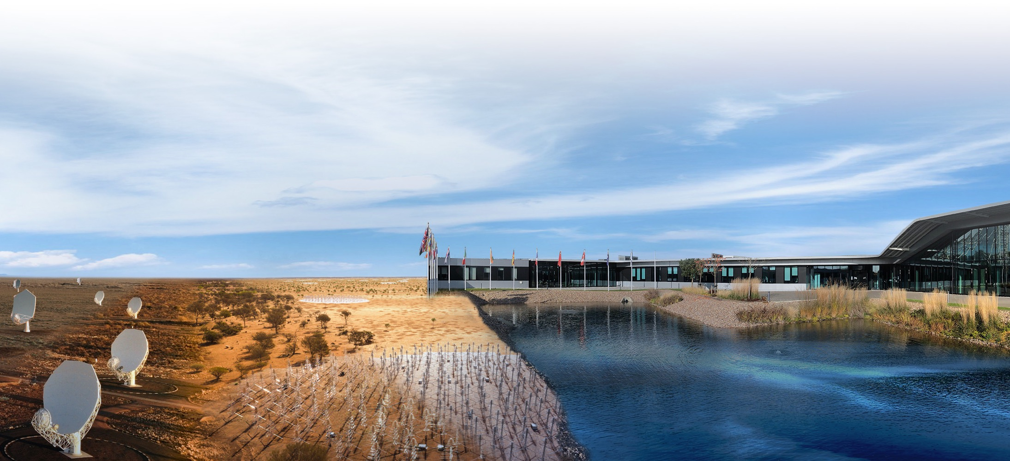
SKAO Project Update
P.Diamond, SKAO Director-General
27 September 2022

Slide 2
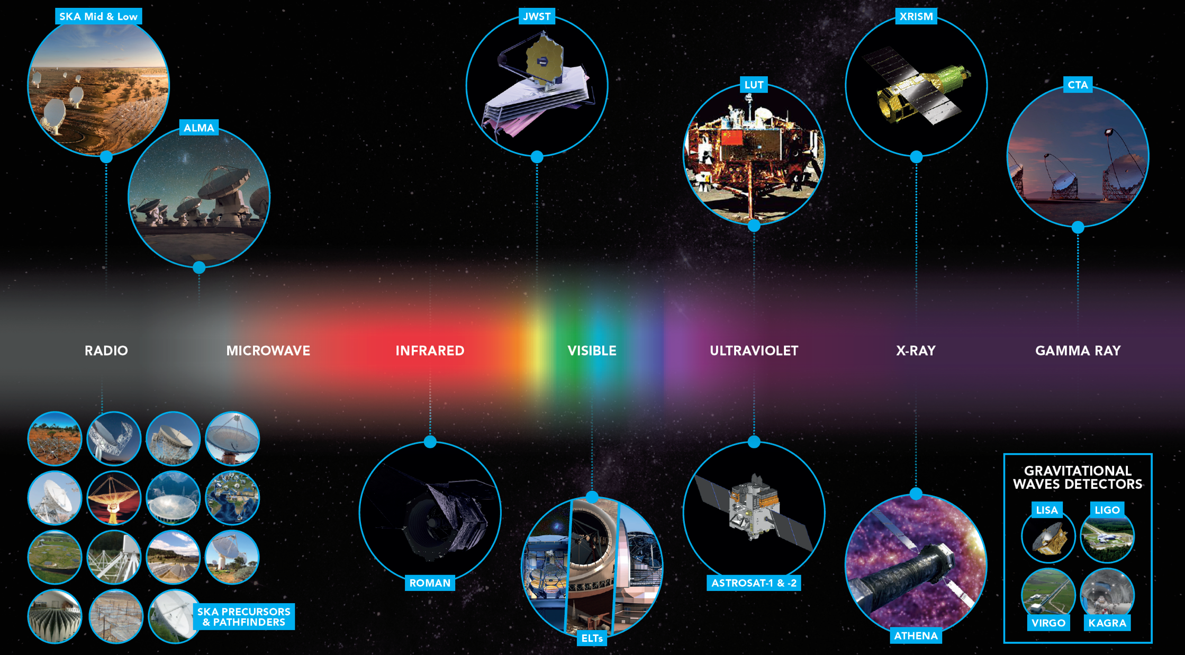

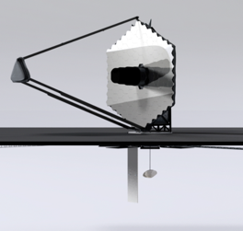
21st Century Astronomy
ngVLA
LUVOIR-B

Slide 3
SKAO Membership
The Square Kilometre Array Observatory (SKAO)
An inter-governmental organization, governed by a treaty. SKAO was born on 4th February 2021.
Australia, China, Italy, Netherlands,
Portugal, South Africa, Switzerland, UK
Full membership
Accession stage
France, Spain
Membership negotiations
Germany
Interim agreements
Canada, India, Sweden
Early stages
Japan, South Korea

Slide 4
Notes:
In the past 12 months:
-

Slide 5
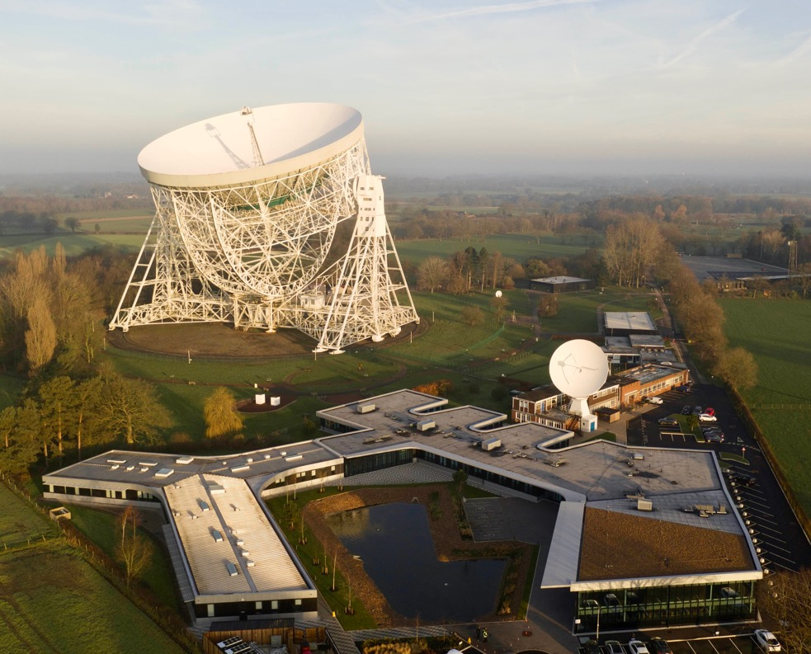
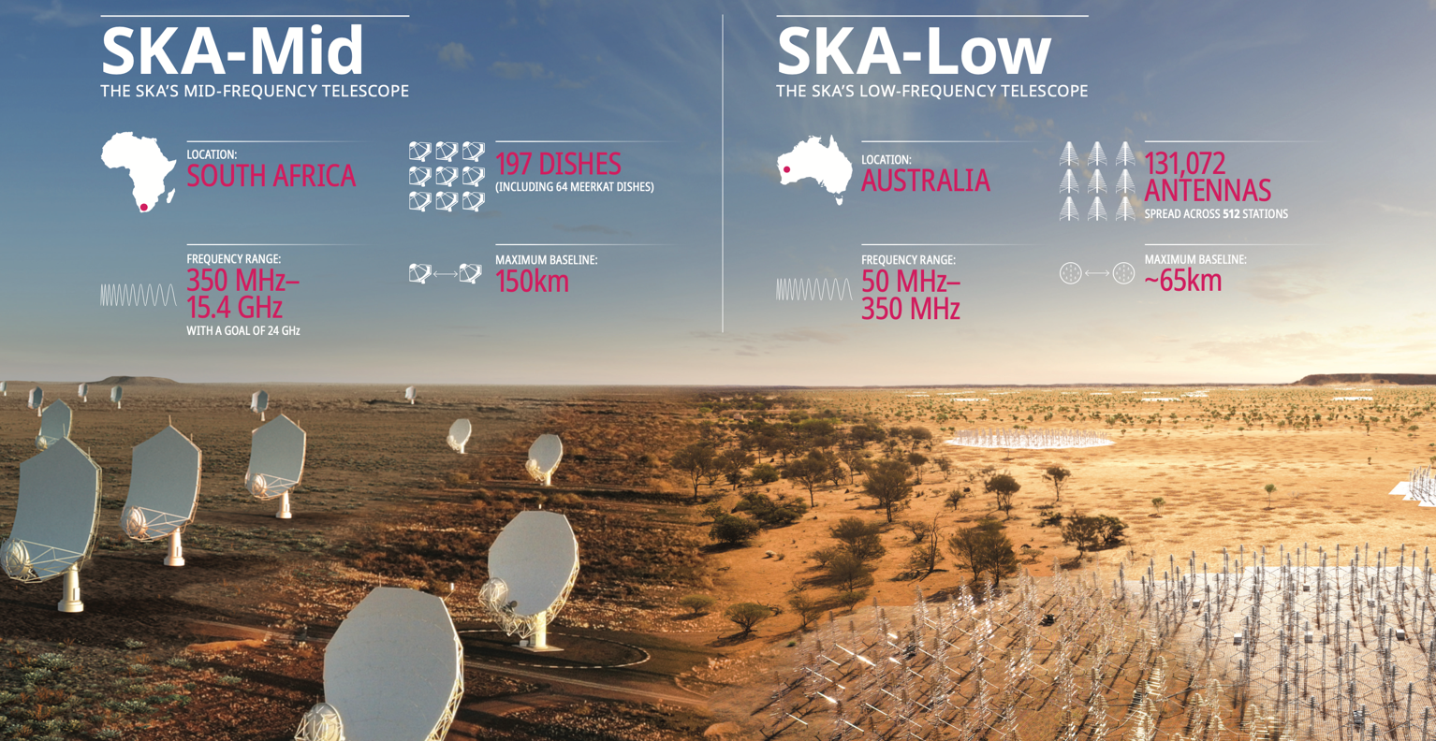
What are we building?
One Observatory, Two Telescopes, Three Sites
SKA-HQ Jodrell Bank, UK
Sites selected for their radio quietness → low population density
Total project cost: ~€2.1B; operational in 2029/2030

Slide 6
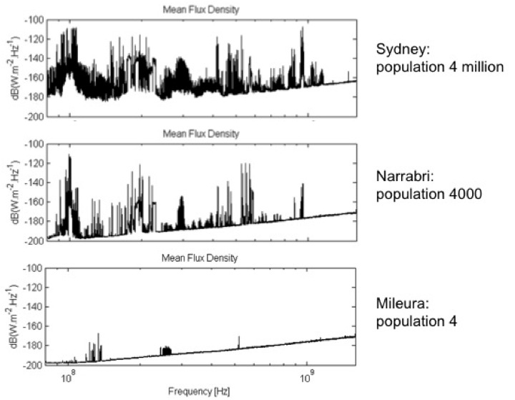
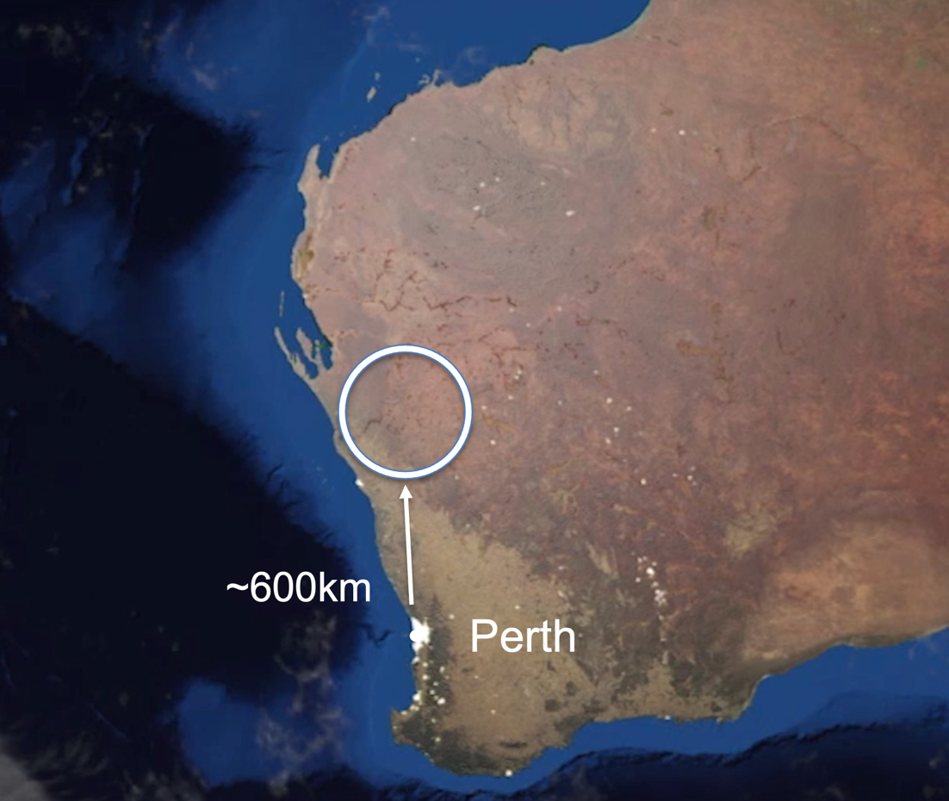
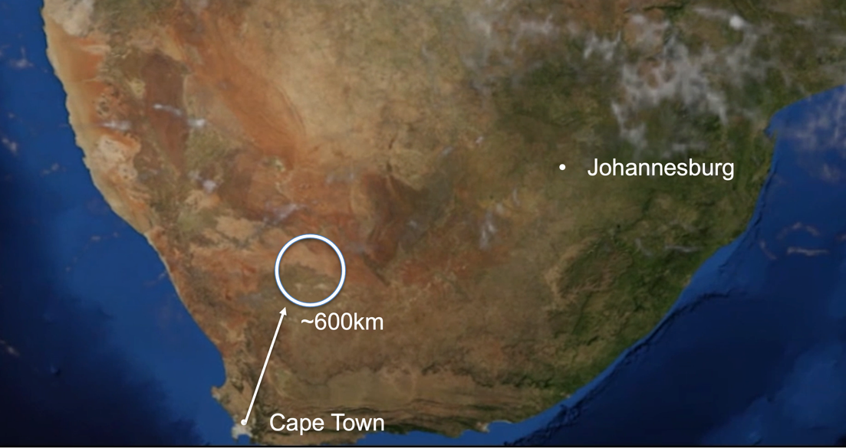
Selecting the sites
SKA Mid
SKA Low

Slide 7
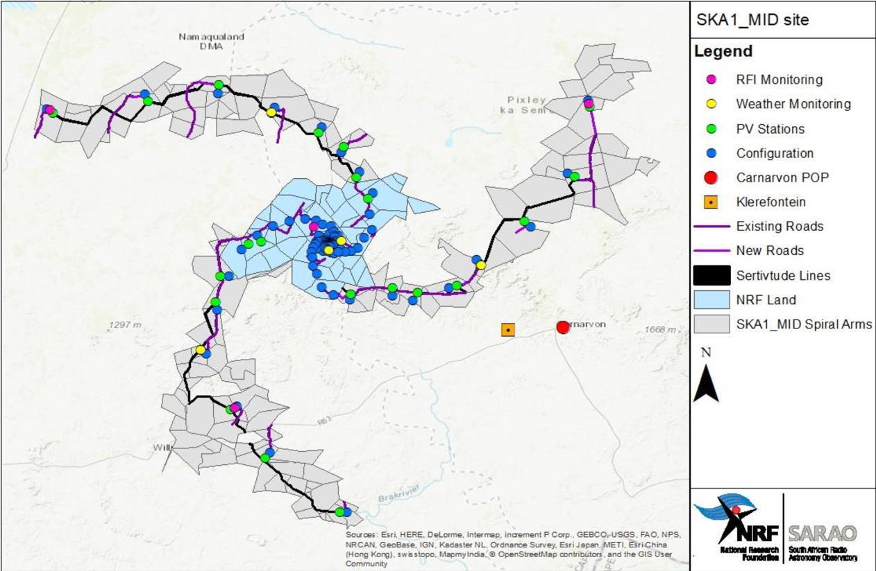
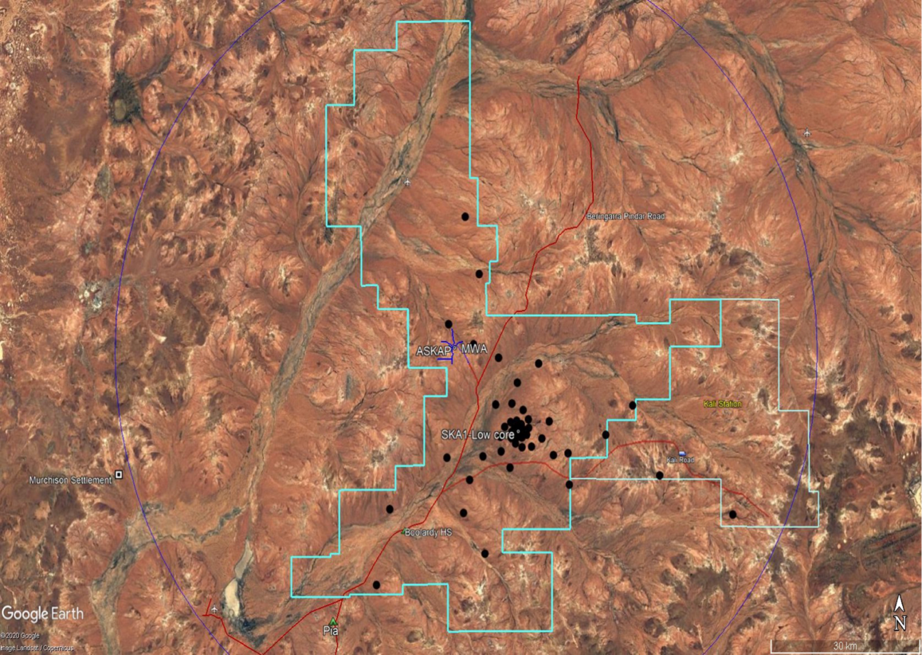
Array configurations in South Africa and Australia
150 km extent
74 km extent

Slide 8


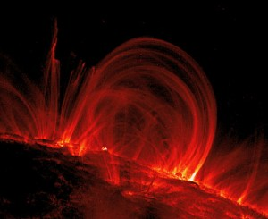





Some of the big SKA Science questions
The Cradle of Life & Astrobiology
  How do planets form? Are we alone?
Strong-field Tests of Gravity with Pulsars and Black Holes
  Was Einstein right with General Relativity?
The Origin and Evolution of Cosmic Magnetism
  What is the role of magnetism in galaxy evolution and the structure of the cosmic web?
Galaxy Evolution probed by Neutral Hydrogen
  How do normal galaxies form and grow?
The Transient Radio Sky
  What are Fast Radio Bursts and how can we best utilise them? What haven’t we discovered?
Galaxy Evolution probed in the Radio Continuum
  What is the star-formation history of normal galaxies?
Cosmology & Dark Energy
  What is dark matter? What is the large-scale structure of the Universe?
Cosmic Dawn and the Epoch of Reionization
  How and when did the first stars and galaxies form?

Slide 9
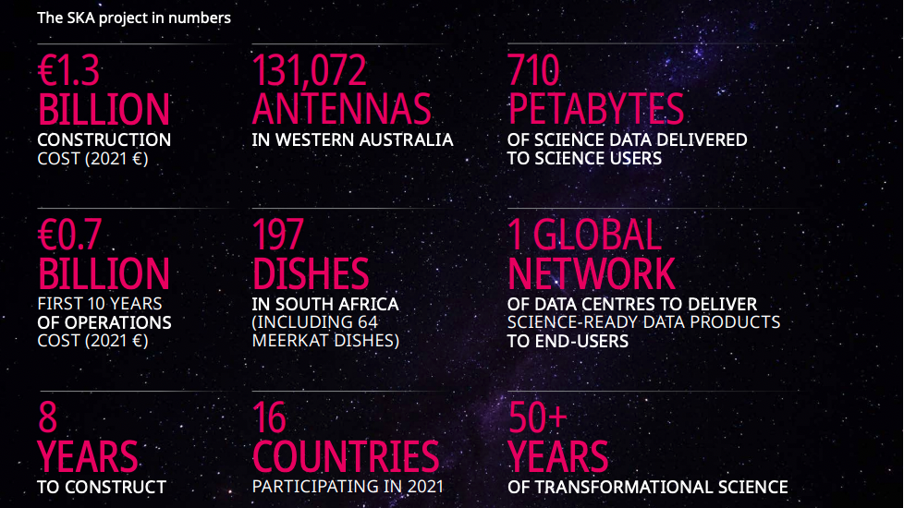

Slide 10
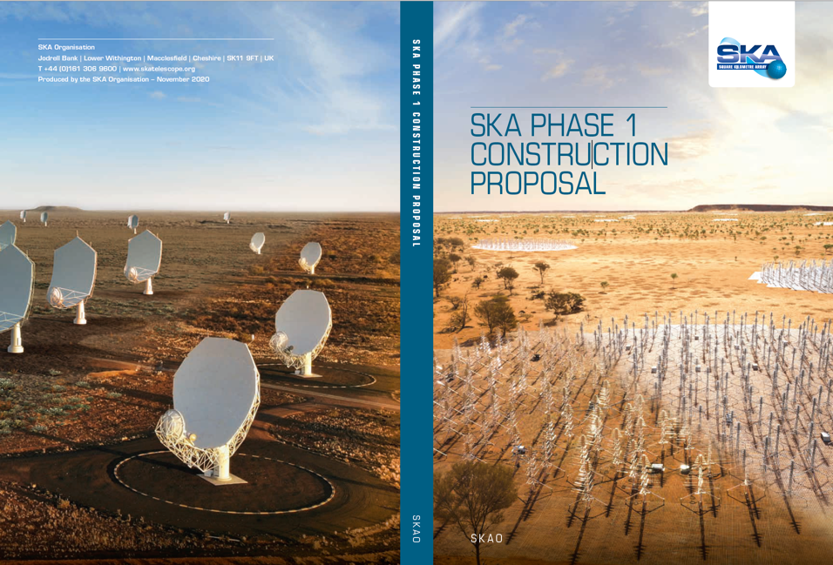
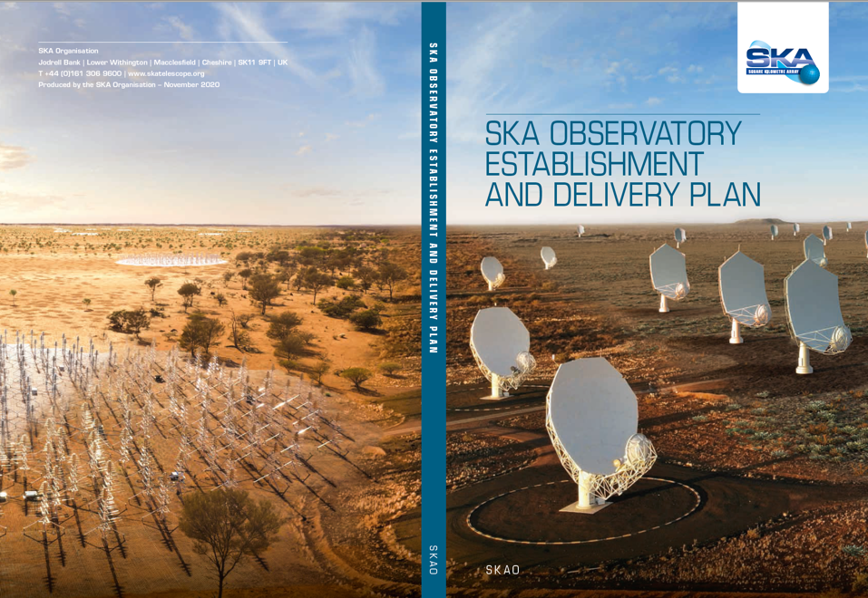
Delivering SKA Observatory
Feb 2021: SKAO born
June 2021: SKAO Council approved the Construction Proposal and the SKAO Establishment and Delivery Plan
July 2021: Construction activities began
Sept 2022: 42 contracts awarded, total cost ~€200M; more major contracts being prepared

Slide 11
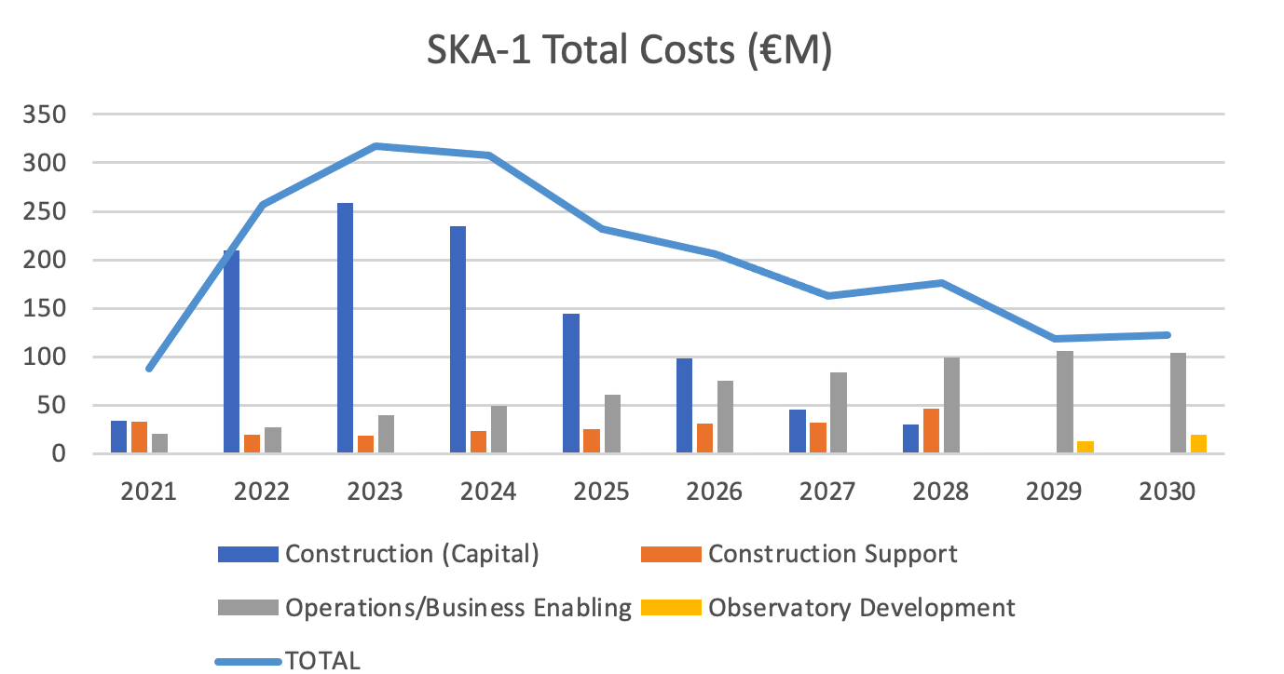
Cost Estimate
Design Baseline | April 2021 | Provided through annual contributions
Total Cost (€M) (June 2021) | Capital cost of construction (€M) | Construction Support Budget (€M) | Observatory Operations & Business-Enabling Functions (€M) | Observatory Development Programme (€M) | Funding Period
 | (880 + 237) 1117 | (142+38) 180
2017 | 1297 |  | 679 | 41 | 2021-2030
China’s contribution: 8%

Slide 12
Construction Strategy
Target: the SKA Baseline Design (197 Mid dishes; 512 Low stations: AA4)
Not all funding yet secured, therefore follow Staged Delivery Plan (AA*)
First Milestone: Develop the earliest possible working demonstration of the architecture and supply chain (AA0.5).
Then maintain a continuously working and expanding facility until achieve the baseline design.
Milestone Event | SKA-Mid (date) | SKA-Low (date)
AA0.5 | 2024 Jul | 2024 May
AA1 | 2025 Sep | 2025 May
AA2 | 2026 Jul | 2026 Jul
AA* | 2027 Jun | 2027 Aug
Operations Readiness Review | 2027 Aug | 2027 Oct
End of Construction | 2028 Jul | 2028 Jul

Slide 13
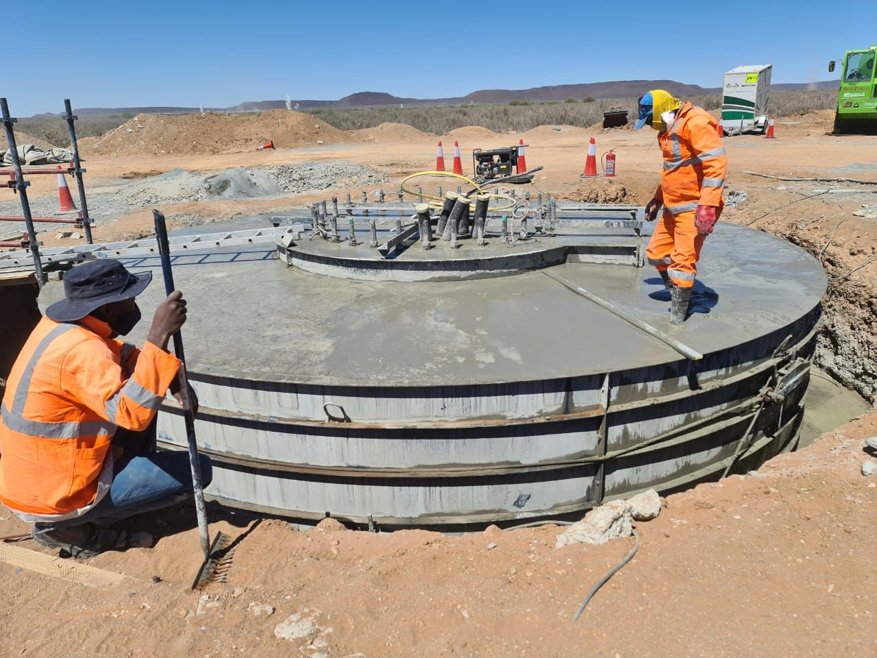
Construction
Photos

Slide 14
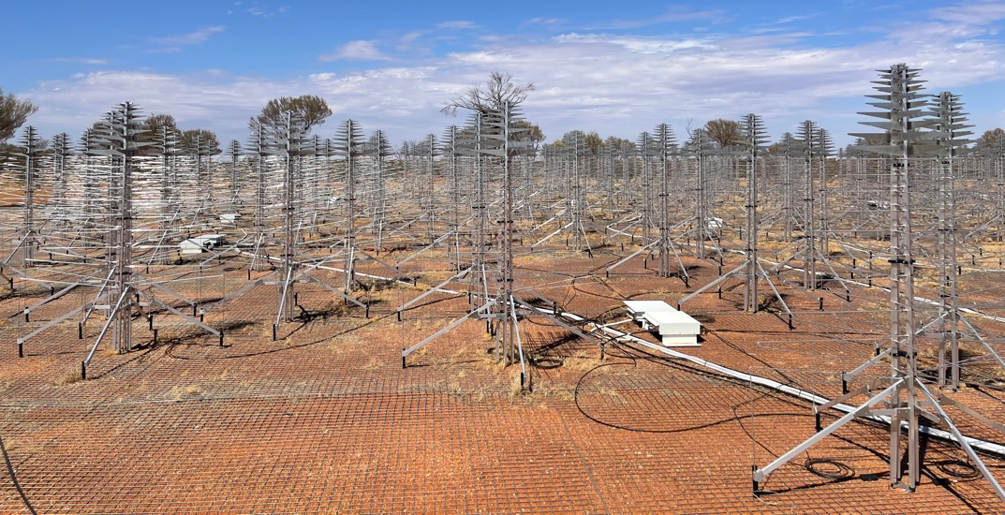
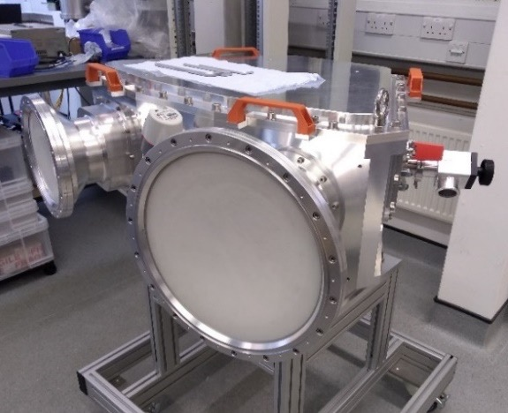
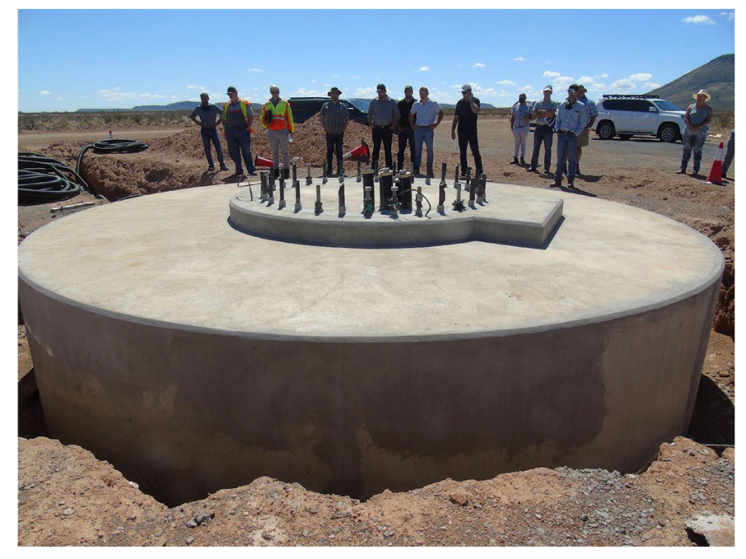
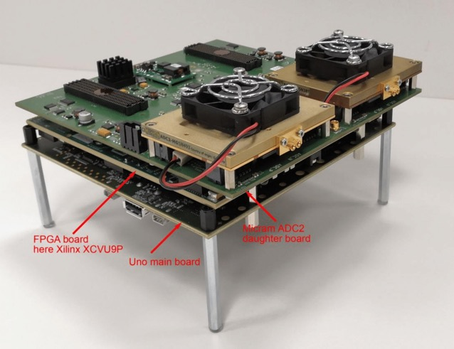
Recent Prototype and Construction Progress
AAVS2
SKA-MP Prototype
Band 5a/5b feeds
5 – 15 GHz
Band 5 Digitiser
2 x 2.5 GHz
Improved dish stiffness
and pointing
First SKA dish foundations

Slide 15
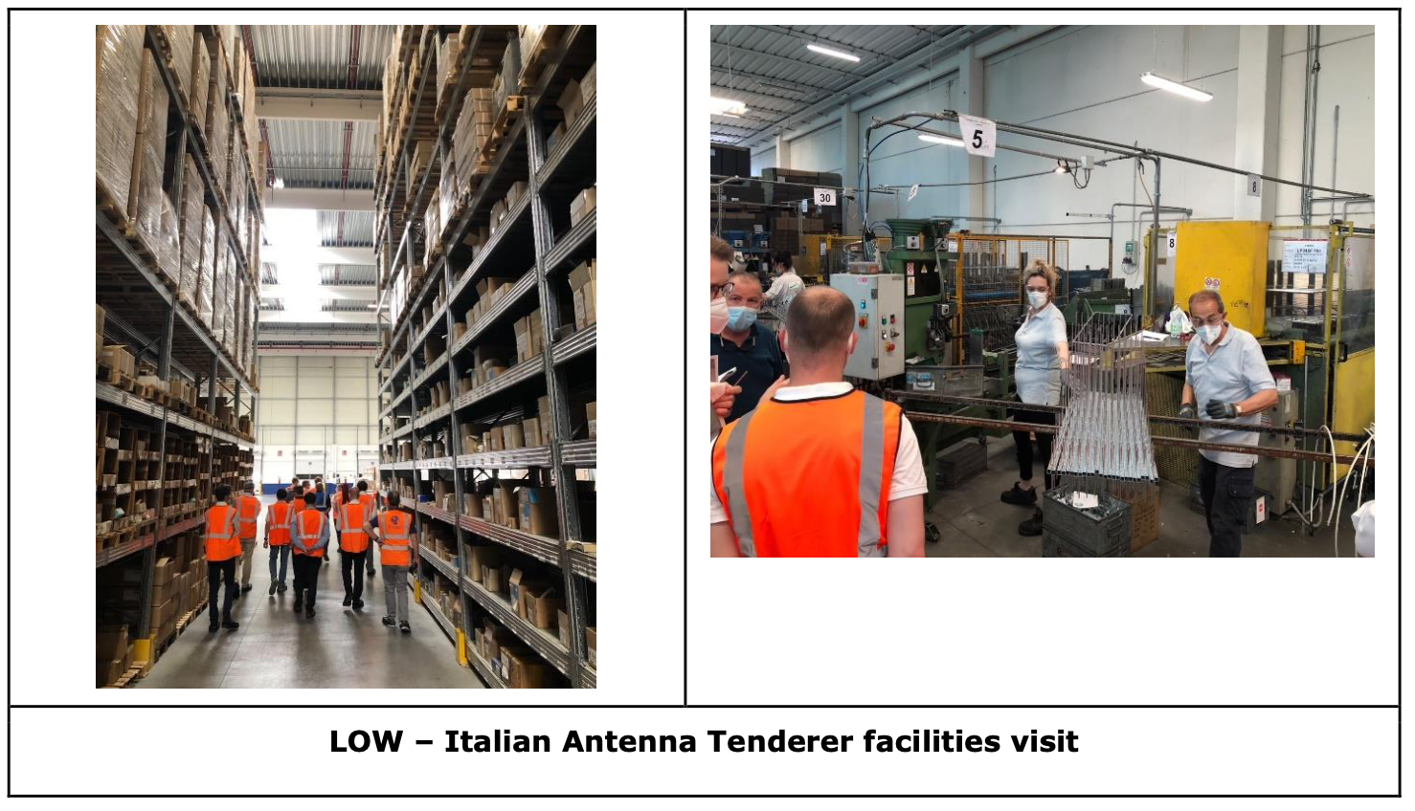

Slide 16
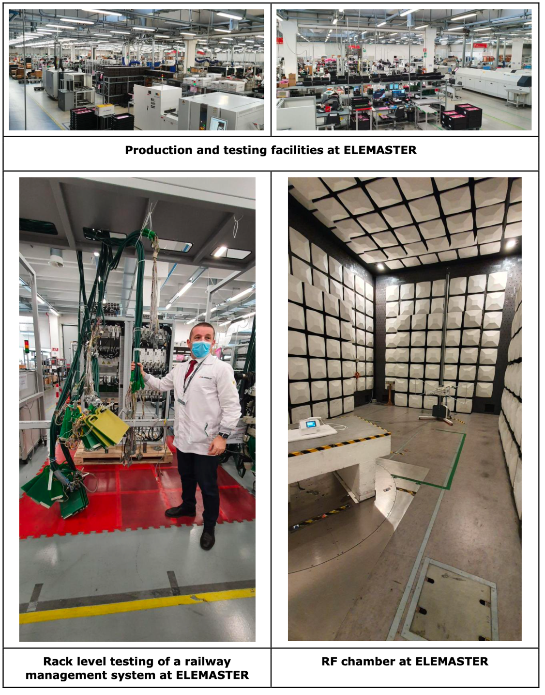

Slide 17
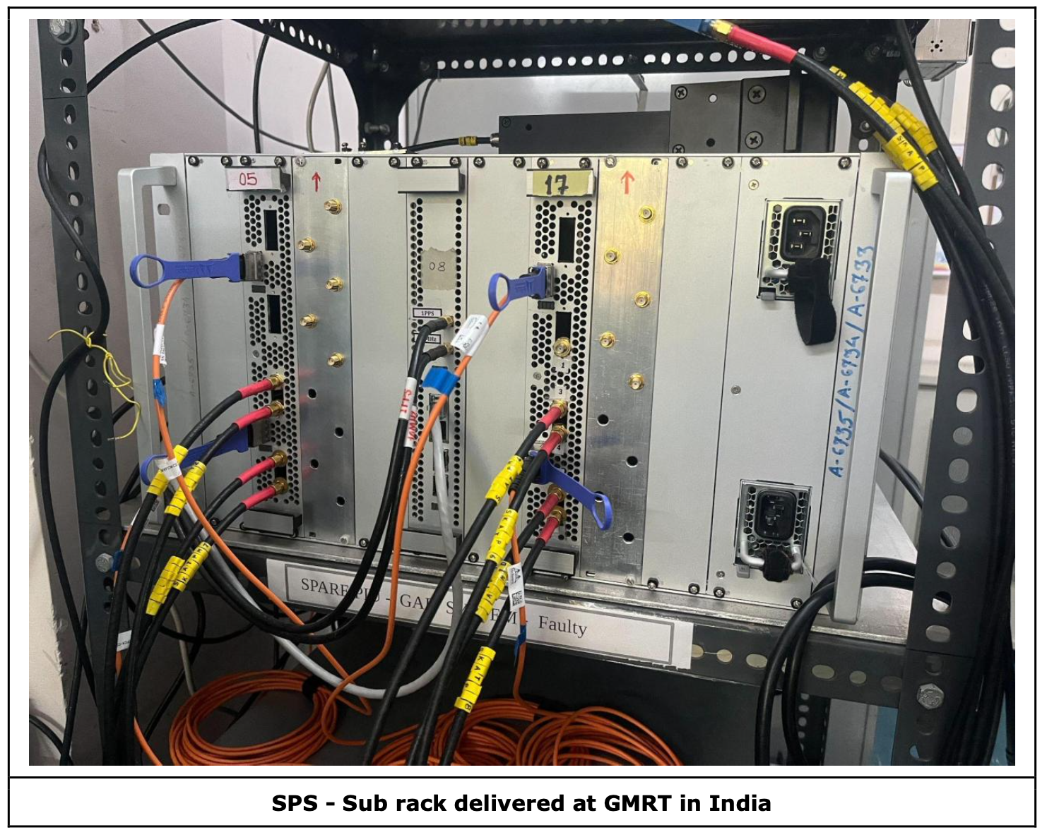

Slide 18
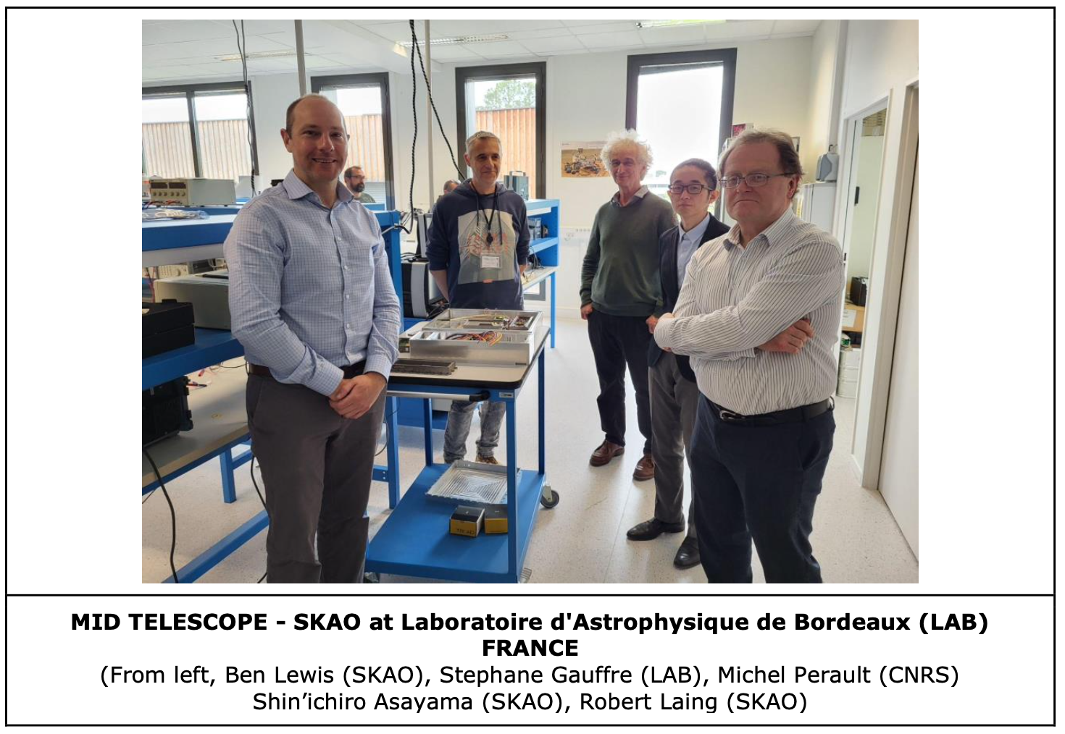

Slide 19
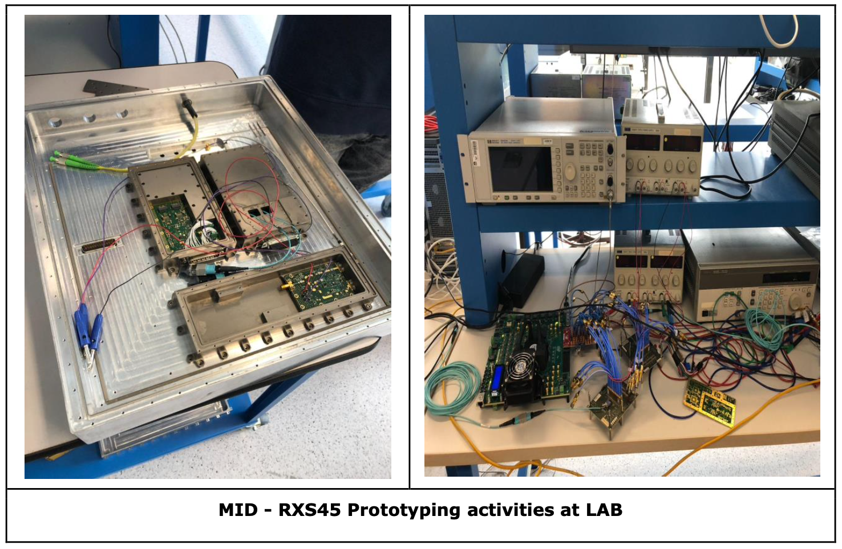

Slide 20
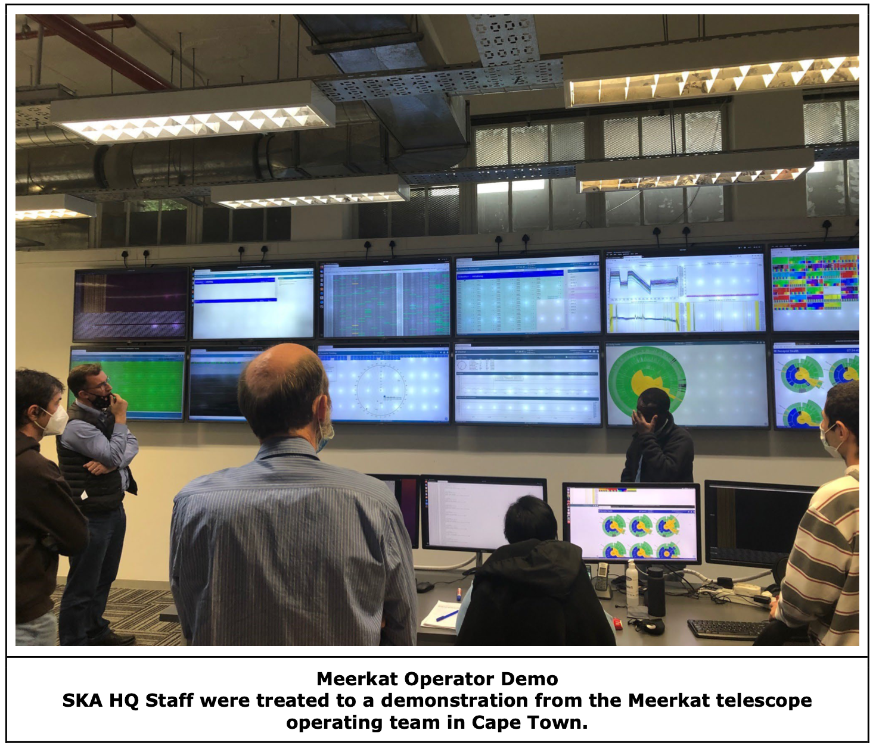

Slide 21
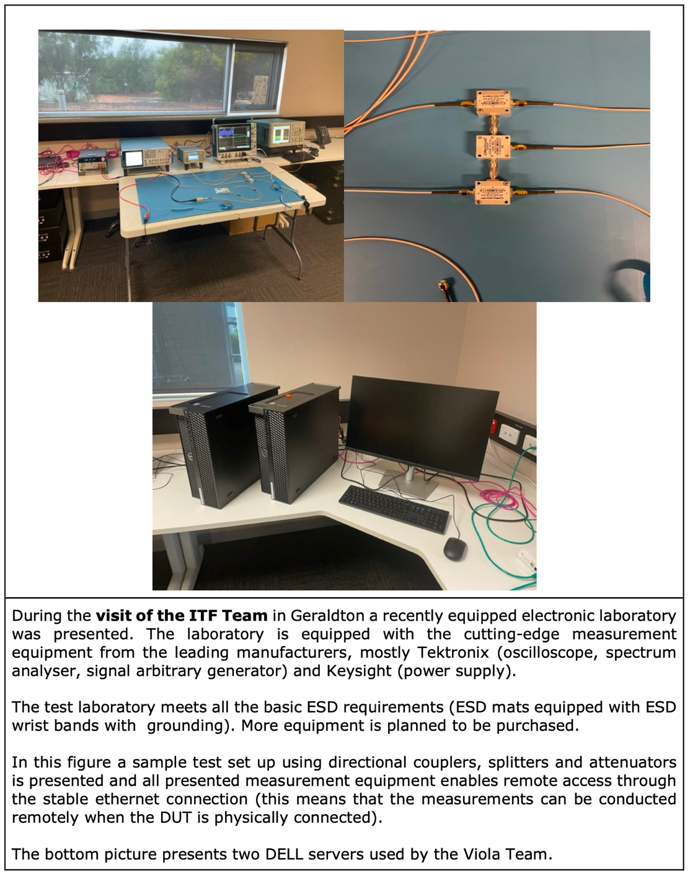
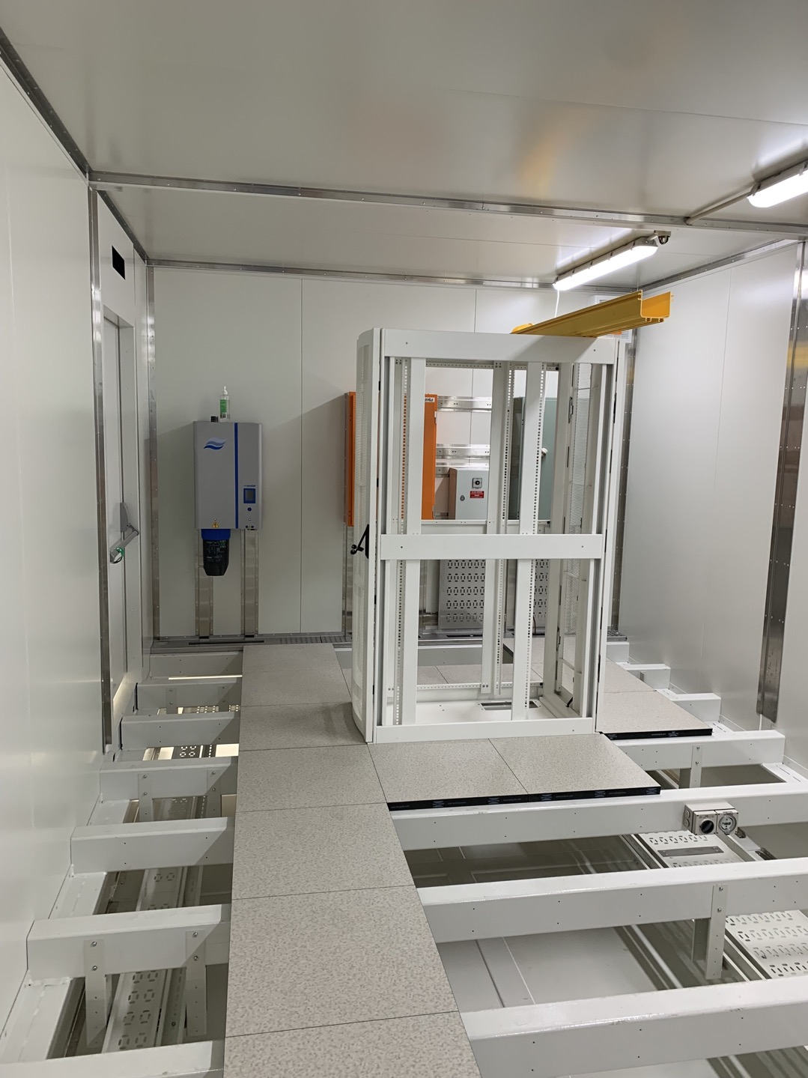

Slide 22
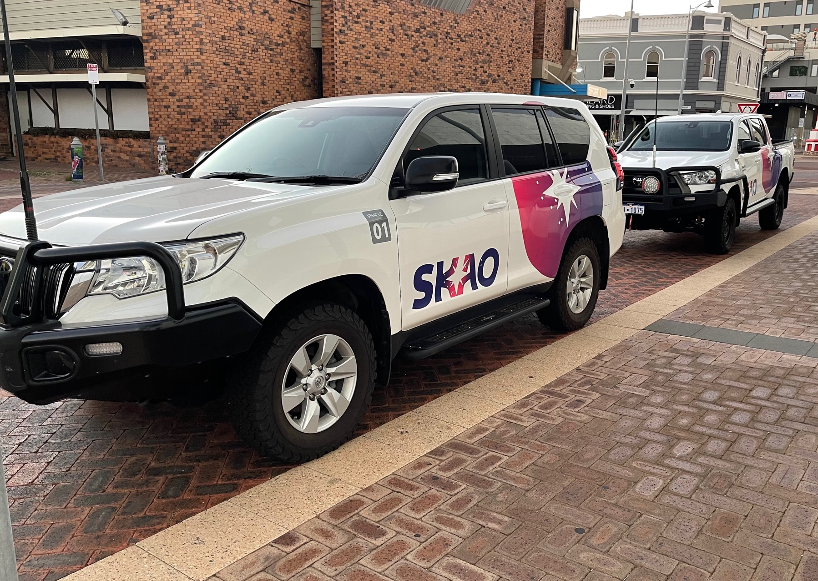
SKAO vehicles now in both Austalia and South Africa

Slide 23
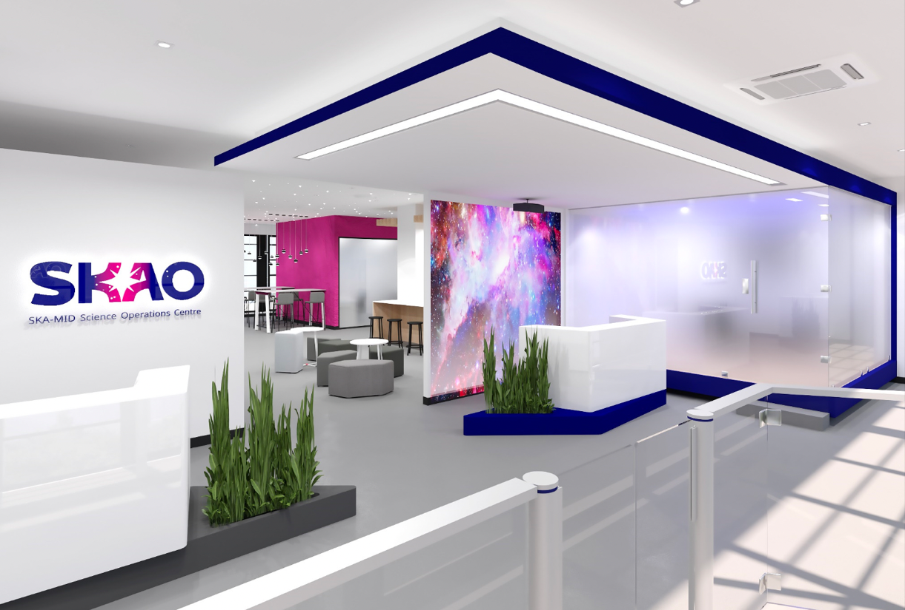
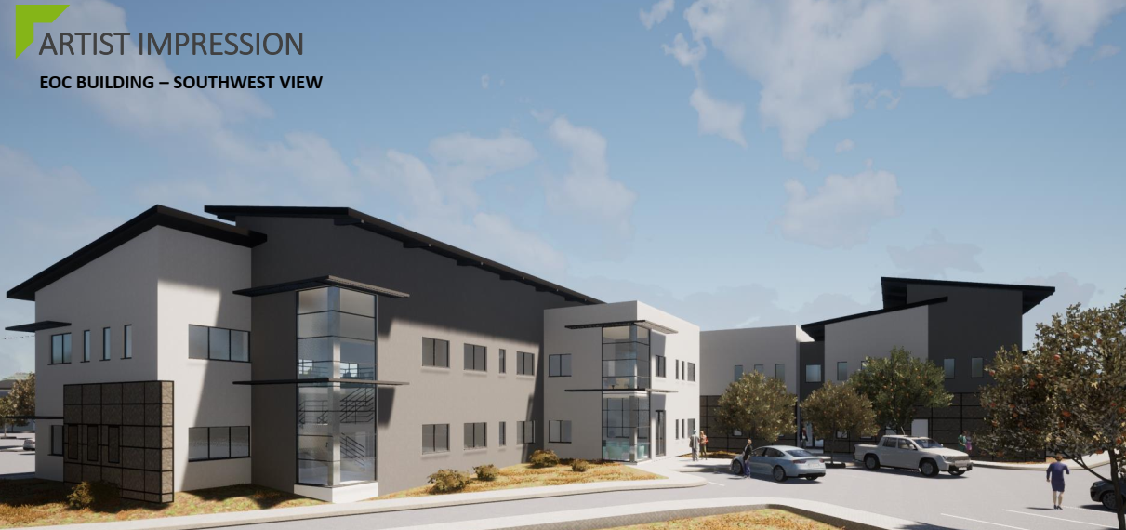
South Africa: interim Science Operations Centre, Cape Town; architect’s view of Engineering Operations Centre in Klerefontein
SOC: open mid-October
EOC: Klerefontein

Slide 24
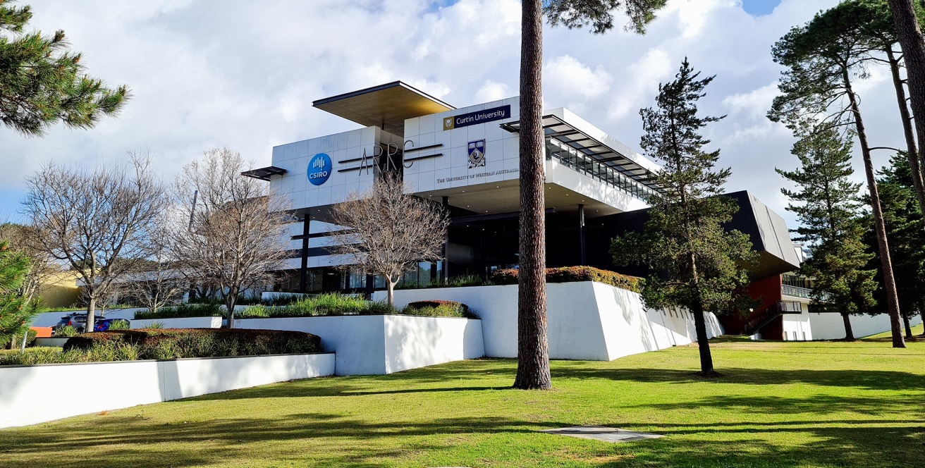
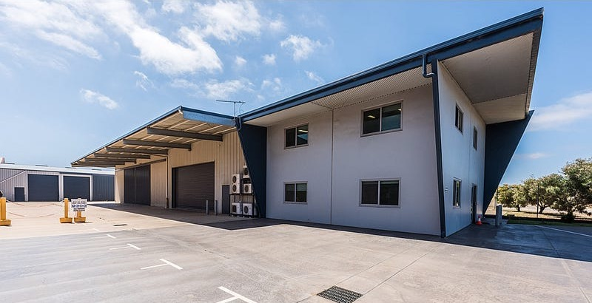
Australia: interim SOC, Perth
: interim EOC in Geraldton
Interim EOC Geraldton

Slide 25
Current key challenges
Impact of external factors (inflation, labour shortages, supply chains) on construction costs and schedules: working with Council and member states to mitigate
Pace of engagement in some of aspiring Member governments, potential for mis-alignment with the construction schedule.
There is the standard list of items we watch and manage carefully, e.g.:
  Residual design processes
  Spectrum management, especially mega-constellations
  Land access timescales
  Stakeholder management (local and international)
  ......

Slide 26

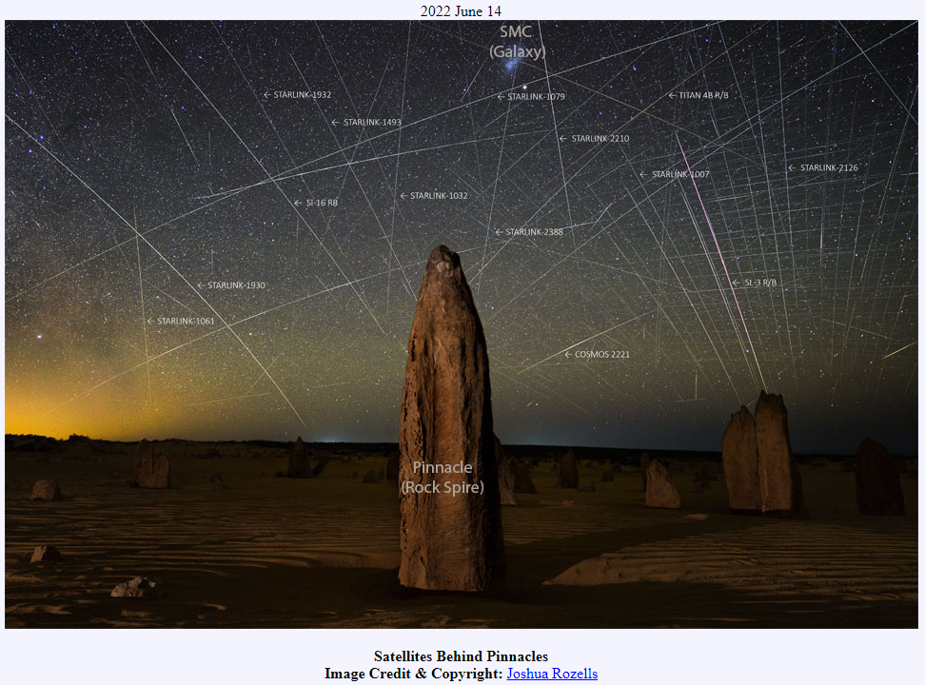
Photo by: Trevor Dobson CC BY-NC-ND 2.0
Notes:
One of the things that can happen is that beautiful astrophotography pictures like this one from the Pinnacles in Western Australia, could become something like this. (click)

Slide 27
Summary
Construction activities are proceeding at pace; residual design issues are being dealt with professionally and expeditiously
Level of risk for the project has increased due to the global situation; mitigations are planned, but they require the commitment of additional resources from Members and the accession of new Members.
SKAO presence in the site host countries is a major positive milestone
SKAO’s reputation and global visibility is growing substantially and positively.

